Slide 1
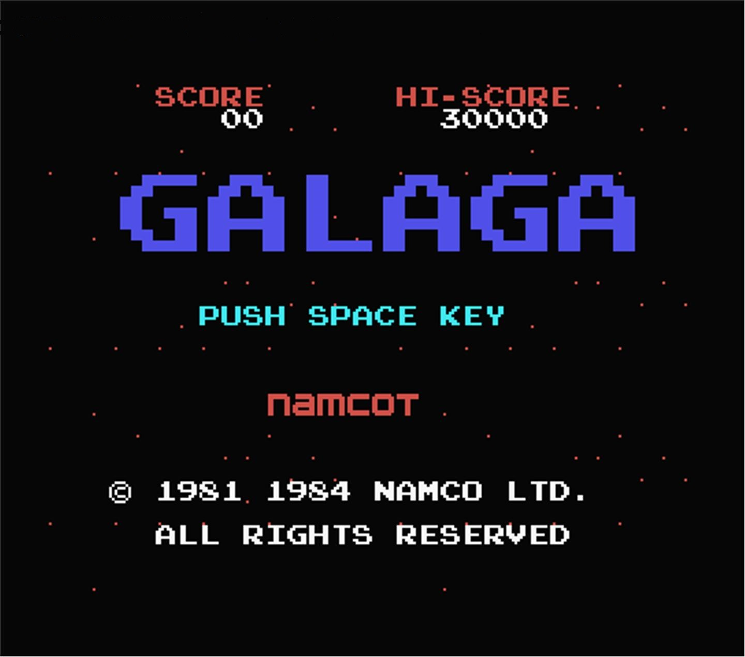
REMADE FOREVER
Brandon goh nian zhou –121309D
Kho liang hao –121320s
Ron ng jian yian -120160y
Sim yuan he -122816d

Slide 2
High concept
A FRESH ENDLESS TAKE ON A CLASSIC.

Slide 3
Player’s motivation
CHALLENGING
COMPETITION

Slide 4
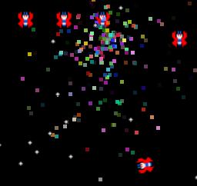
Particles!
PARTICLES
PARTICLE MANAGER
SINGLETON

Slide 5
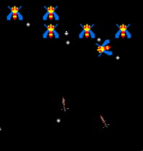
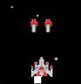

Weapons!
HOMING MISSILES
BULLET SPREAD
DRONE

Slide 6
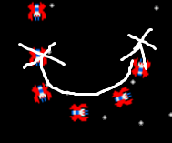
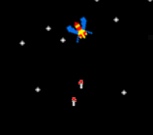
Enemy
WAYPOINTS FOR NAVIGATION
RANDOM ATTACKING BEHAVIOR

Slide 7
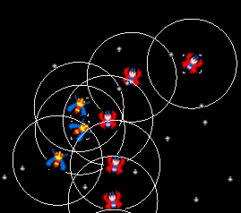
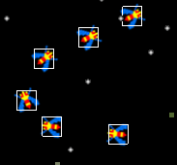
Collision
Collision Manager of Game Objects.
Broad phase, narrow phase.

Slide 8
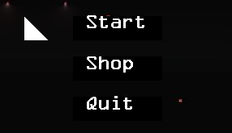
UI
DYNAMIC
ABLE TO PRINT TRUETYPE FONTS

Slide 9
DEMO

