Slide 1
PyLauncher
Victor Eijkhout
Texas Advanced Computing Center

Slide 2
Motivation and basic usage

Slide 3
Why another launcher
The shell-based launcher was static. This can lead to load unbalance
Wish: restart
Wish: dynamic task queue
Wish: multicore jobs, MPI jobs
Wish: customizability
Meanwhile, the shell-based launcher has become quite a bit more sophisticated….

Slide 4
Availability
Through the module system on TACC clusters
Repository: https://bitbucket.org/VictorEijkhout/pylauncher

Slide 5
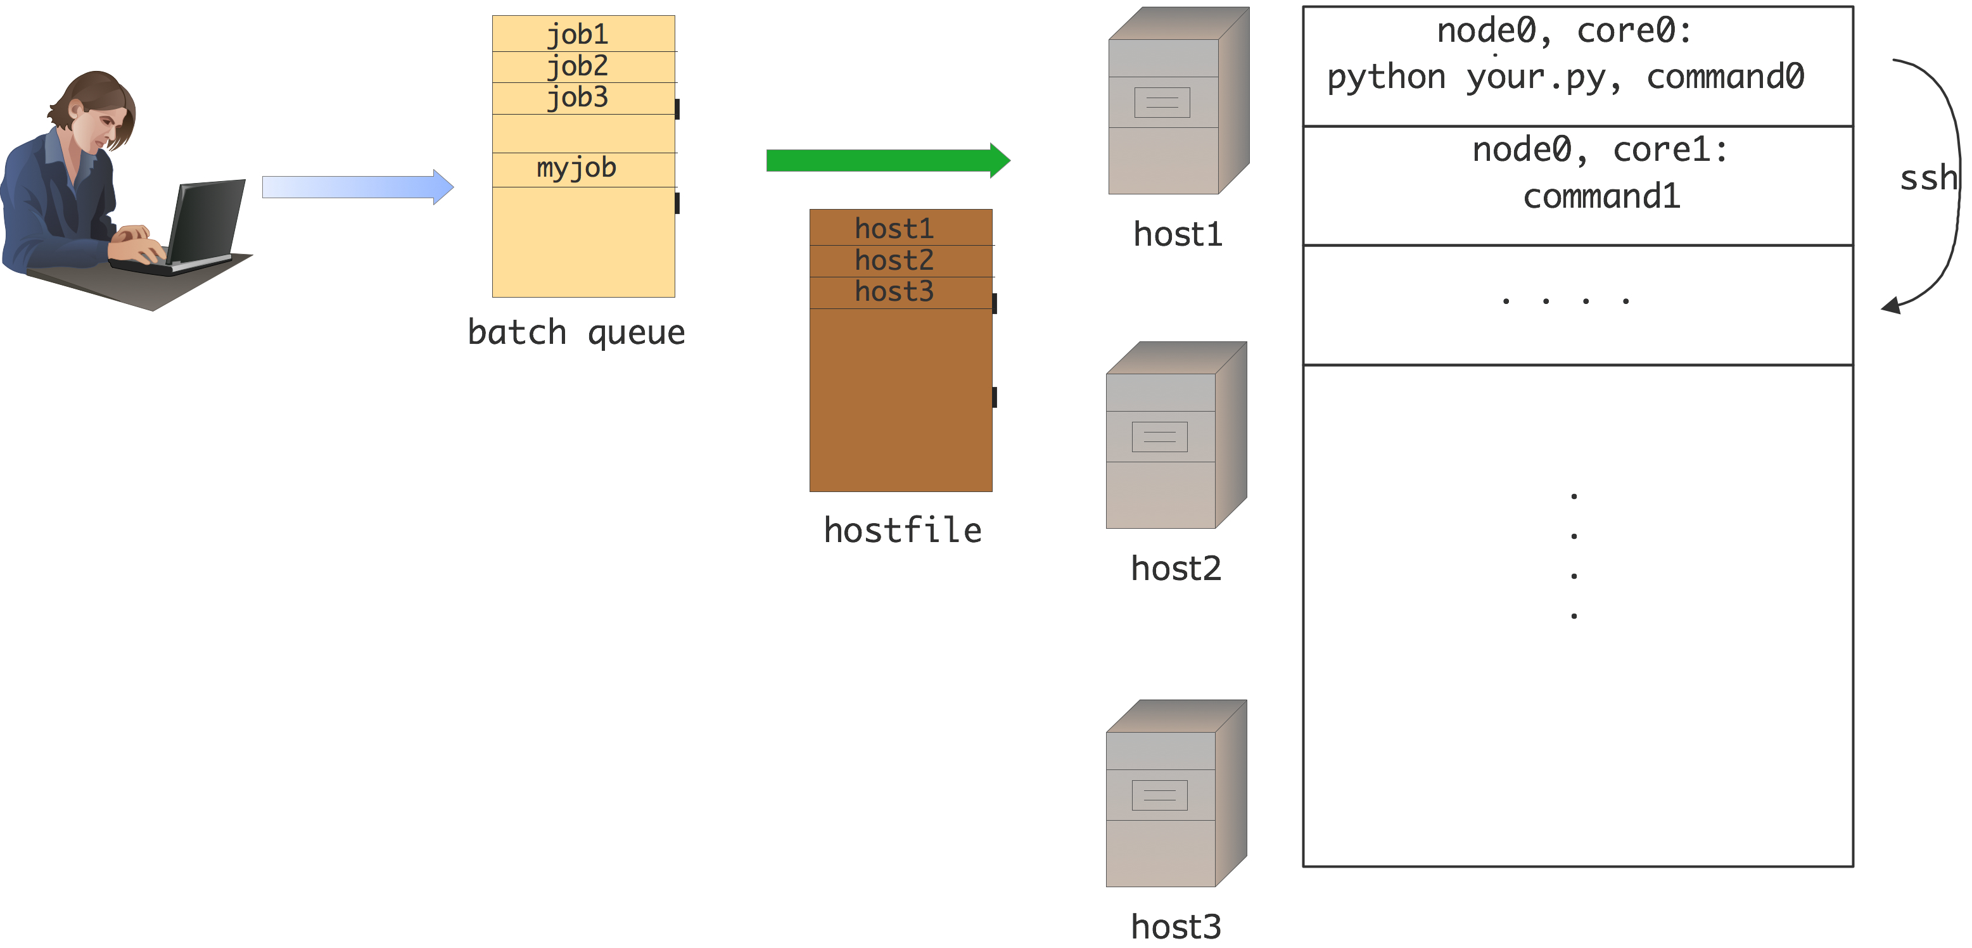
Structure

Slide 6
Scenarios
Single-threaded jobs, one per core
Single-threaded jobs, need more memory
Multi-threaded jobs
MPI jobs
Unifying theme: you have way more jobs than cores

Slide 7
Basic usage
You need to write a little Python. Single core jobs:
Multi-core and large memory jobs:
Variable core:
MPI
MIC:
#!/usr/bin/env python
import pylauncher
pylauncher.ClassicLauncher("commandlines")
pylauncher.ClassicLauncher("commandlines",cores=4)
pylauncher.ClassicLauncher("commandlines",cores=“file”)
pylauncher.IbrunLauncher("commandlines",cores=“file”)
pylauncher.MICLauncher("commandlines",cores=“file”)

Slide 8
Input files
#
# example commandlines
#
echo "command 0"; sleep 21
echo "command 1"; sleep 14
# skip a few
echo "command 9"; sleep 29
echo "command 10"; sleep 16
# core count attached
5,echo "command 0"; sleep 21
5,echo "command 1"; sleep 14
3,echo "command 12"; sleep 13
3,echo "command 13"; sleep 24
3,echo "command 14"; sleep 28
Each line is one job, note blank lines and comments, core count for “file” option
String PYL_ID gets replaced by command number

Slide 9
Some implementation details
Each pylauncher run leaves behind a directory “pylauncher_tmpdir12345” where 12345 is jobid
Each command line gets wrapped into a file “command1”, “command2”
A successfully executed command leaves behind “expire1”, “expire2” &c

Slide 10
Checkpoint / restart
There is also a file “queuestate”
If your job runs out of time or crashes:
This will re-issue all not-finished commands from the aborted job
pylauncher.ClassicLauncher("commandlines",cores=4,
resume=12345)

Slide 11
Use at TACC
“module load pylauncher/2.0”
Define $TACC_PYLAUNCHER_DIR, sets $PYTHONPATH
See “examples” and “documentation” subdirectories.

Slide 12
Unit tests
The source is written for “nosetests”: all functions & classes that start with “test” are unit tests
Currently 30 tests, some specific to TACC (meaning: SGE & SLURM)
Takes about 1 minute to run, mostly because of “sleep” commands
Some classes are only for testing: they generate dummy commands and command files

Slide 13
Customizing the pylauncher

Slide 14
Commandline classes

Slide 15
CommandlineGenerator
“commandline” = < Command , Corecount >
“command” can also be “stall” (dynamic case)
Arguments: list=[c1,c2,…] nmax=0,>0,None
Nmax is None (default): iterate over the list
Nmax>0: stop after that many
nmax==0: wait for finish() call
Method: finish() stop the generator, necessary for dynamic case

Slide 16
FileCommandlineGenerator
Inherits from CommandlineGenerator
Argument 1: filename
Each line is a Unix commandline
Line can optionally start with < [0-9]+ ”,” >
Blank lines and comments with “#” are skipped
Argument 2 (optional): core count

Slide 17
DynamicCommandlineGenerator
Inherits from CommandlineGenerator
Method: append(command[,cores])

Slide 18
Host management classes

Slide 19
Node
Description of a slot for a task
Argument (opt): host=name, core=num, nodeid=num
Methods: occupyWithTask(tid), release()
Test: isfree()

Slide 20
HostList
Contains a list of host,core pairs
Derived class SGEHostList
Derived class SLURMHostList
Derive your own class for LL, PBS, &c
Function: TACCHostlist gives SGE or SLURM hostlist depending on hostname

Slide 21
HostPool
Maintains a pool of Node objects
Arguments (opt): nhosts=num, hostlist=[h1,h2,…] or [h1;c1, h2;c2, …]
Argument (opt): commandprefixer= (see next)
Method: requestNodes(n) (returns HostLocator; see next)
Method: occupyNodes( locator, taskid )
Method: releaseNodesByTask( taskid )

Slide 22
prefixers
Routine: takes a commandline and returns it with “ssh host” or so prefixed
LocalPrefixer: identity
SSHPrefixer(command,pool) returns: cd curdir ; env the_environment ; ssh pool command
IbrunPrefixer(command,pool) returns: ibrun –o poolfirst –n poollength command

Slide 23
HostLocator
Arguments: pool=…, offset=…, extent=…

Slide 24
TACCHostPool
Inherits from HostPool
By default uses SSHPrefixer

Slide 25
Task management classes

Slide 26
Completion
Argument (optional): taskid
Method: attach(command) returns command with completion action attached
Method: test()

Slide 27
FileCompletion
Inherits from Completion
Completion based on creating “stamp” file
Argument: taskid=nnn
Argument (optional): stamproot=basename
Argument (optional): stampdir=directory

Slide 28
Task
Argument: completion=
Argument (optional): size=nnn (default=1)
Argument (optional): taskid=nnn
Method: hasCompleted()
Method: startonnodes( hostlocator,…. )

Slide 29
TaskQueue
Method: enqueue( task )
Method: startQueued( hostpool )
Test: isEmpty()

Slide 30
TaskGenerator
Iteratable, yields a Task or “stall”
Argument 1: commandlinegenerator
Argument (opt): completion = function that gives Completion objects

Slide 31
Tieing it all together

Slide 32
LauncherJob
Method: tick() submits queued jobs, returns:
“finished”: if generator stops, and all jobs finished
“continuing”: generator stopped, jobs still running
“stalling”: generator is stalled
“expired nnn”: reports on completed job
Method: run() repeats tick until completed
Argument (req’d): hostpool=
Argument (req’d): taskgenerator=
Argument (opt): prefixer, jobid, launcherdir

Slide 33
Writing simple launchers is easy!
def ClassicLauncher(commandfile,**kwargs):
cores = kwargs.pop("cores",1)
job = LauncherJob( hostpool=HostPool(hostlist=TACCHostList()),
taskgenerator=TaskGenerator( FileCommandlineGenerator(commandfile,cores), completion=lambda x:FileCompletion( taskid=x,
stamproot="expire",stampdir=workdir),
**kwargs)
job.run()

Slide 34
Customizing launchers is easy too!
# default run method
def run(self):
"""Invoke the launcher job, and call ``tick`` until all jobs are finished.""”
self.starttime = time.time()
while True:
res = self.tick()
if res=="finished":
break
if self.maxruntime>0 and time.time()-self.starttime>self.maxruntime:
break
# post-processing run method
def run(self):
…….
if re.match(res,”expired”):
# post-process
# dynamic launcher
def run(self):
…….
if re.match(res,”expired”):
# post-process, and:
self.taskgenerator.\
commandlinegenerator.append\
( Commandline( newcommand) )

