Slide 1
SPL – PS8
More concurrency issues

Slide 2
Overview
Atomic instructions
Singleton and Thread safe singleton
Callables and Futures
Thread cancellation

Slide 3
Atomic instructions
Most CPU’s today offer a set of atomic instructions designed for multi-threading.
An important such action is the CAS (Compare and set) action.
bool compareAndSet(int *target, int oldValue, int newValue){
if (*target == oldValue){
*target = newValue;
return true;
}
return false;
}
The CAS action is atomic, meaning that the scheduler can’t stop the thread during the action, only before or after.

Slide 4
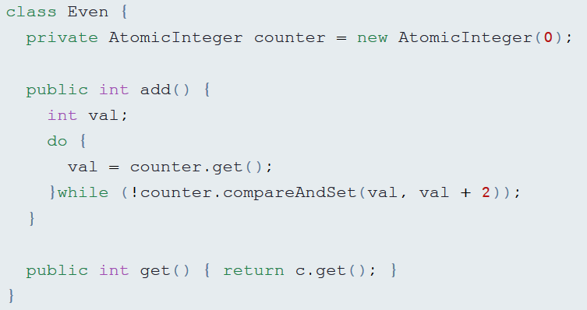
Atomic instructions (cont)
The CAS action can be used through the Java’s atomic library.
We could use the CAS action to write lock-free implementations for thread-safe classes.

Slide 5
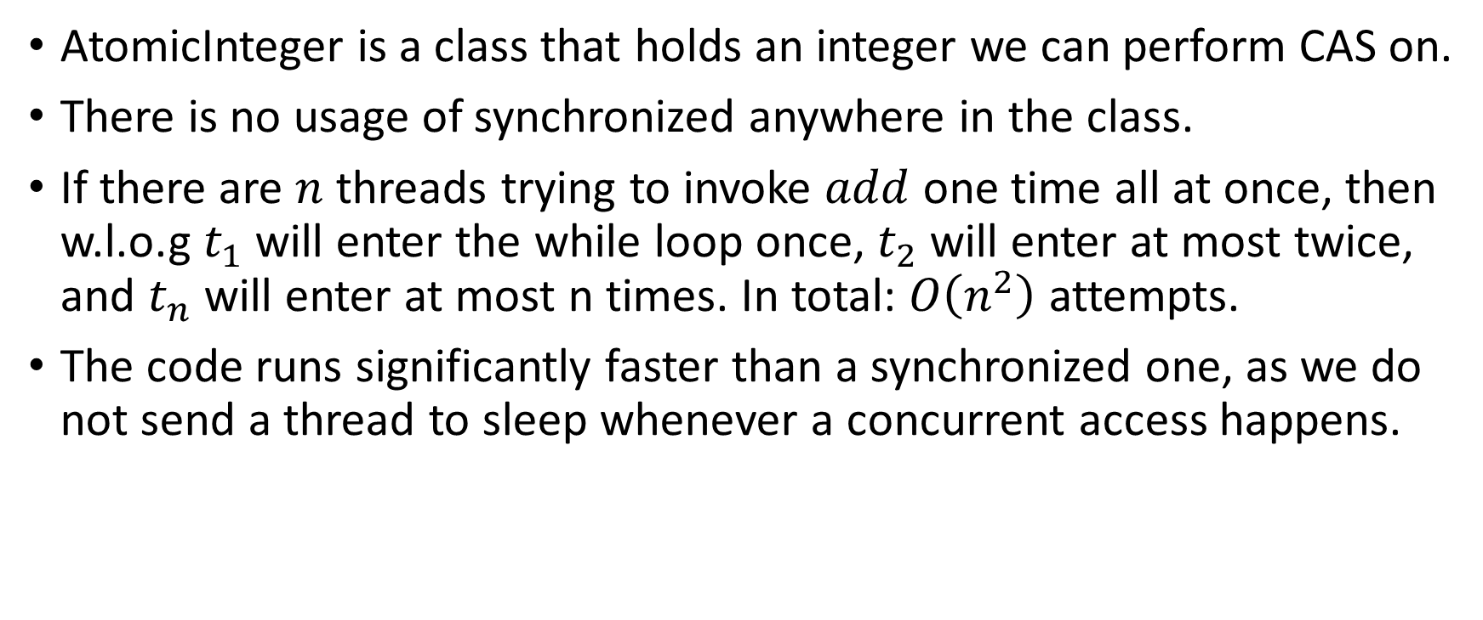
Lock-free Even class
AtomicInteger is a class that holds an integer we can perform CAS on.
There is no usage of synchronized anywhere in the class.
If there are $n$ threads trying to invoke $add$ one time all at once, then w.l.o.g $t_{1}$ will enter the while loop once, $t_{2}$ will enter at most twice, and $t_{n}$ will enter at most n times. In total: $O\left(n^{2}\right)$ attempts.
The code runs significantly faster than a synchronized one, as we do not send a thread to sleep whenever a concurrent access happens.
Notes:
w.l.o.g – without loss of generality

Slide 6
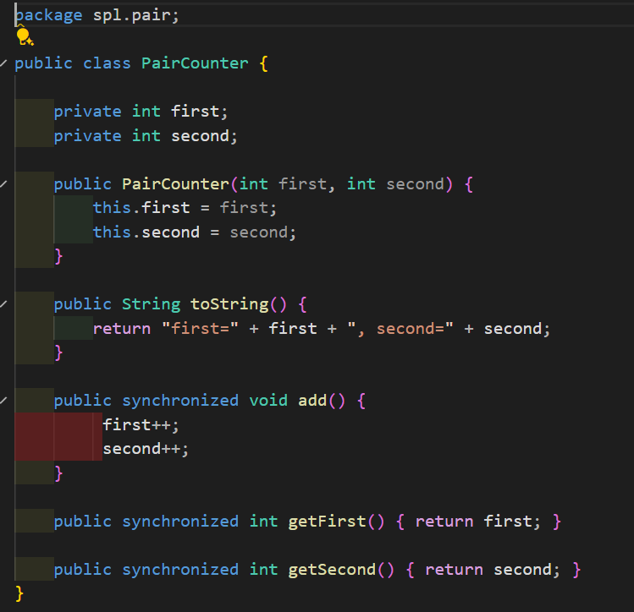
In the following example there are 2 fields.
We want to use the lock-free implementation, How would we do it?

Slide 7
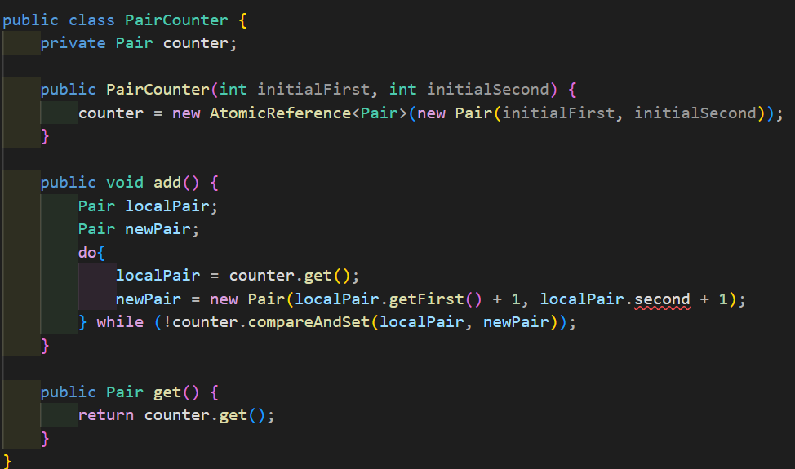
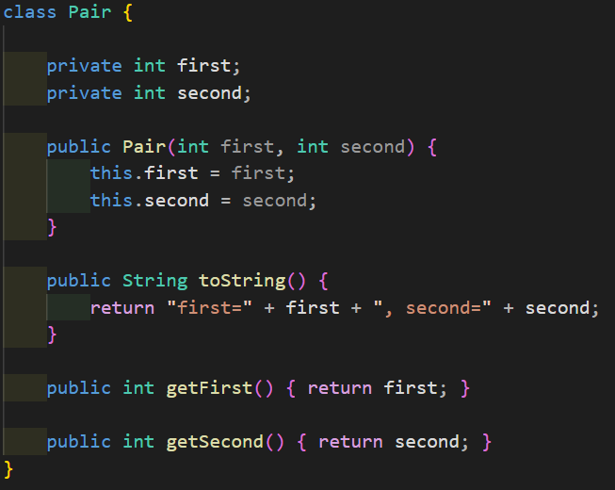
Lock-free Pair Counter
The CAS action can be used through the Java’s atomic library.
Instead of 2 field we use a single field to represents them.
Notes:
This example is also included in the code example files.

Slide 9
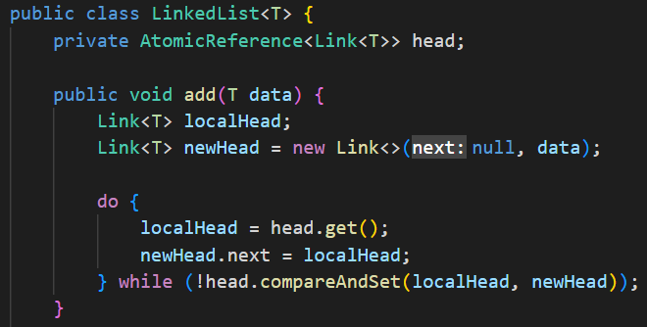
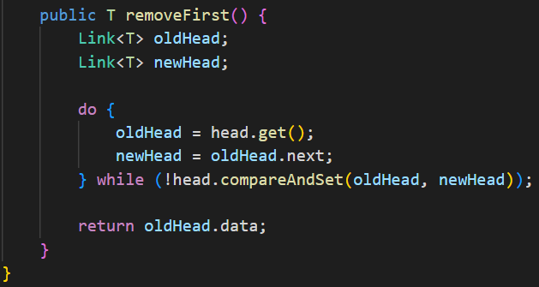
Lock-free Linked List
We can create lock-free implementations for more advanced data structures.
Notes:
Removing elements other than the first using CAS from the list is less trivial, and outside of the scope of the course.

Slide 10
Lock-free implementations (cont)
Lock-free data structures have their limitations.
Since there are no locks we cannot block threads, which may be a required property of the data structure, for example blocking queues.
Lock-free data structures are harder to write.
There are some cases in which the state of the data structure may be complex, and may require a lock-free implementation to copy a large amount of data, in such cases a synchronized approach may be better.

Slide 11
The Singleton Design Pattern
In some cases, you’ll want to have exactly one instance of a class in your program.
Those types of objects are accessed throughout the program, and therefore require a global point of access.
We call such objects singletons. And a naïve implementation could be as follows:
public class ClassicSingleton {
private static ClassicSingleton instance = null;
private ClassicSingleton() {
// initialization code..
}
public static ClassicSingleton getInstance() {
if(instance == null) {
instance = new ClassicSingleton();
}
return instance;
}
}

Slide 12

Singleton (cont)
This naïve implementation of the singleton works well in a single threaded environment, but not in a multi-threaded one.
Can we try to create a thread-safe implementation?
if(instance == null) {
instance = new ClassicSingleton();
}

Slide 13
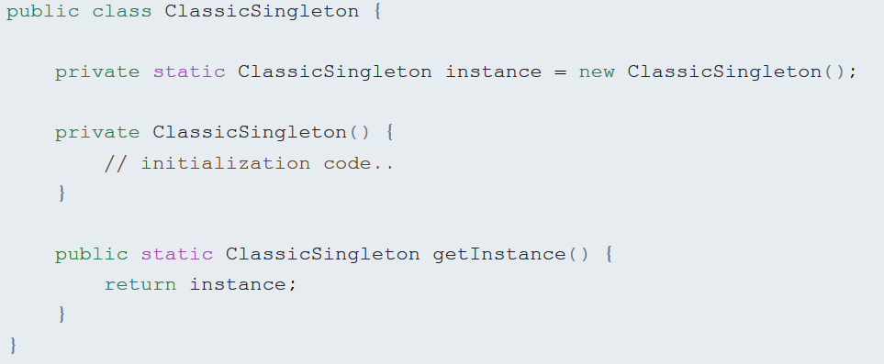
Thread safe singleton using eager initalization
Will work since only one thread in Java is responsible for class loading.
Problem: an instance is created even if the getInstance() method was not called. That is, even if we don’t need it.

Slide 14
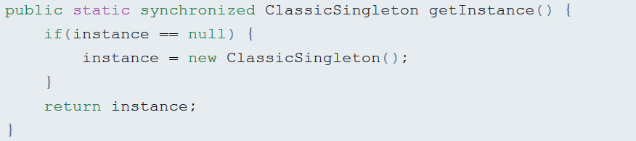
Thread safe singleton using locks
Will work, because the initialization is done in a synchronized block.
Problem: every time we would want to get the instance of the singleton our thread could be blocked. Damages the liveness of our program. A better solution?

Slide 15
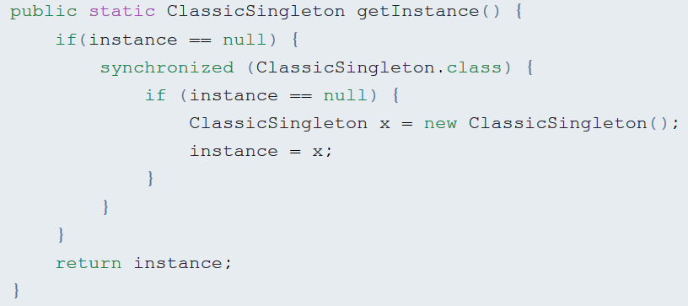
Alternative thread safe singleton using locks

Slide 16
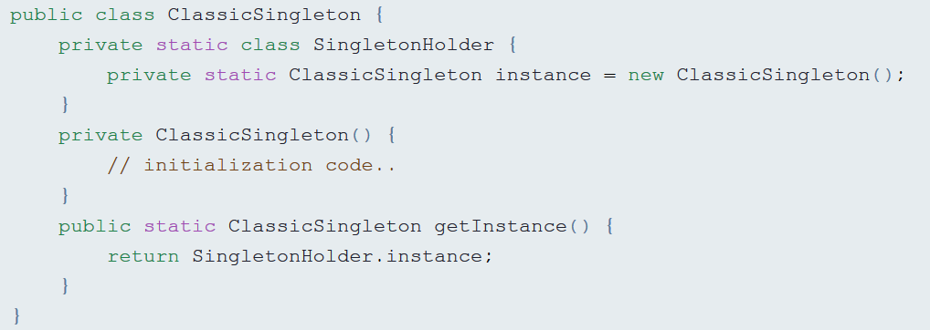
Thread safe singleton solution.
The SingletonHolder class would only be initialized once we call the getInstance() method.
Java guarantees us that the loading and initialization of the static class will be done once, and the static fields will be published safely.

Slide 17
Callables and Futures
If you want your threads to return a completed result you could use java.util.concurrent.Callable.
Callables allow returning of values after a computation.
Since you wish to receive the computed result, you need to keep a connection to the thread executing the Callable.
To do so, you may use Futures and Executors (specifically the ExecutorCompletionService).
(This could be done using normal threads with the use of the FutureTask java class)

Slide 18
Callables and Futures
The Future and Callable interfaces:
public interface Future<V> {
V get() throws InterruptedException, ExecutionException;
V get(long timeout, TimeUnit unit) throws InterruptedException, ExecutionException, TimeoutException;
boolean isCancelled();
boolean isDone();
boolean cancel(Boolean mayInterruptIfRunning)
}
public interface Callable<V> {
V call() throws Exception;
}

Slide 19
Executor Completion Service
When giving a Callable to the Executor, it returns a Future
C
C
F
F
F
A data structure we created

Slide 20
Executor Completion Service - cont
We can use Executor Completion Service if we don’t want to manage the futures by ourselves.
We can use the take method on
the ECS to receive a finished
Future.
ECS
C
C
F
F

Slide 21
Thread cancellation
Each thread has a predefined task it works on, when the task ends, the thread exits.
Sometimes we want to tell a thread to stop working before it finished the task.
One way is calling the thread’s stop() method. This is always unsafe, and you should never do that.

Slide 22
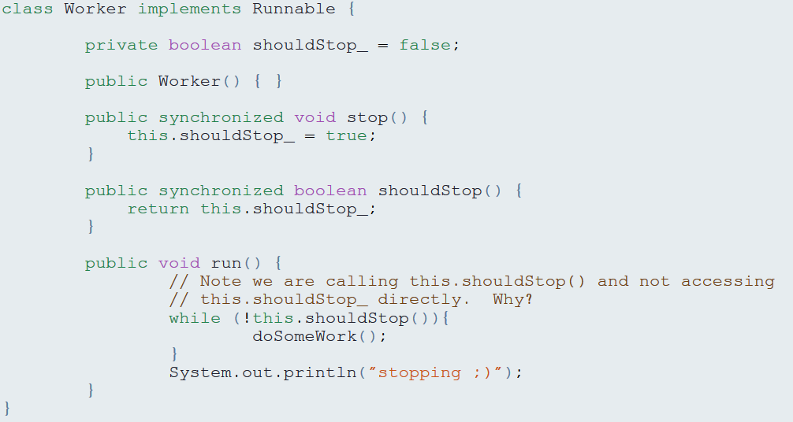
Thread cancellation (cont)
Another way is by changing a variable which the thread sees, for example:

Slide 23
The interrupt mechanism
What if the thread waits or sleeps when receiving the stop signal?
In Java that issue is solved with the interrupt mechanism.
When calling the interrupt method on a thread, a flag (similar to the shouldStop flag) value is changed to true.
If the thread is waiting or sleeping, an InterruptedException is thrown, and he wakes up.
If the thread starts sleeping while the flag is raised, the exception will be thrown immediately.
Note that after an interrupted exception is thrown, the value of the interrupted flag receives false value.

