Slide 1
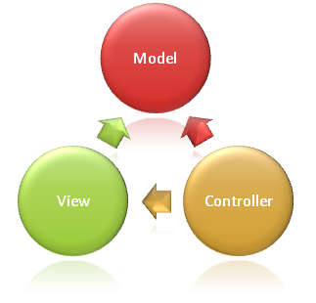
JavaScriptMVC
UX Team
Owen

Slide 2
Topic
What is JavaScriptMVC?
JavaScript Theory
How to develop/test/compress a project?
What is inside?
Weakness & StrongPoint
JavaScriptMVC VS GI VS GWT
More Information

Slide 3
What is JavaScriptMVC?
A collection of the best practices and tools for building JavaScript applications. Built on top of jQuery, it consists of the following standalone component.
StealJS: Dependency management and a easy build tool.
I recommend RequiresJS, http://requirejs.org/docs/api.html
Circular Dependencies
Load Scripts in a Specific Order
Page Load Event Support
FuncUnit: Automatic test tool, Functional testing solution, Write test case in jQuery syntax, run them via command line or browser.(Like GITAK)
jQueryMX：These plugins are the building blocks of large jQuery application： model, view, controller, class, fixtures, and more.
DocumentJS: A JSDoc compliant tool, that turns comments into a searchable documentation app.

Slide 4
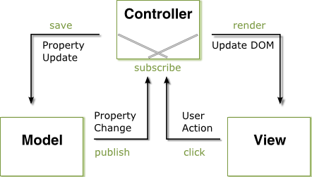
JavaScript Theory

Slide 5
How to develop a project?
Cd javascriptmvc
./js jquery\generate\app cookbook
./js jquery\generate\page cookbook index.html
./js jquery\generate\scaffold Cookbook.Models.Recipe
Edit cookbook/cookbook.js
Steal.plugin()
…
.models(‘recipe’)
.controllers(‘recipe’)
Open cookbook/index.html in Firefox.

Slide 6
How to Test a project?
Edit cookbook/test/qunit/qunit.js
steal
.plugins("funcunit/qunit", "cookbook")
.then("cookbook_test","recipe_test")
Open cookbook/qunit.html, see the unit testing.
Or, funcunit/envjs cookbook/qunit.html
Edit cookbook/test/funcunit/funcunit.js
steal
.plugins("funcunit")
.then("cookbook_test","recipe_controller_test”)
Open cookbook/funcunit.html, see the browser testing.
Or, funcunit/envjs cookbook/funcunit.html

Slide 7
How to Compress a project?
./js cookbook/scripts/build.js
Edit cookbook/index.html
<script type='text/javascript'
src='../steal/steal.production.js?cookbook'>
</script>

Slide 8
What is inside?
Code Generators | ./js jquery/generate/app myapp
Dependency Management | steal.plugins('jquery/controller').then(function($){ ... });
Production Builds | js myapp/scripts/build.js
Testing | S.open("//myapp/myapp.html"); S("#search").click().type("Hello World");
Client Side Templates | $("#menu").html("menu.tmpl",items);
jQuery Widget Factory | $.Controller("Tabs",{ "li click" : function(el, ev){ ... } });
Service/Data Modeling | $.Model("Todo",{ findAll : "/recipes" }, {}); Todo.findAll(function(todos){ ... });
Documentation | js myapp/scripts/docs.js
Code Cleaning and Linting | js myapp/scripts/clean.js
jQuery Special Events | $("#items").delegate(".item","draginit",function(){});
jQuery Utilities | $("#panel").outerWidth(500);

Slide 9
Weakness & StrongPoint
Weakness
Base on jQuery, may be some issue was evoked by jQuery.
File directory structure base on MVC, it doesn’t like AMX plugin folder structure.
StrongPoint
Base on jQuery, we can use jQuery’s feature.
It contains four components, and all the component is standalone.
MVC structure.
Easy testing

Slide 10
Ananta’s Question
 | GI | JSMVC | GWT
1. Can we do a framework similar to AMP? | √ | √ | √
2. How big is the GWT library memory? | More | Less | Less
3. Can we use GWT for gadgets. use 15 iframes with simple screen in one browser. | √ | √ | √
4. How easy to customize default GWT widgets like changing css etc? | √ | √ | √
5. How easy to customize default GWT widgets like modifing their behaviour and add extra behaviour? | √ | √ | √
6. Ability to use other frameworks like Fusion Charts, DOJO component | √ | √ | √
7. How easy to write a GWT wrapper for existing javascript? | √ | √ | √
8. How big the developer community compare to JQuery community? | Tibco | More | Less
9. What is the next version of GWT and when is that planned? | 3.9 | 3.0.5 / 1.5 | 2.2
10. What are the well known GWT webapps as reference other than webapps developed by Google. | Tibco | More | Less

Slide 11
JavaScriptMVC VS GI VS GWT
 | GI | JSMVC | GWT
Develop Architecture | MVC | MVC | MVP
Developer Community | Tibco | Web Developer | Java & Web Developer
Team Technical Community | √ | √ & × | √ & ×
Unit Testing | √ | √ | √
Functional Testing | √, third party | √ | √, third party
Document | √, third party | √ | √
Who user it | Tibco | ?/Web Site | Gmail/Adwards/Orkus
Technical Support | Tibco | JavaScriptMVC | Google
Language | JavaScript | JavaScript | Java/JavaScript
Learning Period | 3-4 Weeks | 1-2 Weeks | 3-4Weeks
Obfuscation | √, third party | √ | √
Optimization | √, third party | √ | √

Slide 12
JavaScriptMVC VS GI VS GWT
 | GI | JSMVC | GWT
Load Scripts in a Specific Order | √ | √ | √
Rich UI | GIUI, UXCore | jQuery UI | Ext/Smart GWT
Visual Edit | √ | × | √
Debug | Firebug | Firebug | Eclipse
Client Code （WYSIWYWrite） | √ & × | √ | √ & ×
Base On | GI | jQuery | GWT
License | BSD | MIT | Apache
Plugin Resources | Less | Most | More
Open Source | √ | √ | √
Speed | Low | Fast | Fast
Memory Leak | High | High | Normal
IDE Support | GI, Any Editor | Any Editor | Eclipse
Browser Support | Firefox/IE8 | Common Browser | Common Browser

Slide 13
More Information
JavaScriptMVC Demo List: http://docs.javascriptmvc.com/demos/index.html
Who recommend it: http://addyosmani.com/blog/large-scale-jquery/
Twitter: @javascriptmvc
Blog: http://jupiterjs.com/pages/javascriptmvc
Forum: http://forum.javascriptmvc.com

Slide 14

Question?

