Slide 1
IBM University Engagement Project Submission
“Exploring the Power of Agentic AI with IBM Granite and IBM Bob”

Slide 2

Project Tile –Fitness Buddy – AI-Powered Personal Fitness Coach
Domain of Project – Healthcare / Fitness & Wellness
Student Name | Recent Passport Photo | Email ID | Mobile number [WhatsApp]
Ronak Prajapati |  | ronakhos6666@gmail.com | 8780192795
Recommended font style and size:
Font Style: Arial
Font Size (Heading): 28
Font Size (Content): 20

Slide 3
Problem Statement -
Problem Statement : Fitness Buddy
The Challenge
Many individuals struggle to maintain a healthy lifestyle due to lack of personalized guidance, time constraints, and inconsistent motivation. Traditional fitness solutions can be expensive and often do not adapt to personal preferences or daily routines. Without personalized, accessible guidance, many people find it difficult to maintain regular workouts, healthy eating habits, and consistency.
The Objective
Build an AI-powered Fitness Buddy that delivers personalized fitness guidance and support for individuals. The solution should:
• Personalized Home Workouts – Recommend workouts based on fitness level, goals, and user input.
• Nutrition Guidance – Suggest simple and nutritious meal ideas based on user preferences and goals.
• Motivation & Inspiration – Provide motivational tips and daily fitness inspiration.
• Habit Building – Encourage consistency through healthy habits, goals, and streak tracking.
• Conversational AI – Allow users to interact naturally with an AI-powered fitness coach.
• Multi-Agent System –
• Profile Agent – Manages user profile and fitness preferences.
• Workout Agent – Generates personalized workout routines.
• Nutrition Agent – Provides healthy meal suggestions.
• Motivation Agent – Provides motivational guidance and habit support.
• Memory Agent – Maintains relevant user information and progress.
• Orchestrator Agent – Identifies user intent and coordinates the appropriate agent.
• Interactive Dashboard – Shows goals, streaks, daily tips, and quick fitness actions.

Slide 4
Proposed Solution -
Proposed Solution
Fitness Buddy is an AI-powered conversational health and fitness assistant designed to provide personalized, accessible, and on-demand guidance for maintaining a healthy lifestyle. The solution uses IBM Granite and Agentic AI to understand user requirements and provide relevant recommendations for fitness, nutrition, motivation, and habit building.
The system consists of multiple specialized AI agents that work together to provide a personalized experience.
• Personalized Workout Agent – Recommends home-based workout routines according to the user’s fitness level, goals, preferences, and available equipment.
• Nutrition Agent – Suggests simple, nutritious, and practical meal ideas based on the user’s requirements and fitness goals.
• Motivation Agent – Provides personalized motivational messages, daily fitness inspiration, and encouragement to help users stay consistent.
• Habit Building – Encourages users to develop healthy routines through daily goals, activity tracking, and streak-based motivation.
• Profile Agent – Understands and manages user preferences, fitness level, goals, and other relevant information.

Slide 5
Technology Used
Technology Used
IBM Bob – Used as the primary AI development environment to build and implement the Fitness Buddy project.
IBM Granite – Used as the core generative AI model for understanding user queries and generating personalized fitness, nutrition, and motivational responses.
IBM Cloud – Provides the cloud-based services and infrastructure required for the AI-powered application.
Python & FastAPI – Used for backend development, API creation, and coordination of the different AI agents.
React & Vite – Used to develop the interactive web-based user interface for Fitness Buddy.
Agentic AI Architecture – Multiple specialized agents such as Profile, Workout, Nutrition, Motivation, Memory, and Orchestrator agents work together to provide personalized assistance.
IBM watsonx.ai – Used to connect the application with IBM Granite for AI-powered response generation.

Slide 6
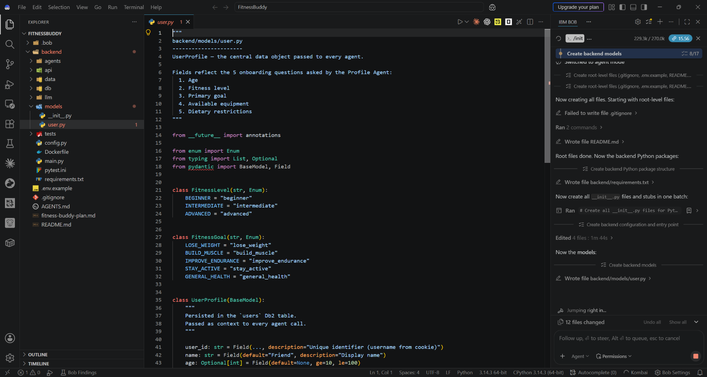
Required Files created using IBM bob -

Slide 7
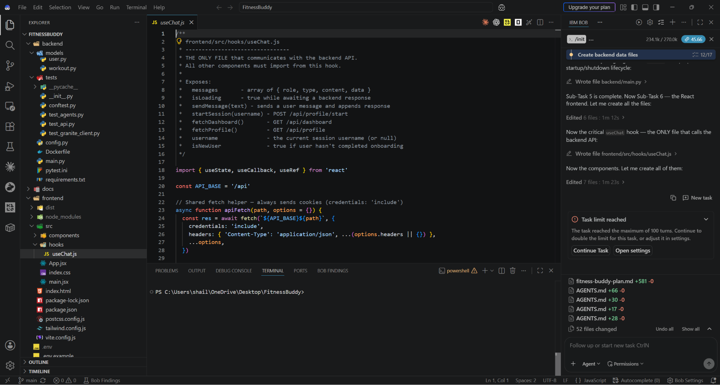
IBM Bob Screenshots:

Slide 8
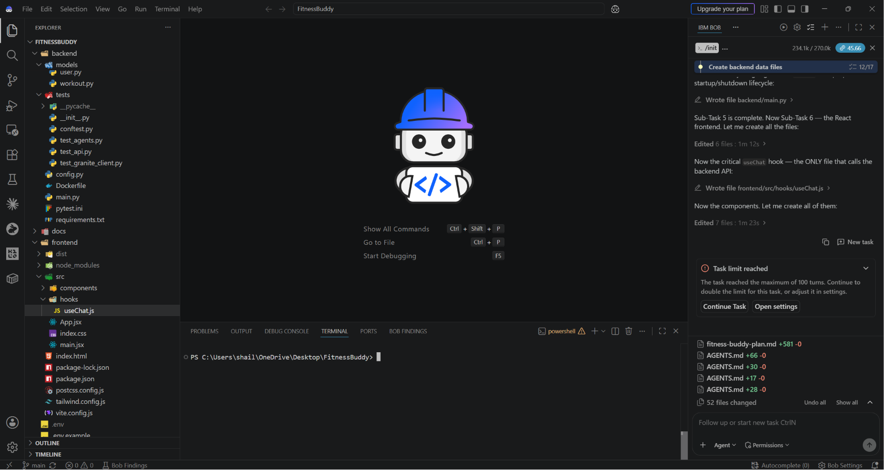

Slide 9
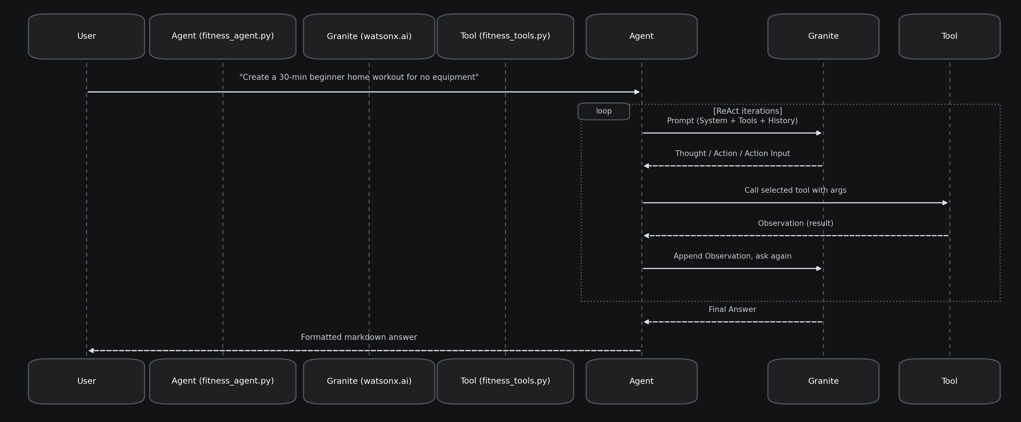
Architecture blueprint for IBM bob:

Slide 10

Role of Agentic AI in the solution
Role of Agentic AI in Fitness Buddy
Agentic AI enables Fitness Buddy to function as an intelligent, autonomous fitness assistant rather than a simple chatbot. Using IBM Granite and IBM Bob, it coordinates multiple specialized agents to deliver personalized fitness, nutrition, motivation, and habit-building guidance.
Each agent performs a specific role—such as understanding the user profile, generating workout plans, suggesting healthy meals, providing motivation, and maintaining user memory—while working collaboratively. This multi-agent approach enables efficient task execution and personalized responses.
Agentic AI also brings context awareness, understanding user details such as fitness level, goals, preferences, and previous interactions to generate relevant recommendations. It supports real-time adaptation, allowing the assistant to respond according to changing user needs and requests.
Additionally, the agents communicate through an Orchestrator Agent, which identifies the user's intent and directs the request to the appropriate specialized agent.
Overall, Agentic AI makes Fitness Buddy personalized, proactive, and goal-driven, acting like a smart digital fitness coach that helps users maintain healthy habits and stay consistent.

Slide 11
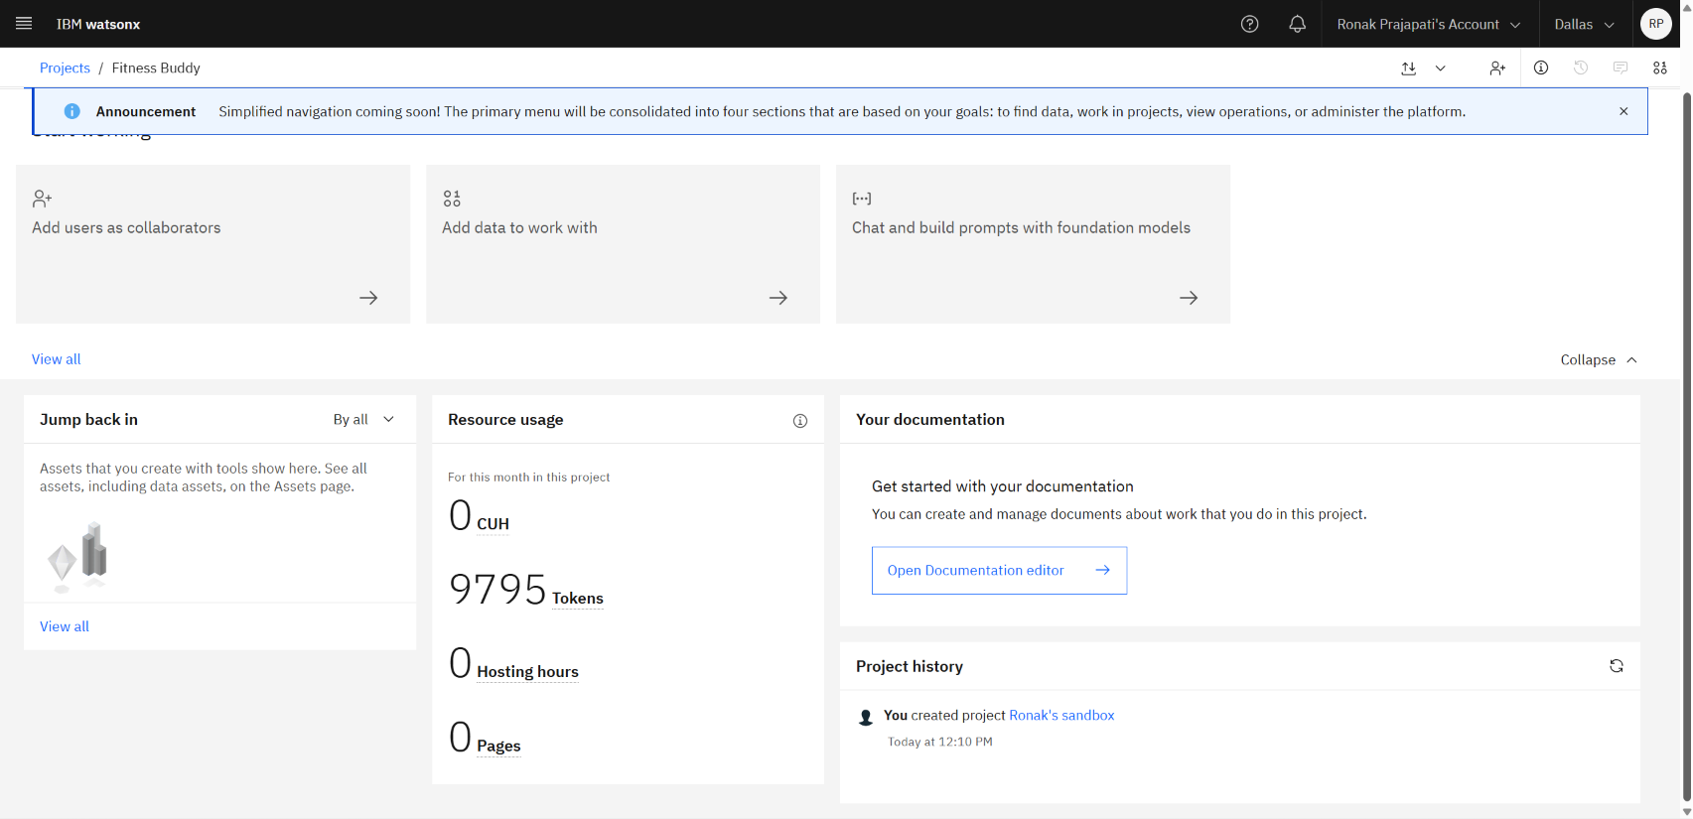
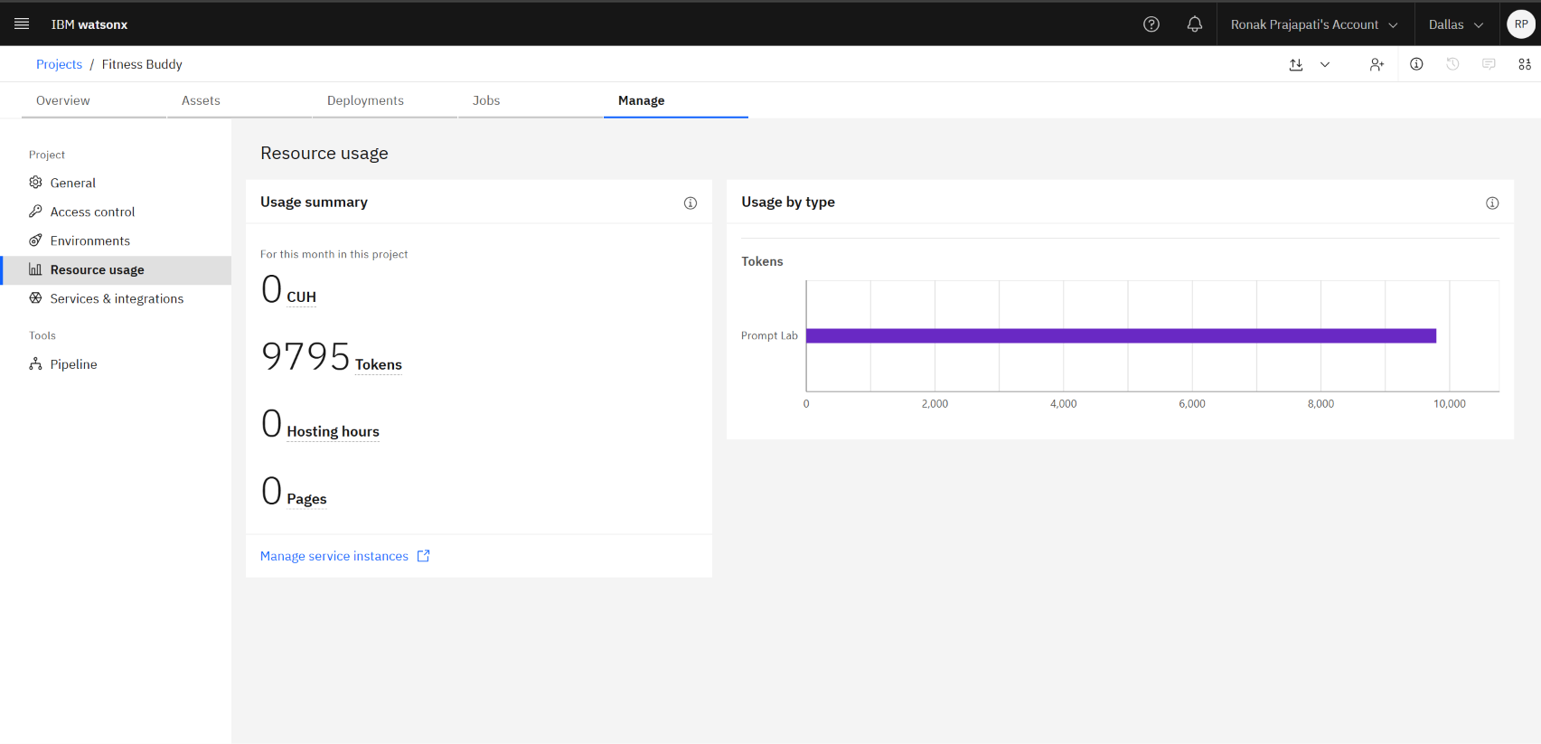
Token Usage
11,761 token are used
Before Prompt
After the Prompt
·
·
·

Slide 12
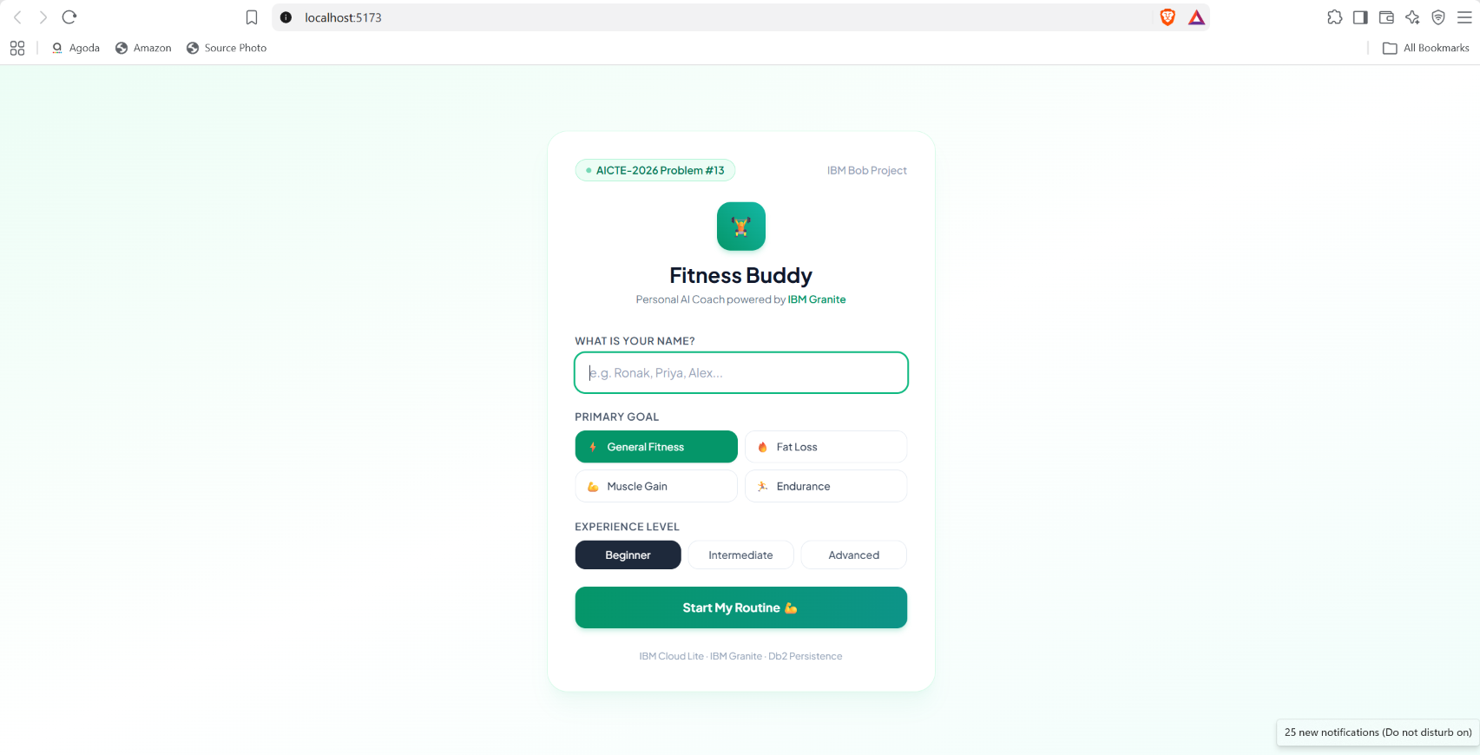
Project Output Screenshot
·
·
·

Slide 13
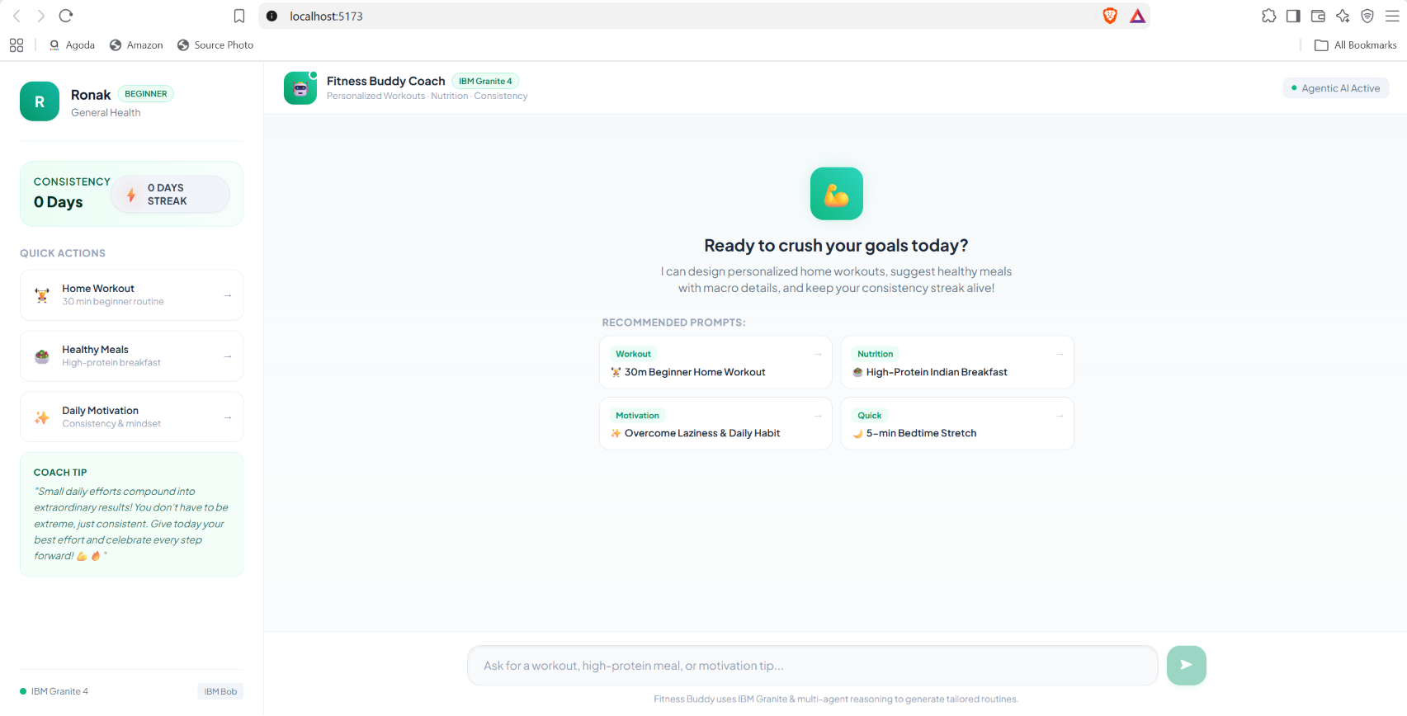
Project Output Screenshot
·
·
·

Slide 14
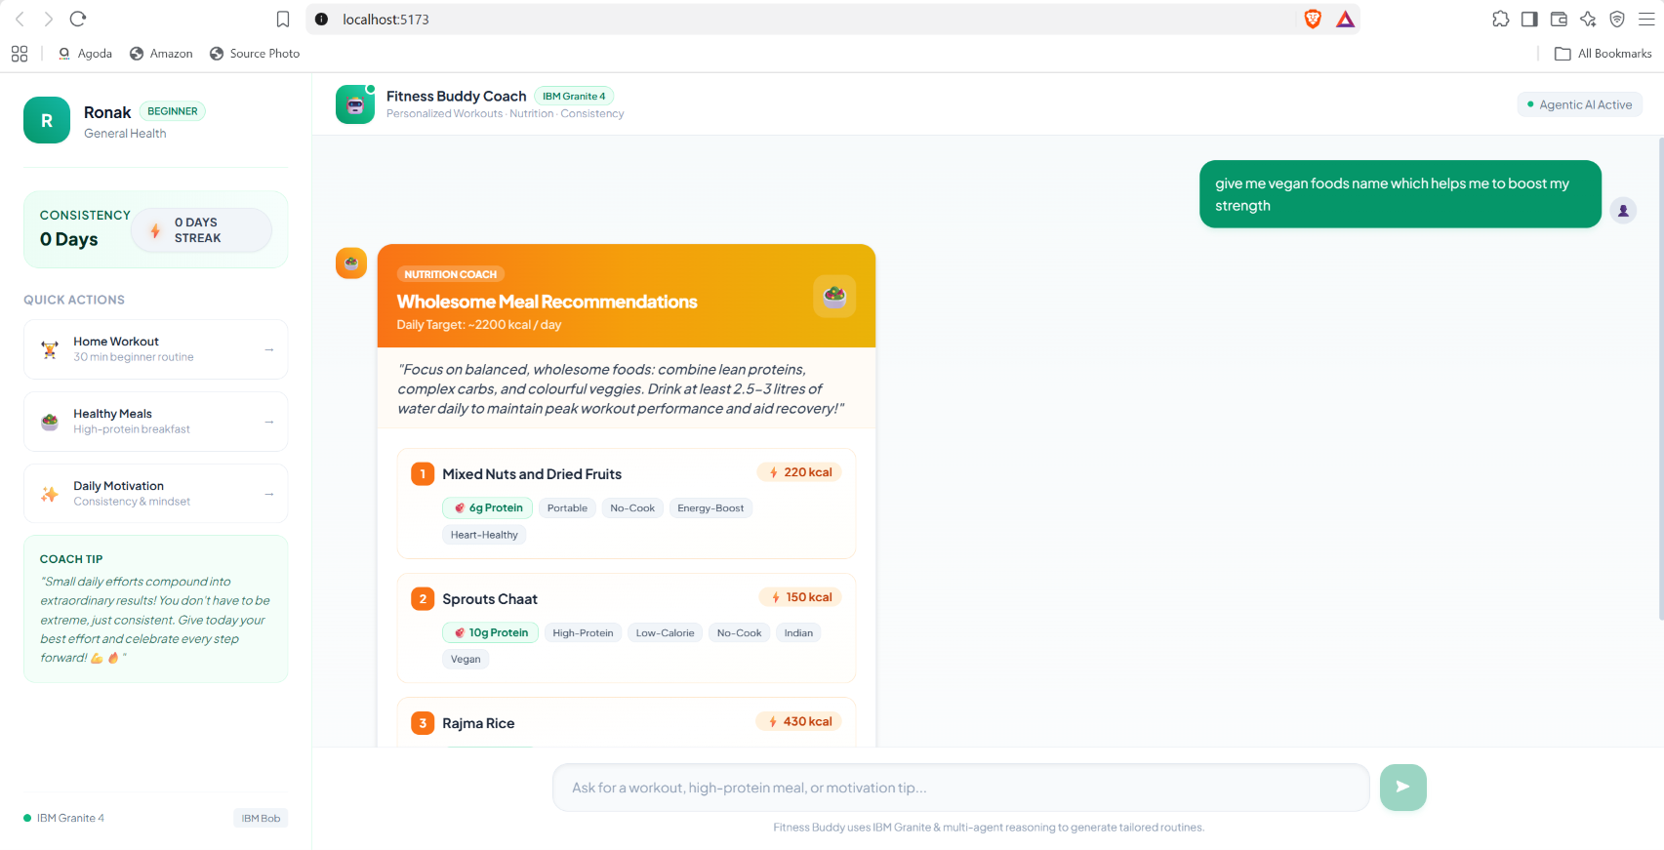
Project Output Screenshot
·
·
·

Slide 15
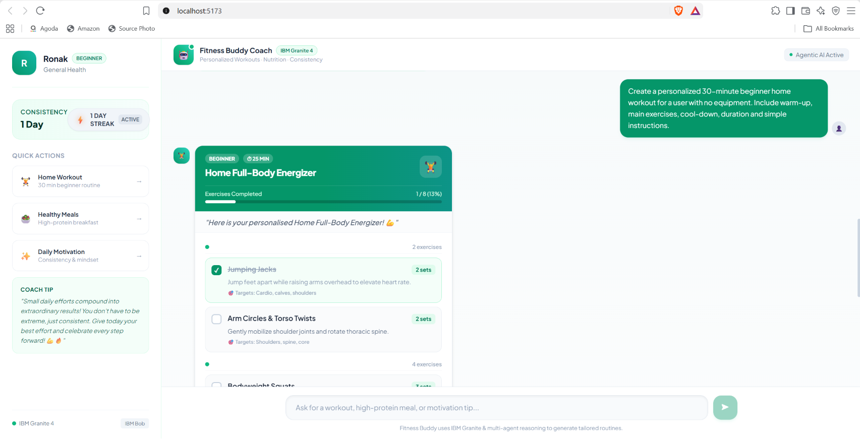
Project Output Screenshot

Slide 16
Novelty and Uniqueness
Fitness Buddy stands out by combining Agentic AI, personalized fitness guidance, and habit-building into a single conversational assistant.
• Multi-Agent Coordination: Specialized agents handle workouts, nutrition, motivation, user profile, and memory independently.
• Zero-Equipment Accessibility: Provides practical home workout recommendations without requiring a gym membership or expensive equipment.
• Personalized Nutrition: Suggests simple and realistic Indian and international meal options according to user needs and fitness goals.
• Behavior-Driven Motivation: Uses daily encouragement, habit challenges, and streak tracking to help users build consistent routines.
• Conversational Personalization: Understands user requests and routes them to the appropriate AI agent for relevant responses.
• IBM Enterprise AI Foundation: Built using IBM Granite, IBM watsonx.ai, IBM Bob, and IBM Cloud for an AI-powered and scalable solution.

Slide 17
Git Hub Link
Working Repository URL:
https://github.com/Ronak-webdev/Fitness-Buddy.git
Repository Contents:
IBM Bob relevant files and project rules
AICTE Problem Statement PDF
Project Presentation PPTX
Complete FastAPI Backend & React Frontend Source Code
Test Suite and Project Documentation
·
·
·

Slide 18
Future Scope
1. Wearable & Smart Device Integration:
Syncing with smartwatches (Apple Watch, WearOS, Fitbit) to ingest real-time biometric metrics (steps, heart rate, active calories, sleep) for dynamic plan adjustments.
2. Computer Vision Form Analysis:
Using camera feeds to provide real-time pose estimation and posture correction during home exercises (squats, pushups, planks).
3. Voice Assistant & Multilingual Support:
Enabling hands-free voice coaching in English, Hindi, Gujarati, and other regional languages during workouts.

Slide 19
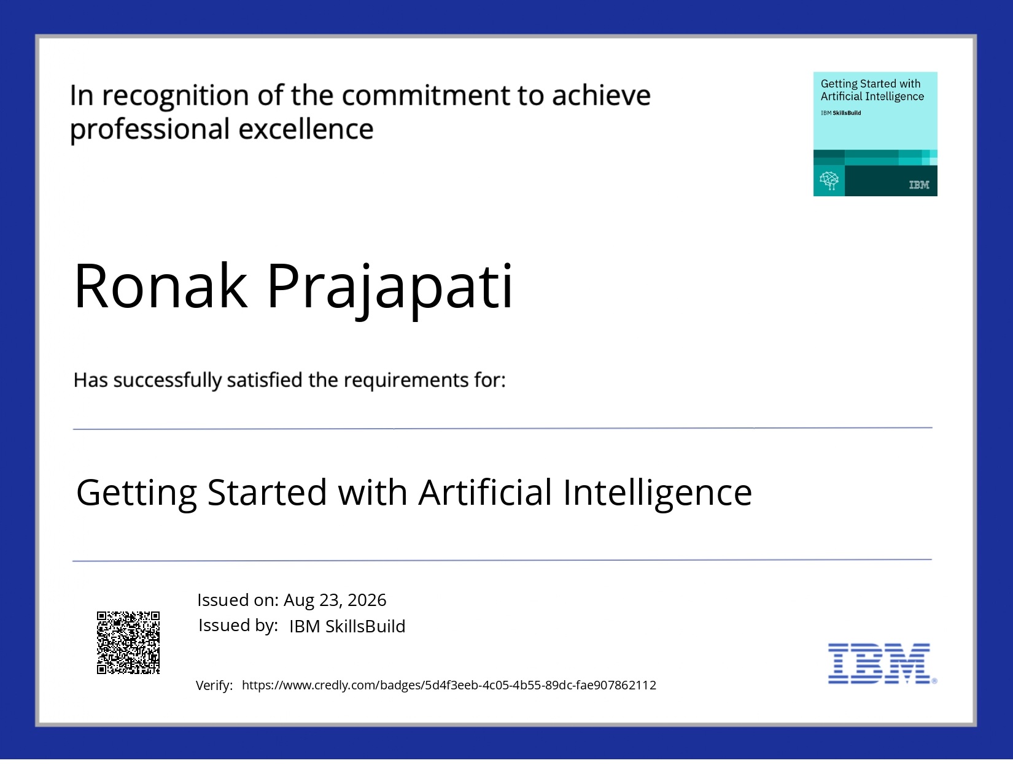
Certificates Earned:

Slide 20
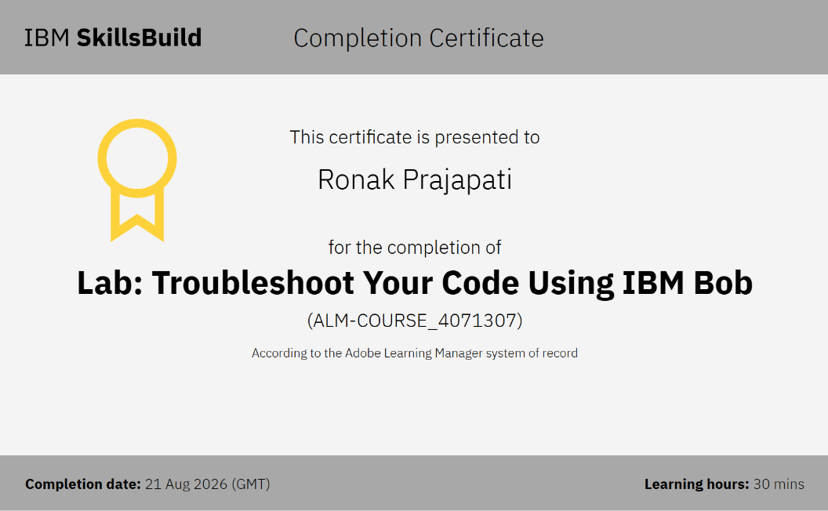
Certificates Earned:​

Slide 21


