Slide 1
IBM Bob Gujarat State level Hackathon Project Submission
Fitness Buddy — AI-Powered Personal Fitness Coach
Powered by IBM Granite and IBM Bob

Slide 2
Project Title: Fitness Buddy — AI-Powered Personal Fitness Coach
Domain of Project: Healthcare / Fitness & Wellness
Student Name | Recent Passport Photo | Email ID | Mobile number [WhatsApp]
 | Your professional profile picture
AICTE-2026 Problem Statement No. 13
Team: Ronak-webdev
Tech: IBM Granite (ibm/granite-4-h-small), Python FastAPI, React 18, IBM Db2 on Cloud Lite

Slide 3
Problem Statement -
Problem Statement No. 13 : Fitness Buddy
The Challenge:
In today's fast-paced world, individuals struggle to maintain a healthy lifestyle due to lack of personalized guidance, time constraints, and inconsistent motivation. Traditional fitness solutions require expensive subscriptions, in-person trainers, or rigid schedules that fail to adapt to personal routines. Without accessible, real-time guidance, people struggle with home workout planning, healthy eating, and building daily consistency.
The Objective:
Build an Agentic AI personal fitness coach that delivers on-demand guidance, healthy lifestyle suggestions, and basic nutrition advice tailored to individual needs:
• Personalized Home Workouts – Tailored routines based on fitness level, available time, and no-equipment constraints.
• Nutritious Meal Ideas – Wholesome Indian & international meal ideas with approximate calories, macros, and practical cooking tips.
• Habit-Building & Daily Motivation – Consistency tracking, streak gamification, and daily encouragement.
• Agentic Multi-Agent System – Orchestrator, WorkoutAgent, NutritionAgent, MotivationAgent, and ProfileAgent.
• Interactive Web App – Clean, responsive UI with streak tracking, quick action prompts, and modular card rendering.

Slide 4
Proposed Solution – Key Pillars:
1. Agentic AI Personal Coach: Uses an intelligent OrchestratorAgent to classify user intent and route queries to specialized agents (Workout, Nutrition, Motivation, Profile).
2. Low-Temperature Structured AI Generation: IBM Granite produces precise, validated JSON routines for workouts and meals (temperature=0.2), while motivational guidance uses conversational warmth (temperature=0.7).
3. Daily Habit & Consistency Engine: Integrates a streak counter and daily habit challenges to reinforce fitness consistency.
4. Resilient Cloud Architecture: Optimized for IBM Cloud Lite with token budget tracking and automatic in-memory fallback for local development.
Proposed Solution: Fitness Buddy Multi-Agent Coach
Proposed Solution: Fitness Buddy Multi-Agent Coach

Slide 5
Technology Used
• IBM Bob platform - For designing, orchestrating, and scaffolding multi-agent workflows
• IBM Granite model - ibm/granite-4-h-small via IBM watsonx.ai for natural language reasoning, structured JSON generation, and conversational coaching
• IBM Cloud Lite & Db2 - Infrastructure for user profile persistence, chat history, and session management
• Python 3.11 & FastAPI & Pydantic - High-performance backend with asynchronous request handling and strict data validation
• React 18, Vite & Tailwind CSS - Responsive, minimalist white-and-green theme with modular card rendering

Slide 6
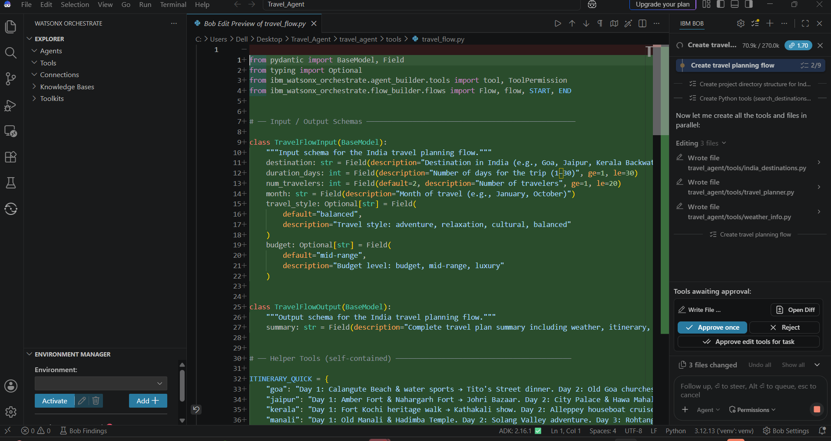
Required Files created using IBM bob -

Slide 7
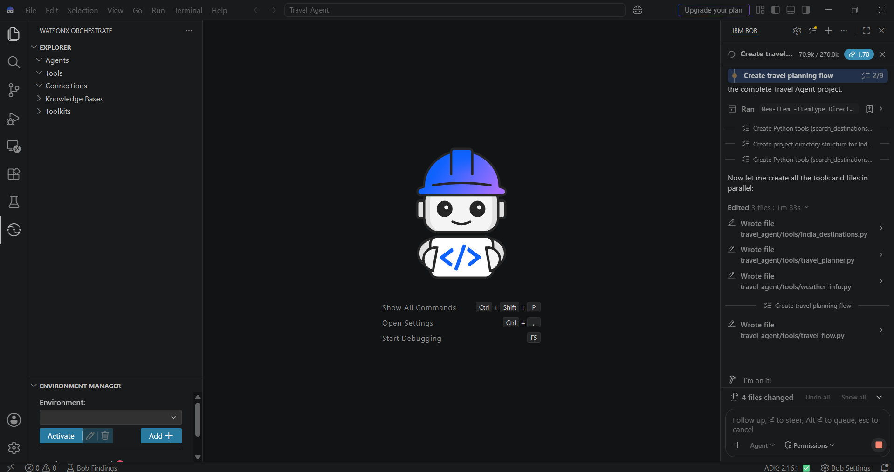
IBM Bob Screenshots:

Slide 8
IBM Bob Screenshots:

Slide 9
IBM Bob Screenshots:

Slide 10
IBM Bob Screenshots:

Slide 11
IBM Bob Screenshots:

Slide 12
IBM Bob Screenshots:

Slide 13
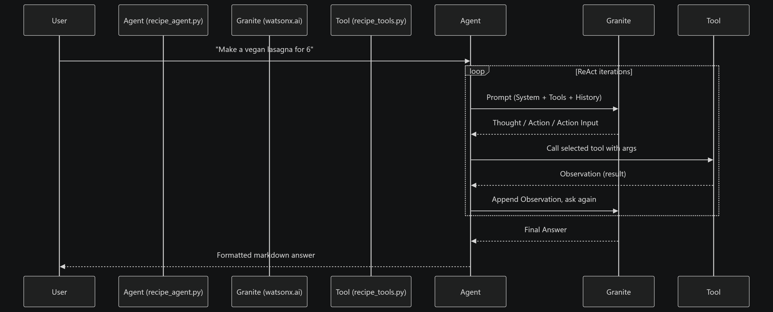
Architecture blueprint for IBM bob:

Slide 14

Role of Agentic AI in the solution
Role of Agentic AI in Fitness Buddy
Agentic AI enables Fitness Buddy to operate as an intelligent, autonomous coaching system rather than a generic chatbot. Using IBM watsonx.ai and IBM Granite models, it coordinates multiple specialized agents:
• Orchestrator Agent: Classifies intent (WORKOUT, NUTRITION, MOTIVATION, PROFILE, GENERAL) and routes requests to the right specialist agent.
• Workout Agent: Generates structured home workout routines with warm-up, main exercises, cool-down, sets, and rest intervals.
• Nutrition Agent: Delivers high-protein meal suggestions with calories, macros, and practical preparation tips.
• Motivation Agent: Provides daily habit-building challenges and positive reinforcement based on the user's streak.
• Profile & Memory Agent: Manages user preferences, fitness goals, experience level, and conversation history.
This multi-agent architecture guarantees zero prompt contamination, high reliability, and domain-specialized responses.

Slide 15
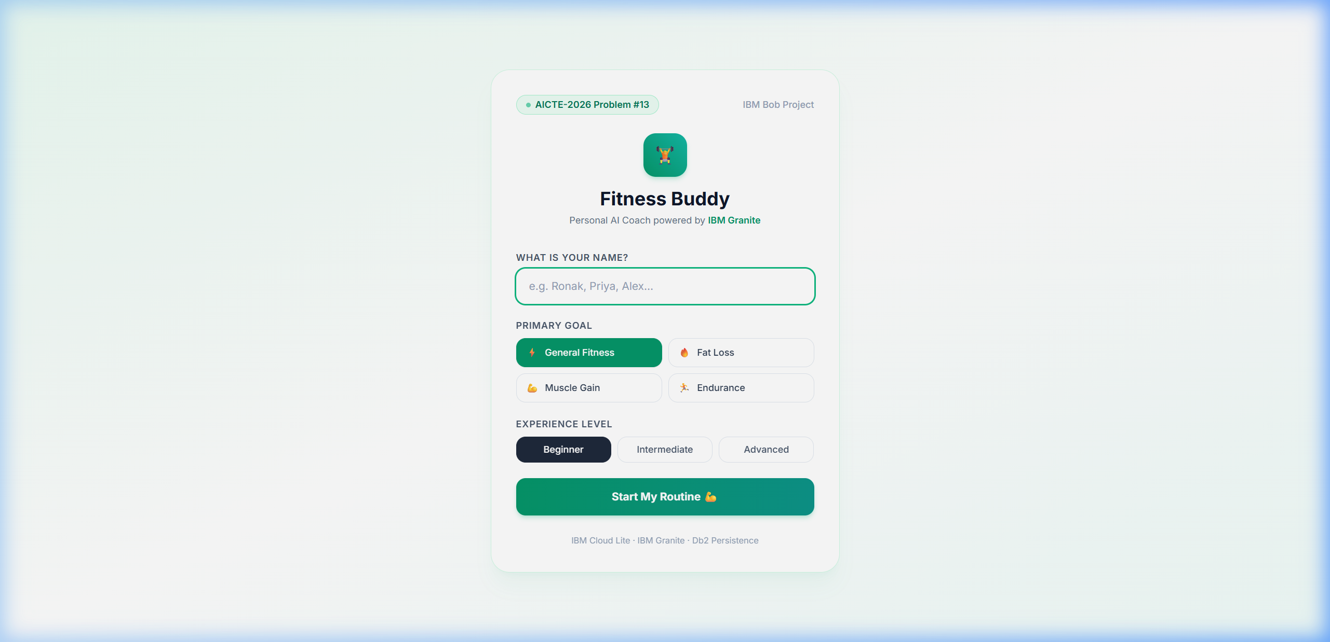
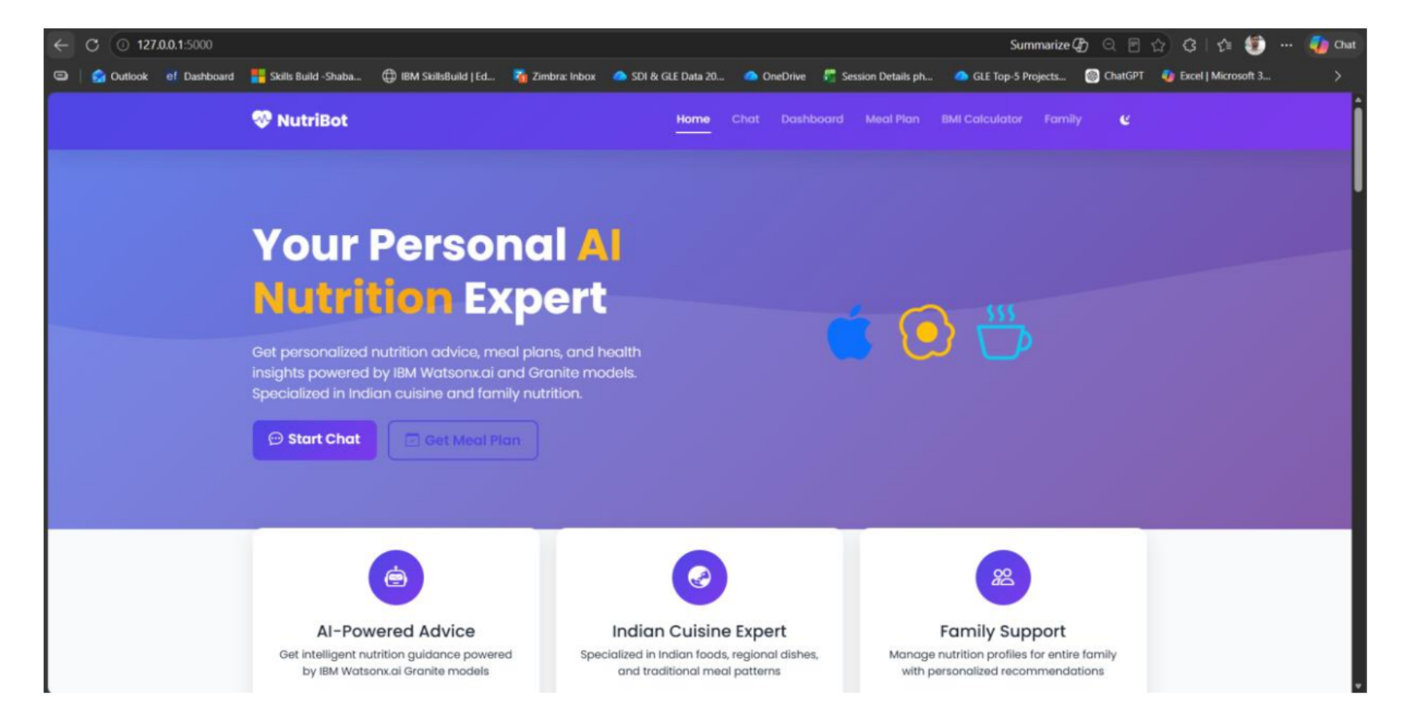
Project Output Screenshot: User Onboarding & Profile Setup

Slide 16
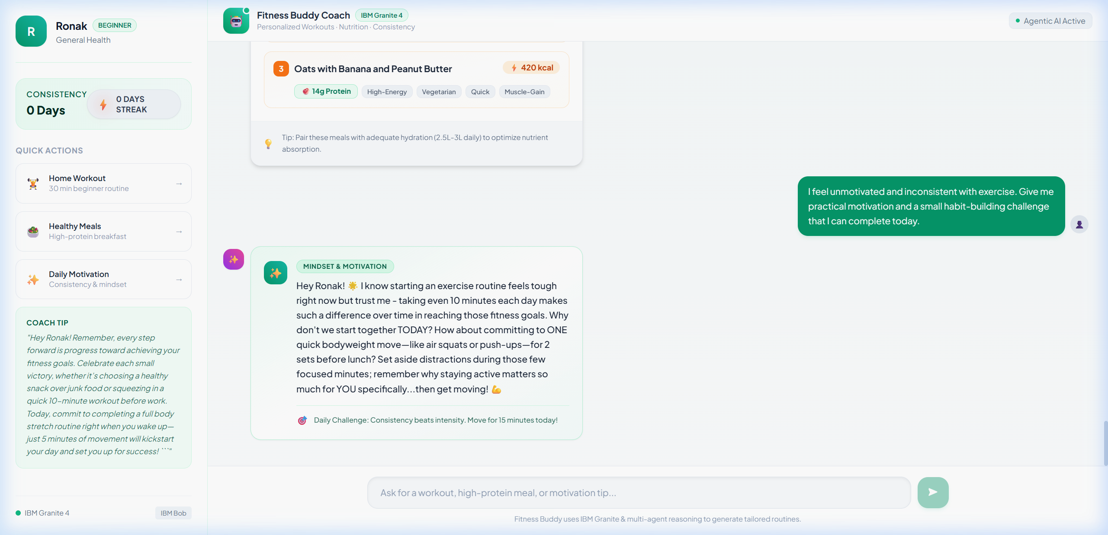
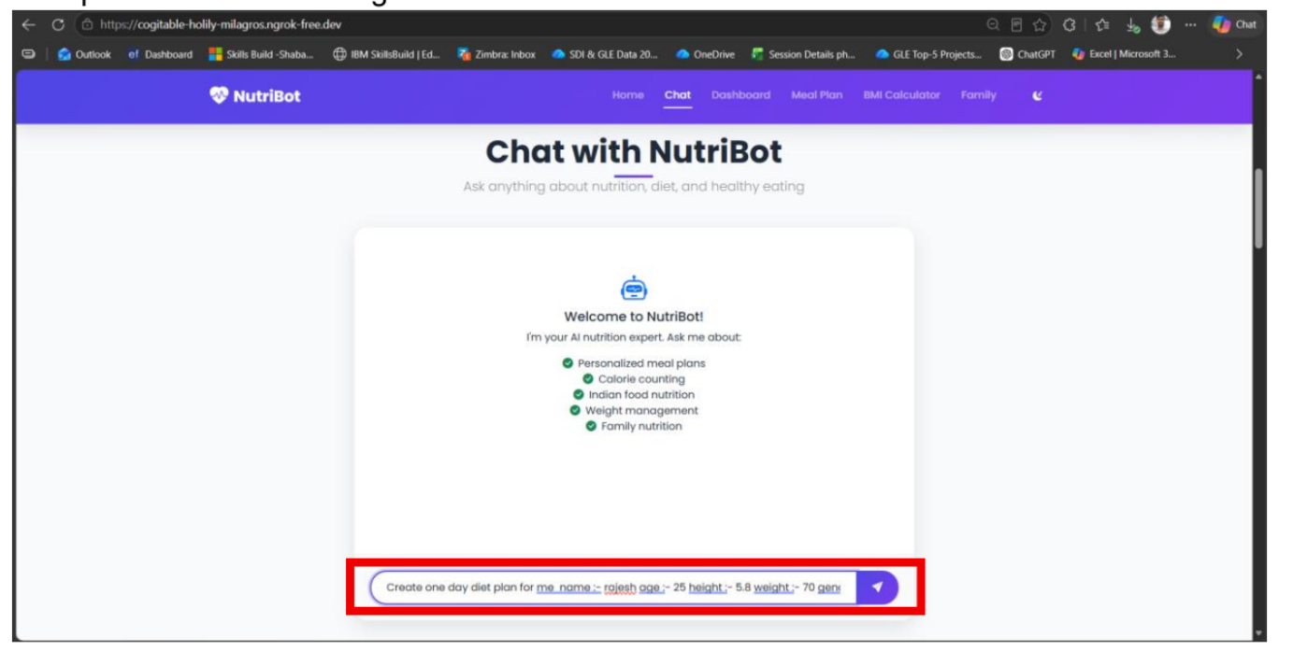
Project Output Screenshot: Home Workout & Nutrition Recommendations

Slide 17
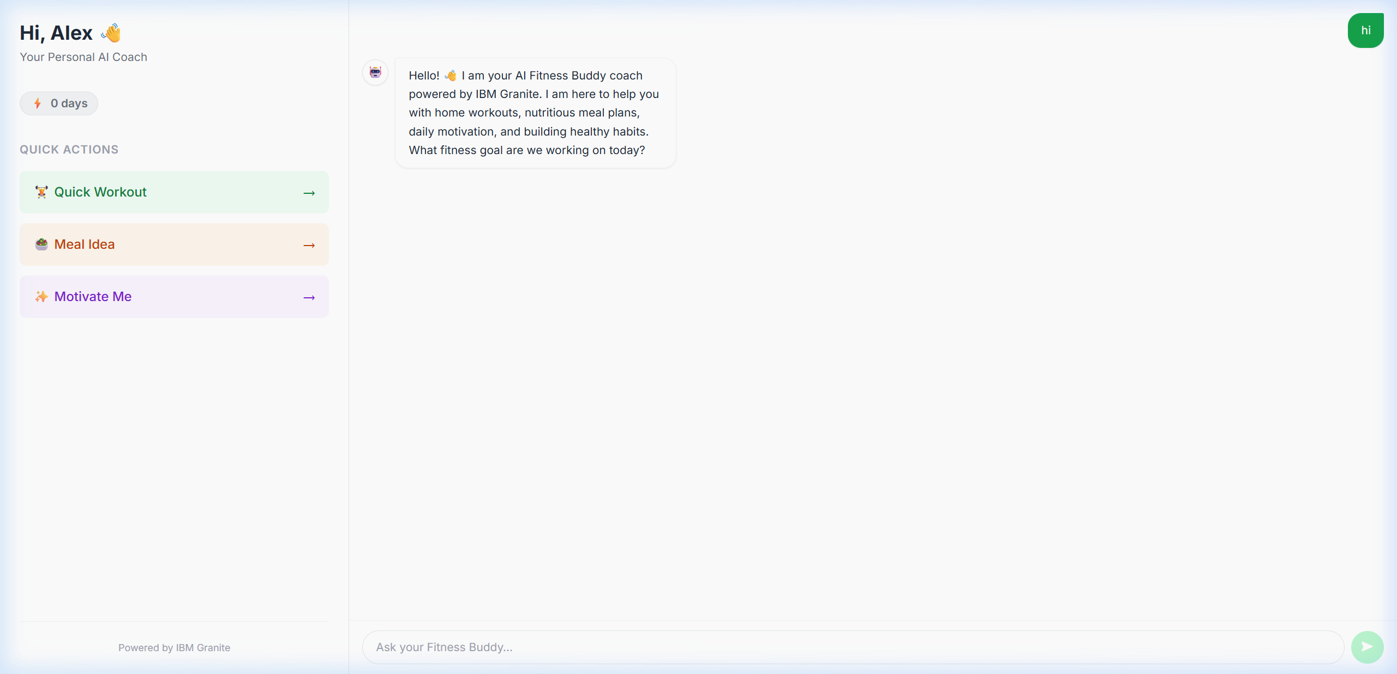
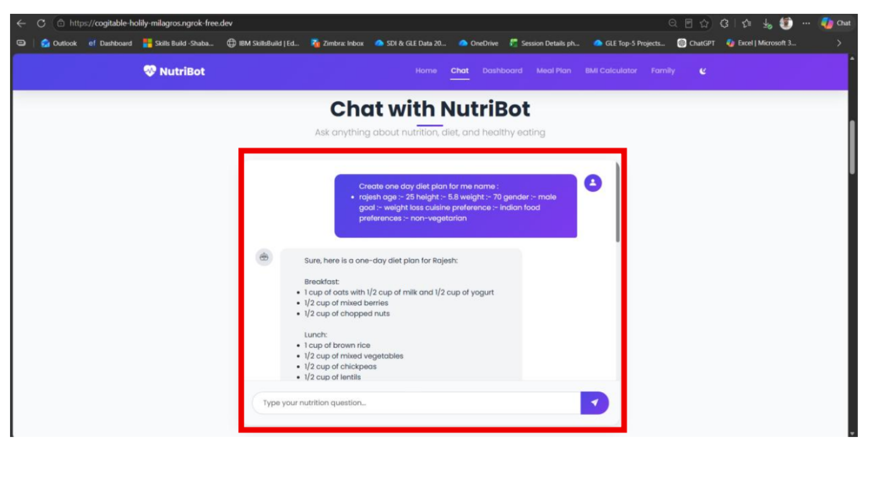
Project Output Screenshot: Interactive Dashboard & Motivation Flow

Slide 18
The Wow Factor Behind Fitness Buddy
1. Multi-Agent Intelligent Routing:
Instead of a monolithic prompt, an Orchestrator classifies user intent and delegates to domain-specialized agents. Workout plans, diet suggestions, and mindset advice never interfere with one another.
2. Dual-Temperature Precision Architecture:
Structured JSON generation for workouts and meals is executed at temperature 0.2 for strict schema adherence, while motivational coaching runs at temperature 0.7 for warm, empathetic human-like tone.
3. Habit-Building & Streak Gamification:
Built-in consistency tracking with dynamic streak badges and daily habit challenges reinforces real-world adherence and long-term wellness.
4. Cloud-Lite & Offline Resiliency:
Engineered for zero-downtime demonstration: seamlessly operates on IBM Cloud Lite or in-memory fallback if credentials/quotas fluctuate.
·
·
·

Slide 19
Novelty and Uniqueness
Fitness Buddy stands out by combining Agentic AI, structured LLM reasoning, and habit science:
• Multi-Agent Coordination: Specialized agents for workouts, meals, motivation, and user memory.
• Zero-Equipment Accessibility: Home workout generation requiring no gym membership or equipment.
• Culturally-Aware Nutrition: Realistic meal recommendations with practical Indian and global options.
• Behavior-Driven Motivation: Micro-challenges to overcome workout resistance and build sustainable routines.
• Privacy & Lightweight Architecture: Client-side session management with secure backend APIs.
• Enterprise Foundation: Built on IBM Granite and watsonx.ai enterprise AI infrastructure.

Slide 20
Future Scope & Roadmap
1. Wearable & Smart Device Integration:
Syncing with smartwatches (Apple Watch, WearOS, Fitbit) to ingest real-time biometric metrics (steps, heart rate, active calories, sleep) for dynamic plan adjustments.
2. Computer Vision Form Analysis:
Using camera feeds to provide real-time pose estimation and posture correction during home exercises (squats, pushups, planks).
3. Voice Assistant & Multilingual Support:
Enabling hands-free voice coaching in English, Hindi, Gujarati, and other regional languages during workouts.
4. Community Fitness Challenges:
Social streak sharing and peer group challenges to enhance accountability and engagement.
Future Scope & Roadmap
1. Wearable & Smart Device Integration:
Syncing with smartwatches (Apple Watch, WearOS, Fitbit) to ingest real-time biometric metrics (steps, heart rate, active calories, sleep) for dynamic plan adjustments.
2. Computer Vision Form Analysis:
Using camera feeds to provide real-time pose estimation and posture correction during home exercises (squats, pushups, planks).
3. Voice Assistant & Multilingual Support:
Enabling hands-free voice coaching in English, Hindi, Gujarati, and other regional languages during workouts.
4. Community Fitness Challenges:
Social streak sharing and peer group challenges to enhance accountability and engagement.
·
·
·

Slide 21
GitHub Repository Link
Working Repository URL:
https://github.com/Ronak-webdev/Fitness-Buddy.git
Repository Contents:
1. All Agent relevant files of IBM Cloud (.bob/ rules, backend/agents/, backend/llm/)
2. Official AICTE Problem Statement PDF (Problem Statement No. 13)
3. Official Project Presentation PPTX
4. Complete FastAPI Backend & React Frontend Source Code
5. Test Suite (17/17 passing) & Comprehensive Project Documentation
GitHub Repository Link
Working Repository URL:
https://github.com/Ronak-webdev/Fitness-Buddy.git
Repository Contents:
1. All Agent relevant files of IBM Cloud (.bob/ rules, backend/agents/, backend/llm/)
2. Official AICTE Problem Statement PDF (Problem Statement No. 13)
3. Official Project Presentation PPTX
4. Complete FastAPI Backend & React Frontend Source Code
5. Test Suite (17/17 passing) & Comprehensive Project Documentation
GitHub Repository Link
Working Repository URL:
https://github.com/Ronak-webdev/Fitness-Buddy.git
Repository Contents:
1. All Agent relevant files of IBM Cloud (.bob/ rules, backend/agents/, backend/llm/)
2. Official AICTE Problem Statement PDF (Problem Statement No. 13)
3. Official Project Presentation PPTX
4. Complete FastAPI Backend & React Frontend Source Code
5. Test Suite (17/17 passing) & Comprehensive Project Documentation
GitHub Repository Link
Working Repository URL:
https://github.com/Ronak-webdev/Fitness-Buddy.git
Repository Contents:
1. All Agent relevant files of IBM Cloud (.bob/ rules, backend/agents/, backend/llm/)
2. Official AICTE Problem Statement PDF (Problem Statement No. 13)
3. Official Project Presentation PPTX
4. Complete FastAPI Backend & React Frontend Source Code
5. Test Suite (17/17 passing) & Comprehensive Project Documentation
GitHub Repository Link
Working Repository URL:
https://github.com/Ronak-webdev/Fitness-Buddy.git
Repository Contents:
1. All Agent relevant files of IBM Cloud (.bob/ rules, backend/agents/, backend/llm/)
2. Official AICTE Problem Statement PDF (Problem Statement No. 13)
3. Official Project Presentation PPTX
4. Complete FastAPI Backend & React Frontend Source Code
5. Test Suite (17/17 passing) & Comprehensive Project Documentation

Slide 22
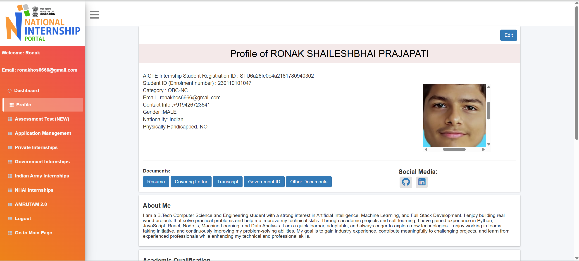
IBM SkillsBuild Profile Screenshot
IBM SkillsBuild Profile Screenshot

Slide 23
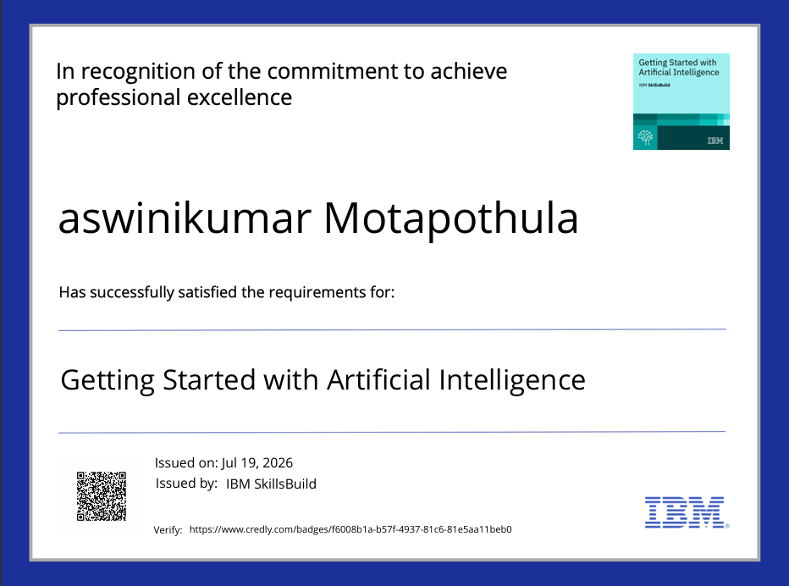
Certificates Earned:
Please add your credly certificate(Getting Started with Artificial Intelligence)

Slide 24

Certificates Earned:​
Add your IBM BOB Certificate

Slide 25


