Slide 1


Problem Statement Number :- PS1433
Problem Statement:- “ Mental Health And Well-Being Surveillance , Assessment and Tracking Solution among Children ”
Organization Name:- Ministry of Education
Domain Bucket:- ‘Smart Education’
Category:- Software
Team Name:- Team Thread
Team Leader : Devki Deshpande (2021BIT030)
College Name: Shri Guru Gobind Singhji Institute of Engineering and Technology, Vishnupuri, Nanded
College AICTE Code: 1-414200305 | College AISHE Code: C-7592 | College IIC ID: IC201810653
SPOC Details: Prof. Suhas Gajre | Dean (Innovation, Incubation and Linkages) | ssgajre@sggs.ac.in | +91-9421851011

Slide 2
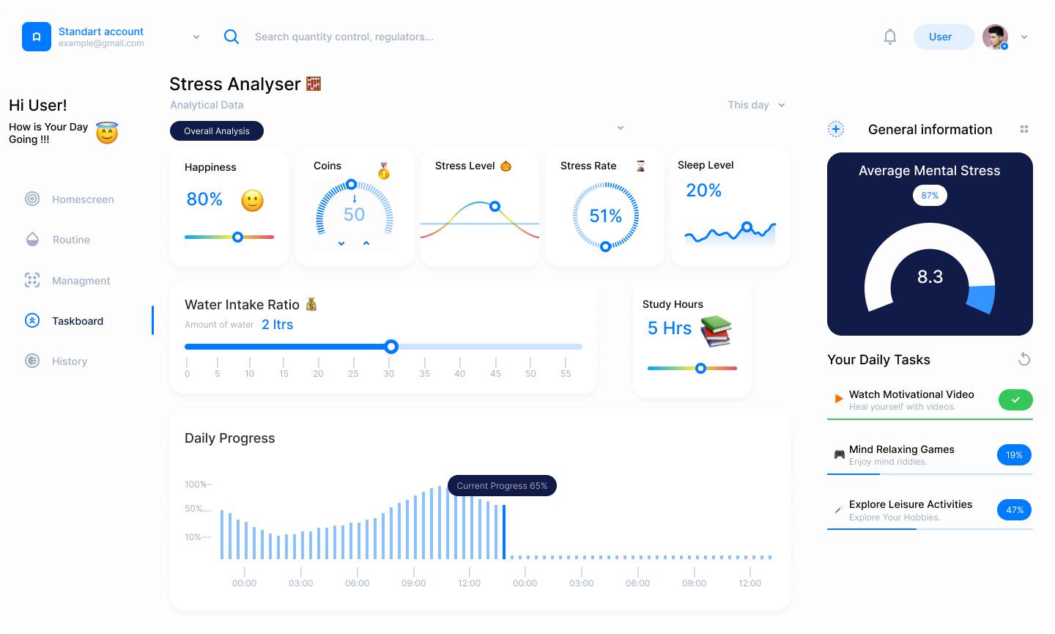
Idea/Solution/Prototype
Schema
Our innovative solution is a secure mobile/Web application designed to empower parents, caregivers, and teachers to foster children's mental well-being and Stress Management .
With robust Aadhaar login authentication, it prioritizes data security. Built with ReactJS , Java , Map Integration , MySQL database administration , Figma ,Push.io and Aadhar Authentication API , it boasts an intuitive interface comprising modules for assessments, mood tracking, and secure analysis.
Collaboration with esteemed physiatrists and psychiatrists ensures expert guidance, while rigorous data encryption and precise user permissions safeguard privacy. This prototype offers a holistic approach to children’s as well as adult mental health , blending technology, expert knowledge, and privacy protection under the guidance of experts .

Slide 3
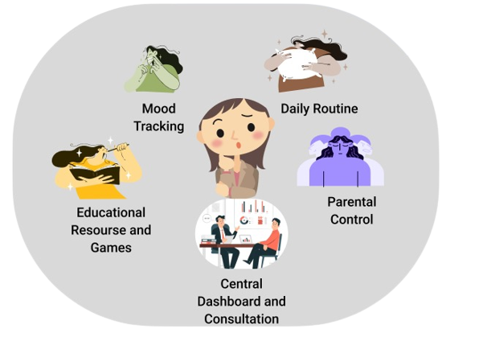
Features
User Authentication through AADHAR CARD
A central dashboard providing an overview on key information
Assessment Module for evaluating child’s mental health , Age – appropriate questionnaires and surveys
Parental control Features for children assessment
Mood Tracking ( visual representation to help children and adult understand their moods).
Daily Routine and Stress Management (Daily routine for children and adults , including stress-reduction and relaxation technique )
Data Analytics and Security (provide insights , robust data encryption and strict user permission)
Educational Resources and Games (For spreading the awareness about the mental health management through fun activities )
Consultation and Guidance (Collaboration with Physiatrists for expert guidance )

Slide 4
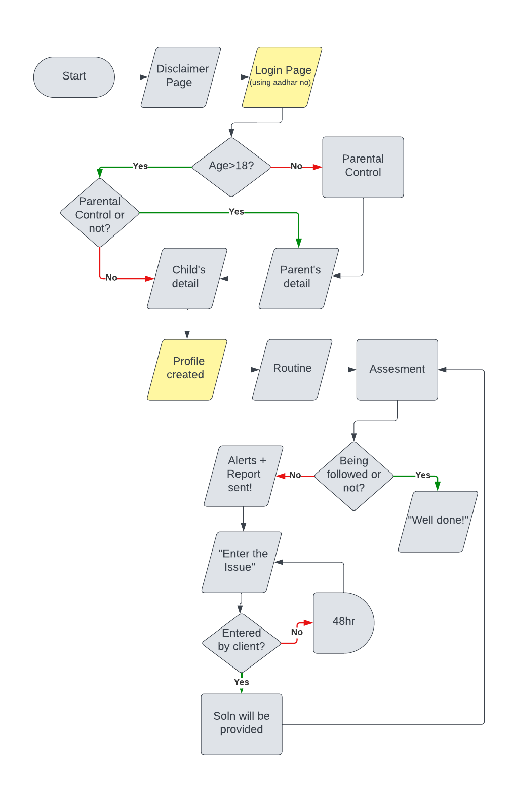
Working of system
Inputs:
User Authentication ( User Login data collection )
User Profile ( users create profile for themselves and children , providing personal Info )
Assessment Module ( Input about the persons mental and physical health )
Parental control ( Parents set up and manage parental control gives inputs accordingly )
Daily Routines and Stress Management ( Users access & customize daily routine activities)
Mood Tracking ( Regularly update the child’s mood and emotion )
Outputs:
User Insights(User gain insights of mental well-being through data and progress report)
Mental Health Support(Children and adults receive guidance and support from professionals)
Daily Routine and Stress Management(Engage in daily routine & stress management activities
Privacy and Security(Data remain secure and private , and system adheres the regulations)
Feedback and Improvement(System incorporates user feedback to continually improve features)
Alerts:
Mood alerts , Assessment Reminders , Appointment Alerts , Emergency Alerts
Privacy Consent Alerts , Progress Report Alerts , Parental Control Alerts .

Slide 5
Technology Stack
Frontend: React.js for a responsive and user-friendly interface.
Backend: Node.js for server-side development.
Java : for handling complex business logic and data processing.
Database: MySQL for flexible data storage.
Authentication: Firebase Authentication for security.
APIs: GraphQL for efficient data querying, Aadhar Authentication API.
Hosting: Amazon Web Services (AWS) for scalability.
Push.io : Provides alerts message to the user.

Slide 6
Existing systems, if any, and why my solution is better
Future Scope
Advanced Data Analytics
Future versions of the prototype can incorporate more sophisticated data analytics and machine learning algorithms to provide more accurate and timely insights into a child's mental health.
AI-Driven Chatbots
AI-driven chatbots and virtual assistants can be integrated to provide immediate support and guidance to children based on their self-reported data and mood tracking.
There are many Apps such as Headspace , Bouncy , Wyass , Calm Harm . But all this apps has one feature and not other our Module combinedly includes all the features and additional feature with respect this apps , Privacy is the main concern in this apps which is at its best provided by our module .
Our solution offers a holistic approach to children's mental health and well-being by combining assessments, mood tracking, secure communication, parental control features, and expert guidance. It addresses the limitations of existing systems by providing a comprehensive and integrated platform for children, parents, caregivers, educators, and mental health professionals to collaborate and support children's mental health needs.
School Partnership
Partnering with schools and educational institutions can help in early identification of mental health concerns and provide resources for teachers and school counsellors to support students.
Customization for Different Age Group
Further customization of assessment and tracking features for different age group and developmental stages can improve relevance and effectiveness of the solution
Limitations
Data Accuracy ( Inaccurate or Incomplete data could impact the system’s insights )
User Engagement ( Maintaining user Engagement , especially among children )
Digital Access Barriers ( Not all children have consistent access to digital device & internet )
Cost Implication ( Developing and maintaining such a comprehensive solution can be costly )

Slide 7
References
Team
International Research Journal of Engineering and Technology (IRJET)
www.Sciencedirect.com/article
ResearchGate
Devki Pradeep Deshpande (2021BIT030)
Ronak Dipak Pawar (2021BIT022)
Ashwin Ramesh Nagapure (2021BIT048)
Ashutosh Ramakant Tamboli (2021BIT035)
Sai Rajesh Bende (2021BIT011)
Aditya Sanjaykumar Baheti (2021BIT002)
Mentors
Faculty mentors:
Rachna Potpelwar, Dept.IT, Shri Guru Gobind Singhji Institute of Engineering and Technology

