Slide 1
Disaster Management Chatbot
BTP Mid-Term Evaluation
Ronak Jain
2101CS67

Slide 2
Problem Statement
Developing an intelligent chatbot to provide real-time earthquake updates based on user location, historical earthquake data, safety guidelines, and emergency contacts to help users stay informed and prepared.

Slide 3
Work Done So Far
Built a chat-bot using gemini and USGS API to retrieve earthquake information which can :
Earthquake Details: Retrieves earthquake information for any location on Earth from the USGS website based on a specified time range.
Country-wise Information: Provides detailed earthquake data categorized by country for easier access and understanding.
Safety Advice: Offers general guidelines and tips on how to safeguard oneself during an earthquake.

Slide 4
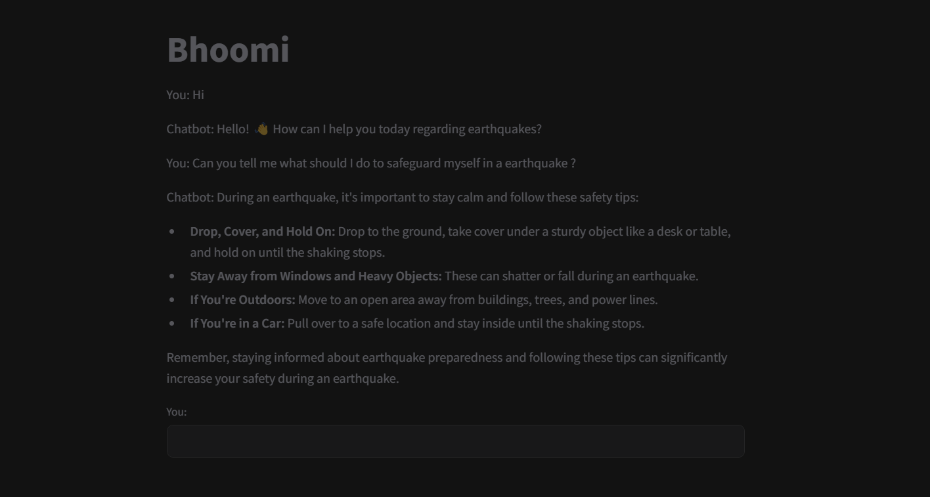
Getting General Guidelines
Chat-bot can give general help and advisory.

Slide 5
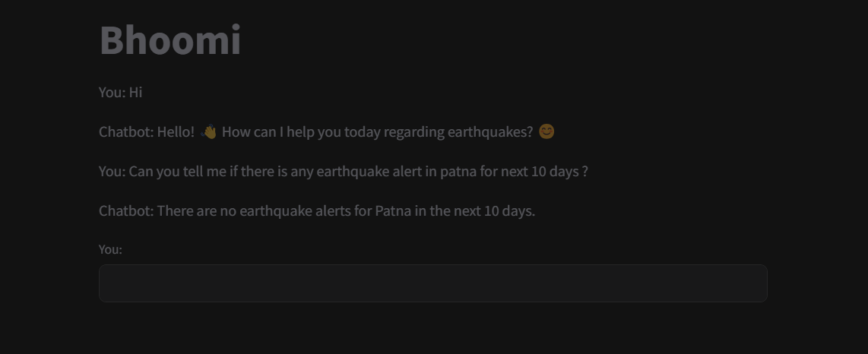
Location specific information
Chat-bot can give real-time data for a particular city, like Patna.

Slide 6
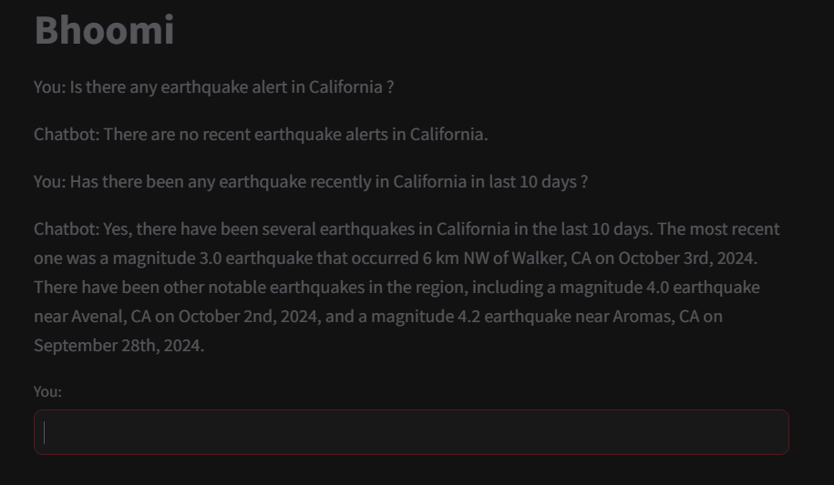
Continued...
Asking for earthquake information at California.

Slide 7
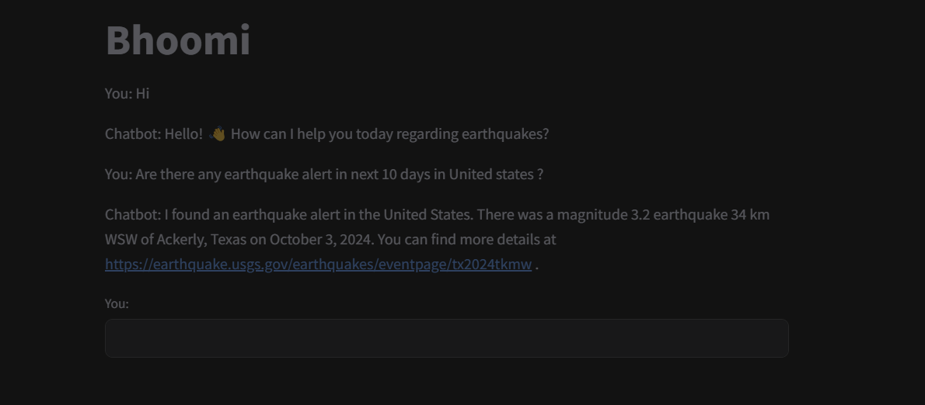
Getting information for a country
Chat-bot can give earthquake detail for a whole country using boundary box.

Slide 8
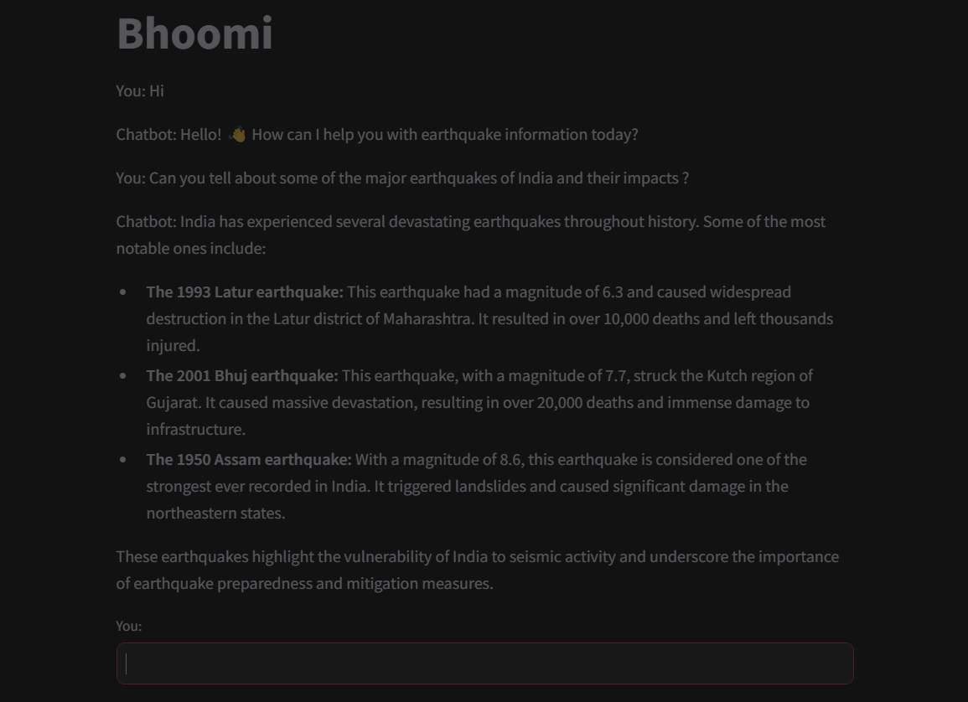
Major earthquakes
Chat-bot can also give information on earlier earthquakes and their impacts.

Slide 9
Future work…
Add Emergency contact information so that user can ask directly chat-bot .
Adding location based service so that user doesn’t need to specify their location again and again.
Extend the chat-bot to work on different disasters including Tsunamis, flood and cyclones.

Slide 10


