Slide 1
IMPACT OF TECHNOLOGY ON MUSIC COMPOSITION AND PRODUCTION
Ronak S Prasad
4 MCA ‘B’,
Register No.: 2247232,
Department of Computer Science,
CHRIST (Deemed to be University)

Slide 2
01
02
03
AGENDA
Introduction
Songwriting, Arrangement and Recording
Audio Programming and VSTs
04
Mixing and Mastering
05
Recent Trends in Audio Effects
06
Conclusion

Slide 3
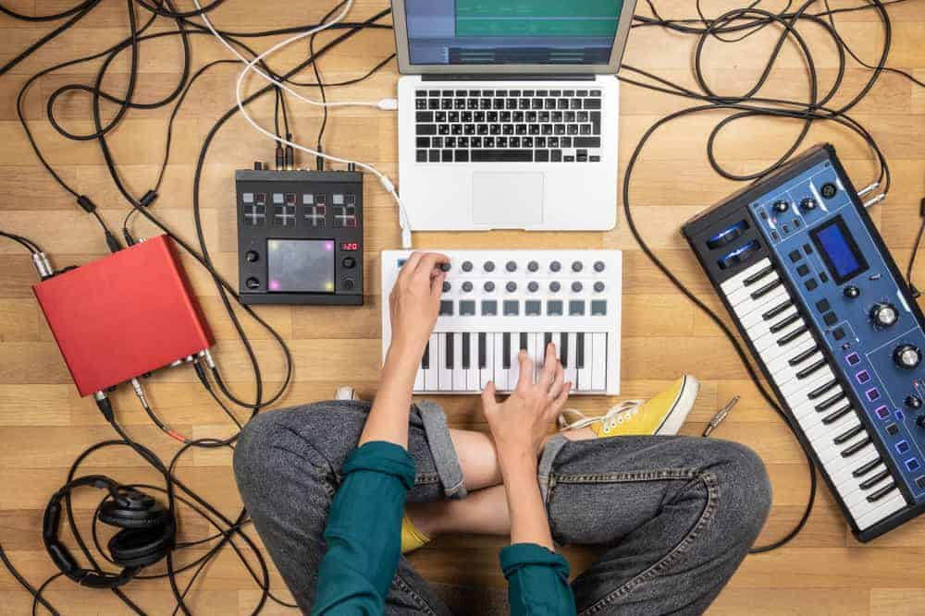
Introduction
Technology has made it easier to access and stream music content.
But how has it helped the ones who create and produce it?

Slide 4
Composition and Production
Music production and composition are distinct yet interconnected aspects of the music-making process.
Music Composition:
Music composition is the art of creating original music, melodies, harmonies, rhythms, and structures to form a complete musical composition.
Music Production:
Music production is the process of taking a musical composition or idea and turning it into a polished and finalized audio recording or track.

Slide 5
Songwriting, Arrangement and Recording
The songwriter is someone who creates the lyrics, vocals and melody of a song.
Digital Workstations:
Digital audio workstations (DAWs) allow songwriters to experiment with melodies, chords, and arrangements digitally. They are software applications used for recording, editing, arranging, and producing audio and music.
MIDI Controllers:
MIDI keyboards and controllers facilitate the input of musical ideas into DAWs, providing a versatile and efficient way to experiment with different sounds and textures.
Music Theory Softwares:
Songwriters can use music theory software to analyze chord progressions, experiment with harmonies, and explore different musical structures.

Slide 6
Key Features of DAWs:
Multitrack Recording: DAWs allow you to record multiple audio and MIDI tracks simultaneously or individually, enabling you to capture different instruments and performances separately.
Editing Capabilities: DAWs offer extensive editing tools for manipulating audio and MIDI data. You can cut, copy, paste, quantize, and adjust timings and pitches.
3. Virtual Instruments: Many DAWs come with built-in virtual instruments such as synthesizers, drum machines, and sample-based instruments. These instruments allow you to create a wide range of sounds directly within the DAW.

Slide 7
4. MIDI Sequencing: DAWs support MIDI data, enabling you to create and edit MIDI sequences for controlling virtual instruments, synthesizers, and hardware MIDI devices.
5. Audio Effects: DAWs provide a variety of audio effects, including equalization (EQ), compression, reverb, delay, chorus, and more. These effects can be applied to individual tracks or the entire mix.
MIDI (Musical Instrument Digital Interface) Controllers
A MIDI controller keyboard is a device used to send MIDI data to a computer or other hardware. In more basic terms, it’s a keyboard that is used to trigger sounds from an external source.
The external source can be another piece of hardware or a virtual instrument in your DAW.

Slide 8
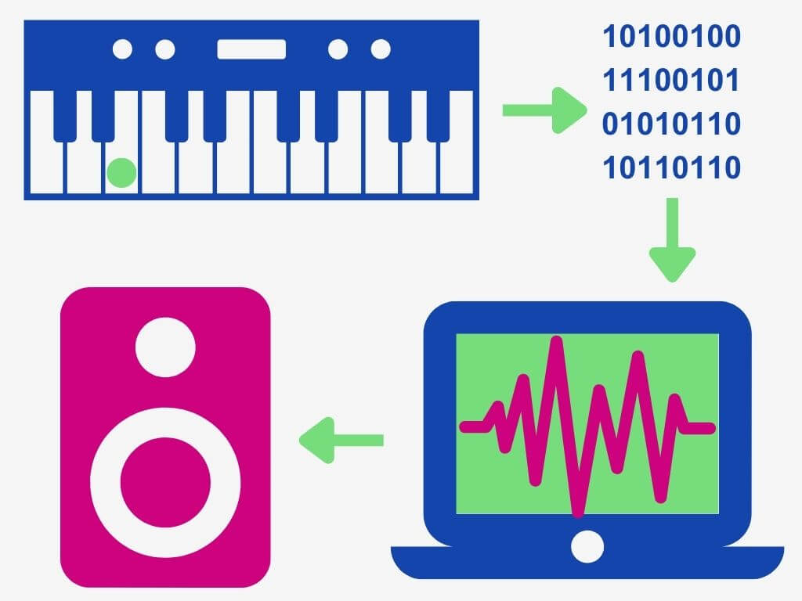
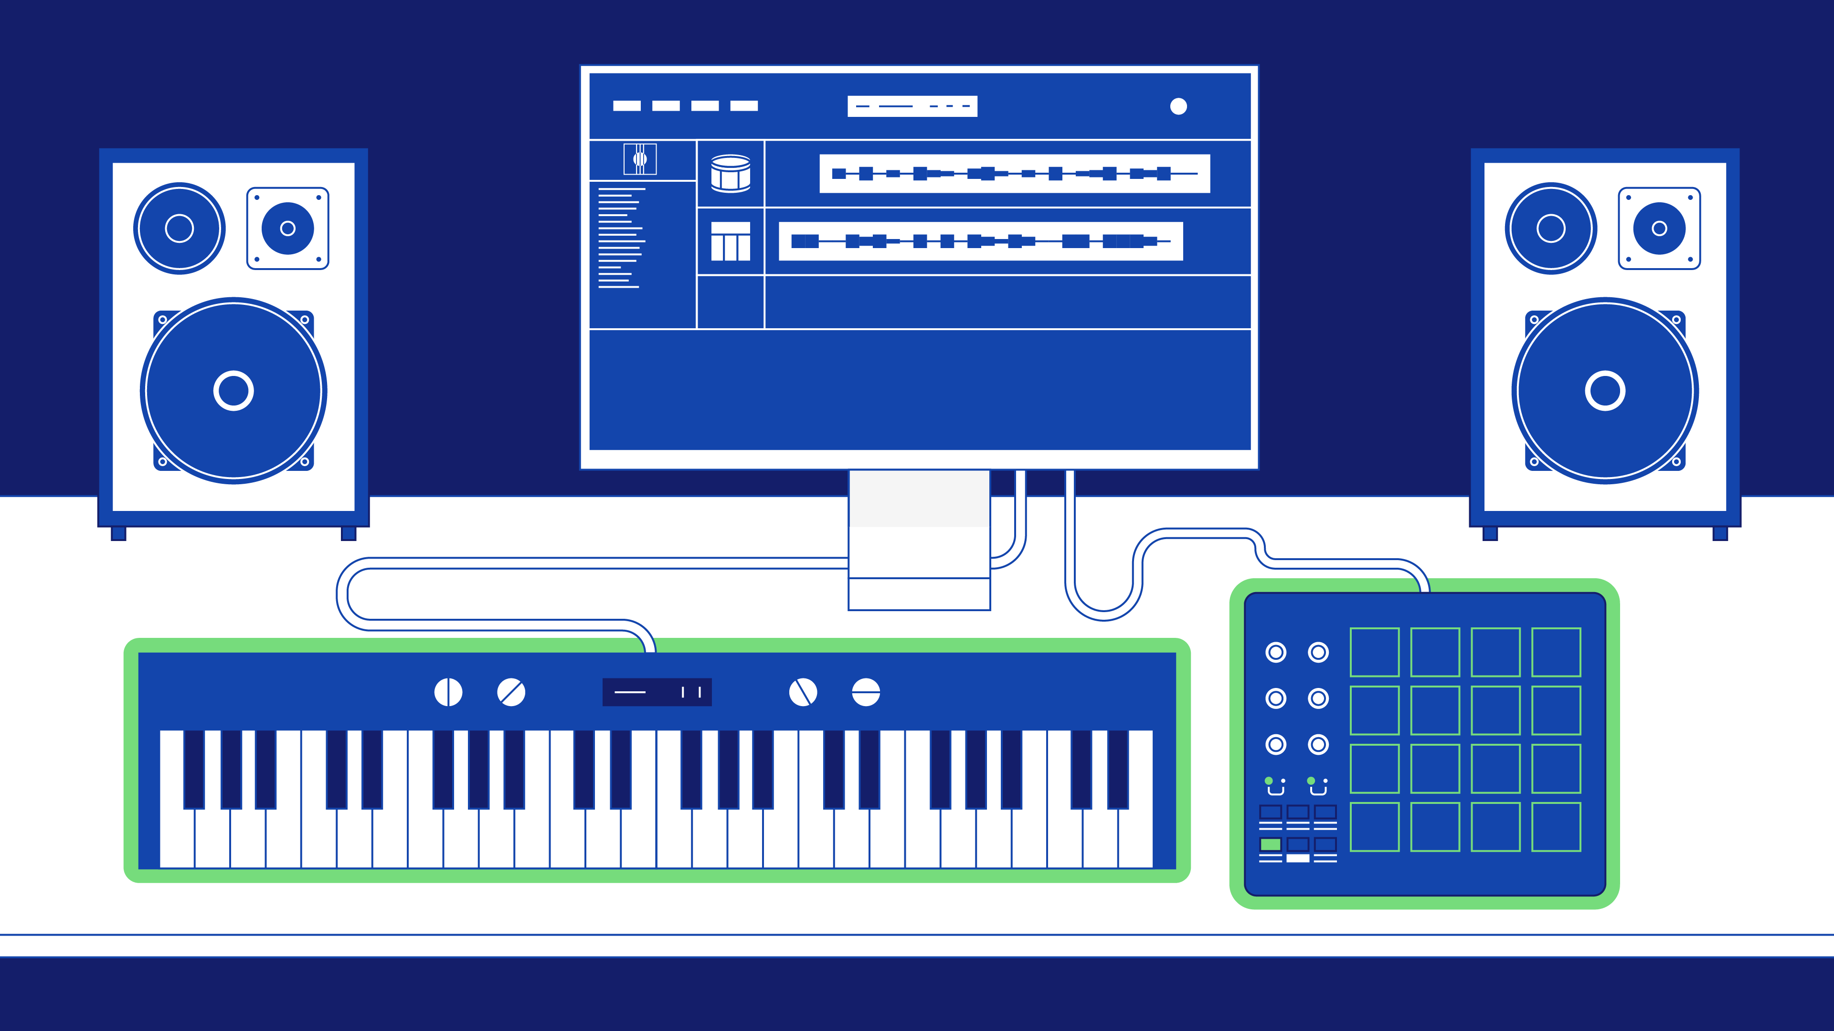
MIDI information only includes data that describes our input – what note you pressed, what knob you adjusted, etc.
In a simple setup like the one in the image above, the sound source is a virtual instrument or software synthesizer on the computer.
Therefore, a MIDI controller allows you to get hands-on when writing music with software instruments and plugins.

Slide 9
Music Theory and Notation Softwares:
Chord Progression Generators: Some software tools can generate chord progressions based on certain criteria, helping composers explore new harmonic ideas.
Scale and Chord Reference: Music theory software often includes databases of scales and chords, aiding musicians in selecting appropriate scales and chords for their compositions.
Visualization Tools: Certain software applications offer visual representations of musical concepts, such as circle of fifths, chord diagrams, and scales on a fretboard.
Key Detection and Transposition: Some software can analyze the key of a piece of music and suggest potential chord progressions or transpose a composition to a different key.

Slide 10
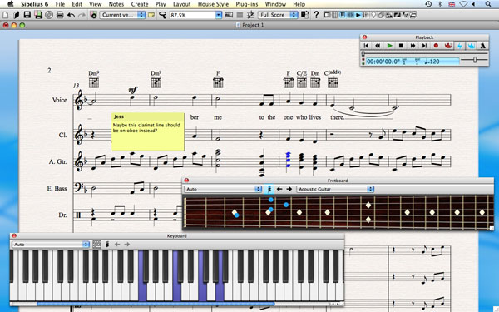
Sibelius 6 Musical Notation

Slide 11
Audio Programming and VSTs
Audio programming involves the development of software applications, tools, and systems that manipulate and process audio signals.
This field combines elements of programming, signal processing, and digital audio technology to create applications that generate, record, analyze, modify, and play back audio content.
1. Signal Processing:
Audio programming often revolves around processing audio signals to achieve desired effects, such as applying filters, equalization, compression, reverb, and other audio effects.
2. Digital Audio Representation:
Audio programming requires a strong understanding of how audio signals are represented digitally using samples and quantization.

Slide 12
3. Real-Time Processing:
Real-time audio programming involves processing audio signals with minimal latency, which is essential for applications like live performances, interactive audio, and video games.
4. Audio Synthesis:
Audio programmers create software synthesizers that generate sound waves, mimicking traditional instruments or creating entirely new sounds.
5. Audio Programming Libraries and Frameworks:
Libraries and frameworks provide pre-built components and tools for audio signal processing and application development.
JUCE: A widely used C++ framework for developing audio applications and plug-ins.
Max/MSP: A visual programming language for music and multimedia.
SuperCollider: A programming language and environment for real-time audio synthesis and algorithmic composition.

Slide 13
6. VST (Virtual Studio Technology) and Audio Plugins:
VST plugins are software modules that can be used within DAWs to add virtual instruments, effects, and processors. VST development often involves the use of the VST SDK (Software Development Kit).
7. Audio Processing Libraries:
Libraries designed specifically for audio signal processing.
PortAudio: A cross-platform audio I/O library.
aubio: A library for audio segmentation and analysis.
Essentia: An open-source library for audio analysis and audio-based music information retrieval.
8. Digital Signal Processing (DSP) Libraries:
Libraries and tools for creating and implementing various digital signal processing algorithms. Examples include:
MATLAB and MATLAB Signal Processing Toolbox: Used for prototyping and testing DSP algorithms.
SciPy: A Python library for scientific and technical computing, including DSP.

Slide 14
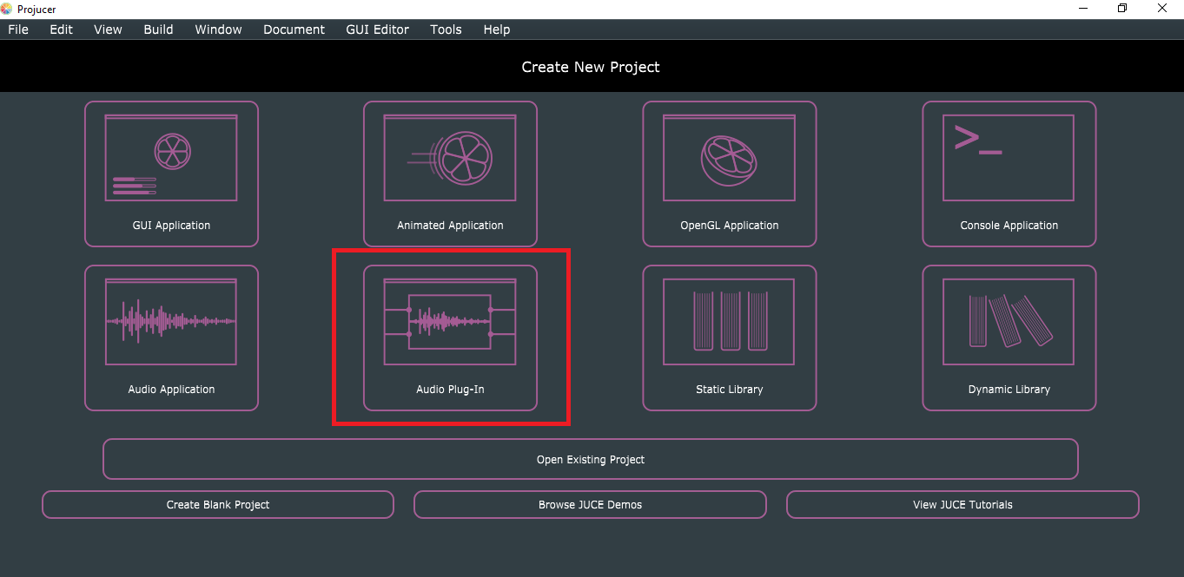
Projucer IDE:
JUCE makes it easy to create both standalone audio applications or plug-ins that can be loaded inside digital audio workstations (DAWs) like Logic, Live, Pro Tools, FL Studio or Cubase.

Slide 15
Virtual Studio Technology (VSTs)
VSTs, or Virtual Studio Technology plugins, are software modules that can be integrated into digital audio workstations (DAWs) and other audio software applications to add new functionalities, instruments, effects, or processing capabilities.
Developed by Steinberg, VST technology has become a standard in the music production and audio industry, allowing users to enhance their creative possibilities by incorporating virtual instruments and audio effects into their projects.
VST plugins have graphical user interfaces that display controls and parameters. Users can manipulate these controls to adjust the plugin's behavior and sound.

Slide 16
Types of VST Plugins:
Virtual Instruments (VSTi):
VSTi plugins are software synthesizers, samplers, and sound generators that allow users to play and create a wide range of instrument sounds. They can replicate traditional instruments or produce entirely unique and electronic sounds.
2. Audio Effects (VST FX):
VST FX plugins process audio signals to alter their sonic characteristics. These effects include tools for reverb, delay, equalization, compression, distortion, modulation, and more.
3. MIDI Effects:
Some plugins process MIDI data instead of audio. They can manipulate MIDI input in various ways, such as generating chords, arpeggios, harmonies, and more.

Slide 17
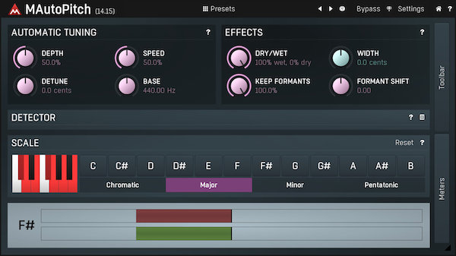
MAutoPitch Auto-Tune VST
While Auto-Tune has its artistic uses, it has also sparked debates about its impact on vocal authenticity and the role it plays in altering the natural qualities of a singer's voice.

Slide 18
Producing Process
It involves a combination of creative and technical skills, using various tools and techniques to transform musical ideas into a polished and professional-sounding composition.
Mixing:
Balancing: Adjusting the volume levels of individual tracks to create a cohesive and balanced mix.
Equalization (EQ): Shaping the tonal balance by boosting or cutting specific frequency ranges.
Compression: Controlling the dynamic range of audio by reducing the difference between loud and quiet parts.
Panning: Placing instruments and sounds in the stereo field to create spatial separation.
Effects Processing: Adding audio effects like reverb, delay, chorus, and more to enhance the sound.

Slide 19
Mastering:
Audio Quality Enhancement: The mastering engineer carefully listens to the mix and identifies any sonic imperfections that can be improved, such as frequency imbalances, dynamic inconsistencies, and tonal issues.
Loudness and Peak Level Optimization: Ensuring that the audio meets loudness standards appropriate for the chosen distribution platforms (streaming services, CD, vinyl, etc.) without compromising audio quality.
Format Conversion: Preparing the audio for different formats, such as CD, digital distribution, vinyl, or cassette. Each format may require specific adjustments to meet the technical requirements.
Quality Control: Thoroughly listening to the mastered tracks and comparing them to the original mixes and reference tracks.
Delivery Formats: Providing the mastered audio in the required formats, resolutions, and bit depths, ready for distribution.

Slide 20
Recent Trends in Audio Effects
Auto-Tune: Auto-Tune is a widely known audio processing technology used in music production to correct or manipulate the pitch of a singer's vocal performance. It was developed by Antares Audio Technologies and has become a hallmark of modern vocal production.
Pitch Shifting: Pitch shifting involves changing the frequency of an audio signal while preserving its overall timing and duration. This means that the original audio's speed remains relatively constant, but the perceived musical pitch is altered.
Shoegaze Reverb: Shoegaze reverb, also known as "dreamy" or "shimmer" reverb, is a specific type of reverb effect that is associated with the shoegaze music genre. Shoegaze is characterized by its ethereal and atmospheric sound, often featuring layers of heavily reverberated guitars and vocals.

Slide 21
CONCLUSION
Technology has heavily impacted the way music is composed and produced over the years.
Modern tools and applications help speed up the process of music making.
Both Music Composition and Production take time to master and hence having technical practice over time is beneficial.
Despite it’s impact, the knowledge of music, vocal techniques and instrumentation are still very much prevalent.

Slide 22


