Slide 1
E-COMMERCE SALES &
CUSTOMER ANALYTICS
A data-driven diagnosis of revenue, profitability, and customer value
using the Tableau Sample Superstore dataset
Business Analytics Portfolio Project | Python · SQL · Power BI

Slide 2
Business Problem & Objective
The Problem
The Objective
The Approach
Superstore generates over $2.3M in revenue but keeps only a 12.5% profit margin. Leadership cannot see which regions, products, or discount practices are quietly destroying profit.
Build an end-to-end analytics pipeline -- cleaning, SQL modeling, and a Power BI executive dashboard -- that pinpoints exactly where profit is won and lost, and what to do about it.
Python for cleaning & feature engineering, MySQL for interview-grade analytical queries, Power BI for an interactive executive dashboard, all built on one verified source of truth.

Slide 3
The Dataset
Tableau Sample Superstore — real order-level retail data, 2018-2021
9,994
5,009
793
Order Line Items
Unique Orders
Customers
1,862
3
4
Products
Sheets: Orders, People, Returns
Years of Data
21 columns per order line: Order/Ship dates, Ship Mode, Customer, Segment, Region, Product hierarchy, Sales, Quantity, Discount, Profit.

Slide 4
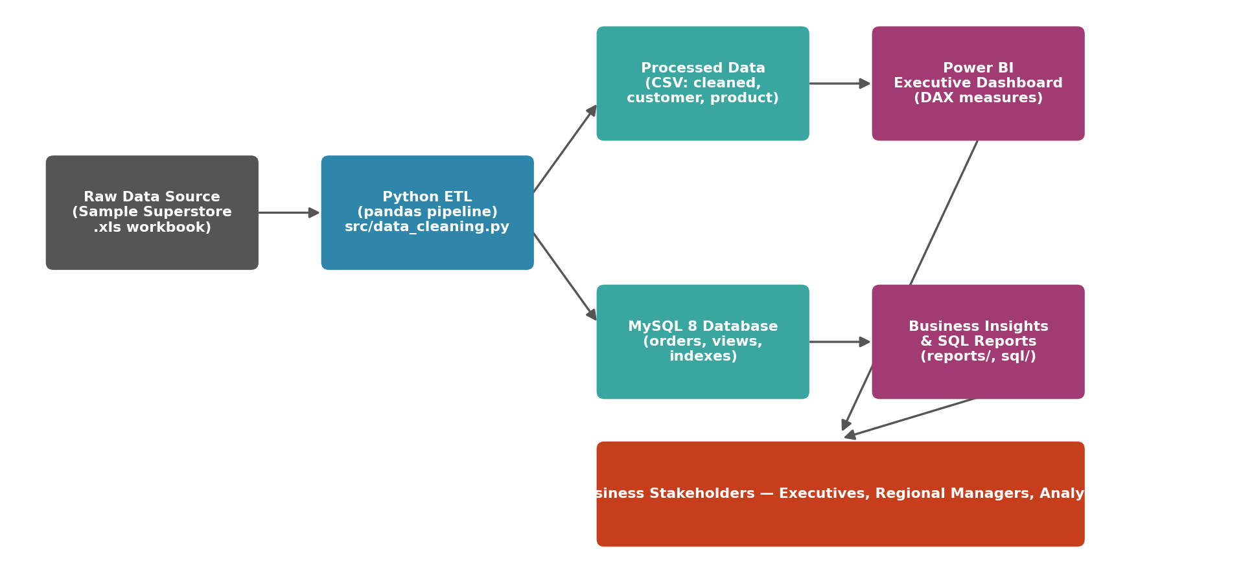
System Architecture

Slide 5
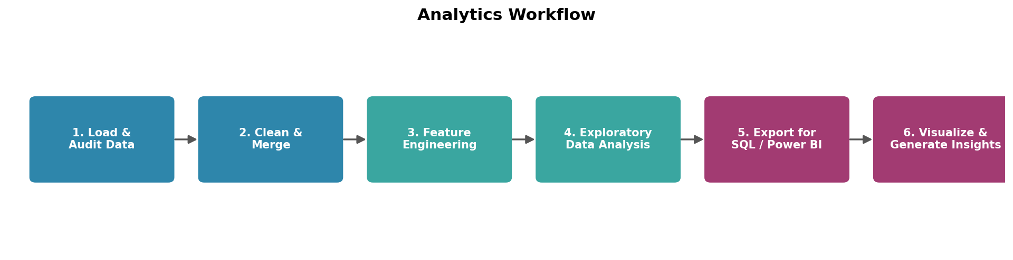
Analytics Workflow
Every stage is a standalone, testable Python module in src/ -- no notebook-only logic.

Slide 6
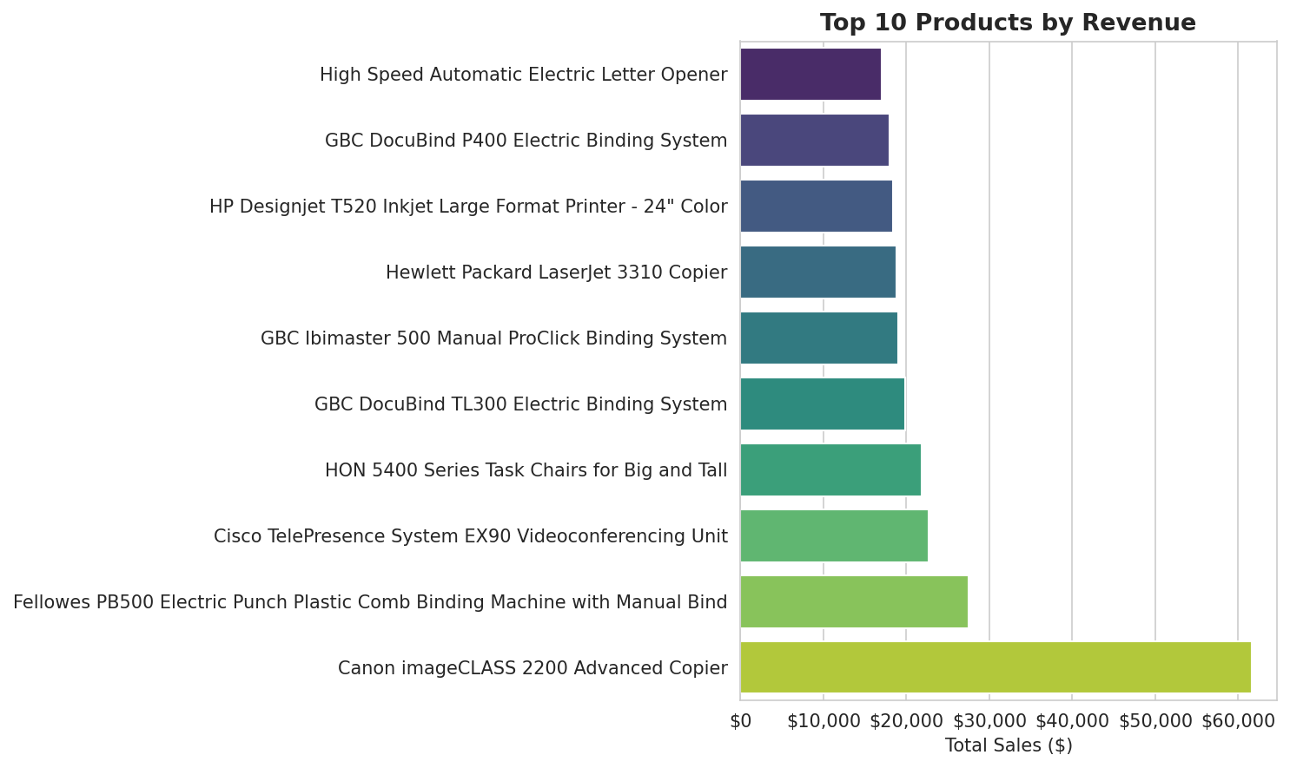
Top Selling Products
Revenue leaders by total sales

Slide 7
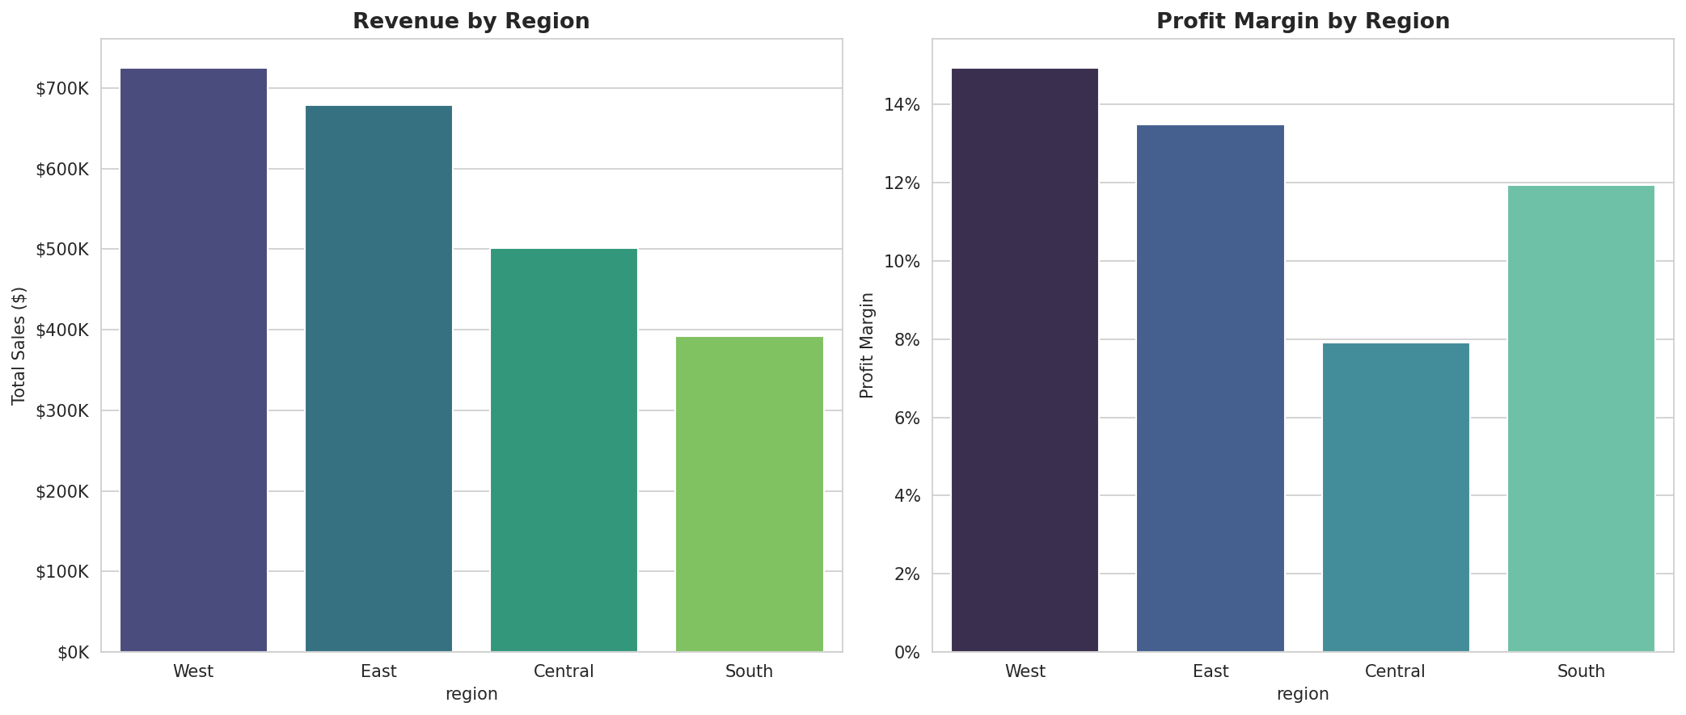
Regional Performance
Revenue and profit margin by region

Slide 8
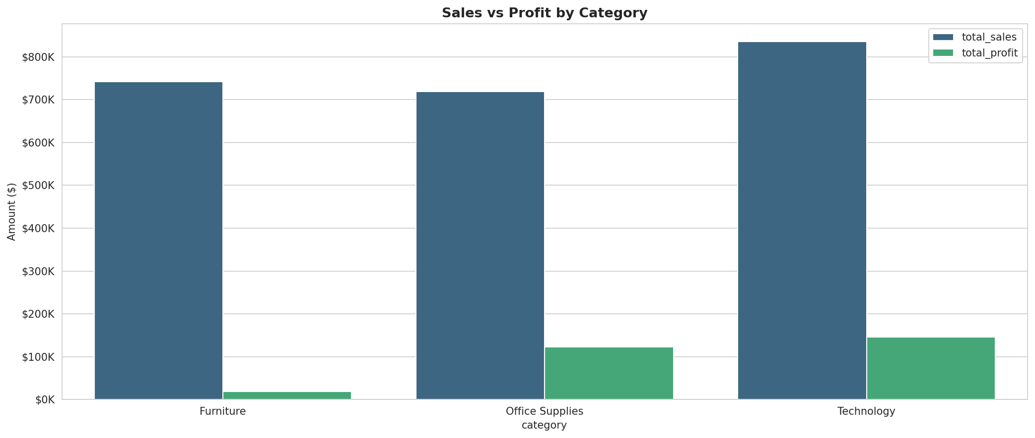
Category Performance
Sales vs. profit by category

Slide 9
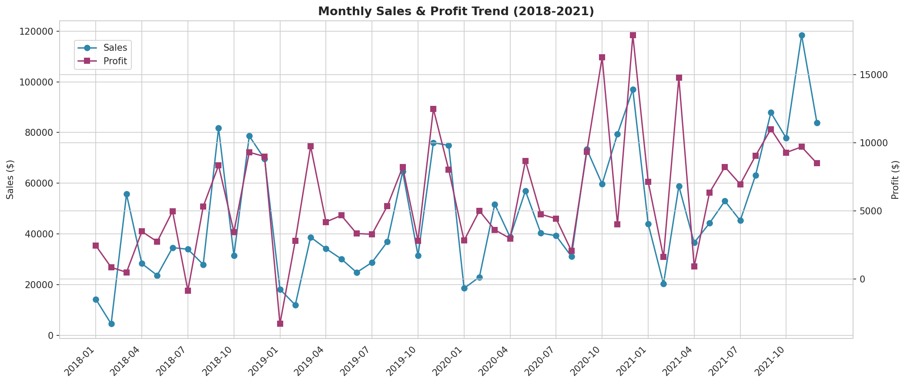
Monthly Trend
Seasonality in revenue and profit, 2018-2021

Slide 10
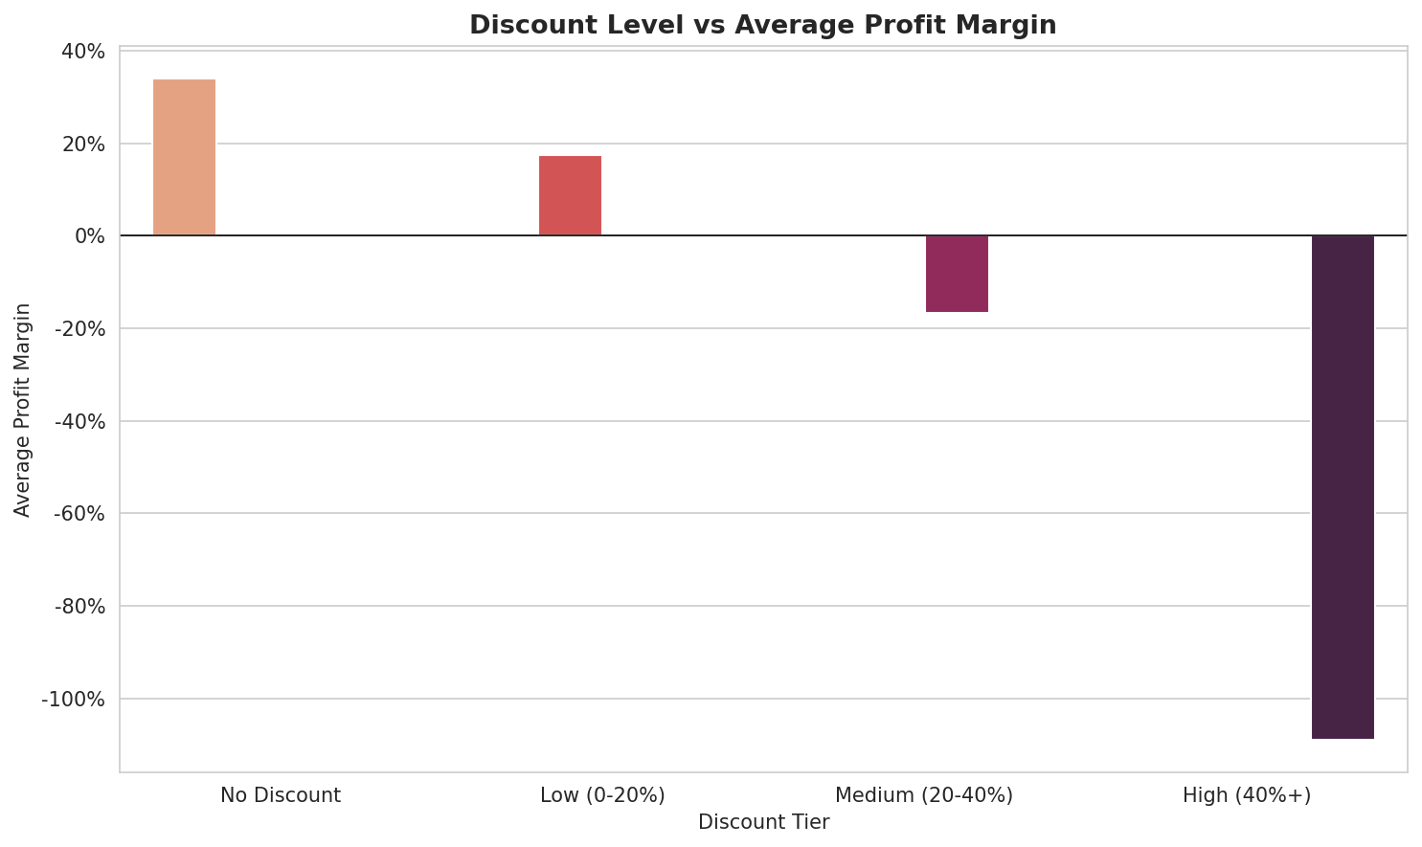
Discount Impact
How discount depth erodes profit margin

Slide 11
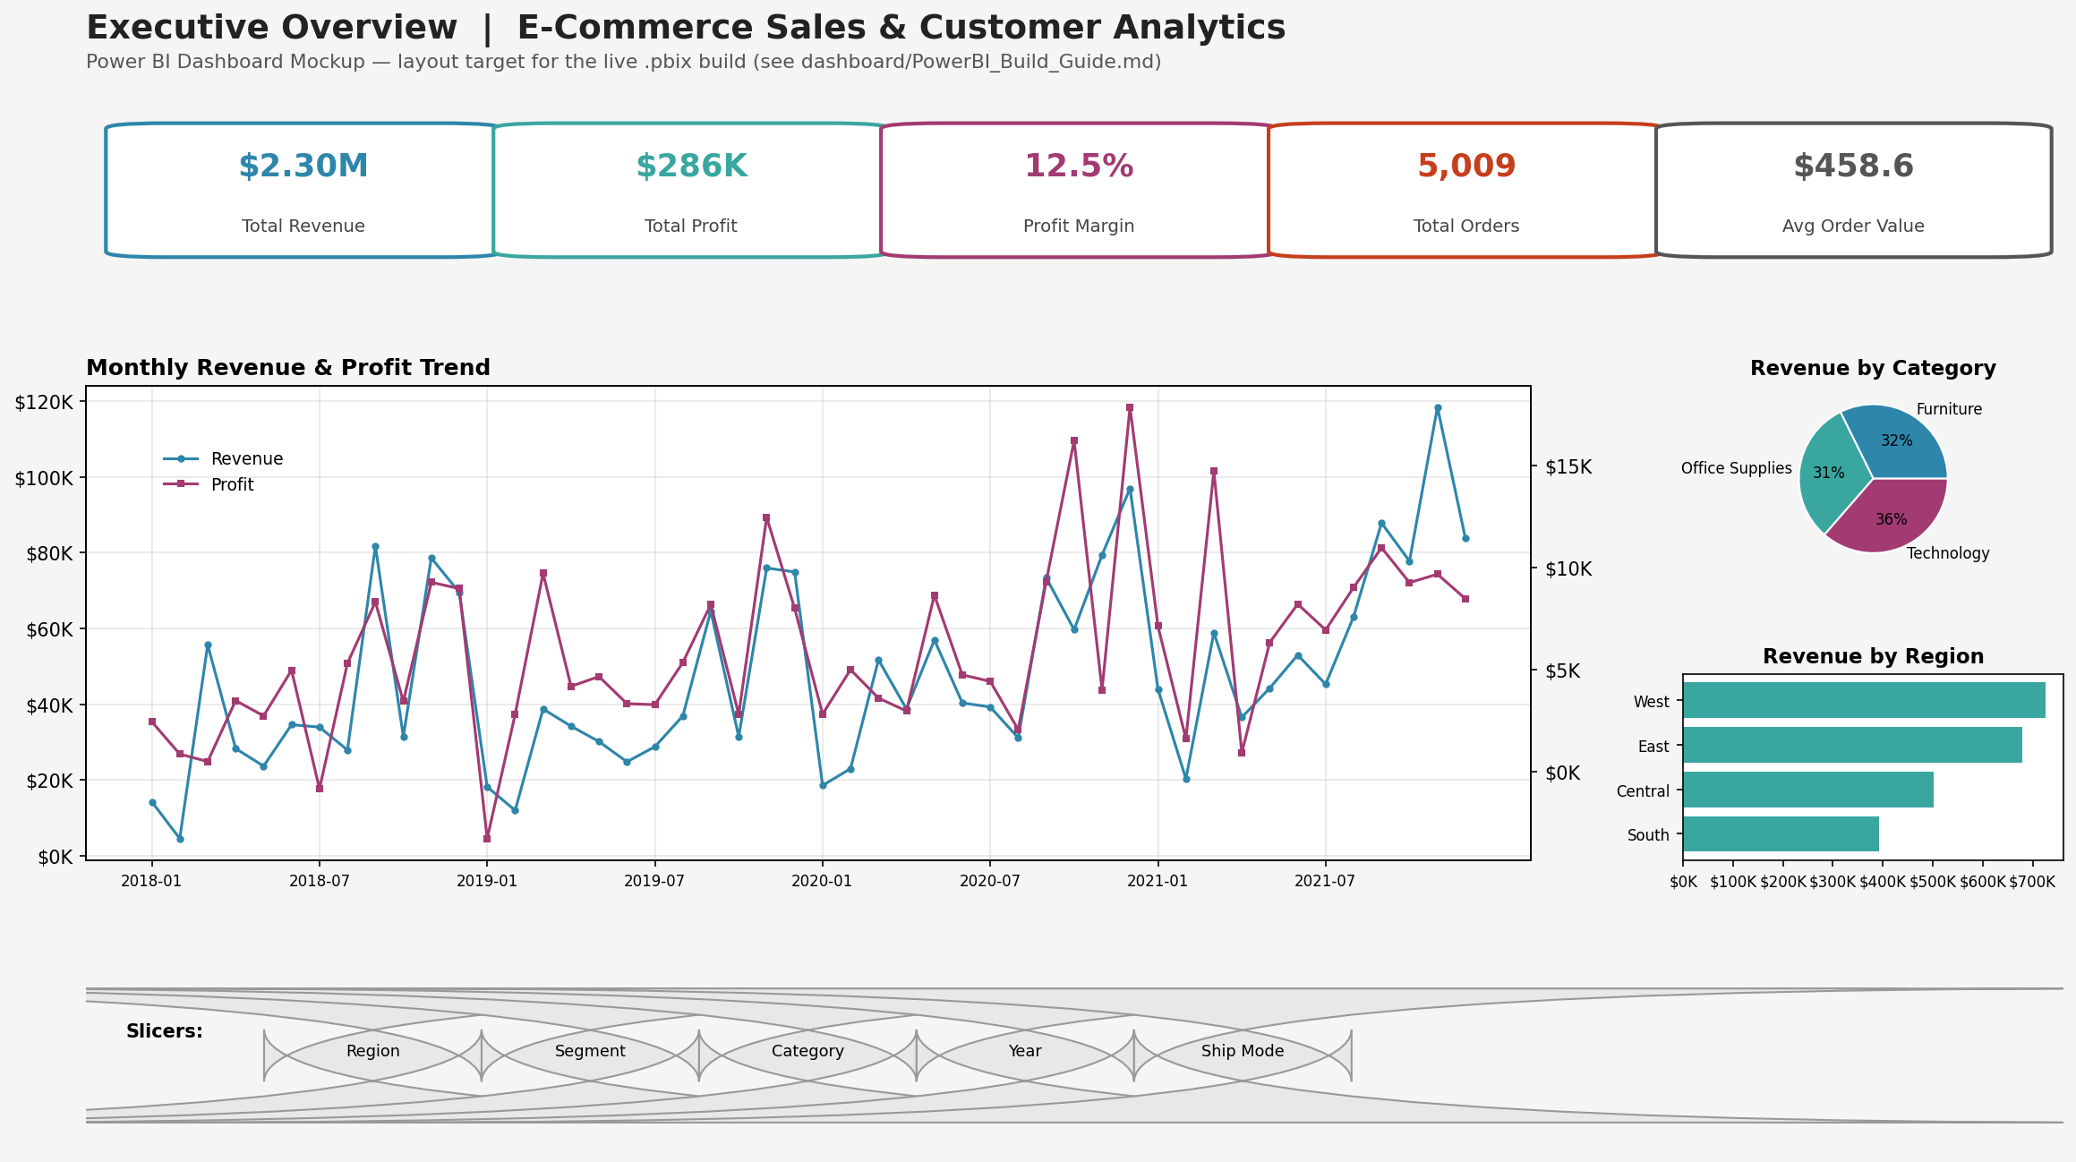
Power BI Executive Dashboard
Full build guide with DAX measures in dashboard/PowerBI_Build_Guide.md

Slide 12
Key Business Insights
Discount discipline is the #1 lever
Orders discounted 40%+ average a -109% profit margin -- every one is a loss.
Furniture is structurally thin-margin
Tables and Bookcases post negative profit overall, driven by heavy discounting.
Technology is the profit engine
Copiers and Accessories deliver the strongest, most reliable margins.
Revenue concentrates in top customers
The top spend quartile drives a disproportionate share of total revenue.
Full 30-insight report: reports/business_insights.md

Slide 13
Recommendations for Leadership
1
Cap standard discounts at 20%; route anything higher through finance sign-off.
2
Re-price or delist chronically loss-making SKUs in Tables and Bookcases.
3
Double down on Technology (Copiers, Accessories) with marketing & inventory priority.
4
Launch a win-back campaign for customers inactive 90+ days, before the 180-day risk mark.
5
Move budgeting from flat monthly targets to seasonally-indexed quarterly targets.

Slide 14
Tech Stack & Repository
Python (pandas, NumPy)
Matplotlib & Seaborn
MySQL 8
Power BI + DAX
Git & GitHub
python-pptx / pptxgenjs
Repository Structure
data/ src/ sql/ dashboard/ images/ reports/ presentation/
README.md · requirements.txt · .gitignore · LICENSE
github.com/<your-username>/Ecommerce-Sales-Analytics

Slide 15
Thank You
E-Commerce Sales & Customer Analytics Dashboard
Full code, SQL, dashboard guide, and reports available on GitHub.

