Slide 1
INTERNSHIP PRESENTATION
Artificial Intelligence
and Machine Learning
Ronak Saini | Roll No. 2410031471
B.Tech CSE | Batch 2026–27
30-Day Virtual Internship | KODACY × SPACE
1

Slide 2
Internship Overview
01
Student
Programme
Internship
Ronak Saini
Roll No. 2410031471
B.Tech CSE
Batch 2026–27
30-Day Virtual Internship
Artificial Intelligence & ML
• Institution: School of Computer Science and Engineering, IILM University, Greater Noida, U.P.
• Conducted by KODACY in association with Scientific Platforms and Cosmic Explorations (SPACE).
• Certificate records successful completion on September 10, 2026.
2

Slide 3
Artificial Intelligence & Machine Learning
02
Artificial Intelligence (AI)
Machine Learning (ML)
A field of computer science focused on systems that can perform tasks involving aspects of human intelligence, including learning, reasoning, pattern recognition and decision making.
A major area within AI in which computer systems learn patterns from data and use those patterns to make predictions or decisions.
• Core connection: mathematics + programming + data preparation + model development + evaluation.
3

Slide 4
Problem Statement
03
• Real-world applications generate large quantities of data that are difficult to analyze effectively using only manually written rules.
• AI/ML systems can learn useful patterns from historical data to support prediction, classification, recommendation and decision-making.
• The key challenge is transforming raw data into a reliable predictive or analytical model.
• Success depends on data quality, meaningful features, appropriate learning methods, training and evaluation.
Focus
A systematic, reusable machine-learning problem-solving process.
4

Slide 5
Project Objectives
04
01
02
Understand fundamental AI and ML concepts
Differentiate supervised and unsupervised learning
03
04
Learn data collection, cleaning and preprocessing
Understand feature selection and preparation
05
06
Study common ML algorithms and applications
Understand training, validation and evaluation
07
08
Develop structured data-driven problem solving
Connect AI/ML concepts with practical software solutions
5

Slide 6
Scope of the Project
05
Supervised Learning
Unsupervised Learning
Educational Scope
Classification
Regression
Choose according to the target variable.
Clustering
Pattern discovery
Useful when labeled target data is not the focus.
Data preparation
Exploratory analysis
Model selection & evaluation
Production-scale deployment is outside scope unless separately specified.
6

Slide 7
Technologies & Tools
06
Python
Jupyter Notebook
NumPy
Primary programming language for data processing and ML workflows.
Interactive environment for experimentation, documentation and visualization.
Numerical computing and array operations.
Pandas
Matplotlib
Scikit-learn
Data loading, cleaning, transformation and tabular analysis.
Visualization of data and model-related results.
ML algorithms, preprocessing, model selection and evaluation metrics.
7

Slide 8
System Architecture
07
Problem
Definition
Data
Acquisition
Data
Preprocessing
Feature
Preparation
Train / Test
Split
Model
Training
Evaluation
Interpretation
& Improvement
Final
Output
Key Insight
Model performance depends not only on the algorithm, but also on data quality and the correctness of the overall workflow.
8

Slide 9
Methodology
08
1 Requirement & problem analysis
2 Data understanding
3 Data preprocessing
Structured workflow from problem definition to model improvement.
Structured workflow from problem definition to model improvement.
Structured workflow from problem definition to model improvement.
4 Exploratory data analysis
5 Model selection
6 Training & validation
Structured workflow from problem definition to model improvement.
Structured workflow from problem definition to model improvement.
Structured workflow from problem definition to model improvement.
7 Evaluation
8 Interpretation & documentation
9 Improvement
Structured workflow from problem definition to model improvement.
Structured workflow from problem definition to model improvement.
Structured workflow from problem definition to model improvement.
9

Slide 10
Evaluation & Expected Outcomes
09
Evaluation Metrics
Expected Learning Outcomes
Classification:
• Accuracy
• Precision
• Recall
• F1-score
Regression:
• Mean Absolute Error (MAE)
• Mean Squared Error (MSE)
• Stronger AI/ML terminology and lifecycle understanding
• Better dataset preparation and analysis skills
• Understanding of training, validation and testing
• Improved model-evaluation and analytical problem solving
• Clear, reproducible documentation of the workflow
10

Slide 11
Key Takeaways
• AI and ML provide data-driven approaches for prediction, classification and decision support.
• A reliable model requires more than algorithm selection: data quality and preprocessing are critical.
• A structured lifecycle—problem definition → data → model → evaluation → improvement—supports better results.
• The internship strengthened foundational understanding of AI/ML workflows and their practical relevance.
11

Slide 12
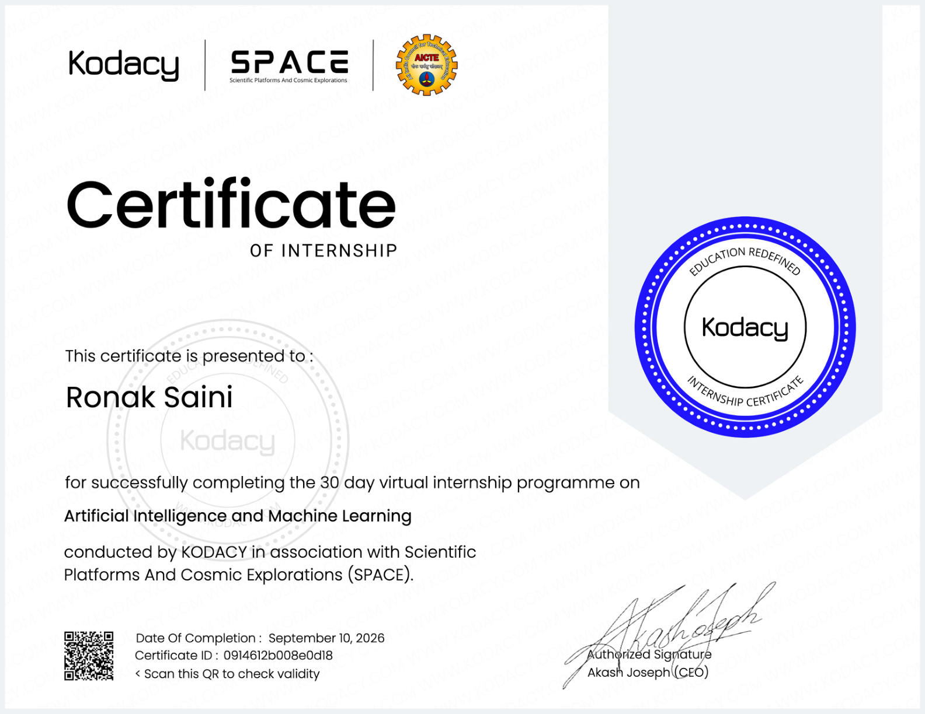
Internship Completion Certificate
10
12

