Slide 1
Weekly Report - Week 2
07/08/2026
Ronak Singh (BS-MS 4th Year)
IMS23319
School of Physics

Slide 2
Summary
Research Topic
Radio frequency Interference mitigation for GMRT pulsar data using U-net architecture.
Goal: Extract weak, periodic millisecond pulsar signals from GMRT data by removing non-Gaussian Radio Frequency Interference (RFI) without losing the actual signal.
Due Date: November 2026
Weekly Achievements
Key Accomplishments
• Paper Review: Completed study of the reference paper (Chen et al. 2023, 2σCRF method).
• Method Selection: Identified limitations of statistical priors & selected U-Net + CRF post-processing as the novel solution.
• Next Goal: Acquire folded PSRFITS dataset & ground truth RFI masks apply U-Net on them
Notes:
does not have a deeply embedded ohysics aspect to it

Slide 3
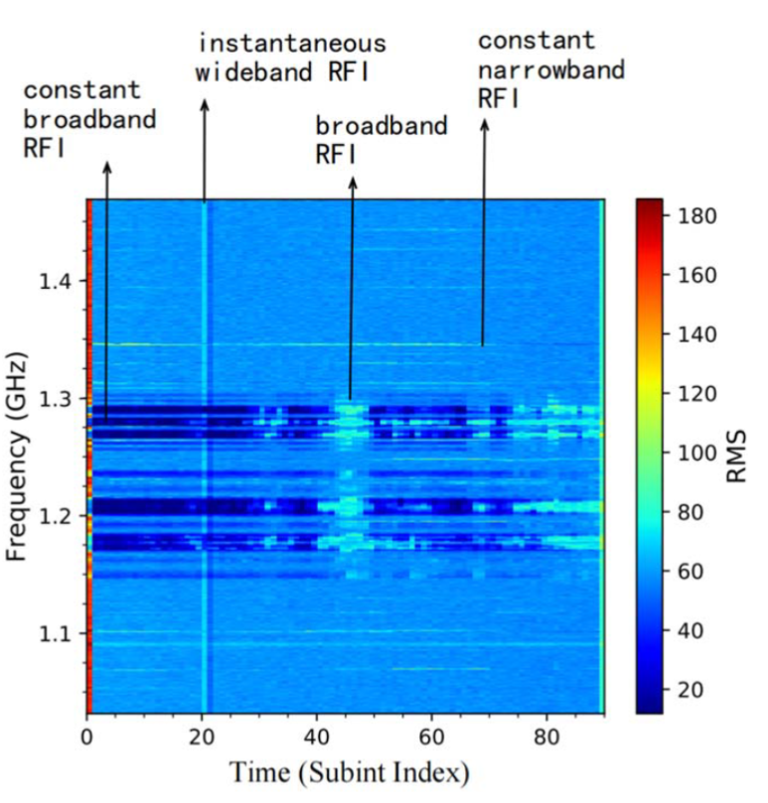
➢ Types of RFI
• Constant Broadband RFI (The thick horizontal bands): These are thick, horizontal light-blue/white stripes between 1.16 GHz and 1.3 GHz. "Constant" means it lasts for the entire observation (all the way across the X-axis). "Broadband" means it covers a wide range of frequencies. The text notes this is usually caused by satellites continuously broadcasting.
• Constant Narrowband RFI (The thin horizontal lines): These are very thin, sharp horizontal lines. These last the whole observation but only affect one specific frequency channel. This is often caused by local terrestrial transmitters (like a specific TV or radio station).
• Instantaneous Wideband RFI (The vertical line): The bright vertical stripe around subint 20. "Instantaneous" means it happened very quickly (just one or two sub-integrations). "Wideband" means it goes across almost all frequencies at once. This can be caused by lightning, power line arcs, or radar sweeps.
• Broadband RFI (The patchy horizontal/vertical blobs): The patchy, cloud-like areas around subint 45. These last for a few minutes and cover several frequencies, but then fade away.
Notes:
An example of folded pulsar data observed by FAST, speci
fi
cally
from FAST tracking data for PSR J1859
+
0430

Slide 4
• The RFI Challenge: Radio telescopes (FAST, uGMRT) record faint astronomical pulsar signals which are corrupted by strong terrestrial Radio Frequency Interference (cell towers, spark plugs, satellite communications).
• Why Basic Tools Fail: Traditional tools like paz -r & CLFD rely on simple statistical median filters. They miss weak broadband RFI or corrupt true pulsar profiles because RFI is non-Gaussian and non-stationary.
• Impact on GW Detection: InPTA timing relies on sub-microsecond precision. Uncleaned RFI distorts Times of Arrival (TOAs) and invalidates gravitational wave background detection.
• 3D Tensor Data Structure: Raw data is folded into a 3D Tensor T(i, j, k) where i = Phase Bins (rotation period), j = Frequency Channels, and k = Time Subintegrations.
• 2D RFI Mapping: RFI detection is framed as a 2D image segmentation task on the Frequency vs. Time subintegration plane using RMS (standard deviation) values of folded profiles.
Notes:
InPTA stands for the Indian Pulsar Timing Array, a collaborative scientific experiment launched in 2016. It involves Indian and Japanese researchers using the upgraded Giant Metrewave Radio Telescope (uGMRT) near Pune to detect low-frequency, nanoHertz gravitational waves and study millisecond pulsars. [1, 2, 3]
in theraw continuous-time domain, the standard deviation of the Gaussian background noise i
mathematically muchlarger than the amplitude of the intrinsic pulsar signal Because the initi
ignal-to-noise Ratio is < I, the deterministic signal is completely obscured by stochastic
Fluctuations over the continuous observation duration.
To resolve this,we divide the total observation time into N discrete segments, where the len
the phase domain.
When we integrate, or sum, these aligned segments, two different mathematical scaling laws
The signal Because the intrinsic pulsar emission is deterministic and perfectly correlat
across every segment, the signal undergoes constructive interference Is amplitude ad
linearly scaling by factor of N.
The Noise: The Gaussian background noise is an uncorrelated, stochastic process.Wh
summing N independent Gaussian variables, their variances sum linearly Therefore, th

Slide 5
➢ 2𝞂CRF Method
• Get 2D image of RMS: Take the 3D data and squash it down to just Time (subint) vs. Frequency, calculating the RMS for each point.
• Baseline deduction: Smooth out the data so it's flat and even.
• Fit the histogram: We fit a gaussian bell curve and find the peak of normal noise.
• Calculate conditional probability: Based on the bell curve, we assign a mathematical probability to each pixel for eg "This pixel is 99% likely to be normal, but this one is only 20% likely."
• Clean Noise Threshold (≤ ±2σ): Pixels with RMS within ±2σ of the Gaussian peak are initially labeled as Clean Background Noise.
• RFI Burst Threshold (> 3σ): Pixels with RMS exceeding 3σ are initially labeled as RFI Interference.
• Ambiguous Region (2σ to 3σ): Borderline pixels fall into an ambiguous region requiring spatial optimization.

Slide 6
➢ CRF Optimization (Step 2)
Why use CRFs?
Pixels in an image aren't isolated; they relate to their neighbors. RFI often appears as continuous lines or bands across an image. Conditional Random Fields (CRFs) help by looking at the context of surrounding pixels to better identify these patterns.
Dense Graph Representation
Every pixel is treated as a point in a fully connected network. This allows the system to make labelling decisions for each pixel by considering the entire image's context rather than just individual spots.
Energy Function Minimization
The system finds the best result by minimizing an "energy" equation, which balances two factors:
Unary Potential: How likely a single pixel is to be RFI based on its initial probability.
Pairwise Potential: How consistent the label is with its neighbors, using appearance (pixel intensity) and spatial closeness (how close pixels are to each other) to ensure smooth, accurate results.
Performance
This approach achieves 93–95% accuracy on FAST telescope data, with the optimization process completing in just 0.37 seconds.

Slide 7
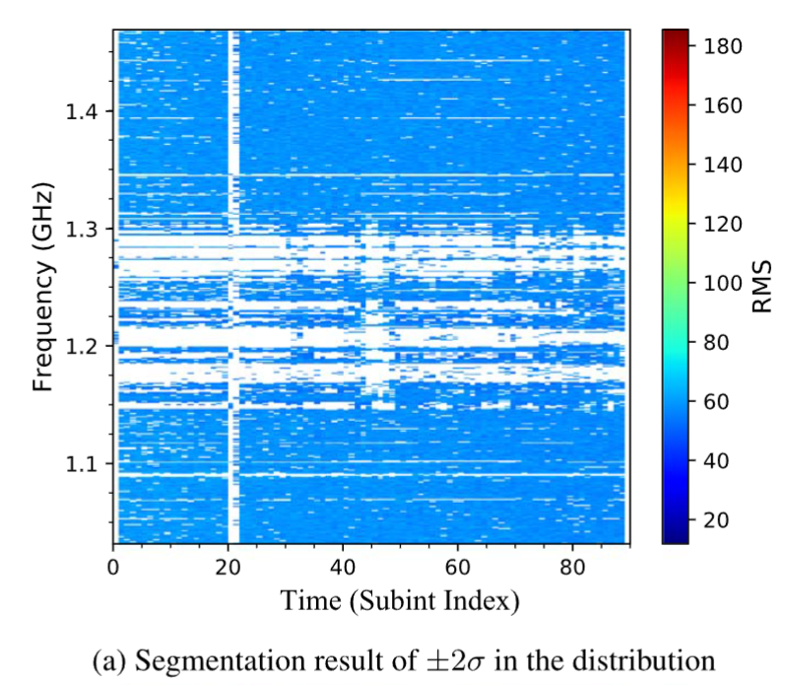
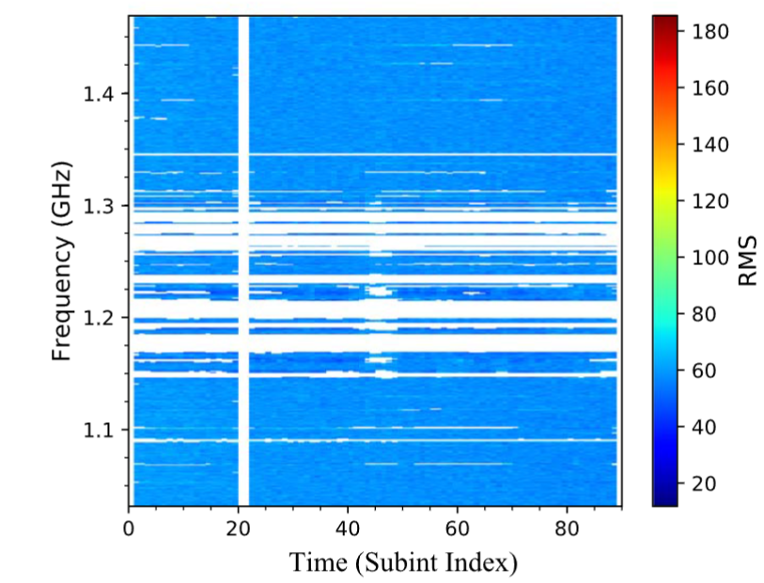
Notes:
Figure 5. Comparison of RFI labeling results using the threshold based on
the distribution of rms values and the final optimized pixel category labels
using the CRFs.

Slide 8
➢ Proposed Solution — U-Net Architecture
Limitations of the 2σCRF Methodology
Dependency on Gaussian Assumptions: The 2σCRF model relies on manual ±2σ statistical assumptions, which fail when Radio Frequency Interference (RFI) becomes complex or non-Gaussian.
uGMRT Challenges: Terrestrial RFI in the 300–500 MHz band (uGMRT, India) is severe, rendering standard Gaussian-based statistical thresholding ineffective.
Proposed Solution: U-Net Integration
I will be shifting from manual thresholding to an U-Net Convolutional Neural Network, enabling the automatic extraction of complex 2D spatial and spectral features.
Hybrid Architecture (U-Net + CRF): This system will use a U-Net for the image segmentation part, with CRF post-processing to refine boundaries and suppress false positives.

Slide 9


➢ To Do Next Week
• Data Acquisition: Acquire folded PSRFITS files and ground truth RFI masks
• Model Understanding and Training: Train the U-Net model from this acquired data.

