Slide 1
Detecting Radio Frequency Interference in
Radio Spectrograms with Convolutional Networks
4 December 2026
Ronak Singh (IMS23319)
Supervisor: Dr. Alwin Poulose
School of Data Science, IISER TVM
Notes:
[0:00 – 0:17] Good morning, everyone. I am Ronak Singh. I will present my minor project, done under the supervision of Dr. Alwin Poulose, on detecting radio frequency interference in radio spectrograms with convolutional networks.

Slide 2
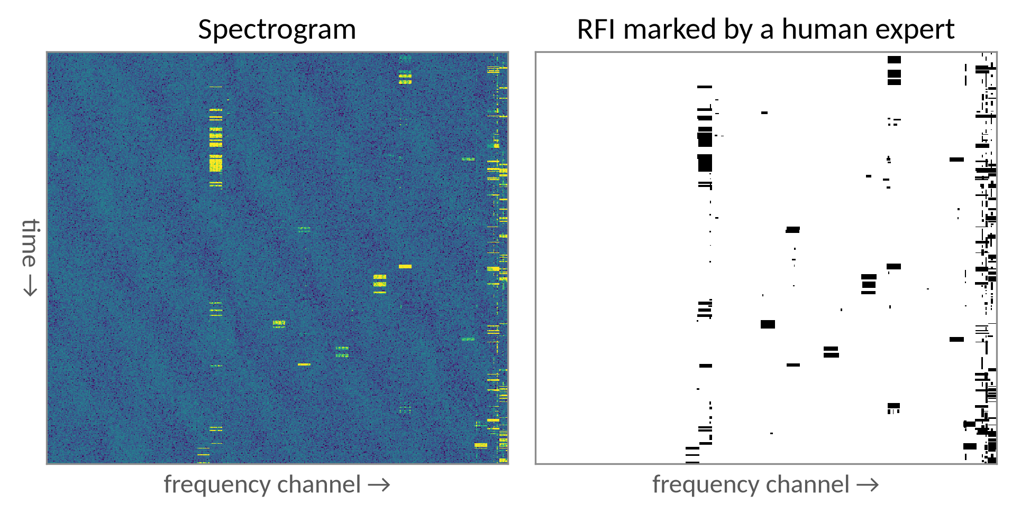
Introduction
Signal
Radio telescopes record very faint signals from space.
Problem
Phones, satellites and aircraft use the same frequencies. This radio frequency interference (RFI) is often far stronger than the signal.
Task
Flag every RFI pixel automatically: an image segmentation problem.
A real LOFAR spectrogram (test image 1). Bright lines and patches are RFI; the right panel shows the RFI marked by a human expert.
Notes:
[0:17 – 0:56] Radio telescopes record extremely faint signals from space. But mobile phones, satellites and aircraft use the same frequencies, and this radio frequency interference, or RFI, is often far stronger than the signal. On the right is a real spectrogram from the LOFAR telescope. The bright lines and patches are RFI, and the second panel shows where a human expert marked them. Our task is to flag every RFI pixel automatically. This is an image segmentation problem.

Slide 3
Motivation of the Study
1
2
3
Simple rules miss faint RFI
Networks are tested on simulated data
Real labels are imperfect
Classical flaggers use fixed thresholds and assume the noise is Gaussian.
Real RFI is rarer and fainter, so results may not carry over.
LOFAR's training labels come from AOFlagger, which agrees with a human expert at F1 = 0.57 only.
Our goal: a network that flags RFI well in real telescope data, checked against a human expert.
Notes:
[0:56 – 1:30] Why is this still an open problem? Classical flaggers use fixed thresholds, so they miss faint RFI. Most neural networks are developed on simulated data, where RFI is easier to see. And real training labels come from another flagger, AOFlagger, which agrees with a human expert at an F1 score of only 0.57. So we wanted a network that works on real data, checked against a human expert.

Slide 4
Literature Review
2012
2015
2017
2020
2022
2023
AOFlagger
U-Net
tf_unet
RFI-Net
LOFAR benchmark
CRF refinement
Offringa et al. [1]
Ronneberger et al. [2]
Akeret et al. [3]
Yang et al. [4]
Mesarcik et al. [5, 6]
Chen et al. [7]
Threshold-based flagger; the standard for LOFAR
Network that labels every pixel of an image
First U-Net for RFI flagging
Residual network for RFI at the FAST telescope
Real LOFAR data with expert test labels; several methods compared
Cleans weak RFI in pulsar data
our baseline
our benchmark
Notes:
[1:30 – 2:00] We build on the following work. AOFlagger is the standard flagger for LOFAR, and it produced our training labels. The U-Net is the standard network for labelling every pixel. Akeret and colleagues first used it for RFI; their code, tf_unet, is our baseline. And Mesarcik and colleagues released real LOFAR data with expert labels, which is our benchmark.

Slide 5
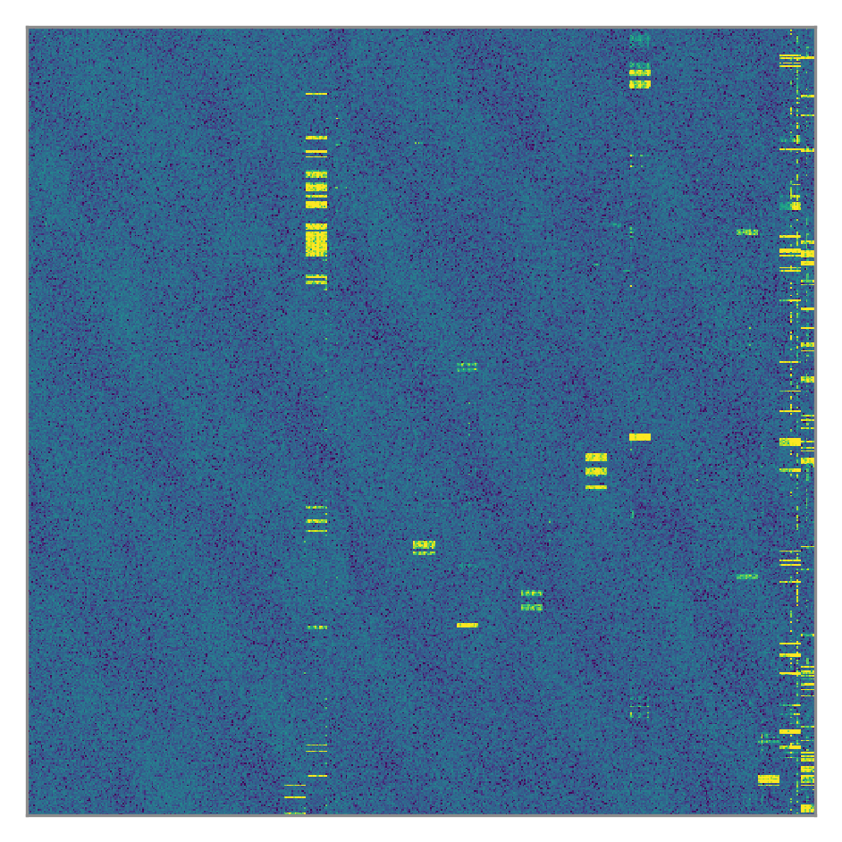
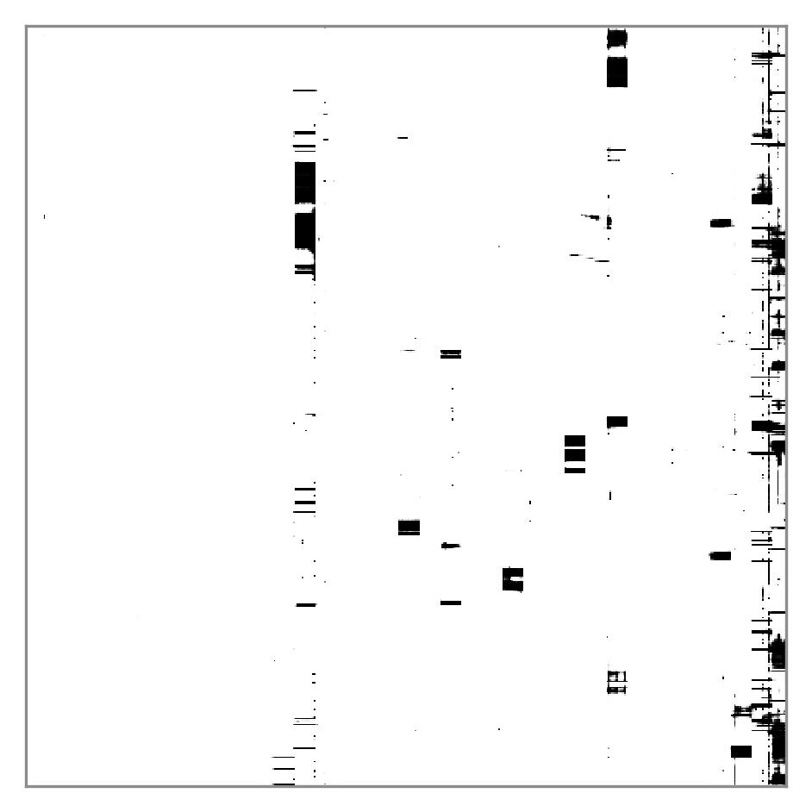
Problem Statement
Give every pixel of a spectrogram a probability of being RFI
Kestrel
a U-Net-based network
Spectrogram, 512 × 512
RFI probability for every pixel
Training: 6621 real LOFAR images, labelled by AOFlagger (imperfect labels)
Testing: 109 real LOFAR images, labelled by a human expert
Notes:
[2:00 – 2:24] Our problem is therefore: given a spectrogram, give every pixel a probability of being RFI. The difficulty is that the network learns from 6621 real images whose labels come from AOFlagger and are imperfect, but it is judged on 109 images labelled by a human expert.

Slide 6
Contributions
0.660
Best score on real LOFAR data. Kestrel's max F1 is above every published method (best: 0.598).
½
Half the size. With the authors' own settings, Kestrel matches their U-Net with half the parameters.
0.675
Expert labels help. Fine-tuning on the expert labels of about 68 images improves Kestrel further.
3 runs
Fair evaluation. Test-image copies removed from training; main results averaged over 3 runs.
Notes:
[2:24 – 2:56] We make four contributions. Our network, Kestrel, reaches an F1 of 0.660 on real LOFAR data, above every published method. With the original authors' own settings, it matches their U-Net using half the parameters. A few expert labels raise its score to 0.675. And we made the evaluation fair, by removing test-image copies from training and repeating the main experiments three times.

Slide 7
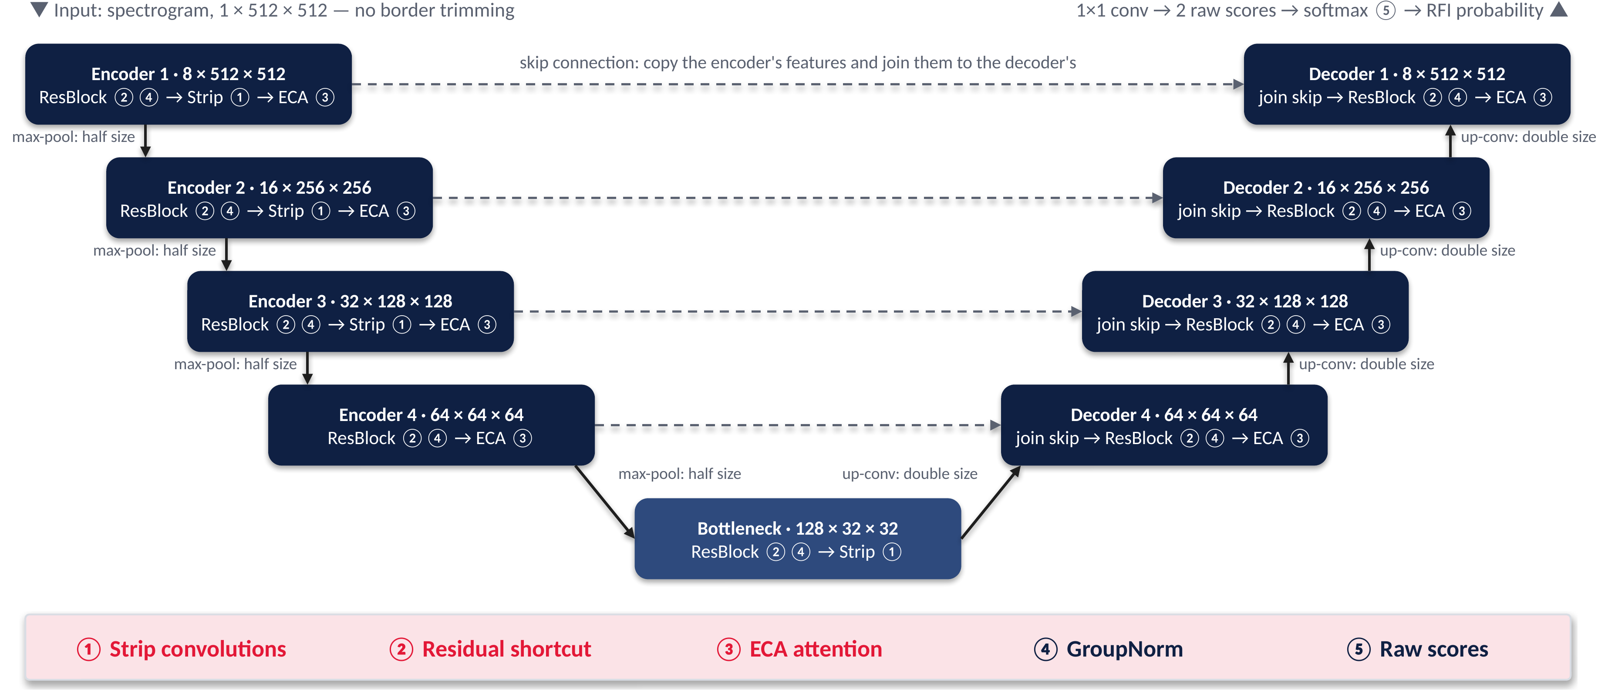
Methodology
Kestrel keeps the U shape of a U-Net and adds five changes
Notes:
[2:56 – 3:40] Kestrel keeps the shape of a U-Net. The encoder, on the left, shrinks the spectrogram step by step to learn what is in it. The decoder, on the right, grows it back to full size to find where the RFI is. Skip connections carry fine detail across, and at the end every pixel gets a probability of being RFI. We added five changes, numbered in the figure: strip convolutions for line-shaped RFI, residual shortcuts, channel attention, group normalisation and raw output scores. Details are in the appendix.

Slide 8
Datasets
Three datasets
Synthetic
HERA
LOFAR
main dataset
generated by us
simulated telescope data
real telescope data
Size: 276 × 600 pixels
Images: 1000 (700 / 150 / 150)
RFI: 14.7% of pixels
Labels: exact
Size: 512 × 512 pixels
Images: 351 train / 135 test (copies removed)
RFI: 2.75% of pixels
Labels: exact
Size: 512 × 512 pixels
Images: 6621 train / 735 validation / 109 test
RFI: 0.77% of test pixels
Labels: AOFlagger (train), human expert (test)
Notes:
[3:40 – 4:09] We used three datasets. Synthetic data that we generated, and simulated data from the HERA telescope, both with exact labels. And most importantly, real LOFAR data: 6621 training images labelled by AOFlagger, and 109 test images labelled by a human expert. RFI covers less than one percent of the LOFAR test pixels, which makes it much harder.

Slide 9
Pseudo Code
Training and testing Kestrel
input : LOFAR spectrograms X, AOFlagger masks Y
1 remove the 109 test-image copies and 35 fully flagged images
2 scale every image with one fixed range (0.5th-99.5th percentile)
3 for epoch = 1 … 40:
4 for step = 1 … 700: # one random image per step
5 p ← softmax(Kestrel(x)) # RFI probability per pixel
6 loss ← cross-entropy(p, y) + Dice(p, y)
7 update the weights with Adam (lr 1e-3, cosine decay)
8 every 2 epochs: max F1 on 150 validation images → keep best
9 test the best model on the 109 expert-labelled images
Notes:
[4:09 – 4:29] In short, we clean the data, scale every image with one fixed range, and train with cross-entropy plus Dice loss, keeping the best model on the validation set. We then test it on the 109 expert-labelled images.

Slide 10
Experimental Setup
 | tf_unet (baseline) | Kestrel (ours)
Framework | TensorFlow | PyTorch
Parameters | 465,986 | 593,842
Loss | cross-entropy + L2 penalty | cross-entropy + Dice
Optimiser | Adam, lr 10⁻⁴ | Adam, lr 10⁻³, cosine decay
Batch size | 4 | 1
Training | 150 epochs × 175 steps | 40 epochs × 700 steps
Hardware
NVIDIA RTX 3060 Laptop GPU, 6 GB
Metrics
max F1 (as in published work), AUROC, AUPRC
Repeats
3 random seeds: mean ± standard deviation
Test sets: 109 expert-labelled LOFAR images · 135 simulated HERA images
Notes:
[4:29 – 4:49] Both networks were trained on one laptop GPU with the settings shown here. Our main results are the mean of three runs, and we report the maximum F1 score, as the published results do, with AUROC and AUPRC.

Slide 11
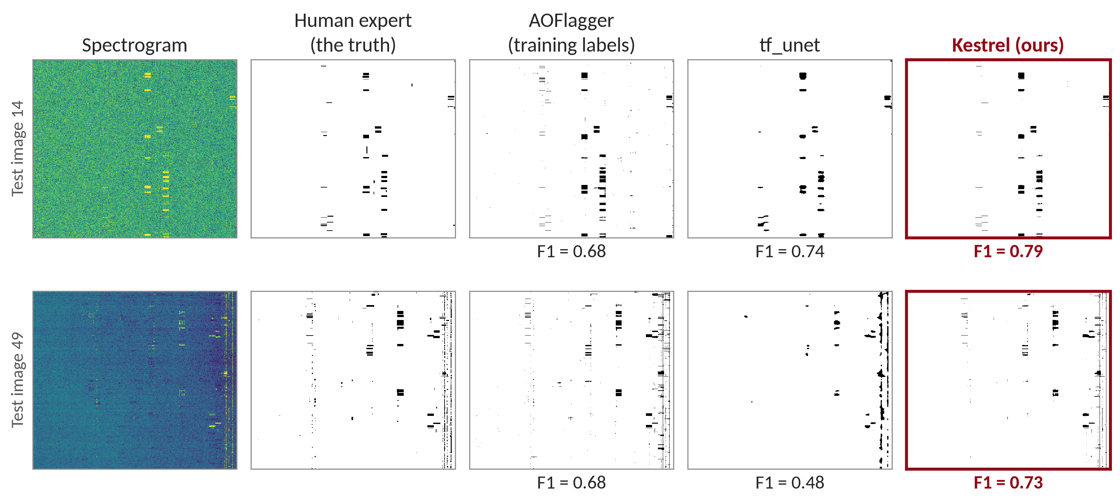
Experimental Results
On real data, Kestrel's masks are the closest to the human expert's
93–99
of 109 test images
where Kestrel's mask beats tf_unet's
per-image F1, in each of the 3 runs
Centre 472 × 472 pixels; first training run; each model at its best threshold; F1 against the expert.
Notes:
[4:49 – 5:34] Now the results, starting with what the models actually flag. Here are two real test images. From left to right: the spectrogram, the expert's mask, AOFlagger's mask, and the masks from tf_unet and from Kestrel, with each mask's F1 score against the expert below it. Kestrel's masks are the closest to the expert's. On the second image, tf_unet merges the thin lines on the right into large blobs, while Kestrel keeps them thin. This holds broadly: Kestrel beats tf_unet on 93 to 99 of the 109 test images.

Slide 12
Experimental Results
Kestrel beats every published method on real LOFAR data
+0.062
above RFI-Net, the best published method (0.598)
+0.090
above AOFlagger (0.570), even though Kestrel learned only from AOFlagger's labels
Max F1 on the 109 expert-labelled test images. Ours: mean of 3 runs. AOFlagger, U-Net and RFI-Net: as published by Mesarcik et al. [5]; σ-clipping: computed by us.
Notes:
[5:34 – 6:11] This chart compares all methods on the 109 expert-labelled images, using the maximum F1 score. The blue bar is our baseline, tf_unet, and the grey bars are other methods. Kestrel reaches 0.660, the highest of all: 0.062 above RFI-Net, the best published method, and 0.11 above tf_unet. One point deserves attention. AOFlagger scores 0.570, and Kestrel learned only from AOFlagger's labels. Yet it ends up closer to the human expert than AOFlagger itself.

Slide 13
Experimental Results
Kestrel matches the authors' U-Net at half the size, and it is fast
Same training settings as Mesarcik et al.
Speed on our laptop GPU
Max F1
0.626
vs 0.617
Kestrel vs their U-Net, one run each
Parameters
0.59 M
vs 1.18 M
Kestrel vs their U-Net
Time per spectrogram
10.8 ms
vs 17.8 ms
Kestrel vs tf_unet, one 512 × 512 image
One training run
25 min
vs 2 h 40 min
Kestrel vs tf_unet on LOFAR
Time per spectrogram: median over the 109 test images, one at a time (PyTorch vs TensorFlow), RTX 3060 Laptop GPU. Training: one full run, including validation.
Notes:
[6:11 – 6:48] A fair question is whether Kestrel wins only because of its training settings. So we also trained it with exactly the settings of Mesarcik and colleagues. It then matches their U-Net, scoring 0.626 against 0.617, with half the parameters. Kestrel is also efficient. On our laptop GPU it processes one spectrogram in 10.8 milliseconds, against 17.8 for tf_unet, and a complete training run takes about 25 minutes instead of 2 hours 40 minutes.

Slide 14
Experimental Results
Expert labels help further, and Kestrel also wins on a second dataset
Fine-tuning with expert labels (LOFAR)
Second dataset: simulated HERA data
0.660
0.675
Method | max F1
AOFlagger (published) | 0.873
RFI-Net (published) | 0.895
U-Net, Mesarcik et al. (published) | 0.902
U-Net, Mesarcik et al. (our run) | 0.916
Kestrel (ours) | 0.945
AOFlagger labels only
plus expert labels of about 68 images
Better in all 3 runs (+0.012 to +0.020)
5-fold cross-validation: no image is tested by a model that saw its expert label
135 test images. Ours: Mesarcik et al.'s training settings, mean of 3 runs. With our own settings tf_unet is slightly ahead (0.955 vs 0.944).
Notes:
[6:48 – 7:39] Two further results. On the left: Kestrel learned only from AOFlagger's imperfect labels, so we fine-tuned it on the expert labels of about 68 images. Its score rose from 0.660 to 0.675, and it improved in all three runs. We used cross-validation, so no image was tested by a model that had seen its expert label. On the right is a second dataset, simulated HERA data. With the authors' settings, Kestrel again beats every published result, scoring 0.945. With our own settings, tf_unet is slightly ahead here, because HERA's labels add a thin rim around the RFI, which Kestrel learns very closely.

Slide 15
Conclusion
1
Best on real data: Kestrel beats every published method on LOFAR (max F1 0.660 vs 0.598).
2
Efficient: with the authors' settings it matches their U-Net at half the size, and it flags a spectrogram in 10.8 ms.
3
Expert labels help: about 68 expert-labelled images raise the score to 0.675.
4
Holds on HERA: with the authors' settings Kestrel also beats the published results (0.945 vs 0.902).
Limitations: with our settings tf_unet is slightly ahead on HERA (0.955 vs 0.944); Kestrel's three added modules contribute little (appendix).
Lesson: test RFI methods on real data, with several runs.
Notes:
[7:39 – 8:22] To conclude. Kestrel beats every published method on real LOFAR data, with a maximum F1 of 0.660. With the authors' own settings it matches their U-Net at half the size, and it is fast. A few expert labels raise its score to 0.675, and on HERA it also beats the published results. Two limitations: with our settings tf_unet is slightly ahead on HERA, and Kestrel's three added modules contribute little. The broader lesson is that RFI methods must be tested on real data, with several runs.

Slide 16
Future Work
1 Explain the full gain
2 Label smarter
3 Real pulsar data
Test the remaining design choices one at a time: output layer, padding, depth, batch size and learning rate.
Find which images an expert should label first, to get the most from a few labels.
Apply Kestrel to real pulsar observations.
Notes:
[8:22 – 8:41] In future, we would like to test the remaining design choices one at a time to explain the full gain, find which images an expert should label first, and apply Kestrel to real pulsar observations.

Slide 17
References
[1] A. R. Offringa, J. J. van de Gronde, J. B. T. M. Roerdink. A morphological algorithm for improving radio-frequency interference detection. Astronomy & Astrophysics 539, A95 (2012).
[2] O. Ronneberger, P. Fischer, T. Brox. U-Net: Convolutional networks for biomedical image segmentation. MICCAI, LNCS 9351, 234–241 (2015).
[3] J. Akeret, C. Chang, A. Lucchi, A. Refregier. Radio frequency interference mitigation using deep convolutional neural networks. Astronomy and Computing 18, 35–39 (2017).
[4] Z. Yang, C. Yu, J. Xiao, B. Zhang. Deep residual detection of radio frequency interference for FAST. MNRAS 492, 1421–1431 (2020).
[5] M. Mesarcik, A.-J. Boonstra, E. Ranguelova, R. V. van Nieuwpoort. Learning to detect radio frequency interference in radio astronomy without seeing it. MNRAS 516, 5367–5378 (2022).
[6] M. Mesarcik. Learning to detect RFI in radio astronomy without seeing it: datasets. Zenodo, doi:10.5281/zenodo.6724065 (2022).
[7] X. Chen, J. Han, Q. Su, Z. Yang, P. Zhou. Cleaning radio frequency interference in pulsar-folded data based on the conditional random fields with an adaptive prior. Research in Astronomy and Astrophysics 23, 104004 (2023).
[8] K. He, X. Zhang, S. Ren, J. Sun. Deep residual learning for image recognition. CVPR, 770–778 (2016).
[9] Y. Wu, K. He. Group normalization. ECCV (2018).
[10] Q. Wang, B. Wu, P. Zhu, P. Li, W. Zuo, Q. Hu. ECA-Net: Efficient channel attention for deep convolutional neural networks. CVPR (2020).
[11] F. Milletari, N. Navab, S.-A. Ahmadi. V-Net: Fully convolutional neural networks for volumetric medical image segmentation. 3DV (2016).
[12] D. P. Kingma, J. Ba. Adam: A method for stochastic optimization. ICLR (2015).
Notes:
[8:41 – 8:45] These are the main references.

Slide 18
Thank You
Questions are welcome
Ronak Singh (IMS23319)
Code and results:
github.com/RonakSinghRaina/MP
Notes:
[8:45 – 8:53] Thank you for your attention. I am happy to take your questions.

Slide 19
Appendix
Backup slides for questions
A1
U-Net
slide 20
A6
LOFAR Table
slide 25
A basic U-Net and how tf_unet differs
All LOFAR results
A2
Kestrel
slide 21
A7
Ablation
slide 26
Kestrel's five changes and why each was added
Removing parts of Kestrel
A3
Loss & Metrics
slide 22
A8
HERA Table
slide 27
The losses and the scores used
All HERA results
A4
Data Cleaning
slide 23
A9
Synthetic Data
slide 28
Fixes to the public LOFAR data before training
Synthetic versus real data
A5
Training Labels
slide 24
A10
Run Time
slide 29
How good AOFlagger's labels are, on LOFAR and HERA
Computation time of the two networks
Notes:
[Backup slide, not presented] Index of the backup slides. Jump to a slide by typing its number and pressing Enter.

Slide 20
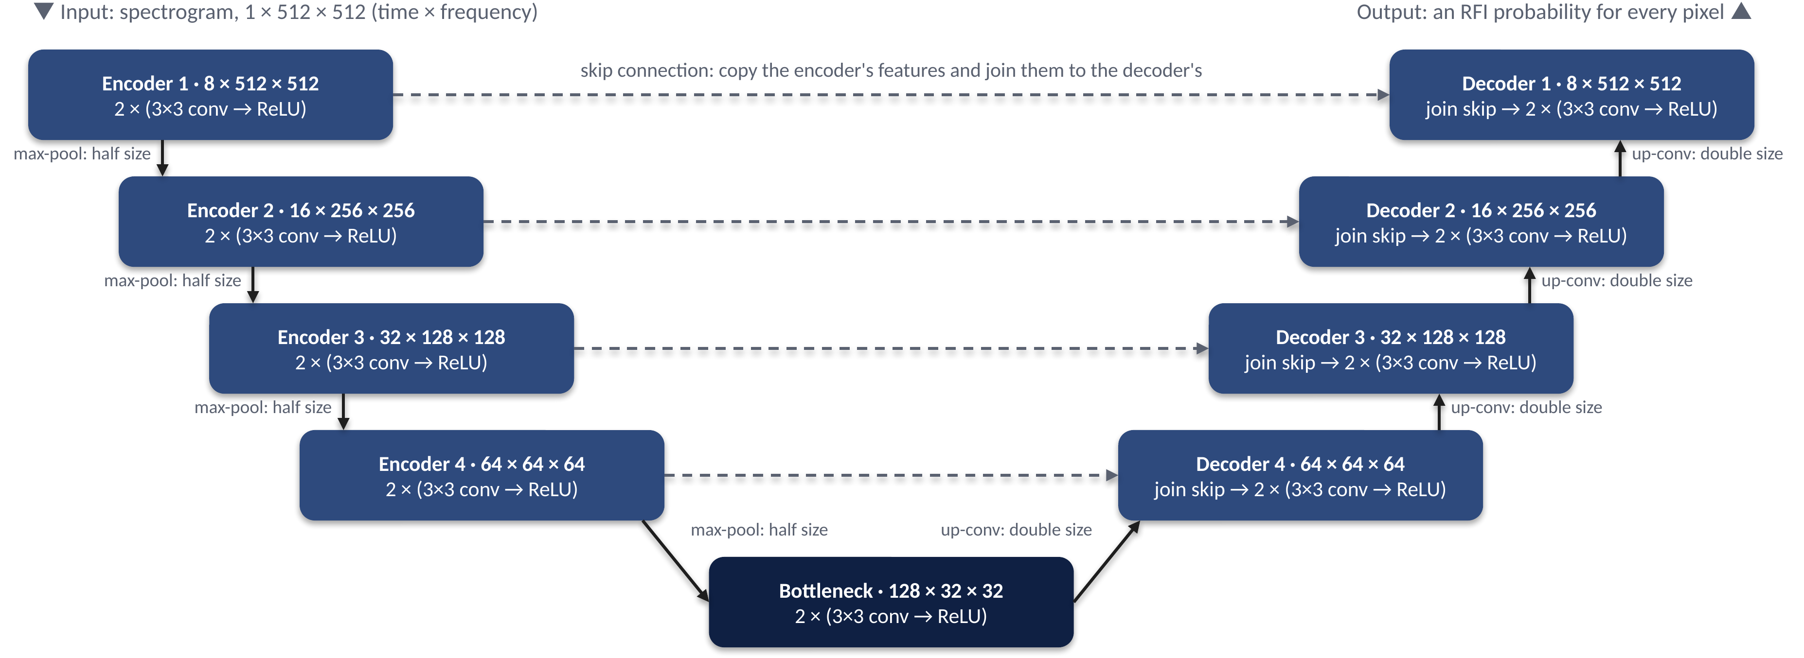
Appendix: U-Net
A basic U-Net, drawn at Kestrel's sizes (channels × height × width)
tf_unet: the same design, but 3 levels, 32 / 64 / 128 filters and no padding (512 × 512 in, 472 × 472 out); 465,986 parameters.
Notes:
[Backup slide, not presented] If asked how a U-Net works: the encoder halves the image at each level and doubles the number of filters; the decoder doubles it back; skip connections join the encoder's features to the decoder's at the same size. A 1 by 1 convolution and a softmax give each pixel its RFI probability.

Slide 21
Appendix: Kestrel
Kestrel's five changes to the U-Net, and why each was added
 | Change | What it does | Why it was added
1 | Strip convolutions | 1×K then K×1 filters, K = 7, 11 and 21 | Add up the signal along line-shaped RFI
2 | Residual blocks [8] | Add each block's input to its output (through a 1×1 convolution) | Keep weak features from fading
3 | ECA attention [10] | Weight each channel from 0 to 1, from the image itself | Keep faint-RFI channels from being drowned out
4 | GroupNorm [9] | Normalise the values within each image | Stable training with one image per batch
5 | Raw output scores | Softmax on the raw scores, with no ReLU before it | tf_unet's ReLU before the softmax can stop learning
 | Same padding | Output the same size as the input | Every pixel gets a prediction
Kestrel: 4 levels, 8 filters in the first layer, 593,842 parameters; loss: cross-entropy + Dice [11]; optimiser: Adam [12].
Notes:
[Backup slide, not presented] The strip filters average K pixels along a line, which makes a faint line stand out from the noise about square-root-of-K times more. ECA uses only 3 learned numbers.

Slide 22
Appendix: Loss & Metrics
The losses used for training and the scores used for testing
Losses
Cross-entropy: minus the mean log-probability of the correct class
Dice loss: 1 − (2Σpg + 1) / (Σp + Σg + 1)
p = predicted RFI probability, g = 1 for RFI pixels; it depends only on the RFI pixels, so the many clean pixels do not swamp it
Kestrel: cross-entropy + Dice
tf_unet: cross-entropy + 0.001 × L2 weight penalty
Scores
Precision = TP / (TP + FP): flagged pixels that are RFI
Recall = TP / (TP + FN): RFI pixels that were found
F1 = 2 · precision · recall / (precision + recall)
Max F1: best threshold on the test set, as in published work; pooled F1: threshold chosen on validation
AUROC, AUPRC: threshold-free; AUPRC stays low unless rare RFI is found with few false alarms
Accuracy misleads: flagging nothing is 99.23% accurate on LOFAR
Notes:
[Backup slide, not presented] Max F1 is optimistic because it uses the test labels to pick the threshold, but it is what the published LOFAR results use. Our headline pooled F1 for Kestrel is 0.6561.

Slide 23
Appendix: Data Cleaning
Two problems in the public LOFAR data were fixed before training
1
2
3
Test copies
Fully flagged images
One fixed scale
All 109 test images are byte-for-byte copies of 109 training images; only the masks differ. Removed from training.
35 training images are flagged as 100% RFI, and several contain only zeros. Removed.
Raw values run from 0 to 1.4 × 10¹¹. Every image uses one range: the 0.5th–99.5th percentiles of 200 training images.
7500
training images
7356
after cleaning
6621 + 735
training + validation
109
expert-labelled test images
Notes:
[Backup slide, not presented] The test-image copies matter: Mesarcik et al.'s own code trains on them. When we ran their code without them it scored 0.6166, against 0.5876 in their paper.

Slide 24
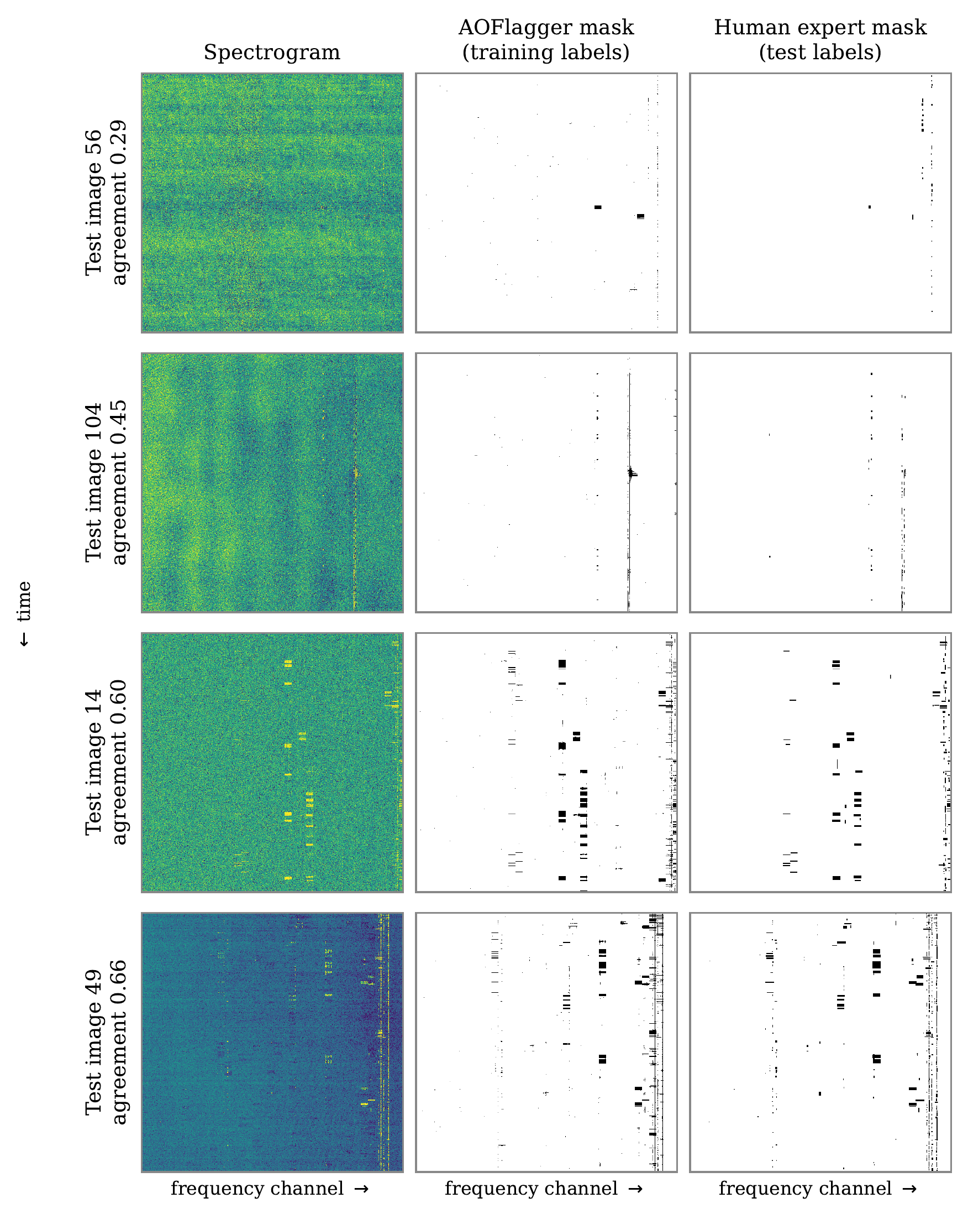
Appendix: Training Labels
AOFlagger's labels are imperfect, in different ways on LOFAR and HERA
 | LOFAR | HERA
Data | real | simulated
Training images | 6621 | 316
RFI pixels in the test images | 0.77% | 2.65%
AOFlagger vs the true labels (F1) | 0.57 | 0.91
Pixels flagged by AOFlagger / true RFI | 1.00× | 1.10×
AOFlagger false alarms within 2 pixels of real RFI | 48% | 75%
On HERA, AOFlagger flags a thin rim of extra pixels around real RFI. Kestrel learns its labels closely and copies the rim; tf_unet copies far less of it.
Notes:
[Backup slide, not presented] Left: LOFAR test images with AOFlagger's mask and the expert's mask; 'agreement' is the F1 between the two masks.

Slide 25
Appendix: LOFAR Table
Method | max F1 | AUROC | AUPRC
Our training settings
tf_unet (3 runs) | 0.5482 ± 0.0139 | 0.9470 ± 0.0074 | 0.5562 ± 0.0152
Kestrel (3 runs) | 0.6603 ± 0.0040 | 0.9378 ± 0.0111 | 0.6583 ± 0.0088
Mesarcik et al.'s training settings
tf_unet, closest (3 runs) | 0.5551 ± 0.0155 | 0.9482 ± 0.0052 | 0.5608 ± 0.0167
U-Net, Mesarcik et al. (1 run) | 0.6166 | 0.8213 | 0.5283
Kestrel (1 run) | 0.6258 | 0.9719 | 0.6401
Published by Mesarcik et al. [5]
AOFlagger | 0.5698 | 0.7883 | 0.5716
U-Net, Mesarcik et al. | 0.5876 ± 0.0031 | 0.8017 ± 0.0058 | 0.5920 ± 0.0031
RFI-Net | 0.5979 ± 0.0012 | 0.8109 ± 0.0037 | 0.5991 ± 0.0038
Simple threshold, no training
σ-clipping | 0.4103 | 0.7029 | 0.3165
109 expert-labelled LOFAR test images; every learned method was trained only on AOFlagger's labels.
Notes:
[Backup slide, not presented] Report Table 5.1. Kestrel's AUROC is slightly below tf_unet's because the Dice loss pushes outputs towards 0 or 1; without Dice its AUROC is 0.987.

Slide 26
Appendix: Ablation
Removing parts of Kestrel: the three added modules contribute little
Variant (one run each) | max F1 | Change
Full model | 0.6624 | —
without strip convolutions | 0.6637 | +0.0013
without channel attention | 0.6557 | −0.0067
without residual blocks | 0.6569 | −0.0055
without all three (partial Kestrel) | 0.6605 | −0.0019
partial Kestrel without GroupNorm | 0.6289 | −0.0335
With three runs each
Kestrel: 0.6603 ± 0.0040
Partial Kestrel: 0.6585 ± 0.0047 (the three modules add only 0.002)
Without GroupNorm as well: 0.6495 ± 0.0178 (a 4× larger spread)
Kestrel without Dice loss: 0.6495 ± 0.0049 (Dice adds 0.011)
A CRF on top did not help: 0.6592 → 0.4884 with Chen et al.'s settings, +0.0012 at best
Notes:
[Backup slide, not presented] Report Table 6.1 lists one run per variant. With three runs, partial Kestrel and the version without GroupNorm differ by 0.009, which is not significant (p = 0.48), but without GroupNorm the results vary four times more between runs. The rest of the 0.11 gain over tf_unet lies in the output layer, padding, depth and width, batch size, learning rate and framework, not tested one by one.

Slide 27
Appendix: HERA Table
Method | max F1 | AUROC | AUPRC
Our training settings
tf_unet | 0.9550 ± 0.0025 | 0.9971 ± 0.0004 | 0.9698 ± 0.0027
Kestrel | 0.9442 ± 0.0043 | 0.9983 ± 0.0007 | 0.9797 ± 0.0022
Mesarcik et al.'s training settings
tf_unet, closest | 0.9533 ± 0.0019 | 0.9955 ± 0.0028 | 0.9664 ± 0.0068
U-Net, Mesarcik et al. | 0.9160 ± 0.0062 | 0.9727 ± 0.0022 | 0.8991 ± 0.0073
Kestrel | 0.9450 ± 0.0020 | 0.9980 ± 0.0004 | 0.9757 ± 0.0056
Published by Mesarcik et al. [5]
AOFlagger | 0.8729 | 0.9736 | 0.8799
U-Net, Mesarcik et al. | 0.9015 ± 0.0074 | 0.9746 ± 0.0009 | 0.8963 ± 0.0074
RFI-Net | 0.8950 ± 0.0068 | 0.9728 ± 0.0007 | 0.8898 ± 0.0086
No training
AOFlagger, run by us | 0.8740 | 0.9739 | 0.8808
135 HERA test images, mean ± sd over 3 runs. With our settings Kestrel is scored on the centre 472 × 472 pixels, like tf_unet.
Notes:
[Backup slide, not presented] Report Table 5.3. With our settings tf_unet leads on max F1, Kestrel on AUROC and AUPRC.

Slide 28
Appendix: Synthetic Data
Results on synthetic data do not carry over to real data
0.93
tf_unet on our synthetic data
0.49
the same code and settings on real LOFAR data
Kestrel scores 0.975 on the same synthetic data.
Synthetic labels are exact, and every labelled pixel lies above the noise by construction.
On LOFAR much RFI is faint, and 44% of the pixels flagged in the training labels are not RFI according to the expert.
Notes:
[Backup slide, not presented] Max F1: tf_unet 0.9317 on the 276 by 600 synthetic data, 0.4901 on LOFAR at learning rate 1e-3 and 60 epochs; Kestrel 0.9749 on synthetic data.

Slide 29
Appendix: Run Time
Kestrel is faster per image and much faster to train
 | Kestrel | tf_unet
Parameters | 593,842 | 465,986
Time per 512 × 512 spectrogram | 10.8 ms | 17.8 ms
One training run, LOFAR | about 25 min | about 2 h 40 min
One training run, HERA | about 20 min | about 2 h 40 min
Framework | PyTorch 2.13 | TensorFlow 2.21
NVIDIA RTX 3060 Laptop GPU (6 GB) on mains power. Time per spectrogram: median over the 109 LOFAR test images, one image at a time, after 10 warm-up passes.
Training: wall-clock time of one complete run, including validation, with the settings behind the reported results.
Notes:
[Backup slide, not presented] Measured with analysis/timing/time_kestrel.py and time_tfunet.py. The two networks run in different frameworks, so part of the speed difference may come from the framework.

