Slide 1
Weekly Report - Week 5
10/09/2026
Ronak Singh (BS-MS 4th Year)
IMS23319
School of Physics

Slide 2
➢ Summary
This Week's Focus
• Environment: moved the whole project from Windows + WSL2 to a Fedora 44 dual boot.
• Baseline: diagnosed why the authors' tf_unet scored only F1 0.39 on our synthetic dataset, and fixed it.
• Datasets: audited HERA and the full LOFAR dataset (9.3 GB, real telescope data).
• Real data: ran the authors' tf_unet on 109 human-expert-labelled LOFAR baselines.
Headline Results
Authors' tf_unet, unmodified code
• Synthetic: F1 0.3879 → 0.9317 by changing only normalisation and class weights.
• Cause: class weighting 66% of the gap, normalisation 34%, epoch count ~0%.
• Real LOFAR: F1 0.5482 ± 0.0139 — essentially reproduces the published U-Net (0.5876).
• Key number: the same code drops −0.383 F1 going from our synthetic data to real data.

Slide 3
# | Normalisation | Class weights | Epochs | ROC AUC | max F1 | Behaviour
1 | per-image | ON | 22 | 0.6681 | 0.3879 | froze at 81.1% error for 15 epochs
2 | per-image | ON | died at 5 | 0.5677 | 0.3064 | collapsed — constant 0.537 everywhere
3 | per-image | OFF | 60 | 0.8747 | 0.7191 | trained normally
4 | fixed range | OFF | 60 | 0.9908 | 0.9317 | trained well

Slide 4
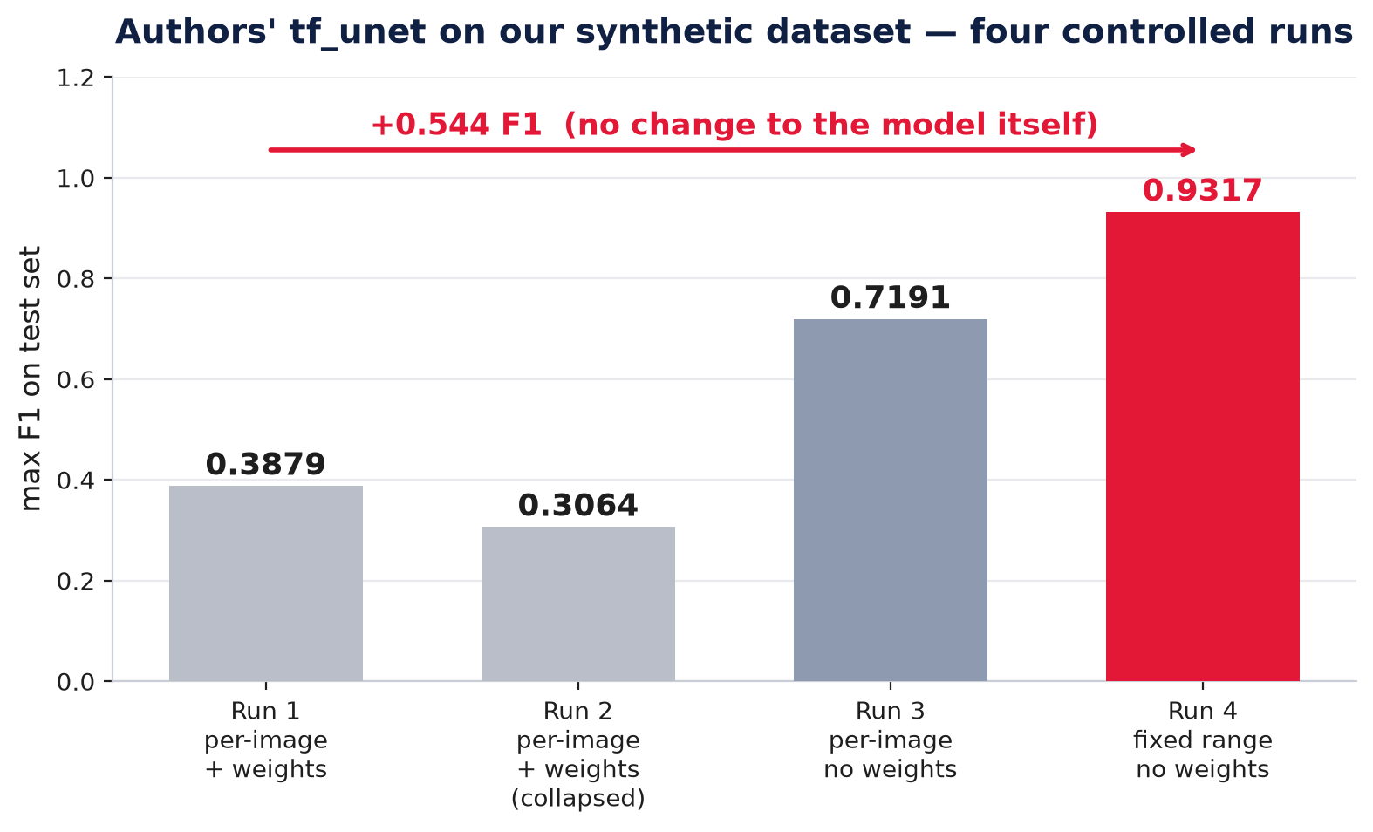

Slide 5
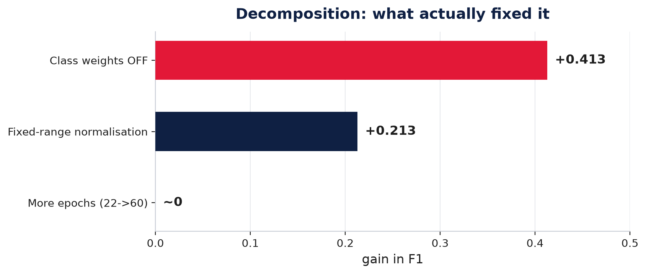
➢ What actually caused it
• Class weighting was the primary cause, not the architecture.

Slide 6
➢ The second cause: per-image normalisation
Each image was being scaled by its own min and max. Measured on this dataset the per-image maximum ranges from 27 to 222 — a factor of 8.2 — so identical physical noise lands at different values in different images and no single threshold works for all of them.
•The authors avoided this. Their own launcher passes a_min=30, a_max=210 — one fixed physical range for every image.

Slide 7
➢ The LOFAR dataset — real telescope data
What it is
• Real observations 9.3 GB pickle, from Mesarcik et al. 2022 (Zenodo 6724065).
• Structure: a list of 4 arrays — 7500 training images and masks, 109 test images and masks.
• Each image: 512×512, rows = time, columns = frequency
• Training labels: produced by AOFlagger, a classical algorithm — not by a person.
• Test labels: 109 baselines hand-labelled by a human expert
• All 109 test images are inside the training set. Byte-identical. We drop them before training — 7356 images remain.

Slide 8
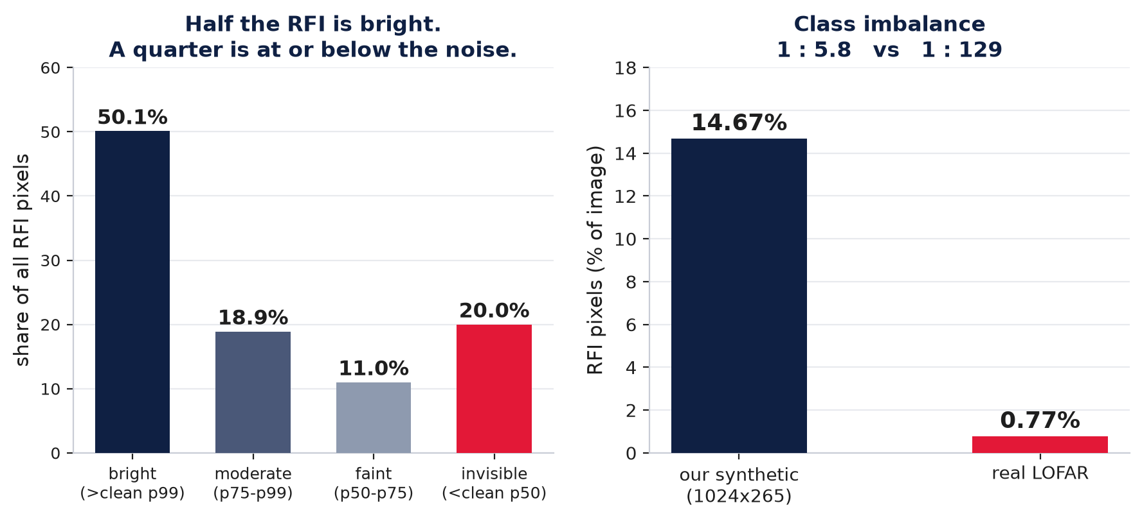
➢ Why real data is much harder
• synthetic label is RFI > 0.5 sigma by construction, so every labelled pixel is brighter than the noise and there is no ambiguity.
• On LOFAR, about a quarter of labelled RFI is dimmer than a typical clean pixel. Those pixels carry no brightness evidence at all — they can only be found from context.

Slide 9
➢ Authors' tf_unet on real LOFAR data
Authors' unmodified tf_unet, layers 3, features_root 32, fixed-range normalisation, no class weights. Trained on 6621 clean images, tested on the 109 human-expert-labelled baselines. Three seeds.
Setting | pooled F1 | max F1 | ROC AUC | best epoch
lr 1e-3, 60 epochs (3 seeds) | 0.4563 ± 0.0279 | 0.4901 ± 0.0495 | 0.9389 ± 0.0045 | 50–58
lr 1e-4, 150 epochs (3 seeds) | 0.5021 ± 0.0259 | 0.5482 ± 0.0139 | 0.9470 ± 0.0074 | 114
• It did not collapse, which was the real risk at 1:129 imbalance with no class weighting.
• The learning rate mattered more than any architecture change we have measured. Dropping from 1e-3 to 1e-4 and training longer gained +0.058 max F1.

Slide 10
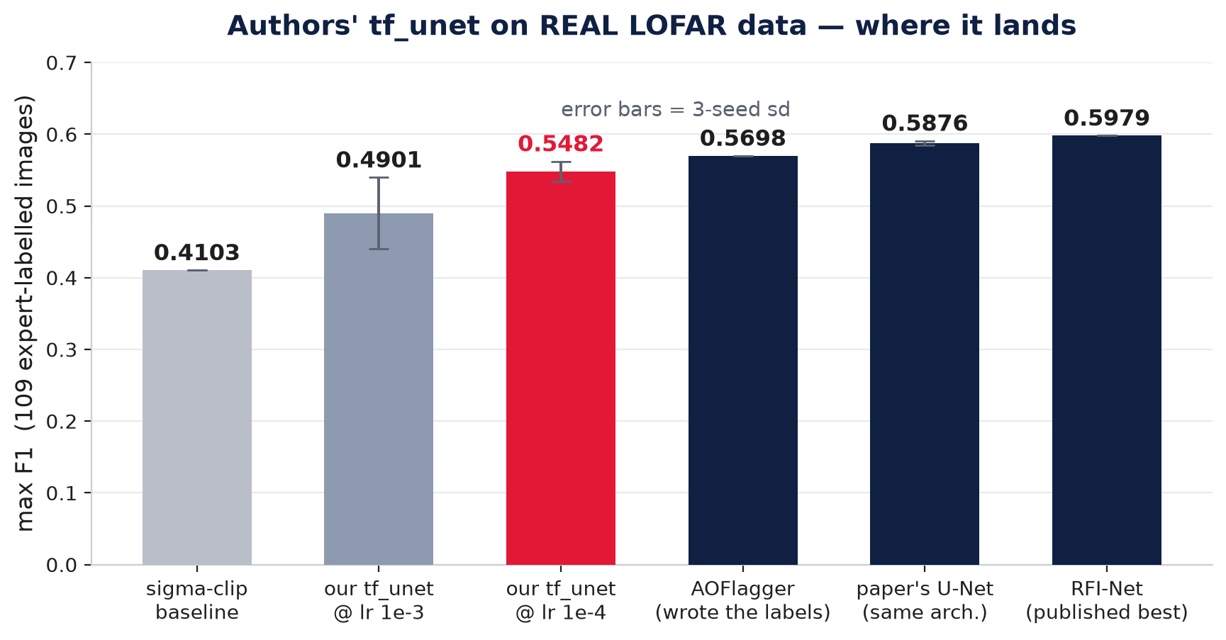
➢ Where that puts us
• We essentially reproduce the published U-Net. 0.5482 against their 0.5876 for the same architecture; the remaining 0.024 is plausibly the two differences left — 32×32 patches and per-image normalisation.
• AOFlagger sits at 0.5698 and it wrote the training labels — every learned method here is taught by something itself only ~57% right.

Slide 11
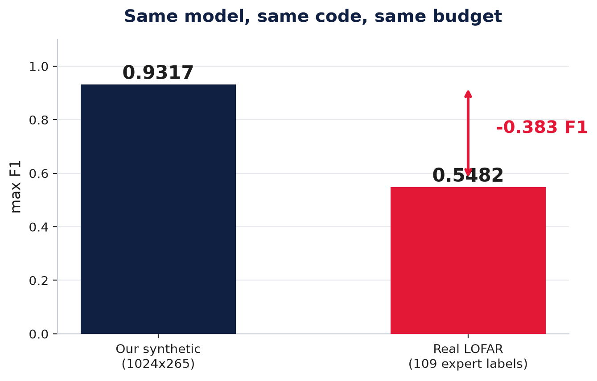
• A synthetic benchmark can overstate a method's real performance by more than 0.38 F1.

Slide 12
➢ The HERA dataset — and a flaw in it
What it is
• Source: Zenodo 6724065, HERA_04-03-2022_all.pkl (440 MB), simulated HERA data from Mesarcik et al.
• Structure: 420 train + 140 test, 512×512, with boolean masks.
• RFI content: 2.75%, against 14.67% in our synthetic dataset.
The published split has train/test leakage
Check | Result
Unique train images | 382 / 420
Unique test images | 135 / 140
Train ∩ test overlap | 31 images
… as a share of the test set | 22%
• 31 test images are byte-identical copies of training images.

Slide 13
➢ To Do Next Week
• Run the authors' tf_unet on HERA: the one gap in this week's comparison — the dataset is audited and deduplicated, but the baseline has not been run on it.
• Present our own hybrid model: results on the synthetic, and on the real LOFAR data against the same published benchmarks.

