Slide 1

DIGITAL FORENSICS / PROJECT PRESENTATION
CUSTODIA
Distributed Digital Evidence and Chain of Custody
A local forensic evidence network for integrity, redundancy, recovery, and accountability.
PRESENTED BY GROUP-I
Forensics theme | SHA-256 | Quorum storage

Slide 2






CUSTODIA / 02
Group Members
Six-member project team with individual names and identification codes.
REAL NAME 01
REAL NAME 02
REAL NAME 03
ID: TNT-1963
ID: TNT-1964
ID: TNT-1965
REAL NAME 04
REAL NAME 05
REAL NAME 06
ID: TNT-1966
ID: TNT-1967
ID: TNT-1968
GROUP-I | CUSTODIA EVIDENCE NETWORK
02

Slide 3
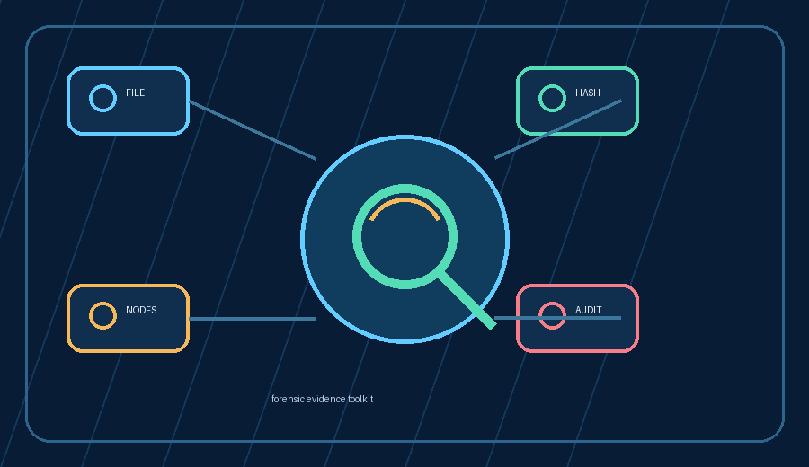
CUSTODIA / 03
Agenda
A simple route from the problem to a working forensic evidence demonstration.
TODAY'S ROUTE
Project purpose and learning objectives
Forensic evidence tools and system architecture
Upload, hash, replicate, verify, and repair
Testing with fictional evidence files
Benefits, limitations, and future direction
Conclusion and questions
Understand the workflow, then run the demo
GROUP-I | CUSTODIA EVIDENCE NETWORK
03

Slide 4
CUSTODIA / 04
Project overview and objectives
Custodia is a learning prototype for protecting digital evidence from intake to report.
1
2
3
4
CAPTURE
PROTECT
PROVE
RECOVER
Register evidence with a case ID, description, and tags.
Hash the file and store redundant copies across nodes.
Verify integrity and show who performed each action.
Detect corruption, repair replicas, and preserve history.
Main lesson: evidence is not only a file—it is a file plus proof, redundancy, and history.
GROUP-I | CUSTODIA EVIDENCE NETWORK
04

Slide 5
CUSTODIA / 05
Why digital evidence needs protection
Evidence is valuable only when its origin, content, and history can be trusted.
THE RISK
THE RESPONSE
A single file copy is not enough
Make every byte accountable
Files can be changed without obvious signs.
Create a cryptographic fingerprint.
A failed drive can make evidence unavailable.
Keep three replicas across four nodes.
Manual history is easy to miss or dispute.
Verify reads with a majority quorum.
Different versions can be confused.
Record every action in a linked ledger.
GROUP-I | CUSTODIA EVIDENCE NETWORK
05

Slide 6
CUSTODIA / 06
Forensic tools inside the project
Each tool answers a different trust question during evidence handling.
WHAT EACH TOOL PROVES
File intake: what was submitted?
SHA-256: did the bytes change?
Node replicas: is the file still available?
Quorum read: do copies agree?
Audit ledger: who did what and when?
GROUP-I | CUSTODIA EVIDENCE NETWORK
06

Slide 7
CUSTODIA / 07
Project architecture
The browser dashboard calls FastAPI, which manages metadata, hashes, replicas, and audit history.
FRONTEND
BACKEND
LOCAL DATA
React + TypeScript
Python + FastAPI
metadata.json
Dashboard Upload, verify, repair, report
Hashing Quorum reads Versioning + permissions
Four node folders Object chunks Quarantine copies
User action → API route → evidence service → verified result + audit event
GROUP-I | CUSTODIA EVIDENCE NETWORK
07

Slide 8
CUSTODIA / 08
End-to-end evidence workflow
One upload moves through intake, distribution, verification, recovery, and reporting.
01
Register
02
Fingerprint
03
Distribute
Choose a file, case ID, description, and tags.
SHA-256 hashes the file and every chunk.
Three replicas are written to the node ring.
04
Verify
05
Recover
06
Report
Two matching replicas are required for a read.
Bad copies are quarantined and rebuilt.
Versions, hashes, events, and certification export.
GROUP-I | CUSTODIA EVIDENCE NETWORK
08

Slide 9
CUSTODIA / 09
Integrity, replication, and recovery
Custodia validates both the individual chunks and the reconstructed whole file.
STORAGE MODEL
WHEN A COPY CHANGES
One file becomes trusted building blocks
Detect → quarantine → repair
Compare bytes with the expected hash.
Use a healthy peer for repair.
FILE
CHUNKS
3 REPLICAS
Quarantine the bad copy.
Write correct bytes atomically.
File hash
Merkle root
2 of 3 quorum
Record repair in the ledger.
GROUP-I | CUSTODIA EVIDENCE NETWORK
09

Slide 10
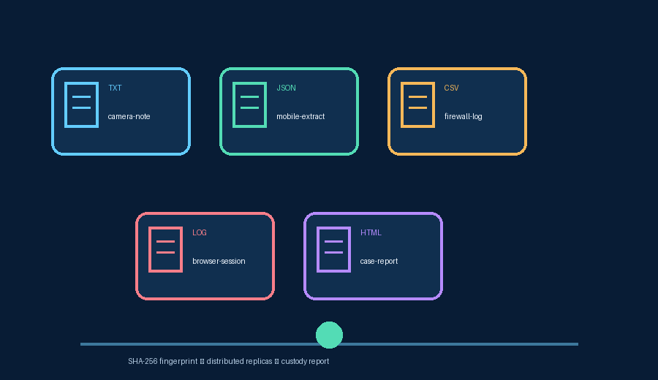
CUSTODIA / 10
Evidence files and case IDs
Different file types can belong to the same case without becoming the same evidence item.
BEGINNER RULE
One case can contain many files
Case ID: CASE-TEST-001
Evidence ID: created per upload
Same case ID groups related files
Filenames keep versions distinct
Example: camera note + mobile extract
GROUP-I | CUSTODIA EVIDENCE NETWORK
10

Slide 11
CUSTODIA / 11
Testing the project
The supplied fictional evidence files let the team demonstrate every current feature safely.
SAMPLE FILES
LIVE TEST SEQUENCE
21 fictional fixtures
1
Upload
2
Verify
Hash & distribute
Healthy result
TXT: camera and interview notes
3
Version
4
Corrupt
JSON: mobile and browser extracts
v1 stays immutable
Status becomes attention
CSV: firewall, GPS, USB, timelines
5
Repair
6
Report
LOG, Markdown, and HTML reports
Replica returns healthy
JSON custody export
Use CASE-TEST-001 to group related files
GROUP-I | CUSTODIA EVIDENCE NETWORK
11

Slide 12
CUSTODIA / 12
Who uses Custodia?
The prototype makes responsibilities visible for investigators, examiners, and administrators.
I
INVESTIGATOR
E
EXAMINER
A
ADMINISTRATOR
Register new evidence, add notes, create versions, and follow case activity.
Download files, check hashes, compare versions, and produce a custody report.
Repair replicas, simulate faults, review audit events, and manage system health.
Permission depends on role
Permission depends on role
Permission depends on role
Use fictional files for demonstrations; never upload real sensitive evidence to this prototype.
GROUP-I | CUSTODIA EVIDENCE NETWORK
12

Slide 13
CUSTODIA / 13
Benefits today, improvements tomorrow
Custodia is a strong learning prototype with a clear path toward production infrastructure.
CURRENT BENEFITS
NEXT ADVANCED STEPS
Tamper detection with SHA-256
PostgreSQL + database migrations
Redundant storage and quorum reads
MinIO/S3 storage on separate servers
Automatic corruption recovery
Real login, MFA, and JWT/OIDC
Immutable version history
AES-256 encryption with KMS
Role-based actions and audit reports
Scheduled workers, alerts, OCR, and analytics
Important: the current nodes are local folders and users are demo identities.
GROUP-I | CUSTODIA EVIDENCE NETWORK
13

Slide 14
CUSTODIA / 14
Roadmap to an advanced platform
The current prototype demonstrates the workflow; these upgrades prepare it for real organizations.
NOW
NEXT
LATER
GOAL
Prototype
Reliable service
Production security
Operational platform
metadata.json, local node folders, demo identities
PostgreSQL, migrations, MinIO/S3, background jobs
AES-256, KMS, TLS, MFA, signed transfers
OCR, malware scanning, alerts, reports, retention
Build one trust layer at a time: data → storage → security → automation
GROUP-I | CUSTODIA EVIDENCE NETWORK
14

Slide 15
GROUP-I / CONCLUSION
Every byte accounted for. Every action attributable.
Custodia demonstrates how hashing, replication, recovery, and audit history work together to protect digital evidence.
Questions and discussion
CUSTODIA | DIGITAL FORENSICS
GROUP-I | CUSTODIA EVIDENCE NETWORK
15

