Slide 1
A DATA STORY · HEALTH SPENDING vs. LONGEVITY
America’s longevity problem isn’t a
budget problem.
It’s upstream of the budget.
Longer lives track education, lifestyle, demographics and how care is priced —
and on every one of these, the country that spends the most falls behind.
Here is what the highest spenders are doing differently.
United States
vs. the world’s 14 highest-income health spenders
Built on the attached Power BI analysis (World Bank WDI). New factors: OECD · WHO · World Bank.

Slide 2
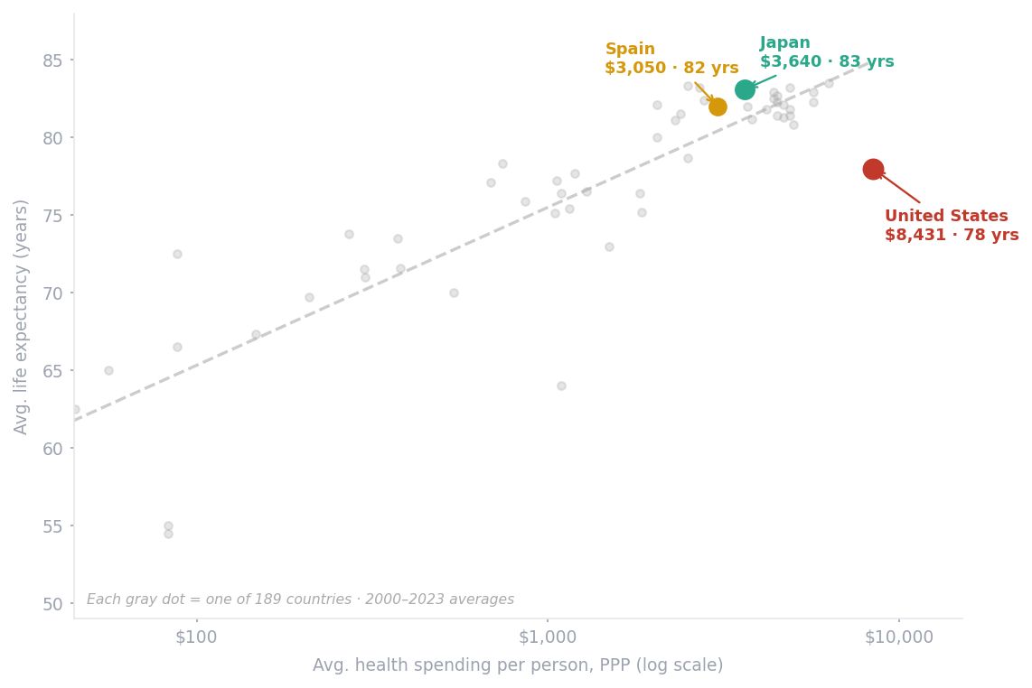
THE SETUP
The biggest spender on Earth buys one of the shortest lives among rich nations
Spending buys longevity — until it doesn’t.
Above roughly $4,000 per person the curve flattens. Yet the U.S. spends ~$8,400 and still lands 5 years below Japan, which spends less than half as much.
So the question isn’t how much to spend. It’s what those dollars sit on top of.
Source: World Bank, World Development Indicators (health expenditure & life expectancy, 2000–2023 averages). Peer comparison restricted to the world’s highest-spending countries.

Slide 3
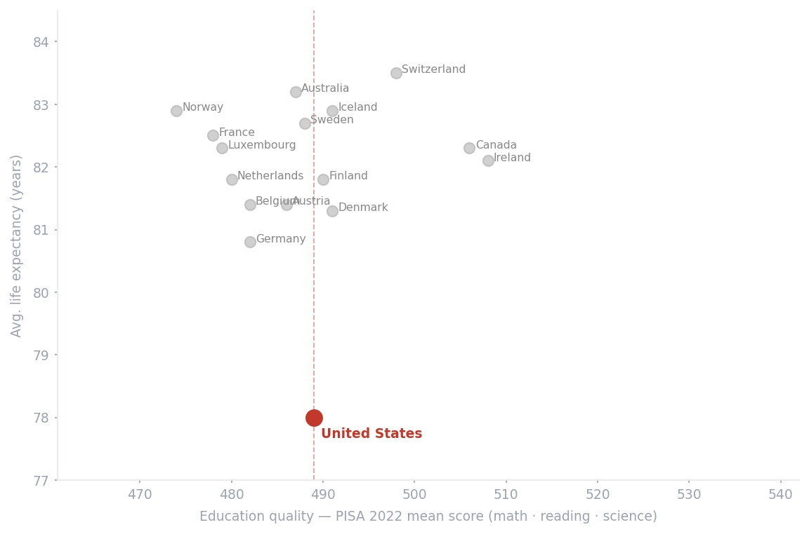
FACTOR 1 — EDUCATION QUALITY
Countries that out-educate the U.S. tend to outlive it
United States
Japan
Japan tops the peer group at 533; the U.S. sits mid-pack at 489.
Skills predict the behaviors — diet,
screening, adherence — that compound
into longer lives. The high-education,
high-longevity countries cluster toward
the upper right; the U.S. does not.
Source: OECD PISA 2022 (mean of mathematics, reading & science). Life expectancy: World Bank WDI, 2000–2023 avg.

Slide 4
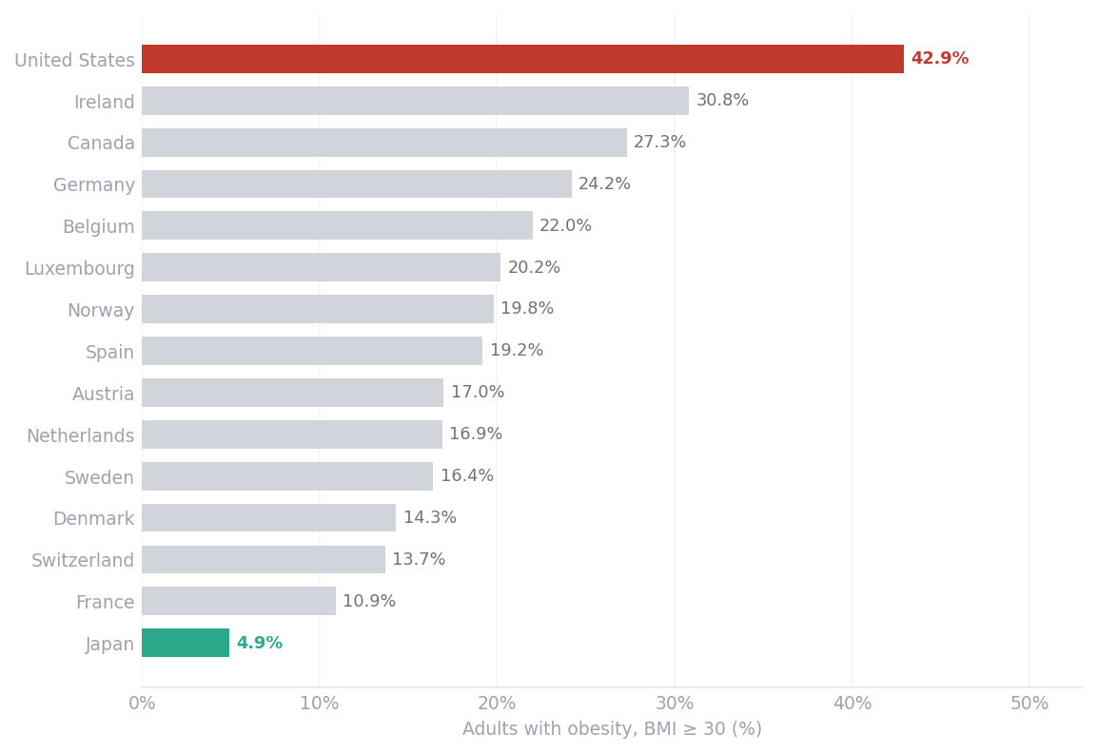
FACTOR 2 — LIFESTYLE
The gap is written in waistlines: 43% obese vs. 5%
Nearly 1 in 2 American adults has obesity — almost 9× Japan’s rate.
Obesity drives diabetes, heart disease
and several cancers — the conditions
that pull life expectancy down. No amount
of treatment spending offsets a
population-wide risk this large.
This single factor does more to explain
the U.S. shortfall than the health budget does.
Source: WHO Global Health Observatory — prevalence of obesity among adults, BMI ≥ 30 (%), 2022.

Slide 5
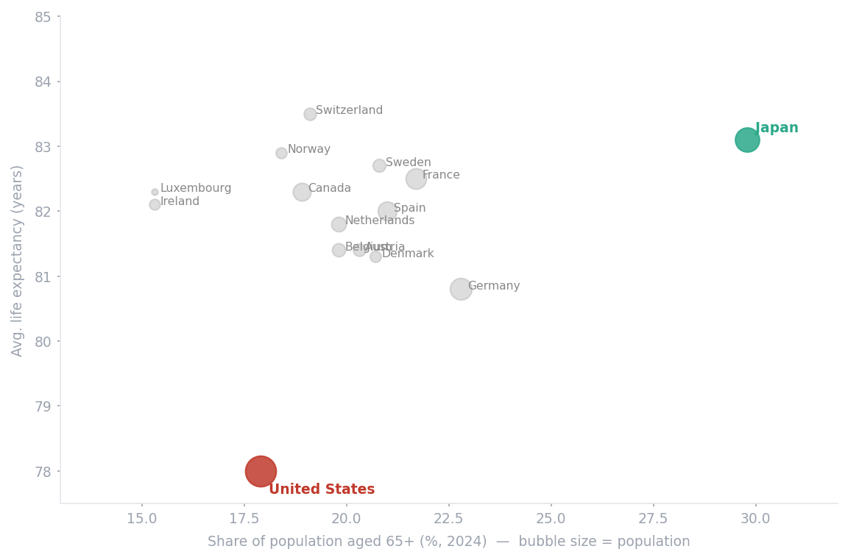
FACTOR 3 — POPULATION & DEMOGRAPHICS
Ageing isn’t the excuse — Japan is the oldest, and lives the longest
United States
Japan
Some argue demographics explain the gap — that the U.S. is simply younger.
The age structure says otherwise.
The U.S. is the youngest of these peers (18% over 65) yet sits lowest. Japan is the oldest (30%) and highest.
A younger population should make
longevity easier, not harder.
Source: UN World Population Prospects / World Bank — population aged 65+ (% of total), 2024; population, 2023. Life expectancy: World Bank WDI.

Slide 6
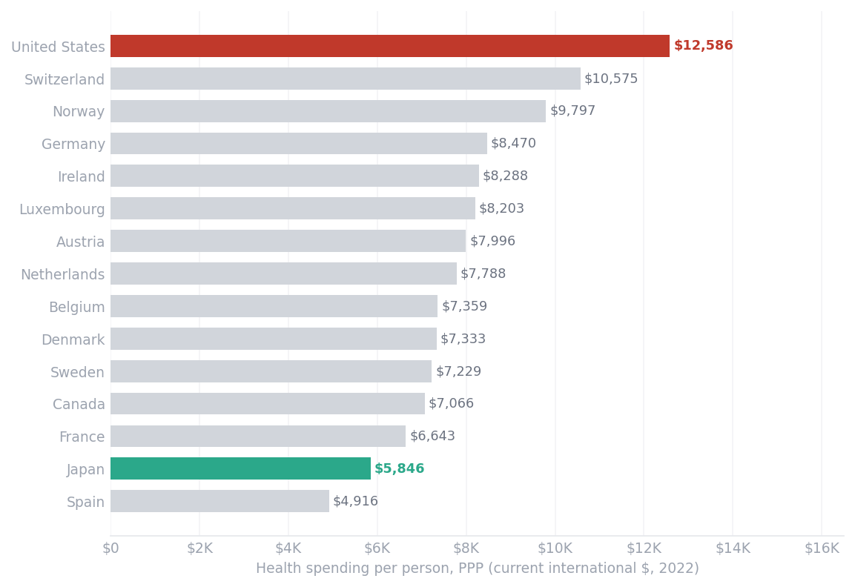
FACTOR 4 — HEALTHCARE COSTS
America’s bill is high because its prices are — not because it uses more care
The U.S. spends ~$12,600 per person — about 2.2× Japan.
It isn’t that Americans see doctors more. It’s unit price: U.S. medical prices run about 43% above the OECD average (price level 143 vs. 100), led by drugs and administration.
Same care, higher price tag — dollars that never reach longer life.
Source: World Bank WDI (spend per person, PPP, 2022). Price level: OECD, Society at a Glance 2024 / Health at a Glance (OECD avg = 100).

Slide 7
THE PATTERN
One country, four red flags — and a budget that can’t fix them
UNITED STATES
JAPAN
Avg. life expectancy
78 yrs
83 yrs
Health spend / person
$12,600
$5,300
Education — PISA 2022
489
533
Adult obesity
42.9%
4.9%
Population aged 65+
17.9%
29.8%
Medical price level (OECD = 100)
143
≈100
The U.S. leads only where leading hurts — spending and prices — and trails on the upstream factors that actually make lives longer.
Sources: World Bank WDI; OECD PISA 2022; WHO GHO 2022; UN/World Bank 2024; OECD price levels. Figures rounded.

Slide 8
THE TAKEAWAY
Stop asking how much to spend.
Fix what the money sits on.
1
Measure outcomes per dollar, not dollars.
Benchmark health systems on life expectancy gained per dollar — the metric on which the U.S. ranks last among peers.
2
Move marginal dollars upstream.
Shift spending toward obesity prevention and education equity — the levers where Japan and Spain win on far smaller budgets.
3
Attack price, not just volume.
Target the ~43% price premium — drug costs and administration — before adding another dollar of treatment spend.
Built on the attached Power BI analysis (World Bank WDI) · added factors: OECD, WHO, World Bank.

