Slide 1
Functional Stream Processing
Stateful and Pure
Ronald Schlenker
F# Applied Challenge 2019
http://schlenkr.binarygears.de/01_fsharp_dsp/01_Introduction.html

Slide 2
Description
Example: „Transform a stream of n `a values into a stream of n `b values“.
Transformation is a computation made up of many functions that are composed to one single function (this is FP).
The computation gets invoked for each single stream element.
The computation doesn‘t „remember“ anything – it‘s pure!
Problem: Some (inner) functions depend on (inner) values from „past“ evaluations – they need to remember something!
How can we solve that?

Slide 3
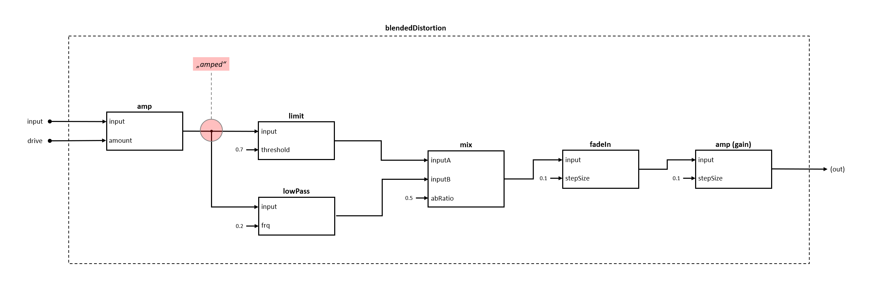
Use Case: Audio Effects

Slide 4


















Pipe Forward

Slide 5
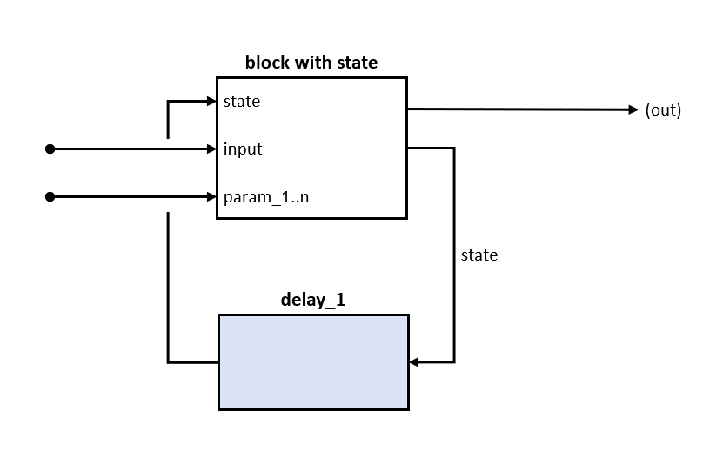
Modeling „Stateful“ Functions
Remaining functions after applying all parameters:
`state -> `value * `state

Slide 6

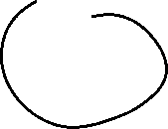






















Composing Stateful Functions

Slide 7










HowTo Compose Stateful Functions: Idea!

