Slide 1
Composing State-Aware Functions

Slide 2
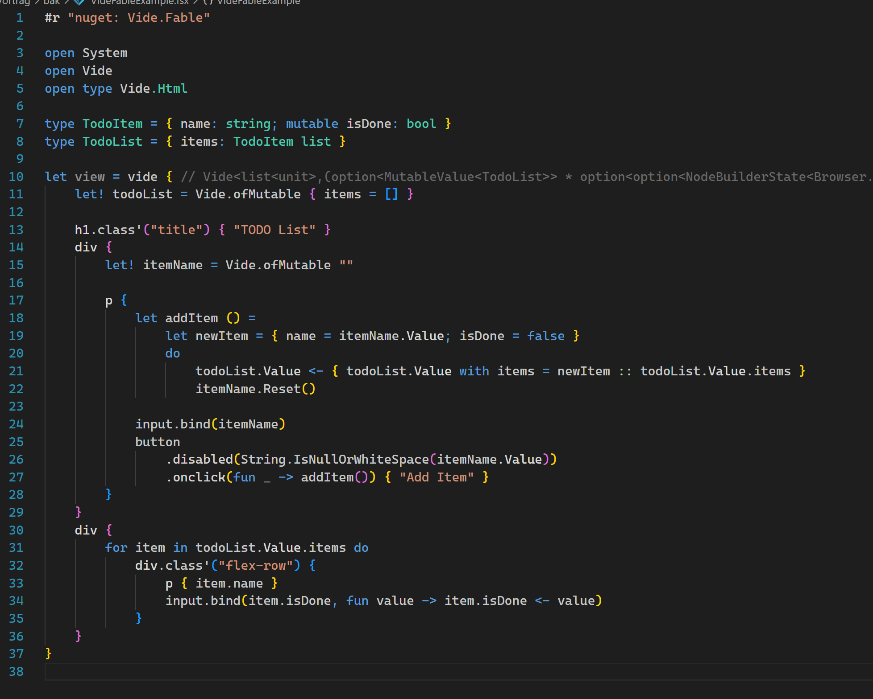
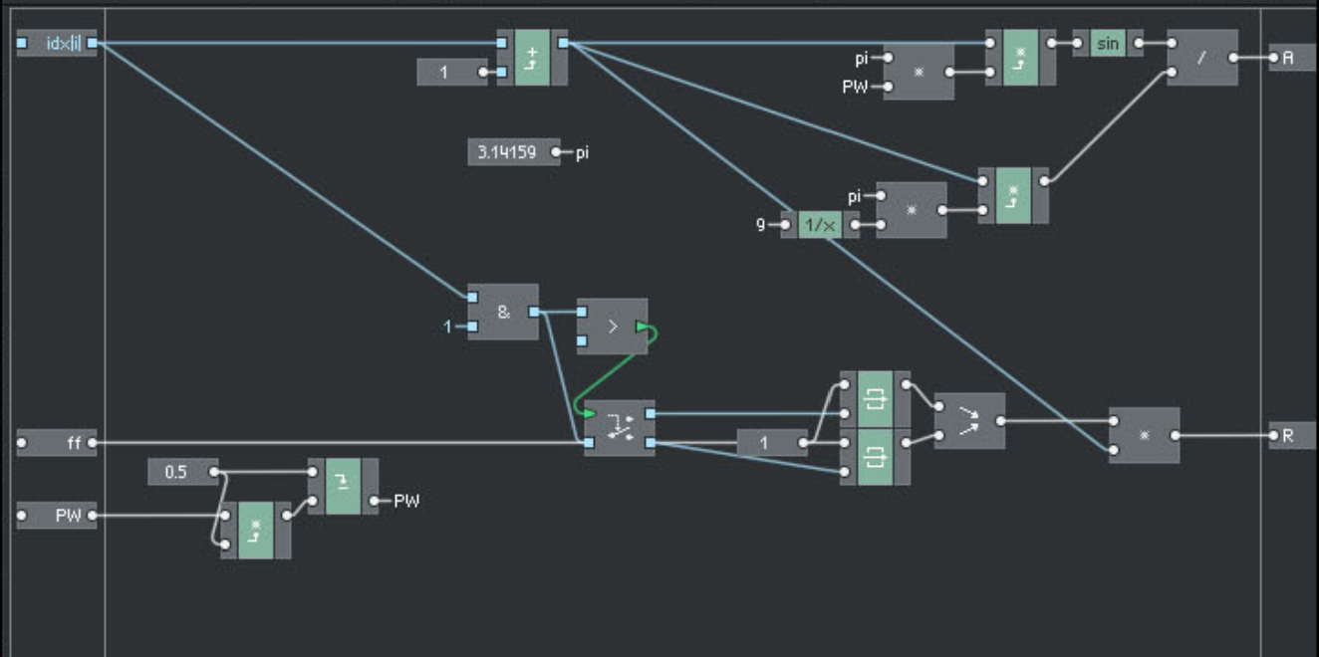
Motivation
Vide API Reasoning
Digital Signal Processing
Textual or Graphical Programming
Convenient way of Composing „stateful“ building blocks (without cartng much)
Notes:
Everything on Vide is based on the initial idea.

Slide 3
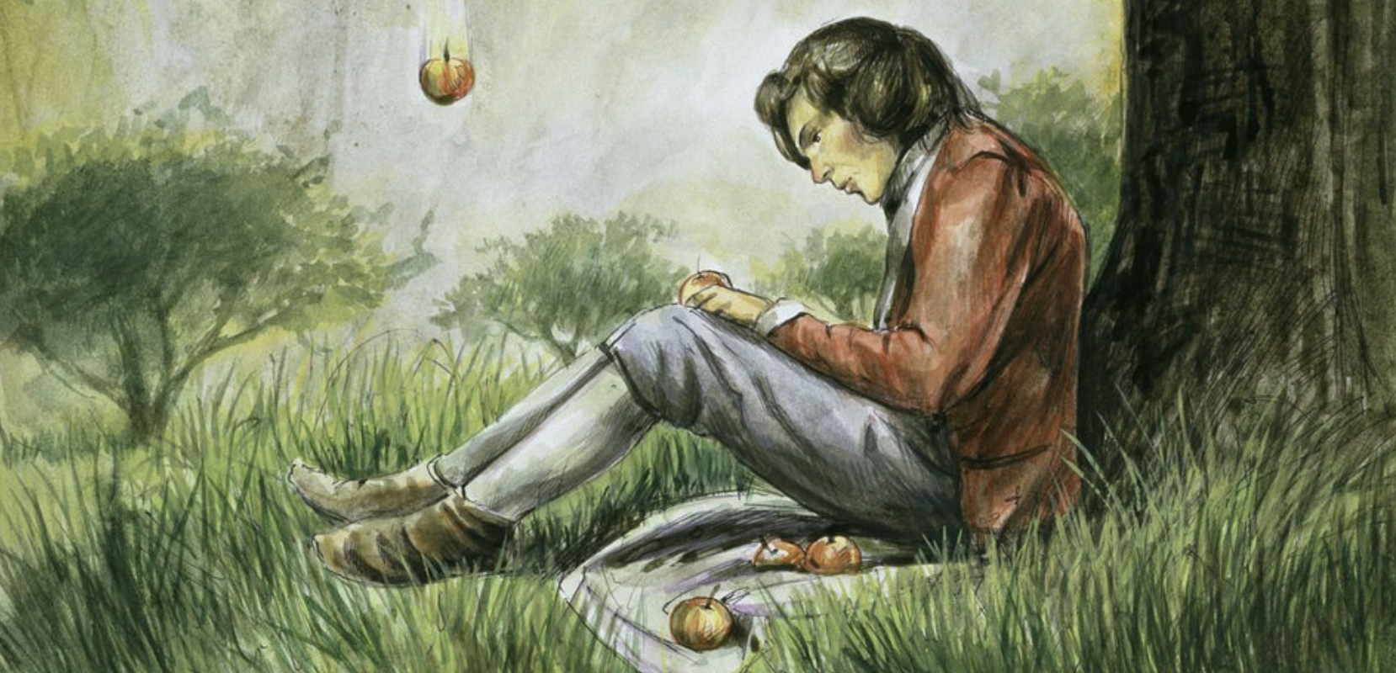
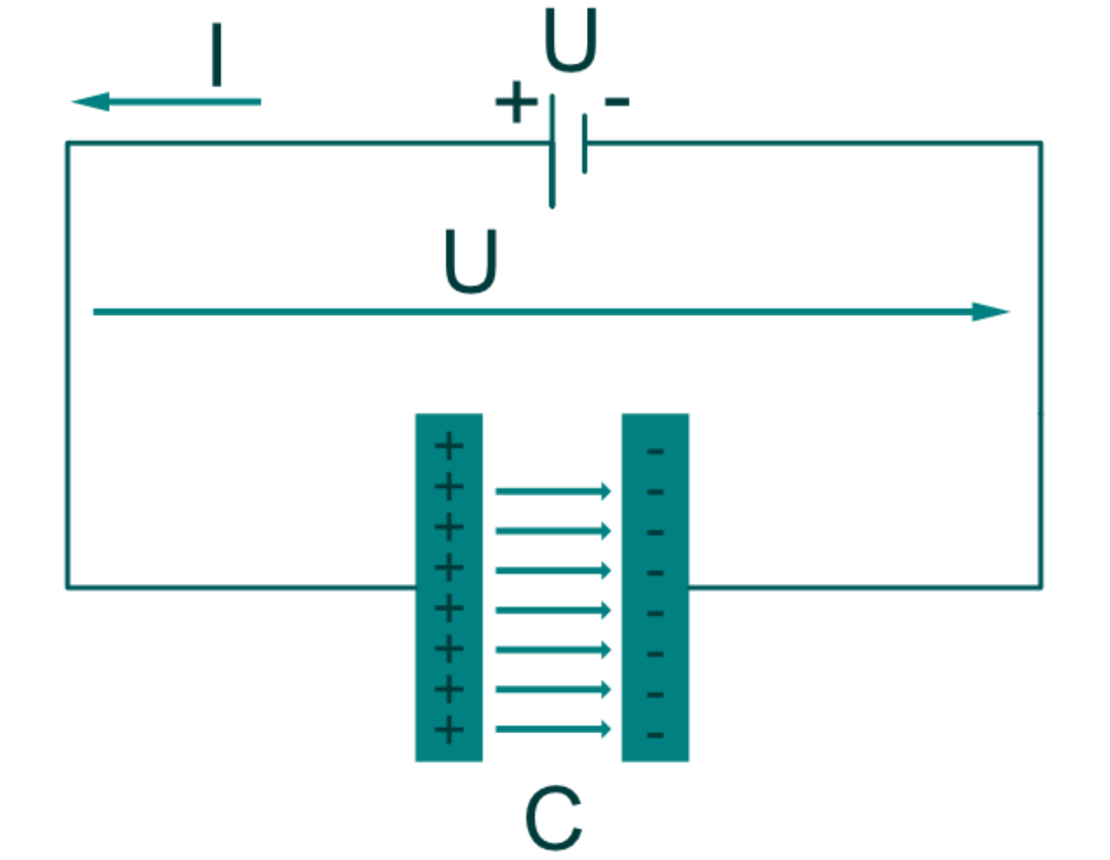
Why State?

Slide 4
What is State? When do we care about it? How to deal with it? ⚠️ Definitions are what I came up with and what helped me.

Slide 5
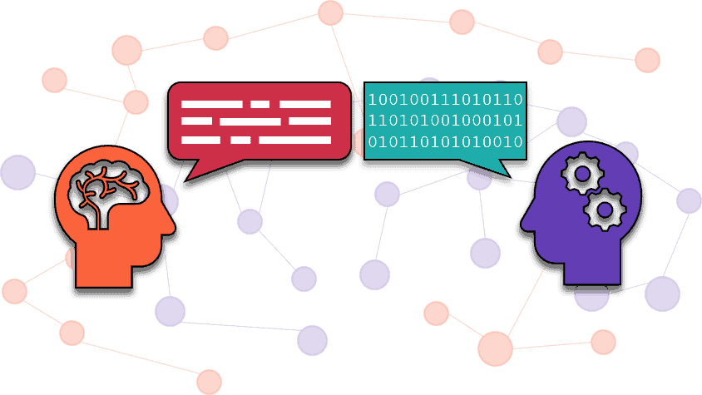
State Definition
Def. by Intuition
Natural Language
Vocabulary is Relevant
It makes (or made) Sense

Slide 6
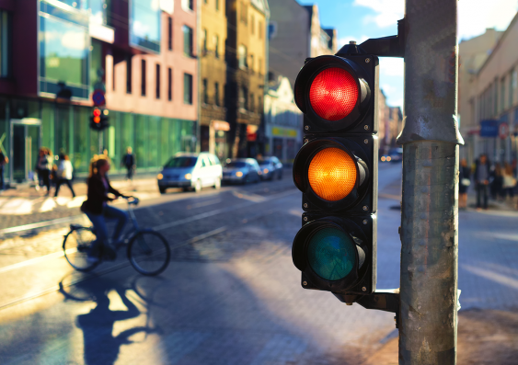
State Definition
A: "Can I drive? "
B: "No, traffic light is red."
…
A: " Can I drive now? "
B: "Yes, now it's green."

Slide 7
State Definition
Can I drive? | No, traffic light is red.
Can I drive now? | Yes, now it's green.
Dissecting the conversation - what to learn?
Values Changing over Time:
A traffic light has values, and they can change over time.
Identifiable “things”:
Nevertheless (the values can change), we can talk about "that" traffic light - it’s (uniquely) identifyable independent of its changing values.
Usually: A unique, invariant, absolute location in a finite address space as identifier (Pointer, (natural) DB-Key).
Sharable / Revisitable:
Different people can refer to the same thing
OR: "that thing" is referencable now, and at another point in time (it's still "that thing").
If all 3 properties occur together, then they become relevant as a whole.
This relevance, we express with the word “state”.
“State” is not only the changing values over time – it’s these 3 properties.

Slide 8
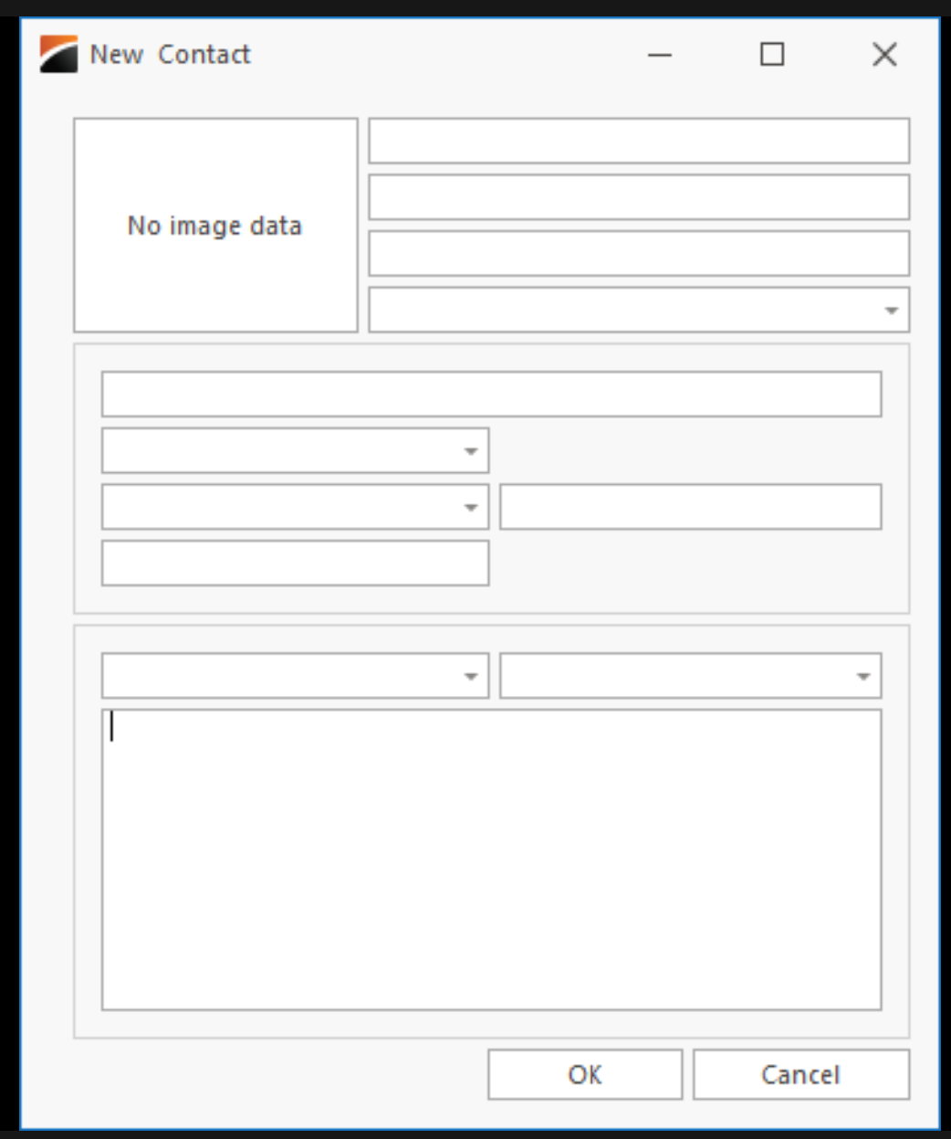
Objects:
Values Changing over Time
Identifiable (via unique, invariant, absolute location in a finite address space)
Sharable / Revisitable
(+ access restriction for the changing values by encapsulation)
„Crazy Number Generator“
Multiple evaluations
Preserves it‘s internal changing values
0
counter
from
1
by
+
out
100
counter
from
10
by
Notes:
All 3 (or 4) properties apply!
mall API (only 1 method on the surface)
Predictability
(even though state is involved)
(Reliable contract for behaviour)
Nicht-Linearitäten ansprechen – Inherently hard to predict!

Slide 9
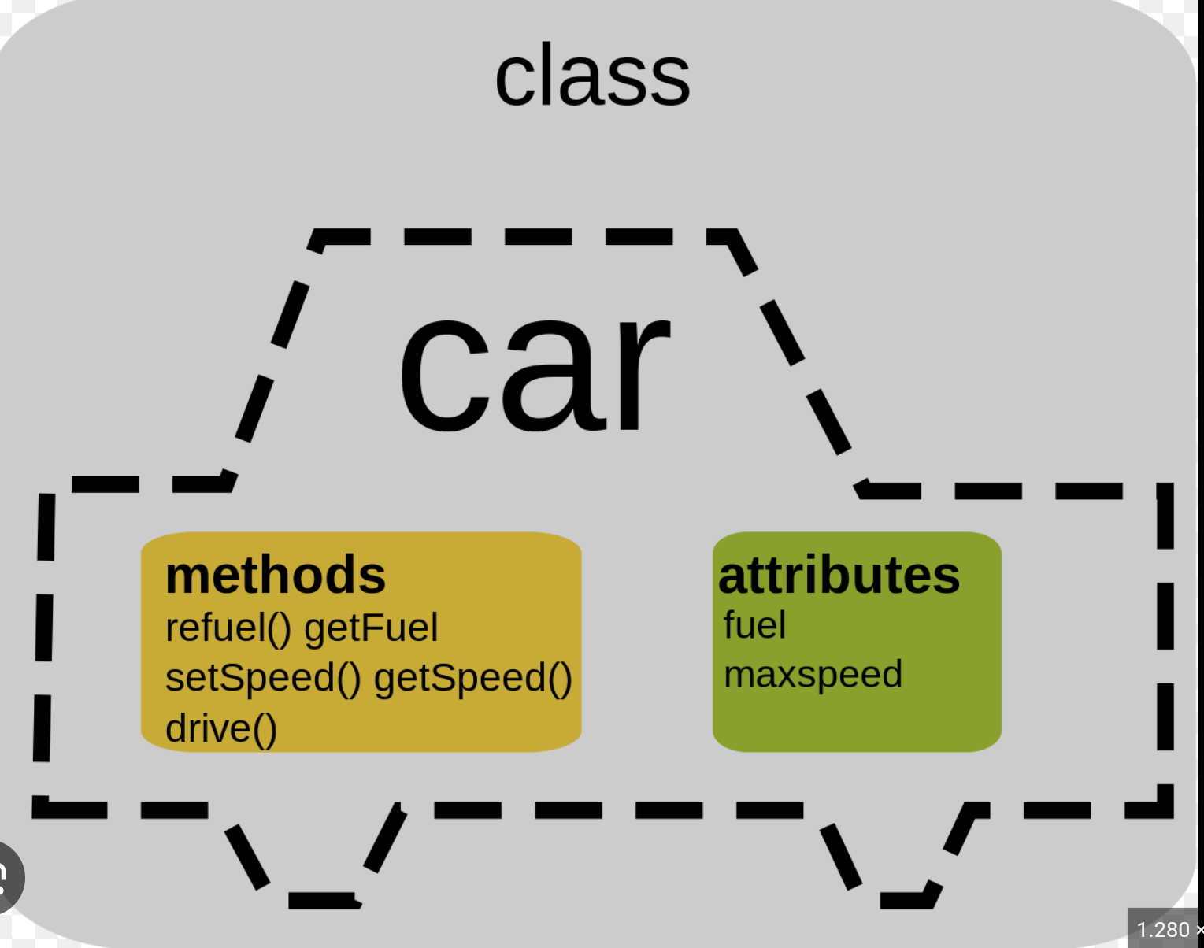
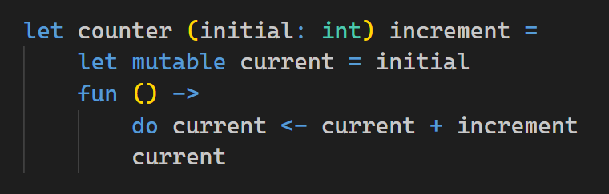
…sounds like: Objects! Values Changing over Time: YES Identifiable “thing”: YES Sharable / Revisitable: YES

Slide 10
Exercise Count from 0 by 1, Count from 100 by 10, Add corresponding values, That’s the resulting series! [ 100; 111; 122; 133; ... ] a) Using Seq Functions b) Using Objects

Slide 11
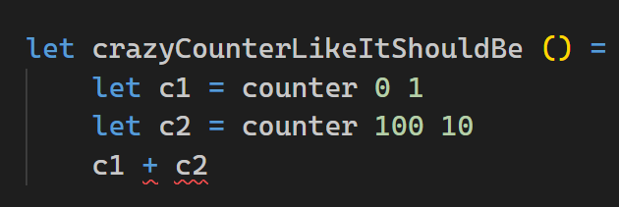
Characteristics
Auto evaluated
Ad-hoc usage of „blocks“ (instead of „up-front“ declaration)
We can leave state considerations aside!
Encourages Play instinct
Error-Proof
Crazy Number Generator
Multiple evaluations
Preserves it‘s internal changing values
0
counter
from
1
by
+
out
Motivation
How must „counter“ look like?
100
counter
from
10
by

Slide 12
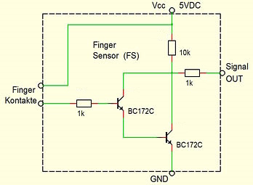
When to (not) care about State?
Counters and Transistors are composable!
Composition result is composable, too (rec)!
Do we care about state? NO! Why not?
Because we compose things by simply pulling them on the surface and connect them!
That’s it! Not more…
(what should be more?)
Counters (have internal changing values over time)
Transistors (have internal changing values over time)

