Slide 1
Composing State-Aware Functions
Notes:
Motivation: Making Vide reasonable

Slide 2
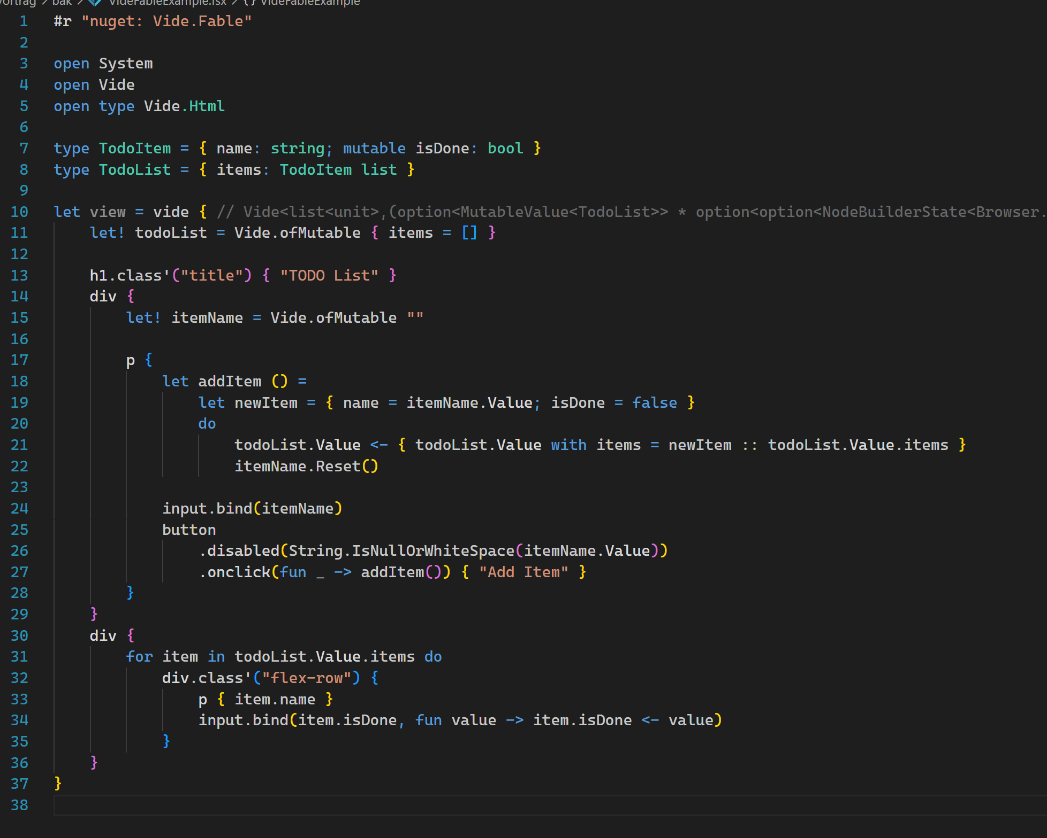
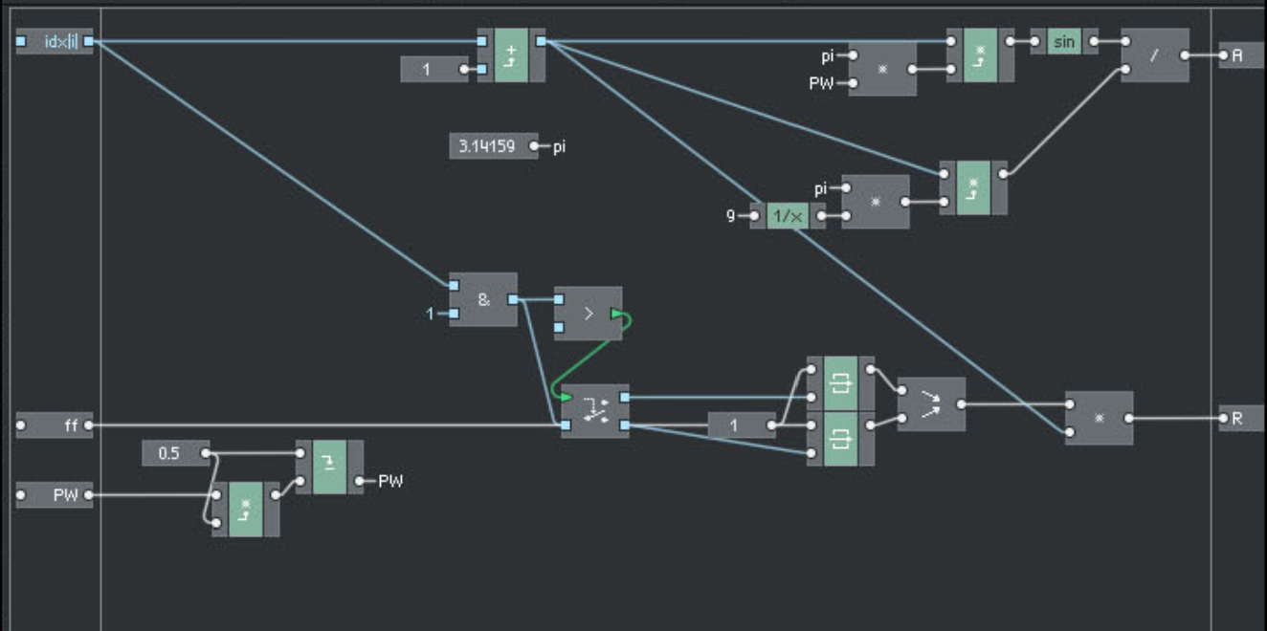
Motivation
Vide API Reasoning
Digital Signal Processing
Textual or Graphical Programming
Convenient way of Composing „stateful“ building blocks

Slide 3
What is State? When do we care about it? How to deal with it? ⚠️ Definitions are what I came up with and what helped me.

Slide 4
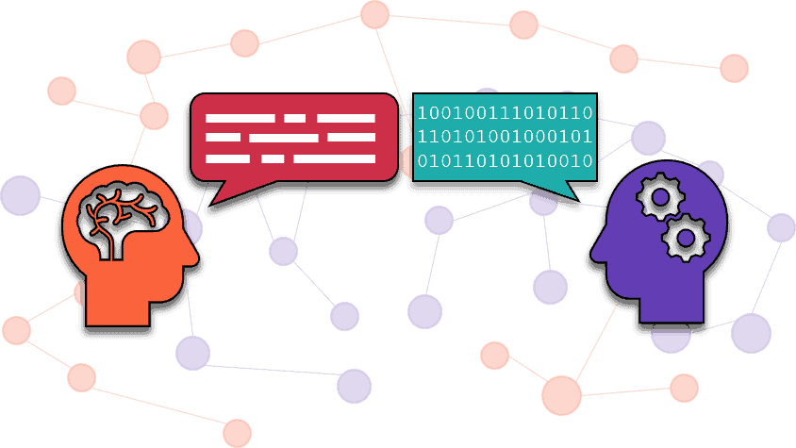
State Definition
Def. by Intuition
Natural Language
Vocabulary is Relevant
It makes (or made) Sense

Slide 5
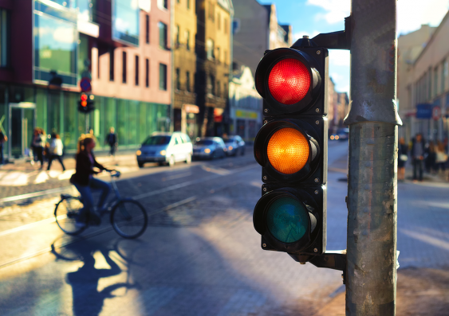
State Definition
A: "Can I drive? "
B: "No, traffic light is red."
…
A: " Can I drive now? "
B: "Yes, now it's green."

Slide 6
State Definition
Can I drive? | No, traffic light is red.
Can I drive now? | Yes, now it's green.
Dissecting the conversation - what to learn?
Values Changing over Time:
A traffic light has values, and they can change over time.
Identifiable “things”:
Nevertheless (the values can change), we can talk about "that" traffic light - it’s (uniquely) identifyable independent of the changing values.
Usually: A unique, invariant, absolute location in a finite address space as identifier.
Sharable / Revisitable:
Different people can refer to the same thing
OR: "that thing" is referencable now, and at another point in time (it's still "that thing").
If all 3 properties occur together, then they become relevant as a whole.
This relevance, we express with the word “state”.
“State” is not only the changing values over time – it’s these 3 properties.

Slide 7
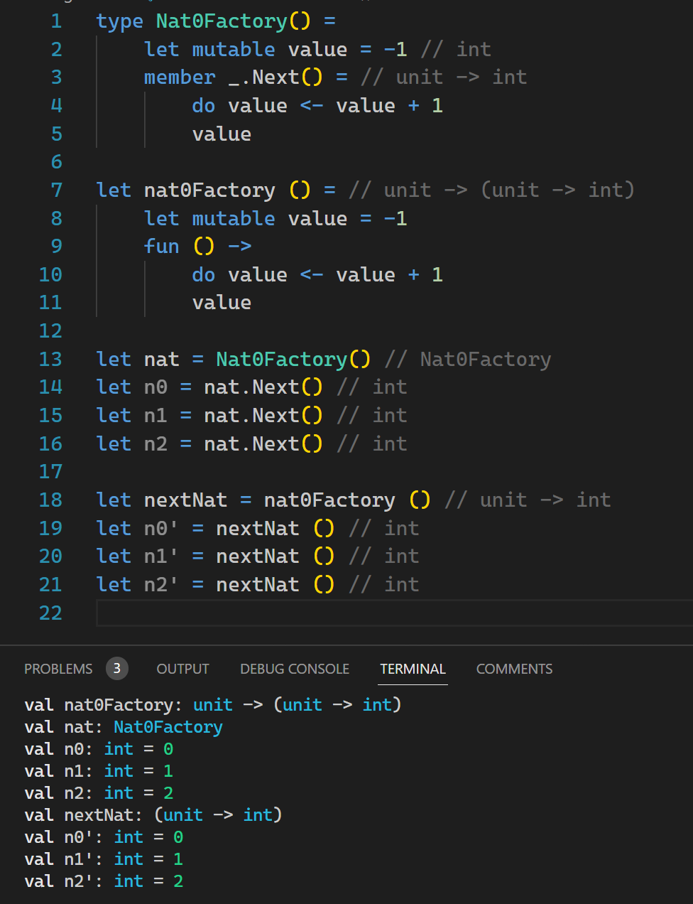
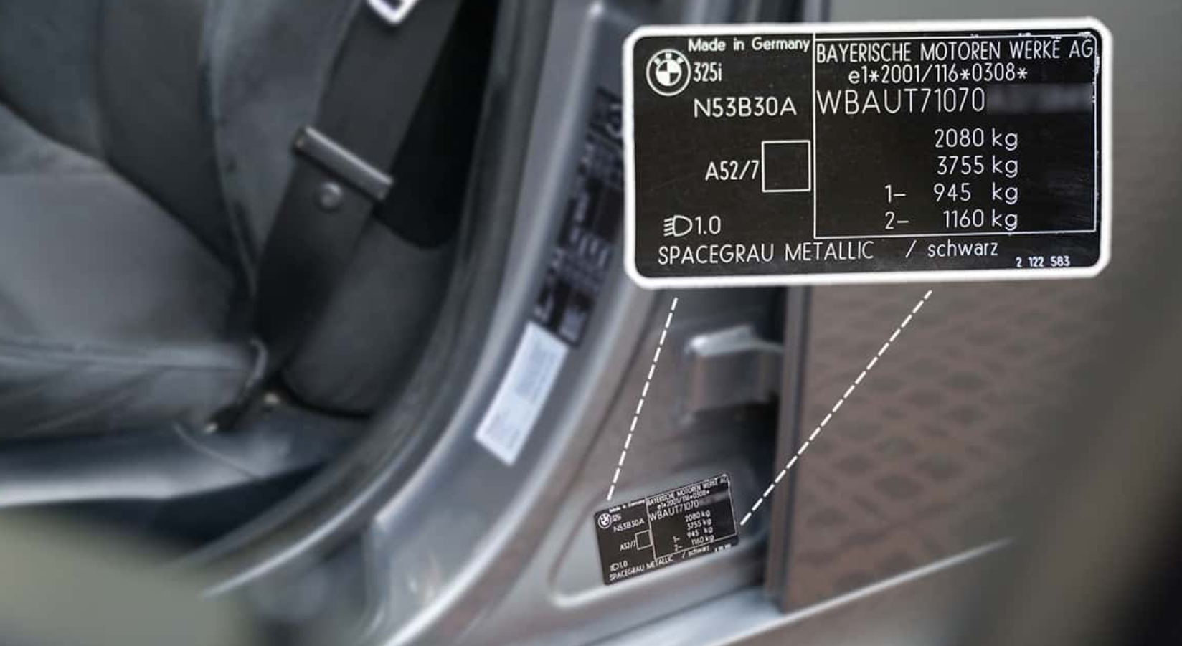
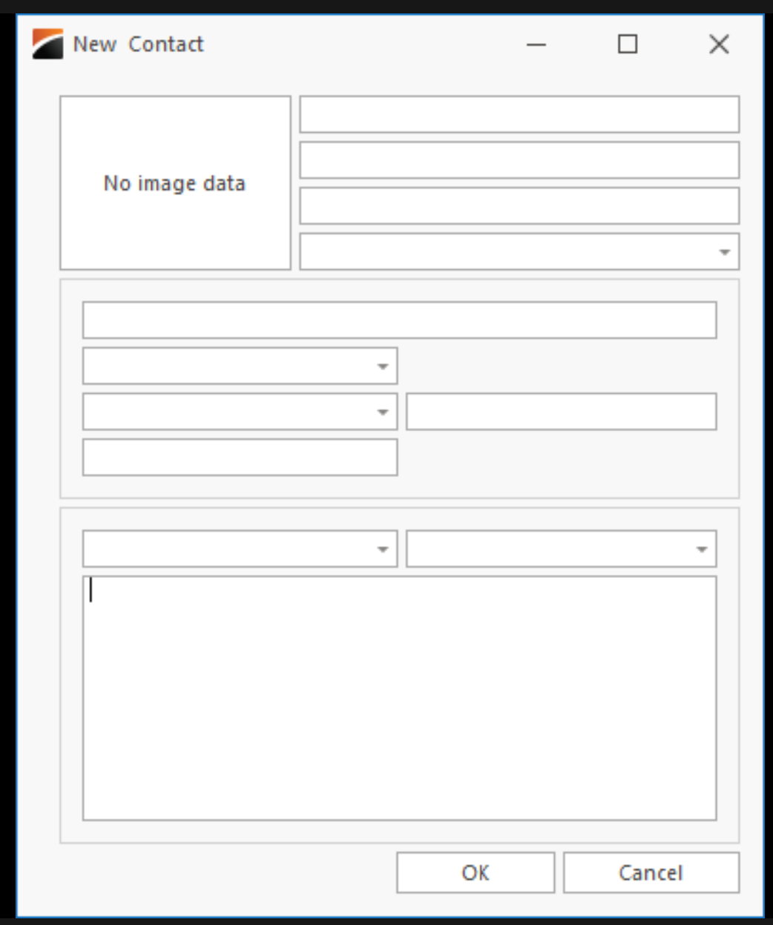

Objects:
Values Changing over Time
Identifiable (via unique, invariant, absolute location in a finite address space)
Sharable / Revisitable
(+ access restriction for the changing values by encapsulation)
Notes:
All 3 (or 4) properties apply!
mall API (only 1 method on the surface)
Predictability (even though state is involved)
Nicht-Linearitäten ansprechen – Inherently hard to predict!

