Slide 1
Composing State-Aware Functions
Notes:
Motivation: Making Vide reasonable

Slide 2
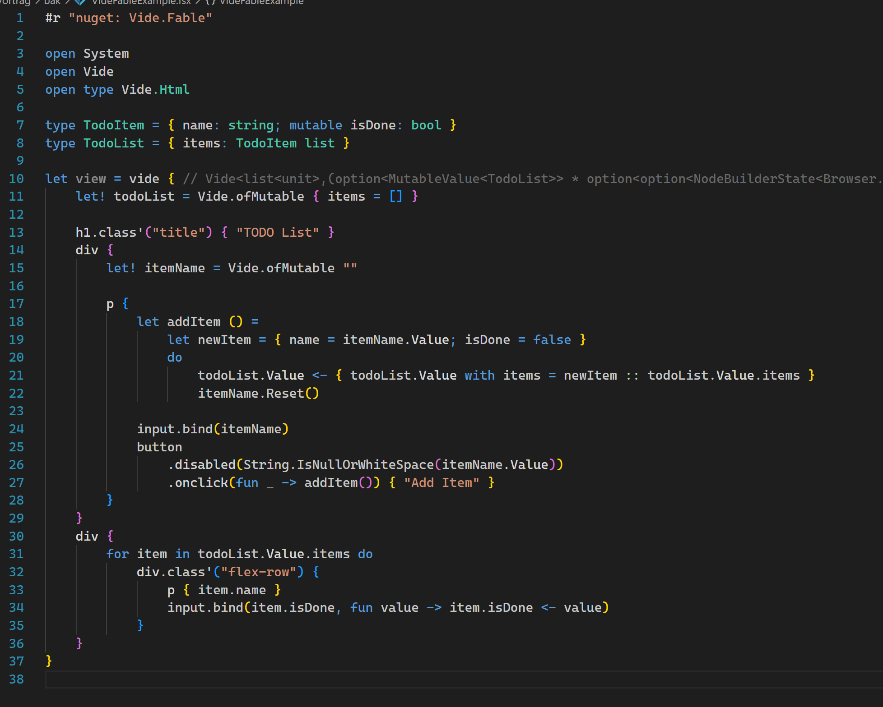
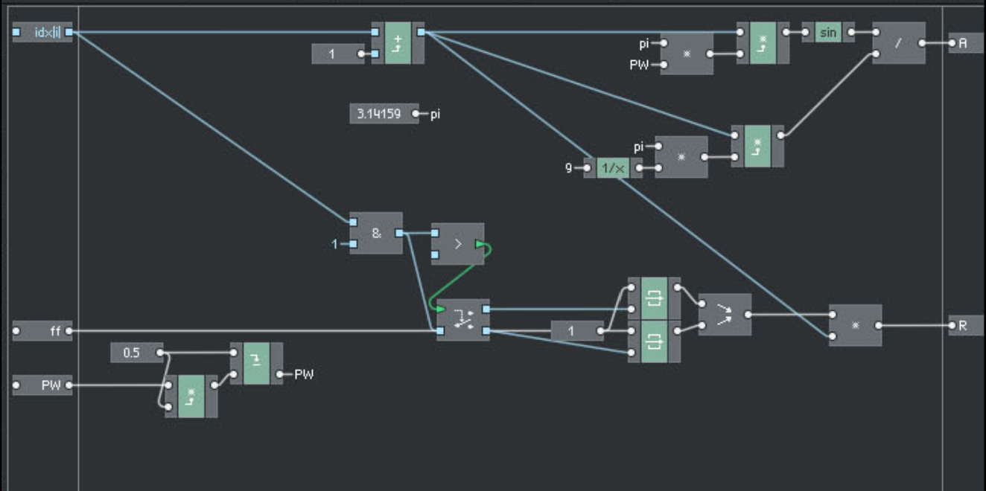
Motivation
Vide API Reasoning
Digital Signal Processing
Textual or Graphical Programming
Convenient way of Composing „stateful“ building blocks

Slide 3
What is State? When do we care about it? How to deal with it? ⚠️ Definitions are what I came up with and what helped me.

Slide 4
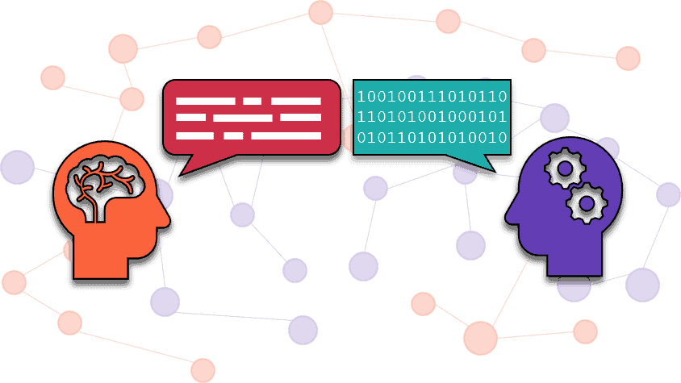
State Definition
Def. by Intuition
Natural Language
Vocabulary is Relevant
It makes (or made) Sense

Slide 5
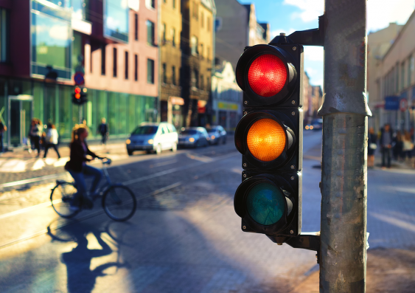
State Definition
A: "Can I drive? "
B: "No, traffic light is red."
…
A: " Can I drive now? "
B: "Yes, now it's green."

Slide 6
State Definition
Can I drive? | No, traffic light is red.
Can I drive now? | Yes, now it's green.
Dissecting the conversation - what to learn?
Values Changing over Time:
A traffic light has values, and they can change over time.
Identifiable “things”:
Nevertheless (the values can change), we can talk about "that" traffic light - it’s (uniquely) identifyable independent of the changing values.
Usually: A unique, invariant, absolute location in a finite address space as identifier.
Sharable / Revisitable:
Different people can refer to the same thing
OR: "that thing" is referencable now, and at another point in time (it's still "that thing").
If all 3 properties occur together, then they become relevant as a whole.
This relevance, we express with the word “state”.
“State” is not only the changing values over time – it’s these 3 properties.

Slide 7
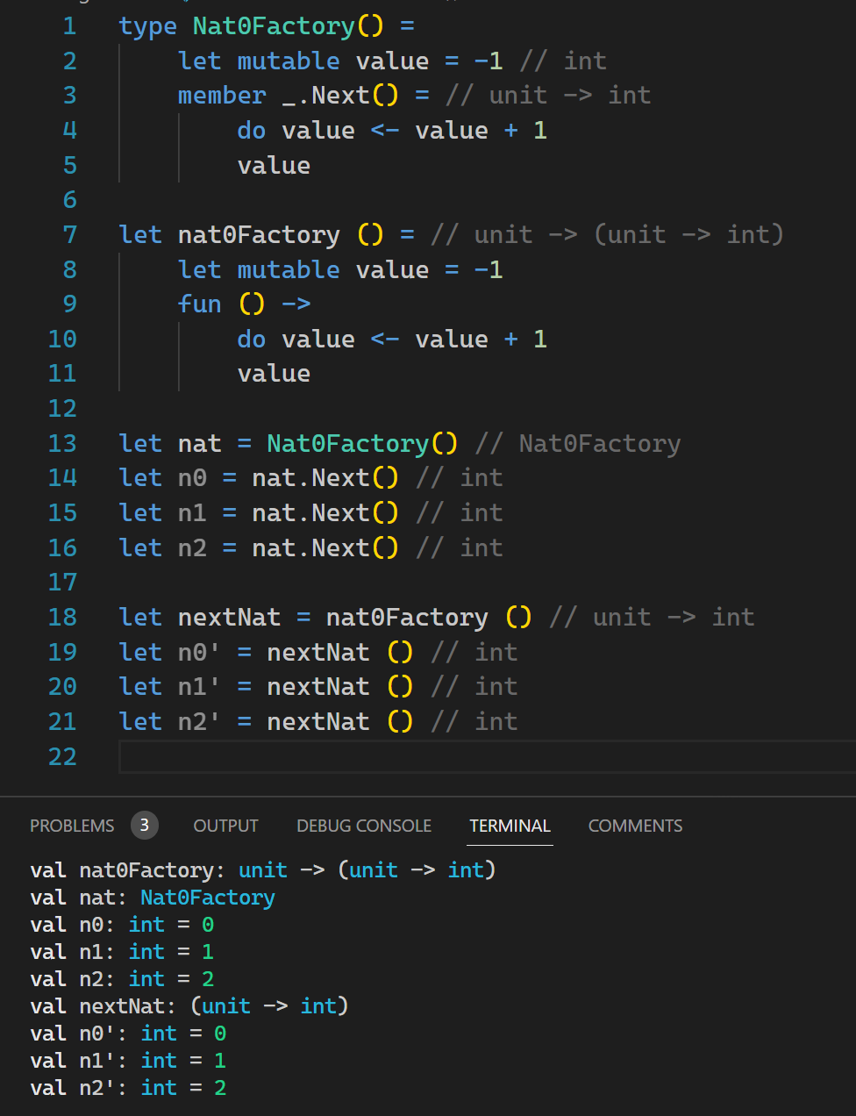
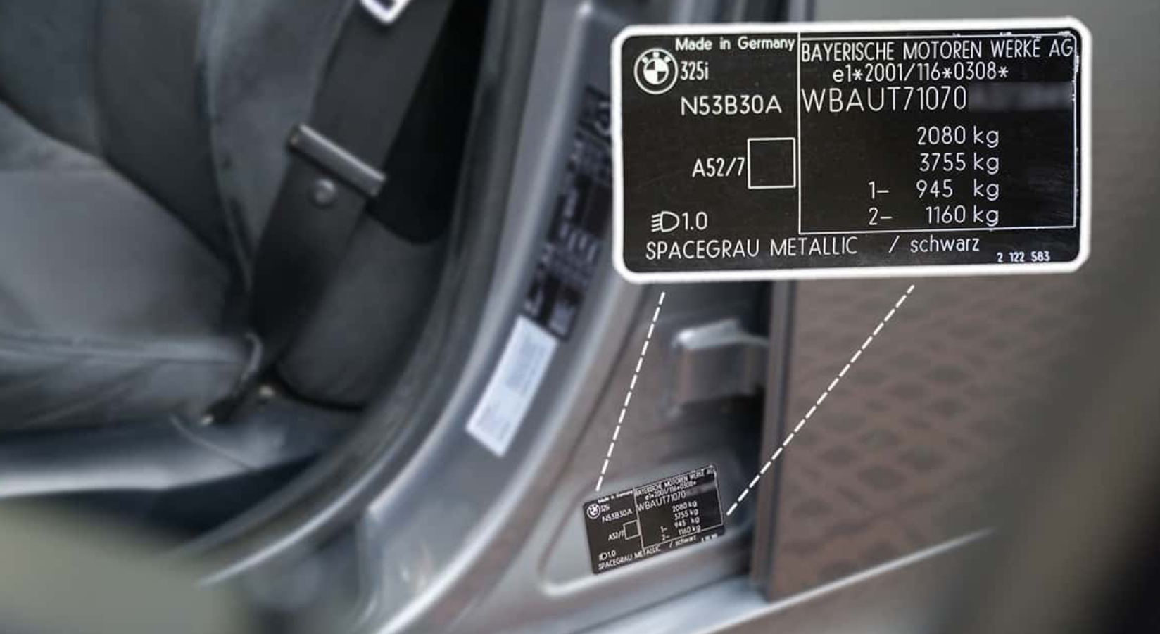
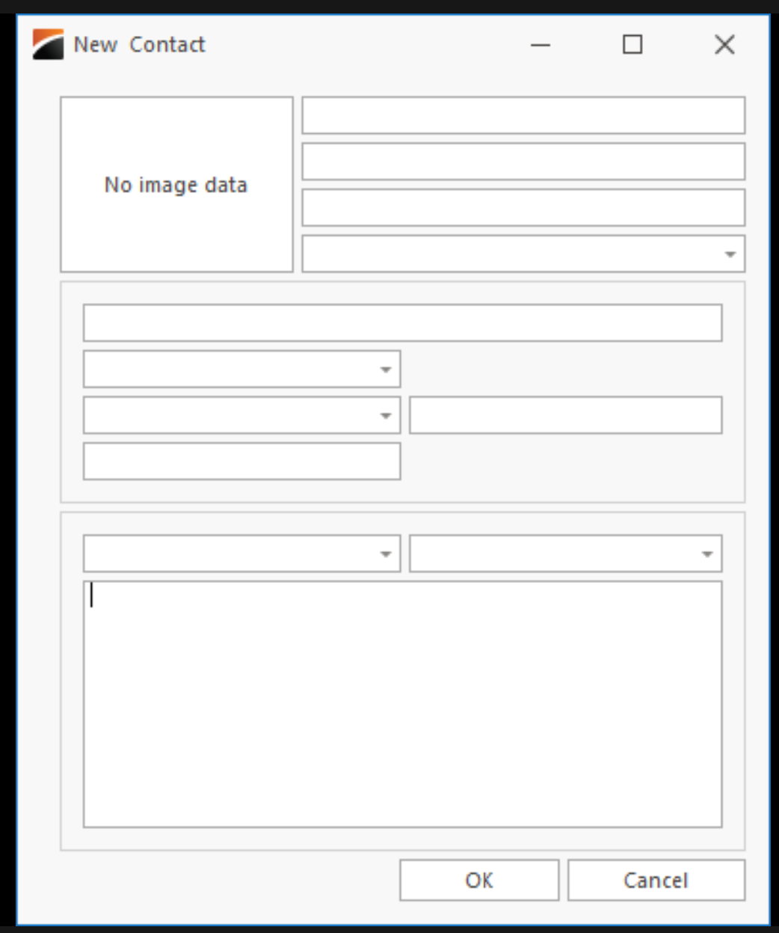

Objects:
Values Changing over Time
Identifiable (via unique, invariant, absolute location in a finite address space)
Sharable / Revisitable
(+ access restriction for the changing values by encapsulation)
Notes:
All 3 (or 4) properties apply!
mall API (only 1 method on the surface)
Predictability (even though state is involved)
Nicht-Linearitäten ansprechen – Inherently hard to predict!

Slide 8
What is State? When do we care about it? How to deal with it? Answer: Not always! …or: not as soon as there's state, we have to care about! Sometimes we can leave state considerations aside and focus on other aspects.

Slide 9
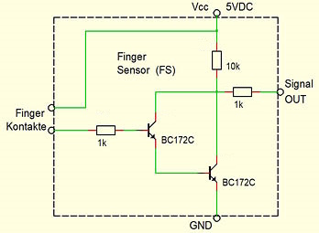
When to (not) care about State?
Counters and Transistors are composable!
Composition result is composable, too (rec)!
Do we care about state? NO! Why not?
Because we compose things by simply pulling them on the surface and connect them!
That’s it! Not more…
(what should be more?)
Counters (have internal changing values over time)
Transistors (have internal changing values over time)

