Slide 1
Medical Simulator Final Project
Ronald Alhazov
Ohad Goldberg
Guidance by Dr.Moshe sulamy

Slide 2
TABLE OF CONTENTS
Research Motivation
Project Overview:
Scenario & Users
01
03
Methodology
02
04
Scenario

Slide 3
Research Motivation
The recent conflicts in Israel have highlighted the critical importance of timely medical intervention on the battlefield. Both team members served in reserve duty and witnessed firsthand the challenges and significance of medical response in emergency situations. These experiences reinforced the need for an effective training tool to enhance medical capabilities in the field.
Objectives
1. Develop an interactive simulation environment for training in medical emergencies.
2. Enable users to experience scenarios that simulate sudden injury situations requiring immediate medical response.
3. Offer an accessible platform for non-professionals to practice medical procedures.

Slide 4


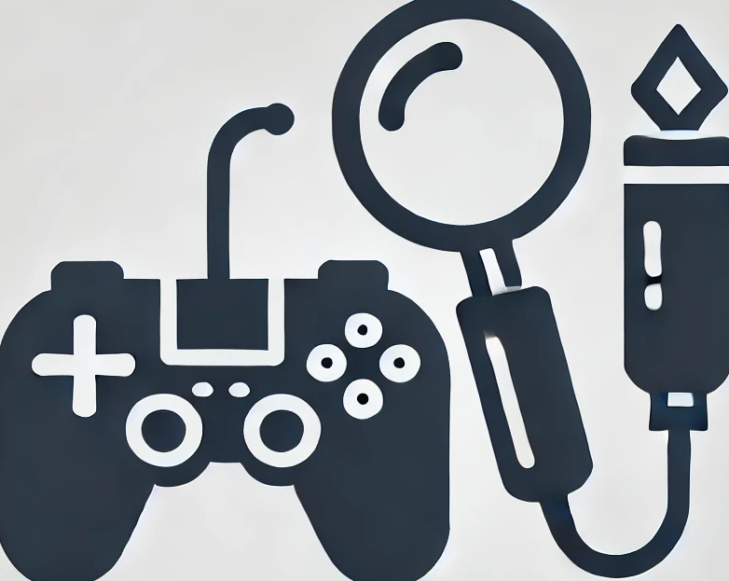
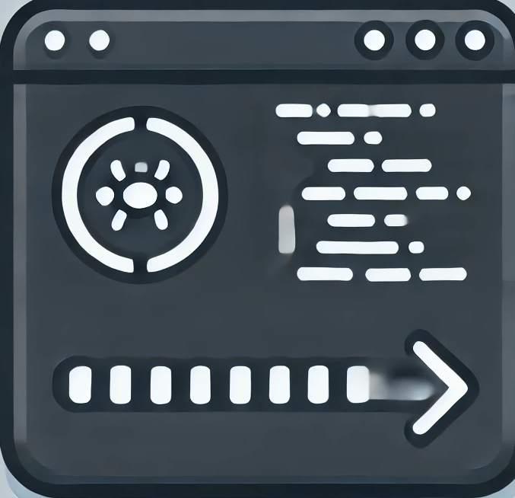
Methodology
Learning to Work with Unity
We explored how to use the Unity game engine, understanding its interface, tools, and capabilities.
Examining Sensor-Based Player Control
We researched different methods and tools for controlling the player in Unity using sensors.
Analyzing Similar Games and Existing Mechanisms
We studied control and interaction mechanisms in similar games through direct experimentation or video analysis.
Project Initialization and Development
After gaining the necessary knowledge, we started our own project and began implementing what we had learned in developing the car accident scenario.
01
02
03
04

Slide 5
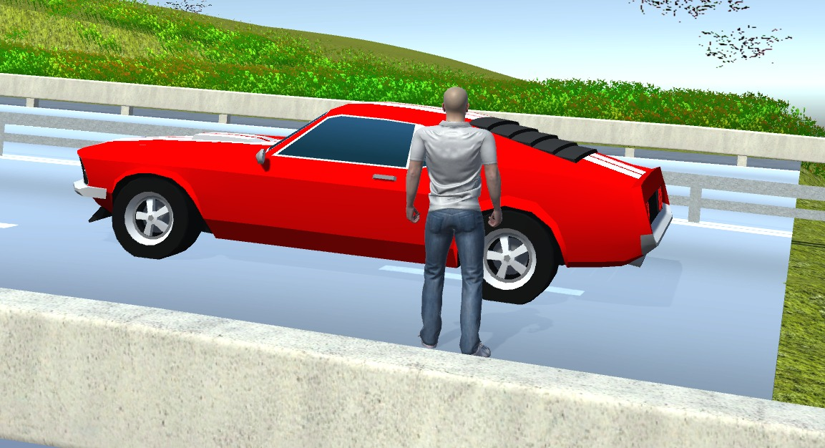
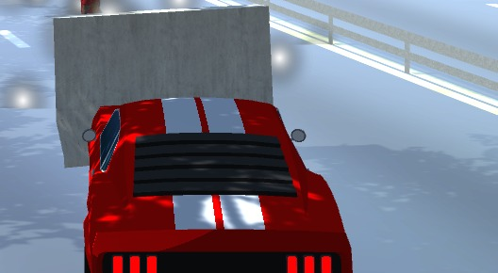
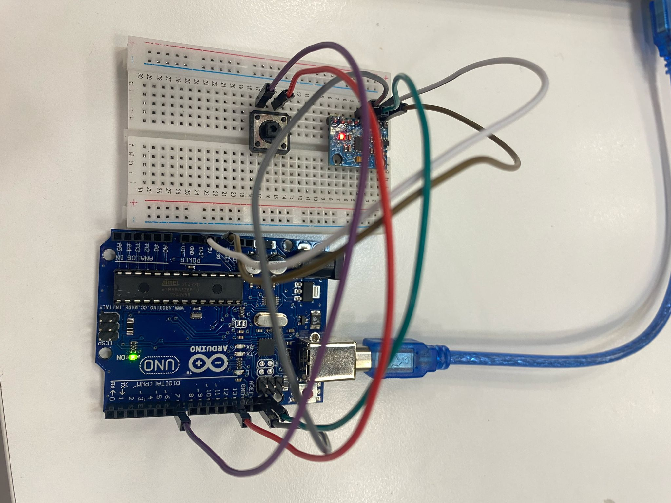
Project Overview: Scenario & Users
01
02
03
Driving the vehicle
Car accident – collision with a barrier
Providing medical
treatment

Slide 6

01
Driving the vehicle
What the Scenario Represents
The simulation represents a routine situation where the user is part of an everyday car driving scenario before a medical emergency occurs, allowing for a natural integration into the scene.
Technological Implementation
Built using Unity and C#.
Utilized the Car Controller asset for vehicle movement (acceleration, braking, steering).
Implemented Rigidbody and WheelColliders for realistic car physics and interactions.
Developed a custom camera script to dynamically follow the car and adjust angles smoothly.

Slide 7
02
Car accident
What the Scenario Represents
The simulation illustrates a sudden injury situation caused by an accident, emphasizing the need for an immediate medical response and decision-making under pressure.
Technological Implementation
Accident detection is handled using Unity’s physics system.
OnCollisionEnter function triggers when the car collides with a designated object (e.g., a barrier).
A camera shake effect enhances the collision realism.

Slide 8
03
Providing medical treatment
What the Scenario Represents
The simulation allows the user to be a part of a basic medical treatment and interact with the recovery process in a controlled environment.
Technological Implementation
An Arduino microcontroller is integrated with an MPU (Motion Processing Unit) sensor to track the injured player's movement.
The MPU detects motion changes and sends real-time data to Unity.
The Arduino code, written in C, processes motion signals and communicates with Unity via a serial connection.
A button-based healing system is implemented, requiring 10 presses to trigger recovery.
Unity responds by animating the injured character’s recovery, completing the treatment process.
Saving treatment history.

Slide 9
Expectation vs Reality
- Another scenario.
- More sensors.
VR kit.
- More explicit medical treatment.

Slide 10
THANKS!

