Slide 1
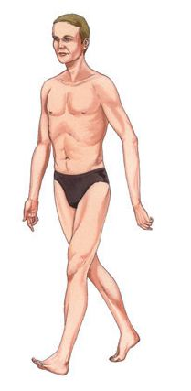
RONALDO
KHAGOKPAM

Slide 2

ANGEL

