Slide 1

ARCHITECTURAL
TECHNOLOGY
PORTFOLIO
Amy Dickson
BSV08103 CW4
Amy Dickson

Slide 2
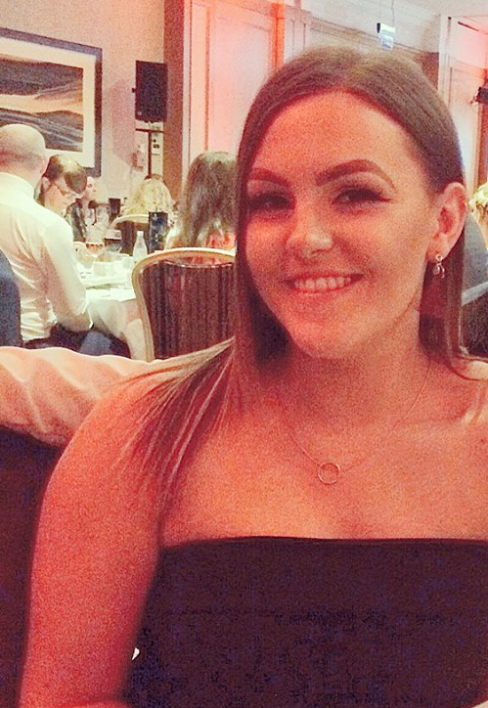



I began studying Architectural Technology in Edinburgh College from 2014-2016 where I achieved my HND with a B in my final year. In college I had the chance to begin working on Revit, study fire and safety and building construction. During my time at college I was given the opportunity to carry out work experience at Cooper Cromer in Glasgow where I had the chance to visit site and work closely with architects within the practice.
From 2016-2017 I worked as a Project Assistant at HTA Design LLP through EDT – The Year In Industry scheme gaining myself experience in both my office and administration skills but also a hands-on architecture experience.
During my time at HTA I was able to grow further in my Revit and AutoCAD skills working closely with Architects and BIM Coordinators.
Having completed my year in industry I have now began my second year at Edinburgh Napier University. Achieving an overall B in my first trimester in Year 2 and an A in my second trimester.
I am projected to graduate in 2020 with my BSC (HONS)
AMY
DICKSON
Architectural Technology Student
amyd996
amysportfolio.uk
amyd996@hotmail.com

Slide 3
AMY
DICKSON
Architectural Technology Student
amyd996
amysportfolio.uk
amyd996@hotmail.com

Slide 4
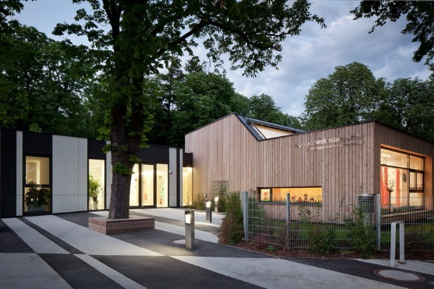
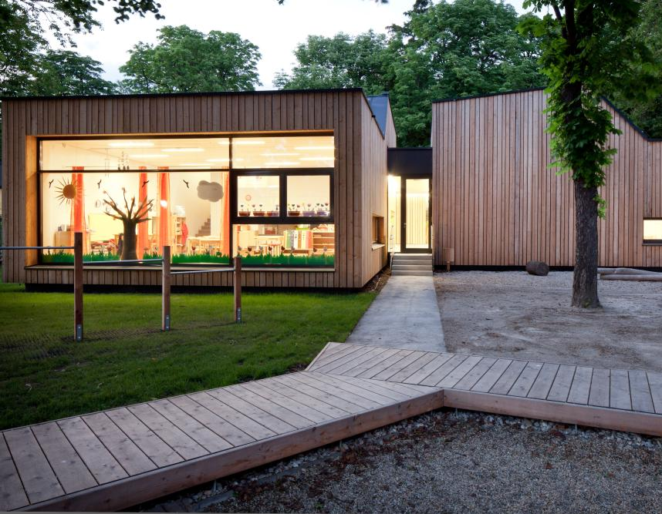
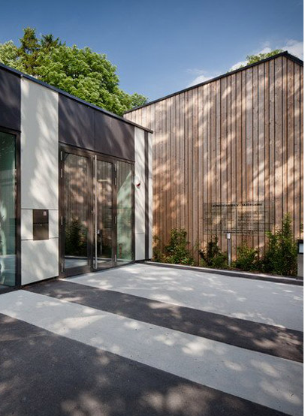
COURSEWORK 1
In coursework 1 I was asked to research the Kindergarten Guntramsdorf Friespiel situated in Guntramsdorf, South Austria.
Guntramsdorf Friespiel was designed by G.O.Y.A (Group Of Young Architects).
In this high-quality open space, the kindergarten was embedded as an open, village structure which translates from the name ‘Guntramsdorf Friespiel’ to ’Free Game.’ The architecture is divided into several buildings, thus maintaining a child-friendly scale.
I was most fascinated by this kindergarten for the clear use of differing materials to show a clear distinction between the staff and administrative spaces to the children's learning zones but for it to still appear as one connected building. I decided to develop this further and take inspiration from this to my own designs.

Slide 5
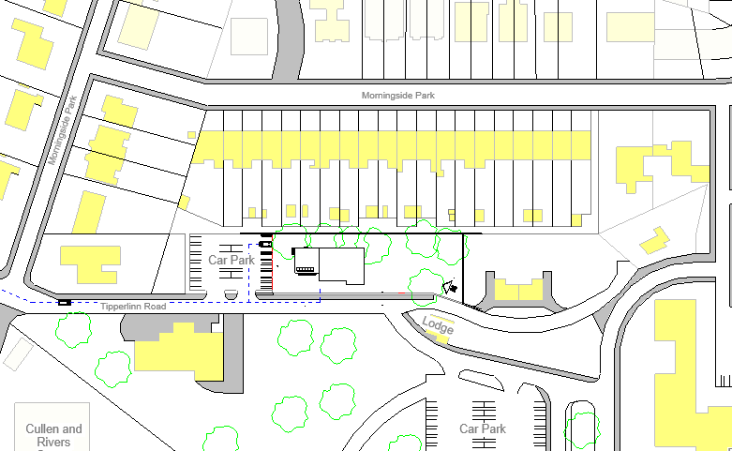
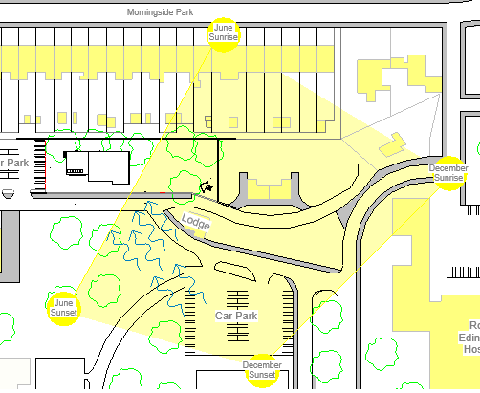




COURSEWORK 2
For coursework 2 I had been asked to further my studies from coursework 1 and create my own kindergarten looking at the criteria for a kindergarten but also the space required for the children.
When first given the site I had too consider how the site itself would actually work and where I felt would best fit my kindergarten.
Tipperlinn Road, Edinburgh
High class area, home, prices range from £500,000 to £2 million
NE sunrise to NW sunset (Jan-Jun) and SE sunrise to SW sunset (Jul-Dec)
Average temp. Ranges from 1-19 degreesC
Deliveries approaching from Colinton Road. Tipperlinn Road is a 10mph zone

Slide 6
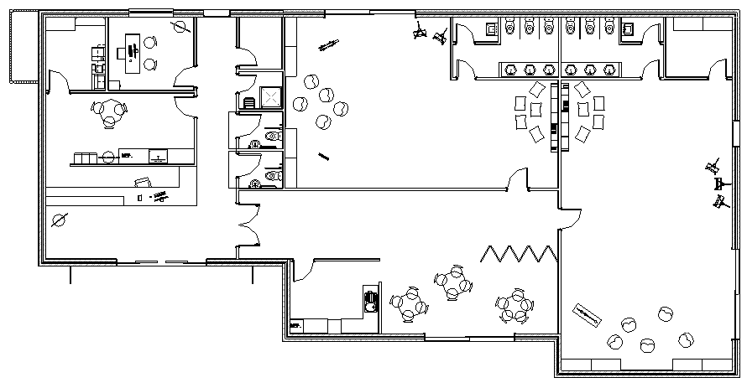
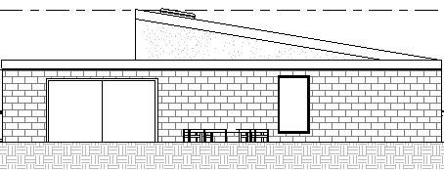
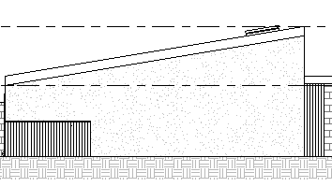
COURSEWORK 2
  The brief for coursework 2 asked for 2 group spaces (each suitable for 15 children), an internal toy store, children's toilets and cloakroom, managers office, administration office, kitchen, staff room, staff toilet, general storage and an external toy store.
  Looking at the brief and the space required for the number of children within the building, this was my concept design and the design I carried through the remainder of the coursework.
  Floor plan and elevations created on Revit.

Slide 7

COURSEWORK 2
  From research of the local area I found Tipperlinn Road to be a very close-nit village and has a lot of history behind it.
  Many years ago Tipperlinn Road was largely known for its large supply of water to Edinburgh and so the name Tipperlinn Road came about from the Gaelic translation ‘the well of the waterfall’ and so I decided to name my kindergarten Waterfall.
  As a way to in keep with the local community and understand their needs and wants I find this name as least intrusive and community welcoming.
WATERFALL
day kindergarten

Slide 8
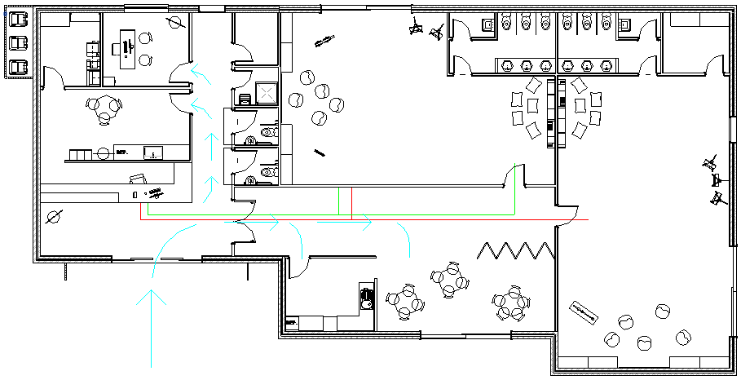
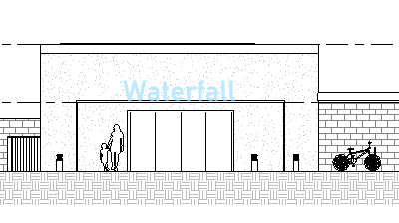
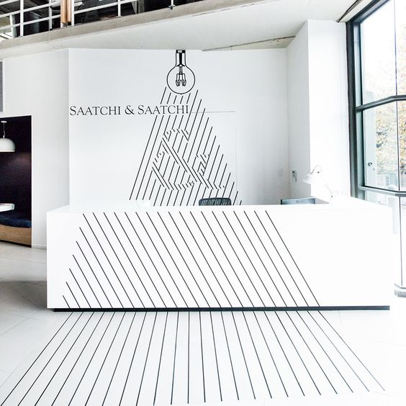
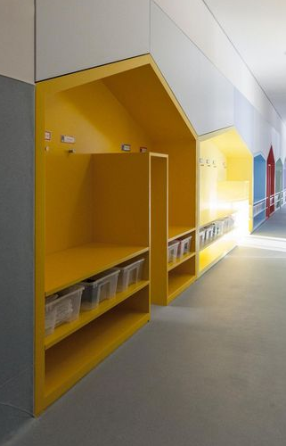
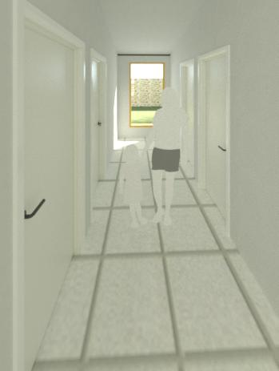
COURSEWORK 2
  The most important vision I had for my kindergarten was the flow of the building between the staff and children zones.
  I decided to take inspiration from hospitals and the use of coloured lines to direct the public to their appropriate departments and so, I incorporated this into my kindergarten allowing children and parents to enter through the main reception and towards the reception desk where the children are to follow their age groups coloured line to the ‘house’ cloakroom and onto their rooms.
  Floor plan created on Revit.

Slide 9

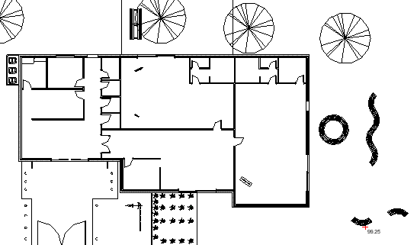
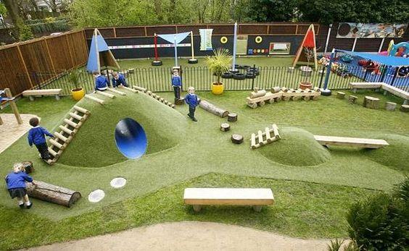
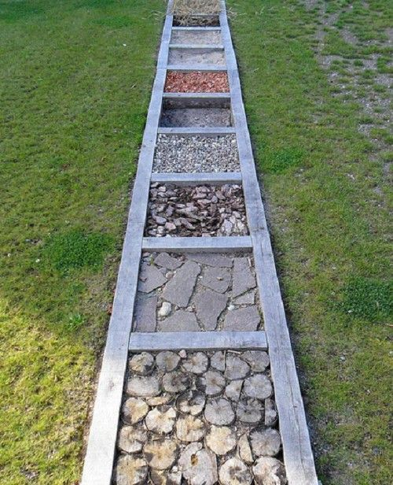
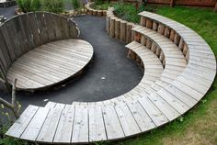
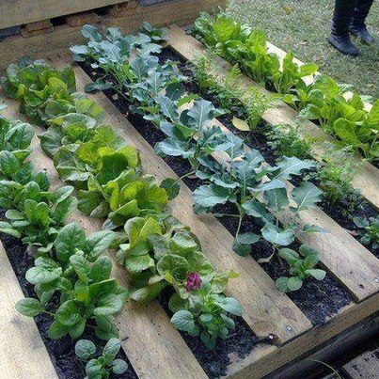
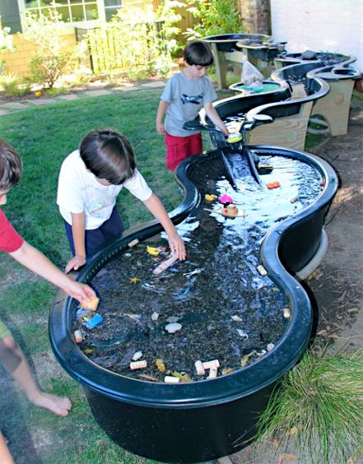

COURSEWORK 2
  The flow of Waterfall kindergarten continues throughout the building and into the landscape.
  I have three glass sliding door exits to different gardens and functions. From the 3-4 year old children’s room, the children are lead out to a senses garden where the children can grow, smell, touch and feel all different materials or objects. The central activity zone leads out to a vegetable/fruit patch where both the children attending the kindergarten and the local community could, perhaps, grow there own tomatoes and use this to make food. The final garden space leads out from the 4-5 year olds room to a further learning zone with a small auditorium space, water tables to play at and contouring landscapes.

Slide 10
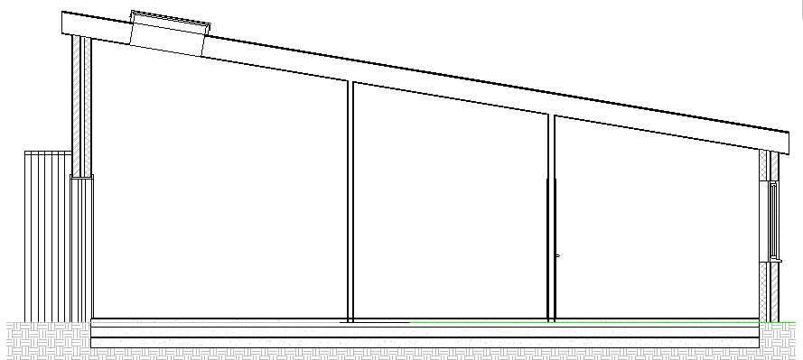

COURSEWORK 3
  In coursework 3 I was asked to give 5 further details within my kindergarten. For my coursework I decided to focus on my ground floor, external wall to lean-to roof, internal to external wall detail, external wall to flat roof detail and lean-to roof to flat roof.
  Details of the structural and architectural materials used are outlined through these sections.
Lean-to Roof to External Wall Detail
Internal to External Detail
Ground Floor Detail

Slide 11
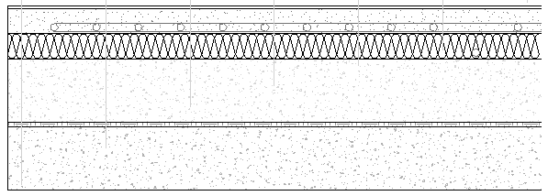


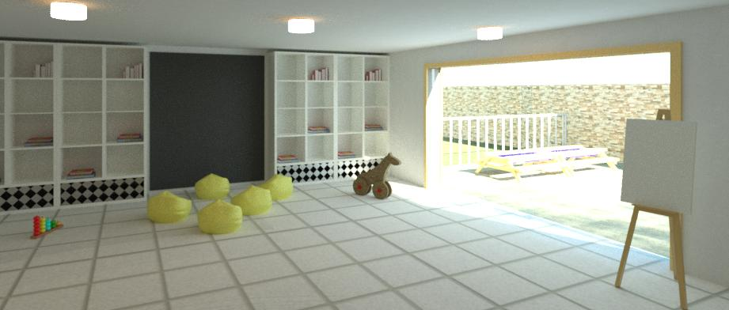
  GROUND FLOOR DETAIL
  Coursework 3
5mm White tile finish lino
60mm Concrete screed with Warm up In screed Under floor heating.
Fixing strips to be placed after pouring 20mm of concrete
Remaining 40mm concrete to be poured above.
60mm Thermafloor TF70 Insulation Board
150mm Concrete Floor Slab.
DPM
Minimum 150mm above ground.
12mm Sand
150mm Hardcore
Notes:
White lino finish. Easy maintenance. Aesthetically pleasing
Underfloor heating. No radiators. Safety
Thermafloor insulation. Resistant to water vapour. Low global warming potential
DPM to prevent moisture transmission into interior spaces
Image 1; Warmup logo Trading Depo https://www.tradingdepot.co.uk/warmup-reg-50m-in-screed-fixing-tape-istape 23.04.2018
Image 2; Kingspan logo Wikipedia https://en.wikipedia.org/wiki/Kingspan_Group 23.04.2018

Slide 12
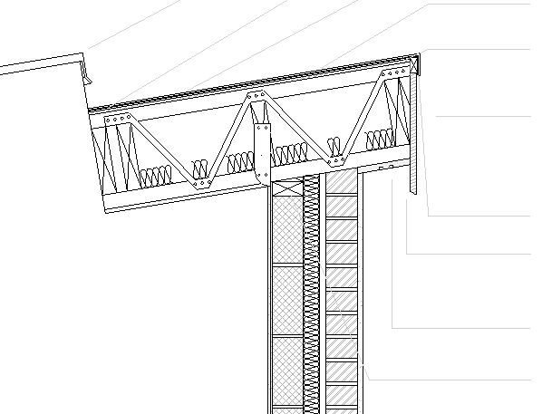


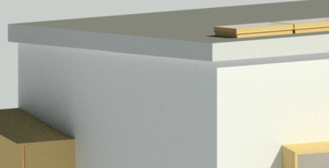
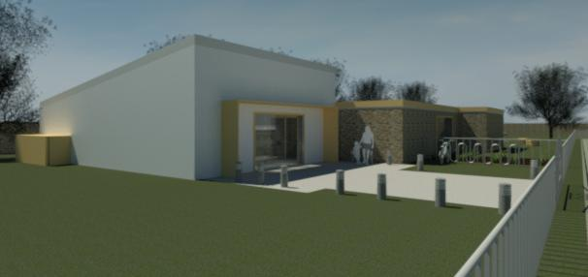
  EXTERNAL WALL to LEAN-TO ROOF DETAIL
  Coursework 3
5mm Roofing felt topped with small aggregate.
`
Vapour Retarder
304 x 47 Timber Joist at 400 centres. Span 10.45m
147 x 47 Chords to allow for services and to be filled with 60mm Rockwool Cladding Roll.
50 x 25 Treated Timber
18mm White plywood fascia.
Angled at base to provide drip
18mm plywood soffit with air vents at 45mm diameter, every 1200mm.
100 x 45mm Timber wall plate fixed with steel anchor bolts.
1200mm Twisted holding down strips fixed to internal block and up to every 3rd timber joist.
Notes:
Vapour retarder to prevent moisture transmission into interior spaces
Declivity plate for slight slope on flat roof
Timber easi-joist. Services/insulation between. Off-site construction
Soffit with air vents to allow for removal of moisture and heat in building
U-Value recommended at 0.14 for new build roofs but easi-joist in 0.195 with added plasterboard, soffit etc.
Only 4 % thermal difference between solid timber and easi-joist so can be considered the same
1hour fire resistance
Image 1; MerronBrook Premier Construction http://directory.premierconstructionnews.com/item/merronbrook/ 23.04.2018
Image 2; Rockwool Specialist Thermal Supplies http://www.specialistthermalsupplies.co.uk/Manufacturers/Rockwool.htm 23.04.2018

Slide 13
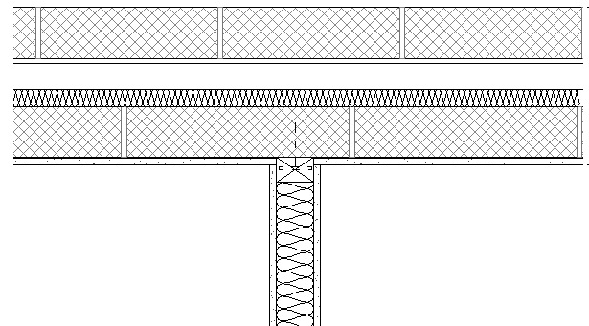
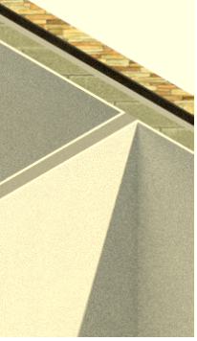
  INTERNAL WALL to EXTERNAL WALL DETAIL
  Coursework 3
Internal Timber stud partition wall is joined to brick/stone external wall with a masonry screw.
Plasterboard will be attached to timber studs with Gyproc drywall screws at 400mm horizontal planes.
Gyproc sealant can be used for optimum acoustic insulation.
Kingspan Thermawall TW55 insulation between timber studs.
Gypsum Plasterboard to wrap at internal points leaving a flush appearance
12.5 mm Gypsum Plasterboard.
FireLine plasterboard and water resistant plasterboard to be used in intermediate zones.
Notes:
Show masonry screw.
Thermawall insulation provides added acoustics between rooms
Fireline plasterboard to be used in intermediate zones. 30-60min protection
Water resistant plasterboard to be used in intermediate zones
External wall has 2-3 hour fire protection.
Image 2; Kingspan logo Wikipedia https://en.wikipedia.org/wiki/Kingspan_Group 23.04.2018

Slide 14
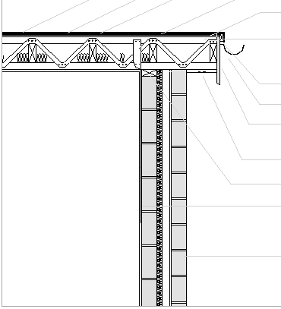
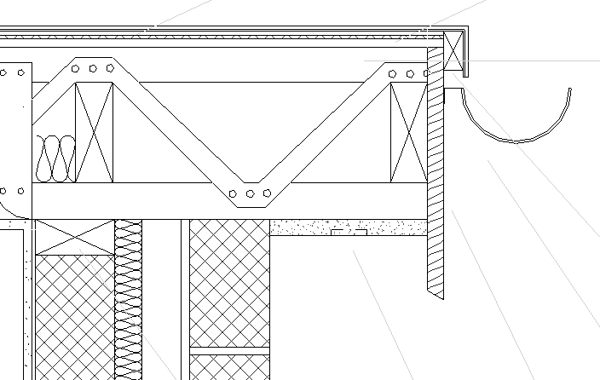
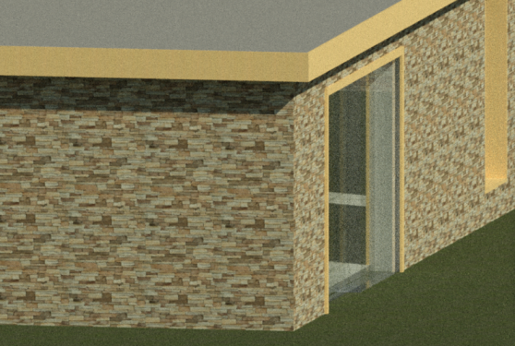
  EXTERNAL WALL to FLAT ROOF DETAIL
  Coursework 3
5mm Roofing felt topped with fine aggregate.
Felt to run to edge of roof down to gutter.
Vapour Retarder
Declivity plate to allow for degree on flat roof. 4º
219 x 47 Timber easi-Joist at 400 centres. Span 7.7m
122 x 47 Chords to allow for services and to be filled with 60mm Rockwool Cladding roll
50 x 25 Treated Timber
18mm C24 Timber fascia board.
Angled at base to provide drip
18mm plywood soffit with air vents at 45mm diameter, every 1200mm.
100 x 45mm Timber wall plate fixed with steel anchor bolts.
1200mm Twisted holding down strips fixed to internal block and up to every 3rd timber joist
Hidden in place by plasterboard
Notes:
Vapour retarder to prevent moisture transmission into interior spaces
Declivity plate for slight slope on flat roof
Timber easi-joist. Services/insulation between. Off-site construction
Soffit with air vents to allow for removal of moisture and heat in building
U-Value recommended at 0.14 for new build roofs but easi-joist in 0.229 with added plasterboard, soffit etc.
Only 4 % thermal difference between solid timber and easi-joist so can be considered the same
1hour fire resistance
Image 1; MerronBrook Premier Construction http://directory.premierconstructionnews.com/item/merronbrook/ 23.04.2018
Image 2; Rockwool Specialist Thermal Supplies http://www.specialistthermalsupplies.co.uk/Manufacturers/Rockwool.htm 23.04.2018

Slide 15
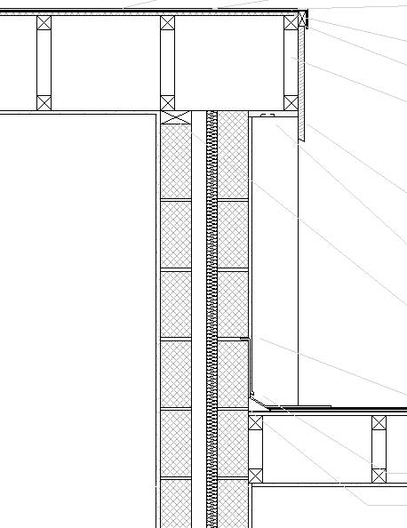
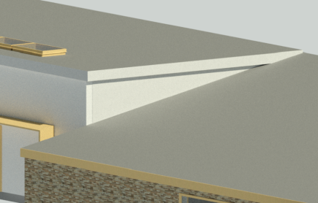
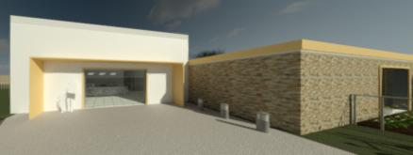
  LEAN-TO ROOF to FLAT ROOF DETAIL
  Coursework 3
5mm Roofing felt topped with small aggregate.
Vapour Retarder
304 x 47 Timber Joist at 400 centres. Span 10.45m
147 x 47 Chords to allow for services and to be filled with 60mm Rockwool Cladding Roll.
50 x 25 Treated Timber
18mm White plywood fascia.
Angled at base to provide drip
18mm plywood soffit with air vents at 45mm diameter, every 1200mm.
100 x 45mm Timber wall plate fixed with steel anchor bolts.
Led flashing.
Running into block mortar.
Render beading, dripping to led flashing
47 x 75mm Angle fillet
Notes:
Vapour retarder to prevent moisture transmission into interior spaces
Timber easi-joist. Services/insulation between. Off-site construction
Soffit with air vents to allow for removal of moisture and heat in building
U-Value recommended at 0.14 for new build roofs but easi-joist in 0.229 with added plasterboard, soffit etc.
Led flashing running into mortar of external wall to prevent passage of moisture.
Render beading with drip for weather and environmental factors
Angle fillet.
Image 1; MerronBrook Premier Construction http://directory.premierconstructionnews.com/item/merronbrook/ 23.04.2018
Image 2; Rockwool Specialist Thermal Supplies http://www.specialistthermalsupplies.co.uk/Manufacturers/Rockwool.htm 23.04.2018

Slide 16
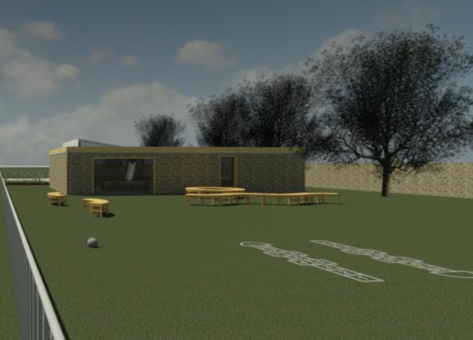
COURSEWORK 3
  Visual appearance of the building externally from entrance at the gates, North-West approach from Colinton Road and the approach from the South.
  To in keep with surrounding buildings I decided to use Ashler stone as my external material in the kindergarten zones and a white render on the staff/entrance to incorporate the use of different materials but to also create a flow between staff and children zones. This was where my inspiration from Guntramsdorf Friespiel was taken.
  Renders created on Revit.

Slide 17
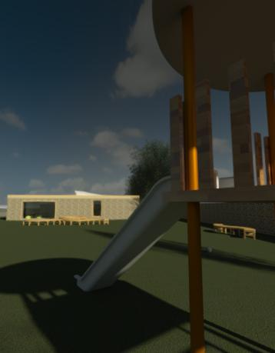
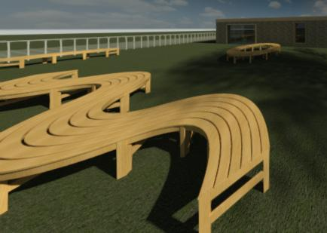
COURSEWORK 3
  Visual appearance of the building externally from the children’s outdoor play area,
  Renders created on Revit.

Slide 18
COURSEWORK 3
  Visual appearance of the building internally, 3-4 year old children's room looking out to the sense garden. Both rooms, 3-4 year olds and 4-5 year olds are similar in finish and style.
  It was my decision to leave the rooms with a lot of design opportunities for the children and the community to design and create their own safe and fun spaces.
  Renders created on Revit.

Slide 19
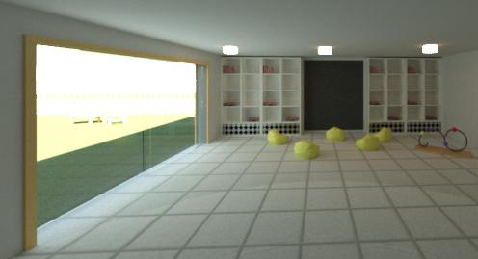
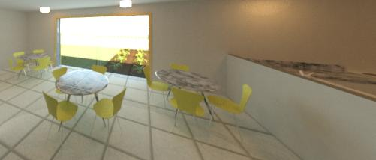
COURSEWORK 3
  Visual appearance of the building internally, 4-5 year old children's room and the central activity zone with kitchen on the right with a half partition wall and looking out to the vegetable/fruit patch.
  It was my decision to leave the rooms with a lot of design opportunities for the children and the community to design and create their own safe and fun spaces.
  Renders created on Revit.

Slide 20
COURSEWORK 4
  Overall I was and am very happy with my design.
  If I had to critic myself I wish I had gave more consideration to my spans within my building as, although I found a supplier of easi-joist, the length of the joists required for my roof were coming to the maximum length.
  One other thing I feel I would change would be to incorporate more fun elements within the children's room to allow the rooms to feel more like a kindergarten instead of leaving the entire building a blank canvas for the occupants.
WATERFALL
day kindergarten

