Slide 1



Uncovering Determinants of Income in the United States
Building a classification model using US Census archive data
06/09/2023

Slide 2

Context
Every ten years, a census is conducted to collect and organize information regarding the US population to effectively allocate billions of dollars of funding to various endeavors.
We were tasked with utilizing data analysis and machine learning to highlight the factors that influence income levels. Our objective was to build a machine learning model capable of classifying individuals into 'low income' (less than 5000) and 'high income' (greater than 5000) categories.
This mission spanned over 7 days and included the following deliverables:
A notebook and the associated environment, available on GitHub
This presentation deck

Slide 3
Data
Types of variables present in the dataset
We have 3 datasets :
Training Data: `census_income_learn.csv` - This dataset was used to train our machine learning model.
Test Data: `census_income_test.csv` - Was used to evaluate the model's performance.
Metadata: `census_income_metadata.csv` - This file contains basic information about variables, we used it to retrieve column details.
Training data
199 522 rows and 42 columns
34 categorical & 8 numerical
High-income (>$5000/year): 6.2% of dataset
Demographic Information
Income and Financial Information
Geographic and Migration Data
Veteran and Military Status
Household Information
Race and Ethnicity

Slide 4
Methodology and Selected Variables
Methodology
Selected variables
Data Importation
Handling Missing Values
Correlation Analysis
Variable Selection Based on Correlations
Variable Recategorization
Variable Selection Using L1 Regression
ElasticNet Logistic Regression
F1 Score
Class Weight 'Balanced'
L1 and L2 Penalization
GridSearchCV for Parameter Optimization
Optimizing F1 with Best Threshold
Influential Factors Analysis
 | Variable name | Variable type
1 | class_of_worker | Categorical
2 | education | Categorical
3 | marital_stat | Categorical
4 | major_industry_code | Categorical
5 | major_occupation_code | Categorical
6 | race | Categorical
7 | sex | Categorical
8 | member_of_a_labor_union | Categorical
9 | full_or_part_time_employment_stat | Categorical
10 | tax_filer_stat | Categorical
11 | detailed_household_summary_in_household | Categorical
12 | num_persons_worked_for_employer | Categorical
13 | family_members_under_18 | Categorical
14 | own_business_or_self_employed | Categorical
15 | veterans_benefits | Categorical
16 | age | Categorical
17 | weeks_worked_in_year | Categorical
18 | investment_feature | Categorical

Slide 5
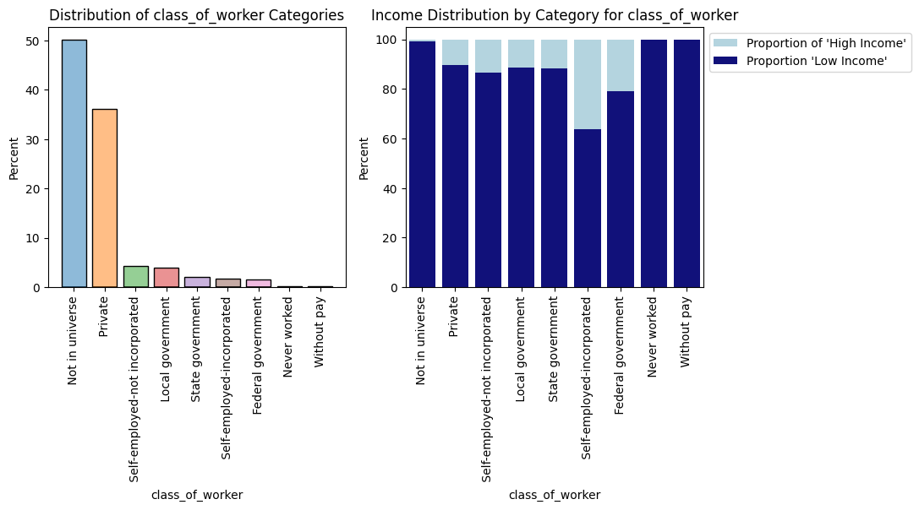
Graphical analysis
Class of worker
Key insights
State government, local government, and private employment sectors have a relatively reasonable distribution of high and low-income individuals.
Categories like "not in universe," "never worked," and "without pay" predominantly consist of individuals with low income, which is logically expected.
The federal government employment sector shows slightly higher income levels compared to the local and state government sectors.
Self-employed individuals with incorporated businesses tend to have higher incomes.

Slide 6
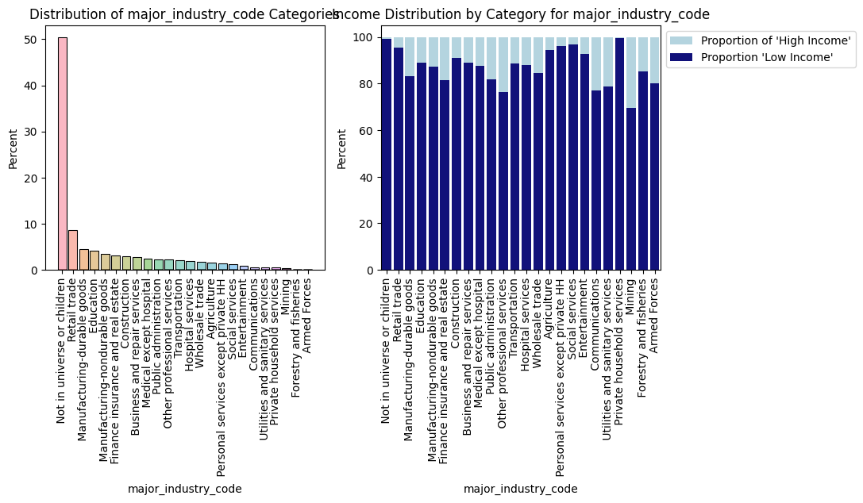
Graphical analysis
Industry
Key insights
The variable contains various categories, with "Not in universe or children" being the most common category, accounting for approximately 99.06% of the samples.
The sectors with the highest representation include Retail Trade, Manufacturing of durable goods, and Education.
Categories such as "Mining" (69.73%), "Communications" (77.09%), and "Other professional services" (76.41%) have relatively lower percentages of low-income individuals.
Categories like "Private household services" (99.45%), "Personal services except private HH" (96.29%), and "Social services" (96.69%) have higher percentages of low-income individuals.
"Private household services" has the highest percentage of low-income individuals (99.45%), indicating that a significant proportion of individuals in this category have low income.

Slide 7
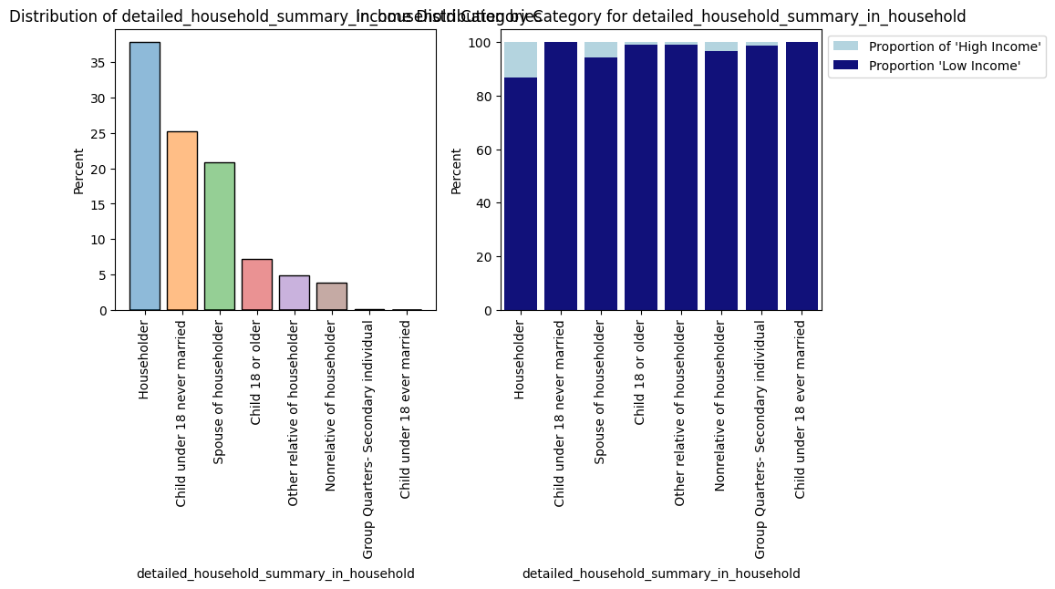
Graphical analysis
Household
Key insights
The most common household relationship category is "Householder," wich represent more than 35 % of the individuals.
The second most prevalent category is "Child under 18 never married," with around 25% of the individuals.
Householders have the highest proportion of high-income individuals, followed by spouses of householders.
Non-relatives have slightly lower incomes, while children and other relatives of householders have the lowest incomes.

Slide 8
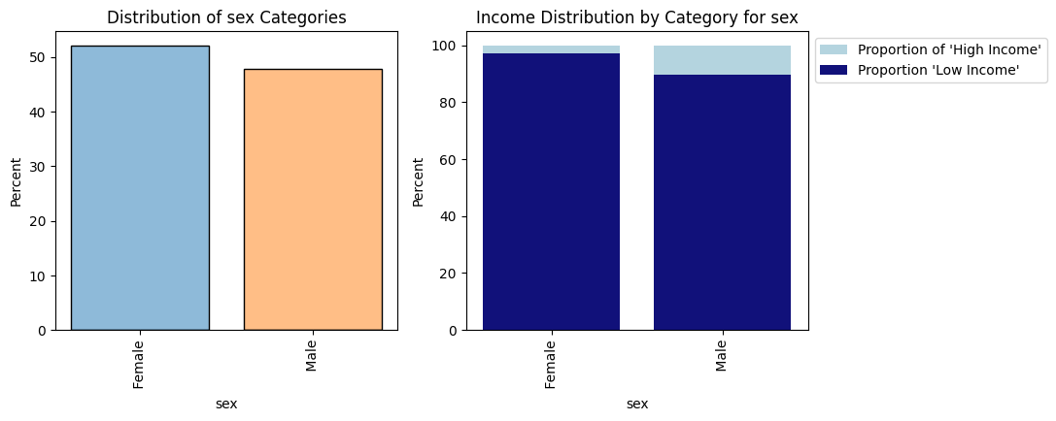
Graphical analysis
Sex
Key insights
The analysis reveals notable income disparities between the two gender categories.
Among women, a significant percentage (approximately 97.33%) fall into the "Low Income" category, indicating that a higher proportion of women in the dataset have lower incomes.
In contrast, among men, a lower percentage (approximately 89.68%) are classified as "Low Income," suggesting that a relatively smaller proportion of men have lower incomes.

Slide 9
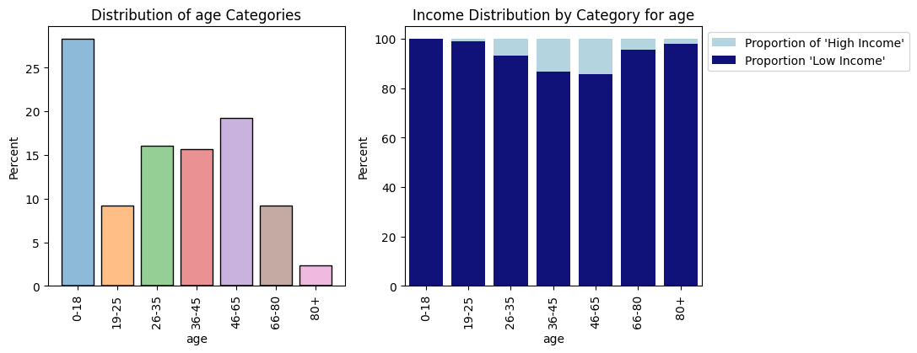
Graphical analysis
Age
Key insights
Individuals within the 0-25 age range tend to have lower incomes
While those in the 26-65 age group generally enjoy higher incomes
Beyond the age of 65, income levels tend to decline

Slide 10
Results (models)
Based on these results, the following observations can be made:
The model performs well in terms of precision and recall for class 0 (<= $ 50,000 income), with high values for both metrics.
However, the model's performance is less balanced for class 1 (> $ 50,000 income). While precision is moderate, recall is relatively low, indicating that the model tends to miss a significant portion of individuals with high income.
The F1-score for class 1 reflects this trade-off between precision and recall, resulting in a lower F1-score.
The model's overall accuracy is high, but it's important to consider the class imbalance. The high accuracy is primarily driven by the correct predictions for class 0, which is the majority class.
Classification report
 | Precision | Recall | F1-Score | Support
< $50000/year | 0.98 | 0.96 | 0.97 | 93575
>$50000/year | 0.53 | 0.63 | 0.57 | 6186
Accuracy |  |  | 0.94 | 99761
Macro Avg | 0.75 | 0.80 | 0.77 | 99761
Weighted Avg | 0.95 | 0.94 | 0.94 | 99761
Confusion matrix
 |  | ACTUAL VALUES
 |  | < $50000/year | >$50000/year
PREDICTED VALUES | >$50000/year | 90112 | 3463
 | >$50000/year | 2296 | 3890

Slide 11
Results & Recommandations
Several variables appear to have a significant impact on income levels. Below are the most influential variables found by our model and associated recommendations:
1. Women:
Recommendation: Promote gender equality in the workforce and ensure fair wages for women.
Public Endeavors: Implement policies that close the gender pay gap, support work-life balance, and encourage women's participation in higher-paying industries and leadership roles.
2. Age Category 19-25:
Recommendation: Invest in education and job opportunities for young adults.
Public Endeavors: Create apprenticeship programs, provide affordable access to higher education, and offer job placement services for this age group.
3. Social Services field:
Recommendation: Enhance career prospects and wages within the social services sector.
Public Endeavors: Increase funding for social services, provide professional development opportunities, and advocate for fair wages and benefits for workers in this field.

Slide 12
Results & Recommandations
Several variables appear to have a significant impact on income levels. Below are the most influential variables found by our model and associated recommendations:
4. Unemployed or Part-Time Workers:
Recommendation: Promote full-time employment and job stability.
Public Endeavors: Implement policies that incentivize businesses to offer full-time positions with benefits, provide unemployment assistance, and create job training programs for unemployed or part-time workers.
5. Education industry:
Recommendation: Strengthen the education sector and enhance job opportunities within it.
Public Endeavors: Invest in education infrastructure, offer competitive salaries and benefits for educators, and provide resources for students in underserved communities.
6. Class of Worker - State Government:
Recommendation: Improve compensation and career advancement opportunities for state government employees.
Public Endeavors: Review and adjust salary structures, offer professional development programs, and ensure that state government positions provide competitive compensation packages.

Slide 13

Next steps
Business check
Review the results from your perspective
Modifications
Plan a meeting for reviewing the code and the results together
On our side, apply modifications to fix potential issues
Automate your analyses
Our data expert can assist you in conducting additional analyses, automating them and build dashboard for you needs.
Engage your business experts and data team.
Confirm and validate the analysis of the project.

