Slide 1
Where Did My Money Go?
Building and analysing a personal-finance dataset of 150 Bangalore students for an AI budgeting assistant
Data collection • Exploration • Cleaning • Feature engineering • Visualisation • Q&A generation
Notes:
Overview of the end-to-end data pipeline behind the student budgeting assistant.

Slide 2
BACKGROUND
The problem: small spends, big blind spot
Students spend in many small amounts across food, travel, shopping, entertainment, subscriptions and online orders.
By month end they know the total is high, but not where it went, what was avoidable, or how to spend less next month.
Goal: an AI assistant that reads a student's monthly spending and gives personal, practical budgeting answers.
This needs a structured dataset: realistic student profiles plus the questions they ask, with answers grounded in their own numbers.
150
student-month records
12
spending categories
43
Q&A topics
2

Slide 3
APPROACH
Methodology: a six-stage data pipeline
1
2
3
4
5
6
Collect
Explore
Clean
Engineer
Visualise
Q&A
Seed sample + generation
Profile structure and quality
Fix, standardise, validate
Derive savings metrics
Charts and correlations
Personalised training pairs
Each stage reads the previous stage's CSV, so every step is reproducible and auditable.
3

Slide 4
COLLECT
Stage 1: data source and design
Seed sample: 67 expense line items across 7 student profiles (PG, hostel, BMTC, home, two-wheeler), with source notes on Bangalore rent, mess, bus pass and petrol costs.
Expanded to 150 student-month records using profile-specific spending ranges, with a random "spender factor" so students differ.
Added a Namma Metro profile, an Online Purchases category, and wider allowance brackets for part-time earners.
Parents-paid rent and mess are flagged and excluded from the student's own spending.
Months: Sep-Nov 2026, with higher shopping in the festive months.
Group | Columns
Profile | type, course, year, age, locality
Income | allowance, part-time, bracket
Spending | rent, mess, food, transport, mobile, subscriptions, education, care, health, fun, shopping, online, other
Behaviour | payment method, rent paid by
The data is synthetic, generated from the seed profiles. It models realistic patterns but is not survey data.
4

Slide 5
EXPLORE
Stage 2: exploration found 11 data-quality issues
Issue | Rows
Exact duplicate records | 6
Missing payment method / age / locality | 6 / 5 / 3
Inconsistent city, locality and payment spelling | 15 / 12 / 8
Amounts stored as text ("₹19,500", "1200/-") | 8
Negative amount (sign typo) | 1
Spend larger than total income (extra-zero typo) | 3
Constant column (data_origin) | 150
Raw file: 156 rows, 28 columns.
Checked column types, null counts, unique values and 5-number summaries.
Max shopping spend (₹23,600) vs median (₹1,640) exposed the outliers.
Outputs: 02a overview, 02b numeric summary, 02c issue register.
5

Slide 6
CLEAN
Stage 3: cleaning, with every change logged
Step | Action | Changed
1 | Removed exact duplicates | 6
2 | Standardised city, locality, payment text | 14 / 10 / 8
3 | Converted ₹/comma/"/-" text to numbers | 8
4 | Corrected negative amount | 1
5 | Fixed extra-zero typos (÷10) | 3
6 | Filled missing values (age by median, "Not provided", "Not specified") | 5 / 6 / 3
7 | Re-derived brackets, dropped constant column | 1 col
8 | Validated: no nulls, unique IDs, no negatives | 150 rows
Outlier rule: a non-rent spend above the student's whole income is impossible, so it was treated as a typo.
6

Slide 7
ENGINEER
Stage 4: feature engineering
total_spend and own_spend (excluding costs parents pay)
total_income = allowance + part-time income
savings = income - own_spend; savings_rate %
top_expense_category
spending_status: Overspending, Low savings (<10%), Healthy savings
49%
21%
30%
Healthy savings (74)
Low savings (31)
Overspending (45)
Average income / own spend / savings
Healthy: ₹12,296 / ₹9,738 / +₹2,558
Low: ₹11,955 / ₹11,194 / +₹761
Overspending: ₹8,978 / ₹9,909 / -₹931
Overspenders earn about 27% less than healthy savers while spending about the same.
7

Slide 8
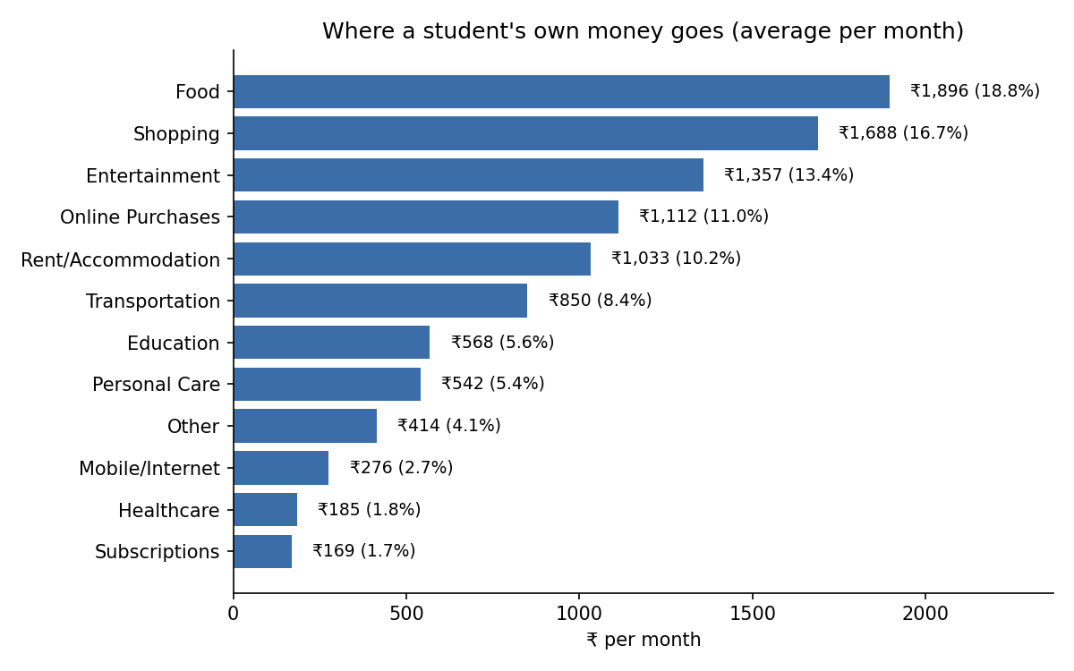
VISUALISE
Finding 1: four flexible categories take 60% of spending
Food (18.8%), shopping (16.7%), entertainment (13.4%) and online purchases (11.0%) lead.
All four are choices, not fixed bills.
Subscriptions are only 1.7%, so small recurring plans are not the main leak.
Savings advice should target eating out, shopping, outings and online orders first.
8

Slide 9
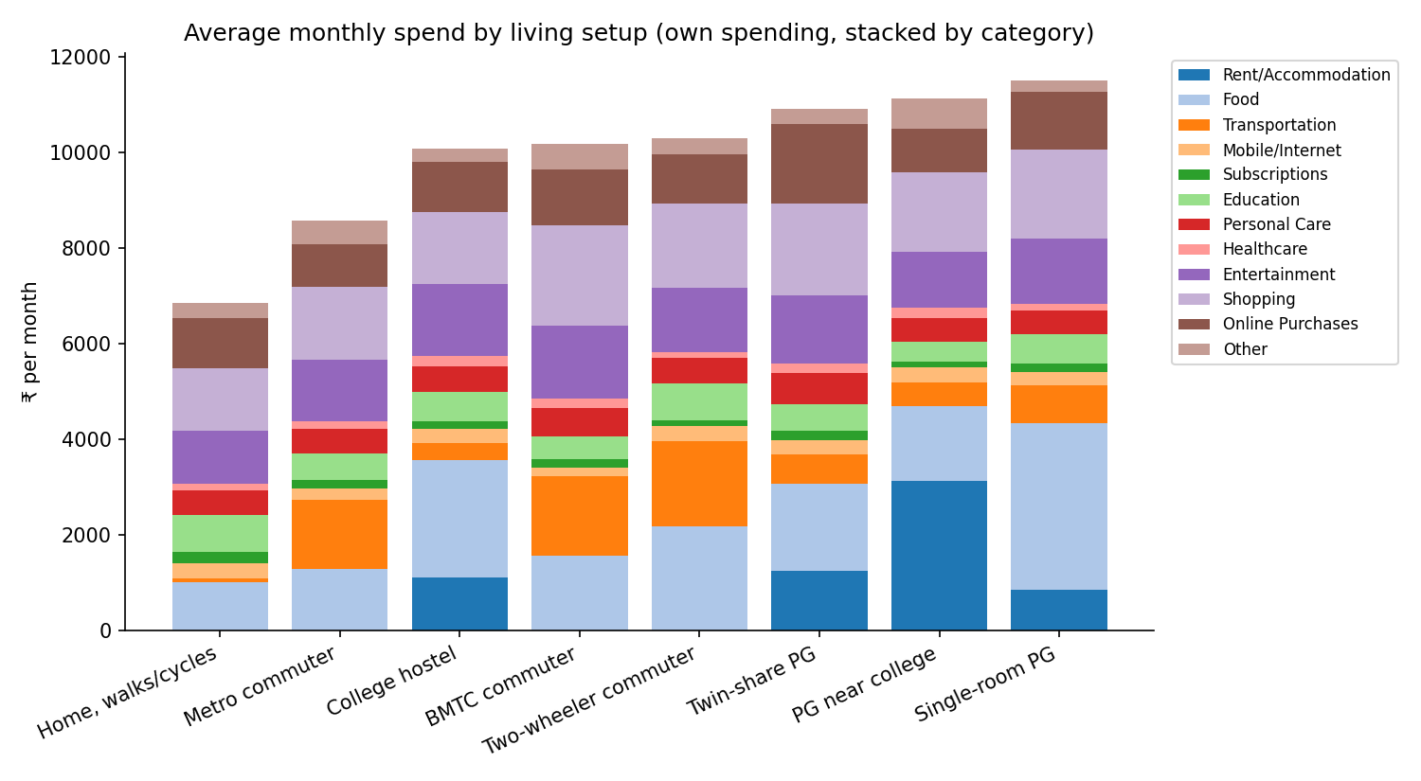
VISUALISE
Finding 2: living setup changes the mix, not the total
Own spending ranges from about ₹6,900 (home, walks) to ₹11,500 (single-room PG).
Rent and food dominate PG students; transport dominates commuters.
Discretionary spending is similar across groups.
Profile type must be a model input, since the same question needs a different answer per setup.
9

Slide 10
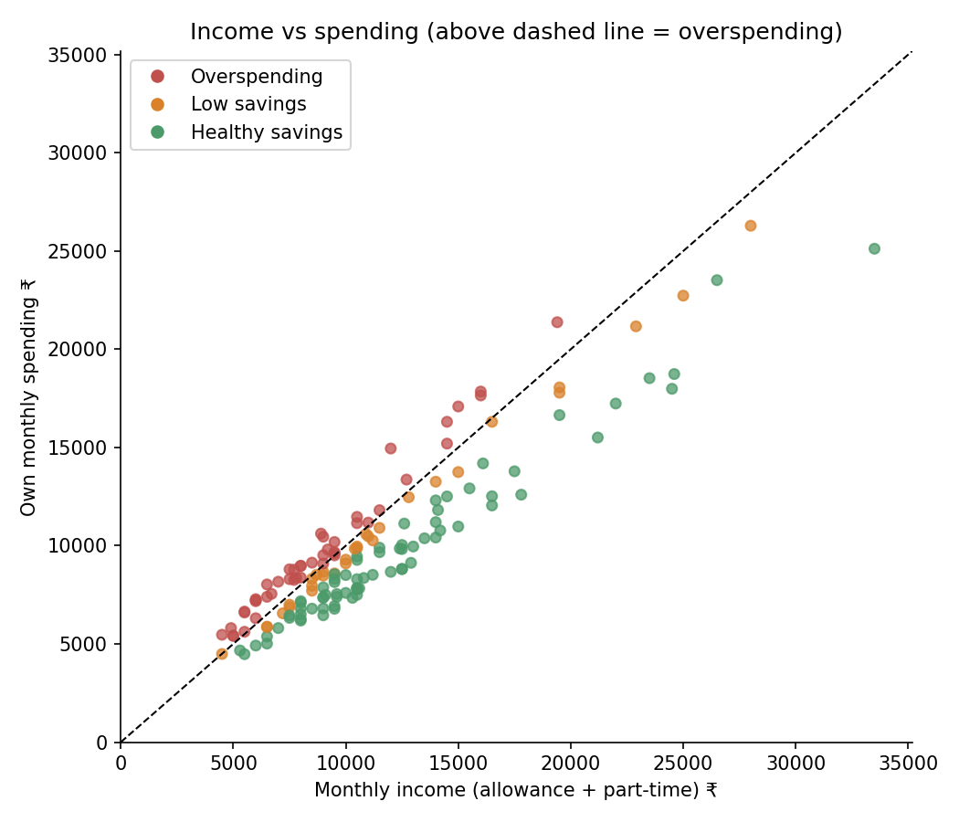
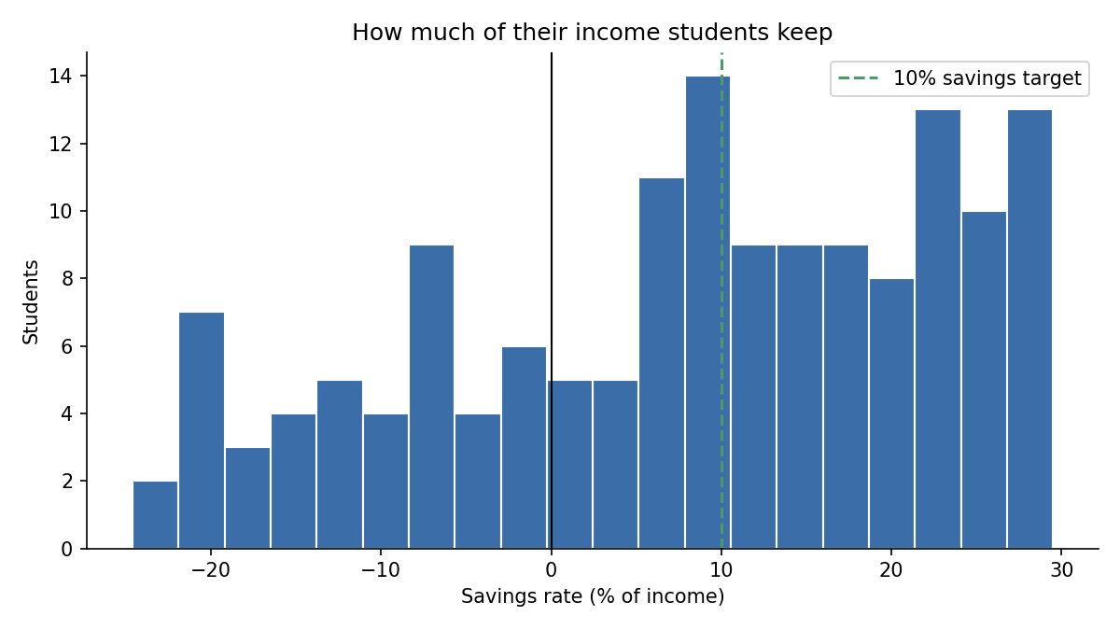
VISUALISE
Finding 3: spending tracks income, savings vary widely
Income and own spend correlate at r = 0.93; 30% of students sit above the break-even line.
Students scale spending to what they receive, so the habit matters more than the amount.
10

Slide 11
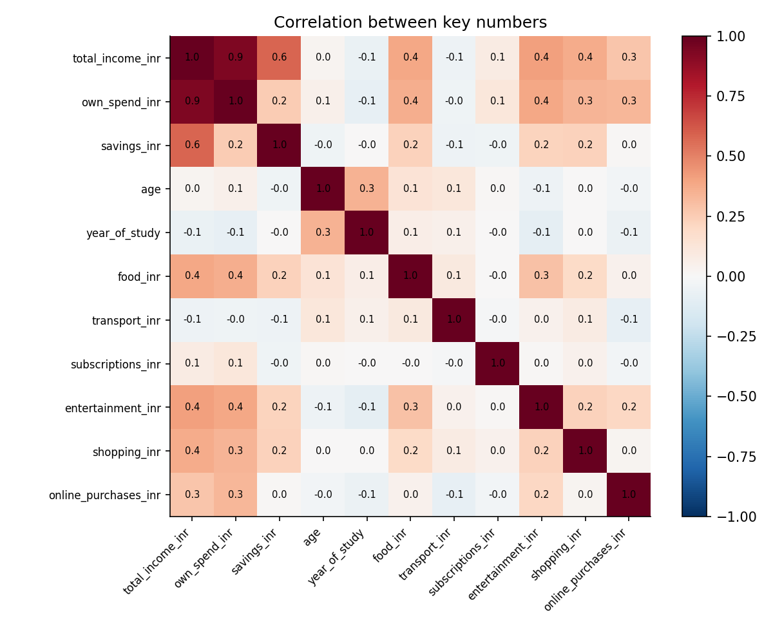
VISUALISE
Finding 4: festive months lift shopping by about 40%
Month | Shopping | Online | Own spend
Sep | ₹1,302 | ₹895 | ₹9,097
Oct | ₹1,786 | ₹1,331 | ₹10,906
Nov | ₹1,899 | ₹1,121 | ₹10,255
Average own spend rose about 20% from Sep to Oct.
Shopping and online spending rise together in festive months.
The assistant should warn students before Diwali-sale months and suggest a festival cap.
11

Slide 12
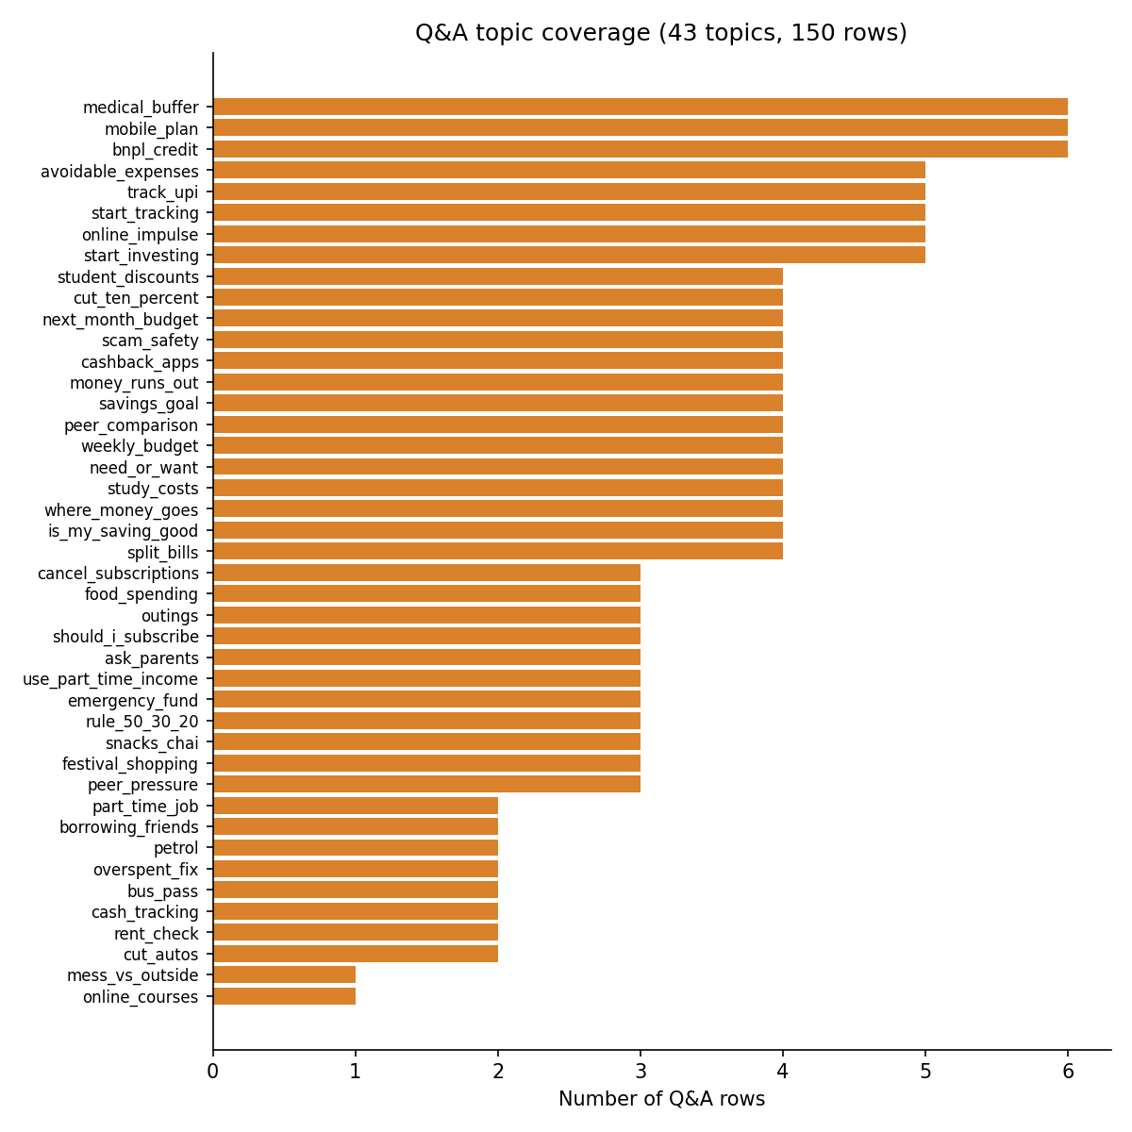
Q&A GENERATION
Stage 6: personalised Q&A for every student
Q: I spent more than I received this month. How do I fix this?
A: You spent ₹21,377 against an income of ₹19,400, so you were short by ₹1,977. Your largest flexible spend was shopping at ₹2,310; trimming it by 25% frees ₹578. After fixed costs you have about ₹1,247 a week, so use that as a weekly cap.
43 topics, each asked only of students it fits
Answers use the student's own figures
40% of questions include profile context
Final file: 04_final_dataset_with_QnA.csv (150 rows, Question and Answer as last columns).
12

Slide 13
CONCLUSION
Limitations and next steps
Limitations
Next steps
Synthetic data: patterns are plausible, not observed.
150 rows suits fine-tuning or retrieval, not training from scratch.
Answers are templated; general guidance, not financial advice.
Validate with a real survey of Bangalore students.
Add more question wordings per topic.
Multi-month records to detect trends.
Evaluate answer quality with student testers.
The pipeline is reproducible: swap in real responses and every stage reruns unchanged.
13

