Slide 2
API FOUNDATIONS
Module 01 · Python Backend Track
REST APIs & FastAPI
AUDIENCE
FORMAT
GOAL
Intermediate Python developers
Concept overview
Understand what each is & why it matters

Slide 3
01 FOUNDATIONS
api.py
What is an API?
Application Programming Interface
A contract between two pieces of software. One side asks for something; the other side answers , in a format both have agreed on.
YOU ASK
GET /users/42
A clear, agreed-upon request.
↓
It hides the implementation. The caller doesn't need to know how the work gets done — only how to ask and what to expect back.
IT ANSWERS
{ "id": 42, "name": "Ada" }
A predictable, structured response.
REST APIs & FastAPI
02

Slide 4
02 THE MENTAL MODEL
Client & Server
Every web API conversation has two roles, and they always talk in the same direction.
CLIENT
SERVER
Initiates.
Responds.
Software that needs data or wants to trigger a change. Sends requests, waits for replies.
→ request
Software that owns the data and the rules. Listens for requests, runs the work, sends a reply.
← response
browser · mobile app · cURL · another service
FastAPI app · database-backed service
REST APIs & FastAPI
03

Slide 5
03 THE STYLE
What is REST?
Representational State Transfer
A resource lives at a URL:
An architectural style for designing networked APIs over HTTP. Not a framework, not a protocol — a set of conventions.
// the resource /users/42 // the actions GET /users/42 PUT /users/42 DELETE /users/42
REST treats your system as a collection of resources — users, orders, posts — each with a stable URL. You act on those resources using standard HTTP verbs.
Same URL. Different verb. Different intent.
REST APIs & FastAPI
04

Slide 6
04 THE CONVENTIONS
REST Principles
Five conventions that make a REST API recognizable and predictable.
01
Resource-oriented URLs
02
Uniform interface
Nouns, not verbs. /orders/17 , not /getOrder?id=17.
A small, fixed set of HTTP verbs (GET, POST, PUT, PATCH, DELETE) for every resource.
03
Stateless
04
Representations
Each request carries everything the server needs. No session memory between calls.
The server sends a representation of the resource — almost always JSON — not the resource itself.
05
Standard status codes
The HTTP status tells the client what happened, before they even read the body.
REST APIs & FastAPI
05

Slide 7
05 THE VERBS
HTTP Methods
Five verbs cover almost every operation a REST API exposes.
METHOD
INTENT
EXAMPLE
SAFE?
GET
Read a resource
GET /users/42
Yes · idempotent
POST
Create a new resource
POST /users
No · not idempotent
PUT
Replace a resource
PUT /users/42
No · idempotent
PATCH
Partially update
PATCH /users/42
No · idempotent*
DELETE
Remove a resource
DELETE /users/42
No · idempotent
REST APIs & FastAPI
06

Slide 8
06 THE REPLY CHANNEL
Status Codes
A three-digit number that tells the client what happened — by family.
1xx
2xx
3xx
4xx
5xx
Informational
Success
Redirection
Client error
Server error
Rare in app code. Hop-by-hop signals.
200 OK 201 Created 204 No Content
301 Moved 304 Not Modified
400 Bad Request 401 Unauthorized 404 Not Found
500 Internal 502 Bad Gateway 503 Unavailable
REST APIs & FastAPI
07

Slide 9
07 THE PAYLOAD
JSON: the common language
REST is verb-and-URL. JSON is what travels in the body — both ways.
A typical response body:
Human-readable.
Plain text. You can read it without tools.
{ "id": 42 ,
"name": "Ada Lovelace" ,
"active": true ,
"roles": ["admin", "author"] ,
"profile": { "city": "London" } }
Language-agnostic.
Every modern language has a parser built in.
Structured.
Nested objects, arrays, primitives — enough for most domains.
Sent as application/json.
The Content-Type header tells the receiver how to parse.
REST APIs & FastAPI
08

Slide 10
08 CONTEXT
Other API styles
REST is dominant, not exclusive. A quick orientation.
MOST COMMON
QUERY-SHAPED
ACTION-SHAPED
REST over HTTP + JSON
GraphQL POST /graphql
RPC gRPC, JSON-RPC
Resources at URLs, standard verbs, status codes. Easy to cache, easy to debug, easy to learn.
One endpoint. Clients describe exactly which fields they want; server returns that shape. Great for complex front-ends, more setup.
You call functions, not resources. Strict schemas, fast binary formats. Common between internal services.
STREAMING
SERVER PUSH
ASYNC
WebSockets ws://
SSE text/event-stream
Webhooks POST callback
Long-lived two-way connection. For chat, live updates, multiplayer — anywhere request/response is too slow.
Server streams events to client over plain HTTP. Simpler than WebSockets when only one direction is needed.
Inverted: the server calls you when something happens. Used for events, integrations, payments.
REST APIs & FastAPI
09

Slide 11
09 THE STACK
Where FastAPI fits
REST and HTTP are the rules. FastAPI is the tool you use to play by them — in Python.
CLIENT
Whoever is calling your API
browser, mobile app, cURL
PROTOCOL
HTTP · the transport & verb system
GET, POST, status codes, headers
STYLE
REST · the design conventions
resources, URLs, JSON
FRAMEWORK
FastAPI · turns Python functions into endpoints
@app.get, @app.post …
RUNTIME
ASGI server · runs your app, handles connections
uvicorn, hypercorn
YOUR CODE
Business logic, database, services
Python · SQLAlchemy · …
REST APIs & FastAPI
10

Slide 12
10 THE VALUE
Why FastAPI?
It does the boring parts of building a REST API for you, well, by default.
Py
Type hints become the API
✓
Validation, free
A function's parameter types and return type define the request shape, the response shape, and the validation rules.
Pydantic checks every incoming payload against your types. Bad input gets a clean 422 — your handler never sees it.
⌁
Async by default
📖
Auto docs
Built on ASGI. Use async def handlers when you want concurrency for I/O.
Interactive Swagger UI and ReDoc generated from your code, kept in sync automatically.
⚡
Fast
∴
Dependency injection
Among the fastest Python web frameworks — performance close to Node and Go for typical I/O workloads.
Auth, DB sessions, config — declared as function parameters and resolved by the framework.
REST APIs & FastAPI
11

Slide 13
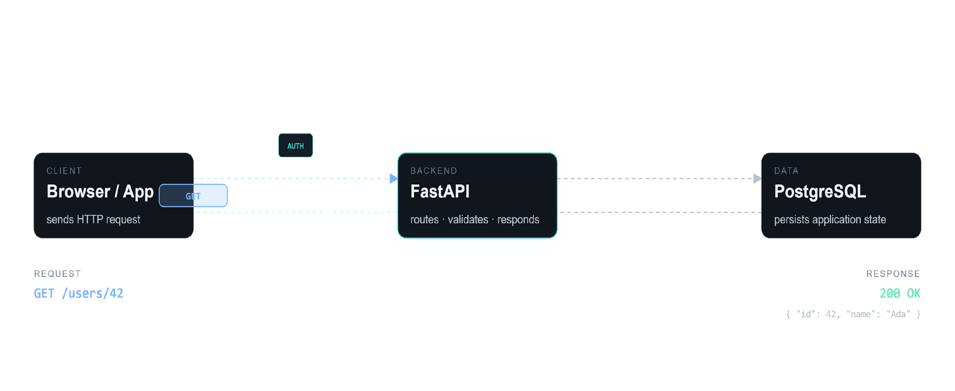
11½ SEE IT MOVE
Toggle Tweaks (top toolbar) to change the request & architecture
Frontend ↔ FastAPI ↔ Database
↻ REPLAY
Tweaks
✕
SCENARIO
Request
Animation speed
0.75×
ARCHITECTURE
Database
Auth gate
Cache layer
External service
STYLE
REST APIs & FastAPI
Labels
12
verbose
minimal

Slide 14
11 END TO END
A request, end to end
What happens between GET /users/42 and the JSON that comes back.
01 · Client
02 · ASGI server
03 · FastAPI
04 · Your code
05 · FastAPI
Sends request
Accepts & parses
Routes & validates
Runs the work
Serializes & sends
Method, URL, headers, optional body. Travels over HTTP.
Uvicorn handles the socket and hands a structured request to FastAPI.
Matches URL to a handler. Pydantic validates inputs against your type hints.
Query the DB, call services, build the result object.
Result becomes JSON, with the right status code and headers. Back to the client.
YOU WRITE STEP 4
FastAPI handles steps 2, 3, and 5. You almost never touch them.
REST APIs & FastAPI
14

Slide 15
12 RECAP
Three things to keep.
01
An API is a contract.
Predictable requests, predictable responses, hidden implementation.
02
REST is the dominant style for web APIs.
Resources at URLs · standard HTTP verbs · status codes · JSON bodies.
03
FastAPI is how Python developers ship REST.
Type hints become the schema, validation, and docs — so you write the logic, not the plumbing.
Up next
Building your first endpoint
END OF MODULE 01

