Slide 1
ANN - Lab 3
Feiyang Liu Junxun Luo
Feb 15th, 2017

Slide 2
The Lab is about...
Self-Organizing Maps (SOM) algorithm
Its practical uses
Folding high-dimensional spaces
Cluster data

Slide 3
SOM is ...
Mapping points in input space to those in output space
Topology preservation: close input points → close output points

Slide 4
How it works...
Training examples
Calculate similarity
Euclidian or Manhattan distance
Search for winner
Define neighborhood
One or two dimension
Update weights
Weight vectors

Slide 5
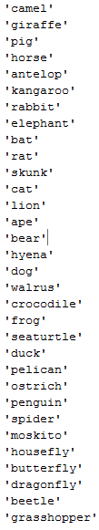
Topological Ordering of Animal Species
Observations:
Good clustering
Node index

Slide 6
Cyclic Tour
Observations:
Tend to find a fairly short route which passes all cities

Slide 7
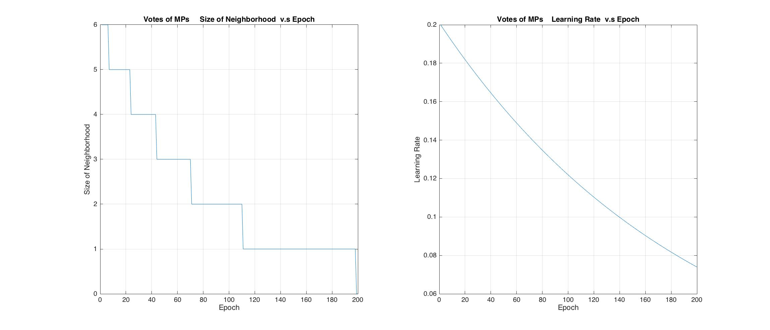
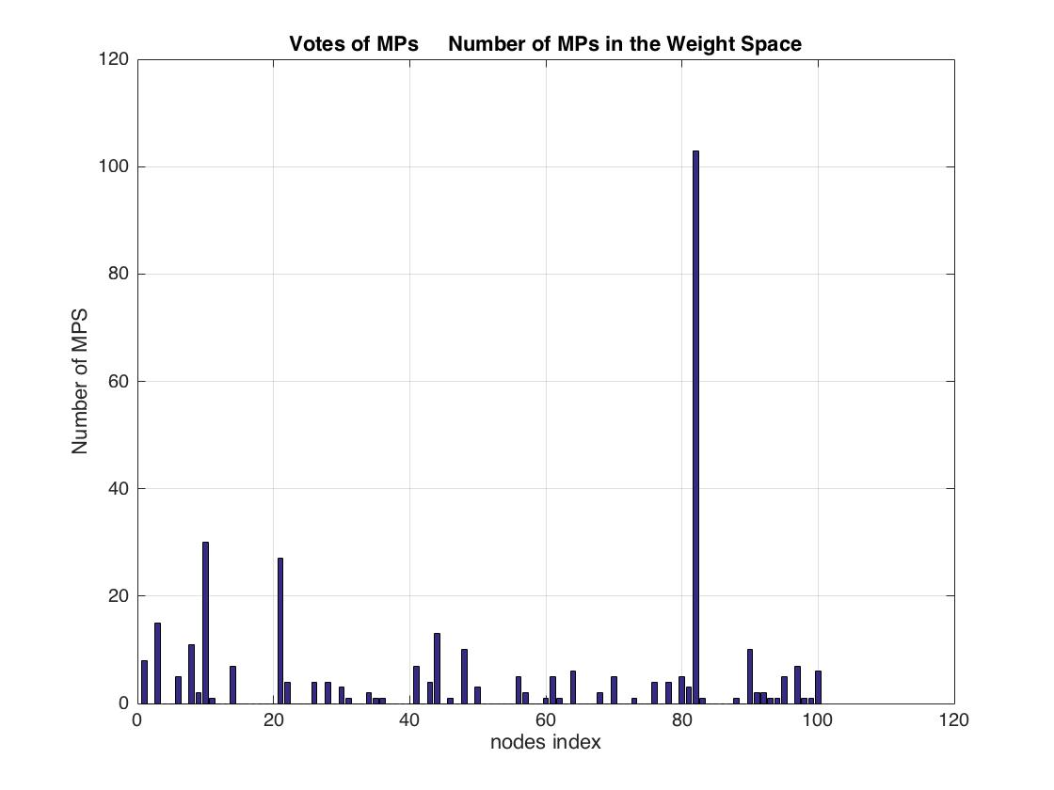
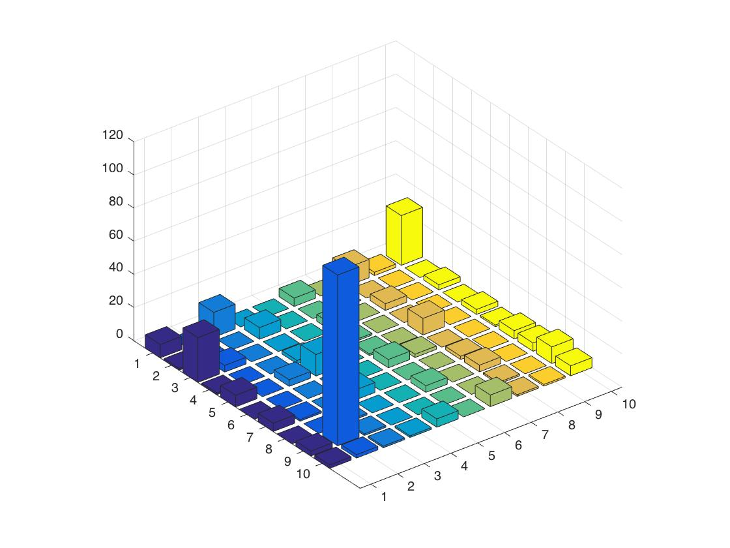
Votes of MPs

Slide 8
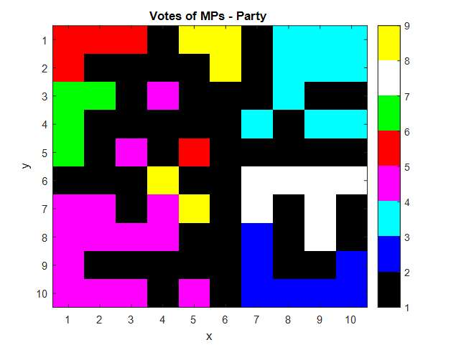
Votes of MPs
Observations:
Different parties tend to vote differently

Slide 9
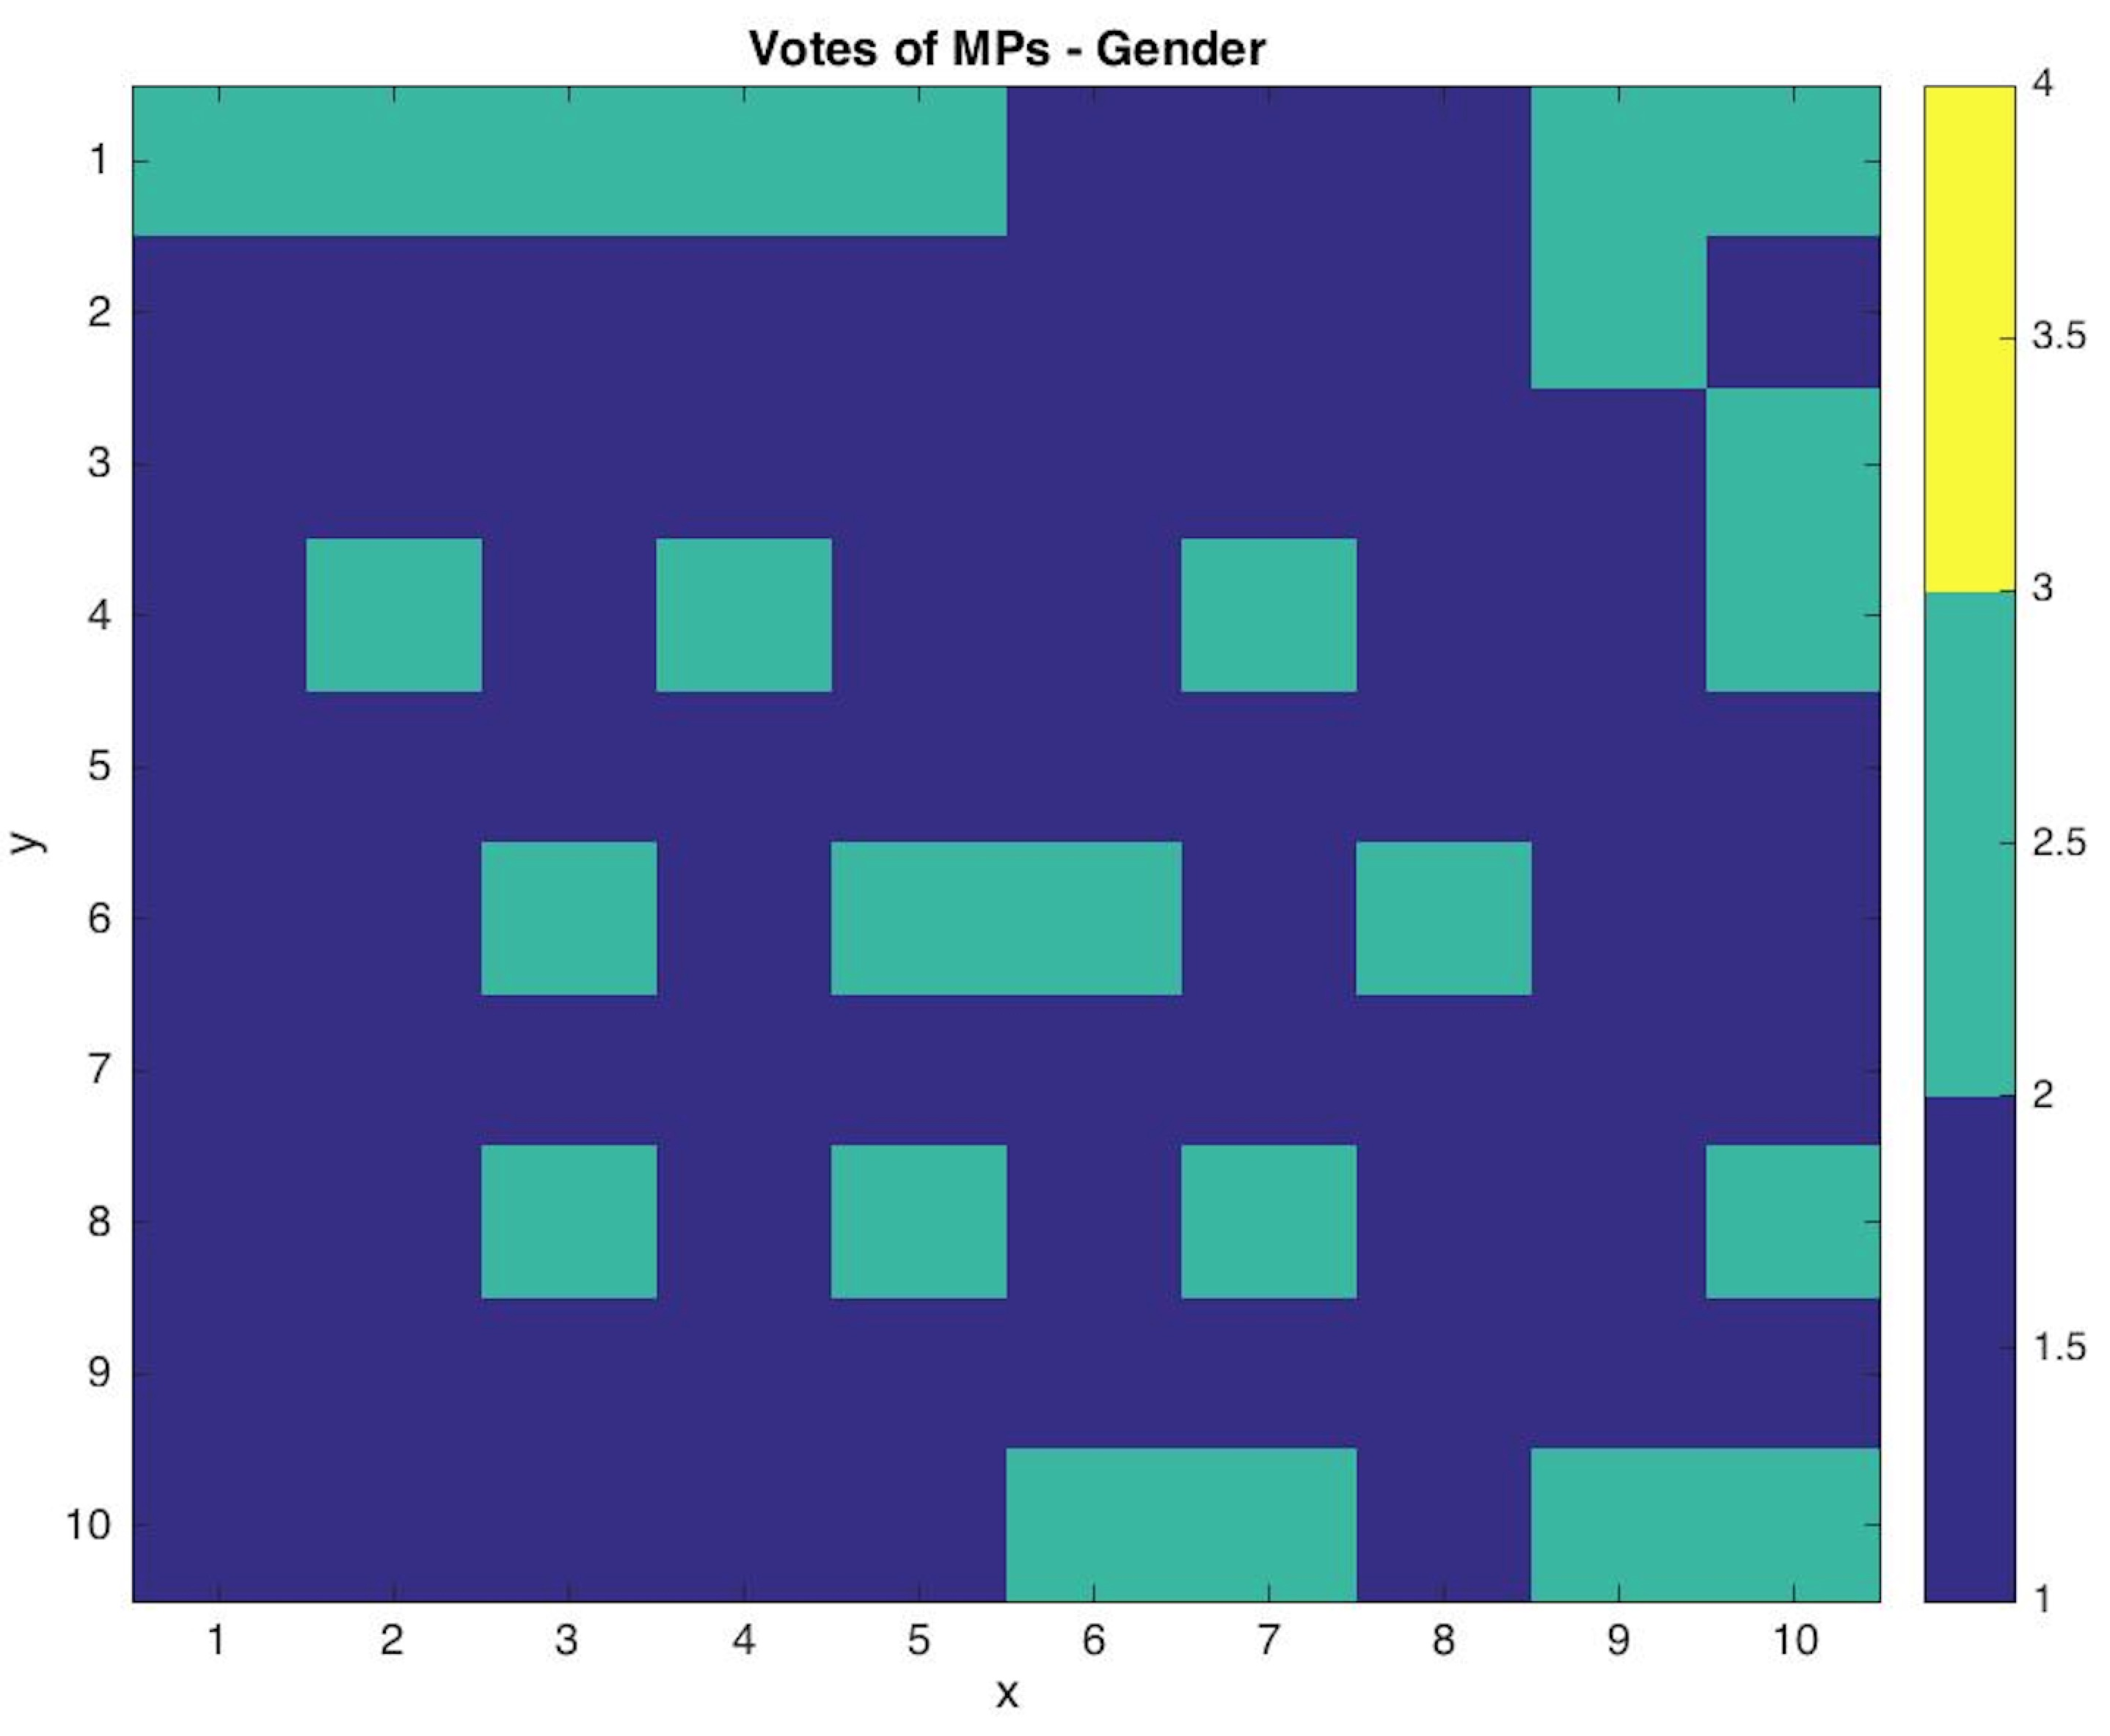
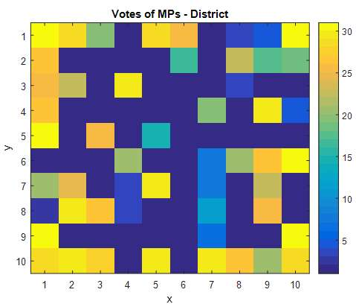
Votes of MPs
Observations:
No rules can be found for different genders of MPs
No rules can be found for different districts where the MPs are from

