Slide 1
KSA: Backend Workshop
James F. Roncesvalles

Slide 2
Goals of this course
Understand basic and advance concepts of PHP
Undestand basic and advance concepts of mysql and database relationship
Able to integrate front end application to your backend
Be knowledgeable in creating API’s
Be the best developer that you can be

Slide 3
Our MOTTO
Lahat Kaya
Walang susuko
Lahat nasesearch

Slide 4
Professors Background

Slide 5
Educational Background
Graduated in Polytechnic University of the Philippines
President of the IT / DICT Organization 2015
Information Technology Major in Programming
Top Performer inline with Programming, Database, Leadership subjects

Slide 6
Professional Background
Having 4 years of web development industry, strongly inclined with backend development.
Programming language known: Java, PHP, C#, Nodejs, Vb6, VB.net
Programming languate mastered: PHP, Nodejs
Currently as Fullstack Developer (Freelance)

Slide 7
Our Timeline
WEEK 1 | WEEK 2 | WEEK 3 | WEEK 4 | WEEK 5
Intro / Review to Javascript | PHP PART 2 | Object Oriented Programming | Database MYSQL | REVIEW / RECAP / QUESTION / SHOWTIME
PHP PART 1 | API CREATION | API CREATION | API CREATION | CHECKING OF YOUR PROGRESS

Slide 8
1st TOPIC: Javascript
JavaScript (JS) is a lightweight, interpreted, or just-in-time compiled programming language
Used in Web / Front End Development
was created by Brendan Eich in 1995
Now it is being used in backend development, Node.js

Slide 9
Jquery
The Write Less, Do More, JavaScript Library
is a JavaScript library designed to simplify HTML DOM tree traversal and manipulation, as well as event handling, CSS animation, and Ajax

Slide 10
Click Events

Slide 11
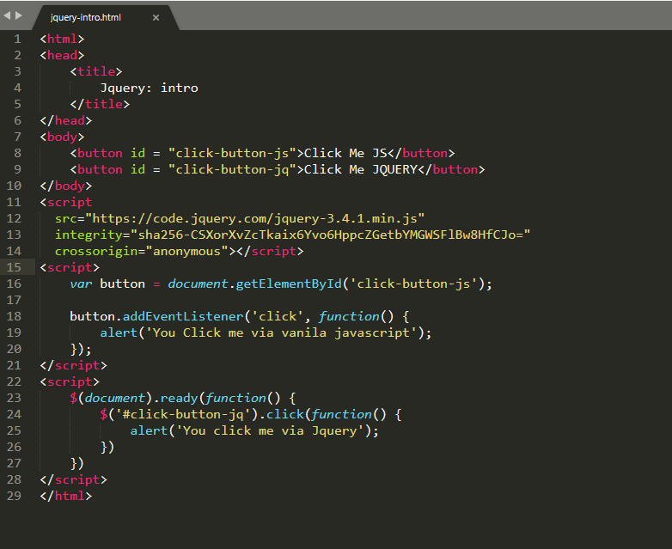
Imagine
When we map an element in our web pages using normal javascript we do

Slide 12
On Change

Slide 13
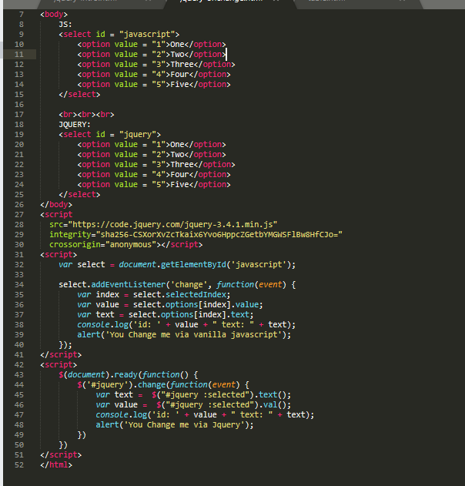

Slide 14
Connecting Front end to Backend

Slide 15
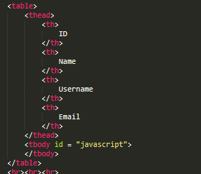

Slide 16
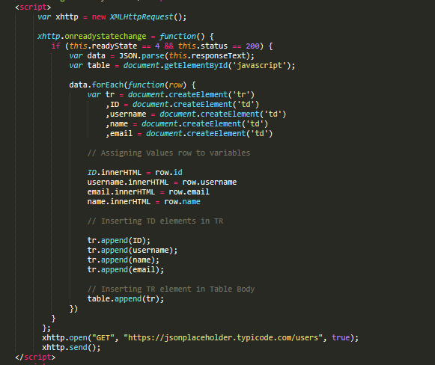
Javascript

Slide 17
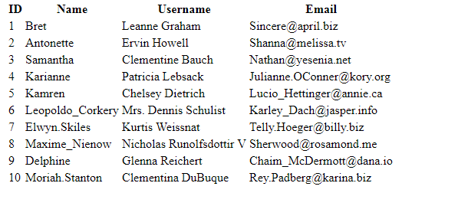

Slide 18
JQUERY

Slide 19
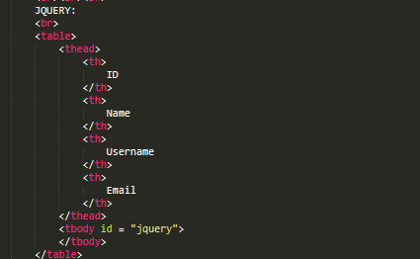

Slide 20
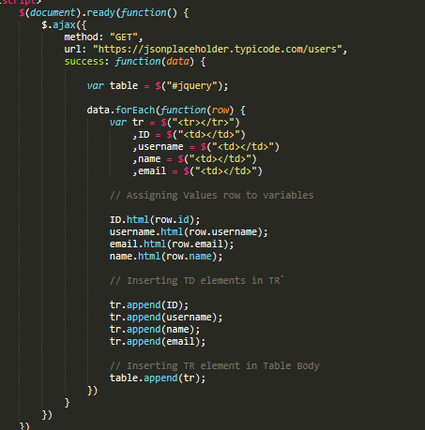

Slide 21
