Slide 1
OOP, SQL joins, Codeigniter

Slide 2
OOP: PHP
Class
Interface
Abstract Class
Traits

Slide 3
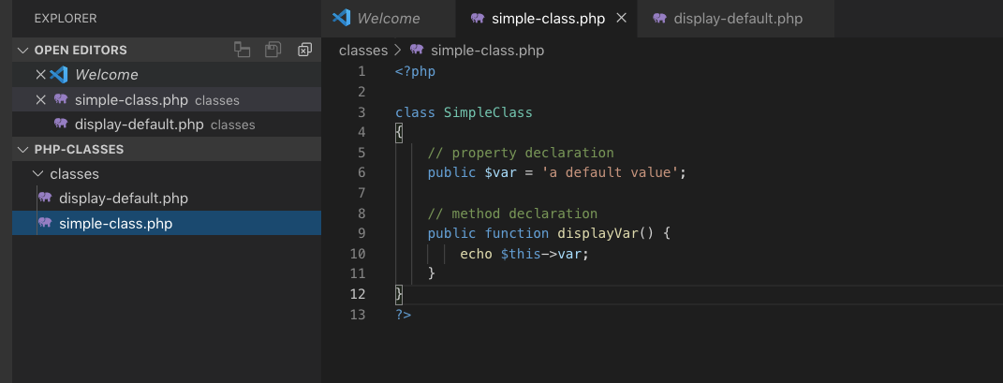
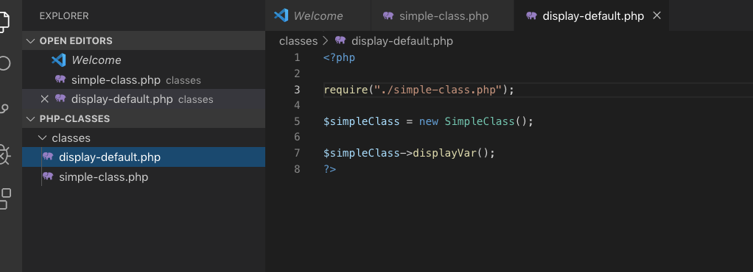
Classes

Slide 5
Things To Remember
public
private
protected
constructor

Slide 6
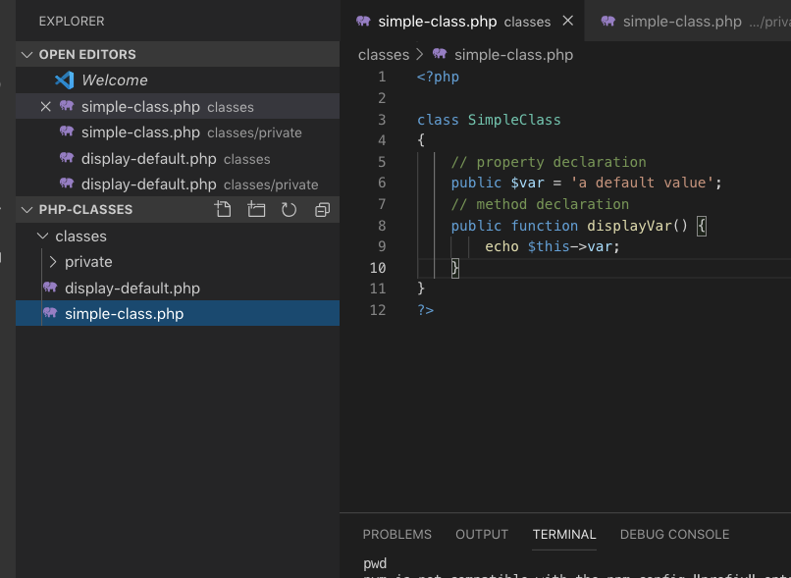
simple-class.php

Slide 7
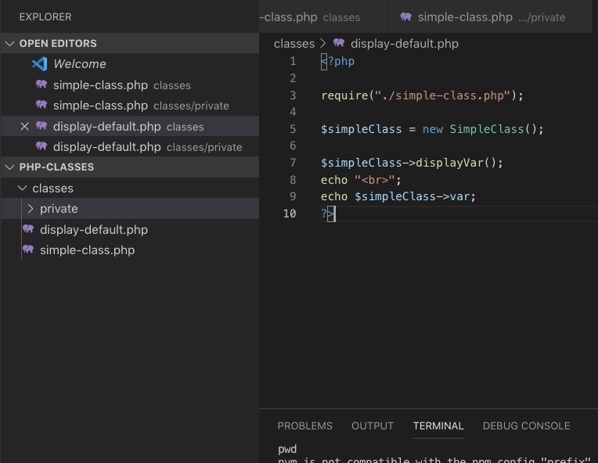
display-default.php

Slide 8
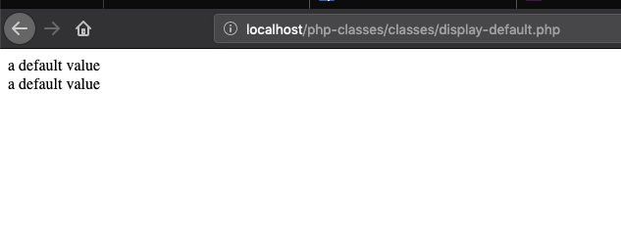

Slide 9
Private

Slide 10
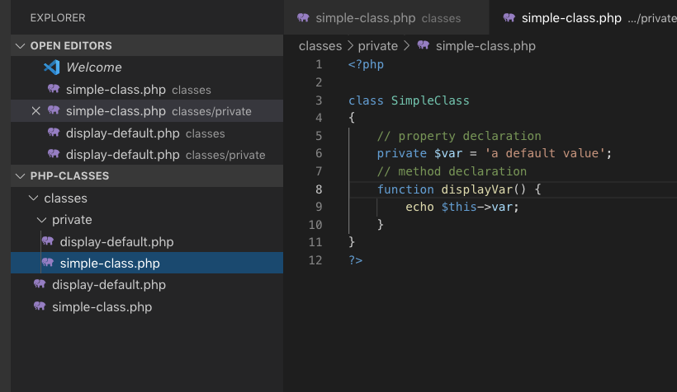
simple-class.php

Slide 11
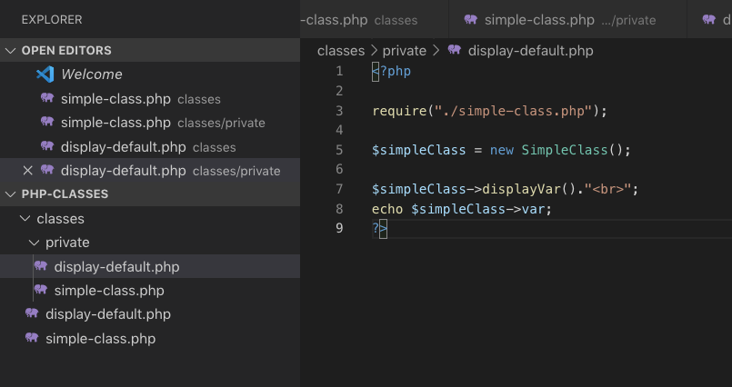
display-default.php

Slide 12
public vs private
Both variables and functions can be declared as public and private
use private as the word itself, for privacy, only within the class is accessible
most likely private functions are use for task implementation inside its class, you don't want to be messed up by other coders to use that class outside

Slide 13
“Protected var, functions
–Watch out for the constructors

Slide 14
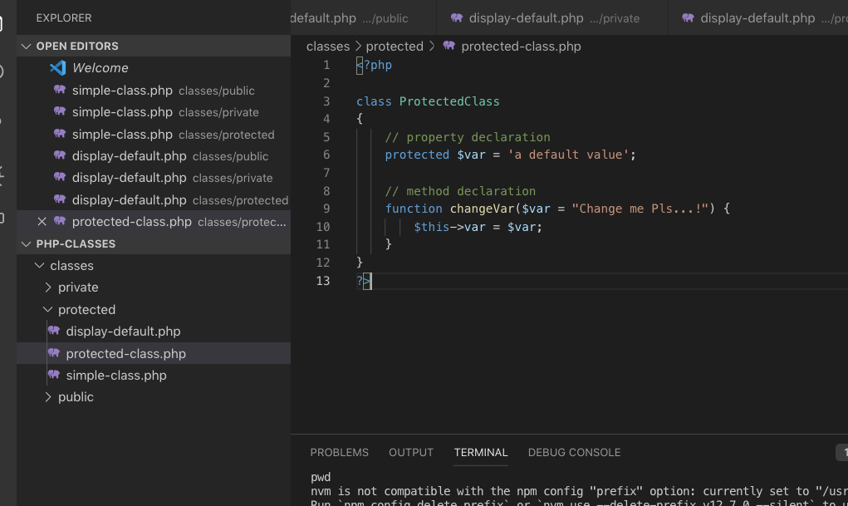
protected-class.php

Slide 15
simple-class.php

Slide 16
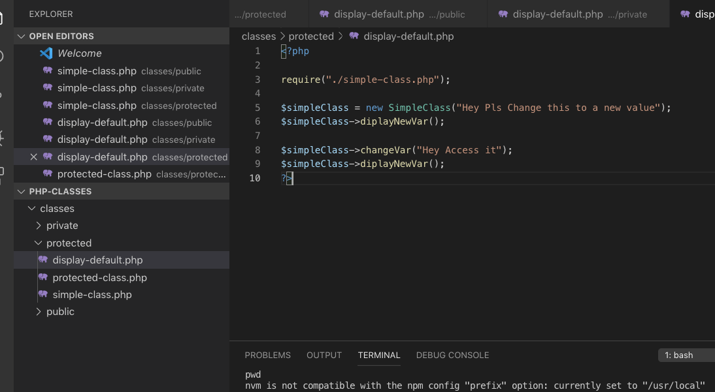
display-default.php

Slide 17
“Protected are only accessible within the class, not outside the class.”
–Learning it by this week

Slide 18
Interface
An interface consists of methods that have no implementations, which means the interface methods are abstract methods.
All the methods in interfaces must have public visibility scope.
Interfaces are different from classes as the class can inherit from one class only whereas the class can implement one or more interfaces.

Slide 19
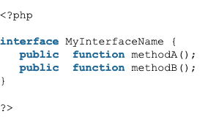
Example of an interface

Slide 20
“Interface just forced you to do something”

Slide 21
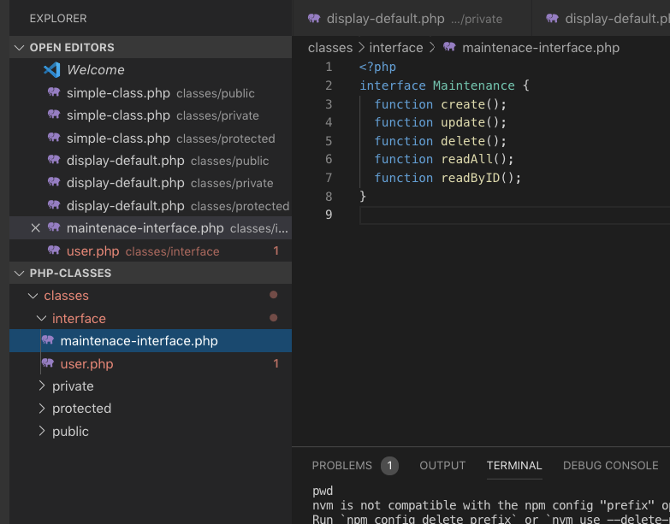

Slide 22
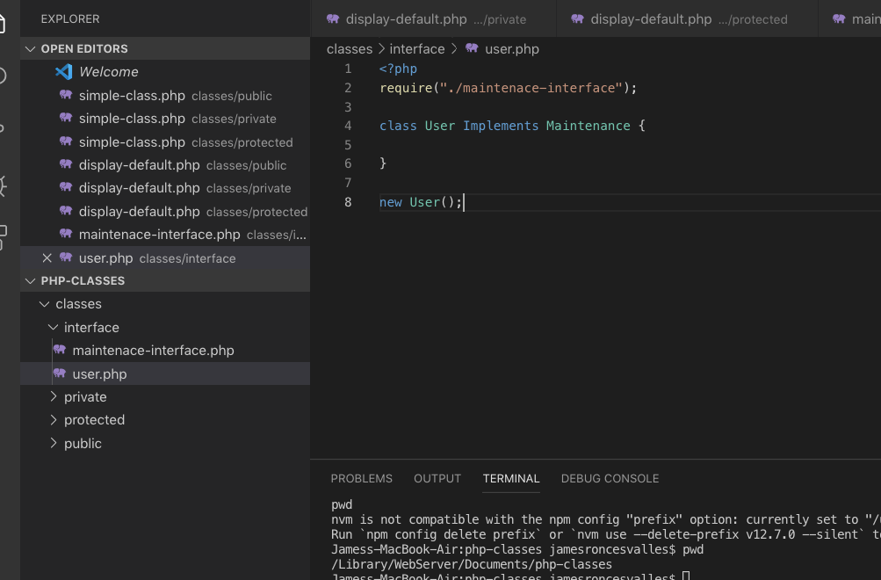
User.php

Slide 23
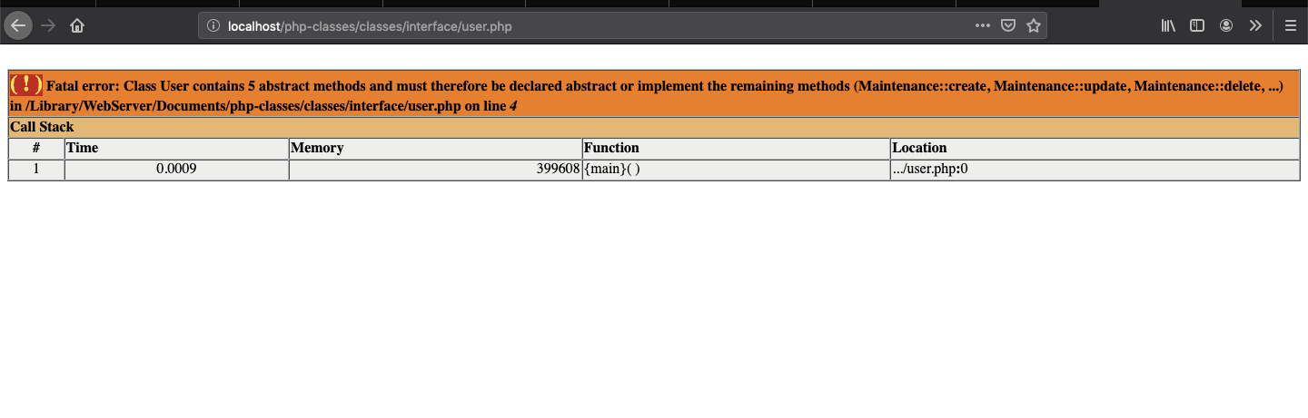

Slide 24
Essence of interface
in my experience, Im using this for maintenance/utilities or i just want to make my code uniform for every instance that I have encountered similar
interface looks cool when someone newbie see your code, so its just a show of

Slide 25
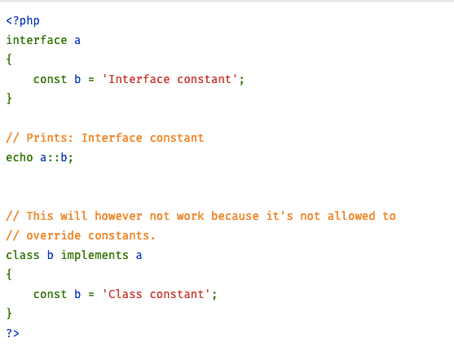

Slide 26
“An interface with a function that has a default doing is abstract”
–Abstract Class

Slide 27
Abstract Class for Maintenance

Slide 28
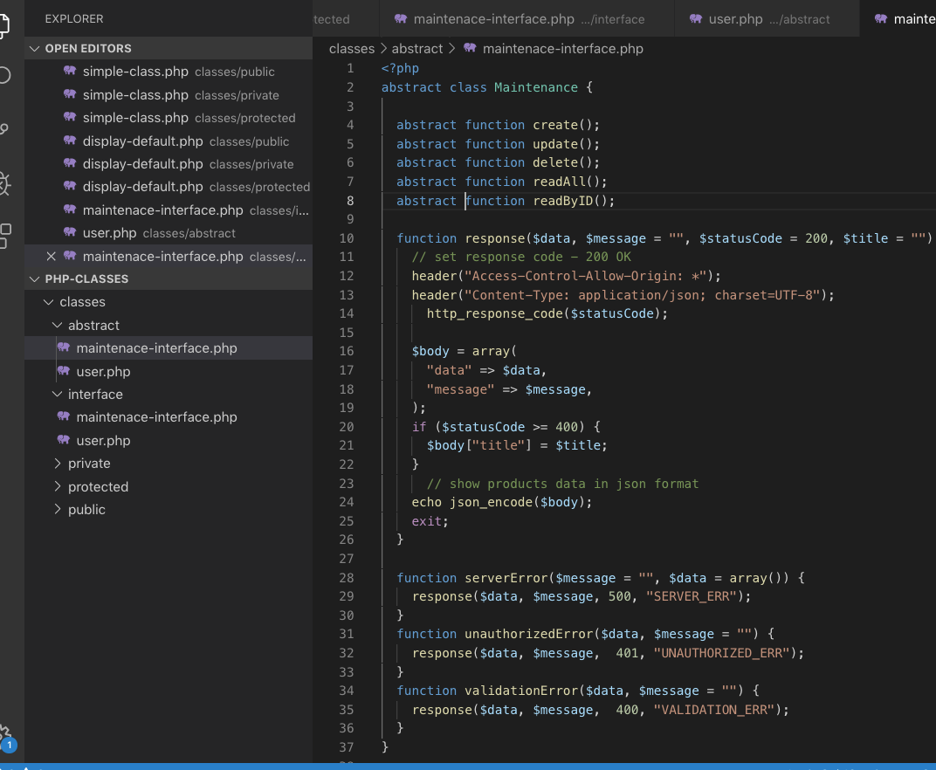

Slide 29
Sql Joins
CROSS JOIN
INNER JOIN
LEFT JOIN
RIGHT JOIN

Slide 30
Relationship
one to one
one to many
many to many

Slide 31
One to one
The simplest kind of relationship is a one-to-one relationship. Best example to produce is a person holding a tin number, sss, philhealth

Slide 32
One to Many
Best example to produce is an employee that have many position history in the company

Slide 33
Many to Many
Many to Many is mostly like use for creating transactional procedures.
Example is a POS counter, you have a transaction number, you have products, and in order to record products purchased in one transcation, you need to create another table linking to both of those.

Slide 34
Frameworks vs Libraries
Frameworks is where you code as where libraries a code you imported in your coding area

Slide 35
Codeigniter
an open-source software rapid development web framework, for use in building dynamic web sites with PHP.
Developed by: BCIT Recreation Services
Developer(s): British Columbia Institute of Technology
Original author: Ellislab

Slide 36
Pros and Cons of Codeigniter

Slide 37
Pros
Has a smaller footprint
Easy set up options
Offers Modern Separation Concept
Supports both Web Page and Database Caching
Comes with Built-in Security Features
Easy to Extend and Customize

Slide 38
Cons
Does not emphasize on code maintainability
Lacks Exhaustive Libraries
Database
Authentication

