Slide 1
OOP, SQL joins, Codeigniter

Slide 2
OOP: PHP
Class
Interface
Abstract Class
Traits

Slide 3
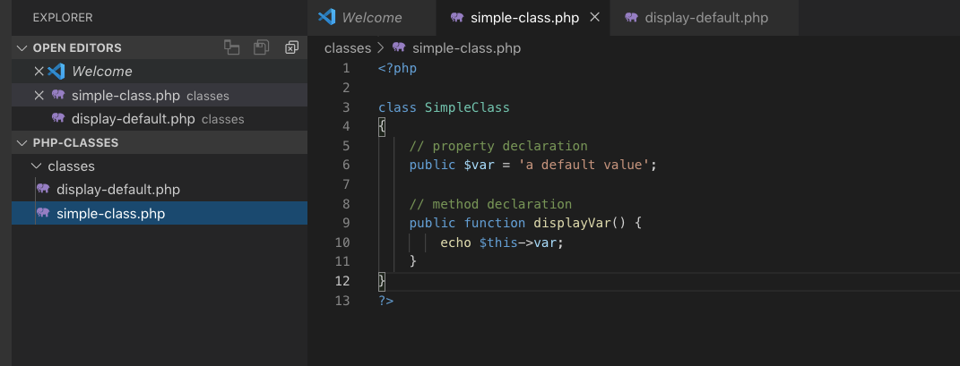
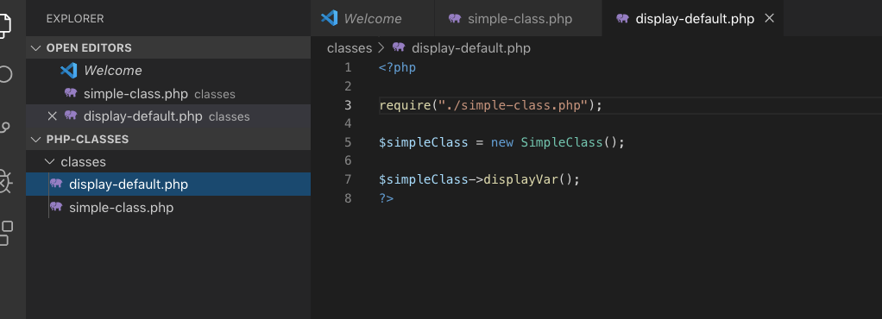
Classes

Slide 5
Things To Remember
public
private
protected
constructor

Slide 6
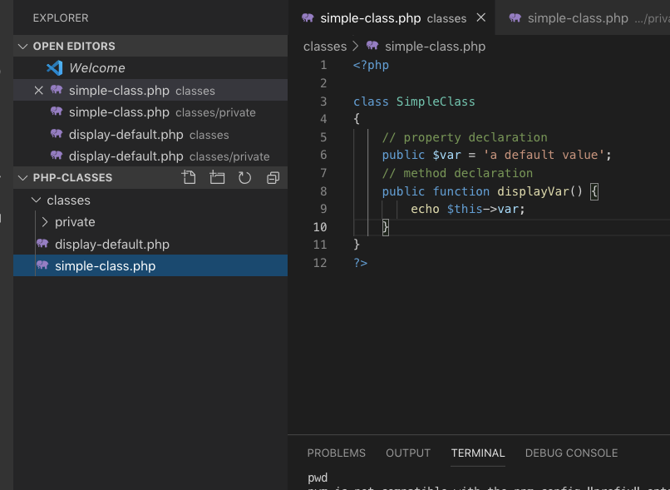
simple-class.php

Slide 7
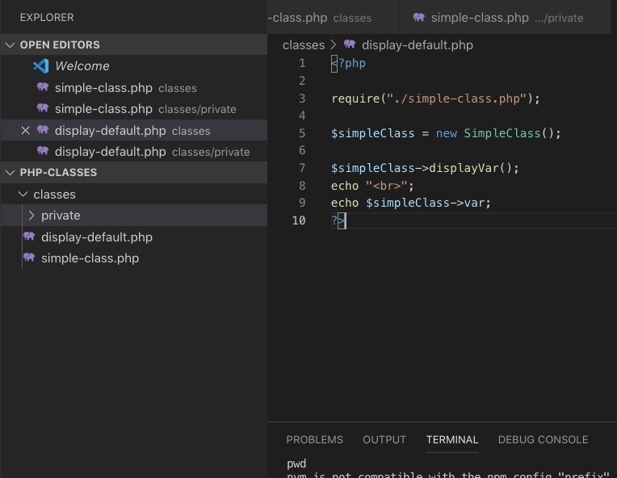
display-default.php

Slide 8
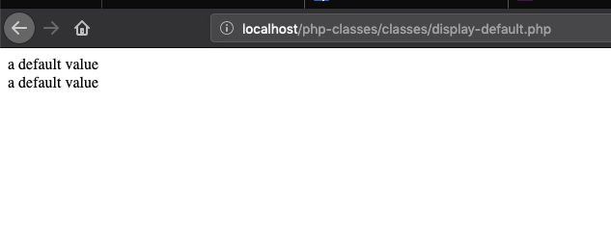

Slide 9
Private

Slide 10
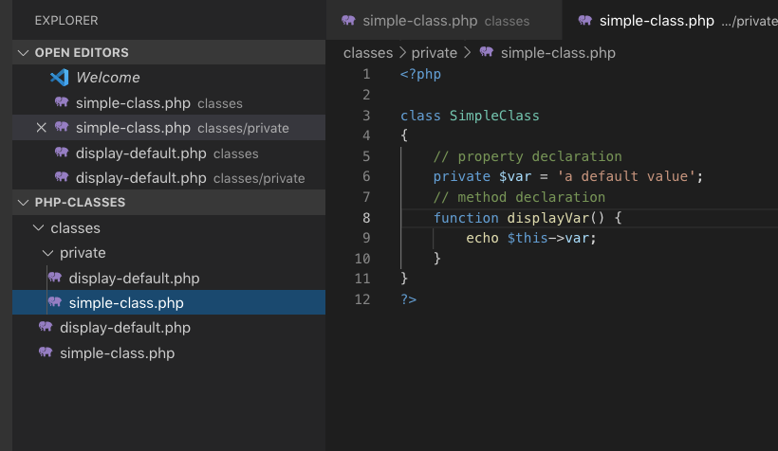
simple-class.php

Slide 11
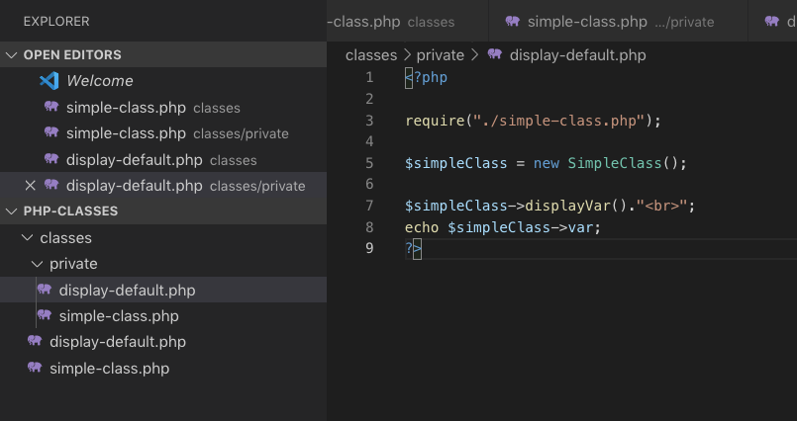
display-default.php

Slide 12
public vs private
Both variables and functions can be declared as public and private
use private as the word itself, for privacy, only within the class is accessible
most likely private functions are use for task implementation inside its class, you don't want to be messed up by other coders to use that class outside

Slide 13
“Protected var, functions
–Watch out for the constructors

Slide 14
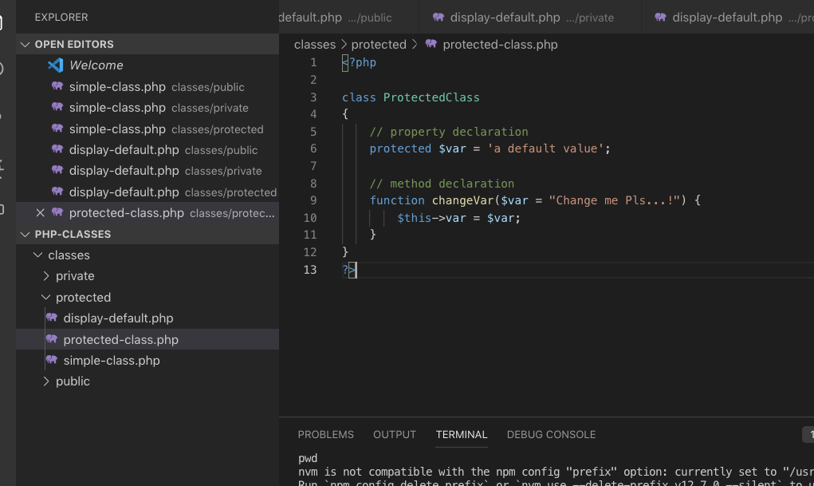
protected-class.php

Slide 15
simple-class.php

Slide 16
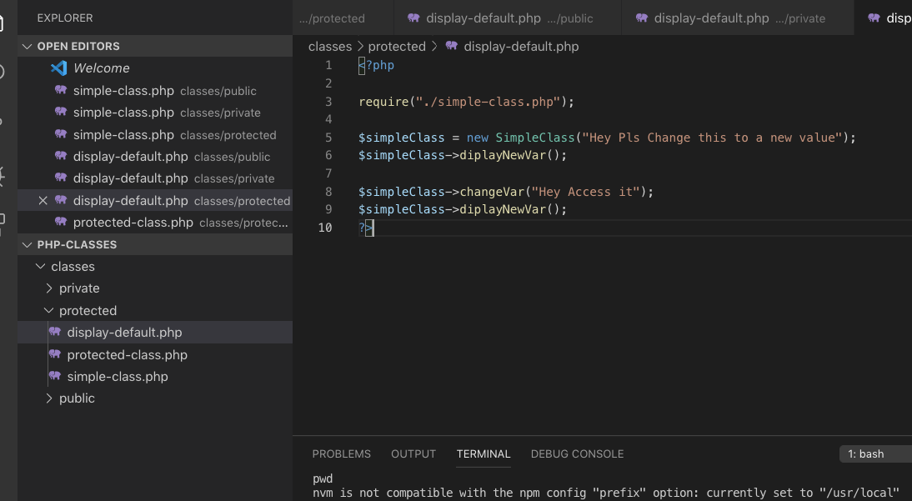
display-default.php

Slide 17
“Protected are only accessible within the class, not outside the class.”
–Learning it by this week

Slide 18
Interface
An interface consists of methods that have no implementations, which means the interface methods are abstract methods.
All the methods in interfaces must have public visibility scope.
Interfaces are different from classes as the class can inherit from one class only whereas the class can implement one or more interfaces.

Slide 19
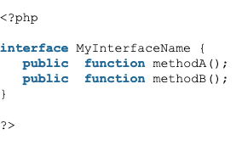
Example of an interface

Slide 20
“Interface just forced you to do something”

Slide 21
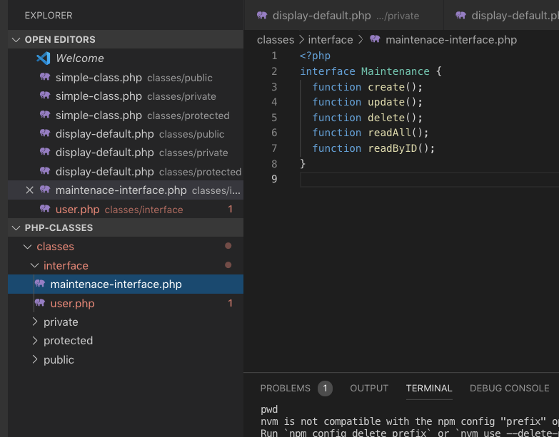

Slide 22
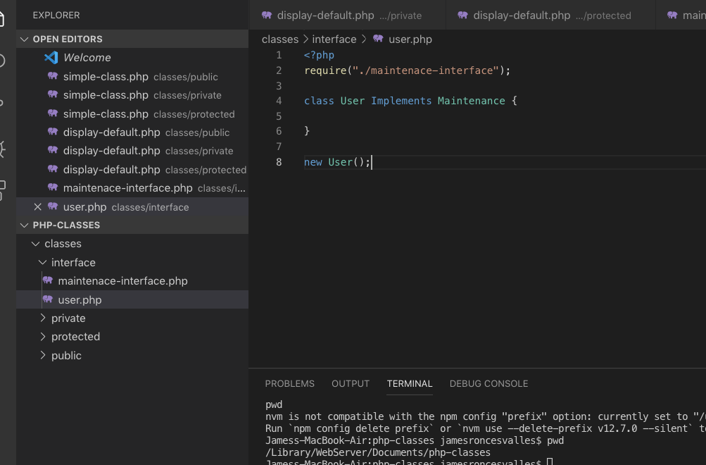
User.php

Slide 23
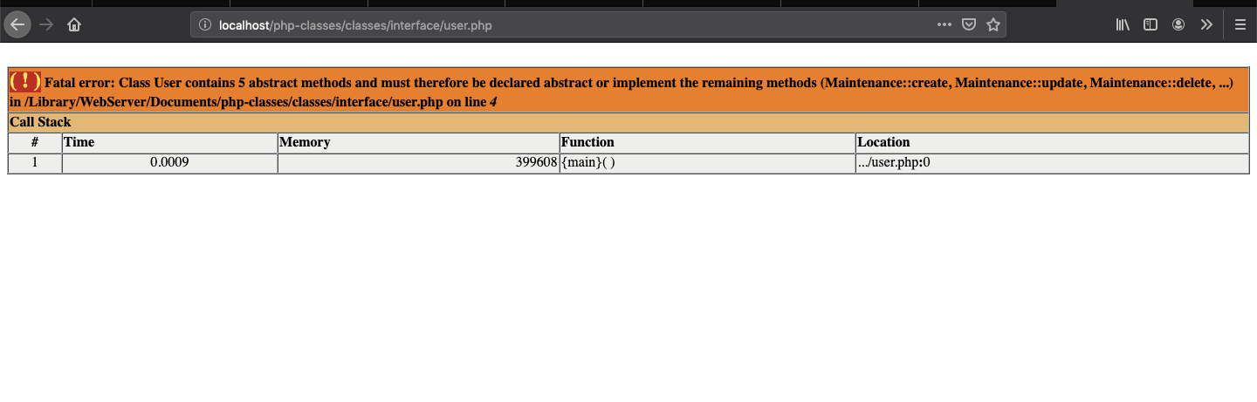

Slide 24
Essence of interface
in my experience, Im using this for maintenance/utilities or i just want to make my code uniform for every instance that I have encountered similar
interface looks cool when someone newbie see your code, so its just a show of

Slide 25
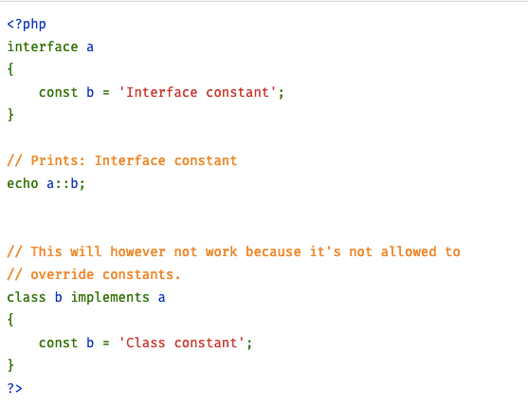

Slide 26
“An interface with a function that has a default doing is abstract”
–Abstract Class

Slide 27
Abstract Class for Maintenance

Slide 28
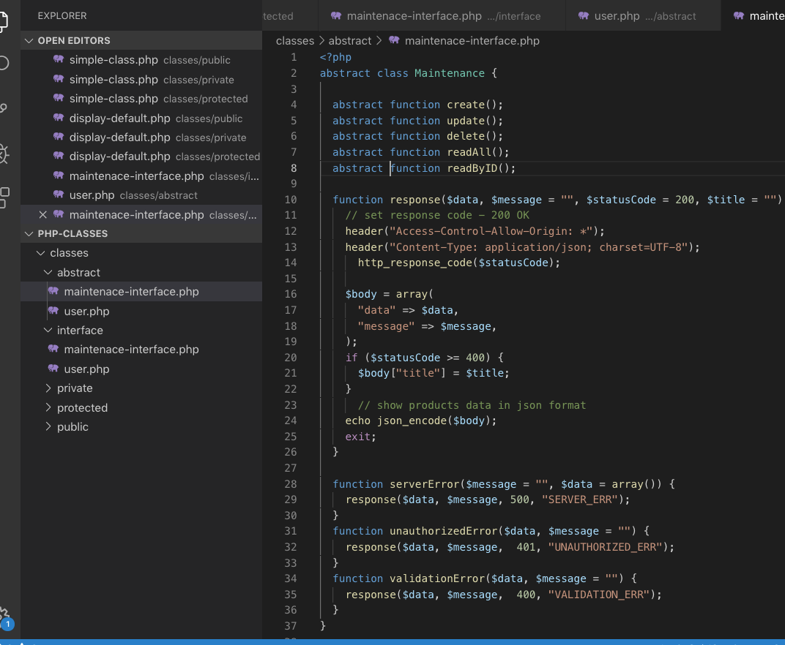

Slide 29
Sql Joins
CROSS JOIN
INNER JOIN
LEFT JOIN
RIGHT JOIN

