Slide 1
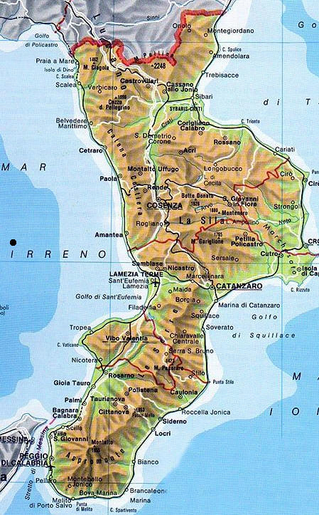
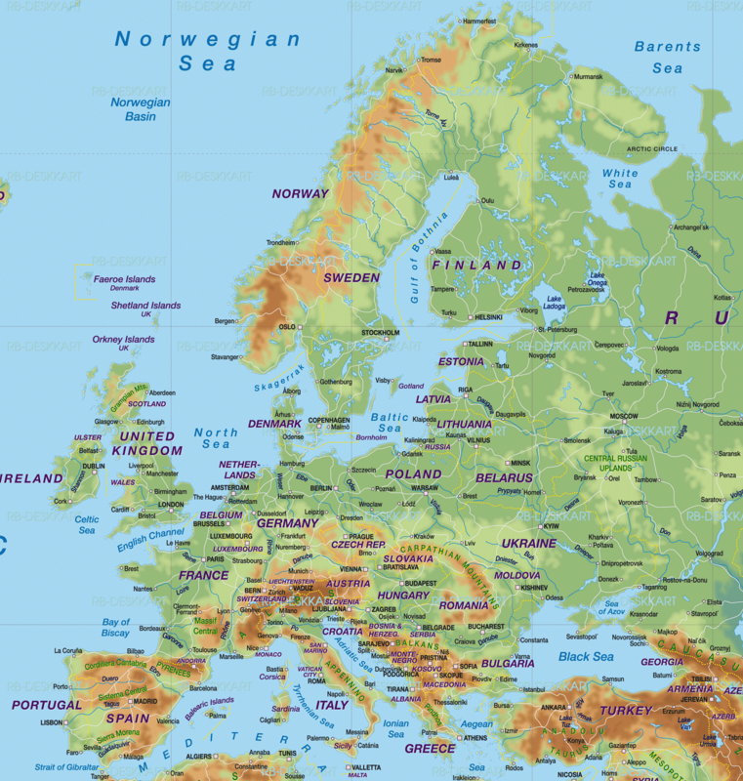
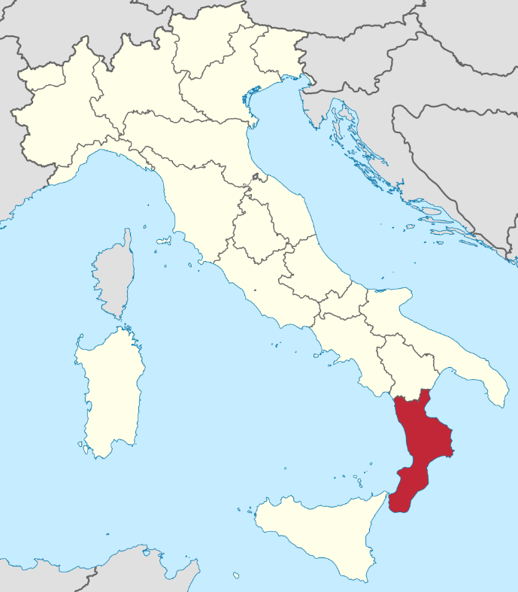
IEEE CYB Conf 2027
Proposed Dates
10-13 May 2027
University
of Calabria
Calabria, Italy

Slide 2

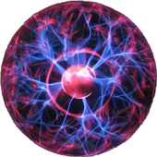


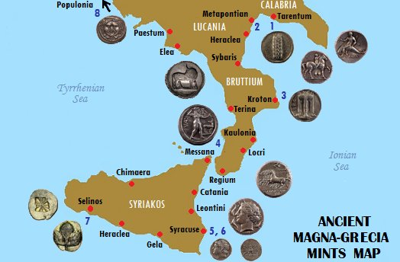
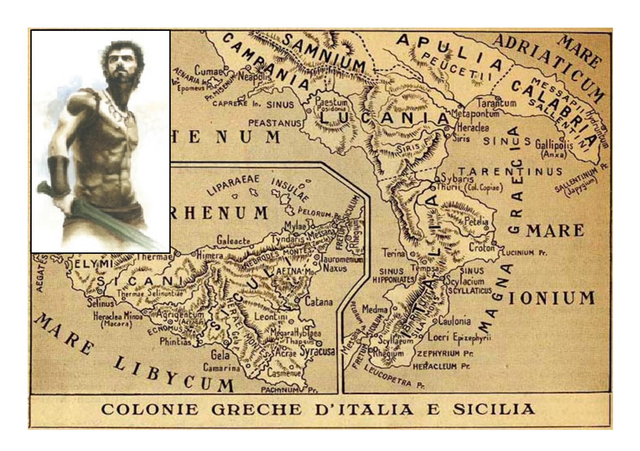
Info on Venue
SPEME Lab: http://speme.dimes.unical.it/
http://www.sensyscal.com
Calabria - the southern-most tip of Italy
Over 500 miles (800 km) of coastline
The main cities (provinces) of Calabria: Cosenza, Catanzaro, Reggio Calabria, Crotone, Vibo Valencia
Cosenza is the city hosting the University of Calabria (UNICAL), established in 1972, a large-sized university with almost 25.000 students. According to CENSIS (the most important Italian ranking system), UNICAL is now ranked n.1 among the large Italian universities.
The conference venue is at the University of Calabria, 50 mins far away from the International Lamezia Terme airport.
Calabria in the first mentioned conference periods (2nd/3rd week of September) has a wonderful weather (average temperatures about 25-27°C) allowing to enjoy the beaches and the mountains.
Calabria was the land of Pythagoras who founded his math school in the city of Kroton on the Jonion see side more than 2000 years ago in the Magna Graecia period.

Slide 3
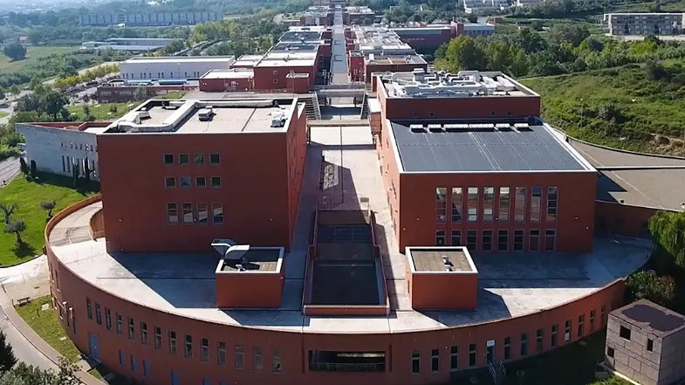
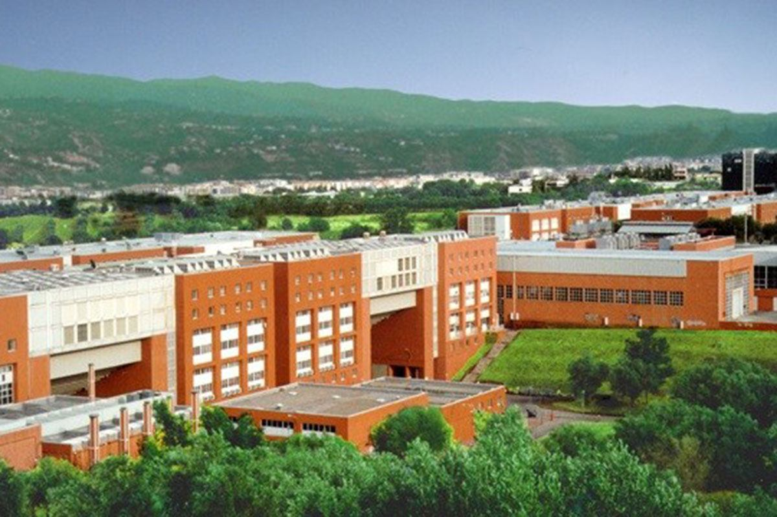
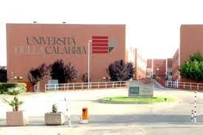
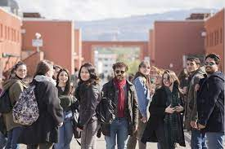
University of Calabria
SPEME Lab: http://speme.dimes.unical.it/
http://www.sensyscal.com

Slide 4
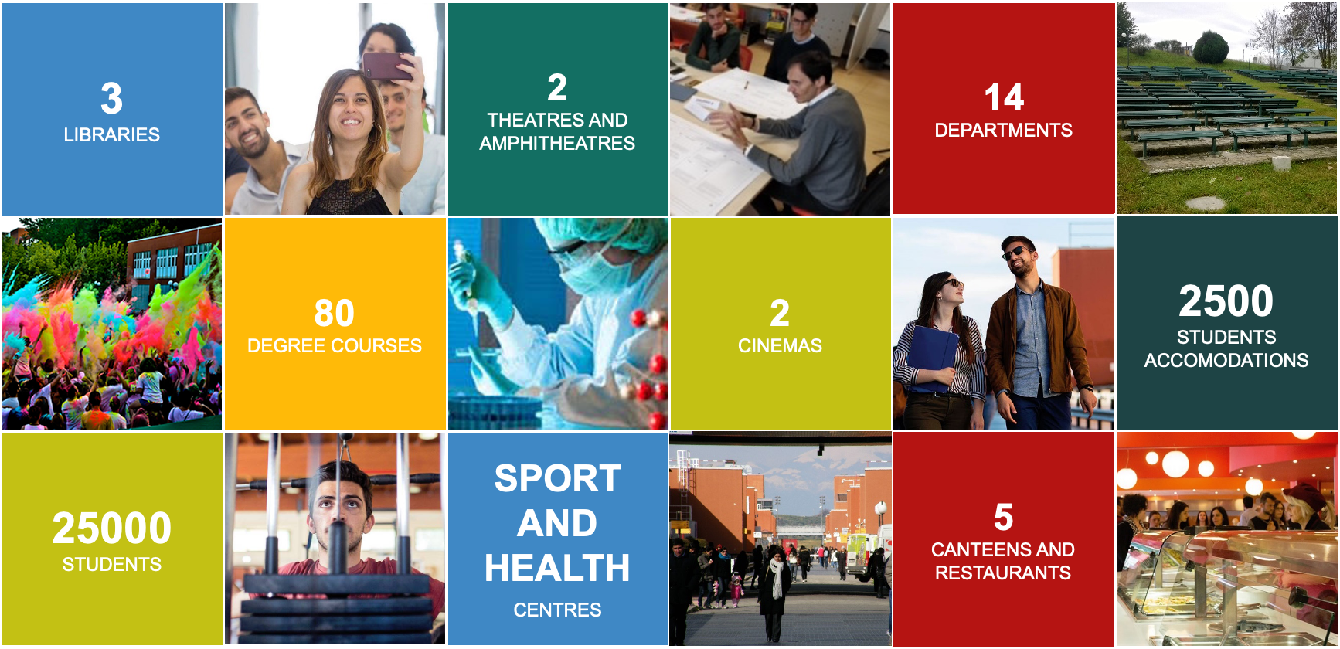
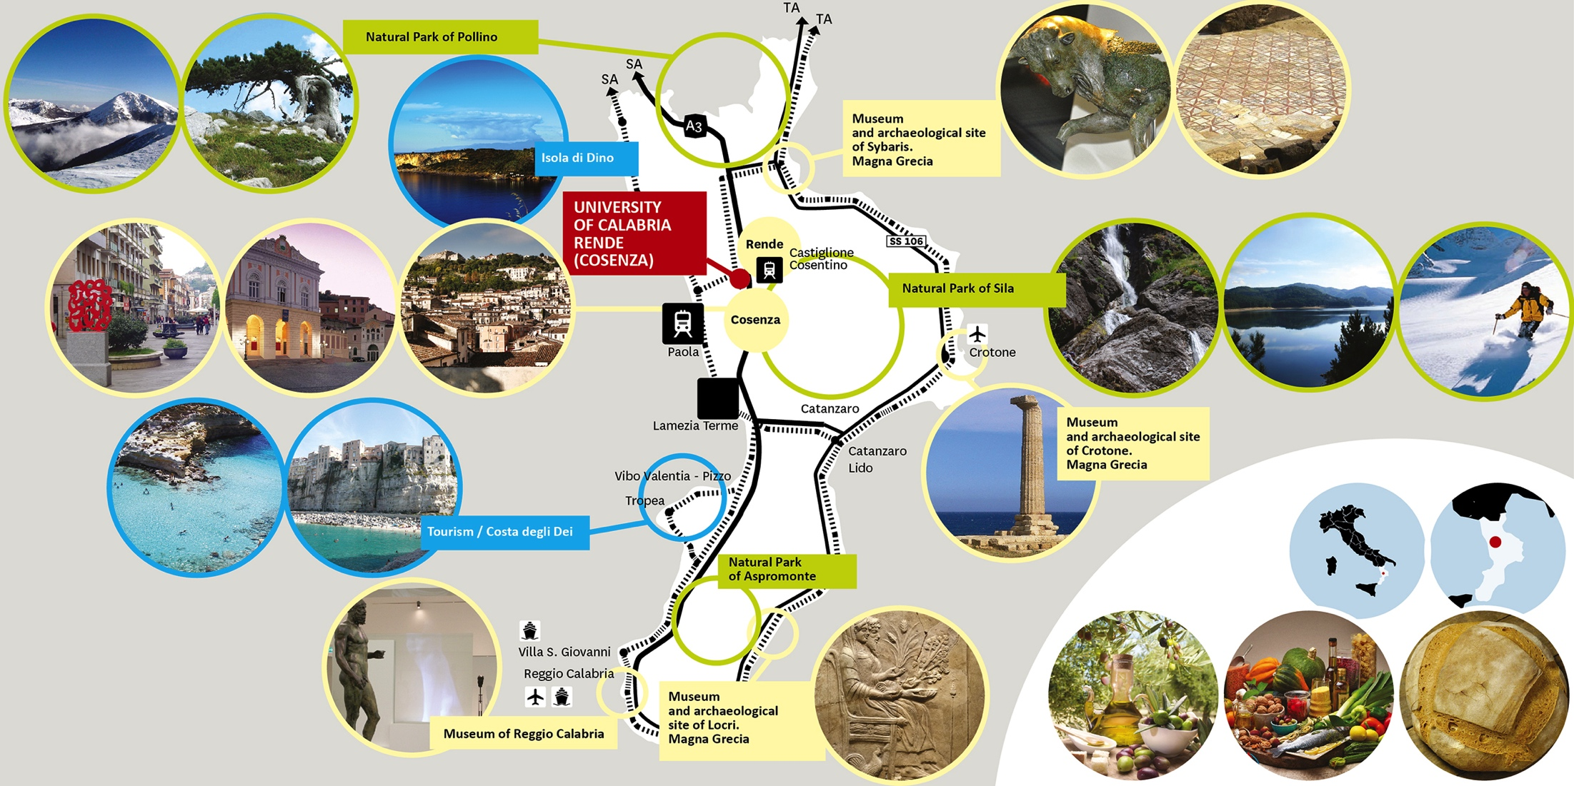
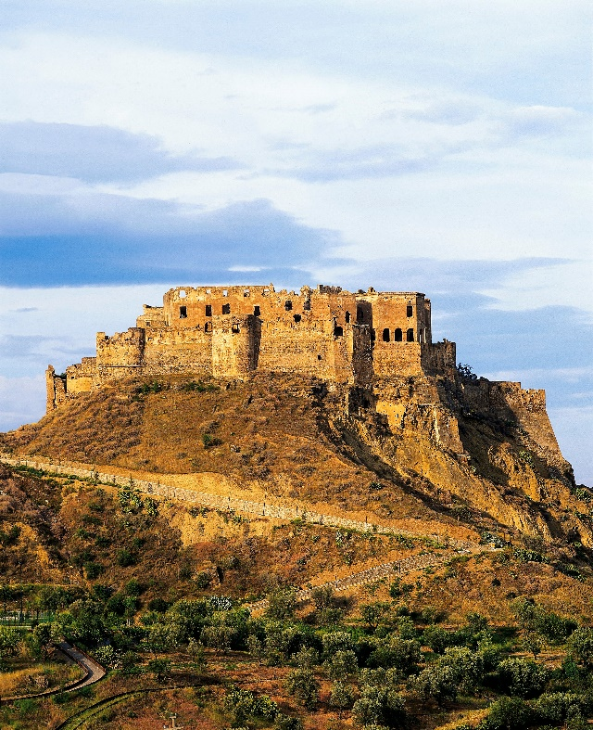
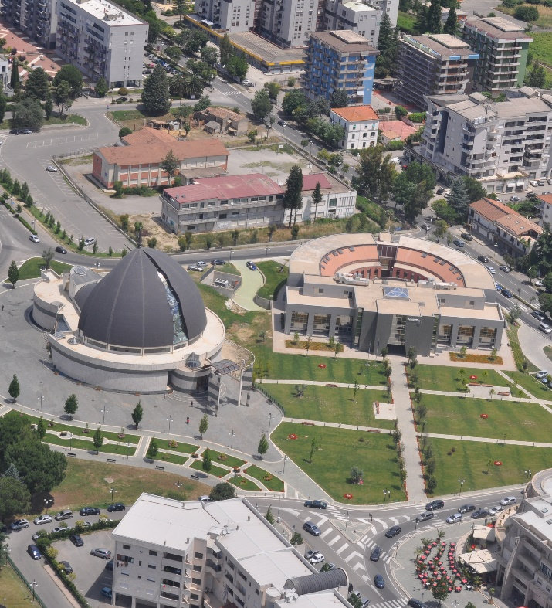




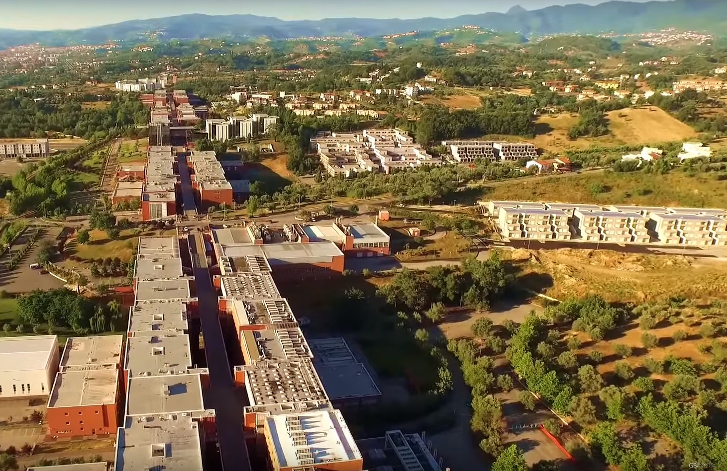
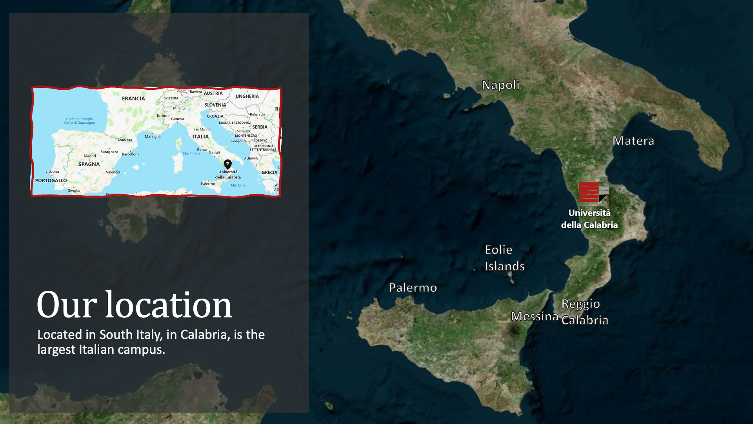
University of Calabria - UNICAL
www.unical.it
https://www.youtube.com/watch?v=5SVpvtZAqu8

Slide 5
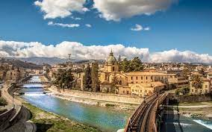
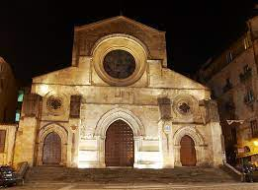
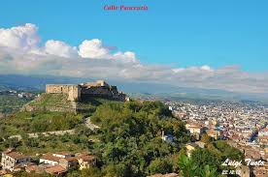
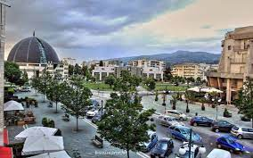
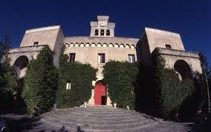
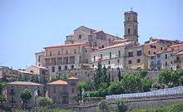
Metropolitan Area of Unical
Cosenza & Rende
SPEME Lab: http://speme.dimes.unical.it/
http://www.sensyscal.com

Slide 6
Organizing Committee
SPEME Lab: http://speme.dimes.unical.it/
http://www.sensyscal.com
Honorary Chair
Saeid Nahavandi, Swinburne University, Australia
General Chairs
Giancarlo Fortino, University of Calabria, Italy (Executive)
Peng Shi, Adelaide University, Australia
Mariagrazia Dotoli, Politecnico di Bari, Italy
Technical Program Chairs
Giuseppe Franzè, University of Calabria, Italy
Mengchu Zhou, New Jersey Institute of Technology, USA
Yan Wan, University of Texas at Arlington, USA
Andrea Salfinger, University of Udine, Italy
Guanghui Wen, South East University, China
Workshop/Special Sessions Chairs
Levent Kovacs, Obuda University, Hungary
Soheil Sabri, University Central Florida, USA
Hong Chen, Tongji University, China
Hui Yu, University of Glasgow, UK
Publicity Chairs
Plamen Angelov, Lancaster University, UK
Hong Yan, City University of Hong Kong, Hong Kong
Daoyi Dong, The Australian National University, Australia
Ying Tang, Rowan University, USA
Chunlin Chen, Nanjing University, China
Enrica Tricomi, Technical University of Munich, Germany
Jinjun Shan, York University, Canada
Industry and Sponsorship Chairs
Ming Hou, Defence Research & Development Canada, Canada
Qingsong Wen, Squirrel AI, USA
Thomas Strasser, AIT Austrian Institute of Technology, Austria
Finance Chair
Antonio Guerrieri, ICAR-CNR, Italy
Giuseppe D’Aniello, University of Salerno
Publication Chair
Vincenzo Barbuto, University of Calabria, Italy.
Web Chairs
Pasquale Rubino, University of Calabria, Italy
Local Arrangements Chairs
Francesco Tedesco, Univ. of Calabria, Italy.
Fabrizio Mangione, Univ. of Calabria, Italy.

Slide 7
TPC
SPEME Lab: http://speme.dimes.unical.it/
http://www.sensyscal.com
The TPC members will be well-know researchers/experts being from Academia and Industry and coming from all areas of the world (America, Europe, Africa, Middle-East, Asia, Australia, etc.) actively working on the topics of the CYBConf conference.
We aim to have at least 100 members to effectively and efficiently support the review phase.
The TPC will be formed later and will be mainly based on the TCs of the Cybernetics area of IEEE SMCS and the Editorial Board of IEEE T. Cynernetics

Slide 8
Links to other conferences organized by prof. Fortino’s team/s in Calabria and Italy
SPEME Lab: http://speme.dimes.unical.it/
http://www.sensyscal.com
IEEE SMC 2028 – Rome, Oct. 1-4, 2028 - expected around 1000 attendees!!!
IEEE SWC 2026 – Calabria, Sep. 7-11, 2026 - expected aroung 450 attendees!!!
EWSN 2023 (Calabria) (120 attendees)
  https://events.dimes.unical.it/ewsn2023/
IEEE CyberSciTech / PICom / DASC / CBDCom 2022 (Calabria) (180 attendees)
  http://cyber-science.org/2022/
IEEE ICHMS 2020 (Rome) – on-line due to pandemic (175 attendees)
  http://ichms.dimes.unical.it/index.html
IDCS 2019 (Naples)
  http://idcs2019.uniparthenope.it/
IEEE ICNCS 2017 (Calabria) – 180 attendees
  http://icnsc2017.dimes.unical.it/
IEEE CSCWD 2015 (Calabria) – 150 attendees
  http://2015.cscwd.org/
IDCS 2014 (Calabria)
  http://plasma.deis.unical.it/events/idcs2014/info.html
IDC 2012 (Calabria)
  http://idc2012.deis.unical.it/

Slide 9
SPEME Lab: http://speme.dimes.unical.it/
http://www.sensyscal.com
CYB Conf 2027: Theme & Specific Topics (not limited to)
Towards Smart Humanoid Robotics
Perception & Sensing
Multimodal sensory integration in humanoid robots (vision, touch, sound, proprioception)
Real-time 3D environment mapping and spatial awareness for bipedal robots
Emotion and facial expression recognition for human-robot social interaction
Motion & Control
4. Dynamic balance and fall recovery in bipedal locomotion
5. Whole-body motion planning for manipulation in unstructured environments
6. Energy-efficient actuator design for humanoid joint systems
7. Imitation learning from human motion capture data
Cognition & AI
8. Large language models integrated into humanoid robot decision-making
9. Commonsense reasoning and situational awareness in autonomous humanoids
10. Continual and lifelong learning for robots operating in changing environments
Human-Robot Interaction
11. Natural language dialogue systems for intuitive human-robot communication
12. Trust calibration and transparency in human-robot collaboration
13. Affective computing — robots that detect and respond to human emotions
14. Proxemics and social norms in human-robot co-habitation
Applications & Deployment
15. Humanoid robots in eldercare and assistive living environments
16. Collaborative humanoid robots in industrial and manufacturing settings
17. Humanoid robots as educators or tutors in learning environments
Ethics, Safety & Design
18. Ethical frameworks for autonomous decision-making in humanoid systems
19. Soft robotics and biomimetic body design for safer human interaction
20. Cybersecurity and adversarial robustness in networked humanoid systems

Slide 10
SPEME Lab: http://speme.dimes.unical.it/
http://www.sensyscal.com
CYB Conf 2027: Regular Topics (not limited to)
Human-Machine Integration
Adaptive brain-computer interfaces (BCIs) for real-time bidirectional communication between humans and machines
Closed-loop cybernetic prosthetics with sensory feedback and neural control
Control & Feedback Systems
3. Self-regulating adaptive control systems using AI for dynamic environment response
4. Cybernetic feedback loops in autonomous systems for predictive error correction
Biological & Hybrid Systems
5. Biocybernetics — modeling and augmenting biological regulatory systems (immune, nervous, endocrine) with computational intelligence
6. Hybrid biological-artificial neural networks for cognitive augmentation
Social & Organisational Cybernetics
7. Second-order cybernetics in complex social systems — how organizations self-regulate and adapt
8. Cybernetic models for collective intelligence and swarm decision-making
Ethics & Governance
9. Ethical boundaries of human enhancement through cybernetic augmentation — identity, agency, and consent
Emerging Frontiers
10. Quantum cybernetics — applying quantum computing principles to feedback and control in intelligent systems

Slide 11
Scientific/Technical Program
SPEME Lab: http://speme.dimes.unical.it/
http://www.sensyscal.com
Planning :
  3 Keynote speakers
  3 Full-day/Half-day Workshops
  2 Tutorials (two tutorials on hot topics on the conference theme)
  5 Special Sessions
  1 Panel on Industry/Research hot issues (Industry Sponsors)
  Poster+Demo sessions during coffee breaks
  Special Issues in ISI-impacted Journals/Scopus-impacted Series
  PhD Forum
  Lunch meeting space for Women in Cybernetics social/networking

Slide 12
Details
SPEME Lab: http://speme.dimes.unical.it/
http://www.sensyscal.com
Important Dates
Full Paper Submission: January 15, 2027
Acceptance Notice: March 1, 2027
Camera Ready Submission: March 31, 2027
Early Bird Registration: March 31, 2027
PAPER TYPES: Full Paper: 6 pages; Short Paper: 4 pages; Poster/Demo papers: 2 pages.
Proceedings with IEEE XPlore

Slide 13
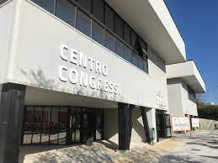
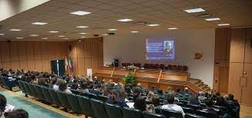
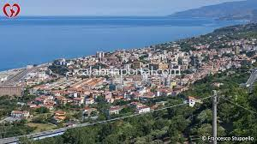
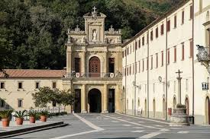
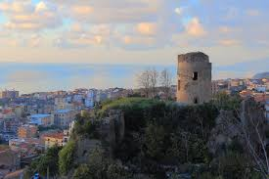
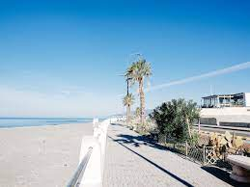
Conference Venue
University of Calabria Conference Center https://www.unical.it/campus/vivere-il-campus/centro-congressi/
SPEME Lab: http://speme.dimes.unical.it/
http://www.sensyscal.com
15 mins by train from the Tyrrenian coast: the beautiful town of Paola

Slide 14
Transportation: Reaching the Venue
SPEME Lab: http://speme.dimes.unical.it/
http://www.sensyscal.com
The conference venue served by the International Airport of Lamezia Terme
https://lameziaairport.com/
International flights to/from:
For international travelers the Best Hub to change the flight for Lamezia Terme is usually Rome Fiumicino (as there are 5 flights daily from Rome to Lamezia T.) and Milan Linate. We strongly advise to fly to Rome!
International Flights from: Dusseldorf, Frankfurt, Stuttgart, ALTENRHEIN, London Stansted, Zurich, Prague, Bruxelles, Geneve, etc.
Domestic Flights from: Rome, Milan, Bologna, Turin, Verona, Bergamo.
Busses and Trains:
Cheap and regular bus service is available from the Airport to Cosenza
A taxy-like service could be reserved to reach the hotel/conference venue from the Lamezia Terme Airport (preferrable).
Trains: from Rome to Cosenza using “Freccia Argento” or “Freccia Rossa”, 3.5-4 hours. Change station is Paola for Cosenza, stop station is Castiglione Cosentino.

Slide 15
Conference Venue: Hotels and Costs
SPEME Lab: http://speme.dimes.unical.it/
http://www.sensyscal.com
University of Calabria - Socrates residence (only bed, 35-45 euros per night)
Many hotels in the area of the University of Calabria
  Hotel Majorana****: https://www.hotelmajorana.com/en/, 60 (double room)-120 (suite)
  Hotel Marconi****: https://www.marconihotelrende.it/, 70 (double room)-150 (suite)
  Hotel Domus****: https://www.grandhoteldomus.it/, 65 (double room)-125 (suite)
  Hotel BV President****: https://www.bvpresidenthotel.com/?lang=en, 70 (double room)-150 (suite)
  others on Booking.com…
The hotels are all at walking distance to/from Unical: 20-25 mins walking.
There are buses connecting the hotel area (which is also the main students’ area) with the University: 5/10 mins connections.

Slide 16
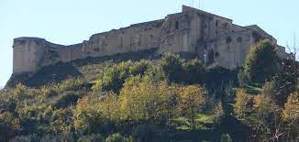
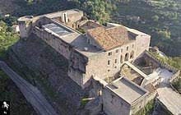
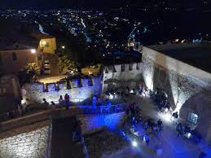
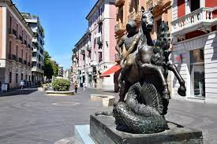
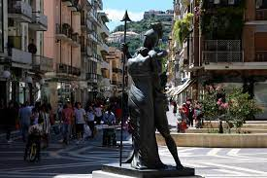
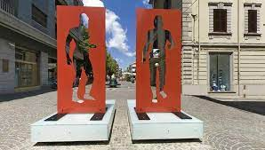
Social Event & Dinner
SPEME Lab: http://speme.dimes.unical.it/
http://www.sensyscal.com
Outdoor Museum MAB: https://it.wikipedia.org/wiki/Museo_all%27aperto_Bilotti
Social Dinner at Cosenza Castle: http://www.castellocosenza.it/

Slide 17
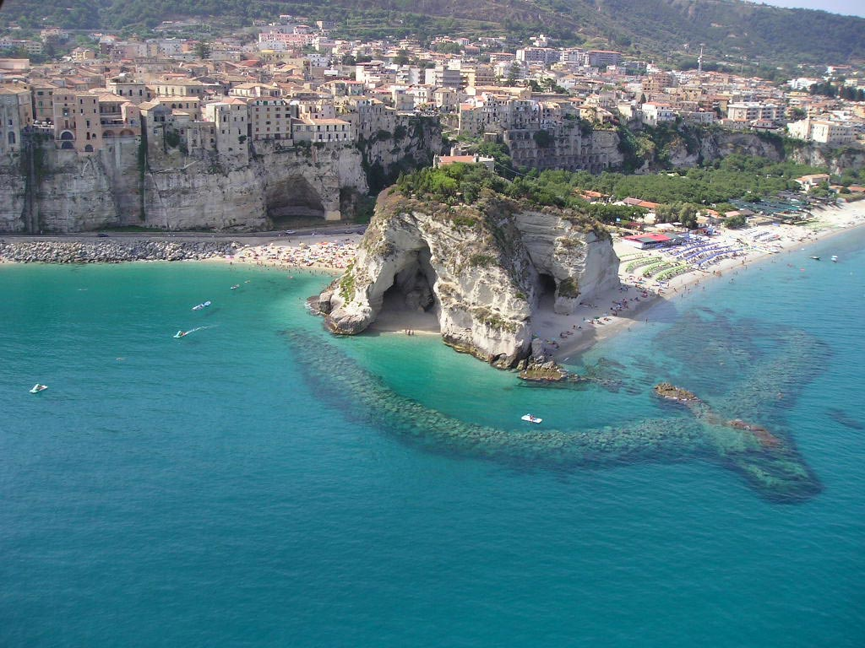
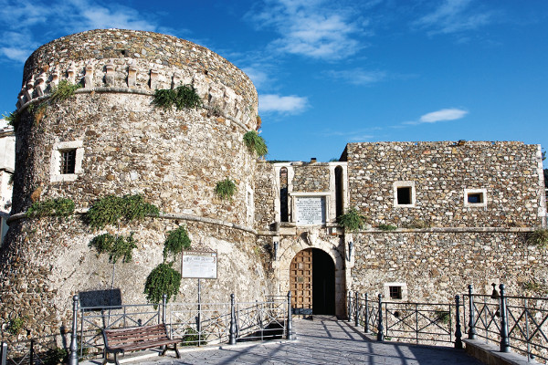
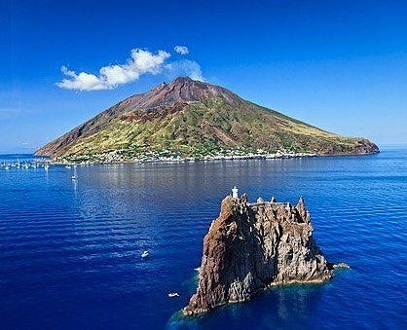
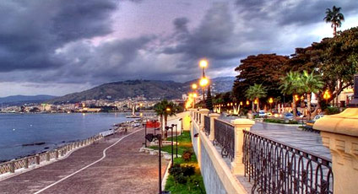
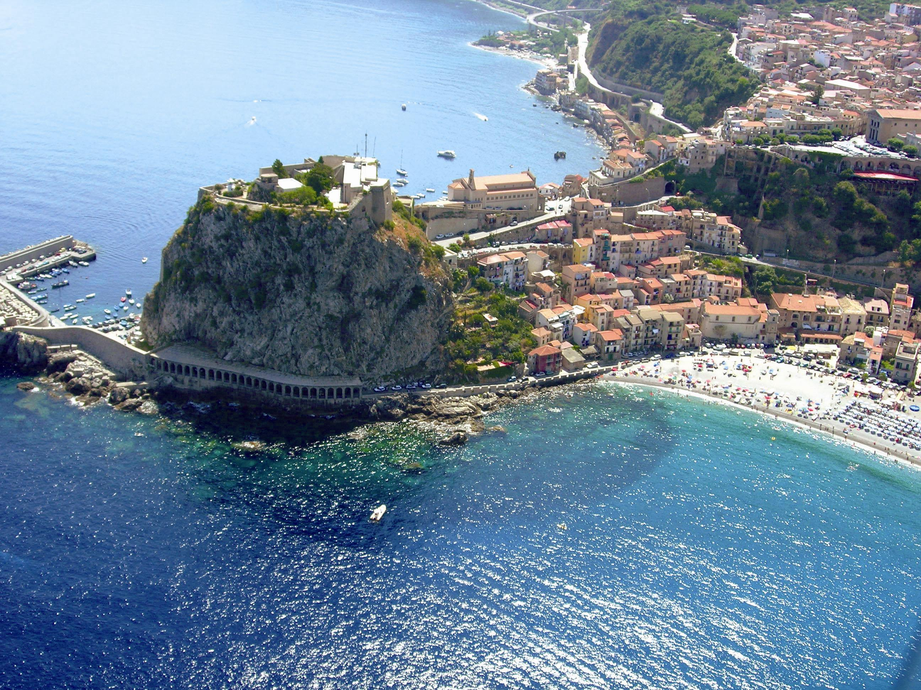
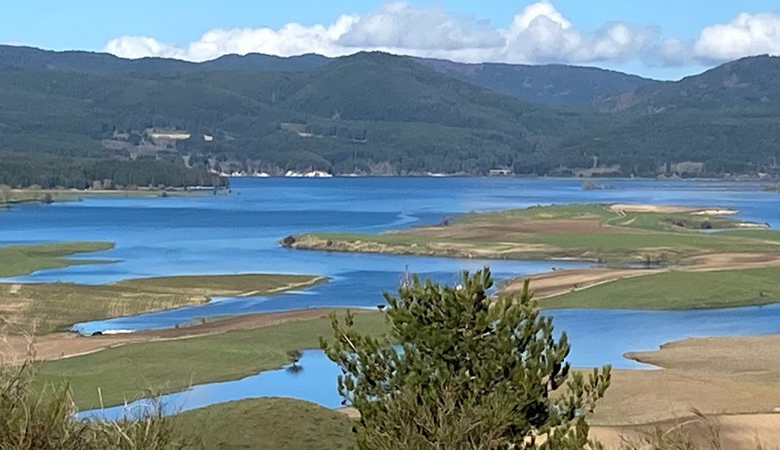
Touristic Info
SPEME Lab: http://speme.dimes.unical.it/
http://www.sensyscal.com
Very famous Touristic (and historical) towns near the conference venue are Tropea (named the Pearl of the Tyrrhenian sea) and Pizzo Calabro (where there is the Murat's Castle and famous for the Black Truffle Ice Cream). From the port of Vibo Valentia, it is possible to take a boat to the Eolie islands, where it is possible to visit the active Stromboli Volcano Island. Green “Sila Mountains” in 20 mins from Cosenza!!!
Reggio Calabria (1 hr and 20 mins by train) famous for its touristic promenade, and the small town of Scilla (1h by car), famous for the Legend of Scilla and Cariddi, and for the white beach and the Ruffo's Castle on the rock dominating the seaside.
See: http://www.italia.it/en/discover-italy/calabria.html
Pizzo
Tropea
Stromboli
Reggio
Calabria
SILA
Scilla

Slide 18
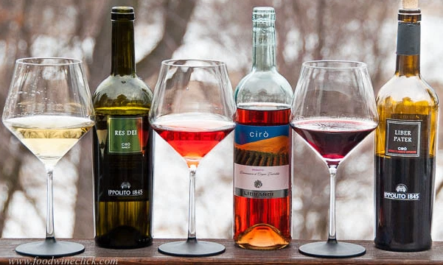
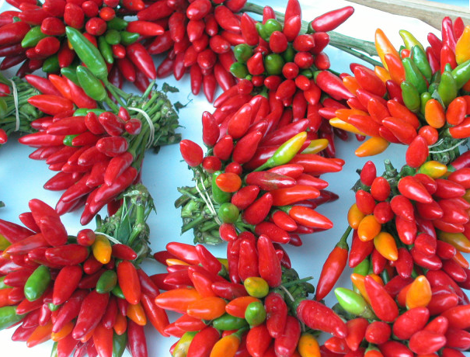
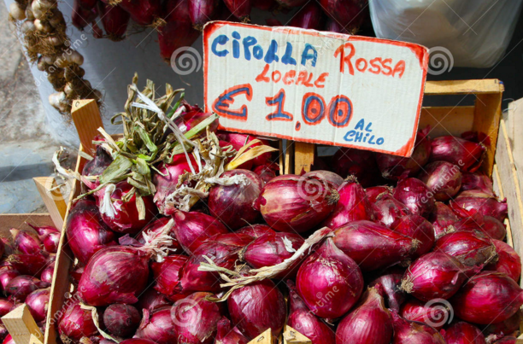
Calabrian Cuisine
SPEME Lab: http://speme.dimes.unical.it/
http://www.sensyscal.com
Calabria's cuisine, one of Italy's most traditional and noteworthy!
Witness the famous Calabrian hot pepper (peperoncino), found in most Calabrian typical dishes.
From toasted bread with n’duja sausage or sardines – called the “caviar of the poor” – to pork sausages, from pasta sauces to fish dishes.
The strong flavor of hot pepper contrasts with the sweet taste of the Tropea red onion, protected by the PGI quality mark. The onion is used for seasoning dishes as well as for curative purposes.
Some of the delicacies among Calabrian products and typical dishes that explorers of this amazing region must try include: extra-virgin olive oil, wines, bergamot liqueurs, liquorice, citron and herbs, honey and jams, special types of homemade pasta (strangugghj, fileja, maccaruni) that are still made today using the old methods.
Finally a great variety of Calabrian (red, white, rosè) wines (Cirò, Libici, Magliocco Calabria, Greco di Bianco) can be found and tasted.
See: http://www.italia.it/en/discover-italy/calabria.html

Slide 19
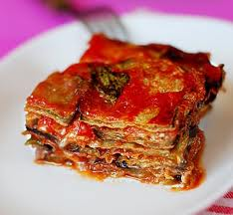
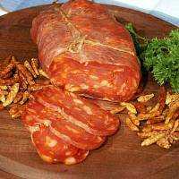
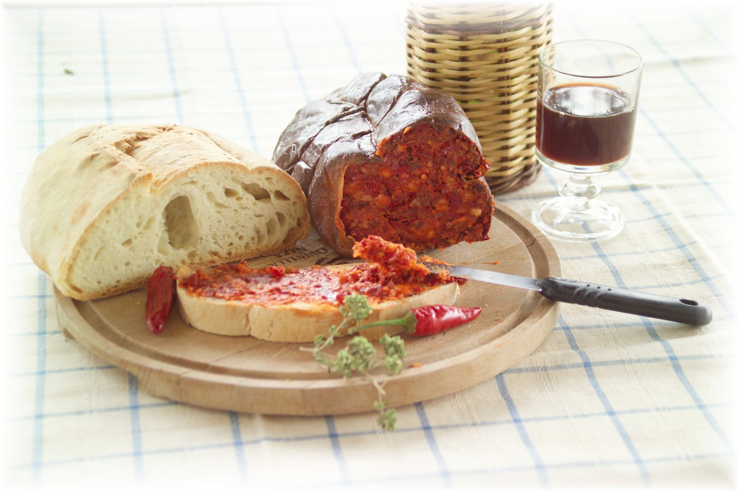
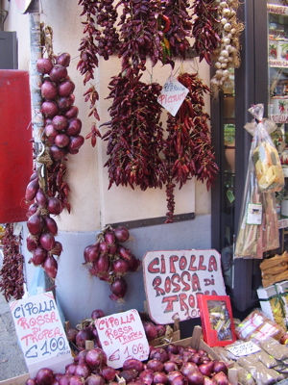
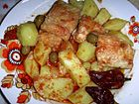
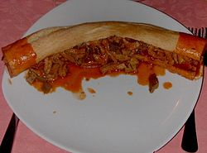
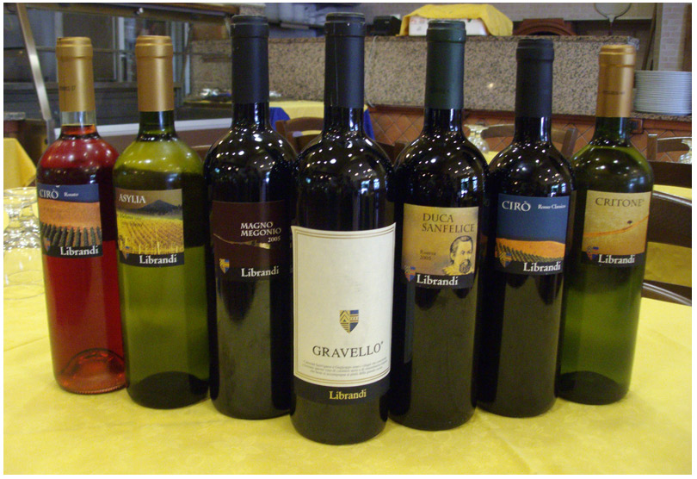



Eating and Wining in Calabria
Soppressata (Calabrian Salami)
Eggplant
Parmisan
Stockfish, Potatos and red hot chili pepper
Red Onion from Tropea
n'duija
Calabrian Caviar
Stuffed Pasta
Selection of Calabrian Wines
Grilled Fresh Seafood
Truffle of Pizzo

Slide 20
GRAZIE & ARRIVEDERCI
in Calabria
2027
Come and join us in Calabria

