Slide 1
The Chomsky Hierarchy
Prof. Busch - LSU

Slide 2
Linear-Bounded Automata:
Same as Turing Machines with one difference:
the input string tape space
is the only tape space allowed to use
Prof. Busch - LSU

Slide 3







Linear Bounded Automaton (LBA)
Input string
Working space
in tape
Left-end
marker
Right-end
marker
All computation is done between end markers
Prof. Busch - LSU

Slide 4
We define LBA’s as NonDeterministic
Open Problem:
NonDeterministic LBA’s
have same power as
Deterministic LBA’s ?
Prof. Busch - LSU

Slide 5
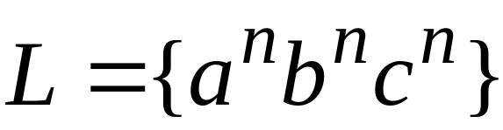
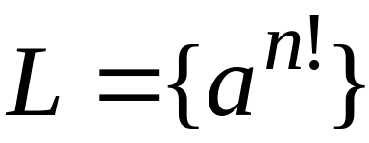
Example languages accepted by LBAs:
LBA’s have more power than PDA’s
(pushdown automata)
LBA’s have less power than Turing Machines
Prof. Busch - LSU

Slide 6

Unrestricted Grammars:
Productions
String of variables
and terminals
String of variables
and terminals
Prof. Busch - LSU

Slide 7
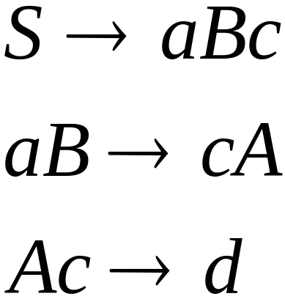
Example unrestricted grammar:
Prof. Busch - LSU

Slide 8

Theorem:
A language is Turing-Acceptable
if and only if is generated by an
unrestricted grammar
Prof. Busch - LSU

Slide 9
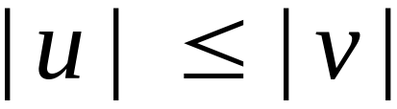
Context-Sensitive Grammars:
Productions
String of variables
and terminals
String of variables
and terminals
and:
Prof. Busch - LSU

Slide 10
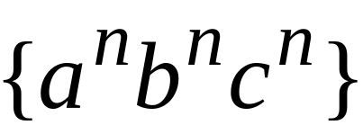
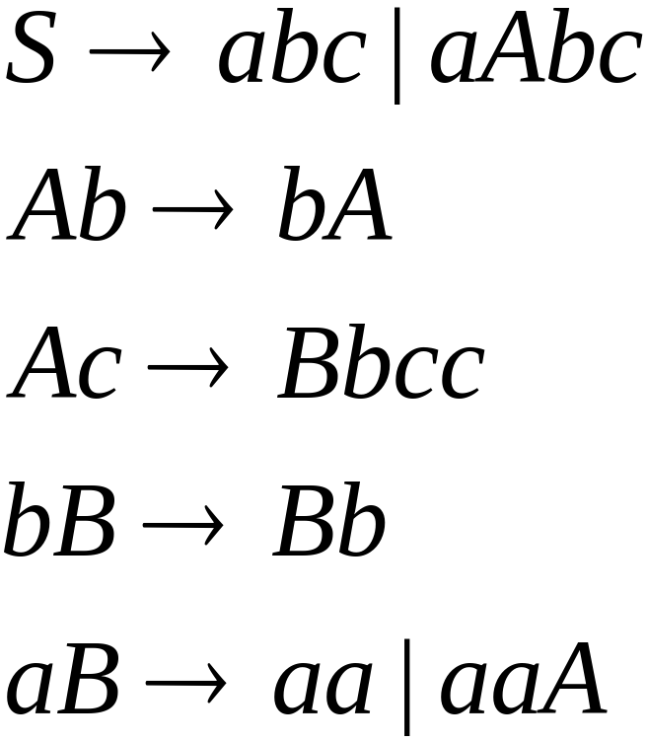
The language
is context-sensitive:
Prof. Busch - LSU

Slide 11
Theorem:
A language is context sensistive
if and only if
it is accepted by a Linear-Bounded automaton
Observation:
There is a language which is context-sensitive
but not decidable
Prof. Busch - LSU

Slide 12
The Chomsky Hierarchy
Non Turing-Acceptable
Turing-Acceptable
decidable
Context-sensitive
Context-free
Regular
Prof. Busch - LSU

