Slide 1
Regular Expressions
Prof. Busch - LSU

Slide 2
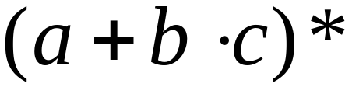
Regular Expressions
Regular expressions
describe regular languages
Example:
describes the language
Prof. Busch - LSU

Slide 3
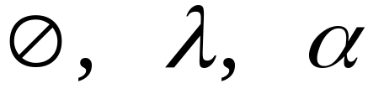



Recursive Definition
Primitive regular expressions:
Given regular expressions and
Are regular expressions
Prof. Busch - LSU

Slide 4
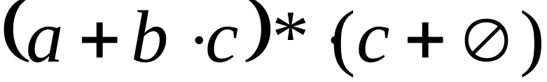
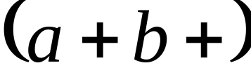
Examples
A regular expression:
Not a regular expression:
Prof. Busch - LSU

Slide 5
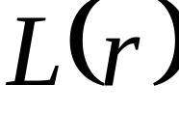

Languages of Regular Expressions
: language of regular expression
Example
Prof. Busch - LSU

Slide 6
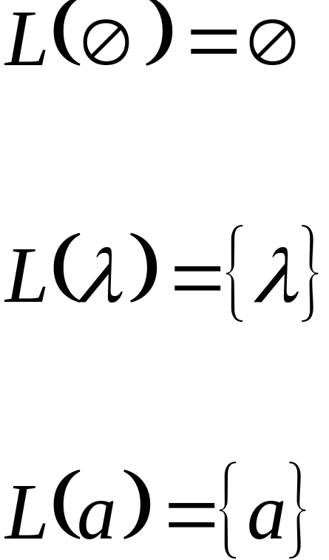
Definition
For primitive regular expressions:
Prof. Busch - LSU

Slide 7


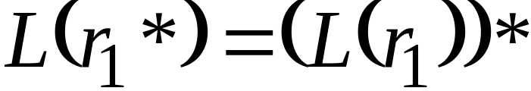

Definition (continued)
For regular expressions and
Prof. Busch - LSU

Slide 8

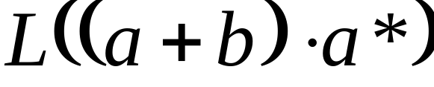


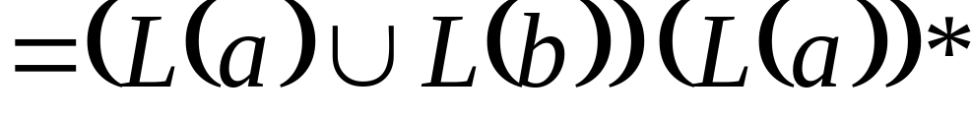
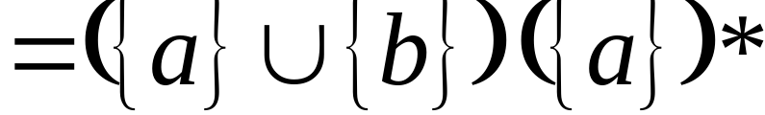
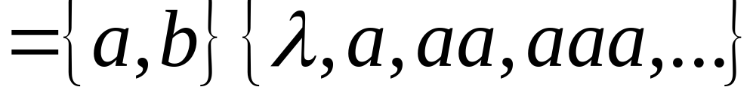
Example
Regular expression:
Prof. Busch - LSU

Slide 9

Example
Regular expression
Prof. Busch - LSU

Slide 10


Example
Regular expression
Prof. Busch - LSU

Slide 11


Example
Regular expression
= { all strings containing substring 00 }
Prof. Busch - LSU

Slide 12
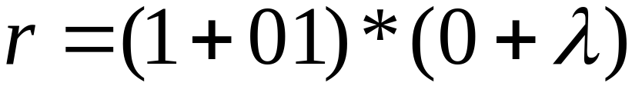
Example
Regular expression
= { all strings without substring 00 }
Prof. Busch - LSU

Slide 13

Equivalent Regular Expressions
Definition:
Regular expressions and
are equivalent if
Prof. Busch - LSU

Slide 14

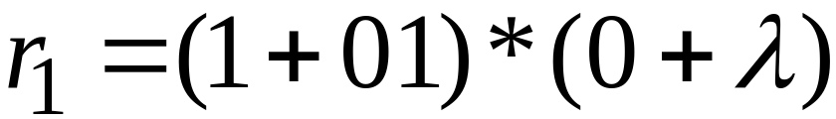

Example
= { all strings without substring 00 }
and
are equivalent
regular expressions
Prof. Busch - LSU

Slide 15
Regular Expressions and
Regular Languages
Prof. Busch - LSU

Slide 16
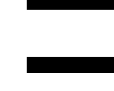
Theorem
Languages
Generated by
Regular Expressions
Regular
Languages
Prof. Busch - LSU

Slide 17
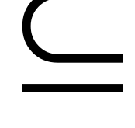

Proof:
Languages
Generated by
Regular Expressions
Regular
Languages
Languages
Generated by
Regular Expressions
Regular
Languages
Prof. Busch - LSU

Slide 18
Proof - Part 1
Languages
Generated by
Regular Expressions
Regular
Languages
For any regular expression
the language is regular
Proof by induction on the size of
Prof. Busch - LSU

Slide 19
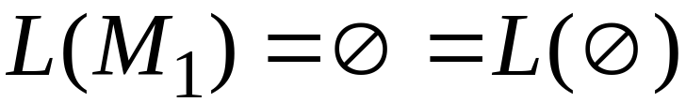
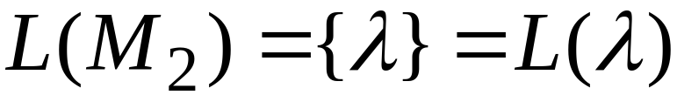

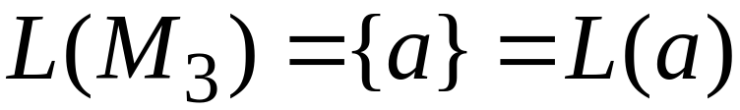
Induction Basis
Primitive Regular Expressions:
Corresponding
NFAs
regular
languages
Prof. Busch - LSU

Slide 20
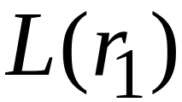
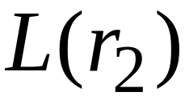
Inductive Hypothesis
Suppose
that for regular expressions and ,
and are regular languages
Prof. Busch - LSU

Slide 21
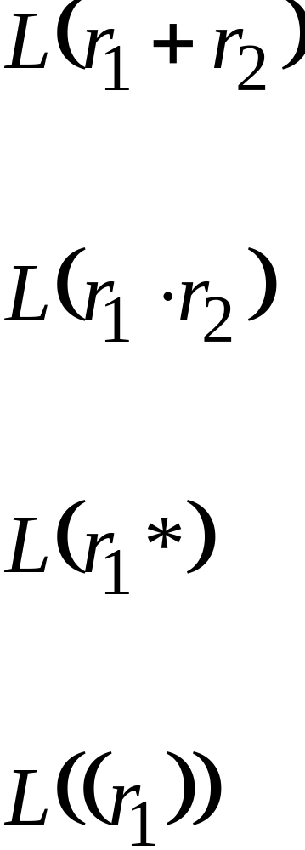
Inductive Step
We will prove:
Are regular
Languages
Prof. Busch - LSU

Slide 22
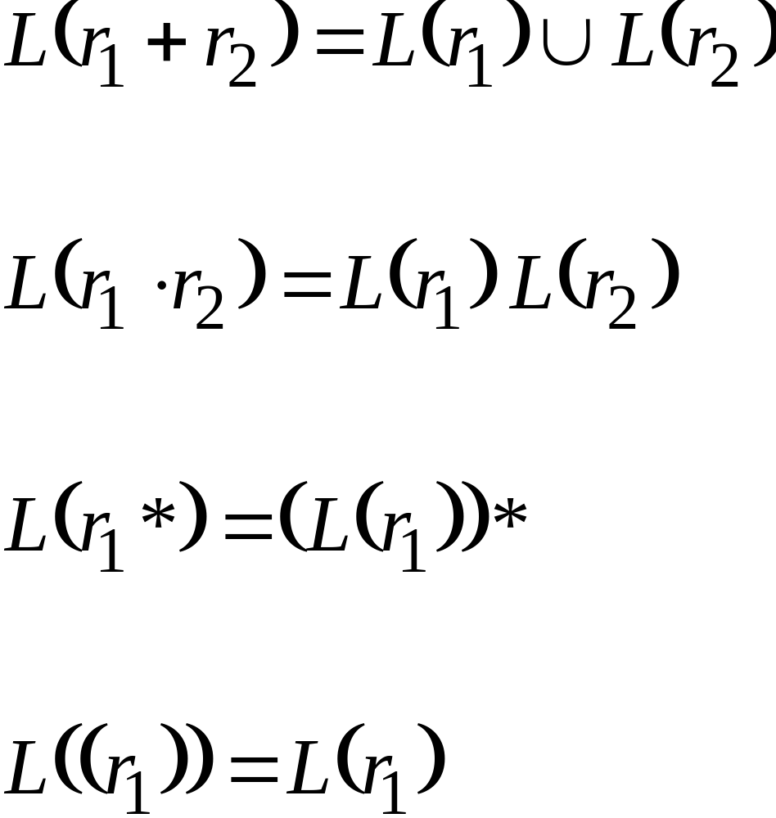
By definition of regular expressions:
Prof. Busch - LSU

Slide 23
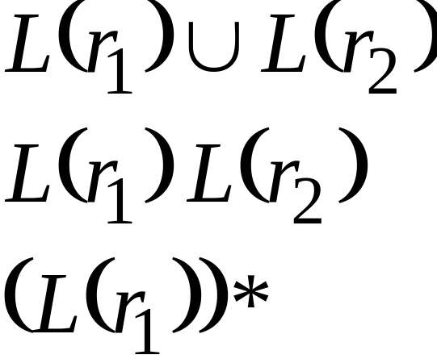
By inductive hypothesis we know:
and are regular languages
We also know:
Regular languages are closed under:
Union
Concatenation
Star
Prof. Busch - LSU

Slide 24
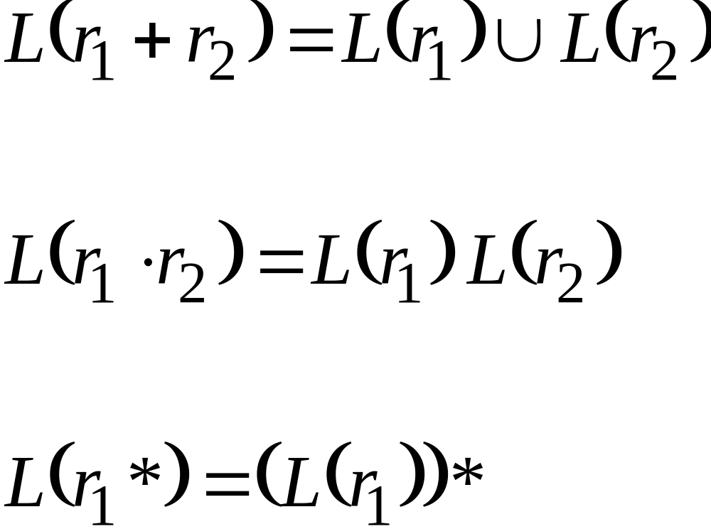
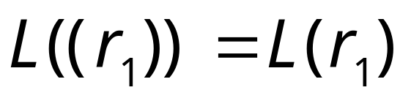
Therefore:
Are regular
languages
is trivially a regular language
(by induction hypothesis)
End of Proof-Part 1
Prof. Busch - LSU

Slide 25
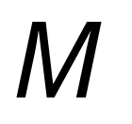
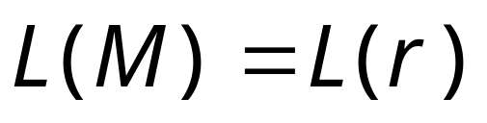
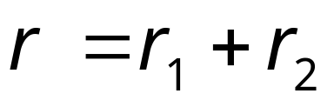



Using the regular closure of these operations,
we can construct recursively the NFA
that accepts
Example:
Prof. Busch - LSU

Slide 26
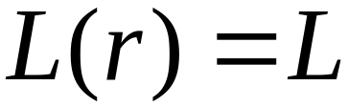
Proof - Part 2
Languages
Generated by
Regular Expressions
Regular
Languages
For any regular language there is
a regular expression with
We will convert an NFA that accepts
to a regular expression
Prof. Busch - LSU

Slide 27

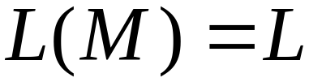
Since is regular, there is a
NFA that accepts it
Take it with a single accept state
Prof. Busch - LSU

Slide 28




From construct the equivalent
Generalized Transition Graph
in which transition labels are regular expressions
Example:
Corresponding
Generalized transition graph
Prof. Busch - LSU

Slide 29




Another Example:
Transition labels
are regular
expressions
Prof. Busch - LSU

Slide 30

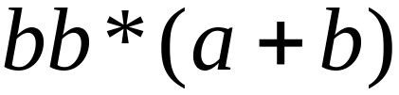
Reducing the states:
Transition labels
are regular
expressions
Prof. Busch - LSU

Slide 31
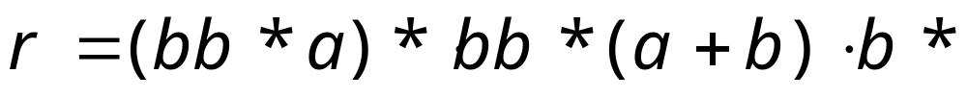
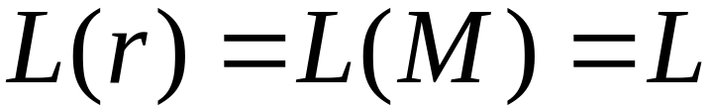
Resulting Regular Expression:
Prof. Busch - LSU

Slide 32









In General
Removing a state:
Prof. Busch - LSU

Slide 33





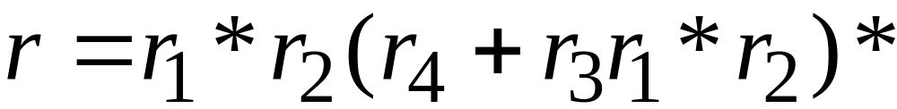
By repeating the process until
two states are left, the resulting graph is
Initial graph
Resulting graph
The resulting regular expression:
End of Proof-Part 2
Prof. Busch - LSU

Slide 34
Standard Representations of Regular Languages
Regular Languages
DFAs
Regular
Expressions
NFAs
Prof. Busch - LSU

Slide 35
When we say:
We are given
a Regular Language
We mean:
Language is in a standard
representation
(DFA, NFA, or Regular Expression)
Prof. Busch - LSU

