Slide 1
Properties of
Regular Languages
Prof. Busch - LSU

Slide 2




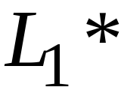
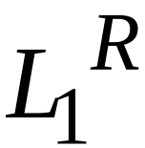


For regular languages and
we will prove that:
Union:
Concatenation:
Are regular
Languages
Star:
Reversal:
Complement:
Intersection:
Prof. Busch - LSU

Slide 3
We say: Regular languages are closed under
Union:
Concatenation:
Star:
Reversal:
Complement:
Intersection:
Prof. Busch - LSU

Slide 4



A useful transformation: use one accept state
NFA
2 accept states
Equivalent
NFA
1 accept state
Prof. Busch - LSU

Slide 5
In General
NFA
Equivalent NFA
Single
accepting
state
Prof. Busch - LSU

Slide 6
Extreme case
NFA without accepting state
Add an accepting state
without transitions
Prof. Busch - LSU

Slide 7
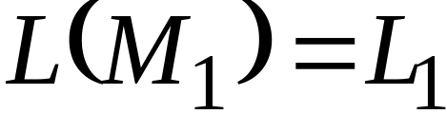
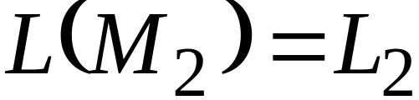


Take two languages
Regular language
Regular language
NFA
NFA
Single accepting state
Single accepting state
Prof. Busch - LSU

Slide 8

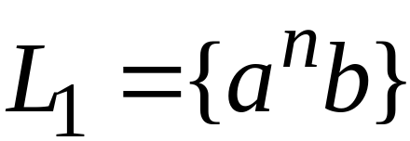
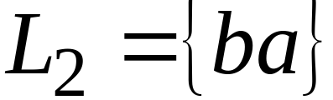
Example
Prof. Busch - LSU

Slide 9
Union
NFA for
Prof. Busch - LSU

Slide 10
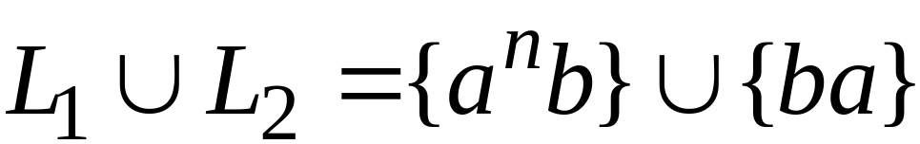
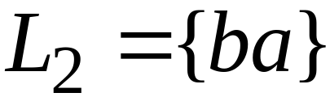
Example
NFA for
Prof. Busch - LSU

Slide 11
Concatenation
NFA for
Prof. Busch - LSU

Slide 12
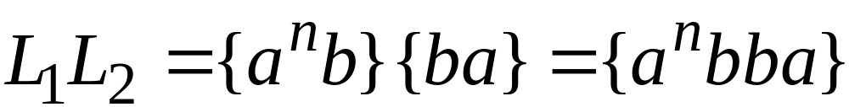
Example
NFA for
Prof. Busch - LSU

Slide 13
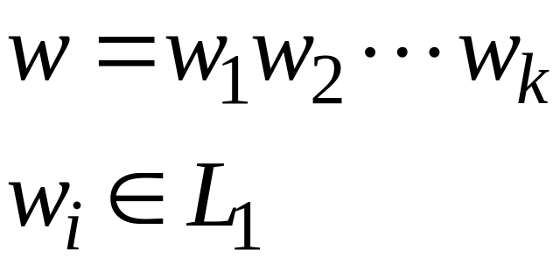
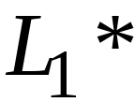
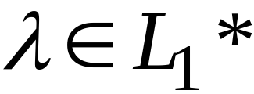
Star Operation
NFA for
Prof. Busch - LSU

Slide 14
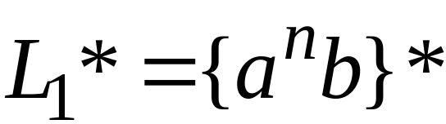
Example
NFA for
Prof. Busch - LSU

Slide 15

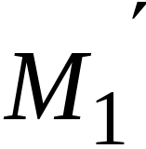
Reverse
NFA for
1. Reverse all transitions
2. Make initial state accepting state
and vice versa
Prof. Busch - LSU

Slide 16
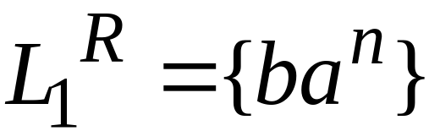
Example
Prof. Busch - LSU

Slide 17
Complement
1. Take the DFA that accepts
2. Make accepting states non-final,
and vice-versa
Prof. Busch - LSU

Slide 18

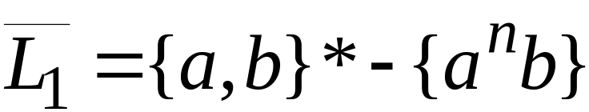
Example
Prof. Busch - LSU

Slide 19
Intersection
regular
We show
regular
regular
Prof. Busch - LSU

Slide 20




DeMorgan’s Law:
regular
regular
regular
regular
regular
Prof. Busch - LSU

Slide 21
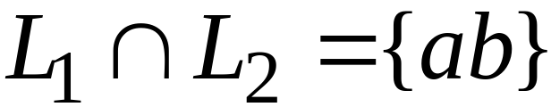
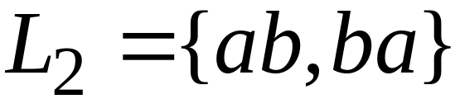
Example
regular
regular
regular
Prof. Busch - LSU

Slide 22

Another Proof for Intersection Closure
Machine
Machine
DFA
for
DFA
for
Construct a new DFA that accepts
simulates in parallel and
Prof. Busch - LSU

Slide 23

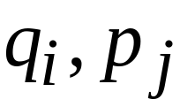
States in
State in
State in
Prof. Busch - LSU

Slide 24




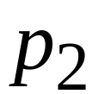
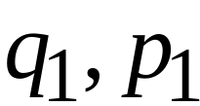
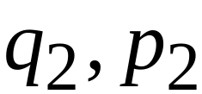
DFA
DFA
transition
transition
DFA
New transition
Prof. Busch - LSU

Slide 25

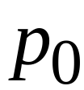
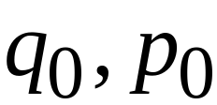
DFA
DFA
initial state
initial state
DFA
New initial state
Prof. Busch - LSU

Slide 26



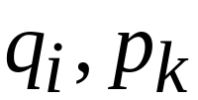
DFA
DFA
accept state
accept states
DFA
New accept states
Both constituents must be accepting states
Prof. Busch - LSU

Slide 27

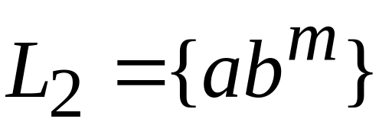








Example:
Prof. Busch - LSU

Slide 28
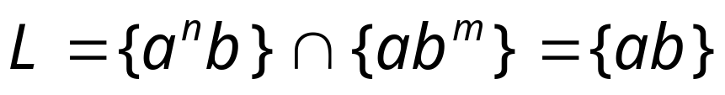







Automaton for intersection
Prof. Busch - LSU

Slide 29


simulates in parallel and
accepts string
if and only if:
accepts string
and accepts string
Prof. Busch - LSU

