Slide 1
Turing’s Thesis
Prof. Busch - LSU

Slide 2
Turing’s thesis (1930):
Any computation carried out
by mechanical means
can be performed by a Turing Machine
Prof. Busch - LSU

Slide 3
Algorithm:
An algorithm for a problem is a
Turing Machine which solves the problem
The algorithm describes the steps of
the mechanical means
This is easily translated to computation steps
of a Turing machine
Prof. Busch - LSU

Slide 4
When we say:
There exists an algorithm
We mean:
There exists a Turing Machine
that executes the algorithm
Prof. Busch - LSU

Slide 5
Variations of the
Turing Machine
Prof. Busch - LSU

Slide 6




The Standard Model
Infinite Tape
Read-Write Head
(Left or Right)
Control Unit
Deterministic
Prof. Busch - LSU

Slide 7
Variations of the Standard Model
Turing machines with:
Stay-Option
Semi-Infinite Tape
Off-Line
Multitape
Multidimensional
Nondeterministic
Different Turing Machine Classes
Prof. Busch - LSU

Slide 8
Same Power of two machine classes:
both classes accept the
same set of languages
We will prove:
each new class has the same power
with Standard Turing Machine
(accept Turing-Recognizable Languages)
Prof. Busch - LSU

Slide 9
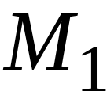
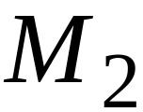
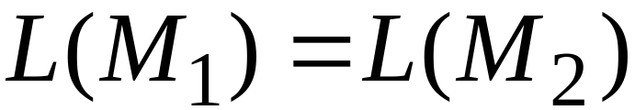
Same Power of two classes means:
for any machine of first class
there is a machine of second class
such that:
and vice-versa
Prof. Busch - LSU

Slide 10
Simulation:
A technique to prove same power.
Simulate the machine of one class
with a machine of the other class
Second Class
Simulation Machine
First Class
Original Machine
simulates
Prof. Busch - LSU

Slide 11
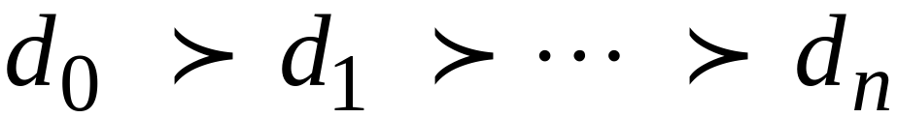
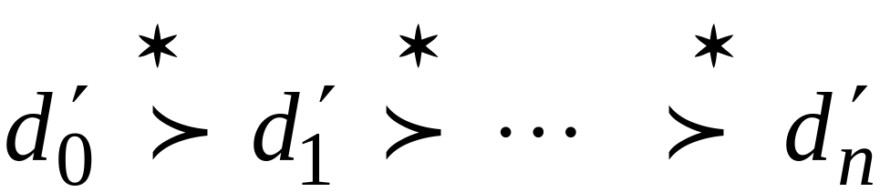
Configurations in the Original Machine
have corresponding configurations
in the Simulation Machine
Original Machine:
Simulation Machine:
Prof. Busch - LSU

Slide 12
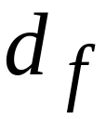
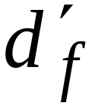
Accepting Configuration
Original Machine:
Simulation Machine:
the Simulation Machine
and the Original Machine
accept the same strings
Prof. Busch - LSU

Slide 13
Turing Machines with Stay-Option
The head can stay in the same position
Left, Right, Stay
L,R,S: possible head moves
Prof. Busch - LSU

Slide 14



Example:
Time 1
Time 2
Prof. Busch - LSU

Slide 15
Theorem:
Stay-Option machines
have the same power with
Standard Turing machines
Proof:
1. Stay-Option Machines
simulate Standard Turing machines
2.
Standard Turing machines
simulate Stay-Option machines
Prof. Busch - LSU

Slide 16
1. Stay-Option Machines
simulate Standard Turing machines
Trivial: any standard Turing machine
is also a Stay-Option machine
Prof. Busch - LSU

Slide 17
2.
Standard Turing machines
simulate Stay-Option machines
We need to simulate the stay head option
with two head moves, one left and one right
Prof. Busch - LSU

Slide 18




Stay-Option Machine
Simulation in Standard Machine
For every possible tape symbol
Prof. Busch - LSU

Slide 19
For other transitions nothing changes
Stay-Option Machine
Simulation in Standard Machine
Similar for Right moves
Prof. Busch - LSU

Slide 20

example of simulation
Stay-Option Machine:
1
2
Simulation in Standard Machine:
1
2
3
END OF PROOF
Prof. Busch - LSU

Slide 21

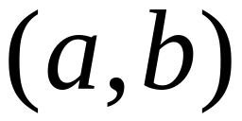
Multiple Track Tape
A useful trick to perform more
complicated simulations
One Tape
track 1
track 2
One head
One symbol
Prof. Busch - LSU

Slide 22
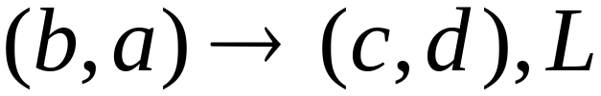
track 1
track 2
track 1
track 2
Prof. Busch - LSU

Slide 23
Semi-Infinite Tape
The head extends infinitely only to the right
.........
Initial position is the leftmost cell
When the head moves left from the border,
it returns to the same position
Prof. Busch - LSU

Slide 24
Theorem:
Semi-Infinite machines
have the same power with
Standard Turing machines
Proof:
1.
Standard Turing machines
simulate Semi-Infinite machines
2. Semi-Infinite Machines
simulate Standard Turing machines
Prof. Busch - LSU

Slide 25


1. Standard Turing machines simulate
Semi-Infinite machines:
Standard Turing Machine
a. insert special symbol
at left of input string
b. Add a self-loop
to every state
(except states with no
outgoing transitions)
Prof. Busch - LSU

Slide 26
2. Semi-Infinite tape machines simulate
Standard Turing machines:
Standard machine
.........
.........
Semi-Infinite tape machine
.........
Squeeze infinity of both directions
in one direction
Prof. Busch - LSU

Slide 27


Standard machine
.........
.........
reference point
Semi-Infinite tape machine with two tracks
Right part
.........
Left part
Prof. Busch - LSU

Slide 28
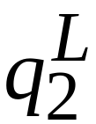
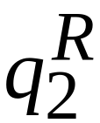
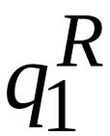
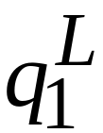
Standard machine
Semi-Infinite tape machine
Left part
Right part
Prof. Busch - LSU

Slide 29

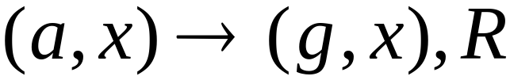
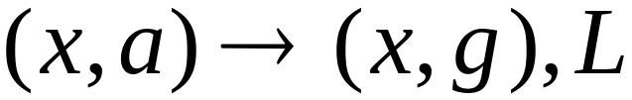

Standard machine
Semi-Infinite tape machine
Right part
Left part
For all tape symbols
Prof. Busch - LSU

Slide 30
Time 1
Standard machine
.........
.........
Semi-Infinite tape machine
Right part
.........
Left part
Prof. Busch - LSU

Slide 31

Time 2
Standard machine
.........
.........
Semi-Infinite tape machine
Right part
.........
Left part
Prof. Busch - LSU

Slide 32
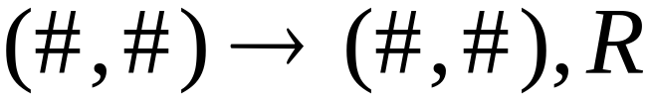
At the border:
Semi-Infinite tape machine
Right part
Left part
Prof. Busch - LSU

Slide 33
Semi-Infinite tape machine
Time 1
Right part
.........
Left part
Time 2
Right part
.........
Left part
END OF PROOF
Prof. Busch - LSU

Slide 34
The Off-Line Machine
Input File
read-only (once)
Input string
Appears on
input file only
Input string
Control Unit
(state machine)
Tape
read-write
Prof. Busch - LSU

Slide 35
Theorem:
Off-Line machines
have the same power with
Standard Turing machines
Proof:
1. Off-Line machines
simulate Standard Turing machines
2.
Standard Turing machines
simulate Off-Line machines
Prof. Busch - LSU

Slide 36
1. Off-line machines simulate
Standard Turing Machines
Off-line machine:
1. Copy input file to tape
2. Continue computation as in
Standard Turing machine
Prof. Busch - LSU

Slide 37
Standard machine
Off-line machine
Input File
Tape
1. Copy input file to tape
Prof. Busch - LSU

Slide 38
Standard machine
Off-line machine
Input File
Tape
2. Do computations as in Turing machine
Prof. Busch - LSU

Slide 39
2. Standard Turing machines simulate
Off-Line machines:
Use a Standard machine with
a four-track tape to keep track of
the Off-line input file and tape contents
Prof. Busch - LSU

Slide 40



Off-line Machine
Input File
Tape
Standard Machine -- Four track tape
Input File
head position
Tape
head position
Prof. Busch - LSU

Slide 41
Reference point
(uses special symbol # )
Input File
head position
Tape
head position
Repeat for each state transition:
Return to reference point
Find current input file symbol
Find current tape symbol
Make transition
END OF PROOF
Prof. Busch - LSU

Slide 42
Multi-tape Turing Machines
Control unit
(state machine)
Tape 1
Tape 2
Input string
Input string appears on Tape 1
Prof. Busch - LSU

Slide 43
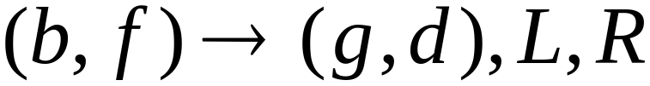
Tape 1
Time 1
Tape 2
Tape 1
Time 2
Tape 2
Prof. Busch - LSU

Slide 44
Theorem:
Multi-tape machines
have the same power with
Standard Turing machines
Proof:
1. Multi-tape machines
simulate Standard Turing machines
2.
Standard Turing machines
simulate Multi-tape machines
Prof. Busch - LSU

Slide 45
1. Multi-tape machines simulate
Standard Turing Machines:
Trivial: Use just one tape
Prof. Busch - LSU

Slide 46
2. Standard Turing machines simulate
Multi-tape machines:
Standard machine:
Uses a multi-track tape to simulate
the multiple tapes
A tape of the Multi-tape machine
corresponds to a pair of tracks
Prof. Busch - LSU

Slide 47

Multi-tape Machine
Tape 1
Tape 2
Standard machine with four track tape
Tape 1
head position
Tape 2
head position
Prof. Busch - LSU

Slide 48
Reference point
Tape 1
head position
Tape 2
head position
Repeat for each state transition:
Return to reference point
Find current symbol in Tape 1
Find current symbol in Tape 2
Make transition
END OF PROOF
Prof. Busch - LSU

Slide 49
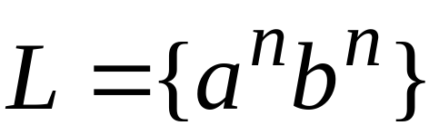
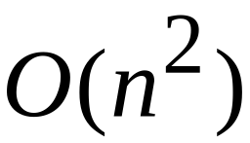
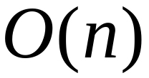
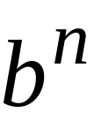
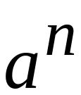
Same power doesn’t imply same speed:
Standard Turing machine:
time
Go back and forth times
to match the a’s with the b’s
2-tape machine:
time
1. Copy to tape 2
( steps)
2. Compare on tape 1
and tape 2
( steps)
Prof. Busch - LSU

Slide 50


Multidimensional Turing Machines
2-dimensional tape
MOVES: L,R,U,D
HEAD
U: up D: down
Position: +2, -1
Prof. Busch - LSU

Slide 51
Theorem:
Multidimensional machines
have the same power with
Standard Turing machines
Proof:
1. Multidimensional machines
simulate Standard Turing machines
2.
Standard Turing machines
simulate Multi-Dimensional machines
Prof. Busch - LSU

Slide 52
1. Multidimensional machines simulate
Standard Turing machines
Trivial: Use one dimension
Prof. Busch - LSU

Slide 53
2. Standard Turing machines simulate
Multidimensional machines
Standard machine:
Use a two track tape
Store symbols in track 1
Store coordinates in track 2
Prof. Busch - LSU

Slide 54


2-dimensional machine
Standard Machine
symbols
coordinates
Prof. Busch - LSU

Slide 55
Standard machine:
Repeat for each transition followed
in the 2-dimensional machine:
Update current symbol
Compute coordinates of next position
Go to new position
END OF PROOF
Prof. Busch - LSU

Slide 56

Nondeterministic Turing Machines
Choice 1
Choice 2
Allows Non Deterministic Choices
Prof. Busch - LSU

Slide 57
Time 0
Time 1
Choice 1
Choice 2
Prof. Busch - LSU

Slide 58

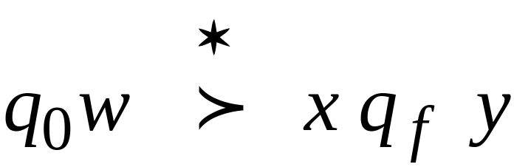
Input string is accepted if
there is a computation:
Initial configuration
Final Configuration
Any accept state
There is a computation:
Prof. Busch - LSU

Slide 59
Theorem:
Nondeterministic machines
have the same power with
Standard Turing machines
Proof:
1. Nondeterministic machines
simulate Standard Turing machines
2.
Standard Turing machines
simulate Nondeterministic machines
Prof. Busch - LSU

Slide 60
1. Nondeterministic Machines simulate
Standard (deterministic) Turing Machines
Trivial: every deterministic machine
is also nondeterministic
Prof. Busch - LSU

Slide 61
2. Standard (deterministic) Turing machines
simulate Nondeterministic machines:
Deterministic machine:
Uses a 2-dimensional tape
(which is equivalent to 1-dimensional tape)
Stores all possible computations
of the non-deterministic machine
on the 2-dimensional tape
Prof. Busch - LSU

Slide 62
All possible computation paths
Initial state
Step 1
Step 2
Step i
reject
accept
infinite
path
Step i+1
Prof. Busch - LSU

Slide 63
The Deterministic Turing machine
simulates all possible computation paths:
simultaneously
step-by-step
in a breadth-first search fashion
Prof. Busch - LSU

Slide 64
NonDeterministic machine
Time 0
Deterministic machine
current
configuration
Prof. Busch - LSU

Slide 65

NonDeterministic machine
Time 1
Choice 1
Choice 2
Deterministic machine
Computation 1
Computation 2
Prof. Busch - LSU

Slide 66
Deterministic Turing machine
Repeat
  For each configuration in current step
  of non-deterministic machine,
if there are two or more choices:
1. Replicate configuration
2. Change the state in the replicas
Until either the input string is accepted
or rejected in all configurations
END OF PROOF
Prof. Busch - LSU

Slide 67
Remark:
The simulation takes in the worst case exponential time compared to the shortest accepting path length of the
nondeterministic machine
Prof. Busch - LSU

