Slide 1
A Universal Turing Machine
Prof. Busch - LSU

Slide 2
A limitation of Turing Machines:
Turing Machines are “hardwired”
they execute
only one program
Real Computers are re-programmable
Prof. Busch - LSU

Slide 3
Solution:
Universal Turing Machine
Attributes:
Reprogrammable machine
Simulates any other Turing Machine
Prof. Busch - LSU

Slide 4

Universal Turing Machine
simulates any Turing Machine
Input of Universal Turing Machine:
Description of transitions of
Input string of
Prof. Busch - LSU

Slide 5
Tape 1
Three tapes
Description of
Universal
Turing
Machine
Tape 2
Tape Contents of
Tape 3
State of
Prof. Busch - LSU

Slide 6
Tape 1
Description of
We describe Turing machine
as a string of symbols:
We encode as a string of symbols
Prof. Busch - LSU

Slide 7








Alphabet Encoding
Symbols:
Encoding:
Prof. Busch - LSU

Slide 8






State Encoding
States:
Encoding:
Head Move Encoding
Move:
Encoding:
Prof. Busch - LSU

Slide 9
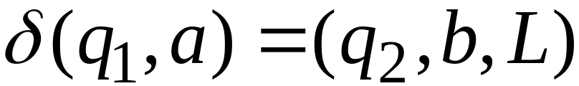
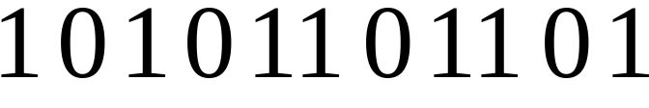
Transition Encoding
Transition:
Encoding:
separator
Prof. Busch - LSU

Slide 10
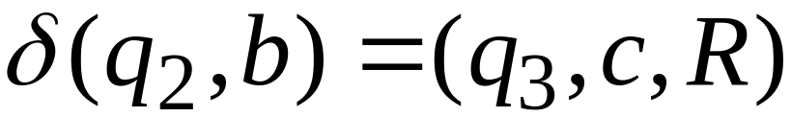

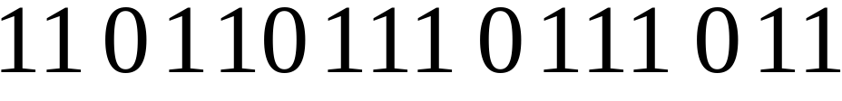
Turing Machine Encoding
Transitions:
Encoding:
separator
Prof. Busch - LSU

Slide 11
Tape 1 contents of Universal Turing Machine:
binary encoding
of the simulated machine
Tape 1
Prof. Busch - LSU

Slide 12
A Turing Machine is described
with a binary string of 0’s and 1’s
Therefore:
The set of Turing machines
forms a language:
each string of this language is
the binary encoding of a Turing Machine
Prof. Busch - LSU

Slide 13
Language of Turing Machines
L = { 010100101,
00100100101111,
111010011110010101,
…… }
(Turing Machine 1)
(Turing Machine 2)
……
Prof. Busch - LSU

Slide 14
Countable Sets
Prof. Busch - LSU

Slide 15
Infinite sets are either:
Countable
or
Uncountable
Prof. Busch - LSU

Slide 16
Countable set:
There is a one to one correspondence
of
elements of the set
to
Natural numbers (Positive Integers)
(every element of the set is mapped to a number
such that no two elements are mapped to same number)
Prof. Busch - LSU

Slide 17
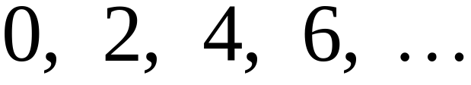
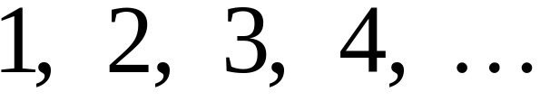


Example:
The set of even integers
is countable
Even integers:
(positive)
Correspondence:
Positive integers:
corresponds to
Prof. Busch - LSU

Slide 18
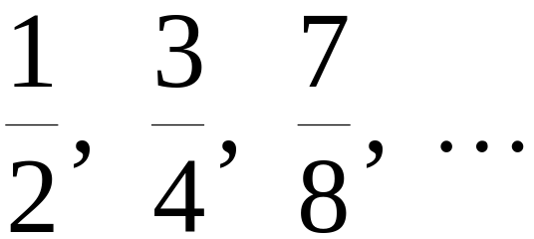
Example:
The set of rational numbers
is countable
Rational numbers:
Prof. Busch - LSU

Slide 19
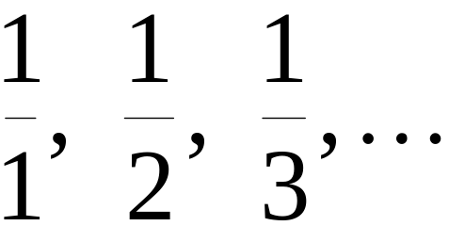
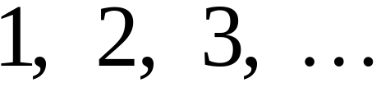
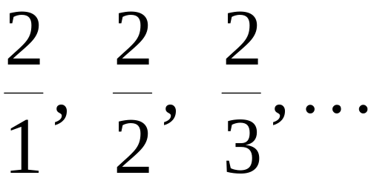
Naïve Approach
Nominator 1
Rational numbers:
Correspondence:
Positive integers:
Doesn’t work:
we will never count
numbers with nominator 2:
Prof. Busch - LSU

Slide 20










Better Approach
Prof. Busch - LSU

Slide 21
Prof. Busch - LSU

Slide 22
Prof. Busch - LSU

Slide 23
Prof. Busch - LSU

Slide 24
Prof. Busch - LSU

Slide 25
Prof. Busch - LSU

Slide 26
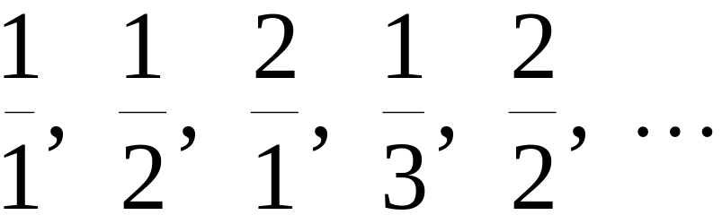
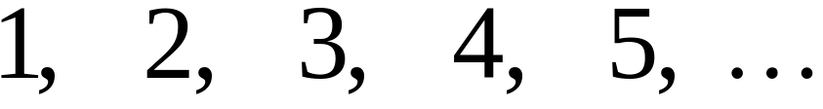
Rational Numbers:
Correspondence:
Positive Integers:
Prof. Busch - LSU

Slide 27
We proved:
the set of rational numbers is countable
by describing an enumeration procedure
(enumerator)
for the correspondence to natural numbers
Prof. Busch - LSU

Slide 28


Definition
Let be a set of strings (Language)
An enumerator for is a Turing Machine
that generates (prints on tape)
all the strings of one by one
and
each string is generated in finite time
Prof. Busch - LSU

Slide 29
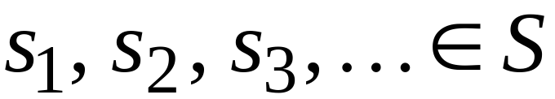
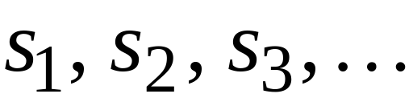

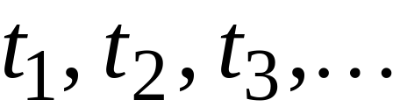
strings
Enumerator
Machine for
output
(on tape)
Finite time:
Prof. Busch - LSU

Slide 30







Enumerator Machine
Configuration
Time 0
prints
Time
Prof. Busch - LSU

Slide 31






prints
Time
prints
Time
Prof. Busch - LSU

Slide 32
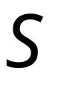
Observation:
If for a set there is an enumerator,
then the set is countable
The enumerator describes the
correspondence of to natural numbers
Prof. Busch - LSU

Slide 33
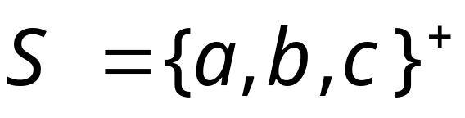
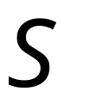
Example:
The set of strings
is countable
Approach:
We will describe an enumerator for
Prof. Busch - LSU

Slide 34






Naive enumerator:
Produce the strings in lexicographic order:
Doesn’t work:
strings starting with
will never be produced
Prof. Busch - LSU

Slide 35
Better procedure:
Proper Order
(Canonical Order)
1. Produce all strings of length 1
2. Produce all strings of length 2
3. Produce all strings of length 3
4. Produce all strings of length 4
..........
Prof. Busch - LSU

Slide 36

















length 1
Produce strings in
Proper Order:
length 2
length 3
Prof. Busch - LSU

Slide 37
Theorem:
The set of all Turing Machines
is countable
Proof:
Any Turing Machine can be encoded
with a binary string of 0’s and 1’s
Find an enumeration procedure
for the set of Turing Machine strings
Prof. Busch - LSU

Slide 38
Enumerator:
Repeat
1. Generate the next binary string
of 0’s and 1’s in proper order
2. Check if the string describes a
Turing Machine
if YES: print string on output tape
if NO: ignore string
Prof. Busch - LSU

Slide 39





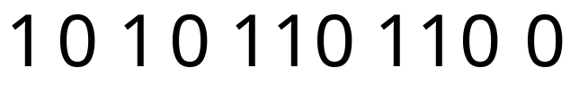

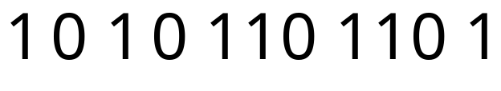
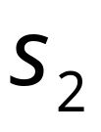
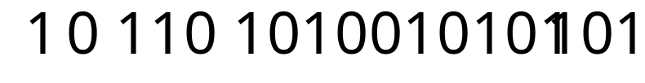
Binary strings
Turing Machines
End of Proof
Prof. Busch - LSU

Slide 40
Uncountable Sets
Prof. Busch - LSU

Slide 41
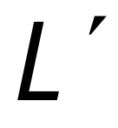
We will prove that there is a language
which is not accepted by any Turing machine
Technique:
Turing machines are countable
Languages are uncountable
(there are more languages than Turing Machines)
Prof. Busch - LSU

Slide 42
Definition:
A set is uncountable
if it is not countable
We will prove that there is a language
which is not accepted by any Turing machine
Prof. Busch - LSU

Slide 43
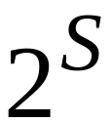
Theorem:
If is an infinite countable set, then
the powerset of is uncountable.
(the powerset is the set whose elements
are all possible sets made from the elements of )
Prof. Busch - LSU

Slide 44
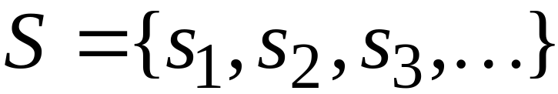
Proof:
Since is countable, we can write
Elements of
Prof. Busch - LSU

Slide 45
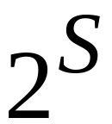

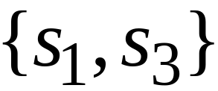
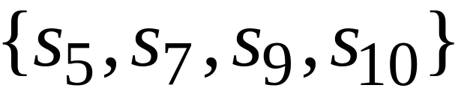
Elements of the powerset have the form:
……
Prof. Busch - LSU

Slide 46




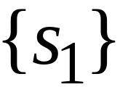

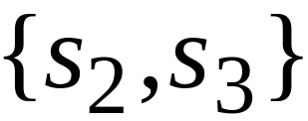
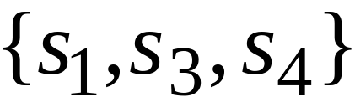
We encode each element of the powerset
with a binary string of 0’s and 1’s
Powerset
element
Binary encoding
(in arbitrary order)
Prof. Busch - LSU

Slide 47
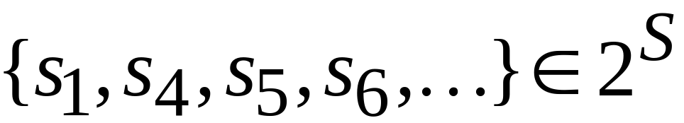
Observation:
Every infinite binary string corresponds
to an element of the powerset:
Example:
Corresponds to:
Prof. Busch - LSU

Slide 48
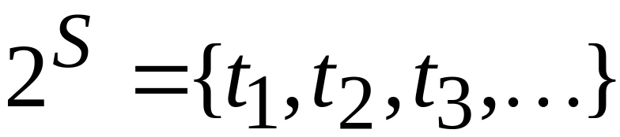
Let’s assume (for contradiction)
that the powerset is countable
Then: we can enumerate
the elements of the powerset
Prof. Busch - LSU

Slide 49




Powerset
element
suppose that this is the respective
Binary encoding
Prof. Busch - LSU

Slide 50
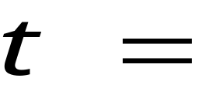
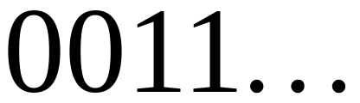
Take the binary string whose bits
are the complement of the diagonal
Binary string:
(birary complement of diagonal)
Prof. Busch - LSU

Slide 51

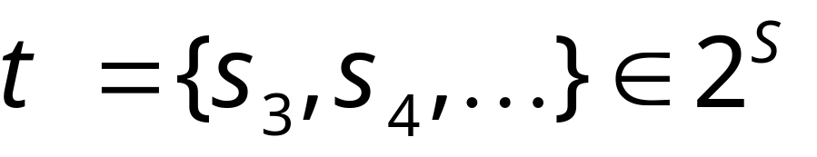
The binary string
corresponds
to an element of
the powerset :
Prof. Busch - LSU

Slide 52


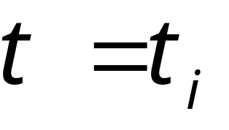
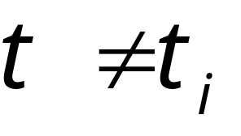
Thus, must be equal to some
However,
the i-th bit in the encoding of is
the complement of the bit of , thus:
i-th
Contradiction!!!
Prof. Busch - LSU

Slide 53
Since we have a contradiction:
The powerset of is uncountable
End of proof
Prof. Busch - LSU

Slide 54
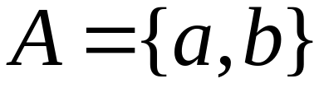
An Application: Languages
Consider Alphabet :
The set of all Strings:
infinite and countable
(we can enumerate the strings
in proper order)
Prof. Busch - LSU

Slide 55
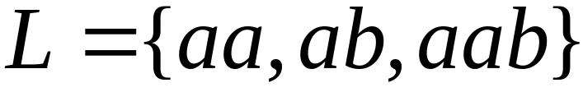
Consider Alphabet :
The set of all Strings:
infinite and countable
Any language is a subset of :
Prof. Busch - LSU

Slide 56
Consider Alphabet :
The set of all Strings:
infinite and countable
The powerset of contains all languages:
uncountable
Prof. Busch - LSU

Slide 57
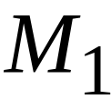
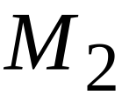
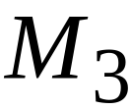



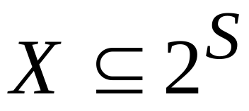
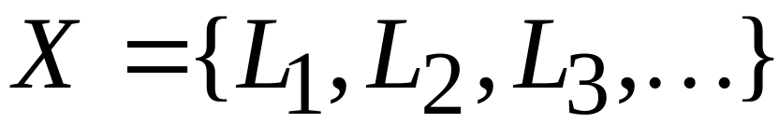

Consider Alphabet :
countable
Turing machines:
accepts
Languages accepted
By Turing Machines:
countable
Denote:
Note:
countable
Prof. Busch - LSU

Slide 58

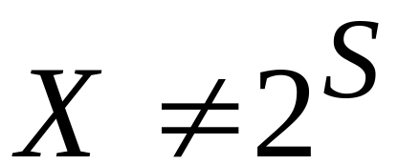
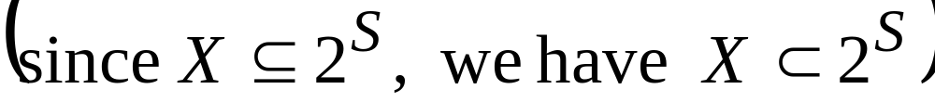
Languages accepted
by Turing machines:
countable
All possible languages:
uncountable
Therefore:
Prof. Busch - LSU

Slide 59

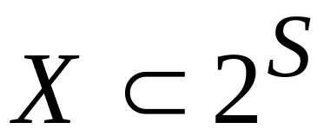
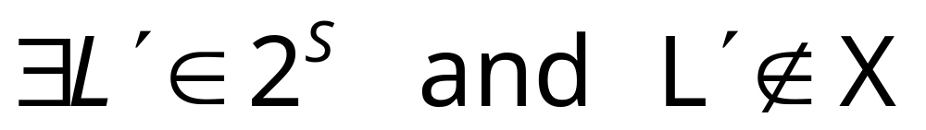

Conclusion:
There is a language not accepted
by any Turing Machine:
(Language cannot be described
by any algorithm)
Prof. Busch - LSU

Slide 60

Non Turing-Acceptable Languages
Turing-Acceptable
Languages
Prof. Busch - LSU

Slide 61
Note that:
is a multi-set (elements may repeat)
since a language may be accepted
by more than one Turing machine
However, if we remove the repeated elements,
the resulting set is again countable since every element
still corresponds to a positive integer
Prof. Busch - LSU

