Slide 1
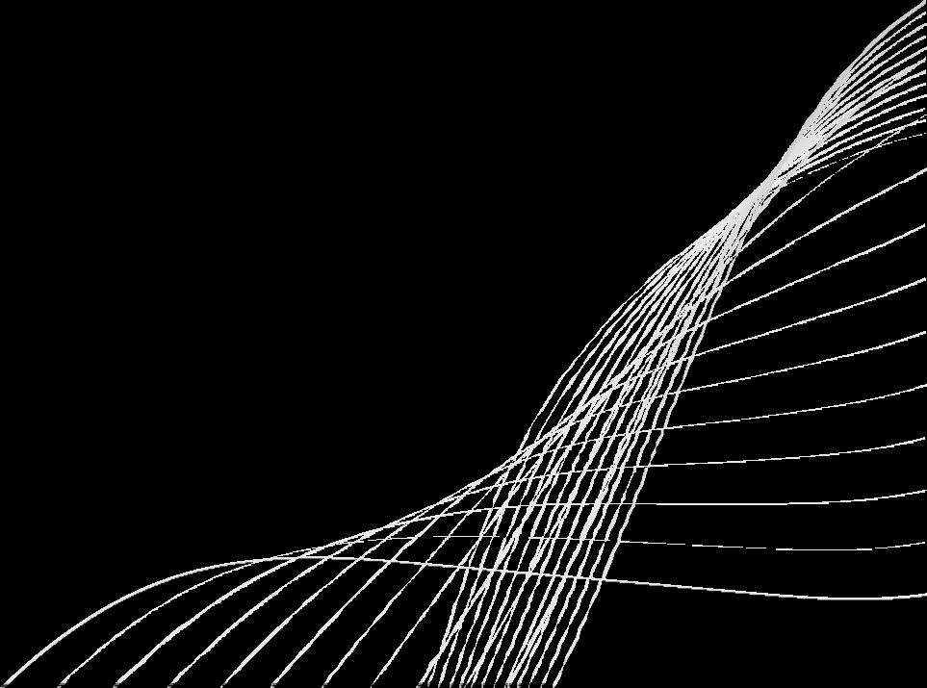
DAYA : Document Aware hYbrid Architecture
By : Roney BABA

Slide 2
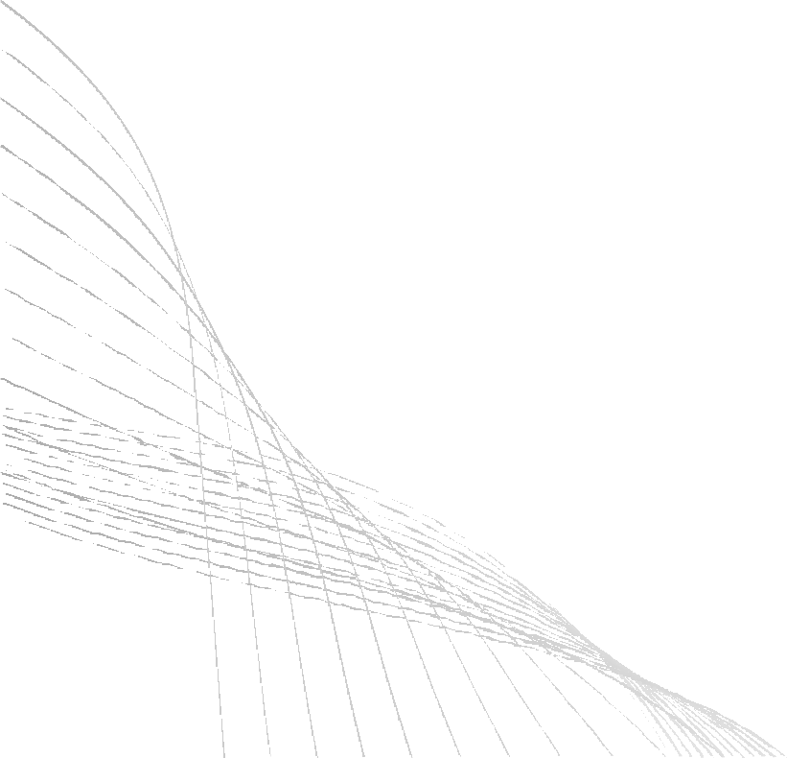
Problem Statement
Traditional RAG pipelines rely on arbitrary token-based chunking and text-only OCR, causing loss of document structure and section hierarchy.
Current enterprise RAG pipelines lack dedicated frameworks for parsing corporate presentations. As a result, critical visual insights from charts and graphs are entirely lost when processing long, highly sensitive slide decks.

Slide 3
Objectives
Eliminate arbitrary token chunking
Build a hierarchical document index in form of a tree
Integrate multi-modal processing
Enable intelligent query handling and retrieval
Deliver grounded and traceable responses
Design a modular, production-ready pipeline

Slide 4
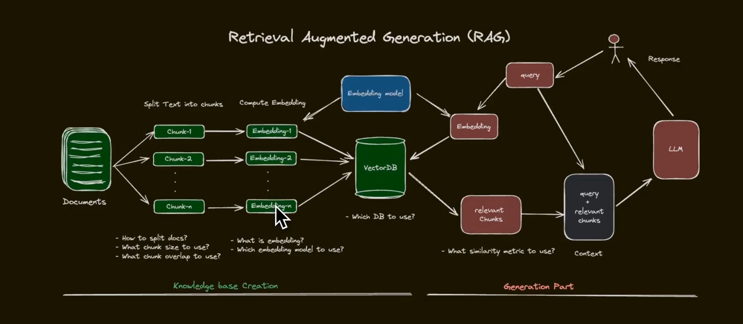
Introduction
Why do we need RAG ?

Slide 5
Issues
Chunking
Semantic Search

Slide 6
Introducing DAYA

Slide 7
Why DAYA Works?
NO Chunking
Relevant searching

Slide 8
Loss of Context
The Question: "Where is the inspection checklist before lifting"
What a Complete Answer Requires:
The 5-point inspection checklist on Page 20 (Ropes, Chains, Hooks, Safety Latch, Drum Spooling)
Traditional RAG Returned responsibility bullets from Page 19 instead of the actual checklist on Page 20.
Why it failed — Chunk Isolation:
Content is split into fixed chunks processed independently
The retrieved chunk ended exactly at "At a minimum, the installer must…"
The actual checklist items lived in the next chunk — never seen by the model
No mechanism to look across chunk boundaries for continuation of content
Result: A confident-sounding but factually wrong answer pointing to the wrong list

Slide 9
How DAYA Solves
Correctly identified the inspection checklist on Page 20 and reproduced all 5 items accurately. (Ropes, Chains, Hooks, Safety Latch, Drum Spooling)
Why it succeeded — No Chunking:
Operates at the document-structure level: section → page → figures
The checklist header and its items were never split across boundaries
Kept the checklist content and associated rigging instructions together as one coherent unit
No artificial chunk cutoffs meant no content was left just out of reach
Result: The complete, correct list — retrieved and reproduced in full

Slide 10
Lack of Reasoning
The Question: "How do I change the dehydrator and what safety precautions apply?"
What a Complete Answer Requires:
Dehydrator replacement procedure — Page 29
Refrigerant-related safety warnings — Page 6
Traditional RAG Retrieved the mechanical procedure on Page 29, but missed the critical Refrigerant Warning on Page 6.
Why it failed — Static, Single-Hop Retrieval:
Matched content based on direct keyword similarity only
Retrieved the dehydrator procedure and stopped there
Could not reason that a dehydrator works with refrigerant
Never made the second "hop" to connect the procedure → working fluid → refrigerant warning
Result: A partial answer that omits a critical safety hazard

Slide 11
How DAYA Solves
Retrieved both the dehydrator replacement procedure (Page 29) AND the critical Refrigerant Warning (Page 6).
Why it succeeded — Structure-Aware Reasoning:
Located the dehydrator replacement procedure on Page 29
Noticed Step 4 referenced "refrigerant leaks" — flagged it as a logical gap
Inferred that refrigerant safety guidance was relevant to complete the answer
Followed document structure to the safety section and retrieved the Refrigerant Warning on Page 6
Result: A complete, safe, and accurate answer — no critical hazard left behind

Slide 12
Hallucinations
The Question: "When is glycol pumping required in closed-loop free cooling? "
What a Complete Answer Requires:
An accurate reflection of the Closed-Loop configuration as described on Pages 20–21 — without mixing in open-loop details.
Traditional RAG Retrieved the mechanical procedure on Page 29, but missed the critical Refrigerant Warning on Page 6.
Why it failed — Context Confusions:
Both open-loop and closed-loop sections share overlapping terms: "free cooling," "valve," "glycol," "flow"
Vector RAG pulled passages from both configurations simultaneously
The LLM, now seeing mixed context, merged details across systems
Gaps were filled with plausible-sounding guesses rather than verified facts
Result: A hallucinated answer that contradicts the manual — wrong system, wrong pump role

Slide 13
How DAYA Solves
Accurately answered using only the Closed-Loop section (Pages 20–21), without importing any open-loop details.
Why it succeeded — Structure-Aware Reasoning:
Used document structure to navigate directly to the Closed-Loop section
Naturally excluded the Open-Loop content that shared overlapping terminology
Never conflated the free-cooling valve (open-loop only) with closed-loop components
Connected only the logical points relevant to the closed-loop glycol pump
Result: A clean, accurate answer with zero cross-contamination from adjacent sections

Slide 14
Tech Stack Used
Category | Technologies & Tools Used
Language & Core | Python 3.10+, Python Abstract Base Classes (ABCs), Google Colab SDK
LLMs & AI Models | openai/gpt-oss-120b , Meta Llama 4 Scout (llama-4-scout-17b-16e-instruct)
Document Parsing | IBM Docling , PyPDF
Embeddings | Jina AI Embeddings v5 (jina-embeddings-v5-text-small) , SentenceTransformers
Vector Database | ChromaDB (In-memory & Persistent Client)
Inference & Cloud APIs | Groq Cloud API

Slide 15
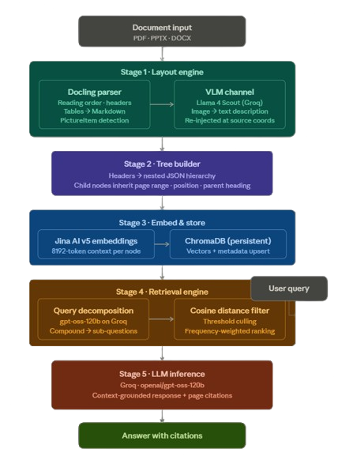
System Flow Chart

Slide 16
System Architecture
1. Document Input
Accepts multi-format files — PDF, PPTX, and DOCX — as raw input to the pipeline.
2. Layout Engine
IBM Docling parses reading order, structural headers, and tables. Images are detected as PictureItem objects and routed to Meta Llama 4 Scout (VLM), which converts them into structured text descriptions.
3. Tree Builder
Document sections and headers are mapped into a nested JSON hierarchy. Each child node automatically inherits contextual metadata — page range, position index, and parent heading — from its parent node.
4. Embed & Store
Every node's text is embedded using Jina AI Embeddings v5 (supports up to 8192 tokens). The resulting vectors along with their metadata are upserted into ChromaDB for persistent storage.

Slide 17
System Architecture
5. Retrieval Engine
The incoming user query is decomposed into individual sub-questions by gpt-oss-120b running on Groq. Each sub-question is independently embedded and matched against ChromaDB using a cosine distance threshold filter. Surviving nodes are ranked by a frequency-weighted engine to identify the most relevant sections.
6. LLM Inference & Response
Top-ranked nodes are assembled in reading order and injected into the LLM's context window. Groq (gpt-oss-120b) generates the final answer, strictly grounded in retrieved content, with page-level citations appended to every statement.

Slide 18
Outcomes
Context-intact document retrieval
Zero visual data loss
Hallucination-free responses
Scalable enterprise-grade architecture
Modular and swappable codebase

Slide 19
THANK YOU

