Slide 1
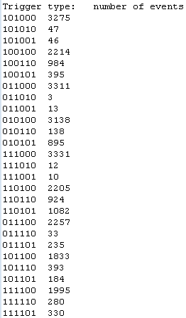
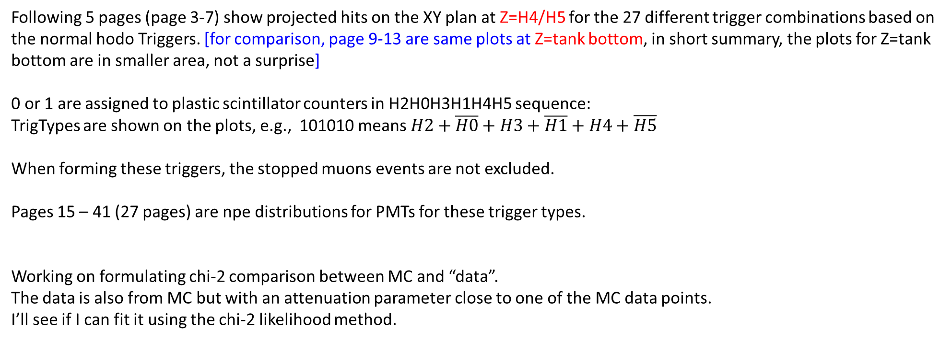
Contents of these slides
Following 5 pages (page 3-7) show projected hits on the XY plan at Z=H4/H5 for the 27 different trigger combinations based on the normal hodo Triggers. [for comparison, page 9-13 are same plots at Z=tank bottom, in short summary, the plots for Z=tank bottom are in smaller area, not a surprise]
0 or 1 are assigned to plastic scintillator counters in H2H0H3H1H4H5 sequence:
TrigTypes are shown on the plots, e.g., 101010 means $H2+\overline{H0}+H3+\overline{H1}+H4+\overline{H5}$
When forming these triggers, the stopped muons events are not excluded.
Pages 15 – 41 (27 pages) are npe distributions for PMTs for these trigger types.
Working on formulating chi-2 comparison between MC and “data”.
The data is also from MC but with an attenuation parameter close to one of the MC data points.
I’ll see if I can fit it using the chi-2 likelihood method.
Number of events for each trigger type
(from 30k total simulated muons)
4/19/2019

Slide 2
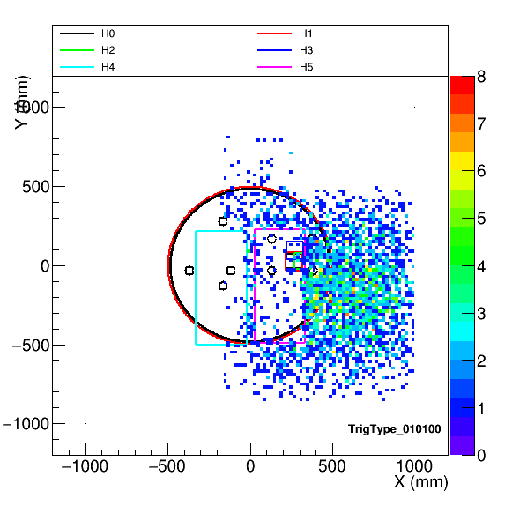
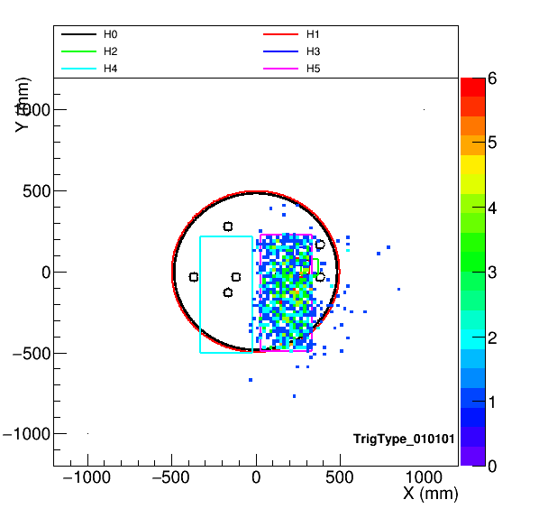
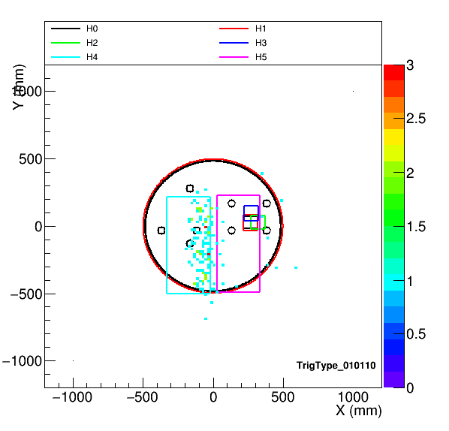
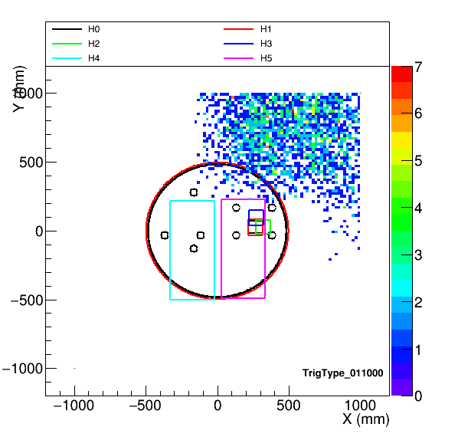
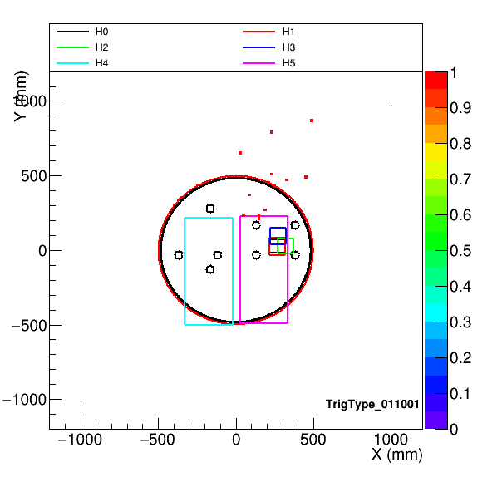


Slide 3
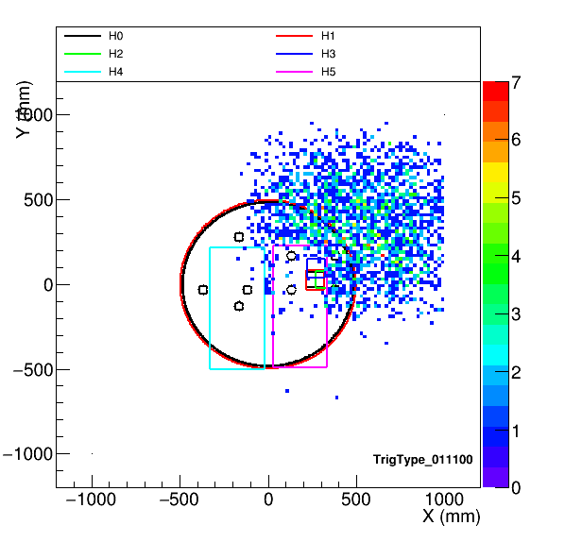
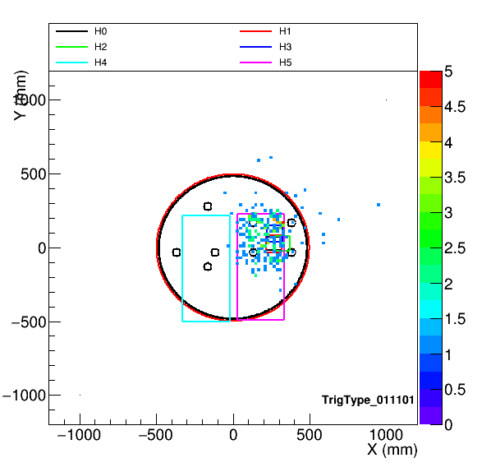

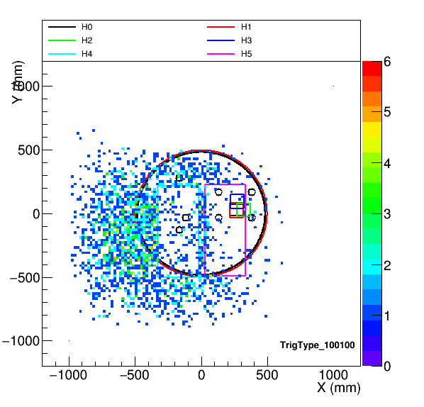
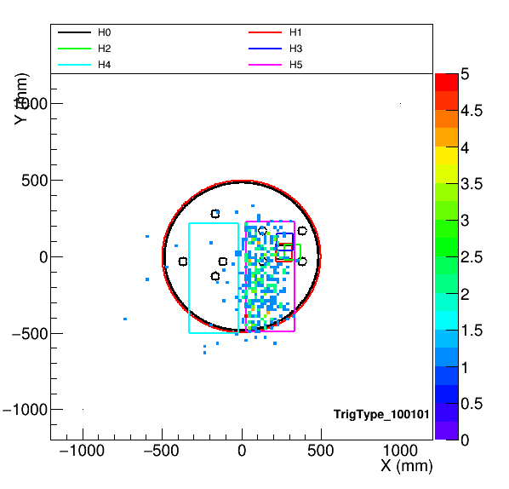
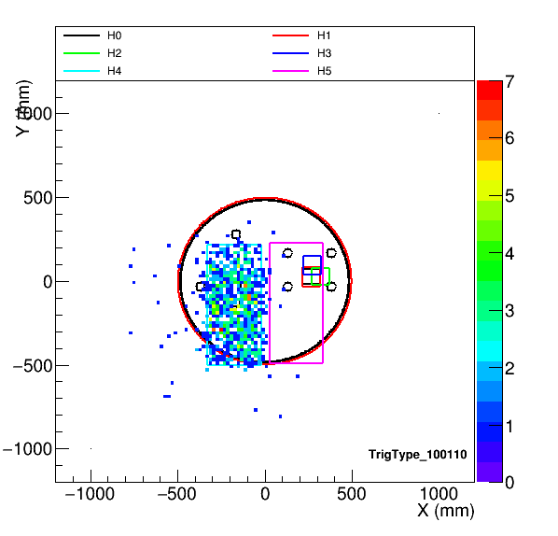

Slide 4
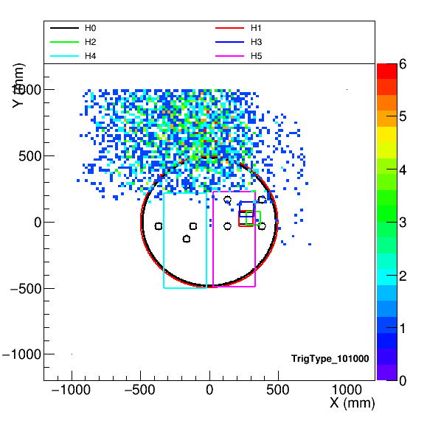


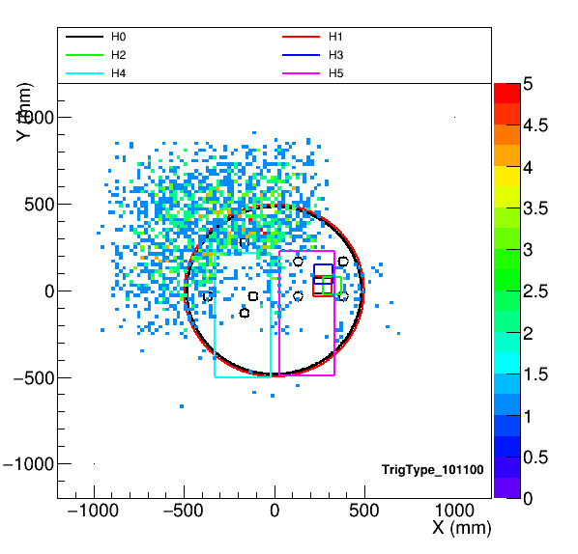
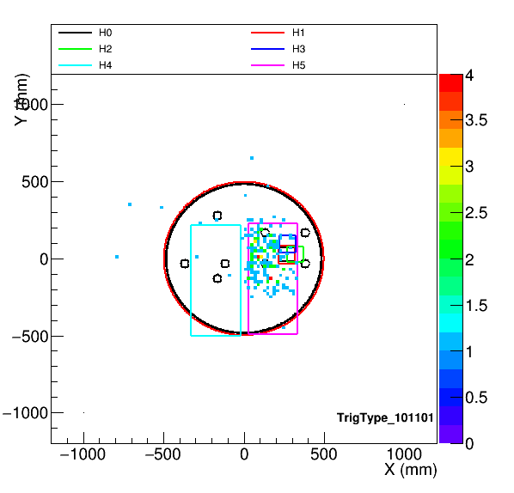
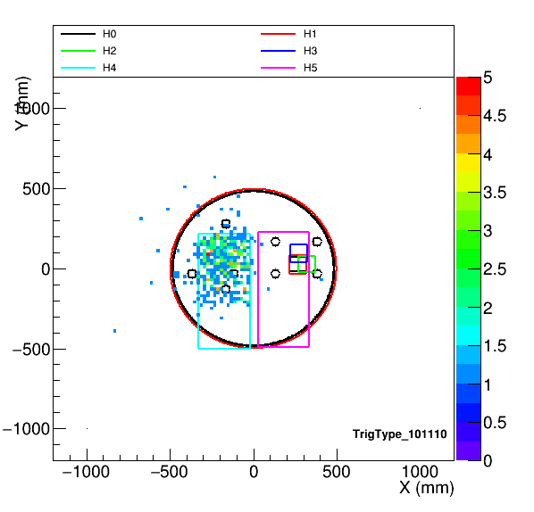

Slide 5
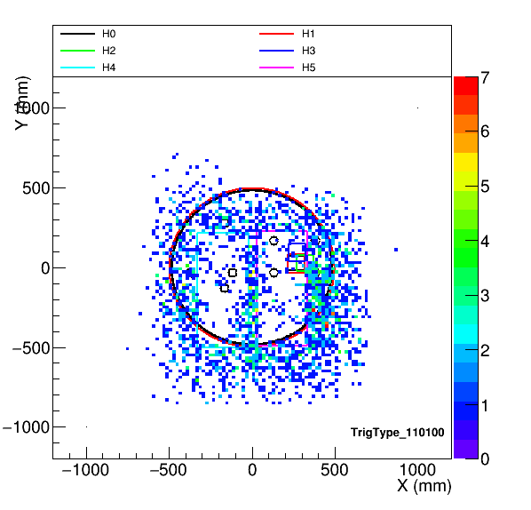
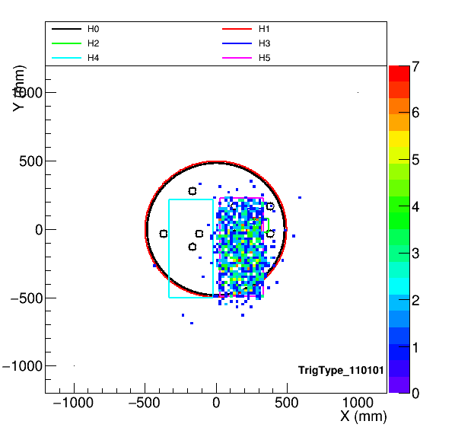

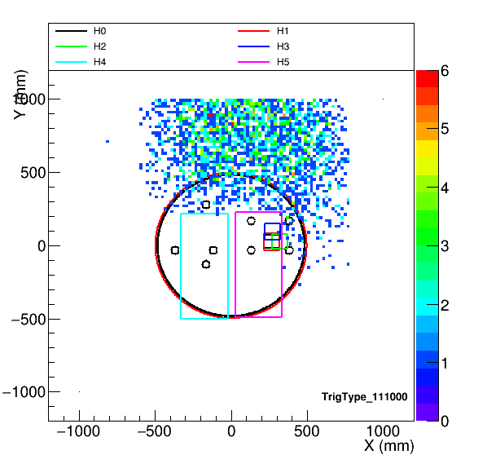



Slide 6
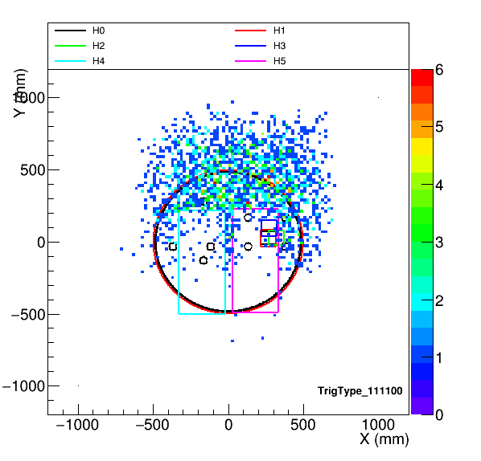
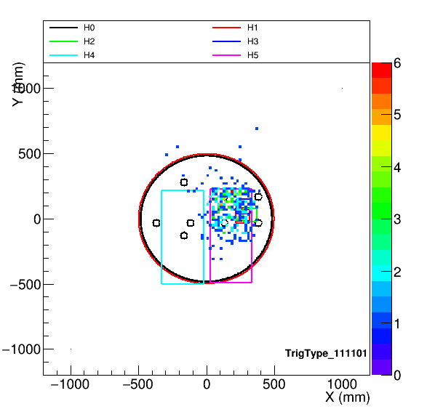
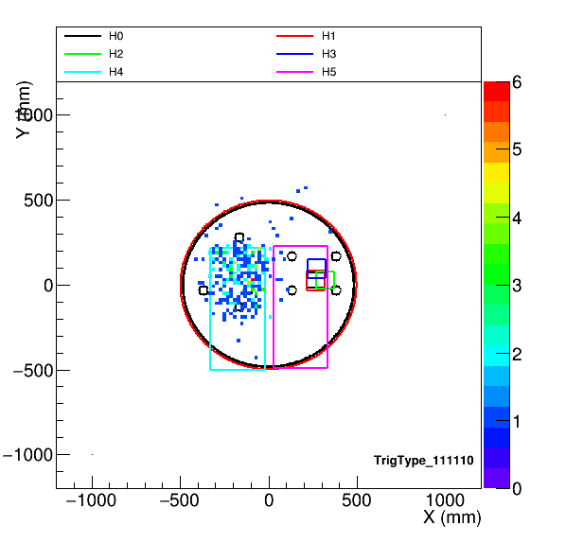

Slide 8
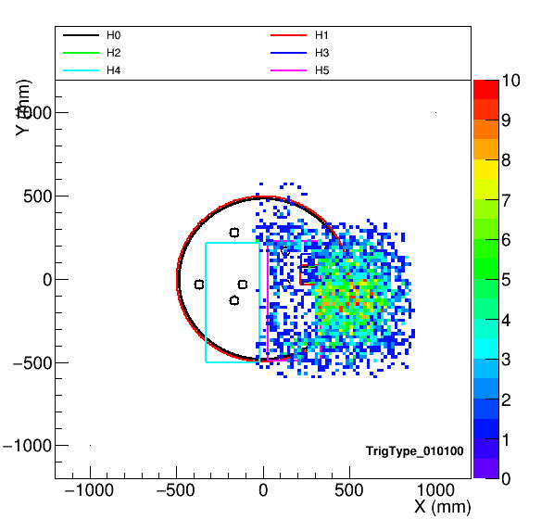
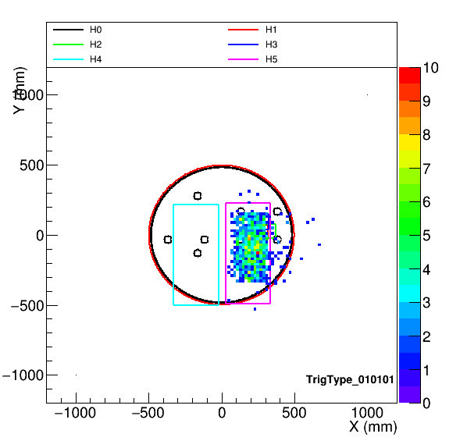
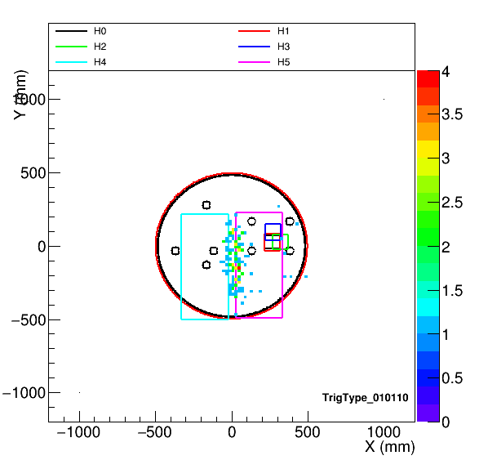
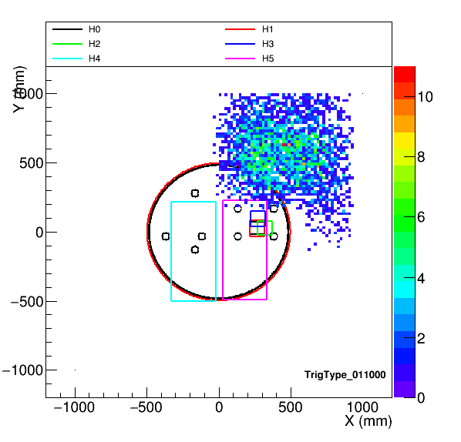



Slide 9
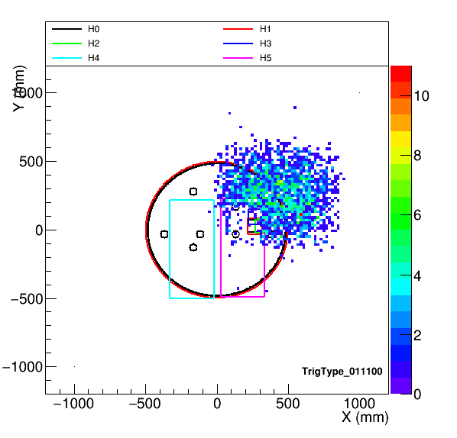
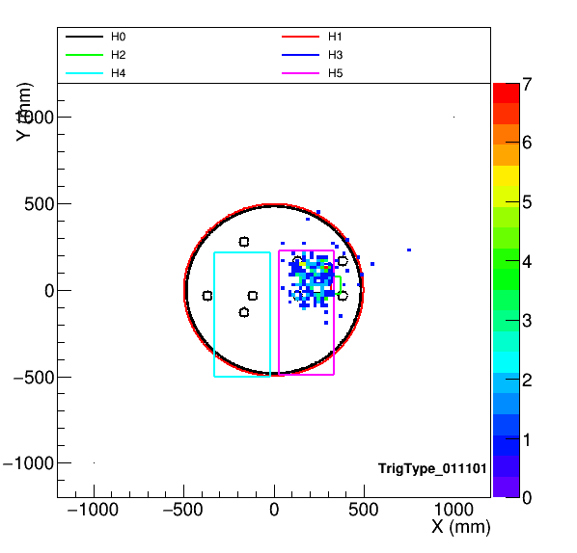

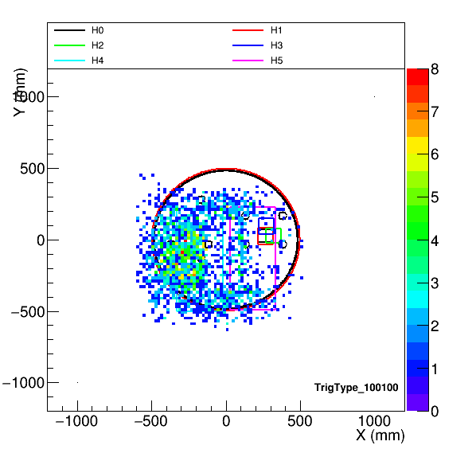
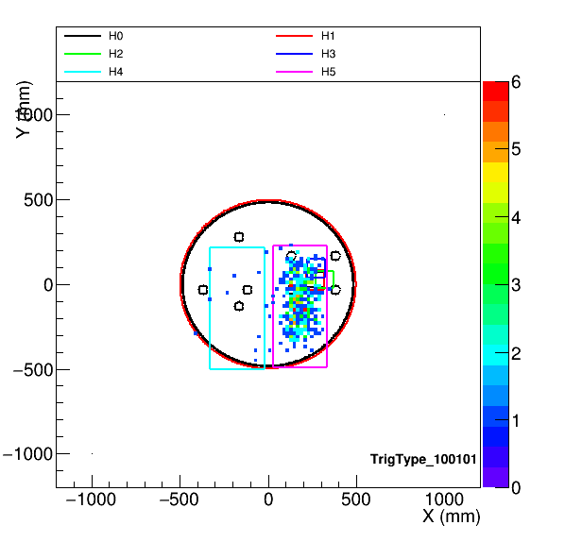
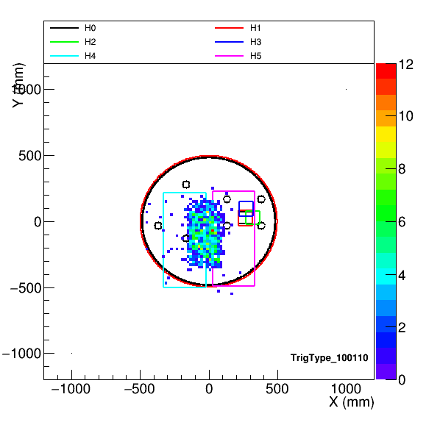

Slide 10
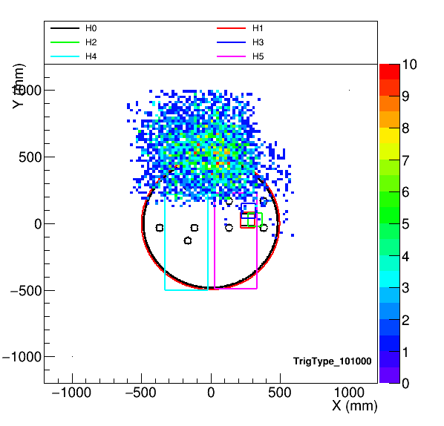
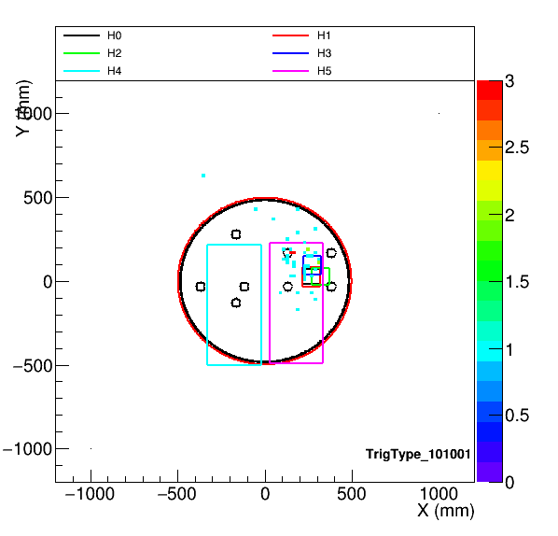
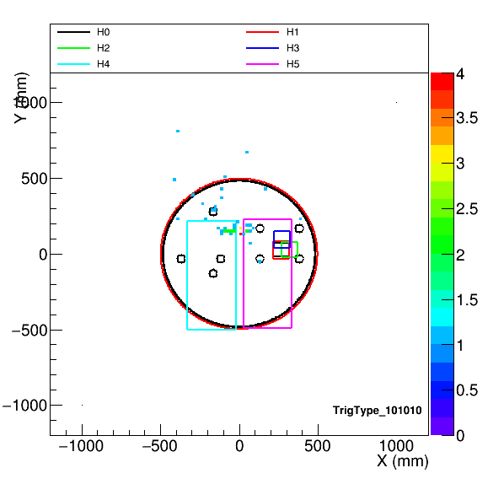
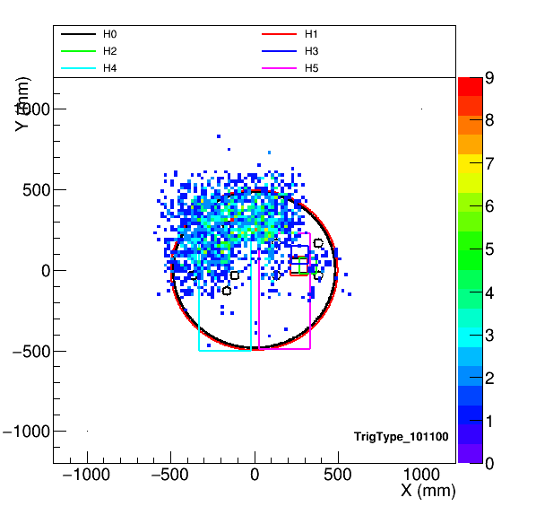
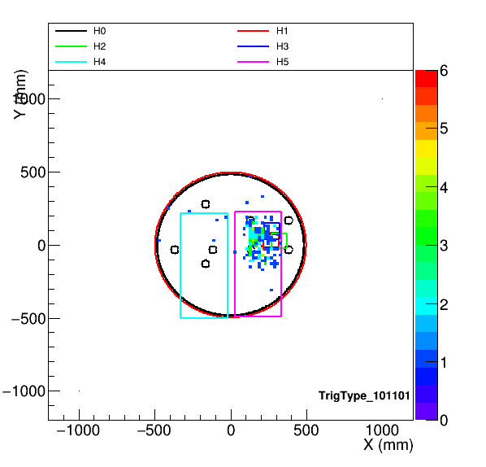
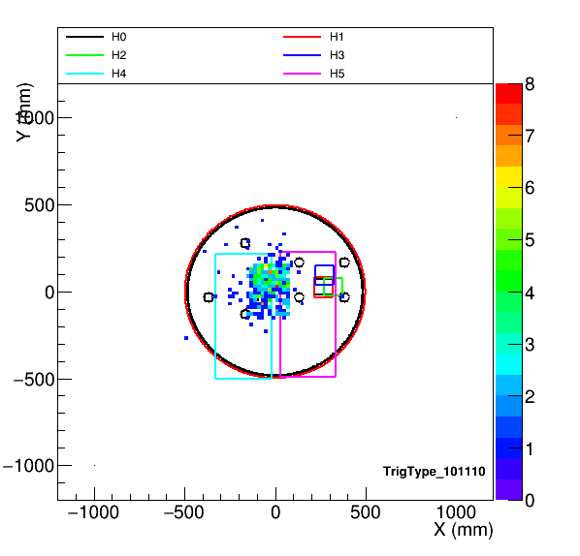

Slide 11
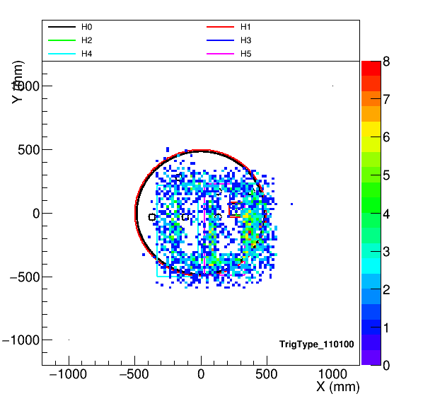
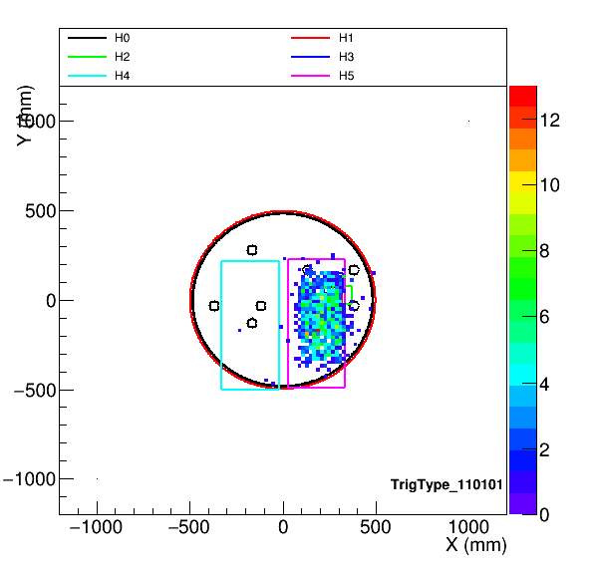
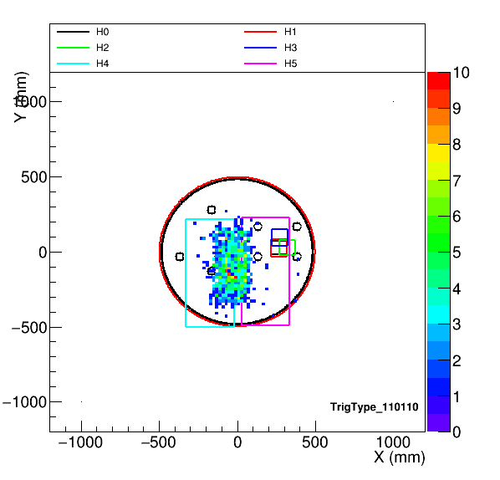
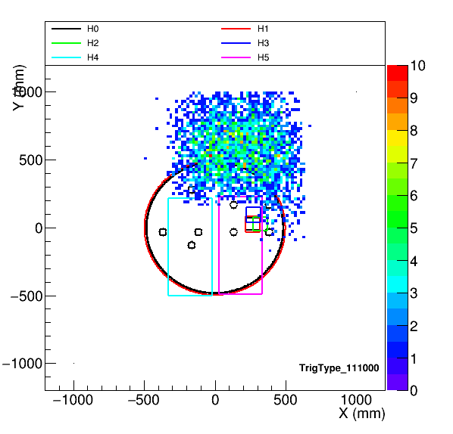



Slide 12
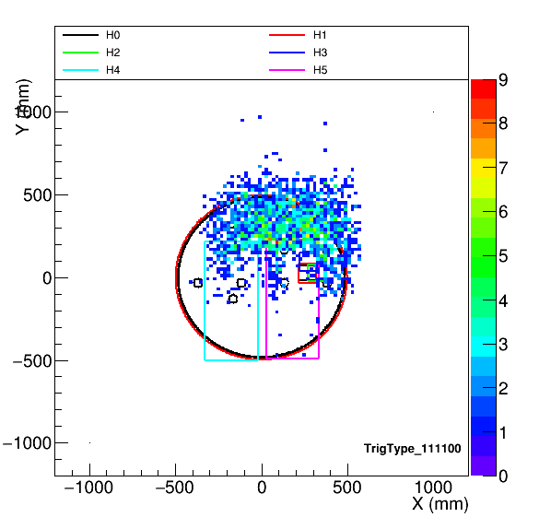

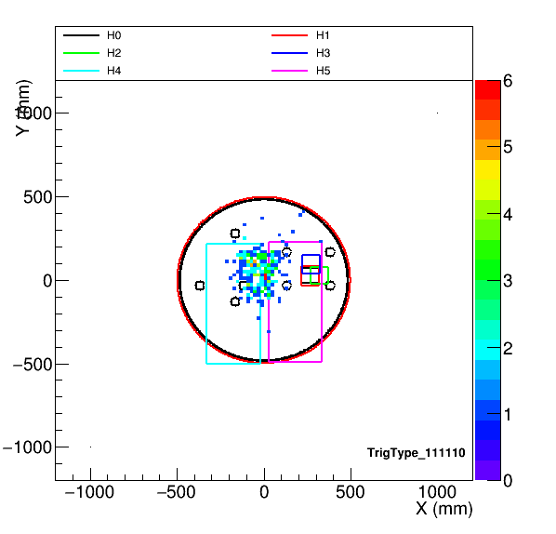

Slide 14
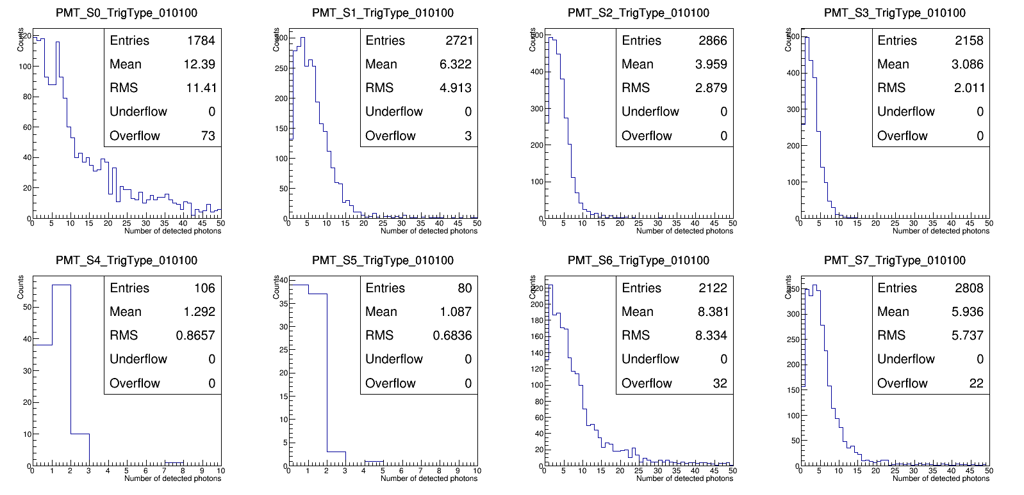
Npe in 2 us window (these plots, from page 14 to page 40, the PMTs not hit by any photons in an event are not counted)

Slide 15
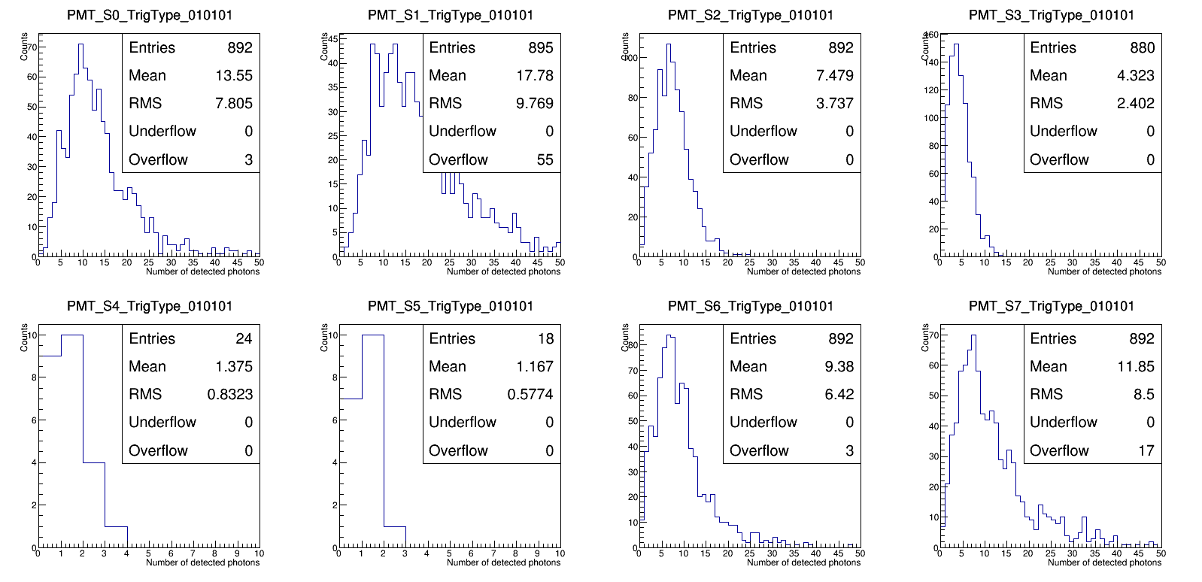
Npe in 2 us window

Slide 16
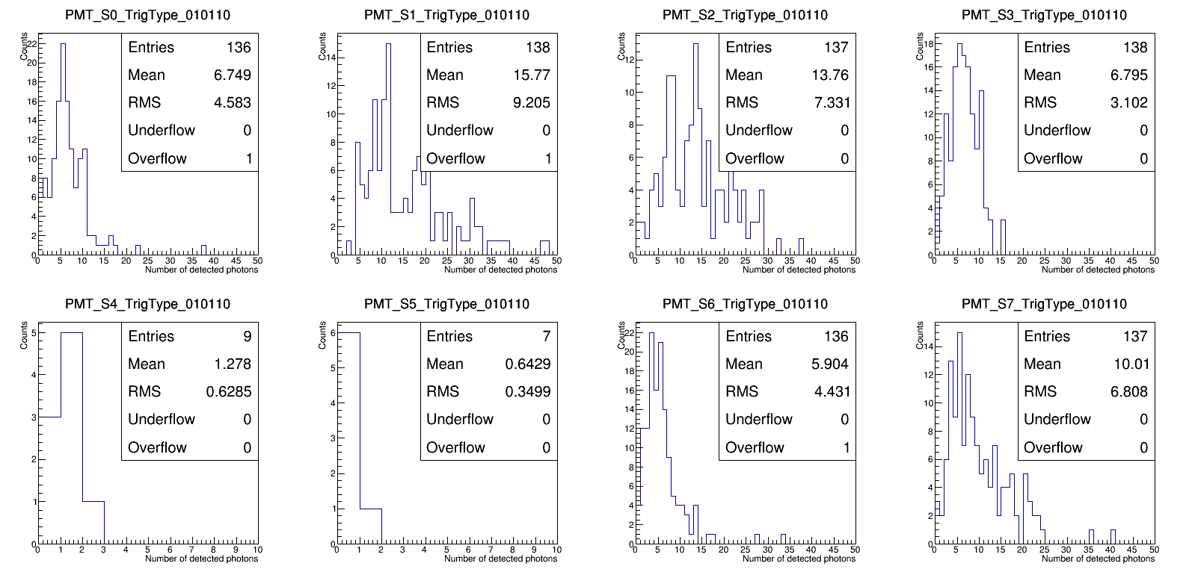
Npe in 2 us window

Slide 17
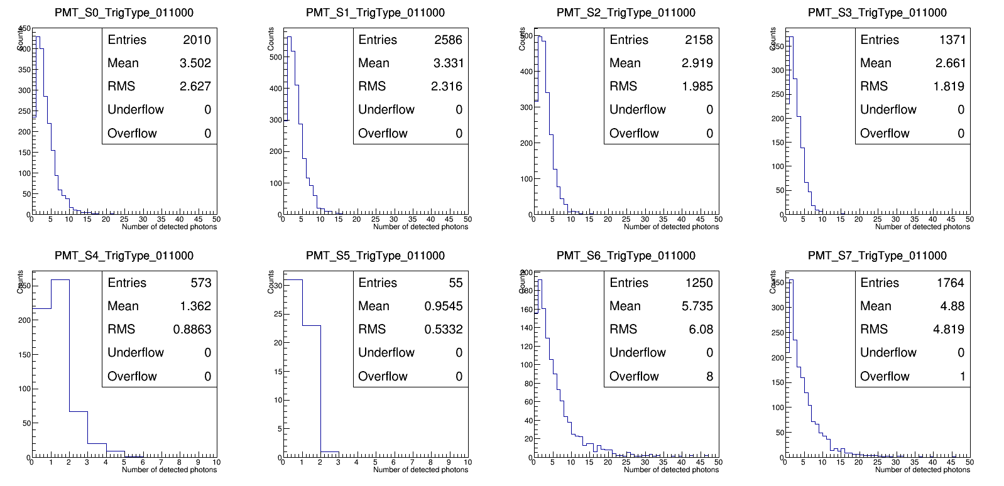
Npe in 2 us window

Slide 18
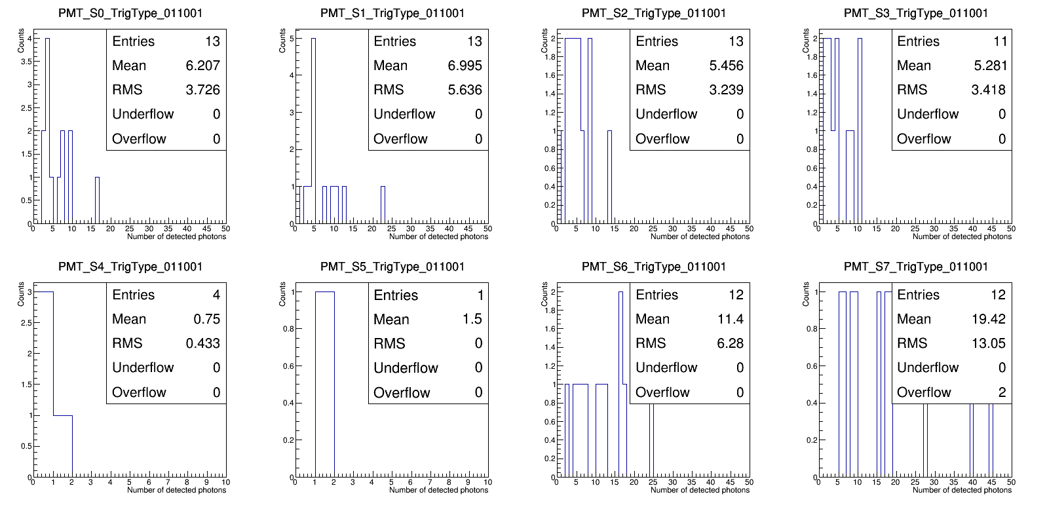
Npe in 2 us window

Slide 19
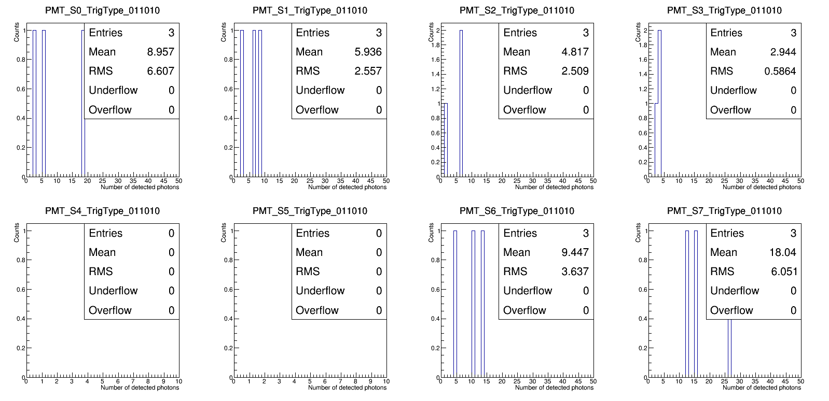
Npe in 2 us window

Slide 20
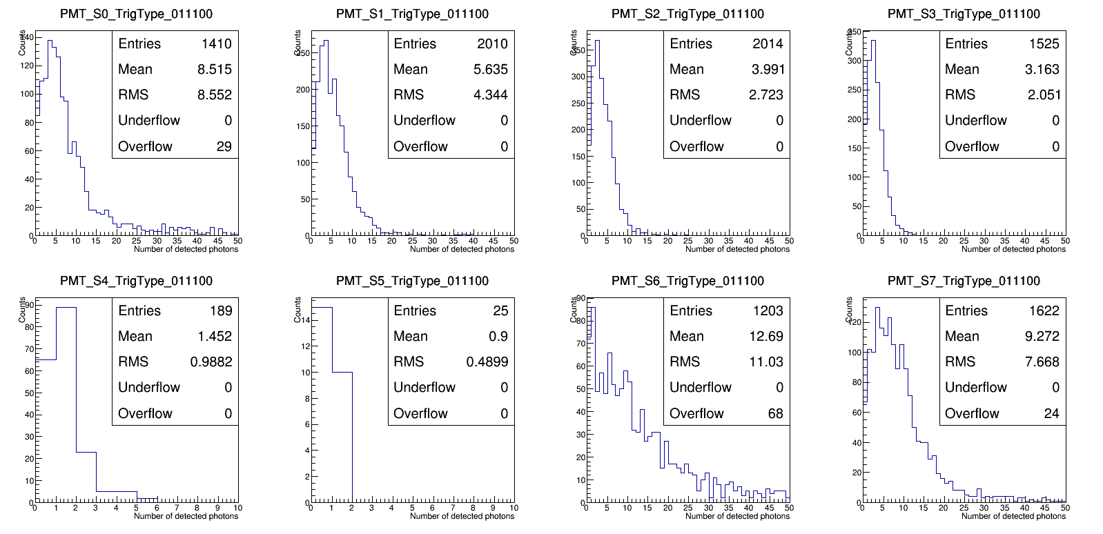
Npe in 2 us window

Slide 21

Npe in 2 us window

Slide 22

Npe in 2 us window

Slide 23

Npe in 2 us window

Slide 24

Npe in 2 us window

Slide 25

Npe in 2 us window

Slide 26

Npe in 2 us window

Slide 27

Npe in 2 us window

Slide 28

Npe in 2 us window

Slide 29

Npe in 2 us window

Slide 30

Npe in 2 us window

Slide 31

Npe in 2 us window

Slide 32

Npe in 2 us window

Slide 33

Npe in 2 us window

Slide 34

Npe in 2 us window

Slide 35

Npe in 2 us window

Slide 36

Npe in 2 us window

Slide 37

Npe in 2 us window

Slide 38

Npe in 2 us window

Slide 39

Npe in 2 us window

Slide 40

Npe in 2 us window

Slide 42

Npe in 2 us (50 ns) window (these plots, from page 42 to page 68, the PMTs not hit by any photons in an event are counted)

Slide 43

Npe in 2 us (50 ns) window (these plots, from page 42 to page 68, the PMTs not hit by any photons in an event are counted)

Slide 44

Npe in 2 us (50 ns) window (these plots, from page 42 to page 68, the PMTs not hit by any photons in an event are counted)

Slide 45

Npe in 2 us (50 ns) window (these plots, from page 42 to page 68, the PMTs not hit by any photons in an event are counted)

Slide 46

Npe in 2 us (50 ns) window (these plots, from page 42 to page 68, the PMTs not hit by any photons in an event are counted)

Slide 47

Npe in 2 us (50 ns) window (these plots, from page 42 to page 68, the PMTs not hit by any photons in an event are counted)

Slide 48

Npe in 2 us (50 ns) window (these plots, from page 42 to page 68, the PMTs not hit by any photons in an event are counted)

Slide 49

Npe in 2 us (50 ns) window (these plots, from page 42 to page 68, the PMTs not hit by any photons in an event are counted)

Slide 50

Npe in 2 us (50 ns) window (these plots, from page 42 to page 68, the PMTs not hit by any photons in an event are counted)

Slide 51

Npe in 2 us (50 ns) window (these plots, from page 42 to page 68, the PMTs not hit by any photons in an event are counted)

Slide 52
Npe in 2 us (50 ns) window (these plots, from page 42 to page 68, the PMTs not hit by any photons in an event are counted)

Slide 53

Npe in 2 us (50 ns) window (these plots, from page 42 to page 68, the PMTs not hit by any photons in an event are counted)

Slide 54

Npe in 2 us (50 ns) window (these plots, from page 42 to page 68, the PMTs not hit by any photons in an event are counted)

Slide 55

Npe in 2 us (50 ns) window (these plots, from page 42 to page 68, the PMTs not hit by any photons in an event are counted)

Slide 56

Npe in 2 us (50 ns) window (these plots, from page 42 to page 68, the PMTs not hit by any photons in an event are counted)

Slide 57

Npe in 2 us (50 ns) window (these plots, from page 42 to page 68, the PMTs not hit by any photons in an event are counted)

Slide 58

Npe in 2 us (50 ns) window (these plots, from page 42 to page 68, the PMTs not hit by any photons in an event are counted)

Slide 59

Npe in 2 us (50 ns) window (these plots, from page 42 to page 68, the PMTs not hit by any photons in an event are counted)

Slide 60

Npe in 2 us (50 ns) window (these plots, from page 42 to page 68, the PMTs not hit by any photons in an event are counted)

Slide 61

Npe in 2 us (50 ns) window (these plots, from page 42 to page 68, the PMTs not hit by any photons in an event are counted)

Slide 62

Npe in 2 us (50 ns) window (these plots, from page 42 to page 68, the PMTs not hit by any photons in an event are counted)

Slide 63

Npe in 2 us (50 ns) window (these plots, from page 42 to page 68, the PMTs not hit by any photons in an event are counted)

Slide 64

Npe in 2 us (50 ns) window (these plots, from page 42 to page 68, the PMTs not hit by any photons in an event are counted)

Slide 65

Npe in 2 us (50 ns) window (these plots, from page 42 to page 68, the PMTs not hit by any photons in an event are counted)

Slide 66

Npe in 2 us (50 ns) window (these plots, from page 42 to page 68, the PMTs not hit by any photons in an event are counted)

Slide 67

Npe in 2 us (50 ns) window (these plots, from page 42 to page 68, the PMTs not hit by any photons in an event are counted)

Slide 68

Npe in 2 us (50 ns) window (these plots, from page 42 to page 68, the PMTs not hit by any photons in an event are counted)

Slide 70

ID | Param. value | Max atten. length (m) | Wavelen. at maxAttL (nm) | Used as Data (D) or MC (M)?
1 | 0.0001 | 202.158 | 417.5 | M
2 | 0.0011 | 99.3408 | 432.5 | M
3 | 0.0033 | 49.885 | 435 | M
4 | 0.0067 | 30.8572 | 472.5 | M
5 | 0.0127 | 19.9011 | 490 | M
6 | 0.0187 | 14.9474 | 490 | M
7 | 0.0311 | 9.9984 | 500 | M
8 | 0.0571 | 6.49973 | 565 | M
9 | 0.0129 | 19.6837 | 490 | D
10 | 0.0043 | 40.792 | 435
11 | 0.0025 | 60.7117 | 435
12 | 0.0017 | 78.0418 | 432.5
13 | 0.0021 | 68.2933 | 432.5
14 | 0.0091 | 25.0536 | 485
15 | 0.0055 | 35.0198 | 472.5
16 | 0.0037 | 45.8012 | 435
17 | 0.0029 | 54.7685 | 435
18 | 0.0005 | 141.782 | 417.5

Slide 71





Chi2
Use all trigger types & all PMTs
True attenuation 19.6837 m
True attenuation 60.712 m
True attenuation 40.792 m
Find: (20.776 ± 0.009) m
Find: (41.570 ± 0.016) m

Slide 72

trigType | S0 | S1 | S2 | S3 | S4 | S5 | S6 | S7
101000 |  |  |  |  | - | -
101010 | - | - | - | - | - | - | - | -
101001 | - | - | - | - | - | - | - | -
100100 |  |  |  |  | - | -
100110 |  | - | - |  | - | -
100101 | - | - | - |  | - | -
011000 |  |  |  |  | - | -
011010 | - | - | - | - | - | - | - | -
011001 | - | - | - | - | - | - | - | -
010100 | - |  |  |  | - | -
010110 | - | - | - | - | - | - |  | -
010101 | - | - |  |  | - | - |  | -
111000 |  |  |  |  | - | -
111010 | - | - | - | - | - | - | - | -
111001 | - | - | - | - | - | - | - | -
110100 |  |  |  |  | - | -
110110 |  |  |  |  | - | -
110101 |  |  |  |  | - | -
011100 | - |  |  |  | - | - | - | -
011110 | - | - | - | - | - | - | - | -
011101 | - | - | - |  | - | - | - | -
101100 |  |  |  |  | - | -
101110 |  | - | - |  | - | -
101101 | - | - | - | - | - | - | - | -
111100 |  |  |  |  | - | -
111110 |  | - | - |  | - | - |  | -
111101 | - | - | - |  | - | - |  | -
For the case fitting a 20m attenuation length.
“-” means chi2 has no discrimination power
If using the triggers in blue, and not counting S4, S5:
The red curve is after the selection

Slide 73

Fit ~20 m individual PMTs and individual event samples

Slide 74

Fit ~20 m individual PMTs and individual event samples

Slide 75

Fit ~20 m individual PMTs and individual event samples

