Slide 1
Pages 2-5:
For trigger type 111101 [hit H2, H0, H3, H1, H5, not H4]
Chi2 vs. attenuation parameter (max. attL) for S3 and S6 minimizes near ~8 m.
Compare MC and data with input water max. attenuation at ~8 m.
PMTs S0, S3, S6 show agreeing npe distributions. While other PMTs don’t (S4 and S5 not compared.)

Slide 2
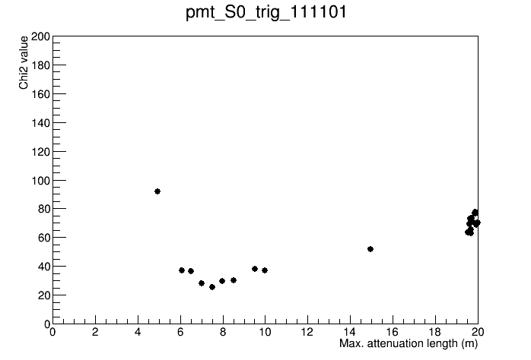
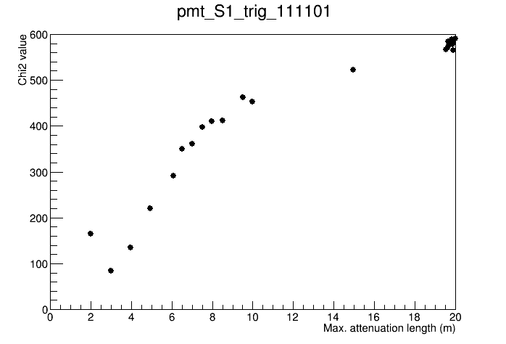
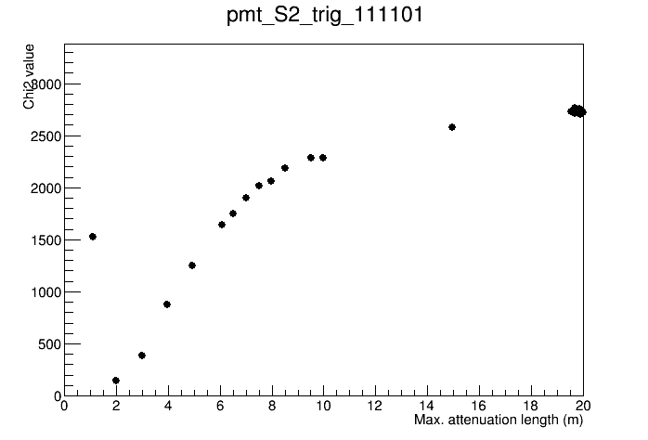
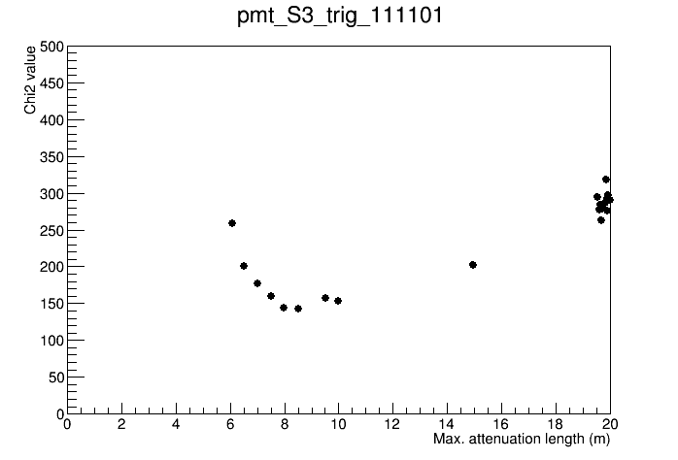
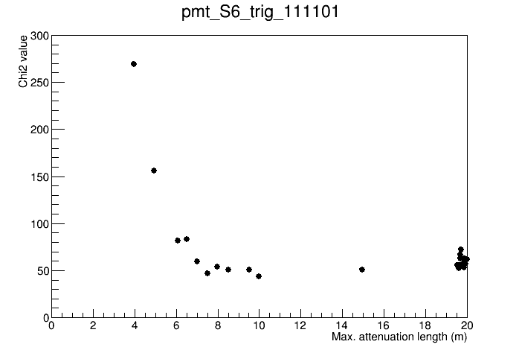
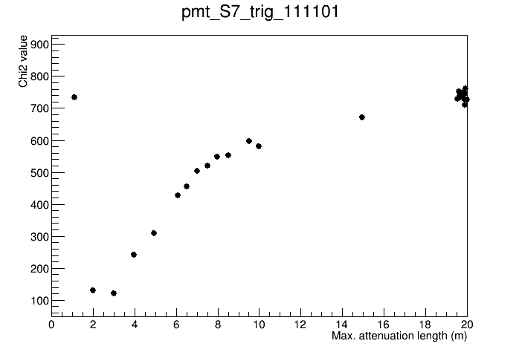
Chi2 vs. max. attL for trigger type 111101 (H2 & H0 & H3 & H3 & H5 & not H4), for different PMTs
For this trigger type, PMT S3 is expected to be most sensitive because it detects Cherenkov photons produced near the top region of the tank. For the same reason, PMT S6 is the second PMT that should be sensitive.
From S3 and S6, min. attL at 8 m.

Slide 3
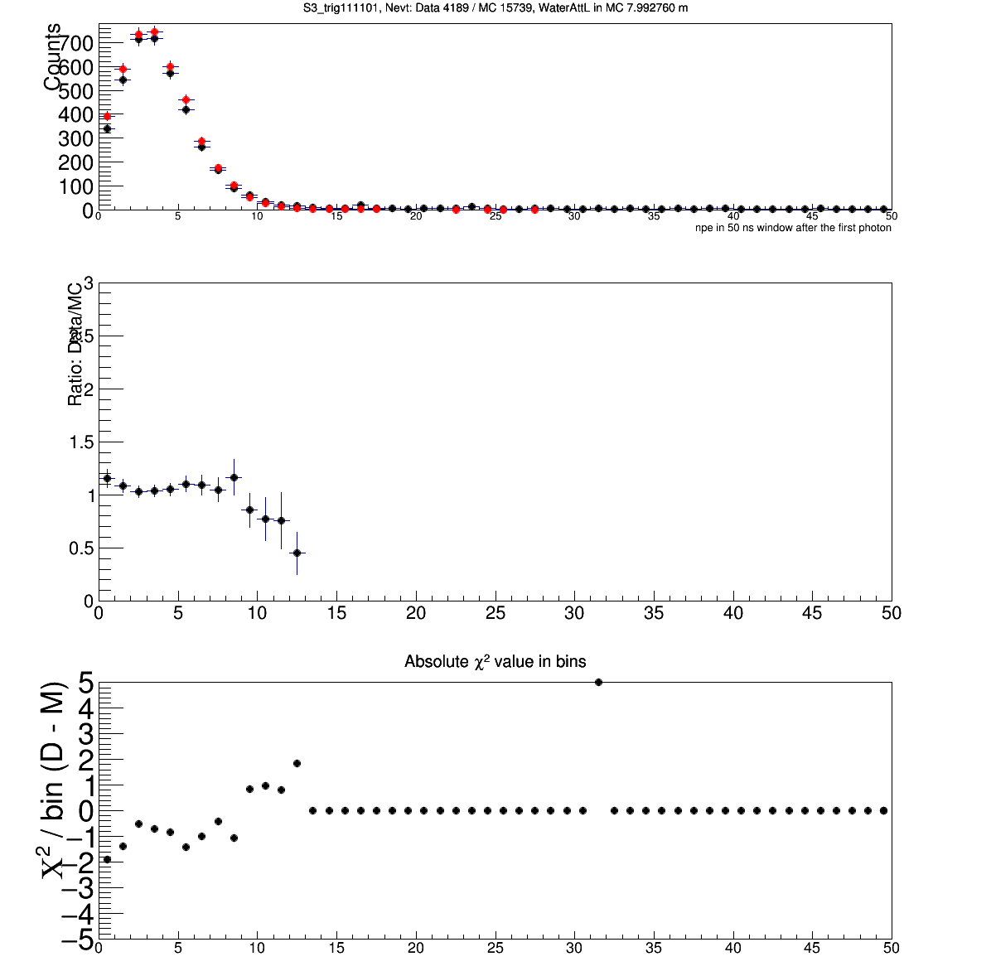
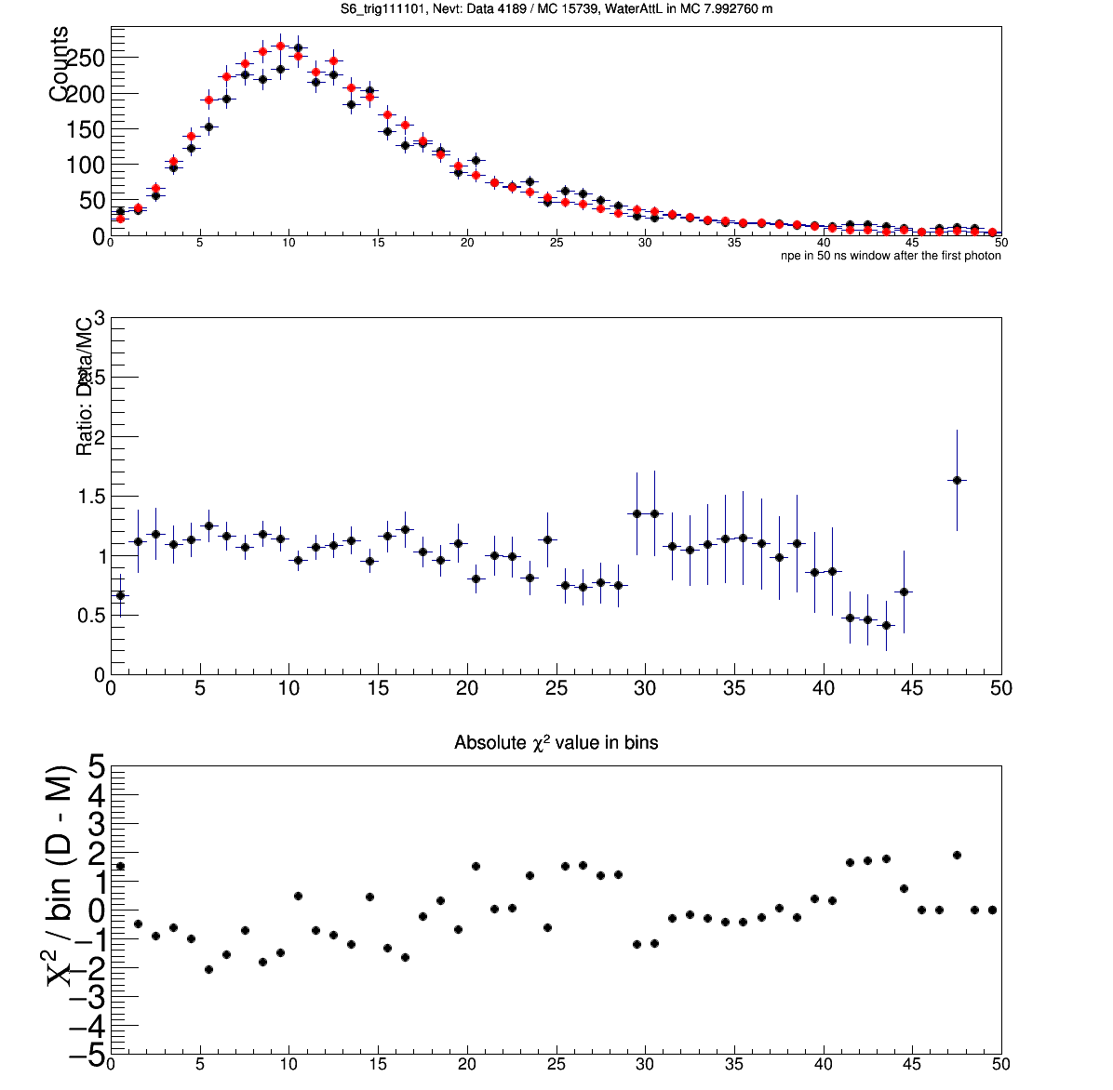
Check the npe distributions for S3 and S6, with input attL ~8 m, for the trigger type 111101.
Number of events in the histograms are shown in the titles, black for data, red for MC.
Data are from 1000 run files (not all)
Chi2 values in each bin are shown too

Slide 4
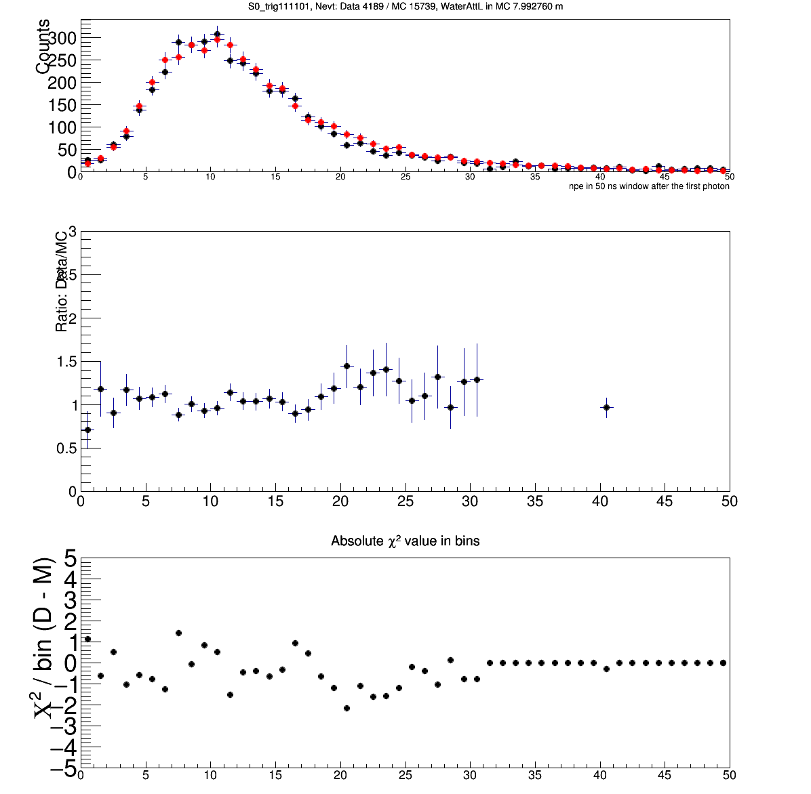
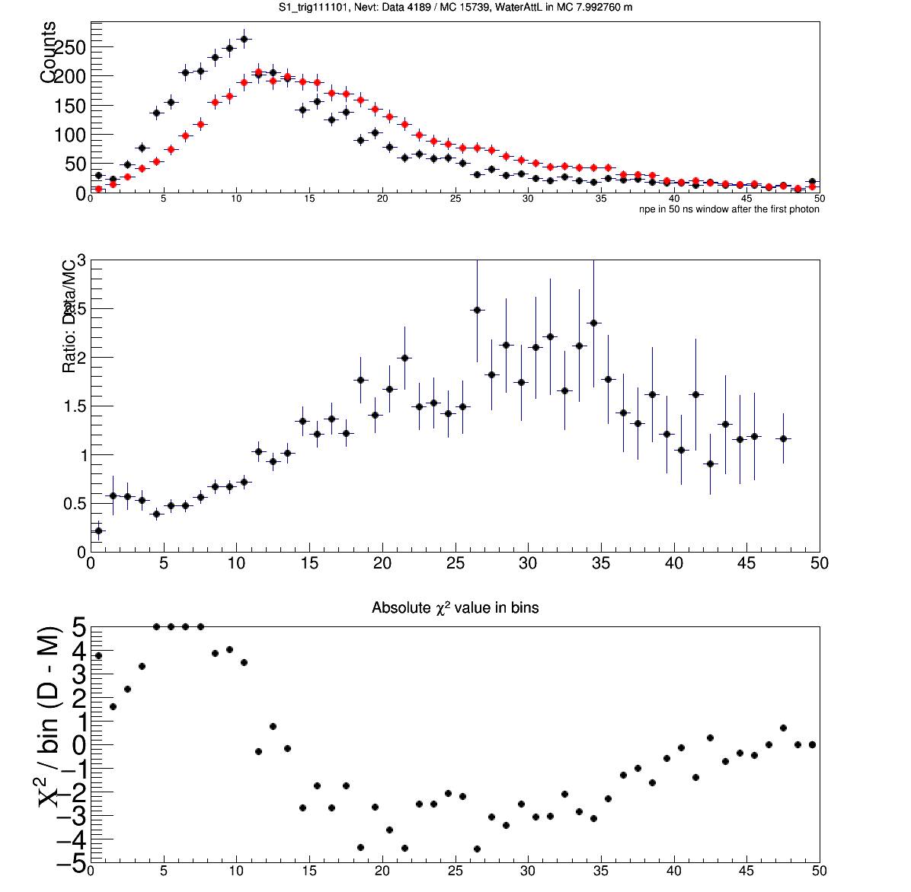
Check the npe distributions for S0 and S1, with input attL ~8 m, for the trigger type 111101.
Number of events in the histograms are shown in the titles, black for data, red for MC.

Slide 5
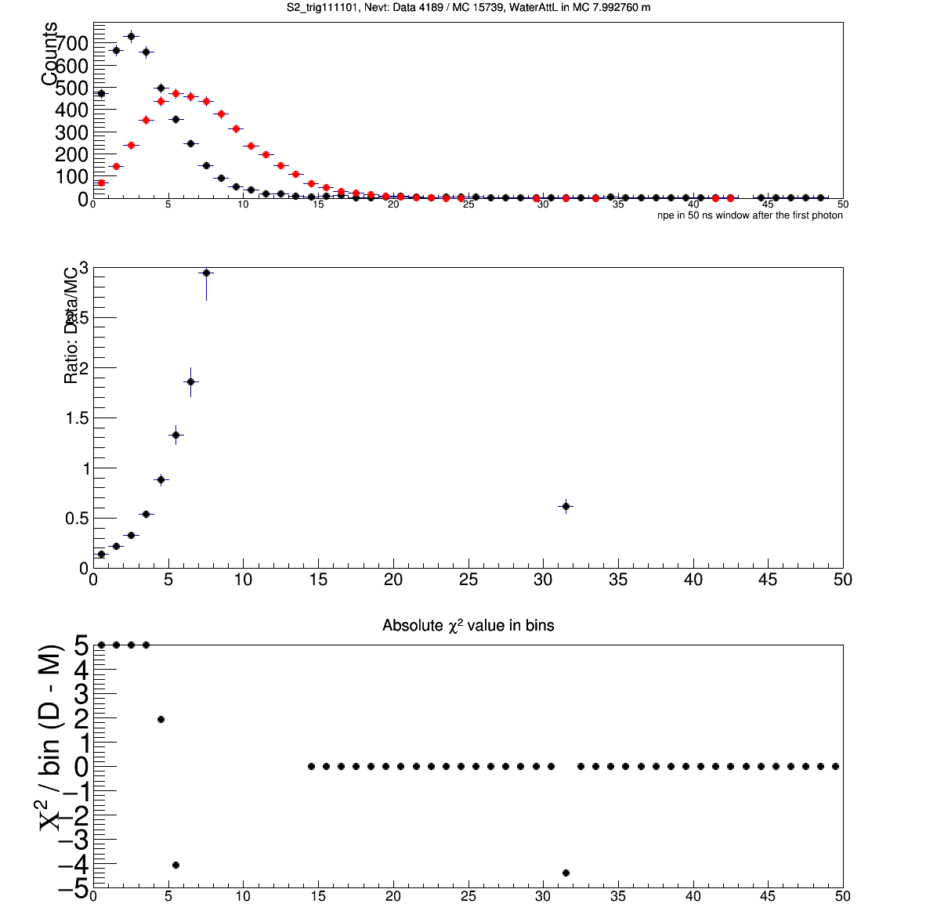
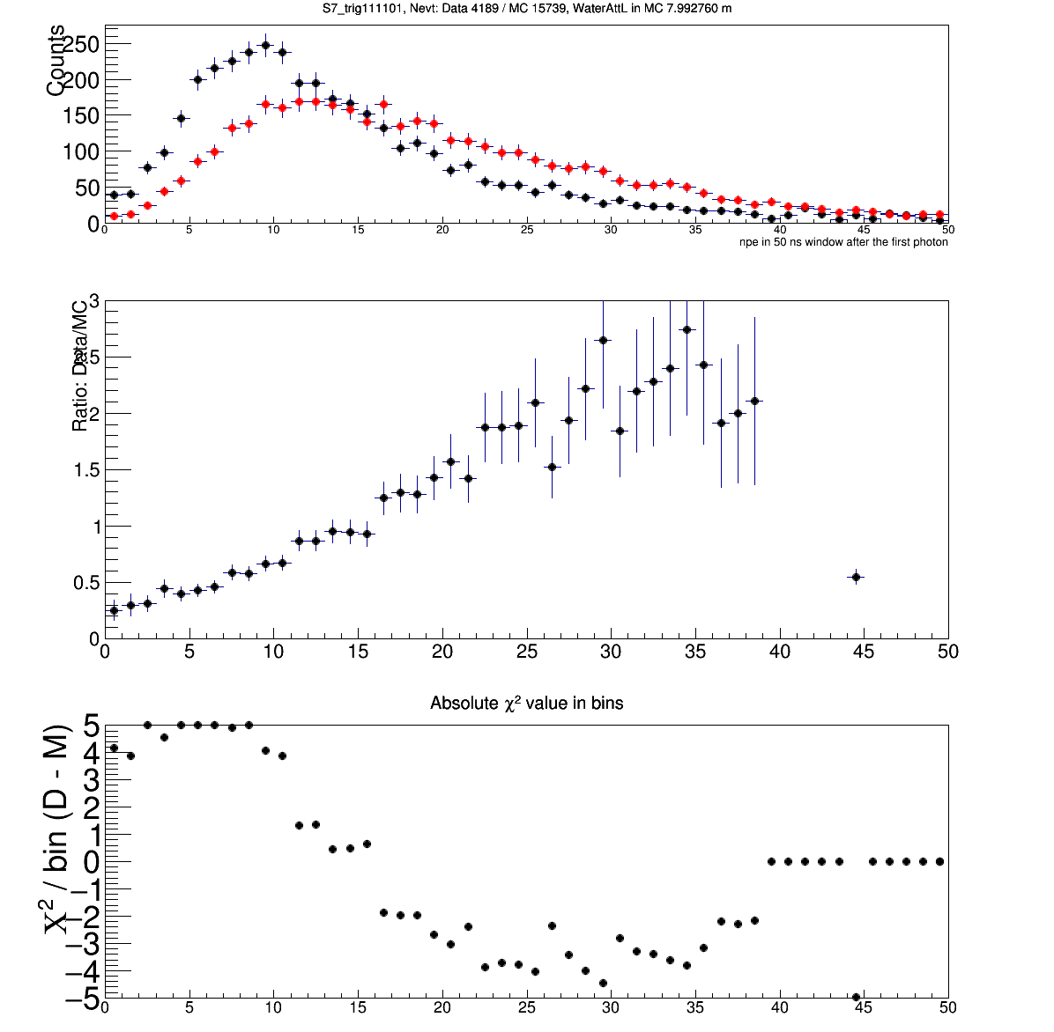
Check the npe distributions for S2 and S7, with input attL ~8 m, for the trigger type 111101.
Number of events in the histograms are shown in the titles, black for data, red for MC.

Slide 6
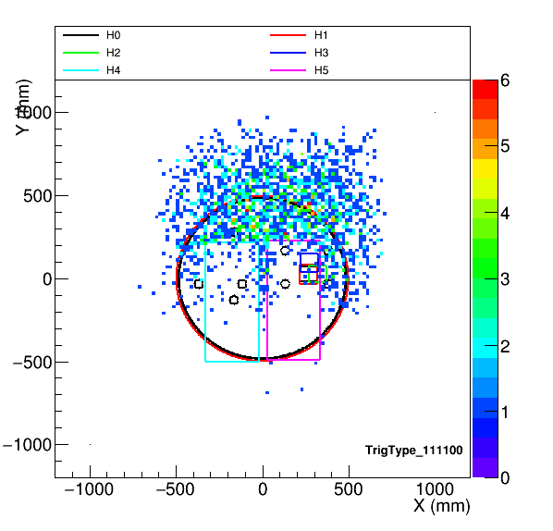
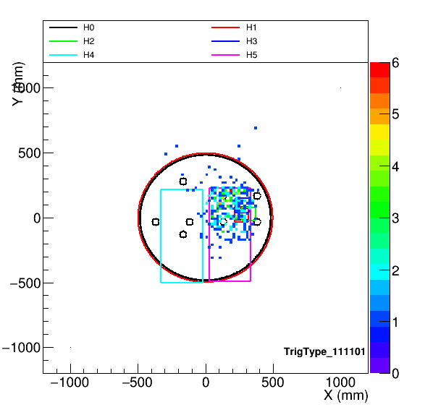
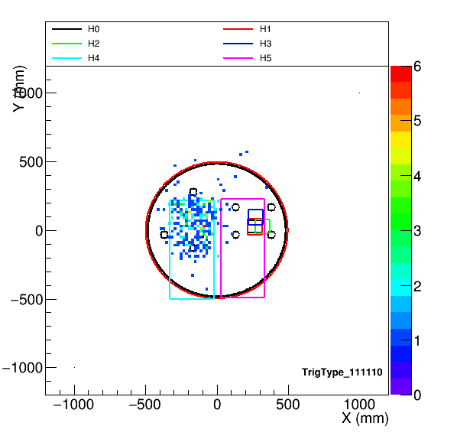
Muon hit locations at Z=H4/H5 using straight line trajectories
There looks similar hits (in numbers of events) for making to H4 comparing to those making to H5

Slide 7
Pages 8-11:
In the case of trigger type 111110
Chi2 vs. attenuation parameter (max. attL) plots for S3 and S7 seem to show minimum near ~5 m.
Compare MC and data with input water max. attenuation at ~8 m.
PMT S1 shows agreeing npe distribution, S7 also is close, other PMTs don’t (S4 and S5 not compared.)

Slide 8
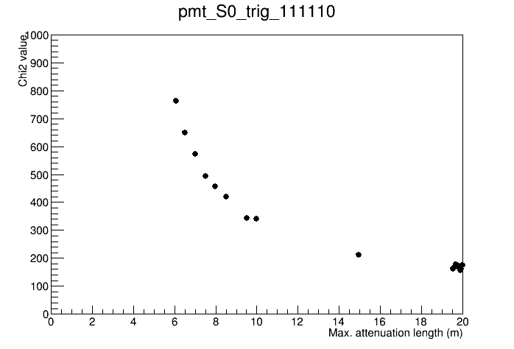
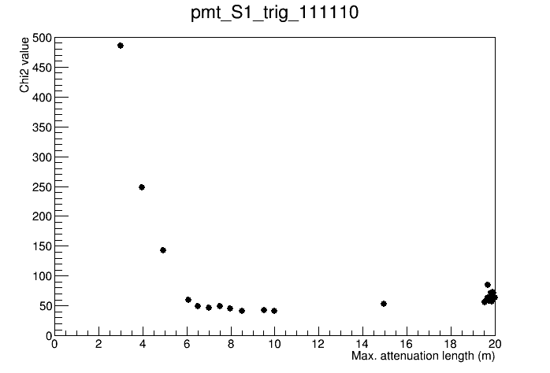
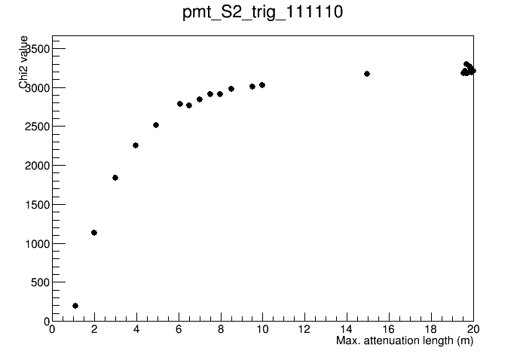
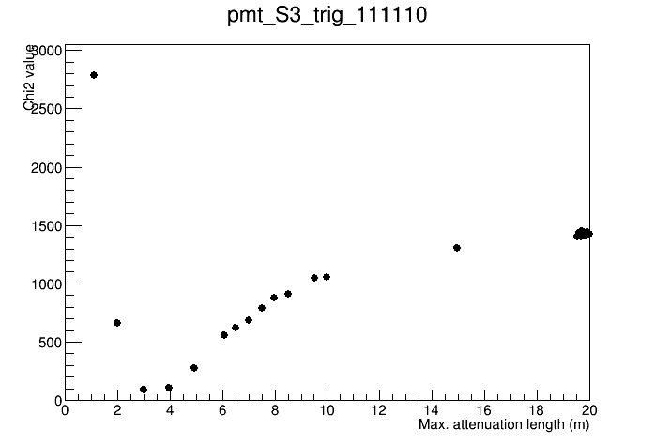
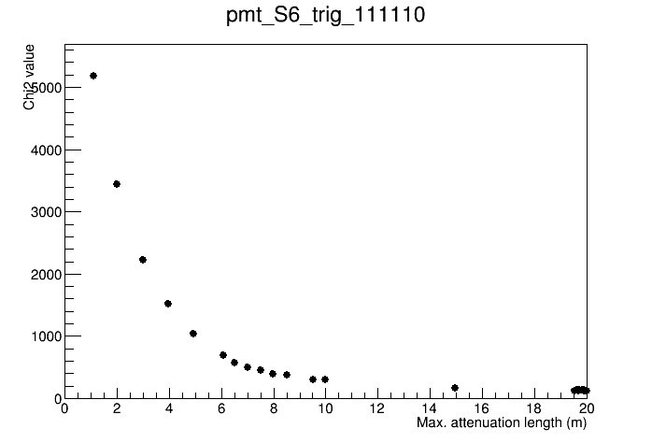
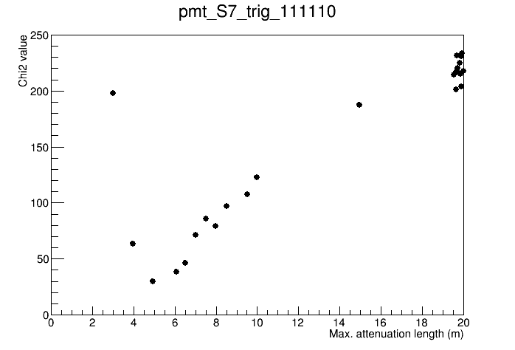
Chi2 vs. max. attL for trigger type 111110 (H2 & H0 & H3 & H3 & not H5 & H4), for different PMTs
So what about trigger 111110?
For this trigger type (111110), only PMTs S3 and S7 show sensitivity to attenuation length, min. attL is 3~5 m.
But remember for trigger 111101, PMT S3 gives best fit for min. attL ~8 m. how to understand the discrepancy?

Slide 9
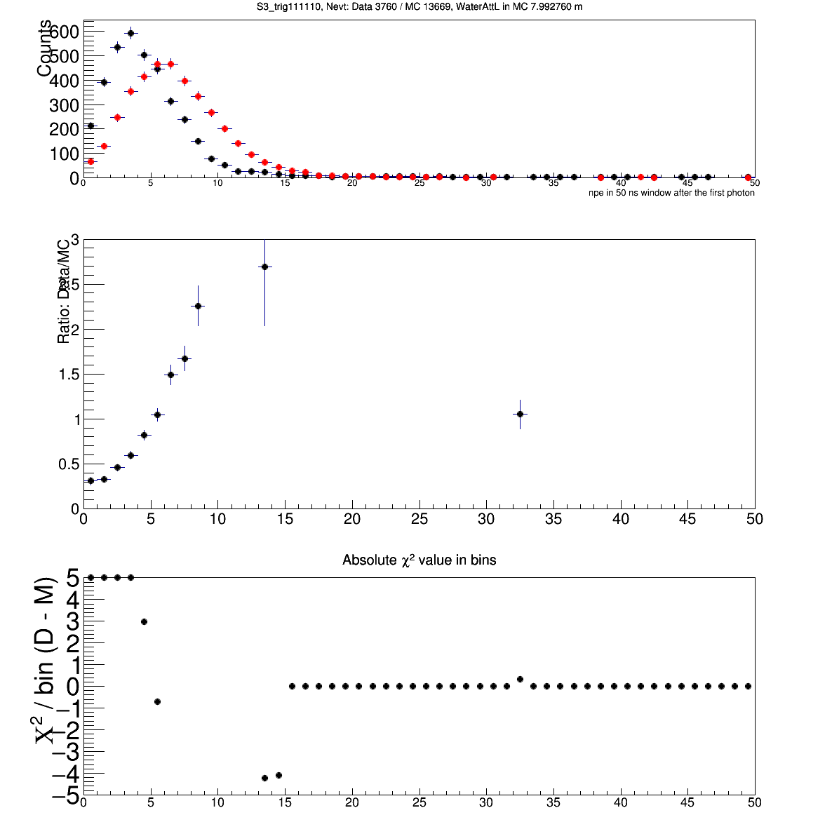
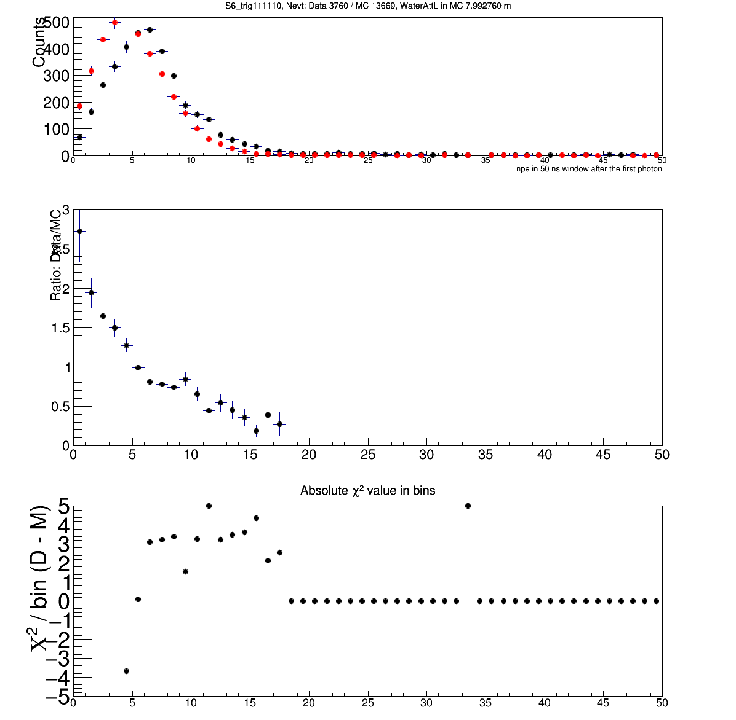
Check the npe distributions for S3 and S6, with input attL ~8 m, for the trigger type 111110.
Number of events in the histograms are shown in the titles, black for data, red for MC.
Look at a different trigger type

Slide 10
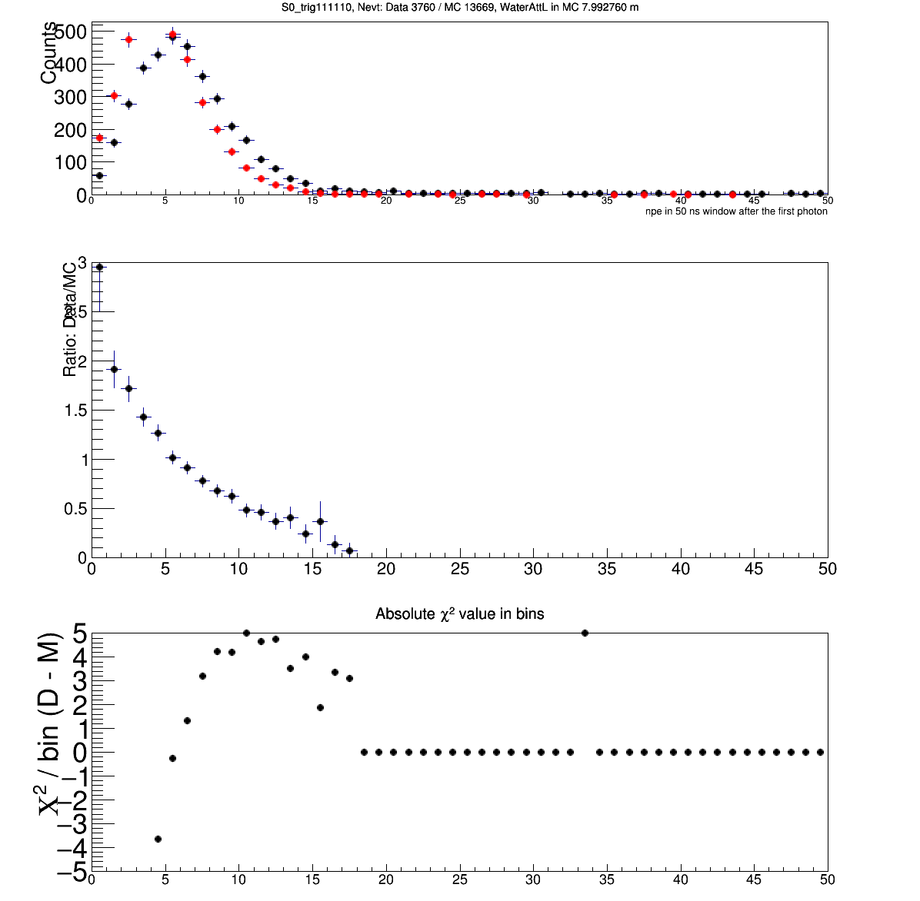

Check the npe distributions for S0 and S1, with input attL ~8 m, for the trigger type 111110.
Number of events in the histograms are shown in the titles, black for data, red for MC.

Slide 11
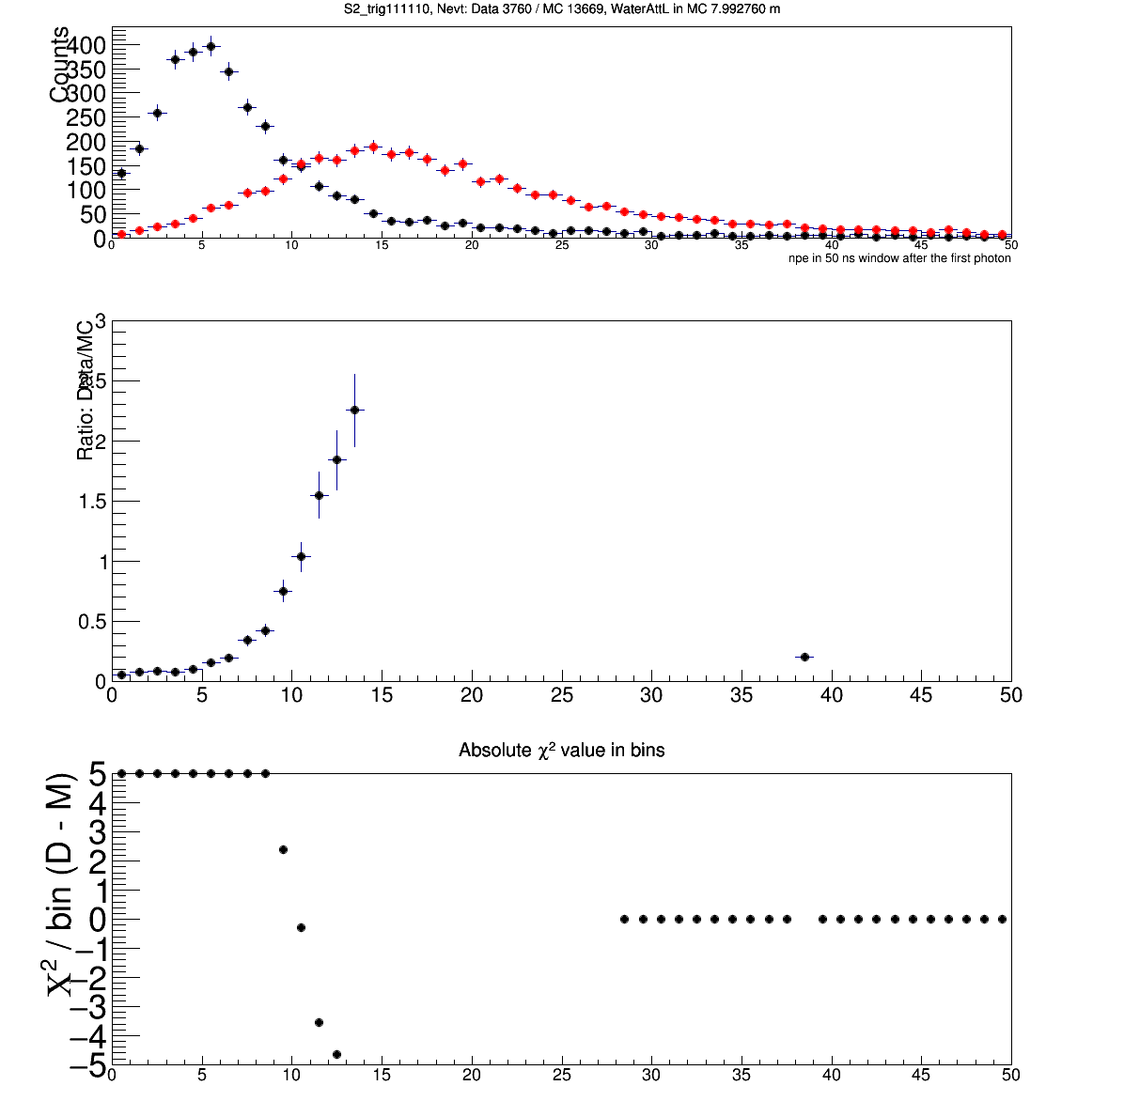
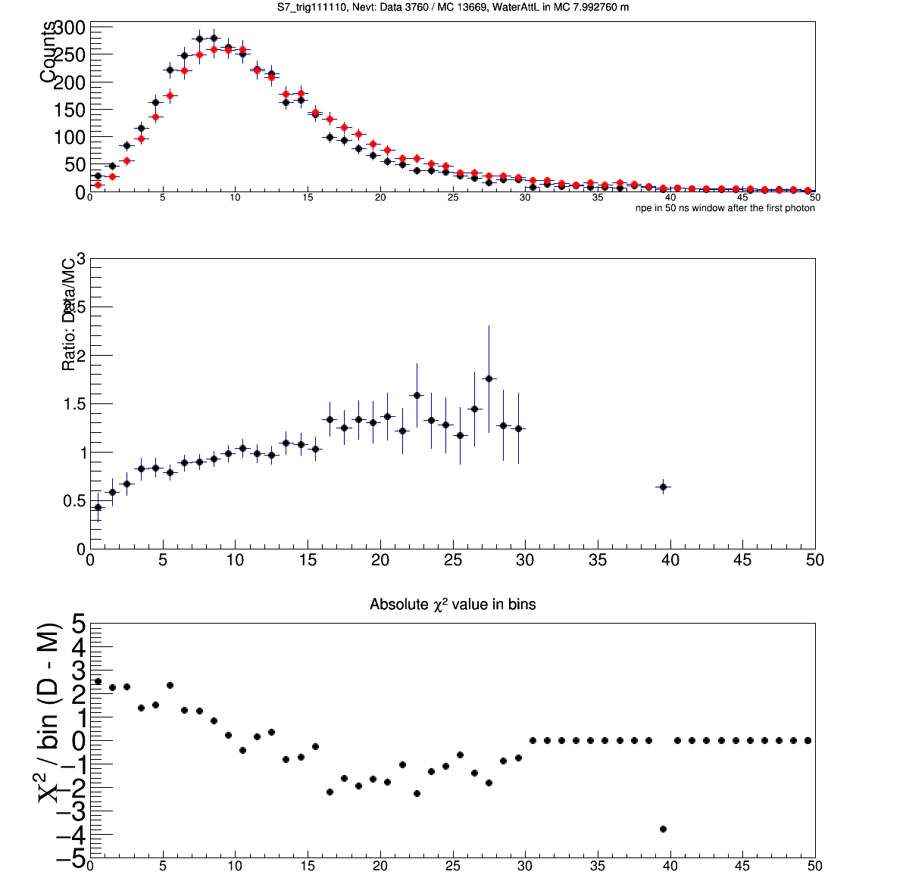
Check the npe distributions for S2 and S7, with input attL ~8 m, for the trigger type 111110.
Number of events in the histograms are shown in the titles, black for data, red for MC.

Slide 12
Pages 8-11:
In the case of trigger type 111110
Chi2 vs. attenuation parameter (max. attL) plots for S3 and S7 seem to show minimum near ~5 m.
Compare MC and data with input water max. attenuation at ~8 m.
PMT S1 shows agreeing npe distribution, S7 also is close, other PMTs don’t (S4 and S5 not compared.)
Pages 13-15:
For trigger type 111101
Compare MC and data with input water max. attenuation at ~5 m.
Non of the PMTs show agreeing npe distributions (S4 and S5 not compared.)

Slide 13
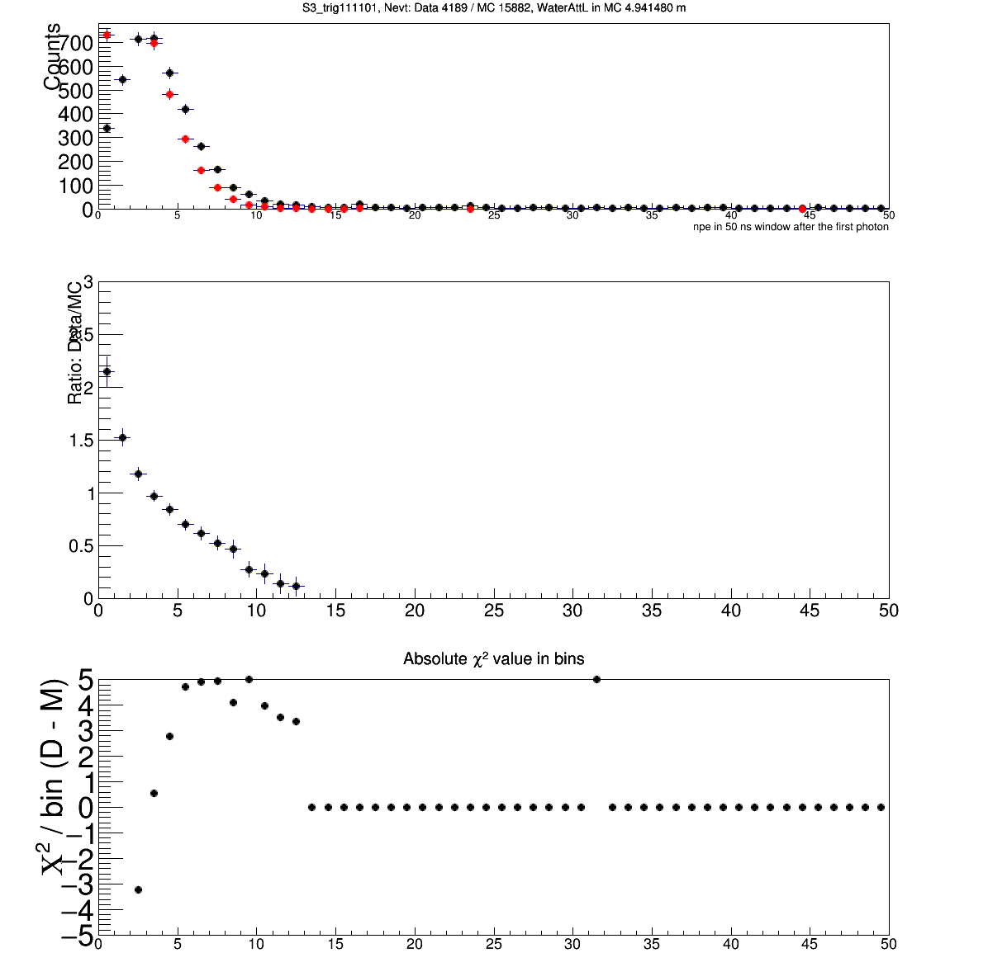
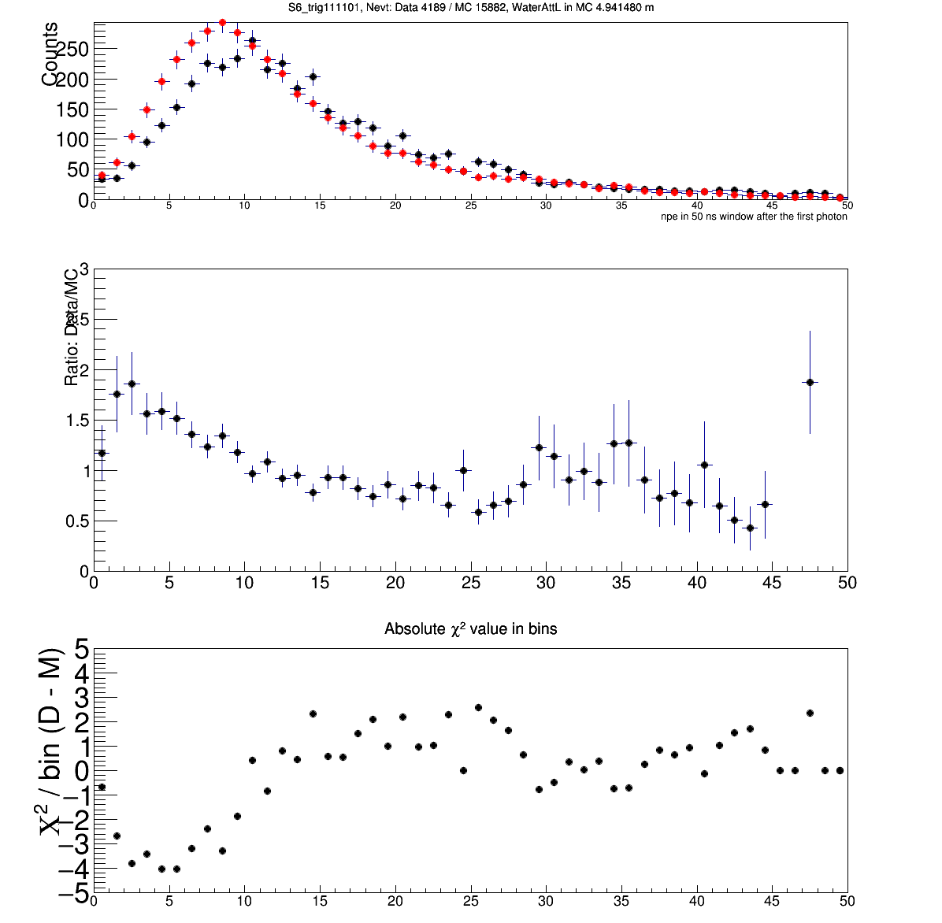
Check the npe distributions for S3 and S6, with input attL ~5 m, for the trigger type 111101.
Number of events in the histograms are shown in the titles, black for data, red for MC.
Data are from 1000 run files (not all)
Chi2 values in each bin are shown too

Slide 14
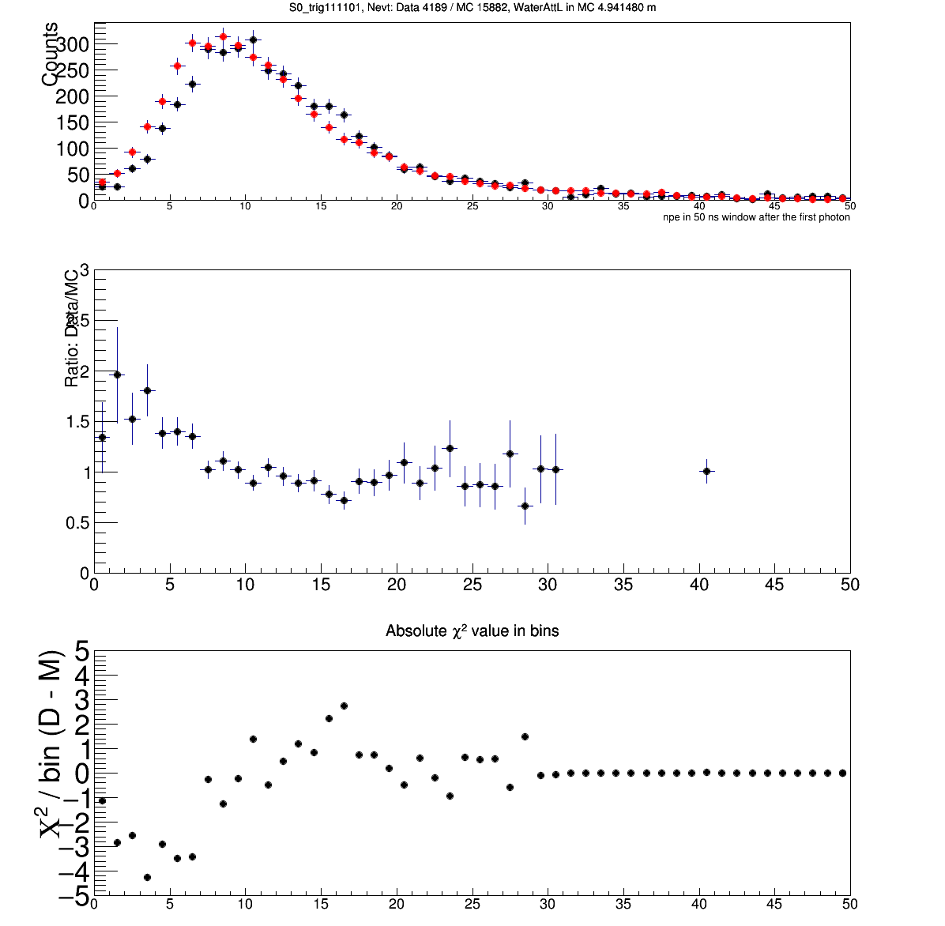
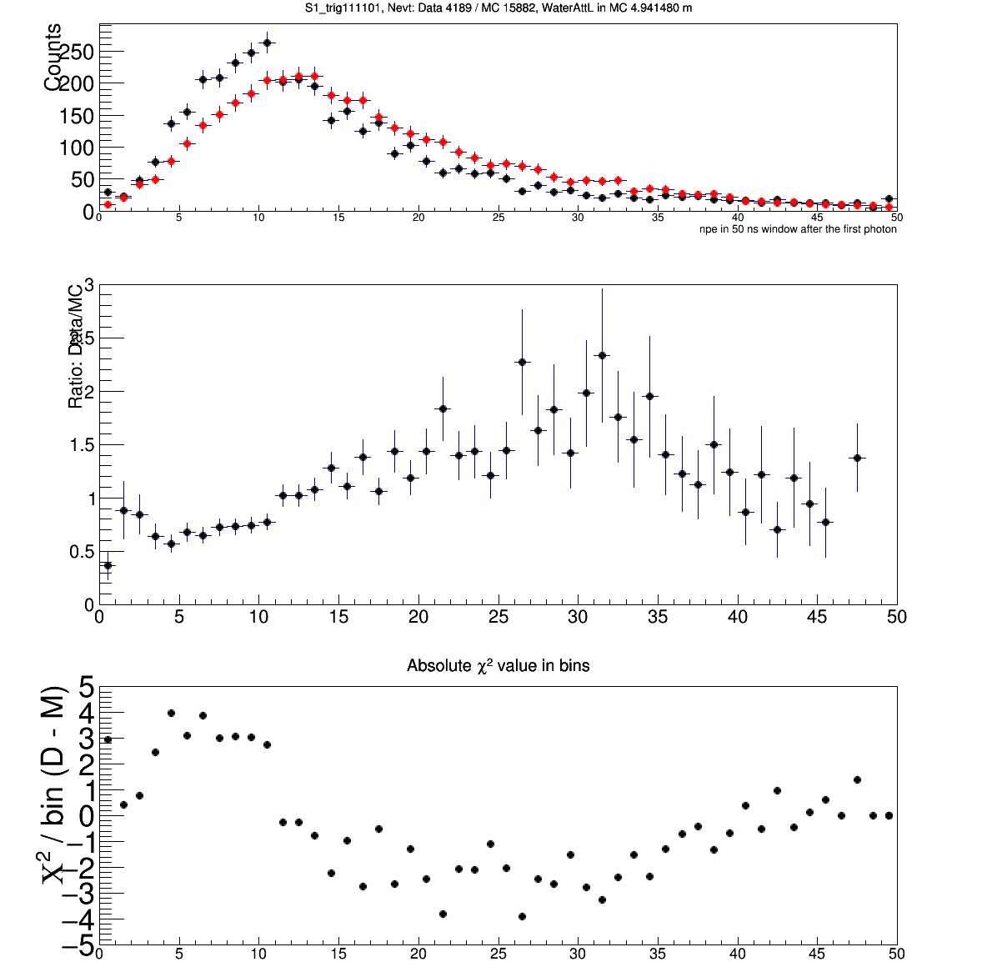
Check the npe distributions for S0 and S1, with input attL ~5 m, for the trigger type 111101.
Number of events in the histograms are shown in the titles, black for data, red for MC.

Slide 15
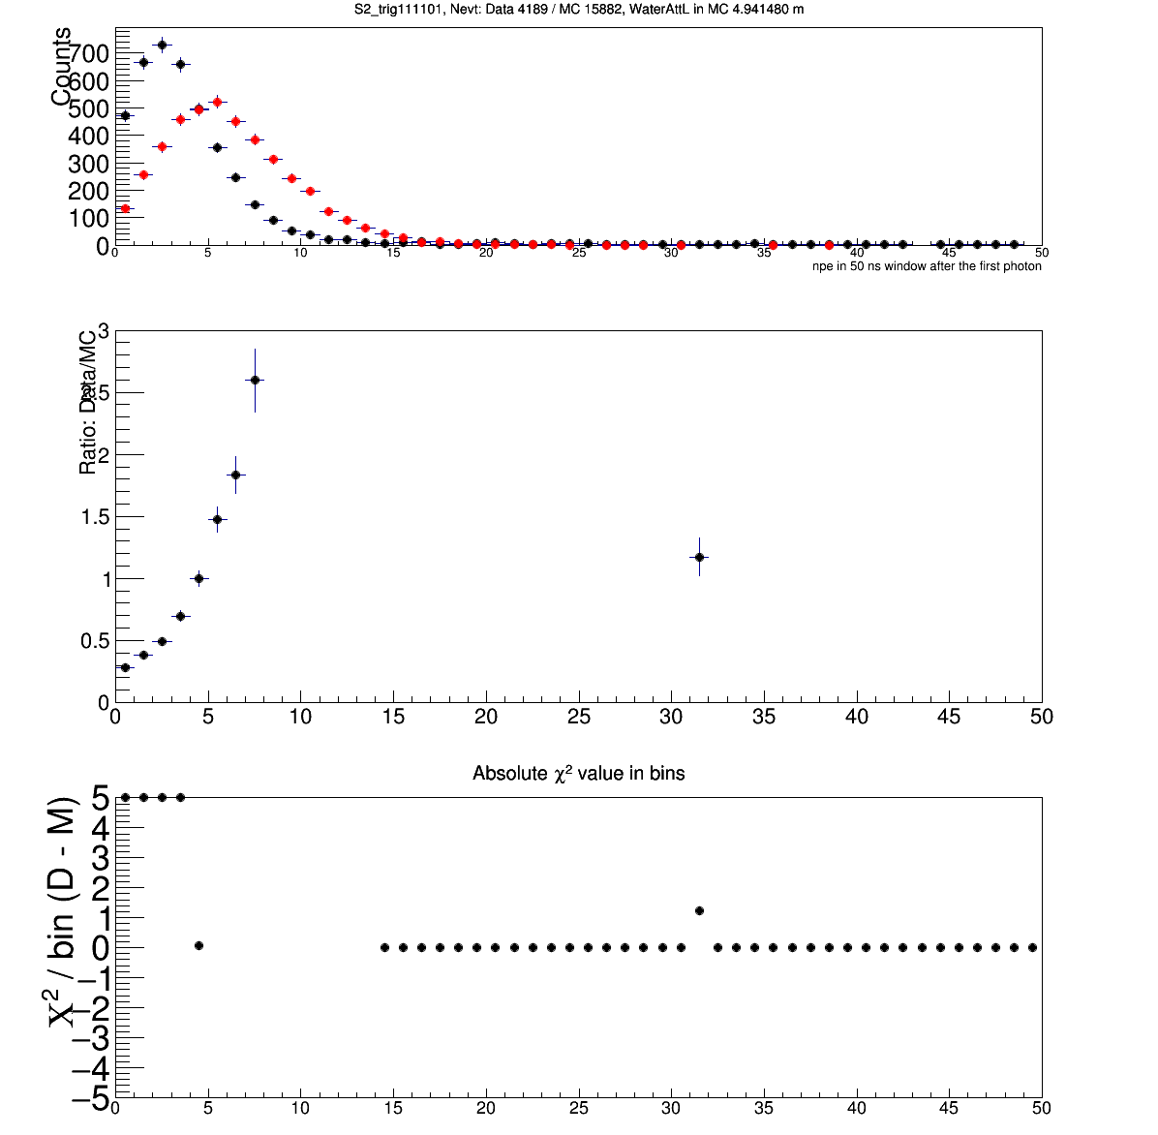
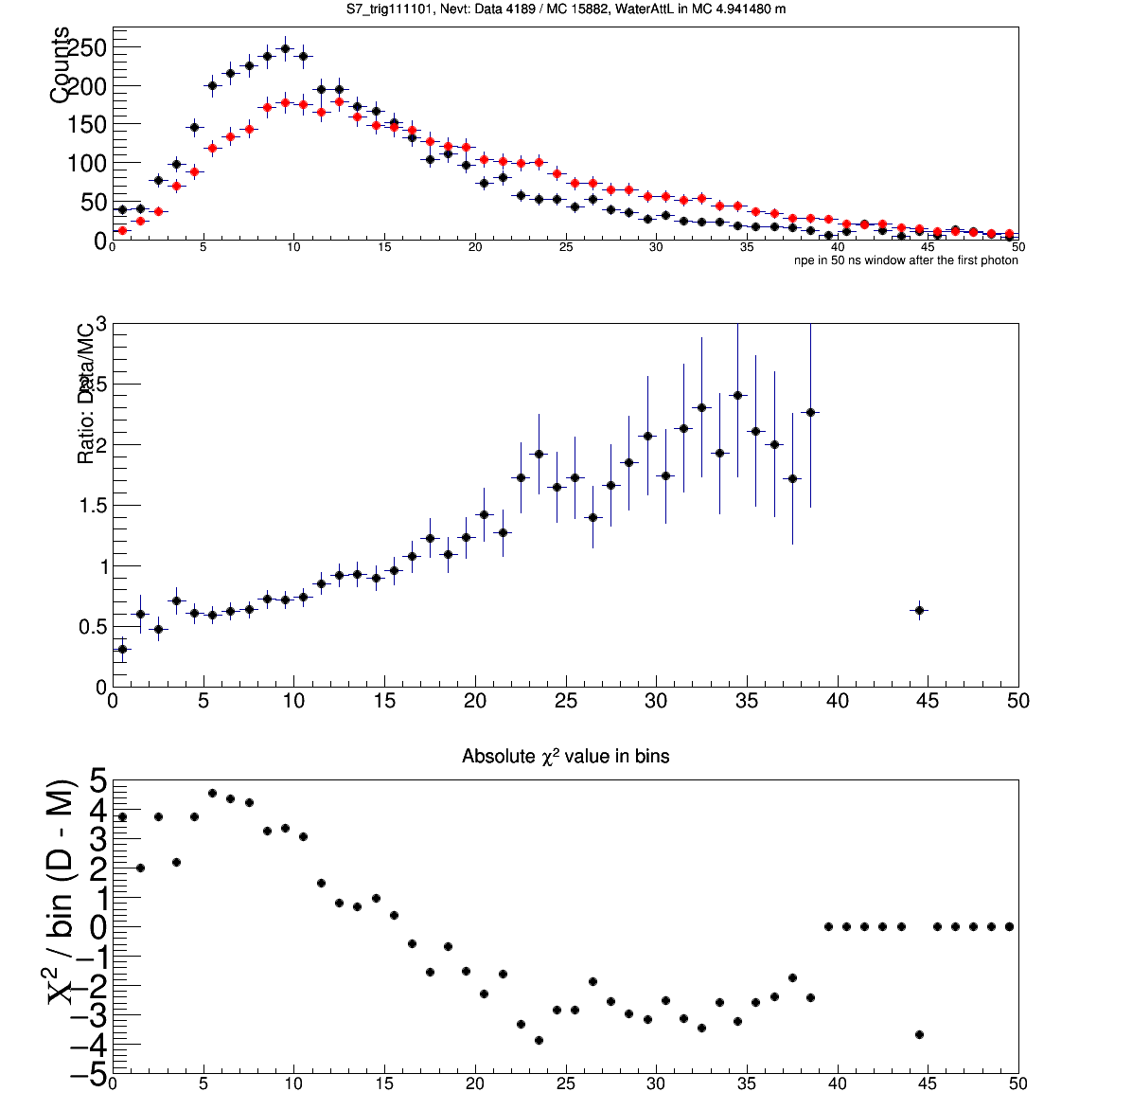
Check the npe distributions for S2 and S7, with input attL ~5 m, for the trigger type 111101.
Number of events in the histograms are shown in the titles, black for data, red for MC.

Slide 16
Pages 8-11:
In the case of trigger type 111110
Chi2 vs. attenuation parameter (max. attL) plots for S3 and S7 seem to show minimum near ~5 m.
Compare MC and data with input water max. attenuation at ~8 m.
PMT S1 shows agreeing npe distribution, S7 also is close, other PMTs don’t (S4 and S5 not compared.)
Pages 17-19:
For trigger type 111110
Compare MC and data with input water max. attenuation at ~5 m.
Only PMT S7 shows agreeing npe distributions (S4 and S5 not compared.)
Pages 13-15:
For trigger type 111101
Compare MC and data with input water max. attenuation at ~5 m.
Non of the PMTs show agreeing npe distributions (S4 and S5 not compared.)

Slide 17
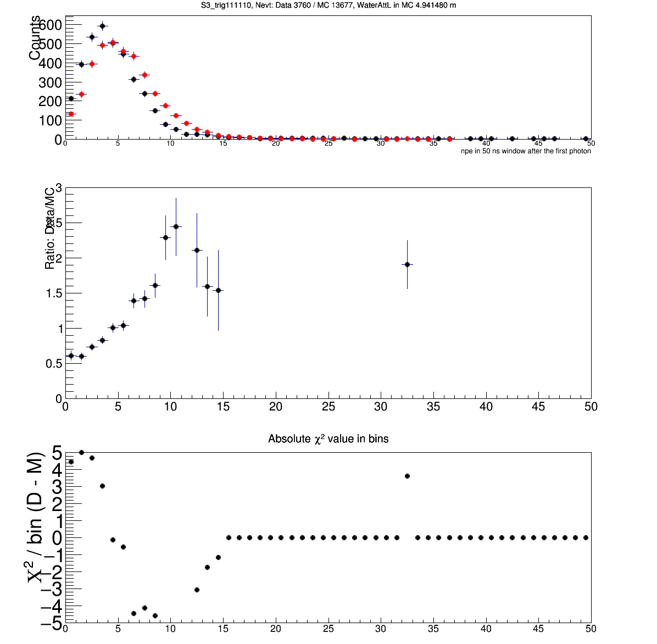
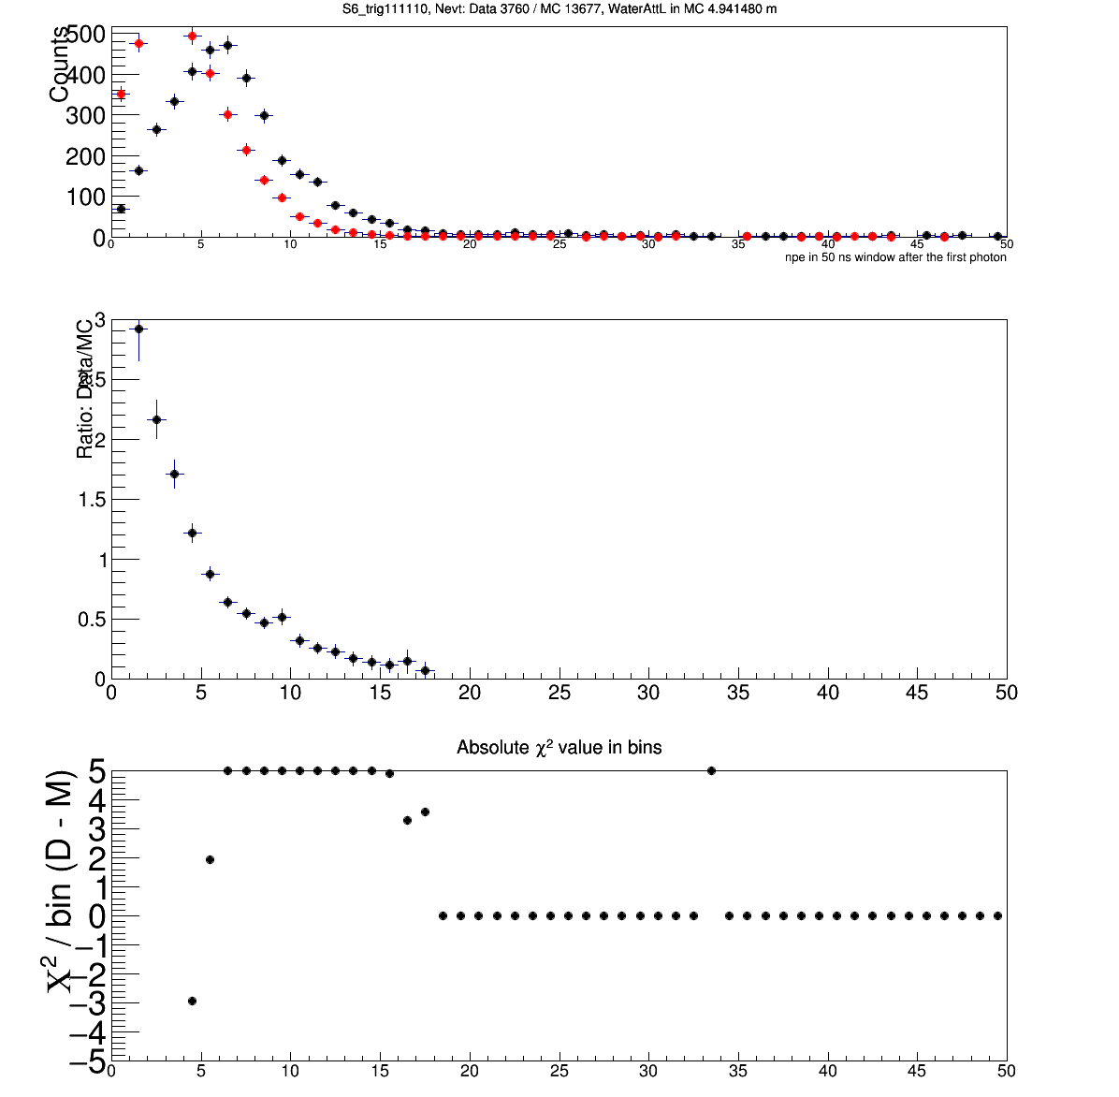
Check the npe distributions for S3 and S6, with input attL ~5 m, for the trigger type 111110.
Number of events in the histograms are shown in the titles, black for data, red for MC.
Data are from 1000 run files (not all)
Chi2 values in each bin are shown too

Slide 18
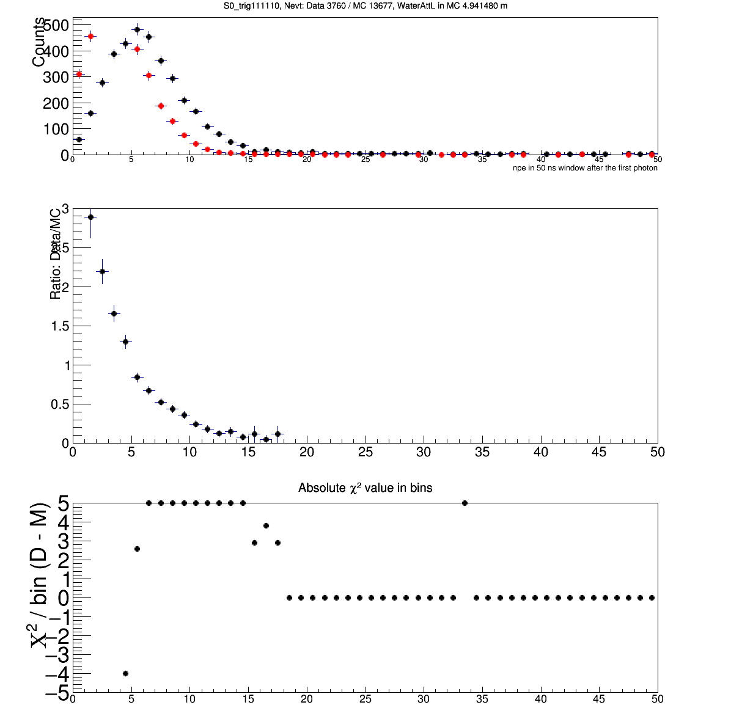
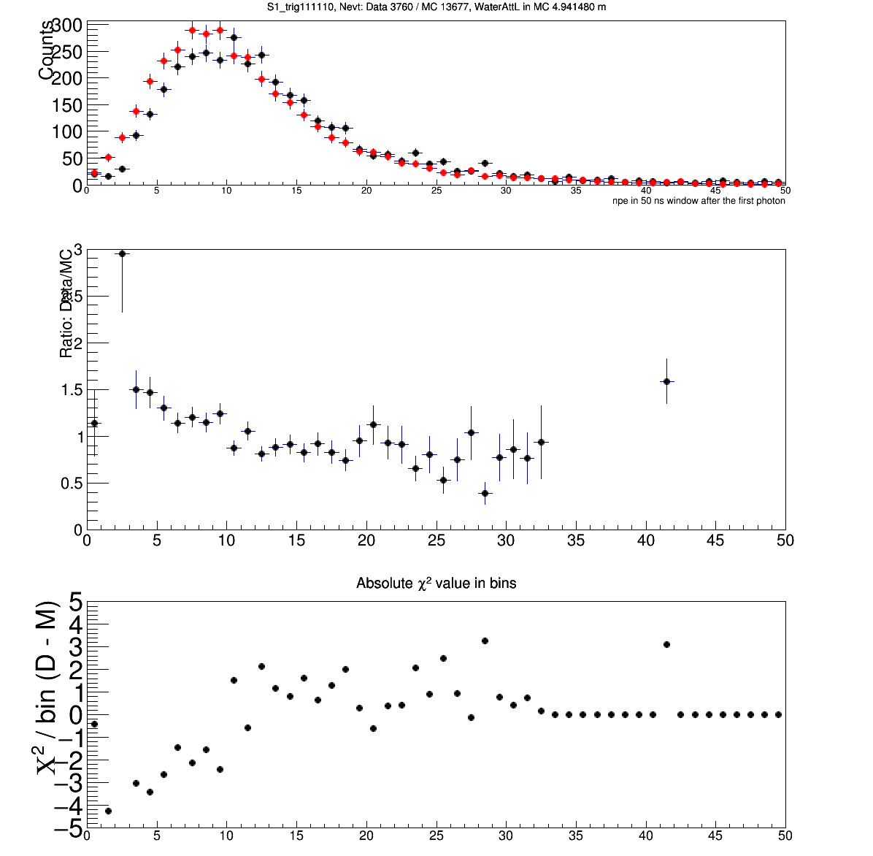
Check the npe distributions for S0 and S1, with input attL ~5 m, for the trigger type 111110.
Number of events in the histograms are shown in the titles, black for data, red for MC.

Slide 19
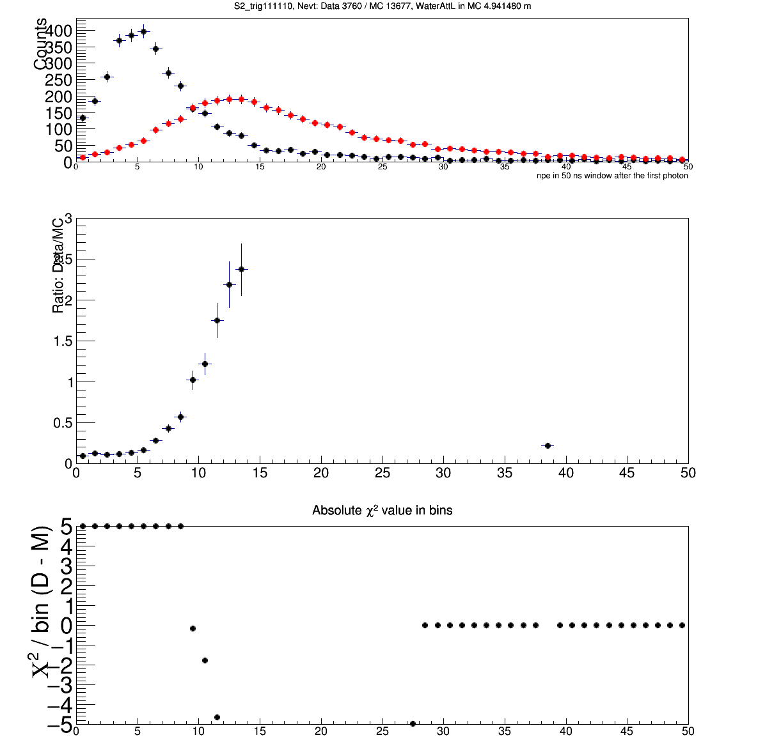
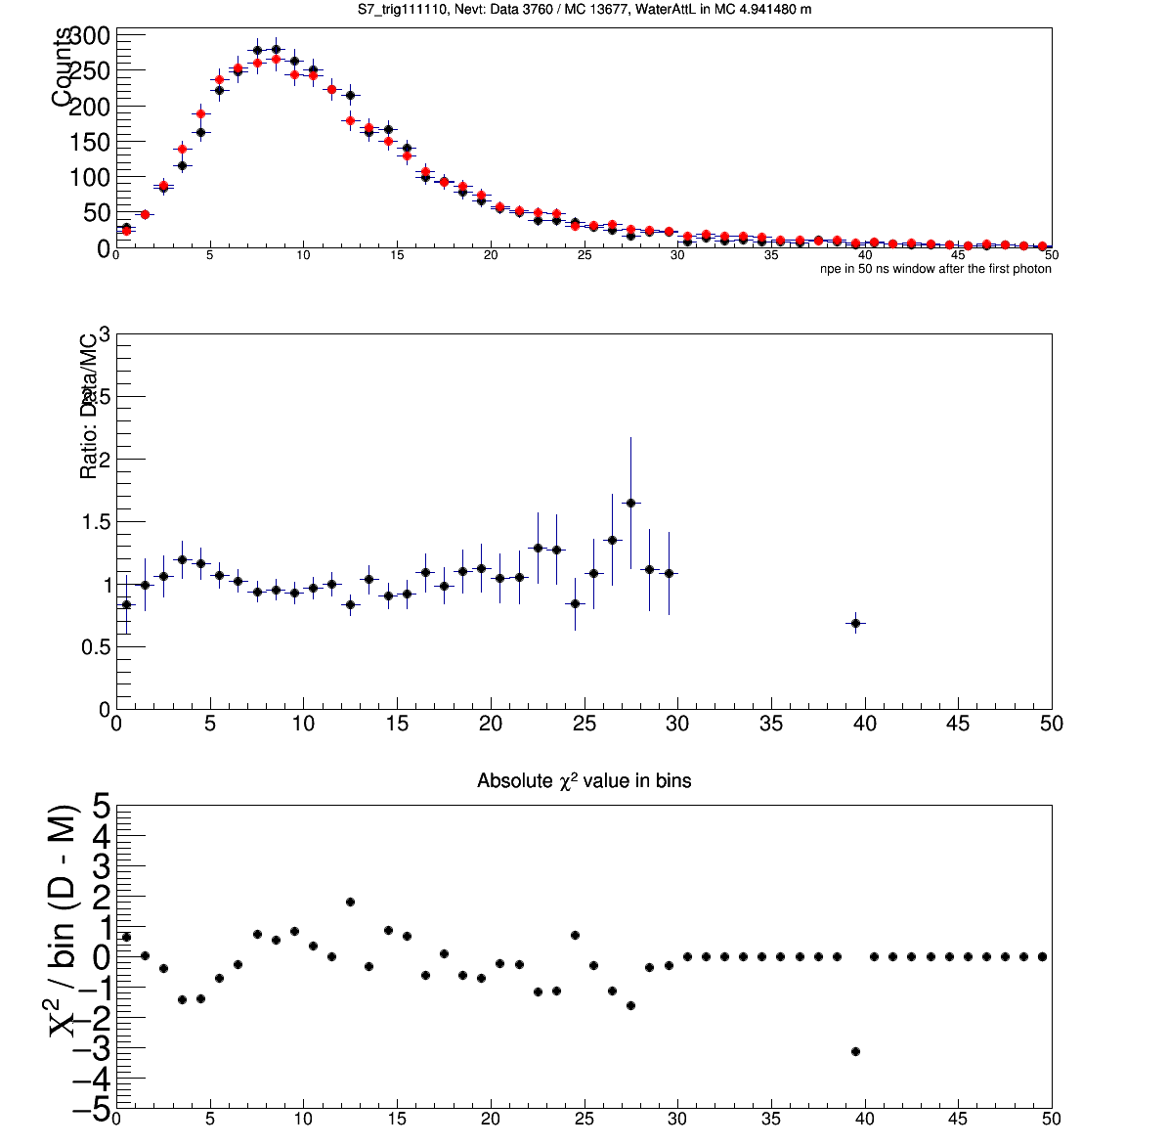
Check the npe distributions for S2 and S7, with input attL ~5 m, for the trigger type 111110.
Number of events in the histograms are shown in the titles, black for data, red for MC.

Slide 20
Now, assume ~8 m attenuation is correct,
and since PMT S0, S3, S6 match data, what about npe distributions for them for other different trigger types?
In these comparison, I require going through muons, because I worry that hodo detector inefficiency could mess up the sample selections (e.g., one truly through going muon could be decided as not hitting H4 nor H5.)
Pages 21-25: for PMT S0 comparison at ~8 m attL.
Pages 27-31: for PMT S3 comparison at ~8 m attL.
Pages 33-37: for PMT S6 comparison at ~8 m attL.
For PMTs S0, S3, S6, almost all samples with hitting H5 seem to agree with data.
for samples with hitting H4, only for 011110 the agreement is not too bad.

Slide 21
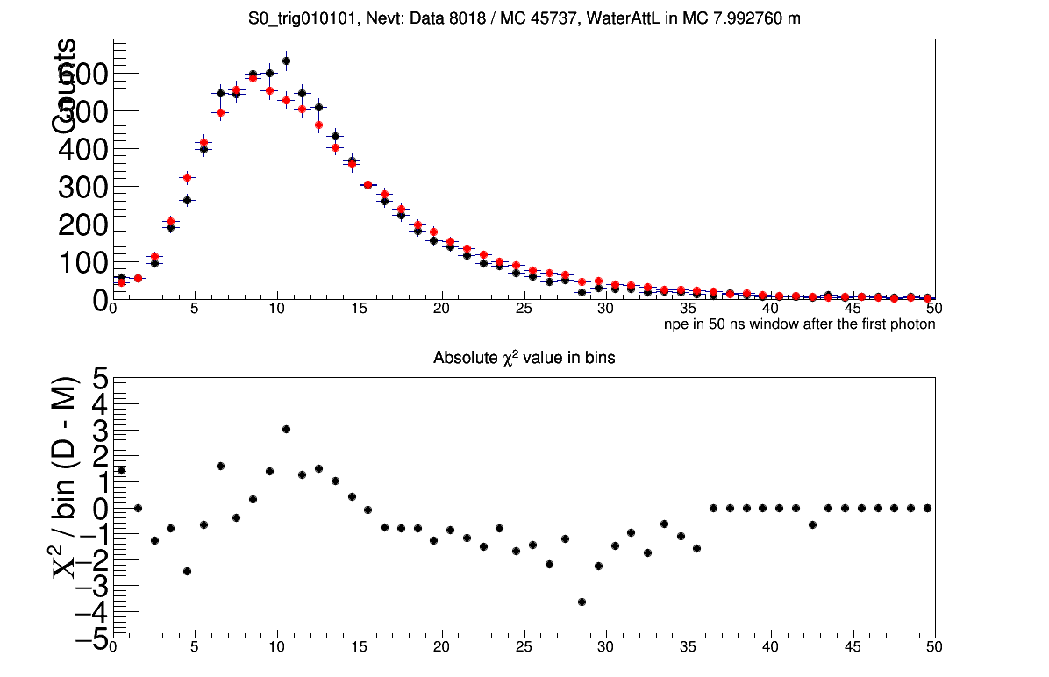
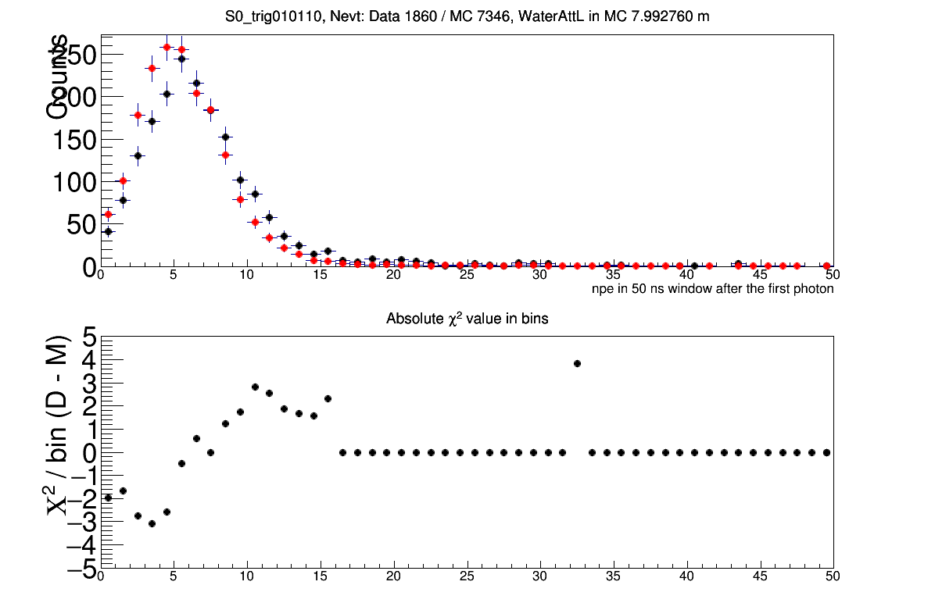
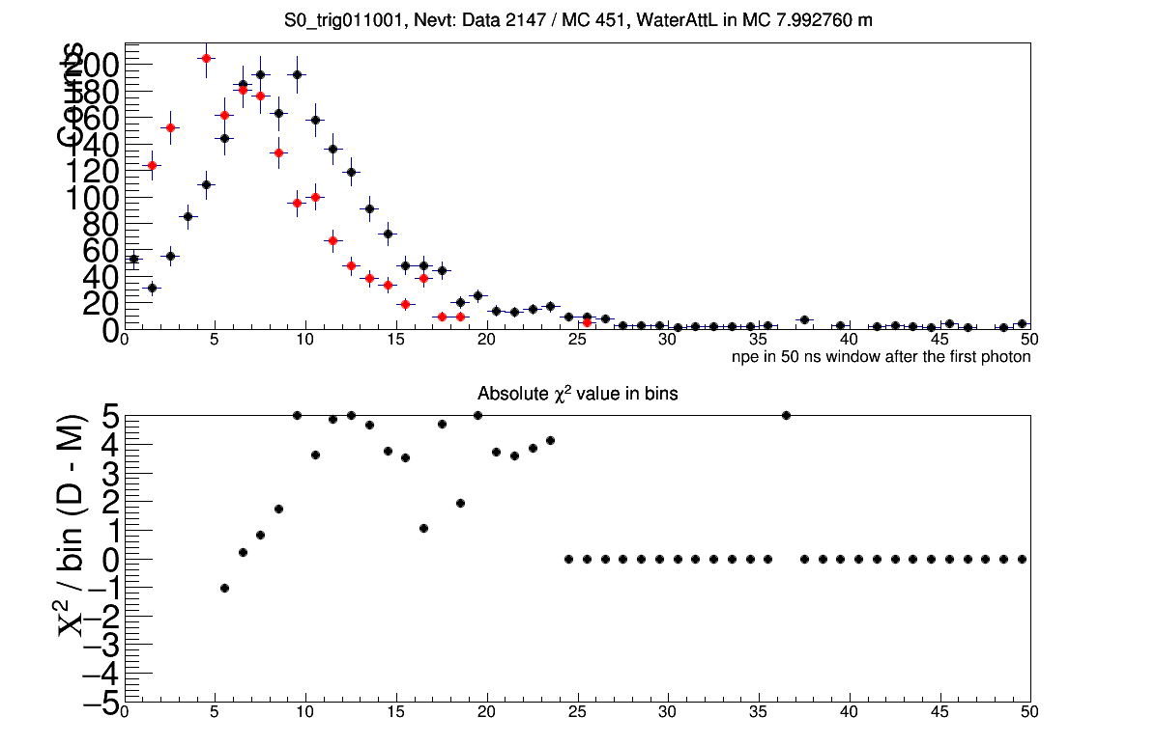
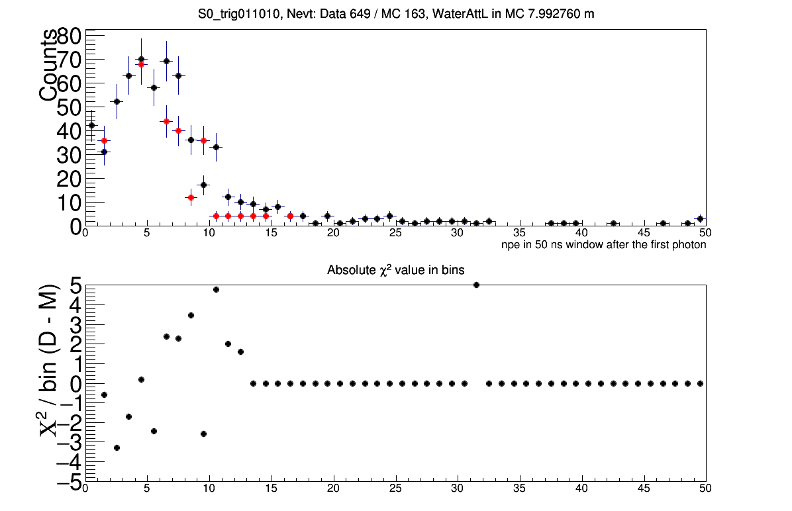
S0
010101
attL ~8 m
010110
attL ~8 m
011001
attL ~8 m
MC statistics low
011010
attL ~8 m
Very low statistics

Slide 22
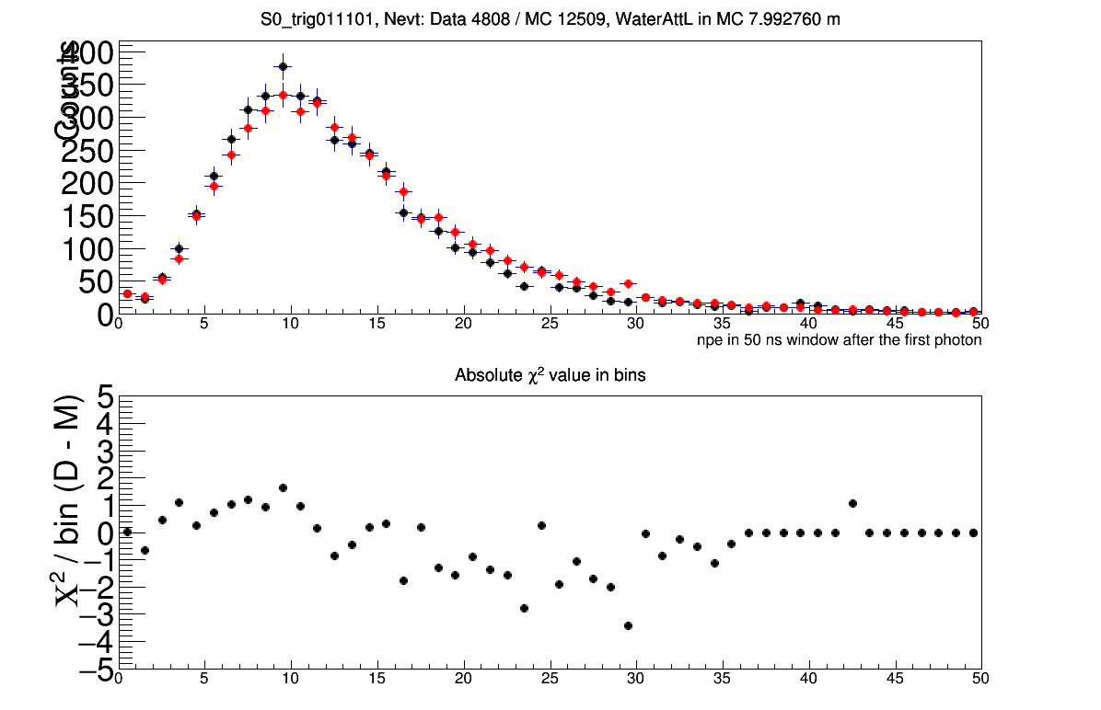
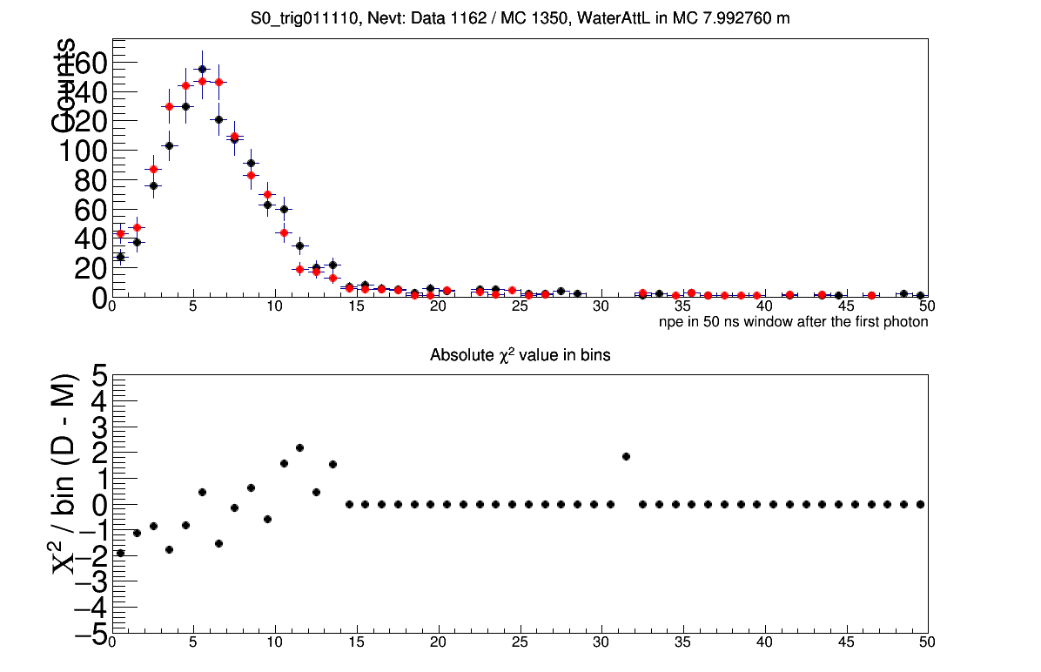
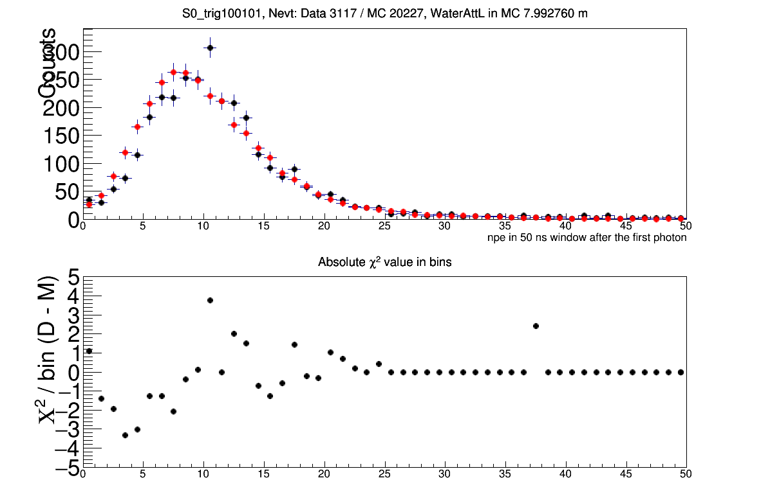
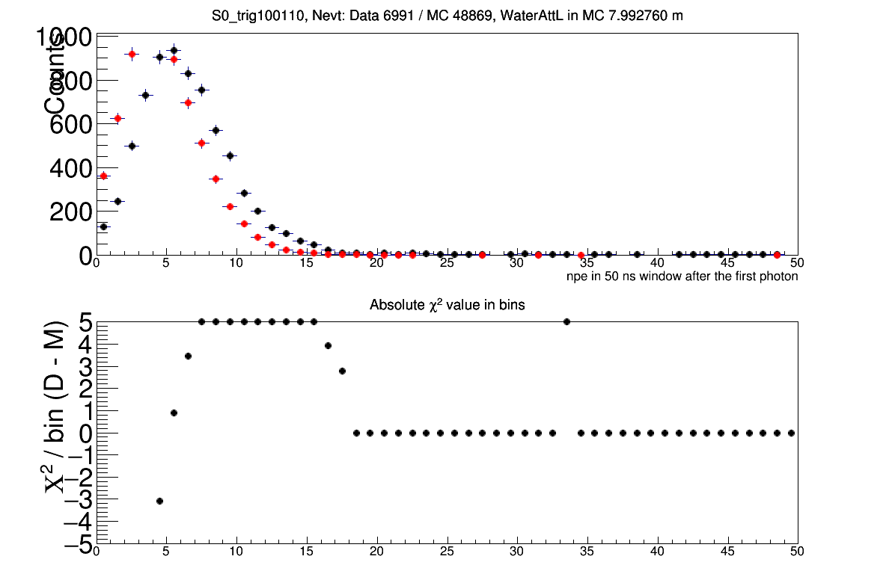
S0
011101
attL ~8 m
011110
attL ~8 m
100101
attL ~8 m
100110
attL ~8 m

Slide 23
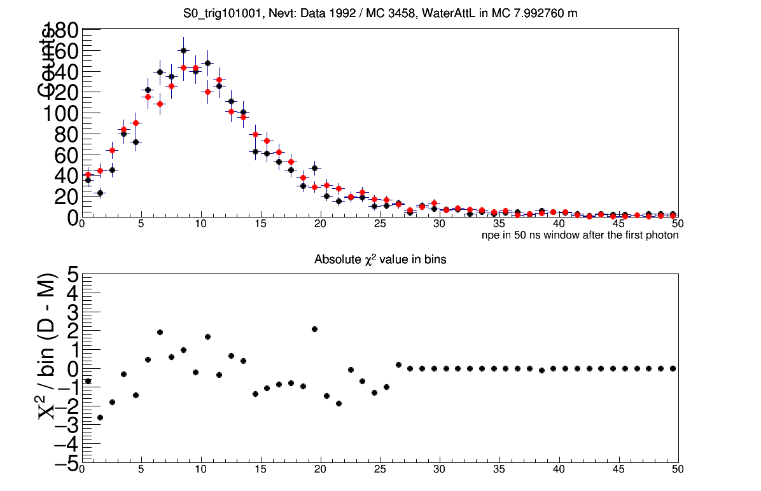
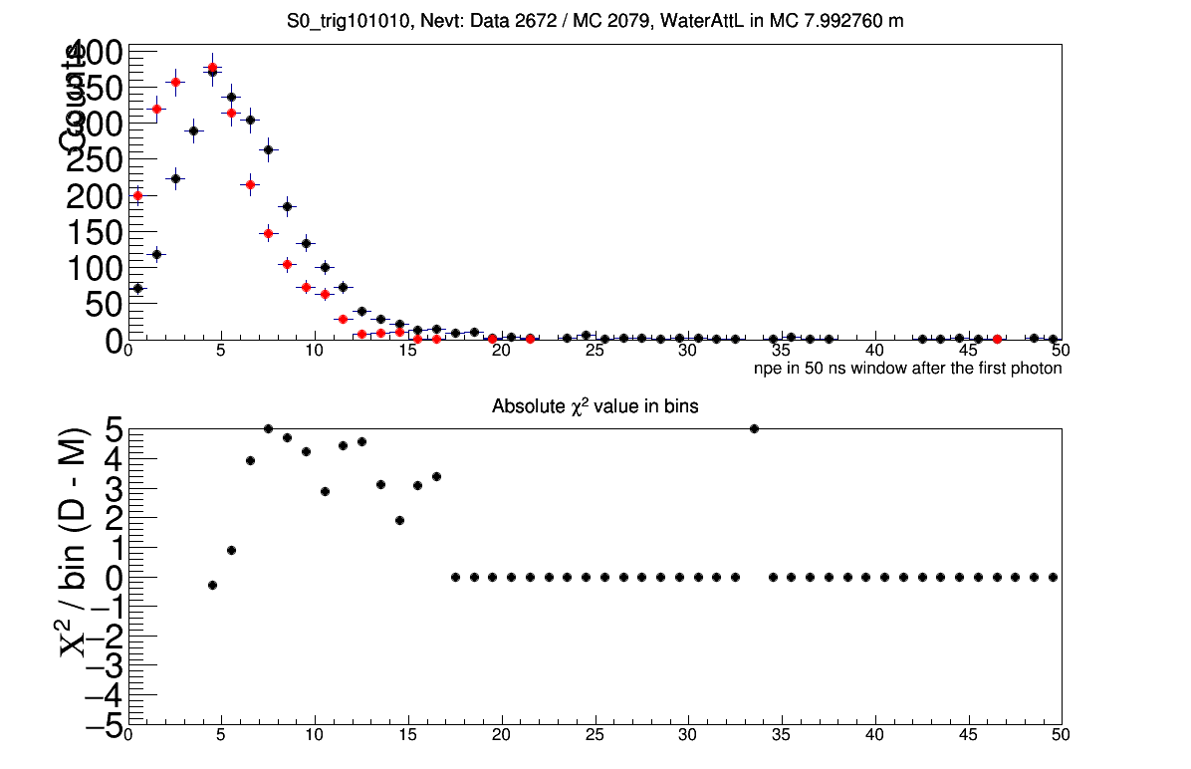
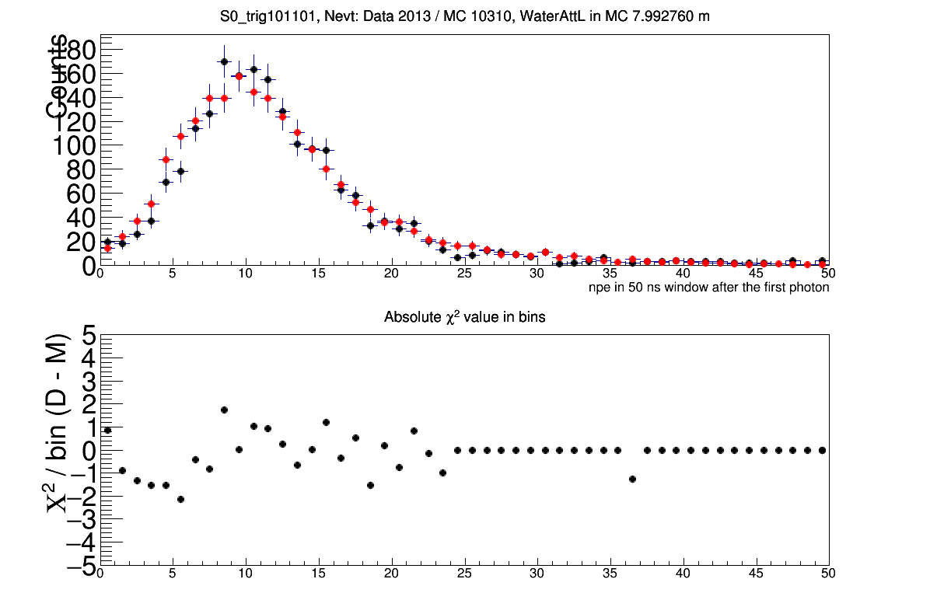
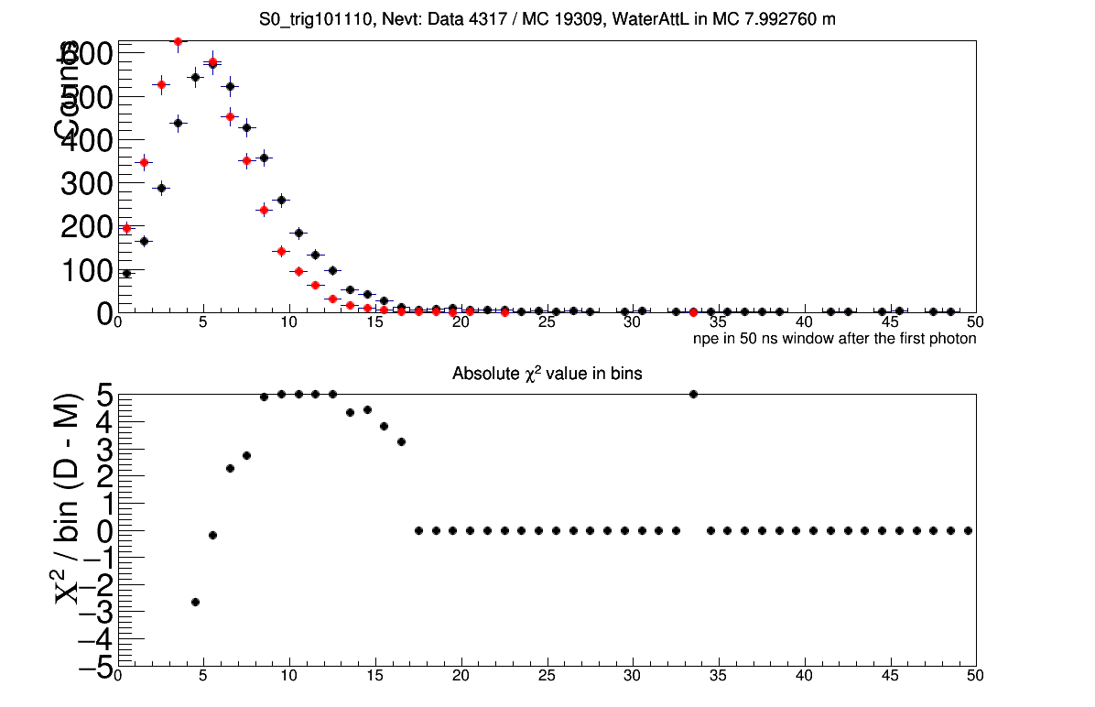
S0
101001
attL ~8 m
101010
attL ~8 m
101101
attL ~8 m
101110
attL ~8 m

Slide 24




S0
110101
attL ~8 m
110110
attL ~8 m
111001
attL ~8 m
MC statistics low
111010
attL ~8 m
MC statistics low

Slide 25


S0
111101
attL ~8 m
111110
attL ~8 m

Slide 27




S3
010101
attL ~8 m
010110
attL ~8 m
011001
attL ~8 m
MC statistics low
011010
attL ~8 m
Very low statistics

Slide 28




S3
011101
attL ~8 m
011110
attL ~8 m
100101
attL ~8 m
100110
attL ~8 m

Slide 29




S3
101001
attL ~8 m
101010
attL ~8 m
101101
attL ~8 m
101110
attL ~8 m

Slide 30




S3
110101
attL ~8 m
110110
attL ~8 m
111001
attL ~8 m
MC statistics low
111010
attL ~8 m
MC statistics low

Slide 31


S3
111101
attL ~8 m
111110
attL ~8 m

Slide 33




S6
010101
attL ~8 m
010110
attL ~8 m
011001
attL ~8 m
MC statistics low
011010
attL ~8 m
Very low statistics

Slide 34




S6
011101
attL ~8 m
011110
attL ~8 m
100101
attL ~8 m
100110
attL ~8 m

Slide 35




S6
101001
attL ~8 m
101010
attL ~8 m
101101
attL ~8 m
101110
attL ~8 m

Slide 36




S6
110101
attL ~8 m
110110
attL ~8 m
111001
attL ~8 m
MC statistics low
111010
attL ~8 m
MC statistics low

Slide 37


S6
111101
attL ~8 m
111110
attL ~8 m

Slide 39

PMT charge distributions from LED calibration

