Slide 1
Smart Multi-Purpose Passerby Counting System
Rongchuan Sun (23715251)
Brandon Ke (22731448)
Aryan Radadiya (23851299)
Yunwei Zhang (23825634)
CITS5506 Internet of Things Project Presentation
Group 40

Slide 2
Context & Background
Constraints with how many people in small locations.
Prevent passing on illnesses e.g., COVID-19
Need for people to monitor and analyse how many people enter and leave during the day.
Aim:
Create a system to monitor the number of people at a location and find out how many people enter and leave over time.
Know these statistics at different times of the day.
Notes:
- problem of overcrowding places – more prevalent these past few years due to COVID19
- people need to find a way that allows them to monitor number of people at a place, and record statistics that can help them make decisions as to how they could improve balancing number of people
- aim is to create a system that lets users keep an eye on number of people as well as number of people that enter and leave to help with decision-making

Slide 3
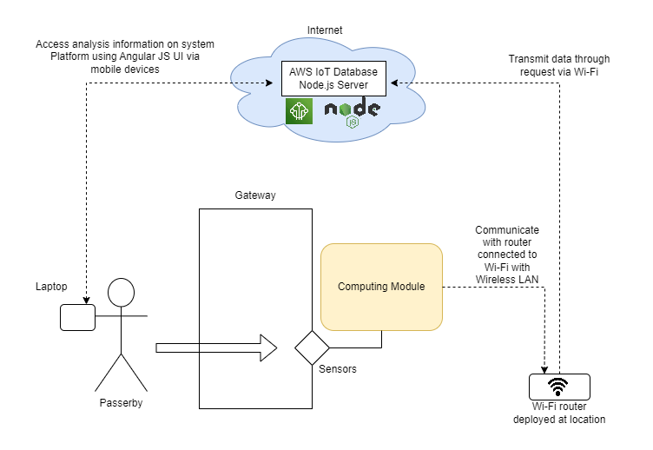
System Design

Slide 4
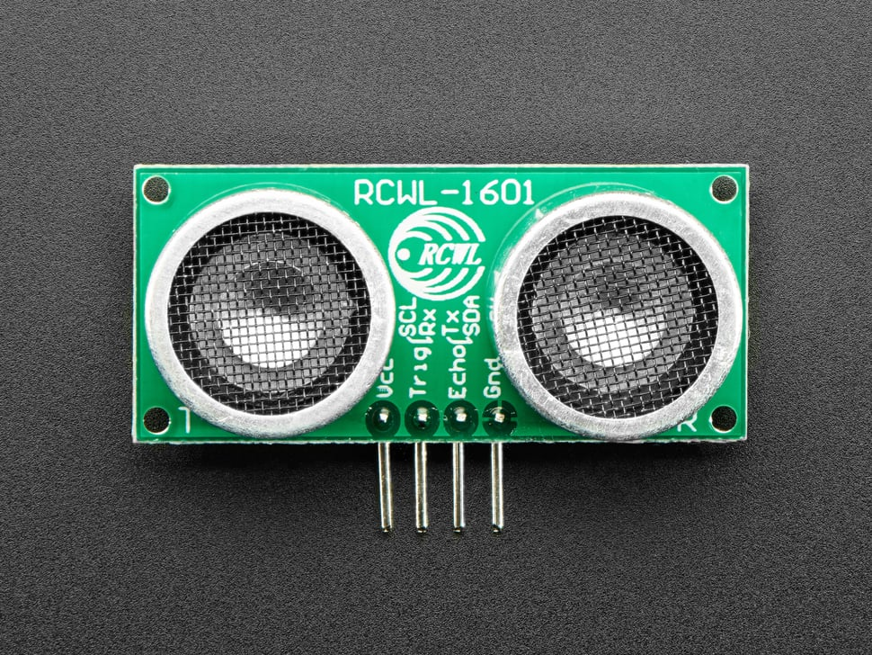
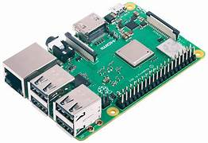
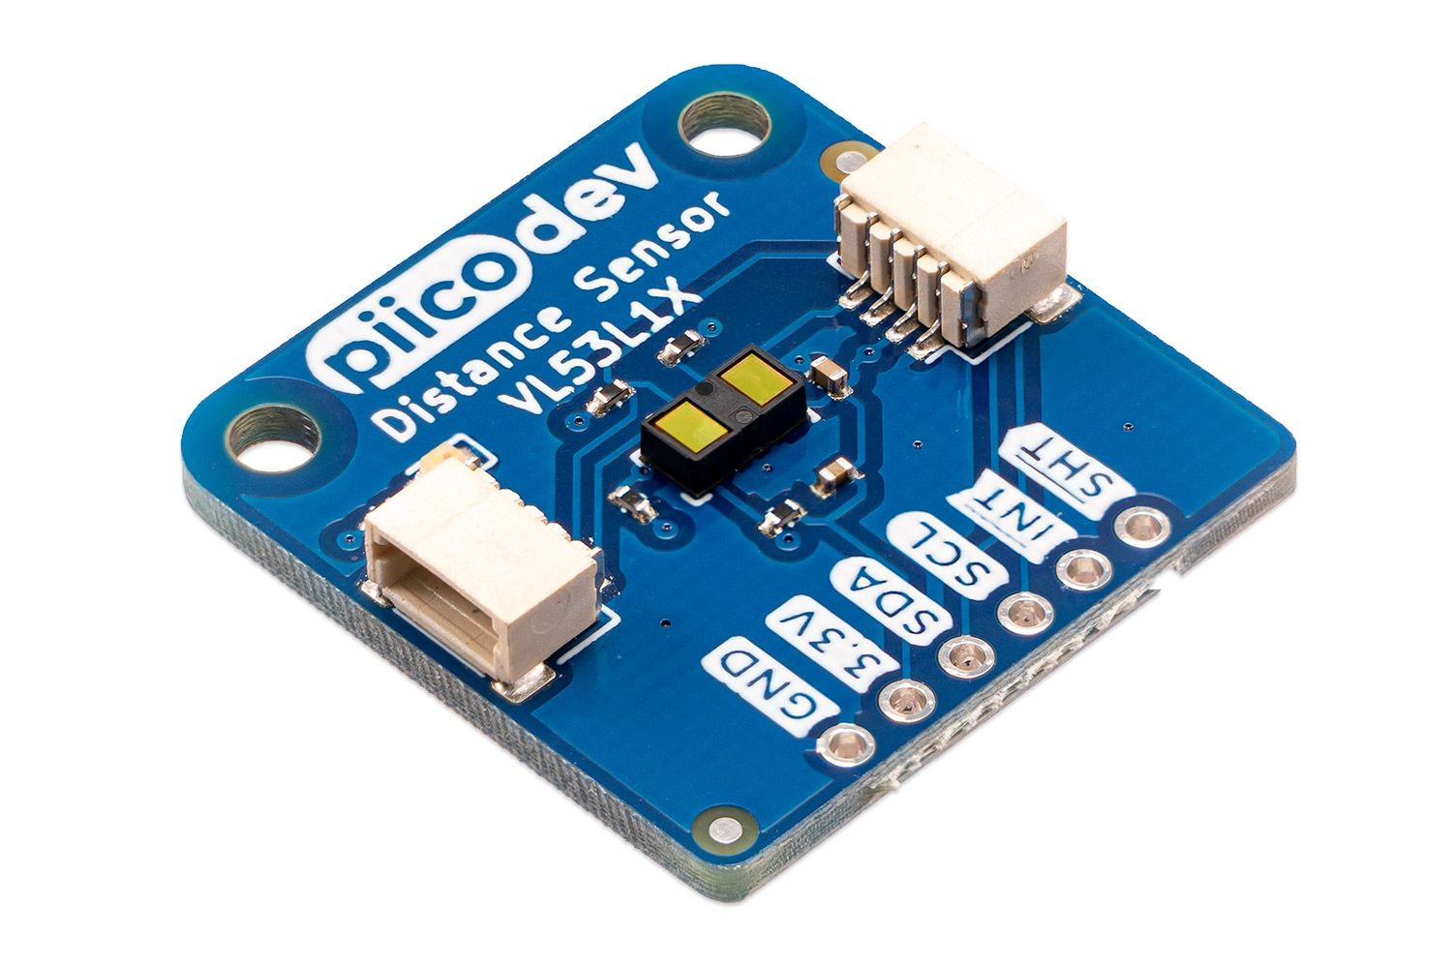
Components Required
Base items:
1 RaspberryPi 3B microcontroller
1 breadboard
1 RaspberryPi 5VDC power plug
Male-to-Female jumpwires
Male-to-Male jumpwires
2 RCWL-1601 Ultrasonic Sensors
6 1k ohm resistors
PiicoDev items:
2 1 VL53L1X PiicoDev Laser Distance Sensor
1 PiicoDev adapter for RaspberryPi
2 1 PiicoDev cables
Ultrasonic Distance Sensor with I2C Interface - RCWL-1601 : ID 4742 : $3.95 : Adafruit Industries, Unique & fun DIY electronics and kits
RASPBERRY PI 3B+: Raspberry Pi 3 B+, 4x 1,4 GHz, 1 GB RAM, WLAN, BT at reichelt elektronik
PiicoDev Laser Distance Sensor VL53L1X | Core Electronics Australia (core-electronics.com.au)

Slide 5
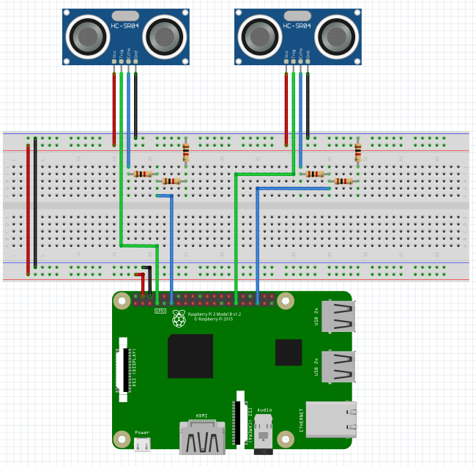
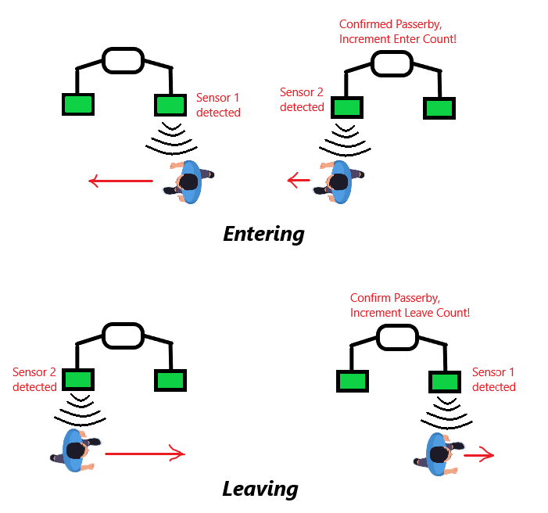
Hardware Design

Slide 6
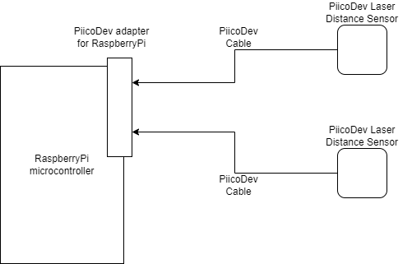
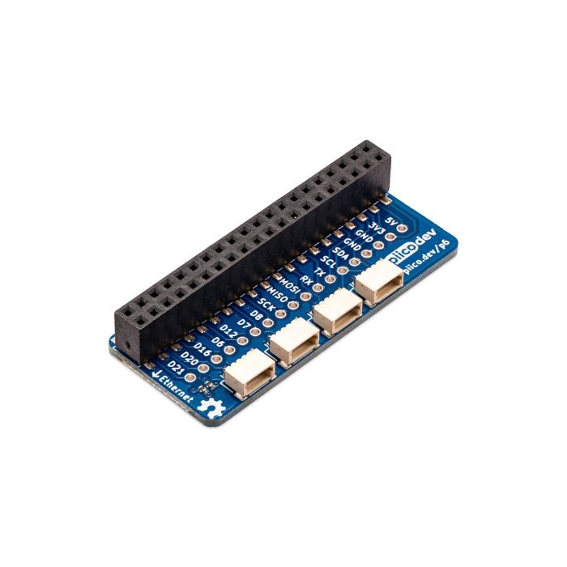
Hardware Design (cont.)
PiicoDev Laser Distance Sensor VL53L1X | Core Electronics Australia (core-electronics.com.au)
PiicoDev Adapter for Raspberry Pi | Core Electronics Australia (core-electronics.com.au)
PiicoDev sensors of same type have the same I2C address – all sensors will give same detection (cannot be used for bi-directional detection).
Limits this version to only being “unidirectional.”

Slide 7
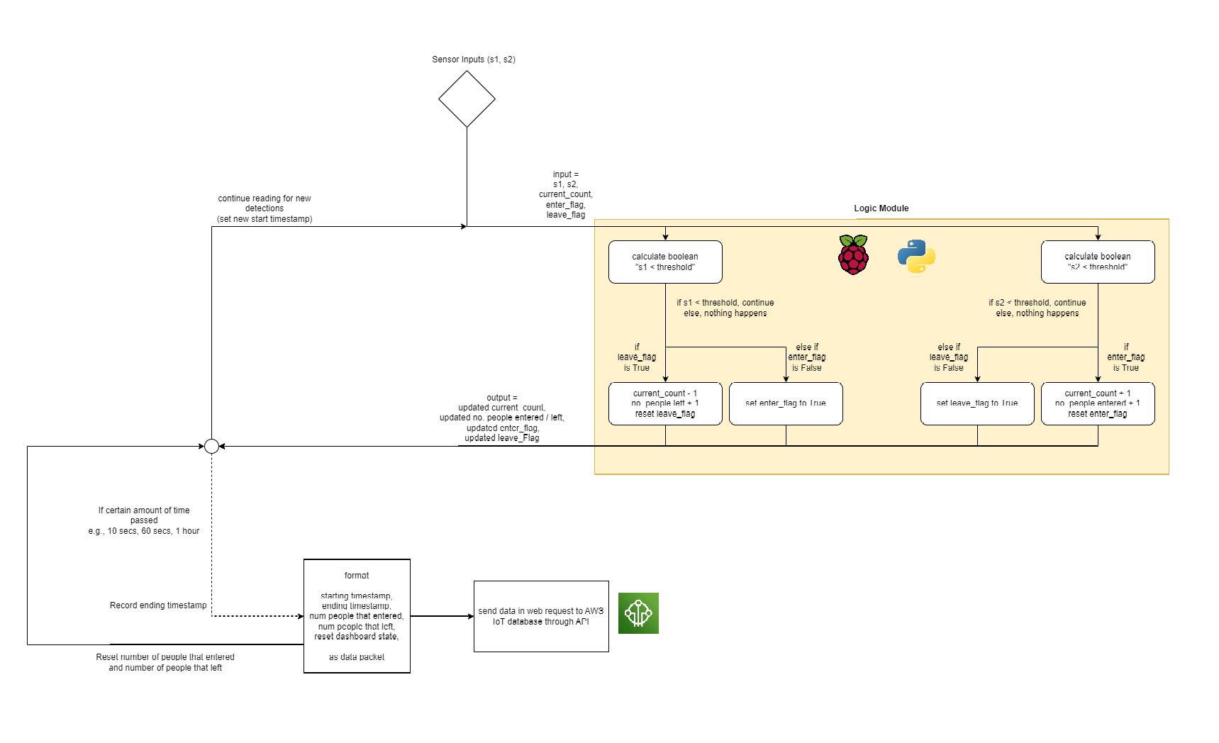
Software Design
For Bi-Directional Ultrasonic Sensors Version

Slide 8
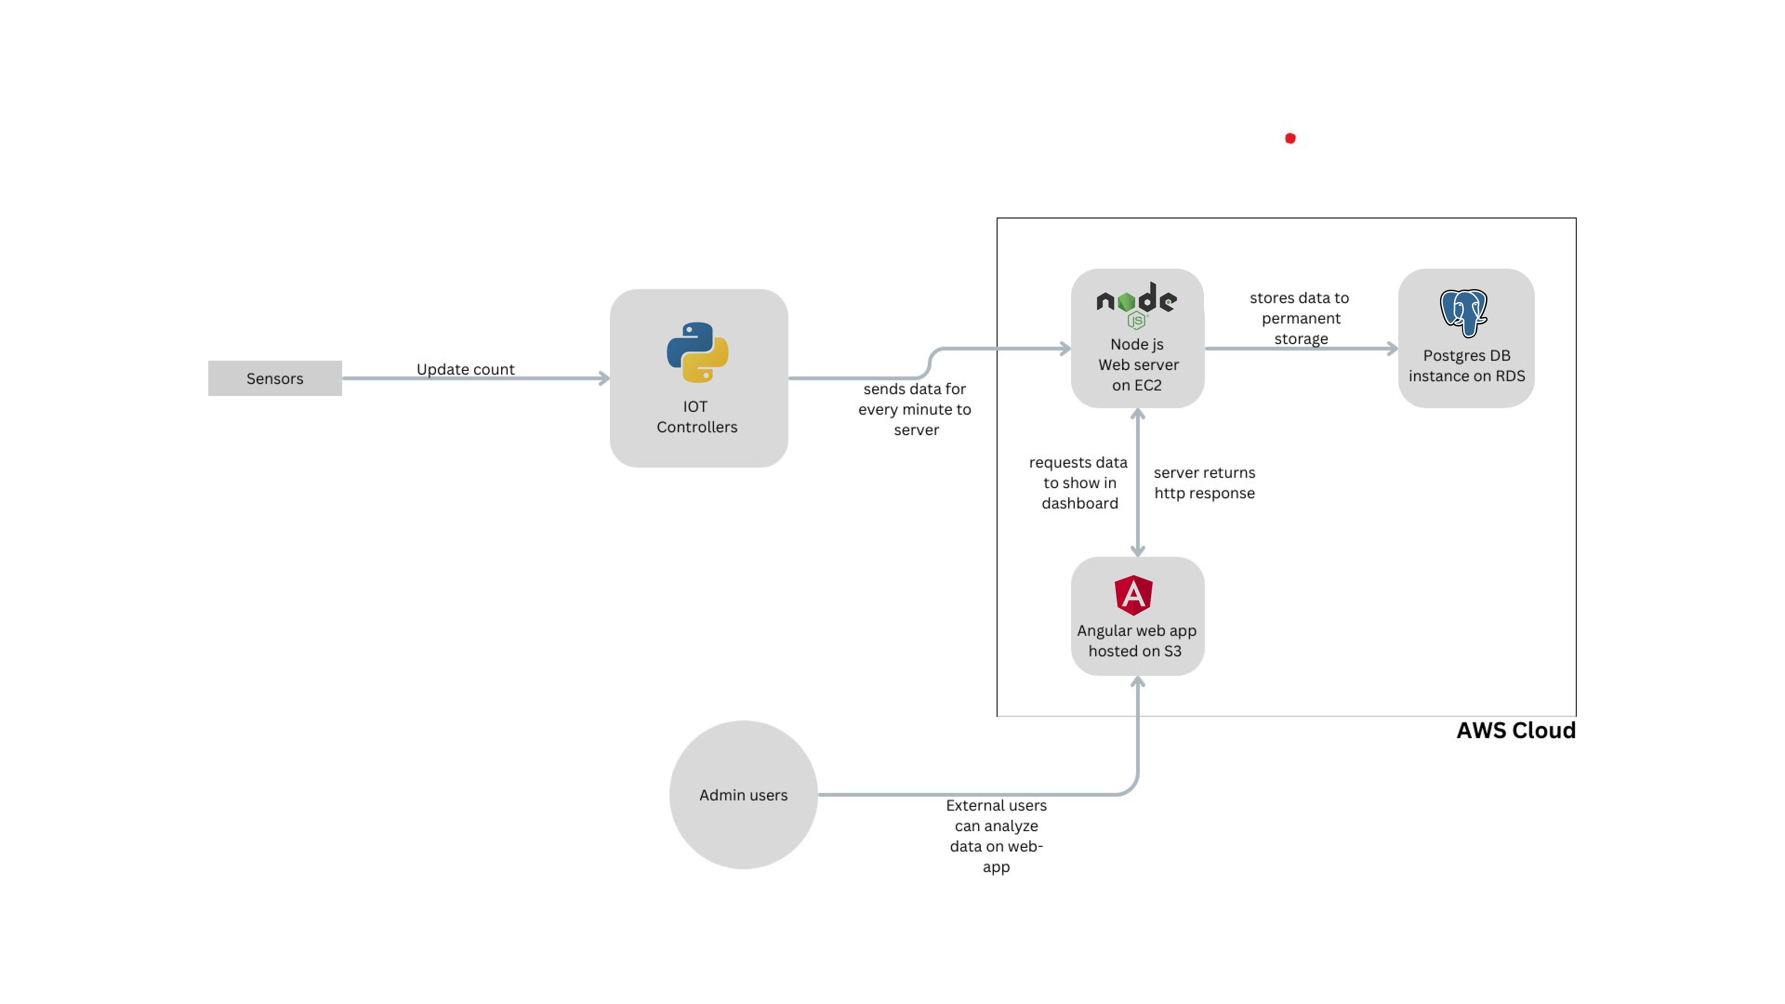
Data flow

Slide 9
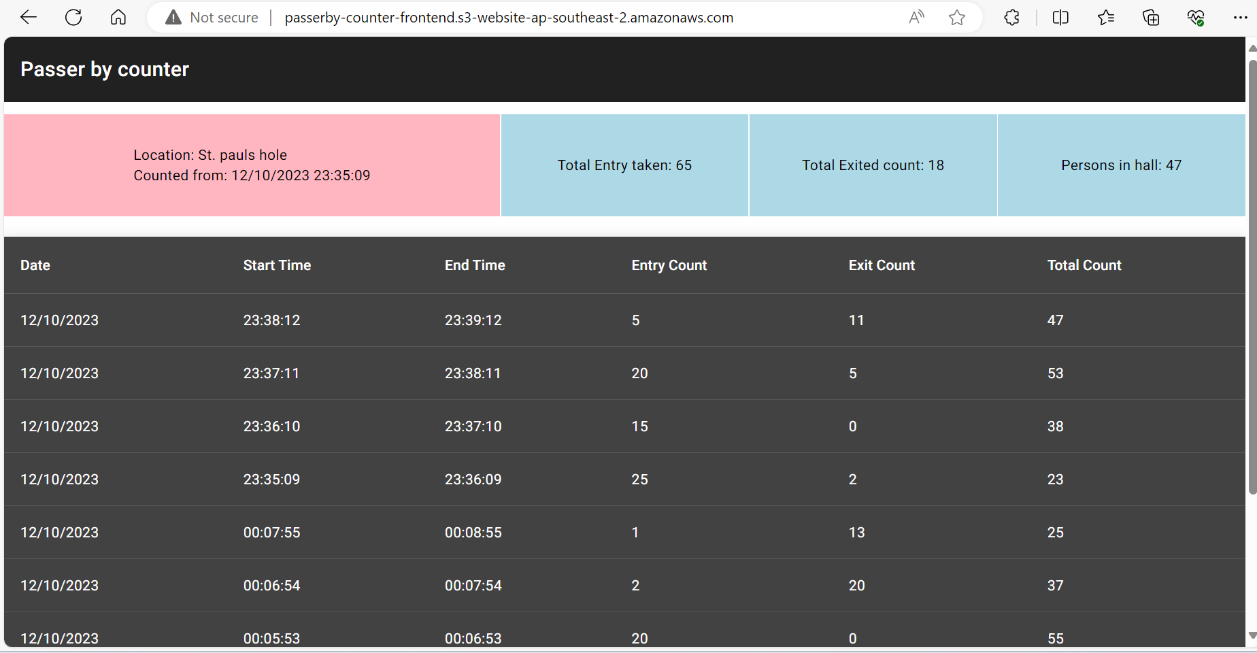
User Interface

Slide 10
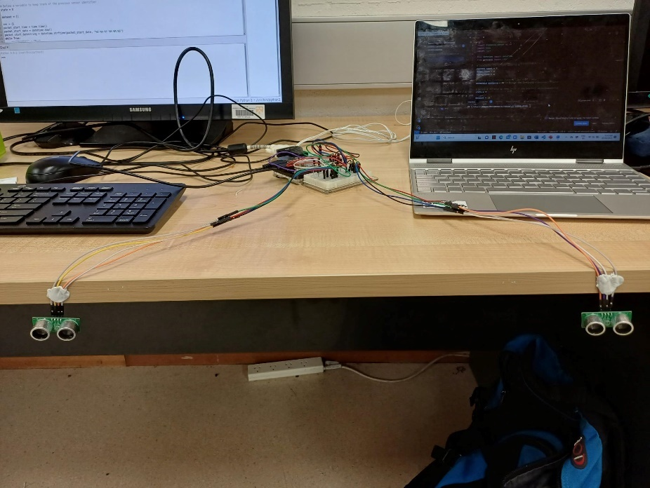
Experimentation & Testing
Accuracy of system with Ultrasonic Sensors, where they are 120cm apart from each other
Case Scenario | F1 Score (%)
People walking in only | 92
People walking in, some walking out | 87
People walking in, everyone leaving | 92
People running in only | 80
People running in, some running out | 68
People running in, everyone running as they leave | 64
Accuracy of system with Laser Distance Sensor
Setup of Bi-directional Ultrasonic Sensors version of System
Case Scenario | F1 Score (%)
People walking in only | 95
People running in only | 100
Notes:
- after experimentation, sensors were tested under different settings and scenarios e.g., distance between sensors, speed of people passing, people passing in and also out, threshold for distance detection, delay between detections
- due to limitation of laser sensors, could not be tested with every case -> could not achieve functionality of this project
- ultrasonic sensors achieved functionality of project, but was not entirely reliable or accurate
- worked better when people were passing by slowly (walking) – could change depending on sensors distance
- laser sensors were the most reliable and accurate (but can depend on delay between detections – may be too fast where it would get false detections)

Slide 11
Findings & Conclusion
Performance of system depends on settings
E.g., distance threshold, distance between sensors, detection delay
Ultrasonic Sensors:
Better when people are walking – running is too fast for them to detect.
Achieved bi-directional function.
Laser Distance Sensors:
Very precise and reliable with detections (almost too precise) – even with fast motions.
Limited to unidirectional.

Slide 12
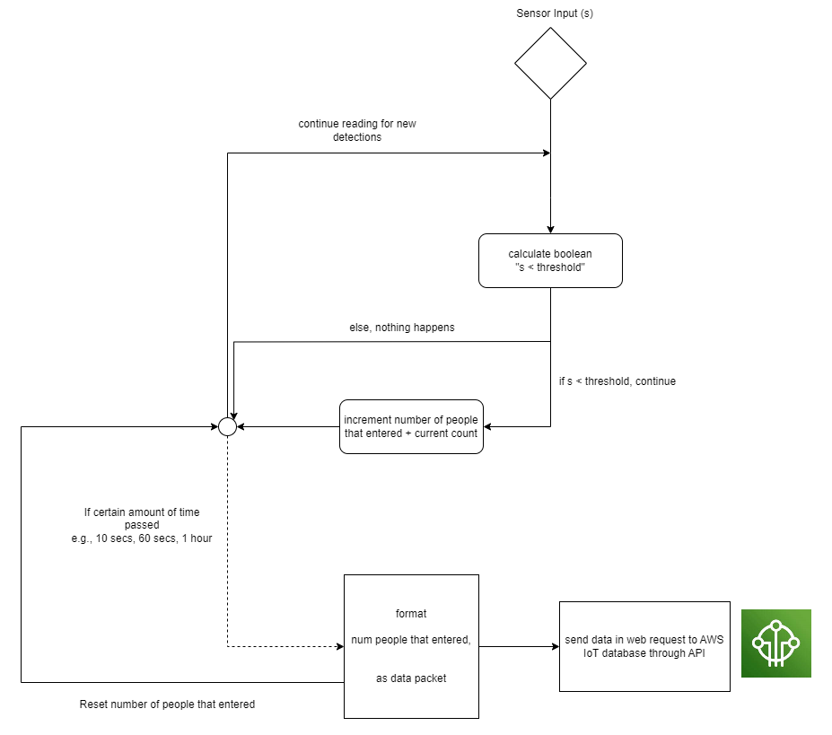
Appendix A: Software Architecture for Unidirectional Laser Distance Sensors version

