Slide 1


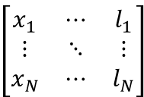
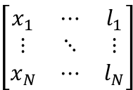






Actor network
$$\left[\begin{matrix}x_{1} & ⋯ & l_{1} \\ ⋮ & ⋱ & ⋮ \\ x_{N} & ⋯ & l_{N}\end{matrix}\right]$$
z
Graph Node
Features
$${\{h}_{i}\}$$
GAT
CNN (ResNet-18)
MLP
$${\{e}_{i}\}$$
Noisy Layers
Policy-A
Critic network
z
$${\{g}_{k}\}$$
$${\{e}_{k}\}$$
Q-value
target Actor network
$$\left[\begin{matrix}x_{1} & ⋯ & l_{1} \\ ⋮ & ⋱ & ⋮ \\ x_{N} & ⋯ & l_{N}\end{matrix}\right]$$
z
Update
$${\{g}_{k}\}$$
GAT
CNN (ResNet-18)
MLP
$${\{e}_{k}\}$$
Noisy Layers
target Policy-A
minimize TD-error
target Critic network
z
$${\{g}_{k}\}$$
$${\{e}_{k}\}$$
target Q-value

Slide 2


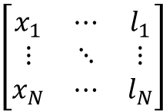








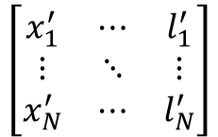

Actor network
$$\left[\begin{matrix}x_{1} & ⋯ & l_{1} \\ ⋮ & ⋱ & ⋮ \\ x_{N} & ⋯ & l_{N}\end{matrix}\right]$$
z
GAT
Graph Node
Features
$${\{g}_{k}\}$$
CNN (ResNet-18)
$${\{e}_{k}\}$$
$${\{g}_{k}\}$$
Noisy Layers
MLP
Policy-A
Critic network
z
$${\{g}_{k}\}$$
$${\{e}_{k}\}$$
Noisy Layers
Q-value
CNN(ResNet-18)
MLP
target Actor network
Update
$$\left[\begin{matrix}x_{1}^{′} & ⋯ & l_{1}^{′} \\ ⋮ & ⋱ & ⋮ \\ x_{N}^{′} & ⋯ & l_{N}^{′}\end{matrix}\right]$$
z
GAT
$${\{g}_{k}\}$$
minimize TD-error
CNN (ResNet-18)
$${\{e}_{k}\}$$
$${\{g}_{k}\}$$
Noisy Layers
target Policy-$A^{’}$
MLP
target Critic network
z
$${\{g}_{k}\}$$
$${\{e}_{k}\}$$
Noisy Layers
target Q-value
CNN(ResNet-18)
MLP

Slide 4
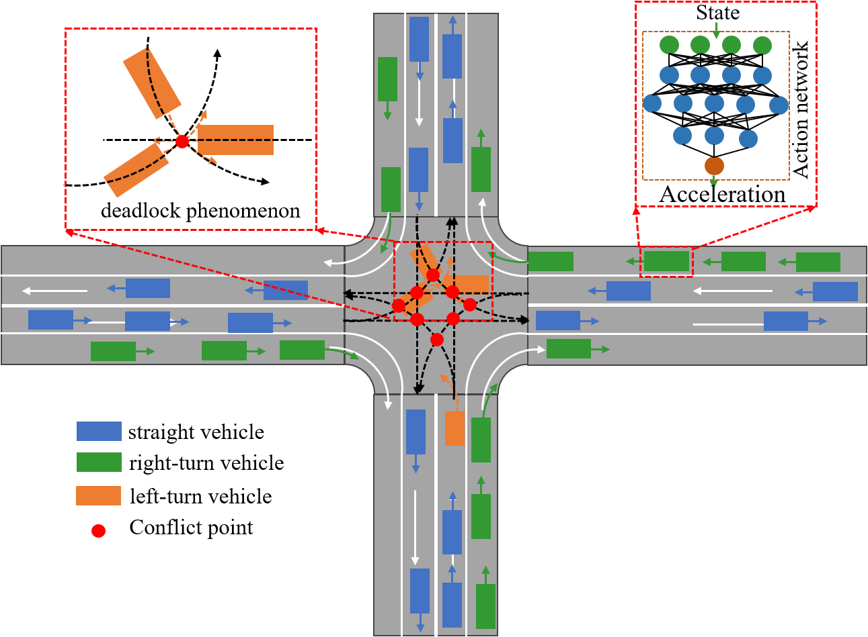


Actor network
$$\left[\begin{matrix}x_{1} & ⋯ & l_{1} \\ ⋮ & ⋱ & ⋮ \\ x_{N} & ⋯ & l_{N}\end{matrix}\right]$$
z
Graph Node
Features
$${\{g}_{k}\}$$
GAT
CNN (ResNet-18)
MLP
$${\{e}_{k}\}$$
Noisy Layers
Policy-A
Critic network
z
$${\{g}_{k}\}$$
$${\{e}_{k}\}$$
Q-value
target Actor network
$$\left[\begin{matrix}x_{1} & ⋯ & l_{1} \\ ⋮ & ⋱ & ⋮ \\ x_{N} & ⋯ & l_{N}\end{matrix}\right]$$
z
Update
$${\{g}_{k}\}$$
GAT
CNN (ResNet-18)
MLP
$${\{e}_{k}\}$$
Noisy Layers
target Policy-A
minimize TD-error
target Critic network
z
$${\{g}_{k}\}$$
$${\{e}_{k}\}$$
target Q-value

Slide 5
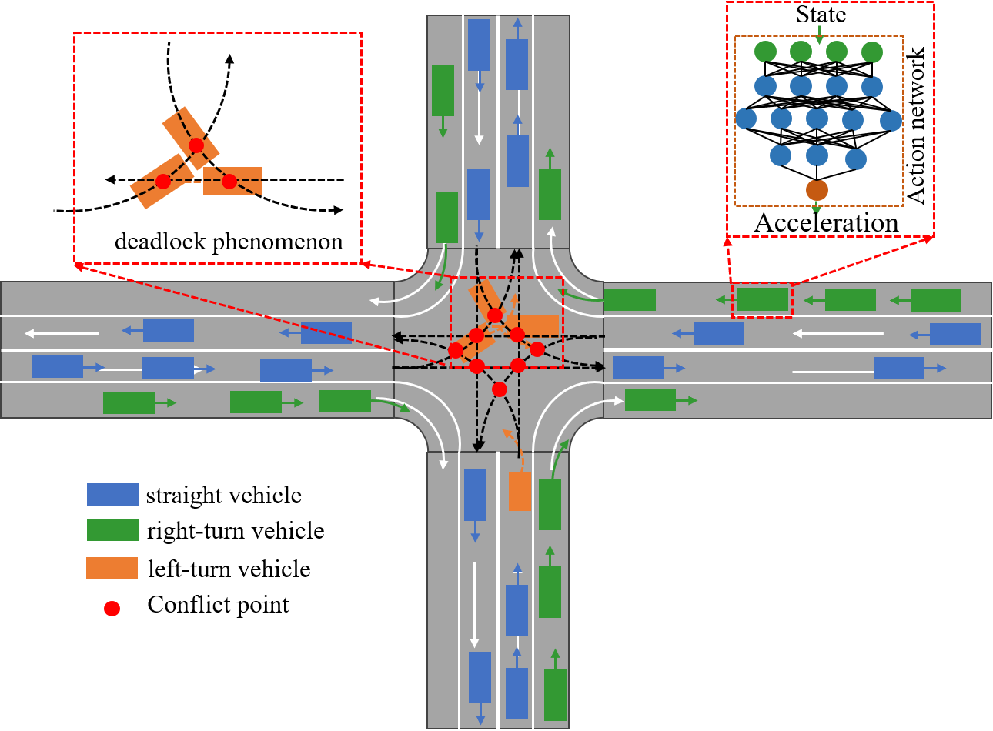














Actor network
$$\left[\begin{matrix}x_{1} & ⋯ & l_{1} \\ ⋮ & ⋱ & ⋮ \\ x_{N} & ⋯ & l_{N}\end{matrix}\right]$$
z
Graph Node
Features
$${\{h}_{i}\}$$
GAT
$${\text{h}}_{\text{i}}^{\text{′}}$$
$$e_{i}$$
Deadlock Detection and Repair Strategy
Critic network
z
$${\text{h}}_{\text{i}}^{\text{′}}$$
$${\{h}_{i}\}$$
CNN
$$e_{i}$$
MLP
target Actor network
Update
$$\left[\begin{matrix}x_{1} & ⋯ & l_{1} \\ ⋮ & ⋱ & ⋮ \\ x_{N} & ⋯ & l_{N}\end{matrix}\right]$$
z
$${\{h}_{i}\}$$
GAT
$${\text{h}}_{\text{i}\text{next}}^{\text{′}}$$
Tanh
$$e_{i}$$
minimize TD-error
Deadlock Detection and Repair Strategy
Concatenate
target Critic network
z
$${\text{h}}_{\text{i}\text{next}}^{\text{′}}$$
Policy
$${\{h}_{i}\}$$
$$e_{i}$$
Q-value

