Slide 1


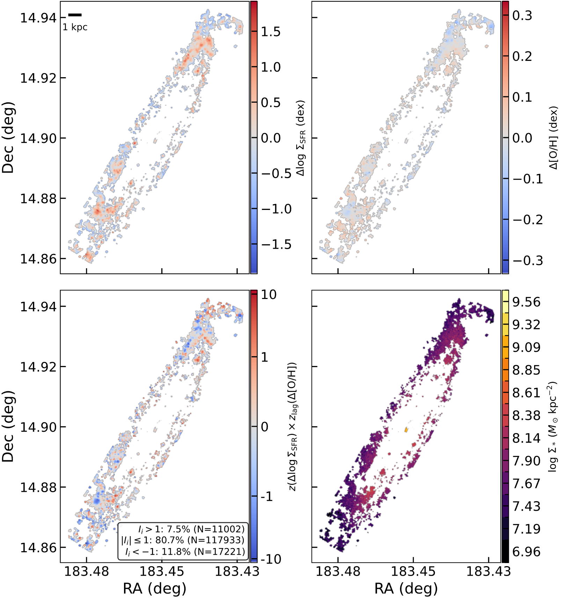
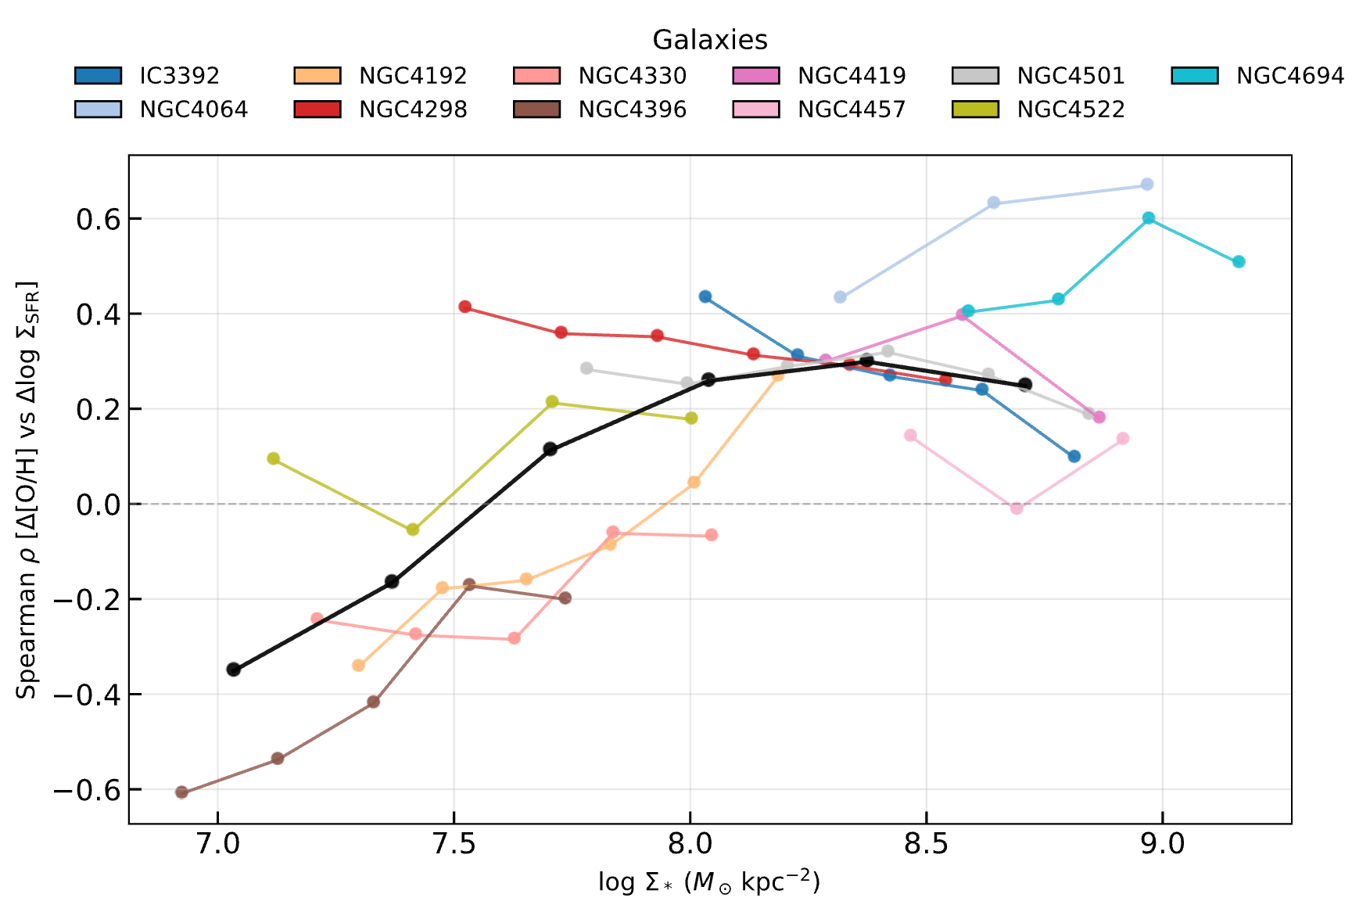
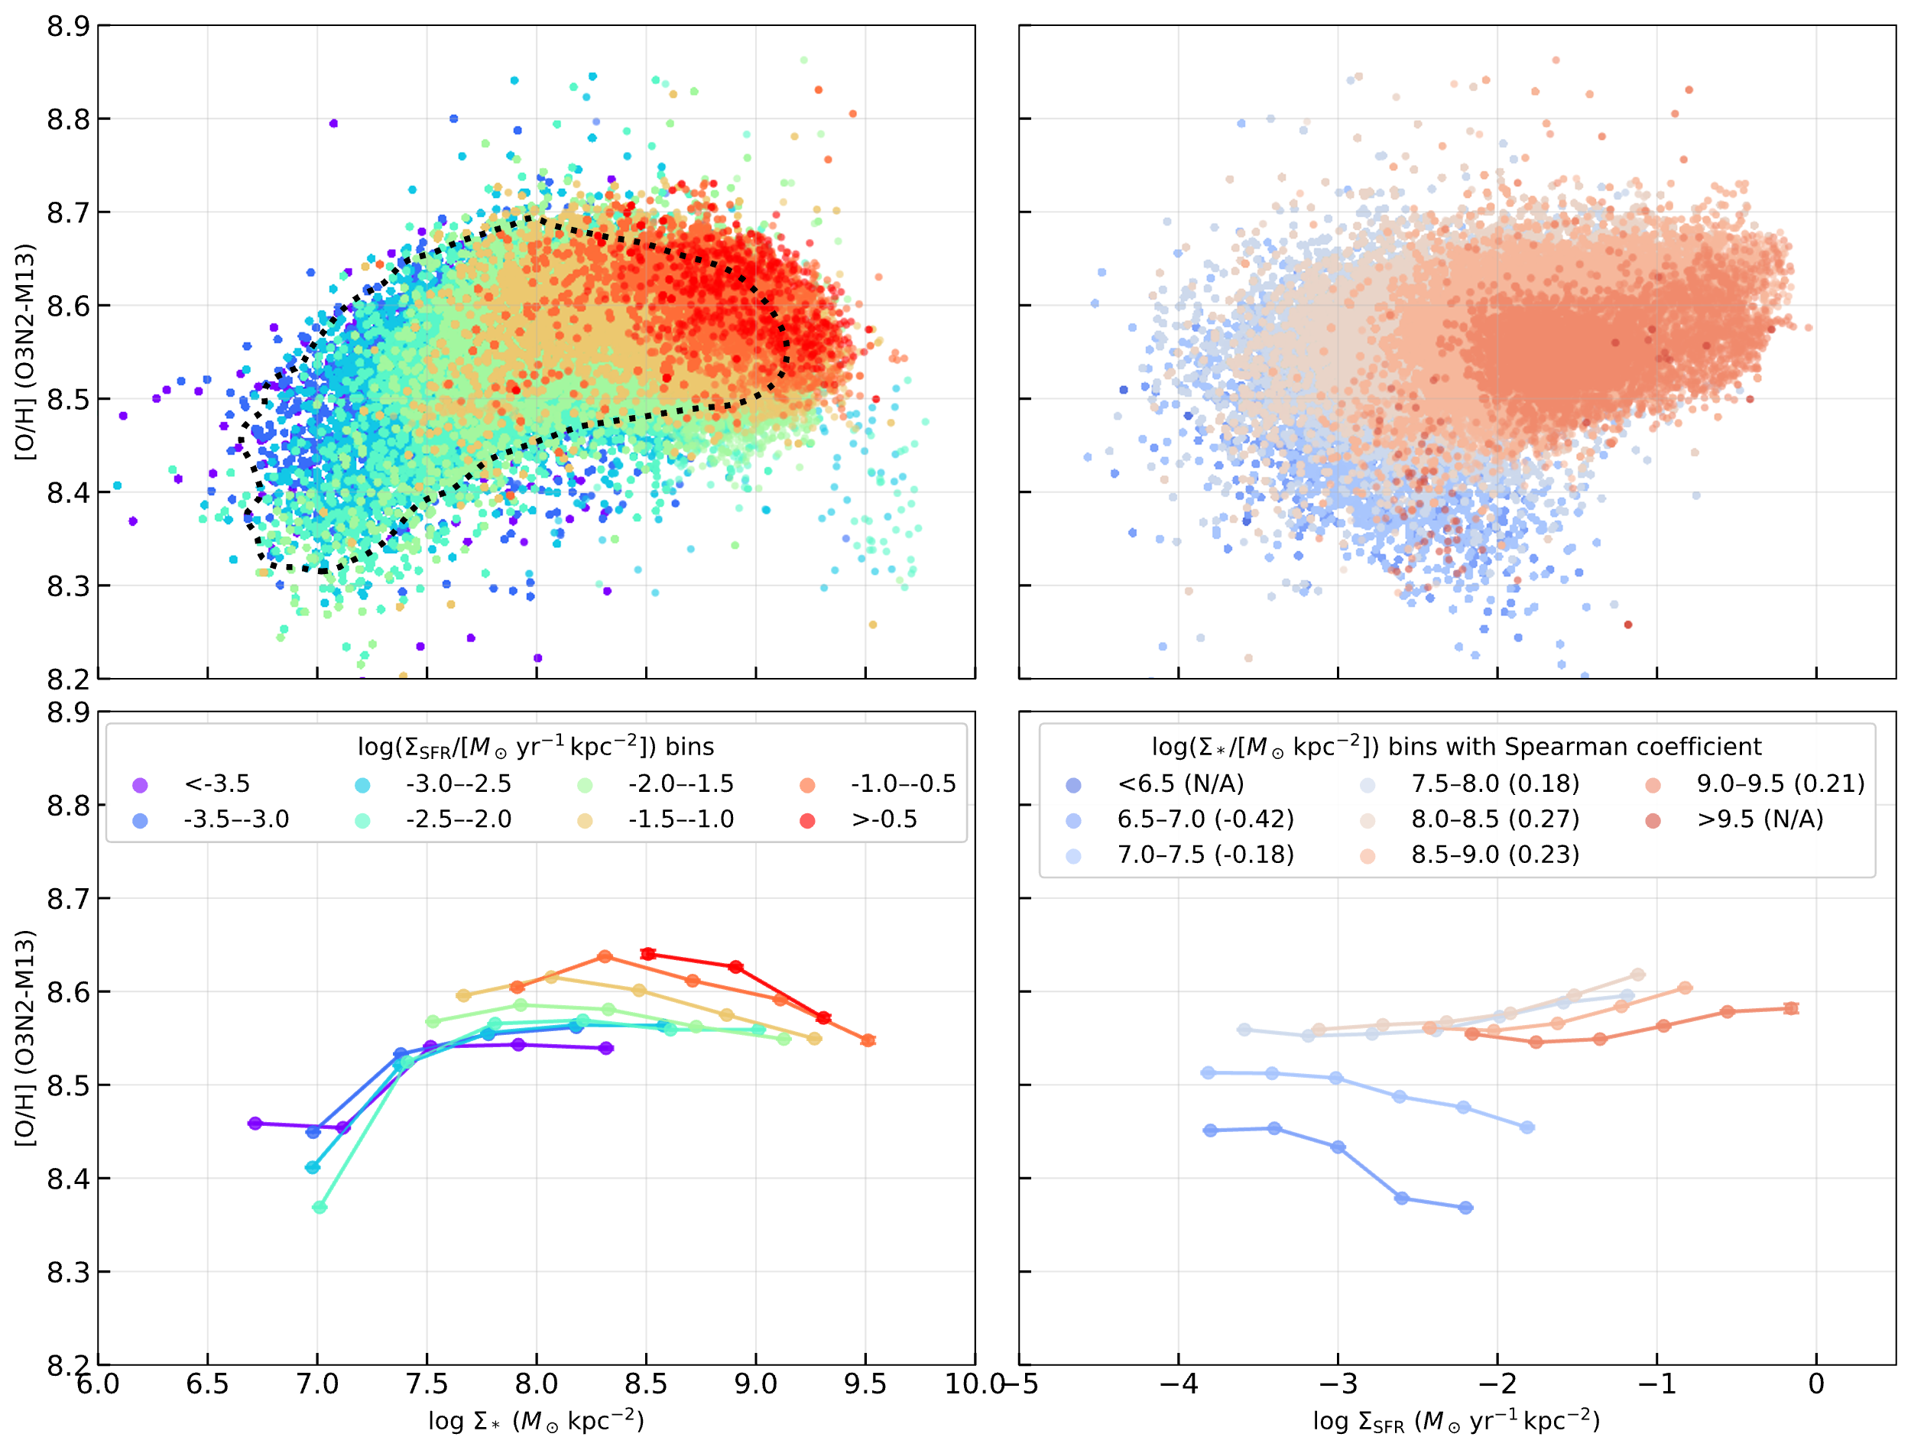
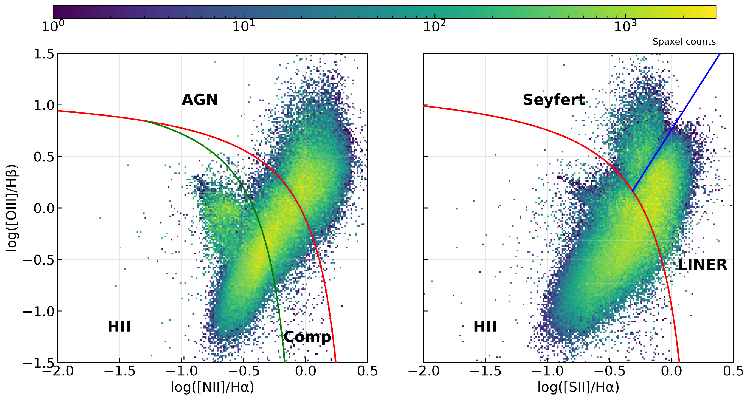
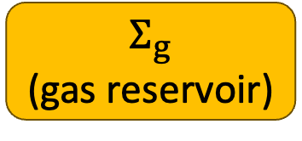
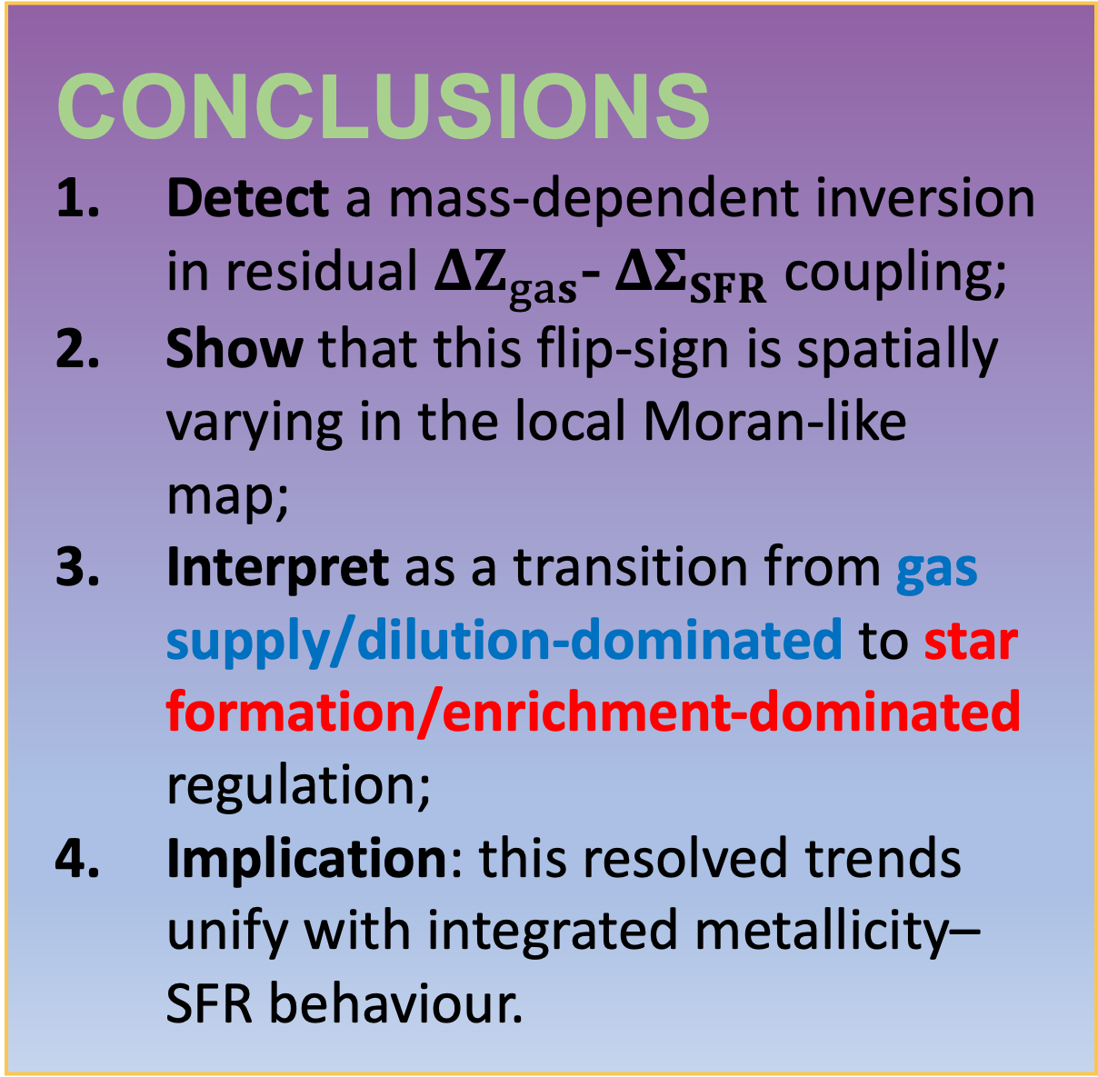
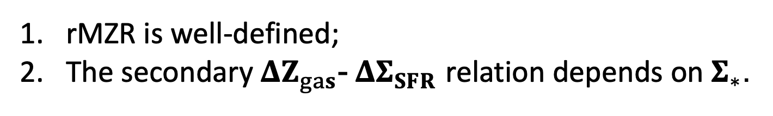
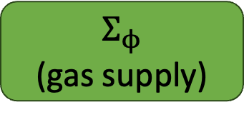
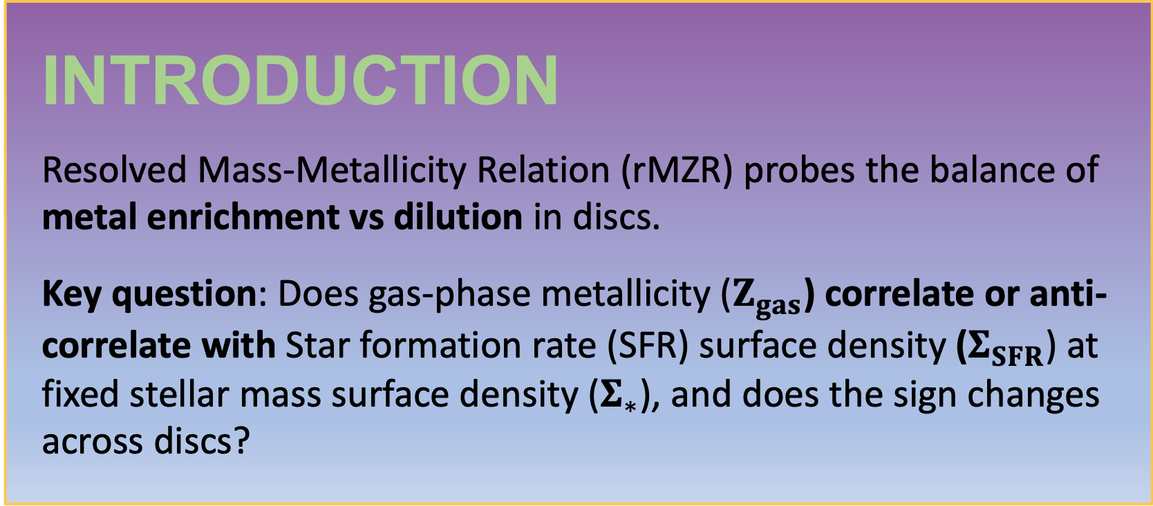
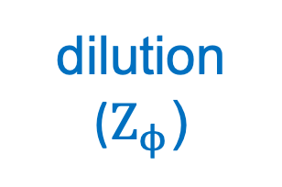

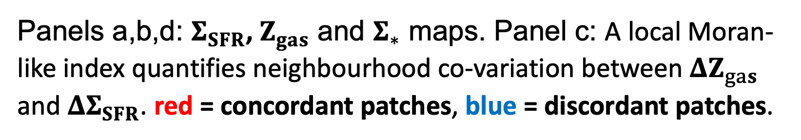
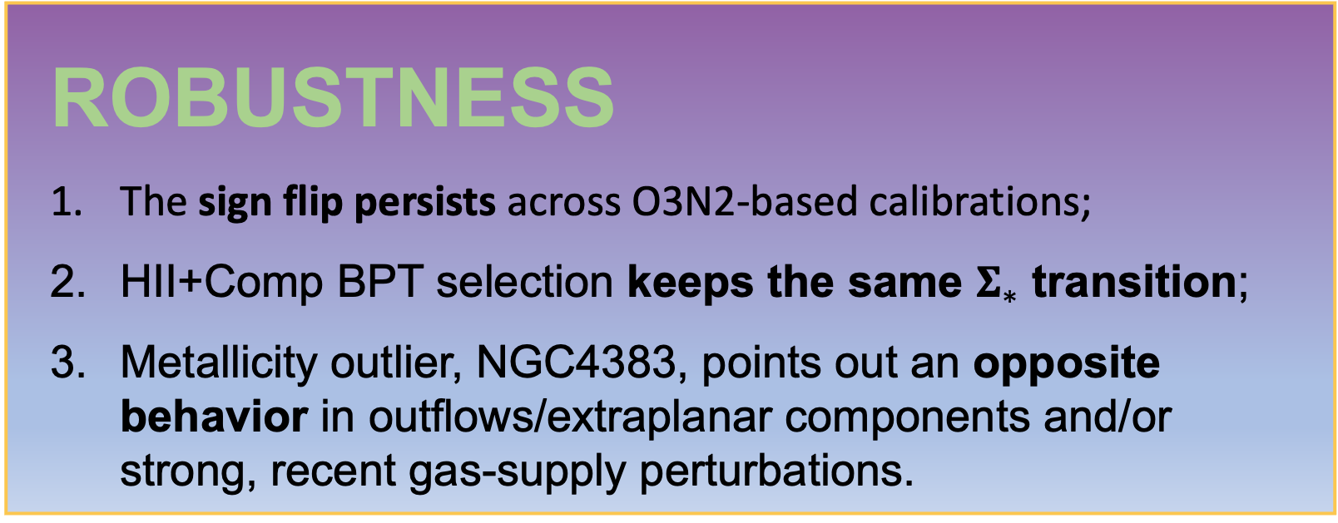
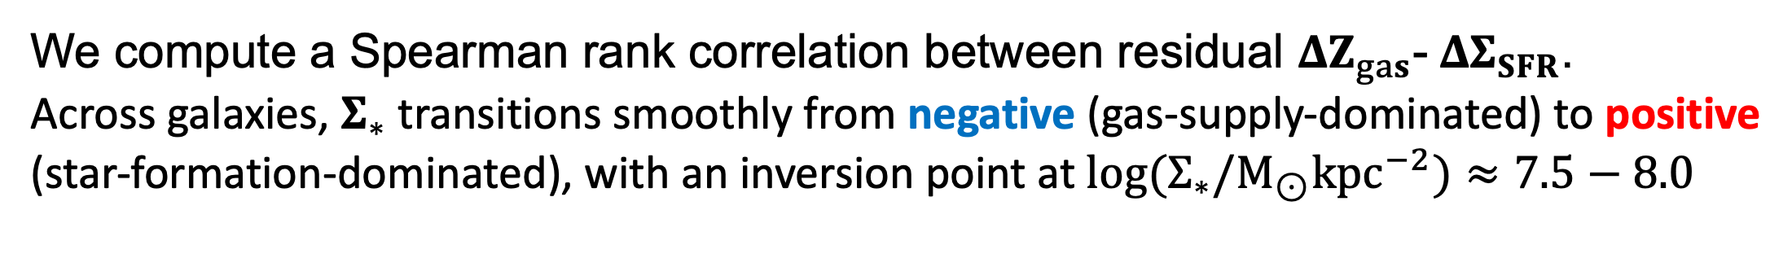


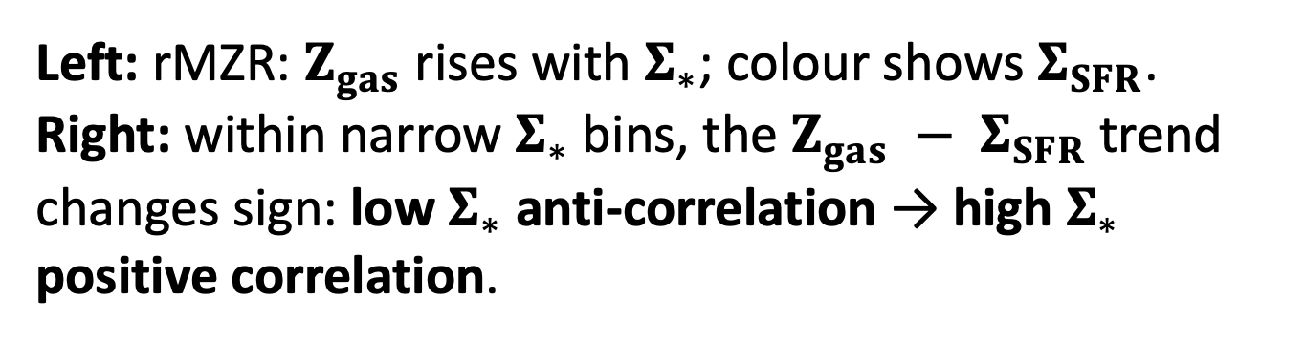


MAUVE-MUSE: When Metallicity Follows or Fights Star Formation
A Mass Dependent Inversion in Virgo Spirals
Rongjun Huang ( 黄镕钧) et al. · MAUVE Collaboration · ICRAR / UWA
Introduction
Resolved Mass-Metallicity Relation (rMZR) probes the balance of metal enrichment vs dilution in discs.
Key question: Does gas-phase metallicity ($Z_{gas}$) correlate or anti-correlate with Star formation rate (SFR) surface density ($Σ_{SFR}$) at fixed stellar mass surface density ($Σ_{∗}$), and does the sign changes across discs?
Results
Example (NGC 4192): correlated and anti-correlated regions coexist locally
a
b
rMZR is well-defined;
The secondary $ΔZ_{gas}$- ${ΔΣ}_{SFR}$ relation depends on $Σ_{∗}$.
Data & Methods
Data: MAUVE–MUSE (Virgo, 100 pc)
Instrument: VLT/MUSE wide-field IFU, delivering stellar mass and emission-line maps on $∼$100 pc scales in Virgo spirals;
Sample: 14 Virgo spirals (MAUVE–MUSE v2 internal release); survey observations are ongoing;
Working set: fiducial ensemble uses 13 galaxies (excluding the metallicity outlier NGC 4383);
Resolved Maps used (co-spatial spaxels): $Σ_{∗}$, $Σ_{SFR}$ and $Z_{gas}$.
Method: isolate star-forming spaxels and measure $Z_{gas}$
Star-Forming selection: keep H II spaxels using [N II] and [S II] BPT selection diagnostic cuts;
Calibration: fiducial $Z_{gas}$from O3N2–M13 (Marino+2013) using strong lines (dust-corrected H$α$ H$β$, [O III], [N II]);
$ΔZ_{gas}$- ${ΔΣ}_{SFR}$ coupling measurement: remove primary mass-dependent trends, then measure residual coupling:
$ρ(Σ_{∗}) = {corr(ΔZ_{gas}, Δlog Σ_{SFR})|}_{Σ_{∗}}$.
c
d
Coloured tracks: individual galaxies; black: ensemble trend.
Left: rMZR: $Z_{gas}$ rises with $Σ_{∗}$; colour shows $Σ_{SFR}$. Right: within narrow $Σ_{∗}$ bins, the $Z_{gas} − Σ_{SFR}$trend changes sign: low $Σ_{∗}$ anti-correlation → high $Σ_{∗}$ positive correlation.
We compute a Spearman rank correlation between residual $ΔZ_{gas}$- ${ΔΣ}_{SFR}$.
Across galaxies, $Σ_{∗}$ transitions smoothly from negative (gas-supply-dominated) to positive (star-formation-dominated), with an inversion point at $log{(Σ}_{∗}/M_{⊙}{kpc}^{−2})≈7.5−8.0$
Panels a,b,d: $Σ_{SFR}$, $Z_{gas}$ and $Σ_{∗}$ maps. Panel c: A local Moran-like index quantifies neighbourhood co-variation between $ΔZ_{gas}$ and ${ΔΣ}_{SFR}$. red = concordant patches, blue = discordant patches.
Interpretation: local gas-regulator
$\frac{d}{dt}Σ_{g}=Σ_{φ}−\left(1−R\right)Σ_{SFR}−Σ_{out};$ $\frac{d}{dt}Z_{gas}=\frac{1}{Σ_{g}}[y\left(1−R\right)Σ_{SFR}+(Z_{φ}−Z_{gas})Σ_{φ}]$
Conclusions
Detect a mass-dependent inversion in residual $ΔZ_{gas}$- ${ΔΣ}_{SFR}$ coupling;
Show that this flip-sign is spatially varying in the local Moran-like map;
Interpret as a transition from gas supply/dilution-dominated to star formation/enrichment-dominated regulation;
Implication: this resolved trends unify with integrated metallicity–SFR behaviour.
ROBUSTNESS
The sign flip persists across O3N2-based calibrations;
HII+Comp BPT selection keeps the same $Σ_{∗}$ transition;
Metallicity outlier, NGC4383, points out an opposite behavior in outflows/extraplanar components and/or strong, recent gas-supply perturbations.
$$Σ_{ϕ}$$
(gas supply)
A spatially resolved bathtub model to describe the local gas regulation.
At fixed $Σ_{∗}$:
$ΔZ_{gas}∝∆log Σ_{SFR}$ - $Δlog Σ_{φ}$
Star-formation-driven variability dominates $⇒ ↑Σ_{SFR}$ (metal yields) with smaller changes in $Σ_{ϕ}$ $⇒ ↑Z_{gas}$.
Gas-supply-driven variability dominates $⇒ ↑Σ_{SFR}$ with with larger changes in $Σ_{ϕ}$ ($Z_{ϕ}$dilution) $⇒ ↓Z_{gas}$.
accretion
dilution
($Z_{ϕ}$)
$$Σ_{g}$$
(gas reservoir)
CONTACT INFORMATION
Email: Rongjun.Huang@icrar.org
Personal Website: www.rongjun-huang.com
MAUVE Website: mauve.icrar.org
star formation
$$Σ_{SFR}$$
metal yields (y)
$$Z_{gas}$$

