Slide 1

CGER GALAXY FORUM / 22 SEPTEMBER 2026
MAUVE-MUSE:
A Resolved View of Star Formation,
Gas Cycling, and Chemical Enrichment
in Virgo Cluster Galaxies
Rongjun Huang
ICRAR / The University of Western Australia
Yonsei University · 22 September 2026
NGC4501 / MUSE RGB
Rongjun Huang | MAUVE-MUSE | Yonsei 2026
1
Notes:
Budget 00:30; cumulative 00:00-00:30.
SPEAKING CUES
Welcome and acknowledge Luca Cortese, Barbara Catinella, Luke Davies and the MAUVE collaboration. The broad question today is how environmental processing changes gas cycling and chemical enrichment within galaxies. The talk moves from the survey to Paper I, the model and three ongoing tests.
OUTLINE DETAIL
### Slide 1. Title and introduction - 0:30
Use the accepted title, presenter, affiliation and Yonsei date, with an existing MUSE galaxy image. Acknowledge Luca Cortese, Barbara Catinella, Luke Davies and the MAUVE collaboration verbally and in the notes. The opening is about the wider survey and physical problem, rather than only the paper title.
SOURCES
Talk brief: https://chatgpt.com/c/6a9d3c52-9460-83ec-be1d-7023ec6a0ae4
MUSE-derived RGB imagery: /Users/Igniz/Desktop/ICRAR/v3tk_to_VRI/*_observed_VRI.png and /Users/Igniz/Desktop/ICRAR/further/20260907_MAUVE_seminar_poster_images/README.md, provenance.json.

Slide 2
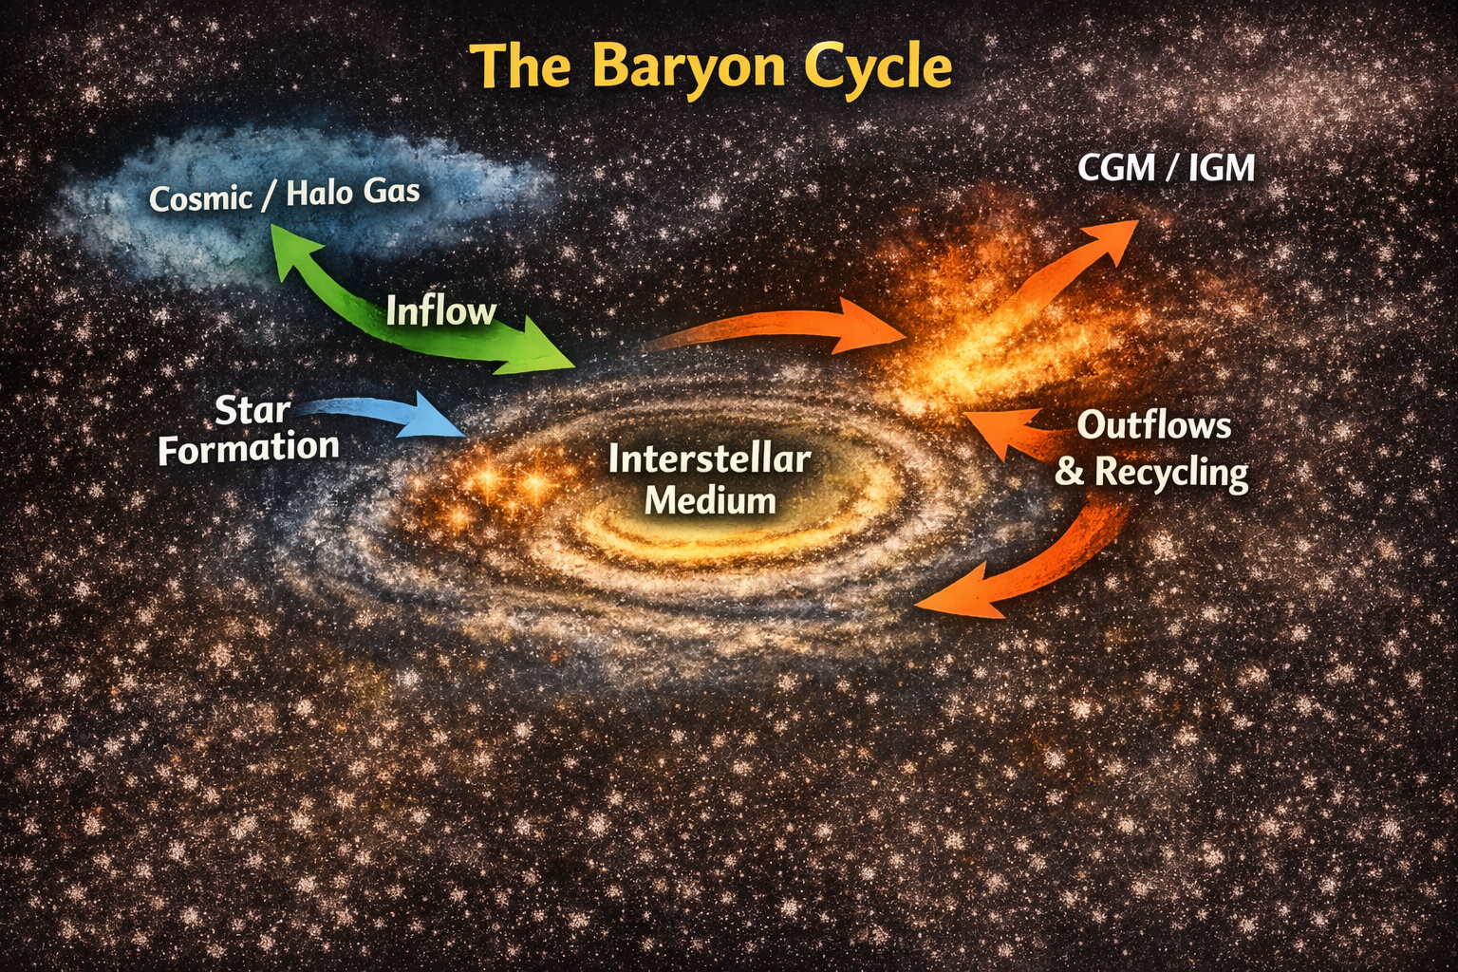
THE PHYSICAL FRAMEWORK
Galaxy evolution is regulated by the baryon cycle
A coupled flow of gas and metals
Gas enters from the halo and feeds the ISM.
Dense gas forms stars and becomes enriched.
Feedback removes, redistributes and recycles material.
Conceptual baryon-cycle artwork from the current Yonsei talk material.
Rongjun Huang | MAUVE-MUSE | Yonsei 2026
2
Notes:
Budget 01:30; cumulative 00:30-02:00.
SPEAKING CUES
A galaxy grows through a baryon cycle. Gas enters from the halo, joins the interstellar medium and can cool into the star-forming reservoir. Star formation locks up some material and synthesizes metals. Stellar feedback returns gas and metals and can drive outflows; some material may recycle. The rates do not need to balance instantaneously, but their competition regulates gas content, star formation and enrichment. This conceptual picture supplies the language for the local continuity equations later in the talk.
OUTLINE DETAIL
### Slide 2. Galaxy evolution is regulated by the baryon cycle - 1:30
Begin with the general physical picture. Galaxies grow because gas enters from the halo and circumgalactic medium, joins the interstellar medium, cools into denser phases, and forms stars. Stellar evolution returns both gas and newly synthesised metals, while feedback drives outflows that may escape, remain in the circumgalactic medium, or recycle. The rates need not balance instantaneously, but their long-term competition regulates gas content, star formation and chemical enrichment. Use the baryon-cycle artwork as a conceptual map, not as a quantitative measurement. This establishes the language used later in the resolved gas-regulator section. [S11]
**Transition:** That picture is usually introduced for galaxies evolving in relative isolation. A cluster adds external forces and can change several links in the cycle at the same time.
SOURCES
Conceptual baryon-cycle artwork reused from the current Yonsei talk material: /Users/Igniz/Desktop/ICRAR/202609Korea/20260922_Yonsei_CGER.pptx, slide 2. No quantitative data.

Slide 3
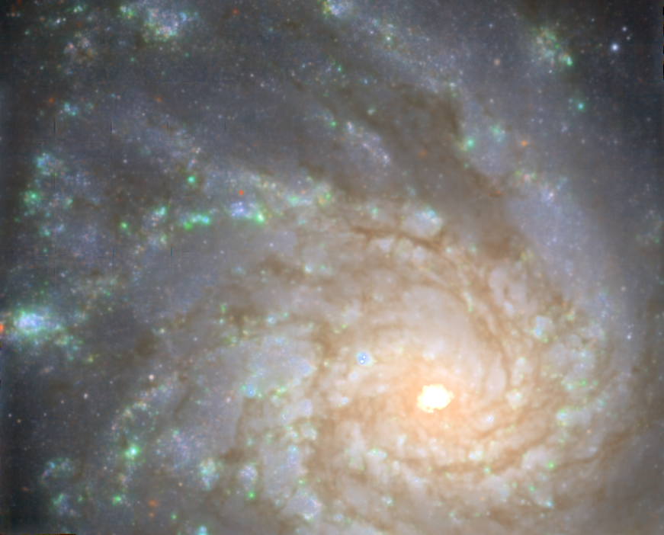
RESOLVED GALAXY SURVEYS
From global averages to local physics
Integral-field spectroscopy maps star formation, chemistry and kinematics within galaxies.
kpc scales
CALIFA, SAMI, MaNGA, MAGPI
Population-wide maps within galaxies
~100 pc scales
MAD and PHANGS-MUSE
H II regions and local ISM structure
With ALMA: linking star formation
to the molecular-gas reservoir
NGC4254 / PHANGS-MUSE. Nearby star-forming discs, including Virgo members.
Rongjun Huang | MAUVE-MUSE | Yonsei 2026
3
Notes:
Budget 01:30; cumulative 02:00-03:30.
SPEAKING NARRATIVE
The baryon-cycle picture now becomes an observational question: where do we measure these processes? Several decades of integrated surveys established global relations among stellar mass, star formation and chemical enrichment. Over the past decade and more, integral-field spectroscopy has brought those measurements inside galaxies. CALIFA, SAMI and MaNGA provide large nearby samples, while MAGPI extends resolved work to intermediate redshift. Their characteristic physical resolution is of order a kiloparsec, with a range across each survey rather than a sharp lower boundary.
For much closer galaxies, MAD and PHANGS-MUSE resolve roughly 100-pc scales, reaching H II regions and local interstellar structure. PHANGS-MUSE often achieves 50-100 pc, and MAD reports about 100 pc or better. Combined with ALMA molecular-gas maps, these observations connect star formation to its local gas reservoir. The image is NGC4254, a Virgo galaxy. Describe these as nearby star-forming-disc surveys, rather than exclusively field samples: PHANGS already includes Virgo members.
TRANSITION
These surveys establish what we can measure locally. How well do we understand those same processes as a galaxy is transformed by a cluster environment?
SOURCES
CALIFA: Sanchez et al. 2016, DR3, https://arxiv.org/abs/1604.02289.
SAMI: Bryant et al. 2015, section 5, https://www.sami-survey.org/system/files/papers/211/MNRAS-2015-Bryant-2857-79_FINALpublishedversion.pdf.
MaNGA: https://www.sdss4.org/surveys/manga. Survey sampling and PSF are distinct; the slide groups surveys only at order-of-magnitude physical scales.
MAGPI: Foster et al. 2021, https://openresearch-repository.anu.edu.au/items/7a607796-8fd3-4234-977a-8293d0e454f4.
MAD: Erroz-Ferrer et al. 2019, https://academic.oup.com/mnras/article/484/4/5009/5298497; https://www.mad.astro.ethz.ch/.
PHANGS-MUSE: Emsellem et al. 2022, https://doi.org/10.1051/0004-6361/202141727.
PHANGS-ALMA: Leroy et al. 2021, https://doi.org/10.3847/1538-4365/abf7b9.
PHANGS Virgo membership: Scheuermann et al. 2022, https://academic.oup.com/mnras/article/511/4/6087/6510829.
Image retained from source deck: /Users/Igniz/Desktop/ICRAR/v3tk_to_VRI/NGC4254_observed_VRI.png.

Slide 4
WHY CLUSTER GALAXIES?
Environment changes the local gas cycle
Most galaxies live outside clusters.
~10% inhabit clusters today (model estimate).*
Integrated surveys establish that environment
changes gas content and star formation, but
cannot locate the affected processes.
What happens inside
the remaining disc?
Where does star formation survive?
How is the gas replenished?
When does enrichment dominate?
*De Lucia et al. 2012: z~0 model, cluster haloes >~10^14 solar masses.
Environment fractions depend on the sample and definition.
NGC4501 / MUSE RGB
Rongjun Huang | MAUVE-MUSE | Yonsei 2026
4
Notes:
Budget 00:45; cumulative 03:30-04:15.
SPEAKING NARRATIVE
Most galaxies live outside massive clusters, in environments ranging from isolated systems to groups. Clusters still matter because they expose gas cycling to external forces, including interaction with the hot intracluster gas and changes to the available gas supply. The approximate ten-percent figure is an illustrative model estimate for the present day, using cluster haloes above about 10^14 solar masses. It is not a universal observational census.
Integrated surveys establish that environment changes gas content and star formation, but cannot tell us where the affected processes operate within the surviving disc. This motivates the three questions on the slide: where does star formation survive, how is the gas replenished, and when does enrichment dominate? The NGC4501 RGB image locates the discussion inside a real galaxy; it does not itself measure those processes.
TRANSITION
Answering these questions requires resolved observations of cluster galaxies. The next slide identifies the remaining gap in physical scale and sample coverage.
FRACTION CONTEXT
De Lucia et al. (2012), Figure 3 and the text immediately preceding section 3, obtain about 10% at z~0 in haloes with M200 >~10^14 solar masses, using the Millennium semi-analytic model. Their tested stellar-mass cuts are approximately 10^9, 10^10 and 10^11 solar masses. Environmental fractions depend on the galaxy selection and classification.
Catalogue single-member groups are not equivalent to physical isolation: Kourkchi & Tully (2017) report 7290 singles out of 15004 known galaxies (48.6%), while Yang et al. (2007) give different fractions with different sample definitions. Therefore the slide does not assert a universal >50% isolated fraction.
SOURCES
De Lucia et al. 2012, MNRAS 423, 1277, Figure 3: https://academic.oup.com/mnras/article/423/2/1277/961582; https://doi.org/10.1111/j.1365-2966.2012.20983.x.
Kourkchi & Tully 2017, section 10: https://arxiv.org/abs/1705.08068.
Yang et al. 2007, Table 3: https://arxiv.org/abs/0707.4640.
Integrated environmental trends and the surviving-disc motivation: /Users/Igniz/Desktop/ICRAR/202609Korea/MAUVE_sci_just_compressed.pdf, page 2.
Image: /Users/Igniz/Desktop/ICRAR/v3tk_to_VRI/NGC4501_observed_VRI.png.
Visual/content reference supplied by the presenter: attached slide titled Environment changes the local gas cycle.

Slide 5
THE OBSERVATIONAL GAP
The observational gap in cluster galaxies
Existing cluster studies
The missing comparison
GASP
Systematic ~100 pc maps
across cluster infall stages
Linking ionized gas and stars
to the molecular-gas reservoir
z = 0.04-0.07 (~0.05)
~1 kpc spatial resolution
Gas stripping across discs and tails
VIRGO ~16.5 Mpc
~100-200 pc across the gas disc
Virgo enables a resolved comparison across environmental stages
Rongjun Huang | MAUVE-MUSE | Yonsei 2026
5
Notes:
Budget 00:45; cumulative 04:15-05:00.
SPEAKING NARRATIVE
Resolved cluster work already exists. GASP maps stripping across galaxy discs and tails at redshifts 0.04-0.07 with characteristic physical resolution of about 1 kpc. Its programme includes several environments and controls.
The missing comparison is systematic mapping at roughly 100 pc across cluster infall stages, with matched information on the ionized gas, stellar populations and molecular reservoir. Nearby-disc surveys supply valuable benchmarks and some Virgo members. MAUVE expands the coverage of environmental transformation rather than establishing the first resolved observations of any cluster galaxy.
Virgo at an adopted 16.5 Mpc makes roughly 100-200 pc observations across the gas disc feasible. One arcsecond corresponds to about 80 pc at that distance, but actual resolution depends on the observations. Comparisons across infall stages are cross-sectional, not time sequences of individual galaxies.
TRANSITION
MAUVE was designed to provide this resolved, multiphase comparison in Virgo.
SOURCES
Poggianti et al. 2017, GASP I, sections 1 and 4: https://arxiv.org/abs/1704.05086; https://doi.org/10.3847/1538-4357/aa78ed.
Mei et al. 2007, Virgo distance: https://arxiv.org/abs/astro-ph/0702510.
Catinella et al. 2025, MAUVE: https://doi.org/10.18727/0722-6691/5393.
MAUVE science justification: /Users/Igniz/Desktop/ICRAR/202609Korea/MAUVE_sci_just_compressed.pdf, pages 2 and 5.

Slide 6
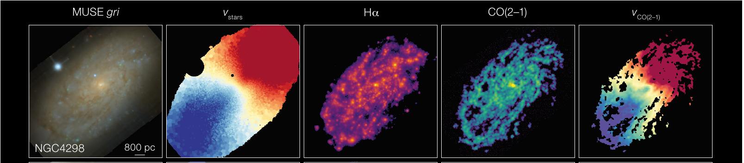
SURVEY
MAUVE resolves the Virgo environment
Multiphase Astrophysics to Unveil the Virgo Environment
40 galaxies
MUSE: stars + ionized gas · ALMA: molecular gas · HST: stellar structure
Catinella et al. 2025, Figure 3 (NGC4298 row). Programme and analysis samples are distinct.
Rongjun Huang | MAUVE-MUSE | Yonsei 2026
6
Notes:
Budget 01:15; cumulative 05:00-06:15.
SPEAKING CUES
MAUVE stands for Multiphase Astrophysics to Unveil the Virgo Environment. The programme was designed for 40 galaxies spanning different infall stages and retaining molecular gas. MUSE links stellar populations and ionized gas at roughly 100 to 200 parsec scales, ALMA the molecular reservoir, and HST stars and clusters. Existing H I observations place them in the wider environmental context. Different analyses use different available subsets.
OUTLINE DETAIL
### Slide 6. MAUVE resolves the Virgo environment - 1:15
Expand the acronym: Multiphase Astrophysics to Unveil the Virgo Environment. Describe the 40-galaxy survey design across infall stages, MUSE ionized gas and stellar spectroscopy at roughly 100-200 pc scales, ALMA molecular gas, and complementary HST stellar/cluster information. Existing atomic-gas observations add wider environmental context. Distinguish programme design from the available subset used in an individual analysis. [S1, S12]
SOURCES
Catinella et al. 2025, The Messenger 195, 15. https://doi.org/10.18727/0722-6691/5393 | /Users/Igniz/Desktop/ICRAR/EAS2026/pdfs/Catinella2025.pdf
MAUVE science justification: /Users/Igniz/Desktop/ICRAR/MAUVE/MAUVE_sci_just_compressed.pdf, pp. 2 and 5, especially Figure 1.

Slide 7
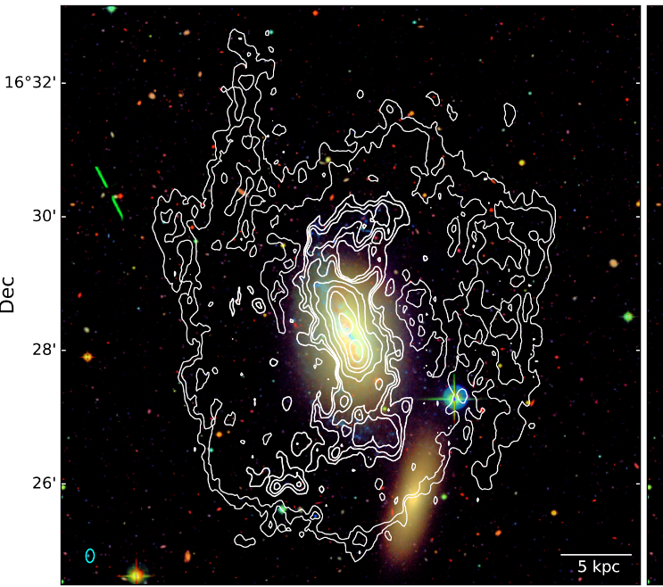
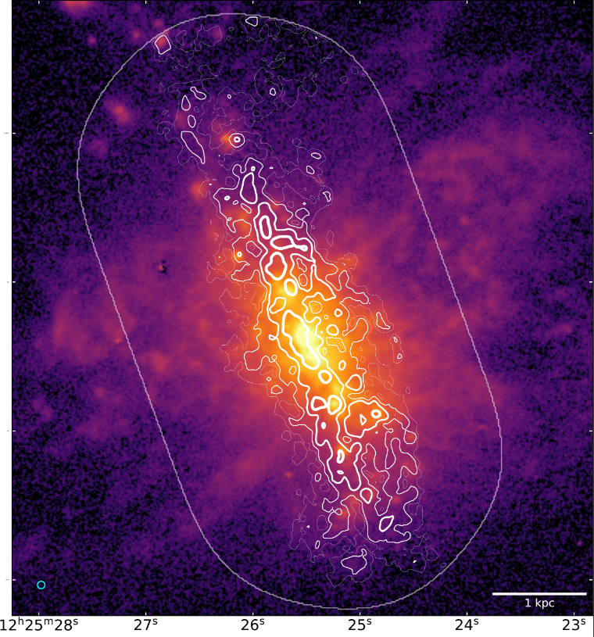
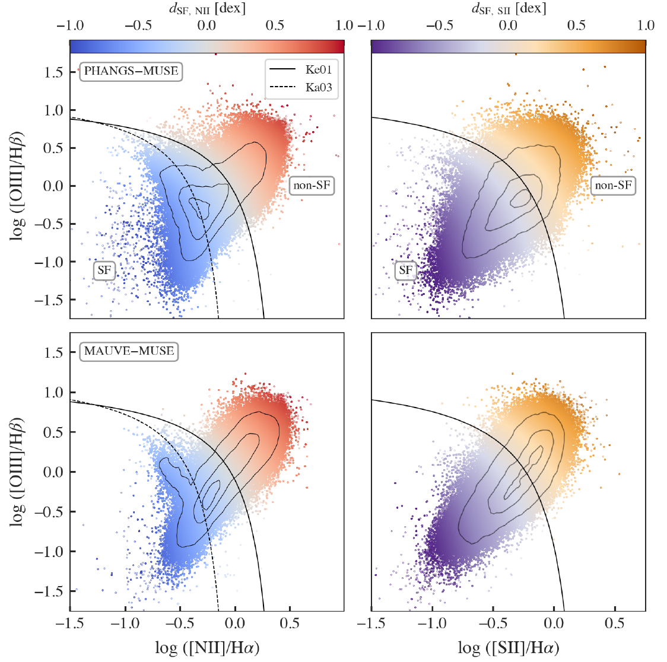
SELECTED COLLABORATION RESULTS
MAUVE early science connects feedback, gas phases and ionization
NGC4383
NGC4064
12-galaxy comparison
Multiphase fountain
Feedback after stripping
DIG as HII emission fades
Environment changes the setting for feedback and recycling.
Structure adapted from Cortese and Brown 2026 MAUVE overview talks; project claims checked against the papers.
Rongjun Huang | MAUVE-MUSE | Yonsei 2026
7
Notes:
Budget 01:15; cumulative 06:15-07:30.
SPEAKING CUES
Luca and Toby introduce the early-science papers as a connected set before presenting individual objects. Use the same structure here. NGC4383 follows an outflow across ionized, molecular and atomic gas and ends in a fountain interpretation. NGC4064 asks whether feedback can complete quenching after stripping. The twelve-galaxy comparison asks why non-HII emission becomes more visible as star formation fades. Together they show that the cluster does more than strip gas: it changes the context in which feedback, recycling and ionization operate.
OUTLINE DETAIL
### Slide 7. MAUVE early science connects feedback, gas phases and ionization - 1:15
Follow the presentation structure used by Luca Cortese and Toby Brown: introduce the early-science projects as one connected set before discussing individual systems. Use three visual cards. NGC4383 follows an outflow across ionized, molecular and atomic phases and reaches a fountain interpretation. NGC4064 asks whether feedback can complete quenching after environmental stripping. The 12-galaxy Brown et al. comparison asks why non-HII emission becomes more visible as star formation fades. The common message is that the cluster changes the physical setting in which feedback, recycling and ionization operate; MAUVE science is broader than gas removal alone. [S2-S5, S16, S17]
SOURCES
Watts et al. 2024, MNRAS 530, 1968. https://academic.oup.com/mnras/article/530/2/1968/7642869 | /Users/Igniz/Desktop/ICRAR/EAS2026/pdfs/Watts2024.pdf
Cortese et al. 2026. https://arxiv.org/abs/2602.01612 | /Users/Igniz/Desktop/ICRAR/EAS2026/pdfs/Cortese2026.pdf; EAS2026 original image34.png is Figure 5 top row.
Attwater et al. 2026. https://arxiv.org/abs/2512.10574 | /Users/Igniz/Desktop/ICRAR/EAS2026/pdfs/Attwater2026.pdf; image35.png reused from EAS2026.
Brown et al. 2026, ApJ 1004, 73. https://arxiv.org/abs/2604.20056 | /Users/Igniz/Desktop/ICRAR/EAS2026/pdfs/Brown2026.pdf; Figure 9 cropped from PDF page 13.
Luca Cortese, MAUVE: Multiphase views of gas cycling and quenching in the Virgo cluster, Ascona 2026. /Users/Igniz/Desktop/ICRAR/202609Korea/cortese_ascona26.pdf, especially pages 11-20.
Toby Brown, How does environment affect the ISM in Virgo Cluster galaxies?, MAUVE colloquium 2026. /Users/Igniz/Desktop/ICRAR/202609Korea/mauve-muse_colloquium.pdf, especially pages 12-26.

Slide 8
SELECTED COLLABORATION RESULTS
NGC4383: from ionized wind to a multiphase fountain
LAUNCH
6 kpc ionized bicone
PHASE
Little molecular gas above ~1 kpc
MASS
HI likely dominates the cold component
FATE
Bound circulation / fountain
Watts et al. 2024; Cortese et al. 2026. HI geometry limits a precise cold outflow rate.
Rongjun Huang | MAUVE-MUSE | Yonsei 2026
8
Notes:
Budget 01:00; cumulative 07:30-08:30.
SPEAKING CUES
Follow the evidence chain used in the Cortese and Brown talks. Watts finds a six-kiloparsec ionized bicone from the central starburst. ALMA shows that molecular gas contributes little above roughly one kiloparsec. MeerKAT indicates that atomic gas likely dominates the cold component farther from the disc. The cold gas velocities remain below the ionized phase and the escape speed, favouring recycling in a galactic fountain. The warped HI disc limits a precise cold mass-loading estimate.
OUTLINE DETAIL
### Slide 8. NGC4383: from ionized wind to a multiphase fountain - 1:00
Use the four-step evidence chain foregrounded in both talks. A central starburst launches a roughly 6 kpc ionized bicone. Molecular gas contributes little above approximately 1 kpc. Atomic hydrogen likely dominates the cold component farther from the disc. Cold-gas velocities remain below those of the ionized phase and below escape, favouring bound circulation in a galactic fountain. Retain the main limitation: the warped H I disc prevents a precise decomposition and cold mass-loading estimate. [S2, S3, S16, S17]
SOURCES
Watts et al. 2024, MNRAS 530, 1968. https://academic.oup.com/mnras/article/530/2/1968/7642869 | /Users/Igniz/Desktop/ICRAR/EAS2026/pdfs/Watts2024.pdf
Cortese et al. 2026. https://arxiv.org/abs/2602.01612 | /Users/Igniz/Desktop/ICRAR/EAS2026/pdfs/Cortese2026.pdf; EAS2026 original image34.png is Figure 5 top row.
Luca Cortese, MAUVE: Multiphase views of gas cycling and quenching in the Virgo cluster, Ascona 2026. /Users/Igniz/Desktop/ICRAR/202609Korea/cortese_ascona26.pdf, especially pages 11-20.
Toby Brown, How does environment affect the ISM in Virgo Cluster galaxies?, MAUVE colloquium 2026. /Users/Igniz/Desktop/ICRAR/202609Korea/mauve-muse_colloquium.pdf, especially pages 12-26.

Slide 9
SELECTED COLLABORATION RESULTS
NGC4064: feedback may complete quenching after stripping
ALREADY STRIPPED
A ~2 kpc bipolar ionized outflow
Ionized outflow rate | 0.53 M☉ yr⁻¹
Integrated SFR | 0.32 M☉ yr⁻¹
Mass loading η | 1.66
Removal / SF depletion | 0.58 / 0.97 Gyr
Feedback can remove the remaining gas faster than star formation consumes it.
Attwater et al. 2026. Values depend on ionized-gas density, geometry and filling factor.
Rongjun Huang | MAUVE-MUSE | Yonsei 2026
9
Notes:
Budget 01:00; cumulative 08:30-09:30.
SPEAKING CUES
Luca and Toby frame NGC4064 as feedback operating after the environment has removed most of the reservoir. The galaxy is a gas-poor backsplash system with concentrated central star formation and an ionized bipolar outflow extending about two kiloparsecs. The inferred ionized outflow rate is 0.53 solar masses per year against an integrated SFR of 0.32, giving mass loading 1.66. Under the paper assumptions, outflow removal is faster than star-formation consumption: 0.58 versus 0.97 gigayears. These estimates depend strongly on density, geometry and filling factor, so the conclusion is that feedback may accelerate final quenching in this object.
OUTLINE DETAIL
### Slide 9. NGC4064: feedback may complete quenching after stripping - 1:00
Adopt the physical framing used by Luca and Toby. NGC4064 is a gas-poor backsplash system whose outer reservoir has already been strongly reduced, but concentrated central star formation drives an ionized bipolar outflow extending about 2 kpc. Present the paper's estimates: ionized outflow rate 0.53 solar masses per year, integrated SFR 0.32 solar masses per year, and mass loading eta = 1.66. Under the assumed density, geometry and filling factor, the inferred removal timescale is 0.58 Gyr compared with 0.97 Gyr for consumption by star formation. Conclude that feedback may accelerate final quenching in this object, with the stated systematic uncertainties. [S4, S16, S17]
SOURCES
Attwater et al. 2026. https://arxiv.org/abs/2512.10574 | /Users/Igniz/Desktop/ICRAR/EAS2026/pdfs/Attwater2026.pdf; image35.png reused from EAS2026.
Luca Cortese, MAUVE: Multiphase views of gas cycling and quenching in the Virgo cluster, Ascona 2026. /Users/Igniz/Desktop/ICRAR/202609Korea/cortese_ascona26.pdf, especially pages 11-20.
Toby Brown, How does environment affect the ISM in Virgo Cluster galaxies?, MAUVE colloquium 2026. /Users/Igniz/Desktop/ICRAR/202609Korea/mauve-muse_colloquium.pdf, especially pages 12-26.

Slide 10
SELECTED COLLABORATION RESULTS
As HII emission fades, diffuse ionized gas becomes visible
12 MAUVE + 12 matched PHANGS
HII fades
DIG becomes the dominant visible component
SF regions
Similar ionized-gas turbulence
High-σ tail
5% vs 1% above 100 km s⁻¹; secondary shocks / mixing
Brown et al. 2026. Figure 9 at left; velocity-dispersion result from Figure 11.
Rongjun Huang | MAUVE-MUSE | Yonsei 2026
10
Notes:
Budget 01:30; cumulative 09:30-11:00.
SPEAKING CUES
Brown compares twelve early MAUVE-MUSE galaxies with twelve matched PHANGS-MUSE field galaxies at roughly one hundred parsec resolution. The BPT distributions show a larger non-star-forming contribution in the cluster sample. The key interpretation in both talks is that environmental quenching suppresses bright HII emission, revealing pervasive diffuse ionized gas as the dominant visible component. Turbulence within the selected star-forming regions remains similar. A small high-dispersion tail above one hundred kilometres per second, five percent in MAUVE versus one percent in PHANGS, supports a secondary contribution from shocks or turbulent mixing layers.
OUTLINE DETAIL
### Slide 10. As HII emission fades, diffuse ionized gas becomes visible - 1:30
Make Brown et al.'s causal ordering clearer. The study compares 12 early MAUVE-MUSE galaxies with 12 matched PHANGS-MUSE field galaxies at roughly 100 pc resolution. Environmental quenching suppresses bright HII emission, allowing pervasive diffuse ionized gas to become the dominant visible ionized component. Turbulence within selected star-forming regions remains similar between samples. A small high-dispersion tail above 100 km/s, containing 5% of MAUVE spaxels versus 1% in PHANGS, supports a secondary contribution from shocks or turbulent mixing layers. The BPT figure on the slide shows the ionization shift; the velocity-dispersion evidence comes from Figure 11. [S5, S16, S17]
**Transition:** These results make it essential to select the SF-dominated emission carefully before interpreting metallicity and SFR together.
SOURCES
Brown et al. 2026, ApJ 1004, 73. https://arxiv.org/abs/2604.20056 | /Users/Igniz/Desktop/ICRAR/EAS2026/pdfs/Brown2026.pdf; Figure 9 cropped from PDF page 13.
Luca Cortese, MAUVE: Multiphase views of gas cycling and quenching in the Virgo cluster, Ascona 2026. /Users/Igniz/Desktop/ICRAR/202609Korea/cortese_ascona26.pdf, especially pages 11-20.
Toby Brown, How does environment affect the ISM in Virgo Cluster galaxies?, MAUVE colloquium 2026. /Users/Igniz/Desktop/ICRAR/202609Korea/mauve-muse_colloquium.pdf, especially pages 12-26.

Slide 11
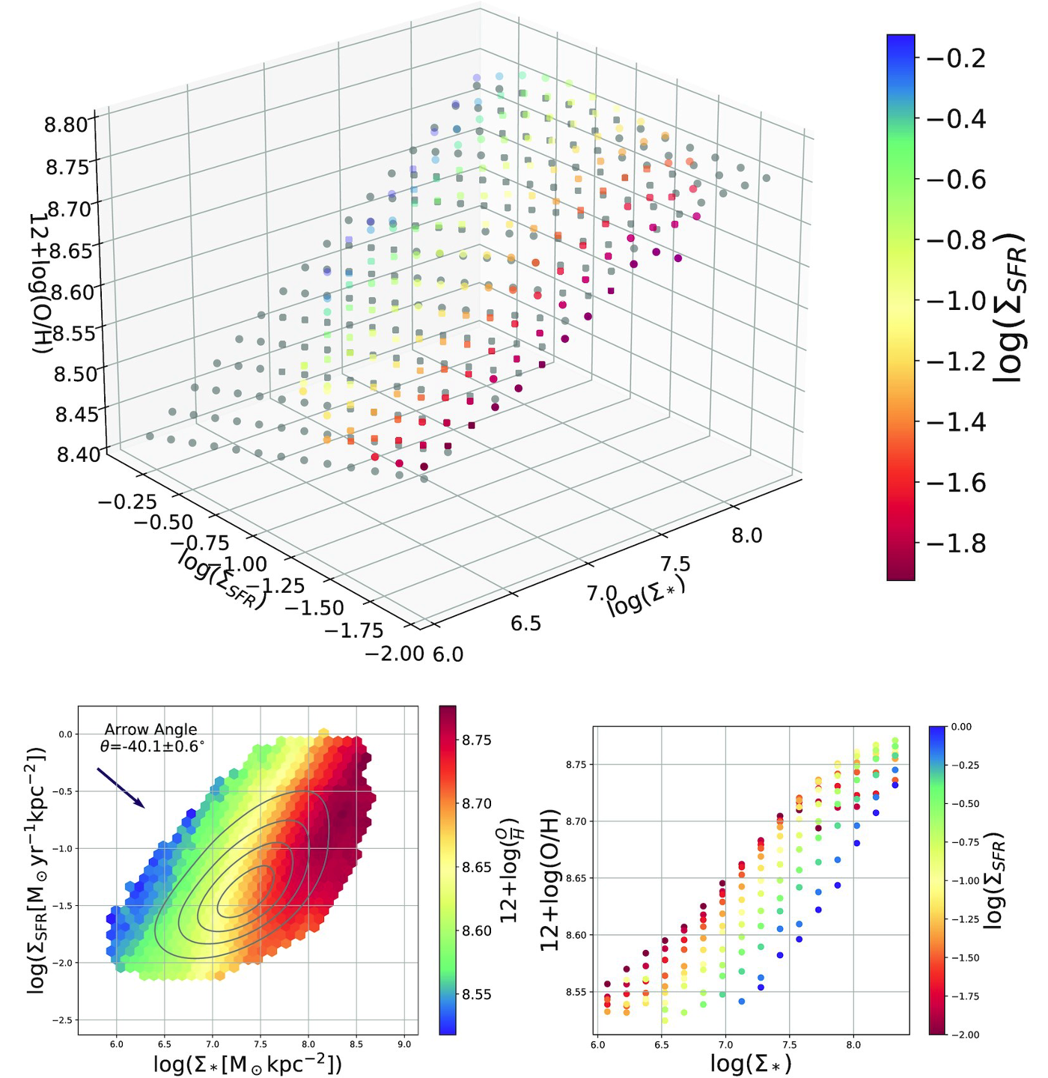
PAPER I / THE QUESTION
The local link between stars, star formation and metals
Quantity | Observable
Σ∗ | Stellar mass per area
ΣSFR | Star formation per area
12 + log₁₀(O/H) | Gas-phase abundance
At fixed Σ∗, does abundance
follow or oppose ΣSFR?
Context figure: Baker et al. 2023, as attributed in EAS2026. Main study: Huang et al. 2026.
Rongjun Huang | MAUVE-MUSE | Yonsei 2026
11
Notes:
Budget 01:00; cumulative 11:00-12:00.
SPEAKING CUES
Define the three measured quantities. The resolved SF main sequence relates SFR surface density to stellar surface density. The rMZR relates abundance to stellar density. The question is the secondary SFR dependence at fixed stellar density, which has been debated across IFU surveys and diagnostics. Baker is context at kiloparsec scales; MAUVE moves to much smaller physical scales.
OUTLINE DETAIL
### Slide 11. The local link between stars, star formation and metals - 1:00
Define stellar mass surface density, SFR surface density and gas-phase oxygen abundance. Briefly distinguish the resolved SF main sequence, the resolved mass-metallicity relation and the debated secondary SFR dependence. Use the EAS conceptual context figure, with its original attribution. [S6, S7]
SOURCES
Huang et al. 2026, MNRAS 549, 1019. https://arxiv.org/abs/2605.31412 | /Users/Igniz/Desktop/ICRAR/EAS2026/pdfs/Huang2026.pdf and /Users/Igniz/Desktop/ICRAR/MAUVE/MAUVE Rongjun Zgas-Sigma_SFR paper/main.tex. Figures are direct crops of the paper PDF, not older standalone versions.
Existing talk: /Users/Igniz/Desktop/ICRAR/EAS2026/EAS2026 SS7 Rongjun Huang.pptx. Image6: Baker et al. 2023 context figure (original slide 2); image43: reservoir schematic. Preserve original scientific attribution.

Slide 12
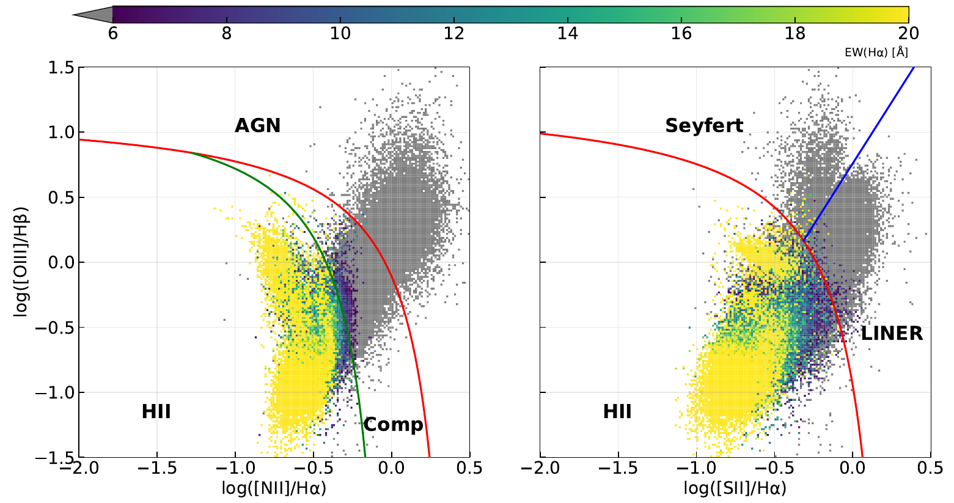
PAPER I / MEASUREMENTS
Selecting star-forming emission
HII in both BPT planes | EW(Hα) > 6 Å | σint(Hα) < 45 km s⁻¹
14 galaxies in Paper I; 13 in the ensemble relation (NGC4383 excluded). Huang et al. 2026, Figure 1.
Rongjun Huang | MAUVE-MUSE | Yonsei 2026
12
Notes:
Budget 01:30; cumulative 12:00-13:30.
SPEAKING CUES
The paper requires secure HII classification in both the nitrogen and sulphur BPT diagrams. The further cuts are EW Halpha greater than six Angstrom and intrinsic Halpha dispersion below forty-five kilometres per second. SFR comes from dust-corrected Halpha. Fourteen galaxies are analysed; NGC4383 is a metallicity outlier excluded from the ensemble, leaving thirteen. The old EAS slide had the dispersion inequality reversed; this slide follows the paper.
OUTLINE DETAIL
### Slide 12. Selecting star-forming emission - 1:30
Show the original BPT diagnostic figure and state the paper's HII selection: secure HII classification in both BPT diagrams, EW(Halpha) > 6 Angstrom, and intrinsic Halpha dispersion < 45 km/s. SFR is derived from dust-corrected Halpha. The analysis uses 14 galaxies from internal release v2; ensemble relations exclude metallicity outlier NGC4383 and therefore contain 13 galaxies. Do not import the incorrect dispersion inequality printed in the old EAS slide. [S6]
SOURCES
Huang et al. 2026, MNRAS 549, 1019. https://arxiv.org/abs/2605.31412 | /Users/Igniz/Desktop/ICRAR/EAS2026/pdfs/Huang2026.pdf and /Users/Igniz/Desktop/ICRAR/MAUVE/MAUVE Rongjun Zgas-Sigma_SFR paper/main.tex. Figures are direct crops of the paper PDF, not older standalone versions.

Slide 13
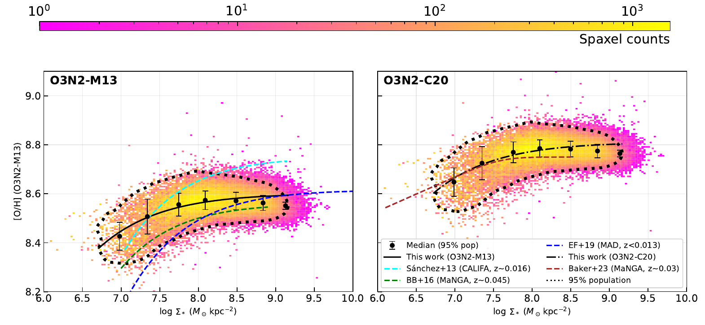
PAPER I / PRIMARY RELATION
The resolved mass-metallicity relation
Abundance rises with stellar surface density and flattens. O3N2-M13 and O3N2-C20 share an index.
Huang et al. 2026, Figure 2. Stellar surface density is in M☉ kpc⁻².
Rongjun Huang | MAUVE-MUSE | Yonsei 2026
13
Notes:
Budget 01:30; cumulative 13:30-15:00.
SPEAKING CUES
First read the axes: log stellar surface density in solar masses per square kiloparsec, and oxygen abundance. The primary relation rises and then flattens at high stellar density. The two panels use O3N2-M13 and O3N2-C20. They share the same line index and are not independent diagnostics. Next we separate this cloud of points by star formation.
OUTLINE DETAIL
### Slide 13. The resolved mass-metallicity relation - 1:30
Show the original O3N2-M13 and O3N2-C20 relation panels. Explain the primary increase and high-density flattening before adding the SFR dependence. Identify stellar surface-density units explicitly. The two O3N2 recipes share an index and are not independent spectral diagnostics. [S6, Figure 2]
SOURCES
Huang et al. 2026, MNRAS 549, 1019. https://arxiv.org/abs/2605.31412 | /Users/Igniz/Desktop/ICRAR/EAS2026/pdfs/Huang2026.pdf and /Users/Igniz/Desktop/ICRAR/MAUVE/MAUVE Rongjun Zgas-Sigma_SFR paper/main.tex. Figures are direct crops of the paper PDF, not older standalone versions.

Slide 14
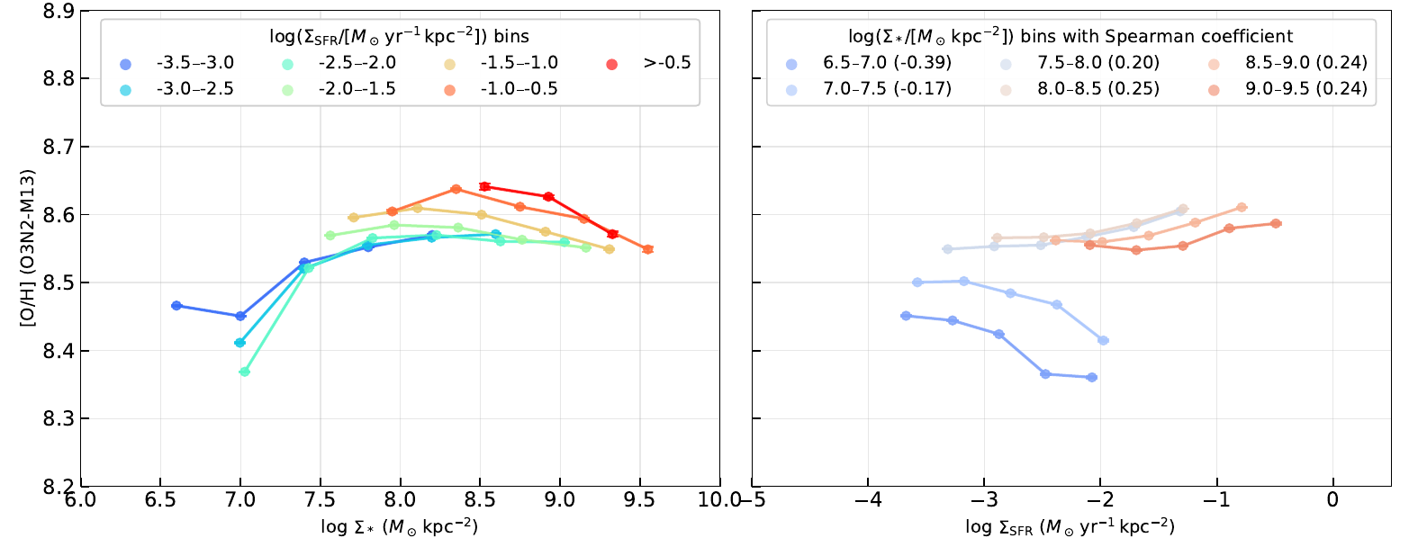
PAPER I / CONDITIONAL ASSOCIATION
At fixed stellar density, the SFR dependence changes
Lower Σ∗: negative association
Higher Σ∗: positive association
Huang et al. 2026, Figure 3 (lower panels); O3N2-M13.
Rongjun Huang | MAUVE-MUSE | Yonsei 2026
14
Notes:
Budget 02:00; cumulative 15:00-17:00.
SPEAKING CUES
These are the lower two panels of Figure 3, enlarged for readability. The left shows abundance against stellar density in SFR bins. The right shows abundance against SFR in stellar-density bins. Read the cool, low-density tracks first: higher SFR corresponds to lower abundance. Then read the high-density warm tracks: the association is positive. This is a conditional spatial association, not a measured temporal response.
OUTLINE DETAIL
### Slide 14. At fixed stellar density, the SFR dependence changes - 2:00
Use the original SFR-stratified relation and explain the low-density and high-density regimes separately. Higher local SFR is associated with lower O3N2-inferred abundance at low stellar surface density and with higher abundance at high surface density. Describe a conditional association, not an observed temporal response. [S6, Figure 3]
SOURCES
Huang et al. 2026, MNRAS 549, 1019. https://arxiv.org/abs/2605.31412 | /Users/Igniz/Desktop/ICRAR/EAS2026/pdfs/Huang2026.pdf and /Users/Igniz/Desktop/ICRAR/MAUVE/MAUVE Rongjun Zgas-Sigma_SFR paper/main.tex. Figures are direct crops of the paper PDF, not older standalone versions.

Slide 15
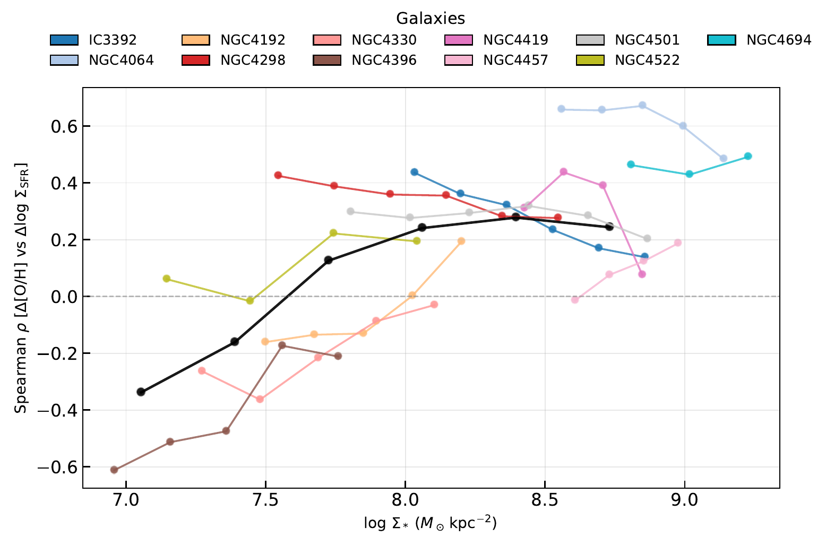
PAPER I / QUANTITATIVE EVIDENCE
The sign changes near log Σ∗ ≈ 7.5–8.0
Original galaxy colours; black = ensemble. Approximate transition in log₁₀(Σ∗ / [M☉ kpc⁻²]).
Huang et al. 2026, Figure 5. Spearman ρ describes association, not causation.
Rongjun Huang | MAUVE-MUSE | Yonsei 2026
15
Notes:
Budget 02:00; cumulative 17:00-19:00.
SPEAKING CUES
Spearman rho is negative when higher SFR accompanies lower abundance and positive when the two increase together. The original colours identify galaxies; black is the ensemble. Both O3N2 calibrations show the density dependence. Quote the transition as approximately 7.5 to 8 in log10 of stellar mass surface density in solar masses per square kiloparsec. It is not a sharp universal threshold.
OUTLINE DETAIL
### Slide 15. The sign changes near log stellar surface density 7.5-8.0 - 2:00
Show the Spearman-versus-density figure with its original galaxy colours and the black ensemble reference. Define the sign of the coefficient. State the approximate transition in log10(Sigma_star / [solar masses kpc^-2]); it is not an exact universal threshold. This figure supplies the quantitative version of the preceding visual result. [S6, Figure 5]
SOURCES
Huang et al. 2026, MNRAS 549, 1019. https://arxiv.org/abs/2605.31412 | /Users/Igniz/Desktop/ICRAR/EAS2026/pdfs/Huang2026.pdf and /Users/Igniz/Desktop/ICRAR/MAUVE/MAUVE Rongjun Zgas-Sigma_SFR paper/main.tex. Figures are direct crops of the paper PDF, not older standalone versions.

Slide 16
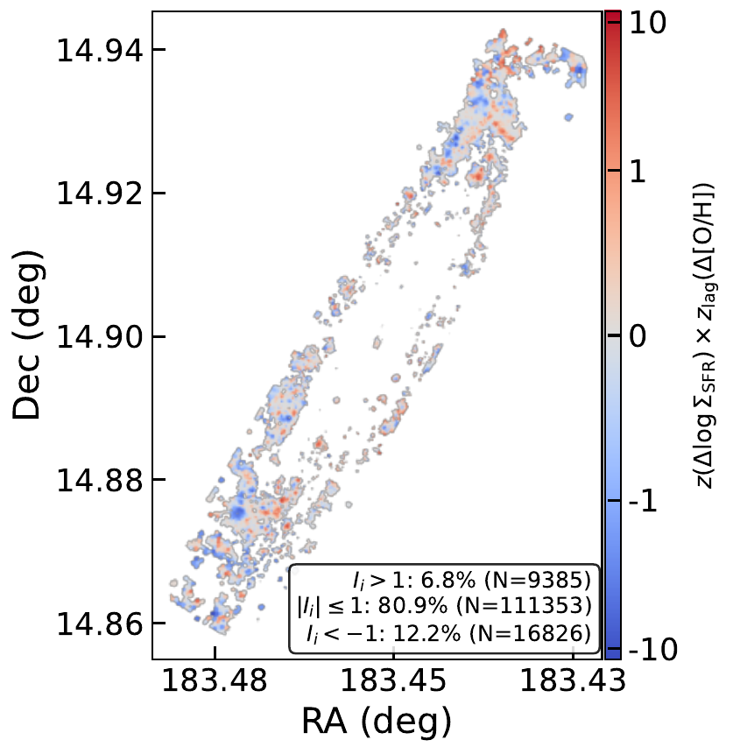
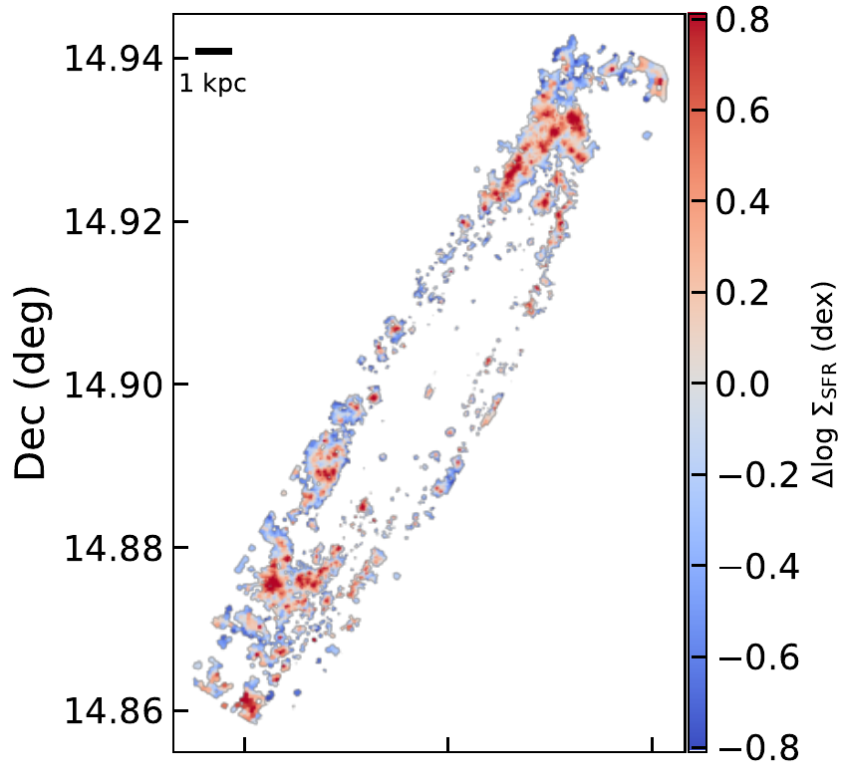
PAPER I / SPATIAL EVIDENCE
Opposite local behaviours coexist in one disc
SFR offset
Local association
NGC4192
Correlated and anti-correlated regions occur within the same disc.
Huang et al. 2026, Figure 4 (selected panels). The local index is not a significance map.
Rongjun Huang | MAUVE-MUSE | Yonsei 2026
16
Notes:
Budget 01:30; cumulative 19:00-20:30.
SPEAKING CUES
NGC4192 is useful because both patterns occur within one system. The left panel is the SFR offset; the middle is the local product of standardized SFR offset and spatially lagged abundance offset. Positive and negative regions describe local association. The Moran-like index and the thresholds in the original figure are not a calibrated significance or causal map. These selected panels are from the same Figure 4 version as the paper.
OUTLINE DETAIL
### Slide 16. Opposite local behaviours coexist in one disc - 1:30
Use the original NGC4192 offset and Moran-like map. Explain that correlated and anti-correlated spatial patterns can occur within one galaxy. The map is a local association diagnostic; neither its colour nor its absolute index is by itself a causal measurement or a calibrated significance map. [S6, Figure 4]
SOURCES
Huang et al. 2026, MNRAS 549, 1019. https://arxiv.org/abs/2605.31412 | /Users/Igniz/Desktop/ICRAR/EAS2026/pdfs/Huang2026.pdf and /Users/Igniz/Desktop/ICRAR/MAUVE/MAUVE Rongjun Zgas-Sigma_SFR paper/main.tex. Figures are direct crops of the paper PDF, not older standalone versions.

Slide 17
PAPER I / A CENTRAL CAVEAT
Metallicity calibration changes the inferred relation
Diagnostic | Metallicity–SFR behaviour
O3N2-M13 | Coherent negative-to-positive inversion
O3N2-C20 | Similar inversion; same underlying index
D16 | Mostly mildly positive over much of the range
S-calibration PG16 | More heterogeneous; can reverse the ordering
Diagnostic dependence is part of the result.
Huang et al. 2026, Section 5.1 and Figure 6 (full figure in backup B2).
Rongjun Huang | MAUVE-MUSE | Yonsei 2026
17
Notes:
Budget 02:00; cumulative 20:30-22:30.
SPEAKING CUES
This caveat belongs in the main result. O3N2-M13 and O3N2-C20 have a coherent inversion but share a line index. D16 is mostly mildly positive across much of the range. PG16 is heterogeneous and can show the opposite ordering. The primary rMZR is more stable than the secondary dependence. Ionization, N over O, diffuse emission and shared line measurements all matter for interpretation.
OUTLINE DETAIL
### Slide 17. Metallicity calibration changes the inferred relation - 2:00
Compare the four diagnostics in an editable summary: O3N2-M13 and O3N2-C20 show the coherent inversion; D16 is mostly mildly positive across much of the density range; S-calibration PG16 is more heterogeneous and can show the opposite ordering. The primary rMZR is more stable than the secondary relation. Discuss ionization, N/O, DIG and shared line measurements as relevant systematics. Keep this caveat in the main talk. [S6, Section 5.1 and Figure 6]
SOURCES
Huang et al. 2026, MNRAS 549, 1019. https://arxiv.org/abs/2605.31412 | /Users/Igniz/Desktop/ICRAR/EAS2026/pdfs/Huang2026.pdf and /Users/Igniz/Desktop/ICRAR/MAUVE/MAUVE Rongjun Zgas-Sigma_SFR paper/main.tex. Figures are direct crops of the paper PDF, not older standalone versions.

Slide 18
PAPER I / SYNTHESIS
What the observations establish
01
An O3N2-based sign reversal with local stellar density
02
Different local behaviours coexist within individual discs
03
The driver must be tested beyond the observed association
Next: a local gas regulator links replenishment, star formation and enrichment.
Rongjun Huang | MAUVE-MUSE | Yonsei 2026
18
Notes:
Budget 01:30; cumulative 22:30-24:00.
SPEAKING CUES
The O3N2-dependent association changes sign with stellar density. Opposite local behaviours coexist within discs. The physical cause remains an interpretation problem, and Paper I alone does not establish ram pressure as the cause of the inversion. A useful model must accommodate both signs and point to another measurable quantity.
OUTLINE DETAIL
### Slide 18. What the observations establish - 1:30
Summarize the O3N2-dependent sign reversal and the coexistence of local behaviours. Separate the observed association from the question of its physical cause. Environment may modulate the gas cycle, but the Paper I result alone does not establish ram-pressure stripping as the cause of the inversion. [S6]
**Transition:** A useful model should explain how both signs can arise locally and identify the additional quantity we need to measure.
SOURCES
Huang et al. 2026, MNRAS 549, 1019. https://arxiv.org/abs/2605.31412 | /Users/Igniz/Desktop/ICRAR/EAS2026/pdfs/Huang2026.pdf and /Users/Igniz/Desktop/ICRAR/MAUVE/MAUVE Rongjun Zgas-Sigma_SFR paper/main.tex. Figures are direct crops of the paper PDF, not older standalone versions.

Slide 19
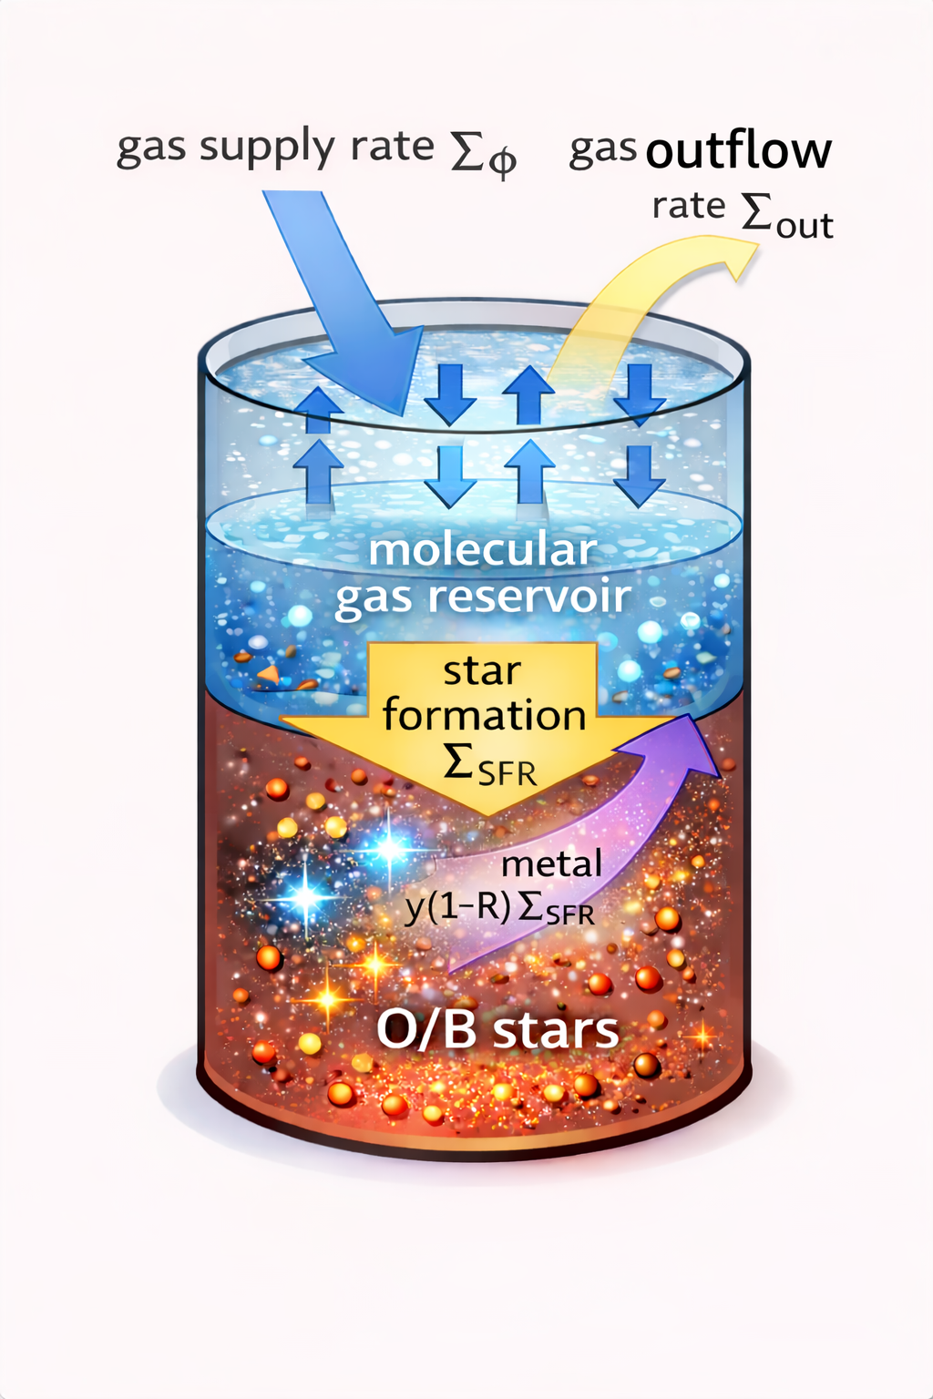
THE RESOLVED REGULATOR
A local molecular reservoir
Replenishment ↔ surrounding ISM
Supply
Local gas reservoir
Stars
Removal also changes the reservoir.
Define the boundary before interpreting a rate.
Existing EAS reservoir illustration (schematic). Model: Huang et al. 2026.
Rongjun Huang | MAUVE-MUSE | Yonsei 2026
19
Notes:
Budget 00:45; cumulative 24:00-24:45.
SPEAKING CUES
The reservoir picture is a schematic. Set a boundary around local star-forming molecular gas. Supply replenishes it from the surrounding ISM, star formation locks some mass into stars, recycling returns some, and removal transfers gas out of the reservoir. Local supply is not automatically pristine cosmological accretion. The boundary and phase definition matter.
OUTLINE DETAIL
### Slide 19. A local molecular reservoir - 0:45
Use the existing EAS reservoir illustration, clearly as a schematic. Define the local molecular gas reservoir, its gas supply, star formation and removal. Local supply means replenishment from the surrounding ISM, not automatically pristine accretion from outside the galaxy. The reservoir boundary matters. [S6, S7, S10]
SOURCES
Huang et al. 2026, MNRAS 549, 1019. https://arxiv.org/abs/2605.31412 | /Users/Igniz/Desktop/ICRAR/EAS2026/pdfs/Huang2026.pdf and /Users/Igniz/Desktop/ICRAR/MAUVE/MAUVE Rongjun Zgas-Sigma_SFR paper/main.tex. Figures are direct crops of the paper PDF, not older standalone versions.
Existing talk: /Users/Igniz/Desktop/ICRAR/EAS2026/EAS2026 SS7 Rongjun Huang.pptx. Image6: Baker et al. 2023 context figure (original slide 2); image43: reservoir schematic. Preserve original scientific attribution.
Reservoir definitions: /Users/Igniz/Desktop/ICRAR/MAUVE/20260831_Molecular_Gas_Supply_Definitions_and_Observational_Inference.md

Slide 20
THE RESOLVED REGULATOR
Gas continuity
Σ
= Σ
/ τ
SFR
g
dep
dΣ
/dt = Σ
− (1 − R)Σ
− Σ
g
Φ
SFR
out
ΣΦ | (1 − R)ΣSFR | Σout
Supply | Long-lived stellar locking | Removal
Surface-density rates; R is the recycled fraction. Single reservoir + instantaneous recycling assumptions.
Rongjun Huang | MAUVE-MUSE | Yonsei 2026
20
Notes:
Budget 01:15; cumulative 24:45-26:00.
SPEAKING CUES
All rates here are per unit area. The star formation law defines a depletion time for the effective reservoir. Supply adds gas, one minus R times SFR is the mass locked in long-lived stars, and the final term removes gas. R is the instantaneous returned fraction. A single effective reservoir and instantaneous recycling are assumptions. None of these derivatives or supply rates is directly measured by a static MUSE map.
OUTLINE DETAIL
### Slide 20. Gas continuity - 1:15
Introduce the gas budget, with all rates per unit area:
$$
\Sigma_{\rm SFR}=\frac{\Sigma_g}{\tau_{\rm dep}},\qquad
\frac{d\Sigma_g}{dt}=\Sigma_\Phi-(1-R)\Sigma_{\rm SFR}-\Sigma_{\rm out}.
$$
Walk through supply, long-lived stellar locking and removal. State that instantaneous recycling and a single effective reservoir are model assumptions. Removal can include feedback and environmental effects, but the equation does not measure either rate from the MUSE maps. [S6, Section 4]
SOURCES
Huang et al. 2026, MNRAS 549, 1019. https://arxiv.org/abs/2605.31412 | /Users/Igniz/Desktop/ICRAR/EAS2026/pdfs/Huang2026.pdf and /Users/Igniz/Desktop/ICRAR/MAUVE/MAUVE Rongjun Zgas-Sigma_SFR paper/main.tex. Figures are direct crops of the paper PDF, not older standalone versions.

Slide 21
THE RESOLVED REGULATOR
Metal enrichment competes with dilution
dZ/dt = [ y(1 − R)Σ
+ (Z
− Z)Σ
] / Σ
SFR
Φ
Φ
g
Enrichment
Dilution when ZΦ < Z
Newly synthesized metals
from star formation
Supply changes abundance
as well as reservoir mass
Z is a linear abundance. Well-mixed removal cancels explicitly, but still changes the reservoir.
Rongjun Huang | MAUVE-MUSE | Yonsei 2026
21
Notes:
Budget 01:15; cumulative 26:00-27:15.
SPEAKING CUES
In linear abundance, gas gets enriched by newly synthesized metals and diluted if the supply abundance is lower. y is the yield and Z Phi is the abundance of supplied gas. The explicit removal term cancels only when removed gas has the same abundance as the reservoir. Removal still changes the gas amount, SFR and response time. The observational axis twelve plus log oxygen over hydrogen must not be inserted as linear Z.
OUTLINE DETAIL
### Slide 21. Metal enrichment competes with dilution - 1:15
Use the abundance equation:
$$
\frac{dZ}{dt}=\frac{y(1-R)\Sigma_{\rm SFR}+(Z_\Phi-Z)\Sigma_\Phi}{\Sigma_g}.
$$
Explain the positive enrichment term and the dilution term when supplied gas has lower abundance. Here Z is a linear abundance, not the plotted 12 + log10(O/H). The explicit removal term cancels only under the assumption that removed gas has the reservoir abundance; removal still changes the reservoir, SFR and response time. [S6, Section 4]
SOURCES
Huang et al. 2026, MNRAS 549, 1019. https://arxiv.org/abs/2605.31412 | /Users/Igniz/Desktop/ICRAR/EAS2026/pdfs/Huang2026.pdf and /Users/Igniz/Desktop/ICRAR/MAUVE/MAUVE Rongjun Zgas-Sigma_SFR paper/main.tex. Figures are direct crops of the paper PDF, not older standalone versions.

Slide 22
THE RESOLVED REGULATOR
The instantaneous target abundance
Z
†
= Z
+ y(1 − R) Σ
/ Σ
Φ
SFR
Φ
τ
= Σ
/ Σ
dZ/dt = (Z
†
− Z) / τ
Φ
g
Φ
Φ
δZ
†
= (Z
†
− Z
) [ δln Σ
− δln Σ
]
Φ
SFR
Φ
Supply rises proportionally more → lower target
SFR rises proportionally more → higher target
Fixed y, R and ZΦ; natural logarithms. The target need not equal the current abundance.
Rongjun Huang | MAUVE-MUSE | Yonsei 2026
22
Notes:
Budget 01:15; cumulative 27:15-28:30.
SPEAKING CUES
Regroup the abundance equation as relaxation toward an instantaneous target. The target depends on the ratio of star formation to supply. Tau Phi is gas mass divided by supply rate. Holding yield, returned fraction and supply abundance fixed, the first-order perturbation uses natural logarithms. A proportionally larger supply change lowers the target; a larger SFR change raises it. This is a conditional statement about the target rather than a theorem for observed correlation signs.
OUTLINE DETAIL
### Slide 22. The instantaneous target abundance - 1:15
Introduce the target and relaxation time:
$$
Z^\dagger=Z_\Phi+y(1-R)\frac{\Sigma_{\rm SFR}}{\Sigma_\Phi},\qquad
\tau_\Phi=\frac{\Sigma_g}{\Sigma_\Phi},\qquad
\dot Z=\frac{Z^\dagger-Z}{\tau_\Phi}.
$$
At fixed yield, recycling and supplied abundance, the first-order relation is
$$
\delta Z^\dagger=(Z^\dagger-Z_\Phi)
\left(\delta\ln\Sigma_{\rm SFR}-\delta\ln\Sigma_\Phi\right).
$$
Natural logarithms are used here. Supply rising proportionally more than SFR lowers the target; SFR rising proportionally more than supply raises it. This is a statement about the target under stated assumptions, not an unconditional theorem about the sign of an observed correlation. [S6]
SOURCES
Huang et al. 2026, MNRAS 549, 1019. https://arxiv.org/abs/2605.31412 | /Users/Igniz/Desktop/ICRAR/EAS2026/pdfs/Huang2026.pdf and /Users/Igniz/Desktop/ICRAR/MAUVE/MAUVE Rongjun Zgas-Sigma_SFR paper/main.tex. Figures are direct crops of the paper PDF, not older standalone versions.

Slide 23
THE RESOLVED REGULATOR
The response has a finite timescale
1 − exp(−t/τ
)
Φ
Abundance lags and smooths
a changing target.
Driver covariance, timescales
and phase all matter.
Analytic fixed-target illustration; not fitted to the data. Maps do not measure time derivatives.
Rongjun Huang | MAUVE-MUSE | Yonsei 2026
23
Notes:
Budget 01:00; cumulative 28:30-29:30.
SPEAKING CUES
This curve is only the exact solution for a fixed target and constant tau, with the response normalized between its initial and final values. At one tau the response has completed about sixty-three percent of the change. A changing target is lagged and smoothed. The observed correlation depends on covariance of drivers, timescales and phases sampled. A spatial map is not a time derivative; tau Phi is not uniquely a measured turbulent mixing time.
OUTLINE DETAIL
### Slide 23. The response has a finite timescale - 1:00
Explain that the observed abundance lags and smooths a changing target. A fixed-target response is used only as an analytic illustration. Correlations depend on how the drivers covary, their timescales and the phases sampled. A spatial map does not directly measure a time derivative. Do not identify the effective relaxation time uniquely with a measured turbulent-mixing time. [S6, Section 4.2]
SOURCES
Huang et al. 2026, MNRAS 549, 1019. https://arxiv.org/abs/2605.31412 | /Users/Igniz/Desktop/ICRAR/EAS2026/pdfs/Huang2026.pdf and /Users/Igniz/Desktop/ICRAR/MAUVE/MAUVE Rongjun Zgas-Sigma_SFR paper/main.tex. Figures are direct crops of the paper PDF, not older standalone versions.

Slide 24
THE RESOLVED REGULATOR
One equation produces both correlation signs
Dominant fractional variability | Expected residual relation
SFR / SFE (shorter τdep) | Higher SFR ↔ higher Z
Gas supply (shorter τΦ) | Higher SFR ↔ lower Z
Comparable amplitudes | Weak or flat relation
δZ ∝ δln τ
− δln τ
Φ
dep
Analytic driver competition; the observed sign remains conditional on covariance and response phase.
Rongjun Huang | MAUVE-MUSE | Yonsei 2026
24
Notes:
Budget 01:00; cumulative 29:30-30:30.
SPEAKING CUES
The analytic result is a competition, not two separate models. If fractional SFR or SFE variability dominates over supply variability, enrichment wins and metallicity follows SFR. If fractional supply variability dominates while supply and SFR co-vary, dilution wins and metallicity opposes SFR. Comparable amplitudes give a weak relation. The finite response time adds phase lag and scatter, but it does not change the identity of the competing drivers.
OUTLINE DETAIL
### Slide 24. One equation produces both correlation signs - 1:00
Present the analytic result as a competition between relative driver amplitudes. If SFR or SFE fluctuations dominate over supply fluctuations, enrichment produces a positive metallicity-SFR correlation. If gas-supply fluctuations dominate while supply and SFR co-vary, dilution produces a negative correlation. Comparable amplitudes yield a weak relation. Express the same statement as delta Z proportional to delta ln tau_Phi minus delta ln tau_dep. The finite response time adds phase lag and scatter without changing the identities of the two competing drivers. [S6, Sections 4.1-4.3]
SOURCES
Huang et al. 2026, MNRAS 549, 1019. https://arxiv.org/abs/2605.31412 | /Users/Igniz/Desktop/ICRAR/EAS2026/pdfs/Huang2026.pdf and /Users/Igniz/Desktop/ICRAR/MAUVE/MAUVE Rongjun Zgas-Sigma_SFR paper/main.tex. Figures are direct crops of the paper PDF, not older standalone versions.

Slide 25
FROM RESOLVED TO INTEGRATED
The regulator is scale-free
RESOLVED
INTEGRATED
(Σ
, Σ
, Σ
, Σ
)
(M
, M
, SFR, Φ)
g
*
SFR
Φ
g
*
δZ ∝ δln SFR − δln Φ ∝ δln τ
− δln τ
Φ
dep
Same functional form · same two drivers · local or global residuals
Scale-free algebra does not imply identical timescales, covariance or spatial averaging.
Rongjun Huang | MAUVE-MUSE | Yonsei 2026
25
Notes:
Budget 01:00; cumulative 30:30-31:30.
SPEAKING CUES
The continuity equations do not depend on the size of the chosen reservoir. Replace each surface density by the corresponding galaxy-integrated quantity and the algebra is unchanged. The same analytic competition therefore predicts positive and negative SFR-metallicity correlations at fixed local stellar density and at fixed total stellar mass. The physical drivers and averaging differ with scale, but the equation does not impose a sign flip merely because the aperture becomes larger.
OUTLINE DETAIL
### Slide 25. The regulator is scale-free - 1:00
Make the resolved-to-integrated mapping explicit. Replace the surface-density variables (Sigma_g, Sigma_*, Sigma_SFR, Sigma_Phi) with their galaxy-integrated counterparts (M_g, M_*, SFR, Phi). The continuity equations and perturbation rule retain the same functional form. At fixed local stellar density or fixed total stellar mass, SFR/SFE-driven variability can therefore produce a positive correlation, while gas-supply-driven variability can produce a negative one. Emphasize that scale-free algebra does not require identical timescales, covariance or spatial averaging at the two scales. [S6, Section 5.3]
SOURCES
Huang et al. 2026, MNRAS 549, 1019. https://arxiv.org/abs/2605.31412 | /Users/Igniz/Desktop/ICRAR/EAS2026/pdfs/Huang2026.pdf and /Users/Igniz/Desktop/ICRAR/MAUVE/MAUVE Rongjun Zgas-Sigma_SFR paper/main.tex. Figures are direct crops of the paper PDF, not older standalone versions.

Slide 26
ANALYTIC CONTRIBUTION
What this adds to earlier regulator models
Study / model | Route to the sign | Scope or limitation
Common bathtub use | Inflow variability → negative | Usually foregrounds dilution
Forbes et al. 2014 | Stochastic accretion; parameter scatter can alter covariance | Mass-loading route is feedback-sensitive
Wang & Lilly 2021 | SFE variability → positive; inflow → negative | Approximate analytic + numerical responses
This work | Relative SFR/SFE versus supply variability | One analytic rule; resolved → integrated
Conclusion: the sign is a competition of relative driver variabilities.
Literature positioning is mechanism-specific; prior positive routes are acknowledged.
Rongjun Huang | MAUVE-MUSE | Yonsei 2026
26
Notes:
Budget 01:00; cumulative 31:30-32:30.
SPEAKING CUES
Most bathtub applications emphasize the inflow-driven negative FMR. Forbes et al. model that stochastic accretion route and discuss parameter scatter, including mass loading, as another possible source of covariance; that feedback-sensitive route is not the mechanism adopted here. Wang and Lilly explicitly showed the positive SFE-driven route using small-amplitude analytic approximations plus numerical experiments. Our contribution is the compact analytic competition between relative SFR or SFE variability and gas-supply variability, written once and carried from resolved to integrated scales.
OUTLINE DETAIL
### Slide 26. What this adds to earlier regulator models - 1:00
Position the result by physical mechanism. Many bathtub applications foreground stochastic inflow and therefore recover the familiar negative FMR. Forbes et al. (2014) primarily model that accretion-driven anticorrelation and discuss how scatter in parameters, including mass loading, can change the covariance; this feedback-sensitive route is not the preferred mechanism here. Wang and Lilly (2021) explicitly demonstrate the positive SFE-driven route and the negative inflow-driven route using small-amplitude analytic approximations and numerical response experiments. The contribution of this work is a compact analytic competition between relative SFR/SFE variability and gas-supply variability, written once and carried from resolved to integrated scales. Do not say that Wang and Lilly provided only numerical solutions: their paper contains approximate analytic expressions that they verify numerically. [S6; Forbes et al. 2014; Wang and Lilly 2021]
SOURCES
Huang et al. 2026, MNRAS 549, 1019. https://arxiv.org/abs/2605.31412 | /Users/Igniz/Desktop/ICRAR/EAS2026/pdfs/Huang2026.pdf and /Users/Igniz/Desktop/ICRAR/MAUVE/MAUVE Rongjun Zgas-Sigma_SFR paper/main.tex. Figures are direct crops of the paper PDF, not older standalone versions.
Forbes et al. 2014, MNRAS 443, 168. https://doi.org/10.1093/mnras/stu1142; Wang & Lilly 2021, ApJ 910, 137. https://doi.org/10.3847/1538-4357/abe413. Forbes et al. primarily model stochastic accretion and note parameter-scatter routes; Wang & Lilly derive small-amplitude approximations and verify them numerically.

Slide 27
ONGOING WORK / PRELIMINARY
Where star formation remains along the RPS sequence
8
5
13
Pre-peak
Close-to-peak
Post-peak
26 product systems in this analysis snapshot
Where is the selected SF population still present?
Existing September analysis; NGC4567_8 is one product for two physical components.
Rongjun Huang | MAUVE-MUSE | Yonsei 2026
27
Notes:
Budget 01:00; cumulative 32:30-33:30.
SPEAKING CUES
Now ask where star formation remains rather than what the surviving SF relation looks like. This existing September snapshot has twenty-six product-level systems after inclination and product-availability selection: eight pre-, five close-, thirteen post-peak. NGC4567 and 4568 are one combined product. The comparison is cross-sectional and the close-to-peak sample is small. No new analysis was run to make the talk.
OUTLINE DETAIL
### Slide 27. Where star formation remains along the RPS sequence - 1:00
Introduce the ongoing occupancy question. Present the analysis snapshot as 26 product-level systems after inclination and product-availability selection: 8 pre-peak, 5 close-to-peak and 13 post-peak. NGC4567_8 is one combined product representing two physical components. These counts belong to this analysis, not the complete 40-target survey. [S8, S9]
SOURCES
Existing analysis snapshot: /Users/Igniz/Desktop/ICRAR/further/20260905_stage_SF_fraction_analysis.md; assets: /Users/Igniz/Desktop/ICRAR/further/20260905_stage_SF_fraction_analysis_assets. No science pipeline recomputed for this presentation.
Latest framing: /Users/Igniz/Desktop/ICRAR/MAUVE/20260906 Where Star Formation Remains along Infall Stages.md

Slide 28
ONGOING WORK / PRELIMINARY
SF, ND and NSF measure different outcomes
Category | Operational definition | Interpretive limit
SF | Selected HII + EW + dispersion | A selected SF population
ND | Required Balmer detection fails | Sensitivity-limited
NSF | Balmer detected; fails SF selection | Several excitation mechanisms
Denominator: the valid observed footprint
ND does not mean zero SFR. NSF alone cannot distinguish DIG, shocks, old stars or nuclear activity.
Rongjun Huang | MAUVE-MUSE | Yonsei 2026
28
Notes:
Budget 01:30; cumulative 33:30-35:00.
SPEAKING CUES
The denominator is the valid observed footprint with finite stellar mass, accepted BINID and mask, and valid radius. SF means the selected HII population with EW and dispersion cuts. ND means one of the required Balmer detections fails; detected means SNR at least three and native flux threshold twenty for Halpha and Hbeta. NSF is detected but fails SF selection. ND is not zero SFR, and NSF mixes possible excitation mechanisms. A further post-fit SNR cut changes this denominator.
OUTLINE DETAIL
### Slide 28. SF, ND and NSF measure different outcomes - 1:30
Define SF as the selected HII/EW/dispersion population; ND as failure of the required Balmer detections; NSF as Balmer-detected emission that fails the SF selection. Define the denominator as the valid observed footprint. ND is sensitivity-limited, and NSF may mix DIG, shocks, old-star and nuclear excitation. The categories do not uniquely identify physical mechanisms. [S8]
SOURCES
Existing analysis snapshot: /Users/Igniz/Desktop/ICRAR/further/20260905_stage_SF_fraction_analysis.md; assets: /Users/Igniz/Desktop/ICRAR/further/20260905_stage_SF_fraction_analysis_assets. No science pipeline recomputed for this presentation.

Slide 29
ONGOING WORK / PRELIMINARY
SF occupancy is lower in the post-peak sample
Equal-galaxy means. The S/N cut changes the denominator and removes much of the ND area.
Rongjun Huang | MAUVE-MUSE | Yonsei 2026
29
Notes:
Budget 02:00; cumulative 35:00-37:00.
SPEAKING CUES
Each galaxy contributes equally to the stage mean. On the full valid footprint, SF fractions are thirty-nine, twenty-five and seven percent; ND rises from thirty-one to fifty-one to seventy-three percent. The right panel restricts the footprint to post-fit SNR at least twenty-five and produces different fractions. It preferentially excludes ND area, so it is a conditional view. These descriptive means do not show whole-galaxy uncertainty; the bootstrap comparison is in backup B4.
OUTLINE DETAIL
### Slide 29. SF occupancy is lower in the post-peak sample - 2:00
Use editable charts made directly from the existing equal-galaxy summary CSVs. Show the full valid footprint alongside the post-fit S/N >= 25 subset. Full-footprint mean SF fractions are 0.388, 0.251 and 0.066 for pre-, close- and post-peak; corresponding ND fractions are 0.312, 0.509 and 0.727. Mark the result as preliminary and cross-sectional. Do not interpret the S/N cut as a neutral removal of bad data: it changes the denominator and preferentially excludes ND area. [S8]
SOURCES
Existing analysis snapshot: /Users/Igniz/Desktop/ICRAR/further/20260905_stage_SF_fraction_analysis.md; assets: /Users/Igniz/Desktop/ICRAR/further/20260905_stage_SF_fraction_analysis_assets. No science pipeline recomputed for this presentation.
/Users/Igniz/Desktop/ICRAR/further/20260905_stage_SF_fraction_analysis_assets/stage_global_equal_uncut.csv
/Users/Igniz/Desktop/ICRAR/further/20260905_stage_SF_fraction_analysis_assets/stage_global_equal_snr25.csv

Slide 30
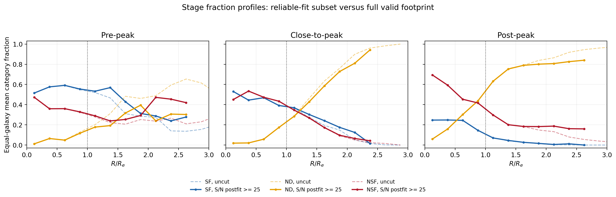
ONGOING WORK / PRELIMINARY
Outer non-detections and central non-SF emission
Solid: S/N ≥ 25 subset Dashed: full valid footprint
Existing equal-galaxy radial profiles. Stage averages are not individual evolutionary tracks.
Rongjun Huang | MAUVE-MUSE | Yonsei 2026
30
Notes:
Budget 01:15; cumulative 37:00-38:15.
SPEAKING CUES
The existing profiles have a panel for each stage. Explain the categories using the legend and radius in effective-radius units. Solid curves are the SNR-selected denominator and dashed curves the full valid footprint. Outer non-detections become dominant while detected non-SF emission is important centrally. The descriptive picture combines contraction and broader occupancy decline. Whole galaxies are the independent units; each supported galaxy receives equal weight in a bin.
OUTLINE DETAIL
### Slide 30. Outer non-detections and central non-SF emission - 1:15
Show the existing equal-galaxy radial profiles, with cut and uncut curves explicitly identified. The descriptive picture combines a contracting SF footprint with a broader decline in occupancy; the destination differs with radius. Outer and low-density regions are increasingly ND, while detected NSF emission becomes prominent centrally. Avoid treating the stage average as the track of every galaxy. [S8, S9]
SOURCES
Existing analysis snapshot: /Users/Igniz/Desktop/ICRAR/further/20260905_stage_SF_fraction_analysis.md; assets: /Users/Igniz/Desktop/ICRAR/further/20260905_stage_SF_fraction_analysis_assets. No science pipeline recomputed for this presentation.
Latest framing: /Users/Igniz/Desktop/ICRAR/MAUVE/20260906 Where Star Formation Remains along Infall Stages.md
/Users/Igniz/Desktop/ICRAR/further/20260905_stage_SF_fraction_analysis_assets/stage_fraction_profiles_radius_equal.png

Slide 31
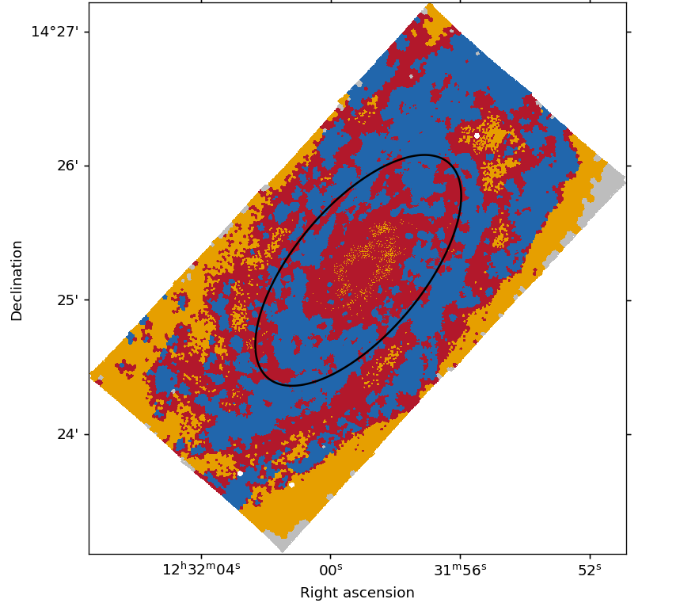
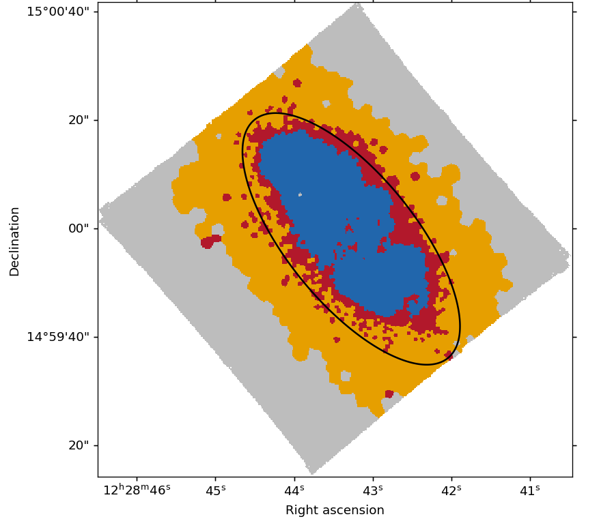
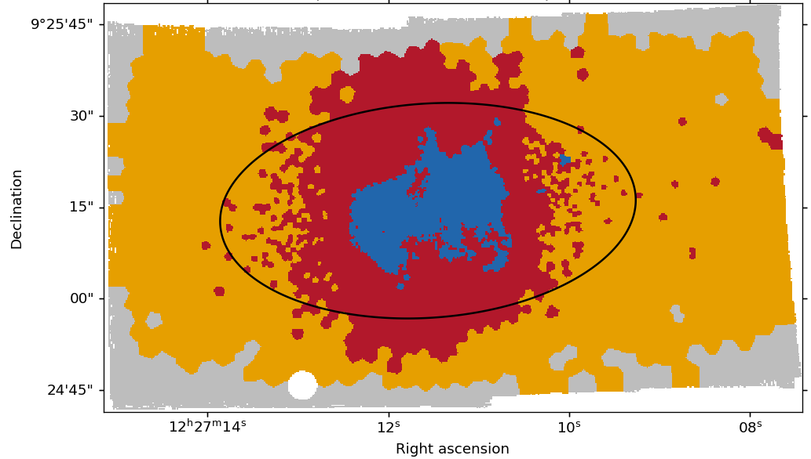
ONGOING WORK / PRELIMINARY
The maps show substantial galaxy-to-galaxy diversity
NGC4501
NGC4424
IC3392
Close-to-peak
Close-to-peak
Post-peak
SF
ND
NSF
S/N excluded
Black contour: 1 Rₑ. Selected panels from the stored spatial category maps; common legend reproduced.
Rongjun Huang | MAUVE-MUSE | Yonsei 2026
31
Notes:
Budget 01:15; cumulative 38:15-39:30.
SPEAKING CUES
Compare the two close-to-peak objects NGC4501 and NGC4424 with post-peak IC3392. Retain the actual category colours. The maps use the SNR-selected classification, grey is excluded by post-fit SNR, and the black contour is one effective radius. The original percentage legends are outside the image crop: they use the original valid-disc denominator and are not the conditional fractions in the preceding chart. Do not infer a physical mechanism for individual NSF patches from these categories alone.
OUTLINE DETAIL
### Slide 31. The maps show substantial galaxy-to-galaxy diversity - 1:15
Use selected existing spatial maps, including contrasting close-to-peak systems and a post-peak example. Keep SF/ND/NSF/excluded colours and labels unchanged. Connect this diversity to the small close-to-peak sample and the need for galaxy-level inference. Do not label an individual NSF feature as a confirmed shock or AGN using the category map alone. [S8, S9]
SOURCES
Existing analysis snapshot: /Users/Igniz/Desktop/ICRAR/further/20260905_stage_SF_fraction_analysis.md; assets: /Users/Igniz/Desktop/ICRAR/further/20260905_stage_SF_fraction_analysis_assets. No science pipeline recomputed for this presentation.
Latest framing: /Users/Igniz/Desktop/ICRAR/MAUVE/20260906 Where Star Formation Remains along Infall Stages.md

Slide 32
ONGOING WORK / NEXT MEASUREMENT
Occupancy and surviving-SF intensity are separate
How much of the disc
is still forming stars?
How strongly do the
surviving regions form stars?
SF fraction
ΣSFR at fixed Σ∗ and radius
Current occupancy measurements do not yet answer the surviving-intensity question.
Rongjun Huang | MAUVE-MUSE | Yonsei 2026
32
Notes:
Budget 00:30; cumulative 39:30-40:00.
SPEAKING CUES
The fractions answer how much of the footprint belongs to selected SF. They cannot say whether surviving SF is enhanced, normal or suppressed. The next comparison must measure the surviving population at matched stellar density and radius.
OUTLINE DETAIL
### Slide 32. Occupancy and surviving-SF intensity are separate - 0:30
State the next measurement: compare the SFR of regions that remain SF at fixed stellar density and radius. The present fractions cannot tell whether those survivors are enhanced, normal or suppressed. [S8]
SOURCES
Existing analysis snapshot: /Users/Igniz/Desktop/ICRAR/further/20260905_stage_SF_fraction_analysis.md; assets: /Users/Igniz/Desktop/ICRAR/further/20260905_stage_SF_fraction_analysis_assets. No science pipeline recomputed for this presentation.

Slide 33
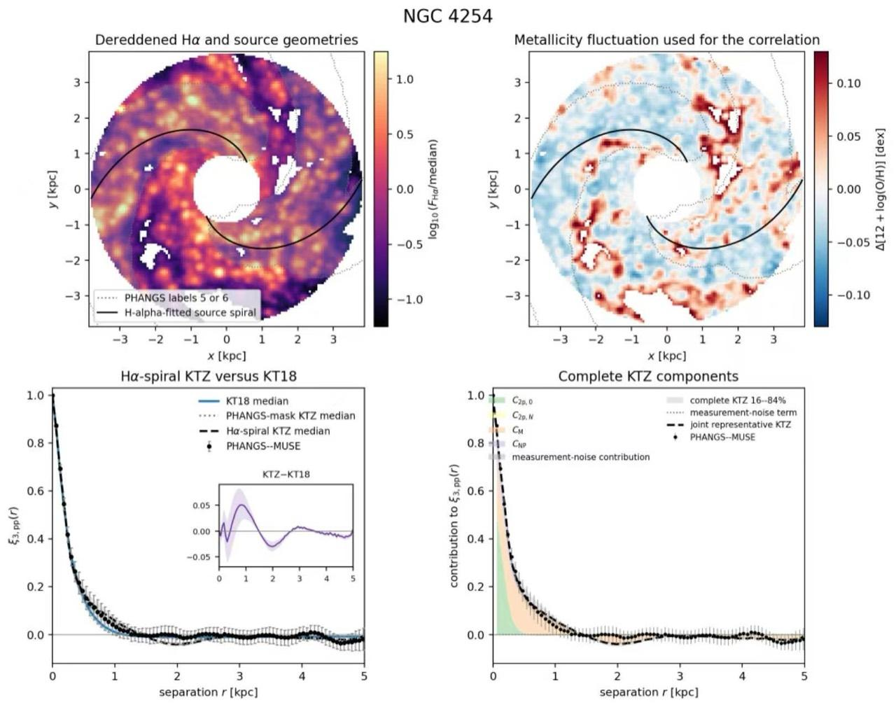
ONGOING WORK / PRELIMINARY
NGC4254: spiral structure shapes metallicity fluctuations
PRELIMINARY
Spiral geometry leaves a measurable imprint
Hα source geometry
Metallicity-fluctuation map
Two-point correlation
Spiral-aware components
User-provided NGC4254 snapshot; no science pipeline recomputed for this talk.
Rongjun Huang | MAUVE-MUSE | Yonsei 2026
33
Notes:
Budget 01:00; cumulative 40:00-41:00.
SPEAKING CUES
This is the current preliminary NGC4254 result. The upper-left map fits the Halpha source geometry; the upper-right map is the metallicity fluctuation used in the correlation. The lower panels compare the measured two-point correlation with the injection-diffusion baseline and a spiral-aware decomposition. The alignment and the nonzero added components show that spiral geometry is shaping the enrichment pattern. Treat this as one-galaxy preliminary evidence, not a sample-wide conclusion.
OUTLINE DETAIL
### Slide 33. NGC4254: spiral structure shapes metallicity fluctuations - 1:00
Present the user-provided four-panel NGC4254 snapshot as a preliminary result. The upper-left panel shows the dereddened H-alpha field and fitted source spirals; the upper-right panel shows the metallicity fluctuation used in the correlation. The lower-left panel compares the measured two-point correlation with the uniform KT18 baseline and spiral-aware model. The lower-right panel decomposes the complete correlation. The result demonstrates that spiral geometry leaves a measurable imprint on the enrichment pattern in this galaxy. Keep the scope explicit: this is preliminary evidence from NGC4254, not a sample-wide measurement. [S15]
SOURCES
User-provided preliminary NGC4254 metallicity-fluctuation figure supplied 10 September 2026. Snapshot copied to /private/tmp/yonsei_build/assets/NGC4254_metallicity_fluctuations_preliminary.jpg. Interpretation and provenance recorded in /Users/Igniz/Desktop/ICRAR/202609Korea/Yonsei_45min_talk_outline.md; no science pipeline recomputed for this presentation.

Slide 34
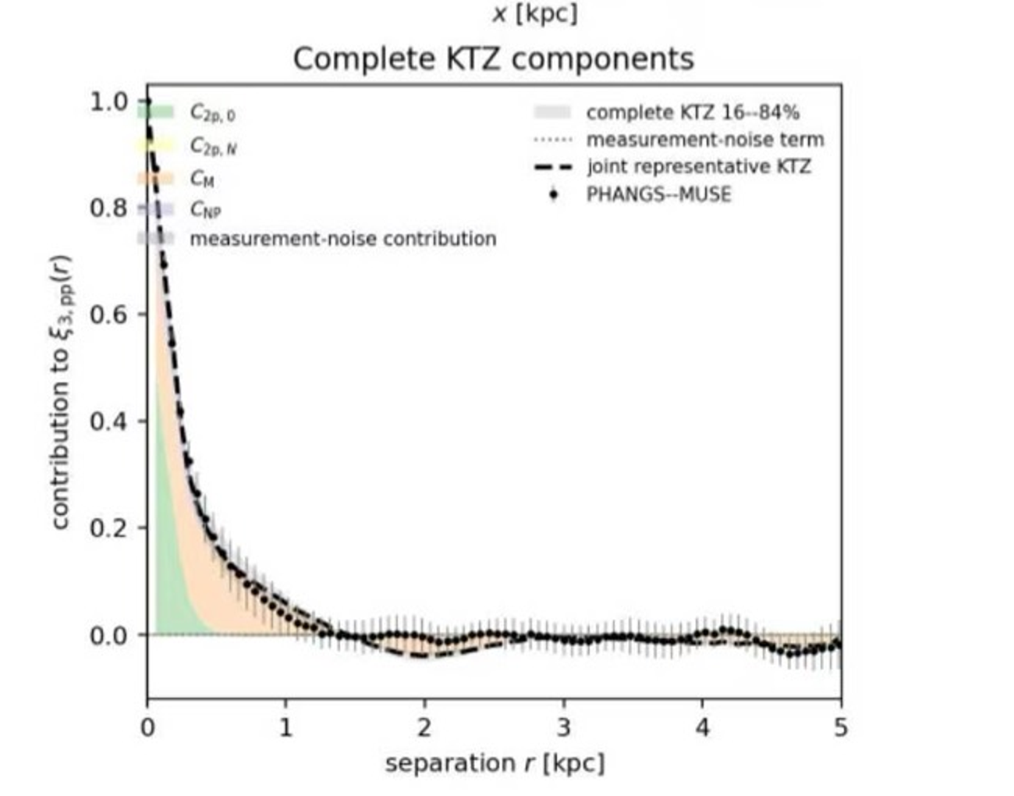
ONGOING WORK / PRELIMINARY
Four terms separate geometry, memory and source clustering
Term | Physical content
C₂ₚ,₀ | Uniform-field injection–diffusion baseline (KT18)
C₂ₚ,N | Perturbed spiral field; net term from asymmetry / incomplete mask
C_M | Cumulative past correlation; spiral memory over the correlation time
C_NP | Born-in source clustering + diffusion, stellar drift and yield delay
Geometry + temporal memory + clustered birth
C₂ₚ,N vanishes for complete symmetric arms under the azimuthal integral; C_NP is a distinct first-order residual.
Rongjun Huang | MAUVE-MUSE | Yonsei 2026
34
Notes:
Budget 01:00; cumulative 41:00-42:00.
SPEAKING CUES
Read the decomposition from physically simpler to richer terms. C two-p zero is the uniform-field injection-diffusion prediction of Krumholz and Ting 2018. C two-p N adds the perturbed spiral field; a complete symmetric arm pattern integrates to zero azimuthally, but asymmetric arms or incomplete masks leave a net term. C M is the mean or cumulative past correlation over the correlation time, so a spiral imprint can remain in the fluctuation phase. C NP is the first-order residual from source clustering: one GMC births correlated clusters whose Gaussian diffusion couples stellar drift to enrichment delay. This born-in correlation is distinct from injection-diffusion and cumulative mean.
OUTLINE DETAIL
### Slide 34. Four terms separate geometry, memory and source clustering - 1:00
Define each correlation component precisely. C_{2p,0} is the uniform-field injection-diffusion prediction of Krumholz and Ting (2018). C_{2p,N} adds the perturbed spiral field. Its azimuthal integral is zero for complete, symmetric arms, but asymmetric arms or incomplete observational masks can leave a nonzero net term. C_M is the mean or cumulative past correlation over the correlation time, allowing a visible spiral imprint to remain in the fluctuation phase. C_NP is the first-order residual from clustered sources after injection-diffusion: one GMC forms correlated clusters whose Gaussian diffusion couples stellar drift to the enrichment yield delay. This born-in source correlation is physically distinct from both the injection-diffusion baseline and the cumulative mean. [S15]
SOURCES
User-provided preliminary NGC4254 metallicity-fluctuation figure supplied 10 September 2026. Snapshot copied to /private/tmp/yonsei_build/assets/NGC4254_metallicity_fluctuations_preliminary.jpg. Interpretation and provenance recorded in /Users/Igniz/Desktop/ICRAR/202609Korea/Yonsei_45min_talk_outline.md; no science pipeline recomputed for this presentation.

Slide 35
ONGOING WORK / MOLECULAR-GAS TEST
ALMA measures the reservoir and depletion time
CO → Σ
τ
= Σ
/ Σ
H₂
dep
H₂
SFR
Measure | Test
Molecular reservoir | Gas content at fixed stellar density
Depletion time / SFE | Does the positive branch track τdep?
Joint spatial structure | Are gas and abundance residuals aligned?
CO conversion, matched beams, apertures, sensitivity and timescales matter. CO does not directly measure ΣΦ.
Rongjun Huang | MAUVE-MUSE | Yonsei 2026
35
Notes:
Budget 01:30; cumulative 42:00-43:30.
SPEAKING CUES
CO gives a molecular reservoir after conversion assumptions. With matched SFR we obtain a depletion time or inverse molecular SFE. Ask whether the positive association tracks depletion-time changes, or whether gas content and carefully defined supply proxies add information. CO alone does not give a replenishment-rate map. Match beams, apertures, sensitivity and tracer timescales, and propagate the CO conversion uncertainty.
OUTLINE DETAIL
### Slide 35. ALMA measures the reservoir and depletion time - 1:30
Define Sigma_H2, tau_dep = Sigma_H2 / Sigma_SFR and molecular SFE. Explain the test of whether the positive branch associates with depletion-time changes or whether gas abundance and supply proxies are more informative. CO constrains molecular mass after conversion assumptions; it is not a direct map of the local replenishment rate. Match beams, apertures, sensitivity and tracer timescales. [S1, S10]
SOURCES
Catinella et al. 2025, The Messenger 195, 15. https://doi.org/10.18727/0722-6691/5393 | /Users/Igniz/Desktop/ICRAR/EAS2026/pdfs/Catinella2025.pdf
Reservoir definitions: /Users/Igniz/Desktop/ICRAR/MAUVE/20260831_Molecular_Gas_Supply_Definitions_and_Observational_Inference.md

Slide 36
FROM EVIDENCE TO TESTS
A connected research programme
Environment
Where SF remains
Internal structure
Where metals fluctuate
Molecular gas
What feeds the reservoir
Rongjun Huang | MAUVE-MUSE | Yonsei 2026
36
Notes:
Budget 00:30; cumulative 43:30-44:00.
SPEAKING CUES
Connect the three directions. Environmental occupancy identifies where SF remains. The preliminary NGC4254 decomposition shows that spiral geometry, temporal memory and source clustering can shape metallicity fluctuations. Molecular gas tests the reservoir and depletion time. Common emission-line diagnostics and forward-modelled comparisons connect these measurements.
OUTLINE DETAIL
### Slide 36. A connected research programme - 0:30
Connect the three ongoing directions: environmental SF occupancy, internal metallicity structure, and molecular-reservoir tests. Emission-line products and simulation comparisons support diagnostic robustness and physical interpretation; avoid making them a separate long project list. [S0]
SOURCES
Talk brief: https://chatgpt.com/c/6a9d3c52-9460-83ec-be1d-7023ec6a0ae4
User-provided preliminary NGC4254 metallicity-fluctuation figure supplied 10 September 2026. Snapshot copied to /private/tmp/yonsei_build/assets/NGC4254_metallicity_fluctuations_preliminary.jpg. Interpretation and provenance recorded in /Users/Igniz/Desktop/ICRAR/202609Korea/Yonsei_45min_talk_outline.md; no science pipeline recomputed for this presentation.

Slide 37
MAUVE SCIENCE SO FAR
What MAUVE has revealed so far
Feedback regulates the remaining gas
A multiphase fountain in NGC4383; feedback may accelerate final quenching in NGC4064.
Watts et al. 2024 · Cortese et al. 2026 · Attwater et al. 2026
NGC4383
Environment changes the ionized ISM
As classical H II emission fades, diffuse ionized gas becomes more visible across stripped satellites.
Brown et al. 2026
NGC4064
Local enrichment reflects competing processes
The metallicity-SFR connection reverses with stellar surface density.
Huang et al. 2026
Resolved ISM
THE SURVEY IS ONLY BEGINNING
mauve-pis@googlegroups.com
mauve.icrar.org
New ideas and collaborators are welcome.
Rongjun Huang | MAUVE-MUSE | Yonsei 2026
37
Notes:
Budget 01:00; cumulative 44:00-45:00.
SPEAKING NARRATIVE
MAUVE is already producing a connected set of results. First, feedback remains important throughout environmental transformation. In NGC4383, ionized and cold gas trace a multiphase outflow whose cold component is consistent with a fountain. In NGC4064, centrally concentrated star formation drives an outflow after stripping has removed much of the cold-gas reservoir, so feedback may accelerate the final stages of quenching.
Second, the ionized interstellar medium changes as galaxies are processed by the cluster. Brown et al. find elevated optical line ratios and a larger contribution from ionization outside classical H II regions in the early MAUVE-MUSE sample. The interpretation is that diffuse ionized gas becomes more visible as H II-region emission fades; it is not a claim that the environment creates all of the diffuse gas.
Third, Huang et al. show that the resolved metallicity-SFR association reverses with stellar surface density. The diagnostic dependence is part of the result, and the physical interpretation is a competition among enrichment, gas supply and star formation rather than one universal causal pathway.
These results are only the beginning of the data exploitation. The collaboration welcomes new science ideas and collaborators; contact mauve-pis@googlegroups.com or visit mauve.icrar.org.
TRANSITION
Thank the MAUVE collaboration, invite questions, and use the backup slides as needed.
SOURCES
Watts et al. 2024, MNRAS 530, 1968-1983, https://doi.org/10.1093/mnras/stae898.
Cortese et al. 2026, PASA 43, e034, https://doi.org/10.1017/pasa.2026.10159.
Attwater et al. 2026, arXiv:2512.10574; local manuscript: /Users/Igniz/Desktop/ICRAR/EAS2026/pdfs/Attwater2026.pdf.
Brown et al. 2026, accepted in ApJ on 17 April 2026, arXiv:2604.20056; local manuscript: /Users/Igniz/Desktop/ICRAR/EAS2026/pdfs/Brown2026.pdf.
Huang et al. 2026, MNRAS 549, stag1019, https://doi.org/10.1093/mnras/stag1019.
Collaboration website and contact: https://mauve.icrar.org/; mauve-pis@googlegroups.com.
Visual/content reference supplied by the presenter: attached MAUVE summary slide.

Slide 38
BACKUP B1
Survey and analysis sample bookkeeping
Scope | Count | Definition
MAUVE survey design | 40 | Programme targets
Paper I | 14 | Internal MUSE release v2 sample
Paper I ensemble | 13 | NGC4383 excluded
Occupancy snapshot | 26 | 8 pre / 5 close / 13 post product systems
NGC4567_8 represents two physical components in one product. Counts are attached to their analysis scope.
Rongjun Huang | MAUVE-MUSE | Yonsei 2026
B1
Notes:
Backup; outside the 45-minute talk.
SPEAKING CUES
These counts describe different scopes. Forty is the programme design, fourteen is the Paper I sample, thirteen is its ensemble relation, and twenty-six is the product-system occupancy snapshot. NGC4567_8 is combined, so product-system and physical-galaxy counts are not interchangeable.
OUTLINE DETAIL
Survey and analysis sample bookkeeping
SOURCES
Catinella et al. 2025, The Messenger 195, 15. https://doi.org/10.18727/0722-6691/5393 | /Users/Igniz/Desktop/ICRAR/EAS2026/pdfs/Catinella2025.pdf
Huang et al. 2026, MNRAS 549, 1019. https://arxiv.org/abs/2605.31412 | /Users/Igniz/Desktop/ICRAR/EAS2026/pdfs/Huang2026.pdf and /Users/Igniz/Desktop/ICRAR/MAUVE/MAUVE Rongjun Zgas-Sigma_SFR paper/main.tex. Figures are direct crops of the paper PDF, not older standalone versions.
Existing analysis snapshot: /Users/Igniz/Desktop/ICRAR/further/20260905_stage_SF_fraction_analysis.md; assets: /Users/Igniz/Desktop/ICRAR/further/20260905_stage_SF_fraction_analysis_assets. No science pipeline recomputed for this presentation.

Slide 39
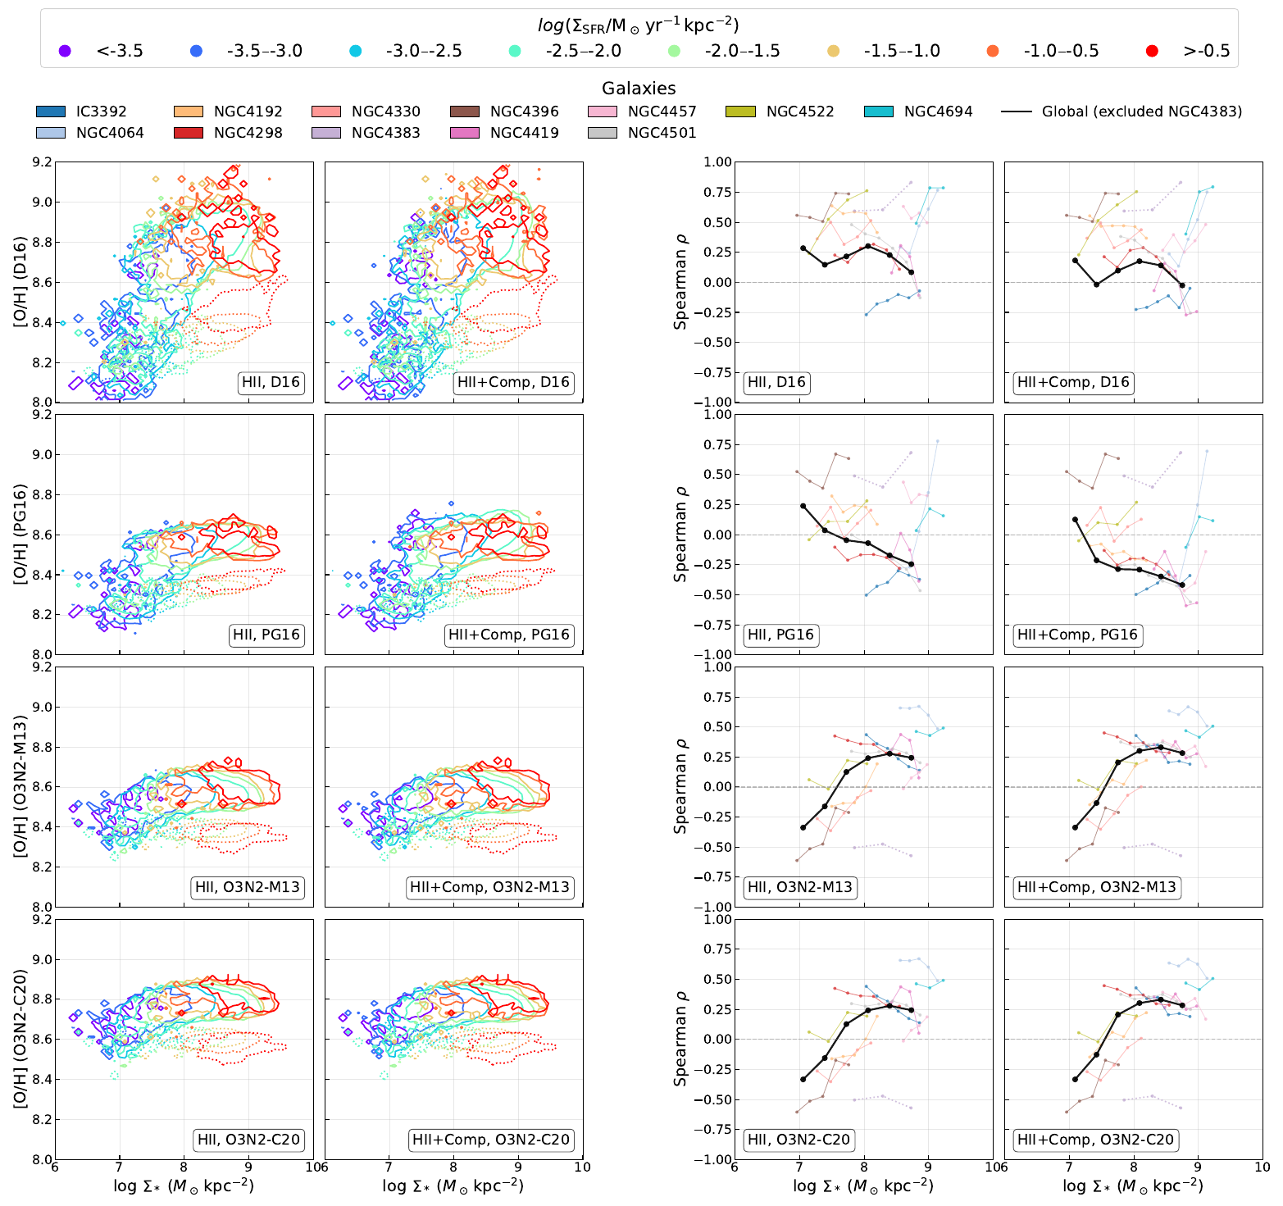
BACKUP B2
Full metallicity-diagnostic comparison
Huang et al. 2026, Figure 6. Full four-diagnostic comparison; source axis labels and colours retained.
Rongjun Huang | MAUVE-MUSE | Yonsei 2026
B2
Notes:
Backup; outside the 45-minute talk.
SPEAKING CUES
Full Figure 6 from the paper version. Walk through the primary and secondary relations for each calibration. Do not describe the O3N2 result as calibration-independent. D16 and PG16 provide distinct index dependencies and possible systematic effects.
OUTLINE DETAIL
Full metallicity-diagnostic comparison
SOURCES
Huang et al. 2026, MNRAS 549, 1019. https://arxiv.org/abs/2605.31412 | /Users/Igniz/Desktop/ICRAR/EAS2026/pdfs/Huang2026.pdf and /Users/Igniz/Desktop/ICRAR/MAUVE/MAUVE Rongjun Zgas-Sigma_SFR paper/main.tex. Figures are direct crops of the paper PDF, not older standalone versions.

Slide 40
BACKUP B3
Metal continuity and the removal term
d(Σ
Z)/dt = Z
Σ
+ y(1 − R)Σ
g
Φ
Φ
SFR
− Z(1 − R)Σ
− ZΣ
SFR
out
Σ
dZ/dt = d(Σ
Z)/dt − Z dΣ
/dt
g
g
g
Explicit cancellation requires the removed gas to have abundance Z.
Metal-enhanced removal would add a term.
Rongjun Huang | MAUVE-MUSE | Yonsei 2026
B3
Notes:
Backup; outside the 45-minute talk.
SPEAKING CUES
Begin with metal mass surface density Sigma g times Z. Supplied metals add Z Phi times supply, newly produced metals add y one minus R times SFR, and gas locked or removed carries the current reservoir abundance under well-mixed assumptions. Apply the product rule and subtract Z times gas continuity. Stellar locking and same-abundance removal cancel explicitly. Metal-enhanced winds would change this equation.
OUTLINE DETAIL
Metal continuity and the removal term
SOURCES
Huang et al. 2026, MNRAS 549, 1019. https://arxiv.org/abs/2605.31412 | /Users/Igniz/Desktop/ICRAR/EAS2026/pdfs/Huang2026.pdf and /Users/Igniz/Desktop/ICRAR/MAUVE/MAUVE Rongjun Zgas-Sigma_SFR paper/main.tex. Figures are direct crops of the paper PDF, not older standalone versions.

Slide 41
BACKUP B4
Selection and uncertainty in occupancy
S/N ≥ 25 footprint | Mean SF fraction | 95% bootstrap interval
pre-peak | 0.494 | 0.396–0.596
close-to-peak | 0.332 | 0.107–0.556
post-peak | 0.101 | 0.054–0.152
Equal-galaxy weighting; resample whole galaxies.
The S/N cut is a change of denominator, not a neutral quality filter.
Rongjun Huang | MAUVE-MUSE | Yonsei 2026
B4
Notes:
Backup; outside the 45-minute talk.
SPEAKING CUES
These are the existing whole-galaxy bootstrap intervals for SF occupancy on the SNR-at-least-25 denominator. Equal galaxy weighting gives each system the same total contribution; resample whole galaxies, not pixels. The close-to-peak interval is broad with five systems. Binned profiles require at least fifty valid pixels for an individual galaxy/bin and stage support of at least three galaxies and one thousand pixels. The bootstrap is conditional on the observed selected sample.
OUTLINE DETAIL
Selection and uncertainty in occupancy
SOURCES
Existing analysis snapshot: /Users/Igniz/Desktop/ICRAR/further/20260905_stage_SF_fraction_analysis.md; assets: /Users/Igniz/Desktop/ICRAR/further/20260905_stage_SF_fraction_analysis_assets. No science pipeline recomputed for this presentation.
/Users/Igniz/Desktop/ICRAR/further/20260905_stage_SF_fraction_analysis_assets/whole_galaxy_bootstrap.csv

Slide 42
BACKUP B5
What CO can and cannot measure
From CO + matched SFR | Still requires additional constraints
ΣH₂ after a conversion model | Replenishment rate into the local reservoir
τdep and molecular SFE | HI → H₂ conversion rate
Molecular spatial structure | Transport across a chosen boundary
Define the reservoir, boundary and gas phase before naming a supply rate.
Rongjun Huang | MAUVE-MUSE | Yonsei 2026
B5
Notes:
Backup; outside the 45-minute talk.
SPEAKING CUES
Molecular gas mass and depletion time are measurable after CO conversion and matched-aperture choices. Supply can mean replenishment into a molecular reservoir, conversion from atomic gas, or transport across a boundary; these are different rates. A gas map alone does not determine them. Spatial dynamics, multiple tracers and simulations can constrain interpretations, subject to their assumptions.
OUTLINE DETAIL
What CO can and cannot measure
SOURCES
Reservoir definitions: /Users/Igniz/Desktop/ICRAR/MAUVE/20260831_Molecular_Gas_Supply_Definitions_and_Observational_Inference.md
Catinella et al. 2025, The Messenger 195, 15. https://doi.org/10.18727/0722-6691/5393 | /Users/Igniz/Desktop/ICRAR/EAS2026/pdfs/Catinella2025.pdf

Slide 43
BACKUP B6
References and related MAUVE results
Study | Topic | Link / reference
Catinella et al. 2025 | MAUVE survey | doi.org/10.18727/0722-6691/5393
Watts et al. 2024 | NGC4383 ionized outflow | MNRAS 530, 1968
Cortese et al. 2026 | NGC4383 cold gas / fountain | arxiv.org/abs/2602.01612
Attwater et al. 2026 | NGC4064 outflow | arxiv.org/abs/2512.10574
Brown et al. 2026 | Ionization and kinematics | arxiv.org/abs/2604.20056
Forbes et al. 2014 | Stochastic regulator / FMR | doi.org/10.1093/mnras/stu1142
Wang & Lilly 2021 | Inflow versus SFE variability | doi.org/10.3847/1538-4357/abe413
Huang et al. 2026 | Metallicity–SFR inversion | arxiv.org/abs/2605.31412
MAUVE publications: mauve.icrar.org/publications.html
September occupancy snapshot and local source paths are documented in the notes and accompanying outline.
Rongjun Huang | MAUVE-MUSE | Yonsei 2026
B6
Notes:
Backup; outside the 45-minute talk.
SPEAKING CUES
Full source paths and links are in the notes and outline. The early-science sequence was revised after comparing Luca Cortese's Ascona talk and Toby Brown's MAUVE colloquium, then checking quantitative claims against the papers. Main paper versions, the September occupancy snapshot and the user-provided preliminary NGC4254 figure are explicitly distinguished. The main deck includes thirty-six slides timed to forty-five minutes; the six backups are for discussion.
OUTLINE DETAIL
References and related MAUVE results
SOURCES
Talk brief: https://chatgpt.com/c/6a9d3c52-9460-83ec-be1d-7023ec6a0ae4
Catinella et al. 2025, The Messenger 195, 15. https://doi.org/10.18727/0722-6691/5393 | /Users/Igniz/Desktop/ICRAR/EAS2026/pdfs/Catinella2025.pdf
Watts et al. 2024, MNRAS 530, 1968. https://academic.oup.com/mnras/article/530/2/1968/7642869 | /Users/Igniz/Desktop/ICRAR/EAS2026/pdfs/Watts2024.pdf
Cortese et al. 2026. https://arxiv.org/abs/2602.01612 | /Users/Igniz/Desktop/ICRAR/EAS2026/pdfs/Cortese2026.pdf; EAS2026 original image34.png is Figure 5 top row.
Attwater et al. 2026. https://arxiv.org/abs/2512.10574 | /Users/Igniz/Desktop/ICRAR/EAS2026/pdfs/Attwater2026.pdf; image35.png reused from EAS2026.
Brown et al. 2026, ApJ 1004, 73. https://arxiv.org/abs/2604.20056 | /Users/Igniz/Desktop/ICRAR/EAS2026/pdfs/Brown2026.pdf; Figure 9 cropped from PDF page 13.
Huang et al. 2026, MNRAS 549, 1019. https://arxiv.org/abs/2605.31412 | /Users/Igniz/Desktop/ICRAR/EAS2026/pdfs/Huang2026.pdf and /Users/Igniz/Desktop/ICRAR/MAUVE/MAUVE Rongjun Zgas-Sigma_SFR paper/main.tex. Figures are direct crops of the paper PDF, not older standalone versions.
Existing analysis snapshot: /Users/Igniz/Desktop/ICRAR/further/20260905_stage_SF_fraction_analysis.md; assets: /Users/Igniz/Desktop/ICRAR/further/20260905_stage_SF_fraction_analysis_assets. No science pipeline recomputed for this presentation.
Reservoir definitions: /Users/Igniz/Desktop/ICRAR/MAUVE/20260831_Molecular_Gas_Supply_Definitions_and_Observational_Inference.md
MAUVE science justification: /Users/Igniz/Desktop/ICRAR/MAUVE/MAUVE_sci_just_compressed.pdf, pp. 2 and 5, especially Figure 1.
Forbes et al. 2014, MNRAS 443, 168. https://doi.org/10.1093/mnras/stu1142; Wang & Lilly 2021, ApJ 910, 137. https://doi.org/10.3847/1538-4357/abe413. Forbes et al. primarily model stochastic accretion and note parameter-scatter routes; Wang & Lilly derive small-amplitude approximations and verify them numerically.
User-provided preliminary NGC4254 metallicity-fluctuation figure supplied 10 September 2026. Snapshot copied to /private/tmp/yonsei_build/assets/NGC4254_metallicity_fluctuations_preliminary.jpg. Interpretation and provenance recorded in /Users/Igniz/Desktop/ICRAR/202609Korea/Yonsei_45min_talk_outline.md; no science pipeline recomputed for this presentation.
Luca Cortese, MAUVE: Multiphase views of gas cycling and quenching in the Virgo cluster, Ascona 2026. /Users/Igniz/Desktop/ICRAR/202609Korea/cortese_ascona26.pdf, especially pages 11-20.
Toby Brown, How does environment affect the ISM in Virgo Cluster galaxies?, MAUVE colloquium 2026. /Users/Igniz/Desktop/ICRAR/202609Korea/mauve-muse_colloquium.pdf, especially pages 12-26.

