Slide 1

MAUVE-MUSE: When Metallicity Follows or Fights Star Formation
A mass-dependent inversion in Virgo galaxies
Rongjun Huang
On behalf of Luca Cortese, Barbara Catinella, Luke Davies and the MAUVE Team
MNRAS in press
MAUVE-MUSE
arXiv:2605.31412
Lausanne / EAS2026 SS7 / 30 June 2026

Slide 2
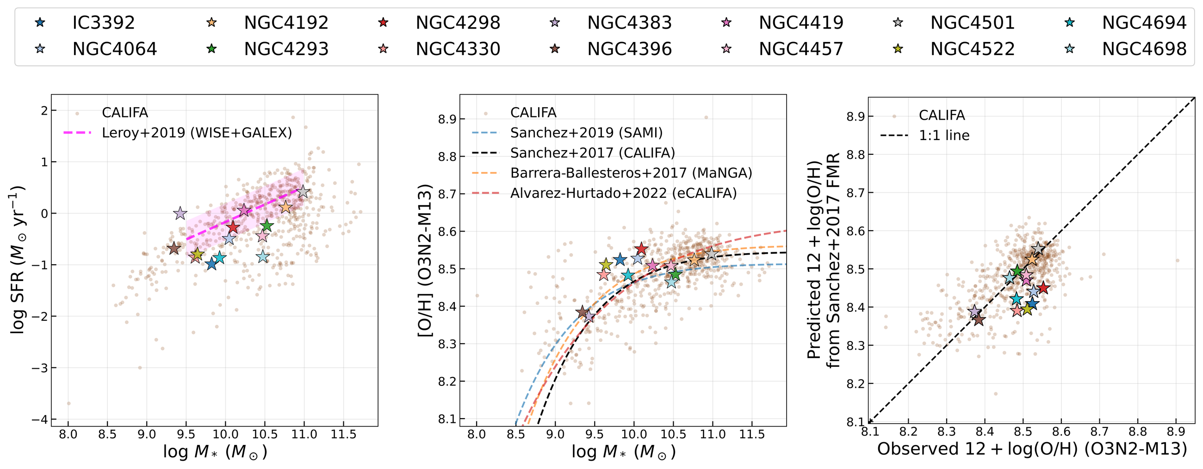
MOTIVATION
Why this matters: integrated scaling relations mix local regimes
Global view
At fixed mass, high-SFR galaxies are often metal-poor: the integrated FMR.
Resolved gap
At kpc scales the local metallicity-SFR coupling is not a simple universal anti-correlation.
SS7 bridge
At ~100 pc HII-region scales, unresolved measurements combine physically different enrichment regimes.
Question for this talk: does gas-phase metallicity locally follow or fight star formation?
Answer: the sign changes with local stellar mass surface density.
EAS2026 SS7 | MAUVE-MUSE
2

Slide 3
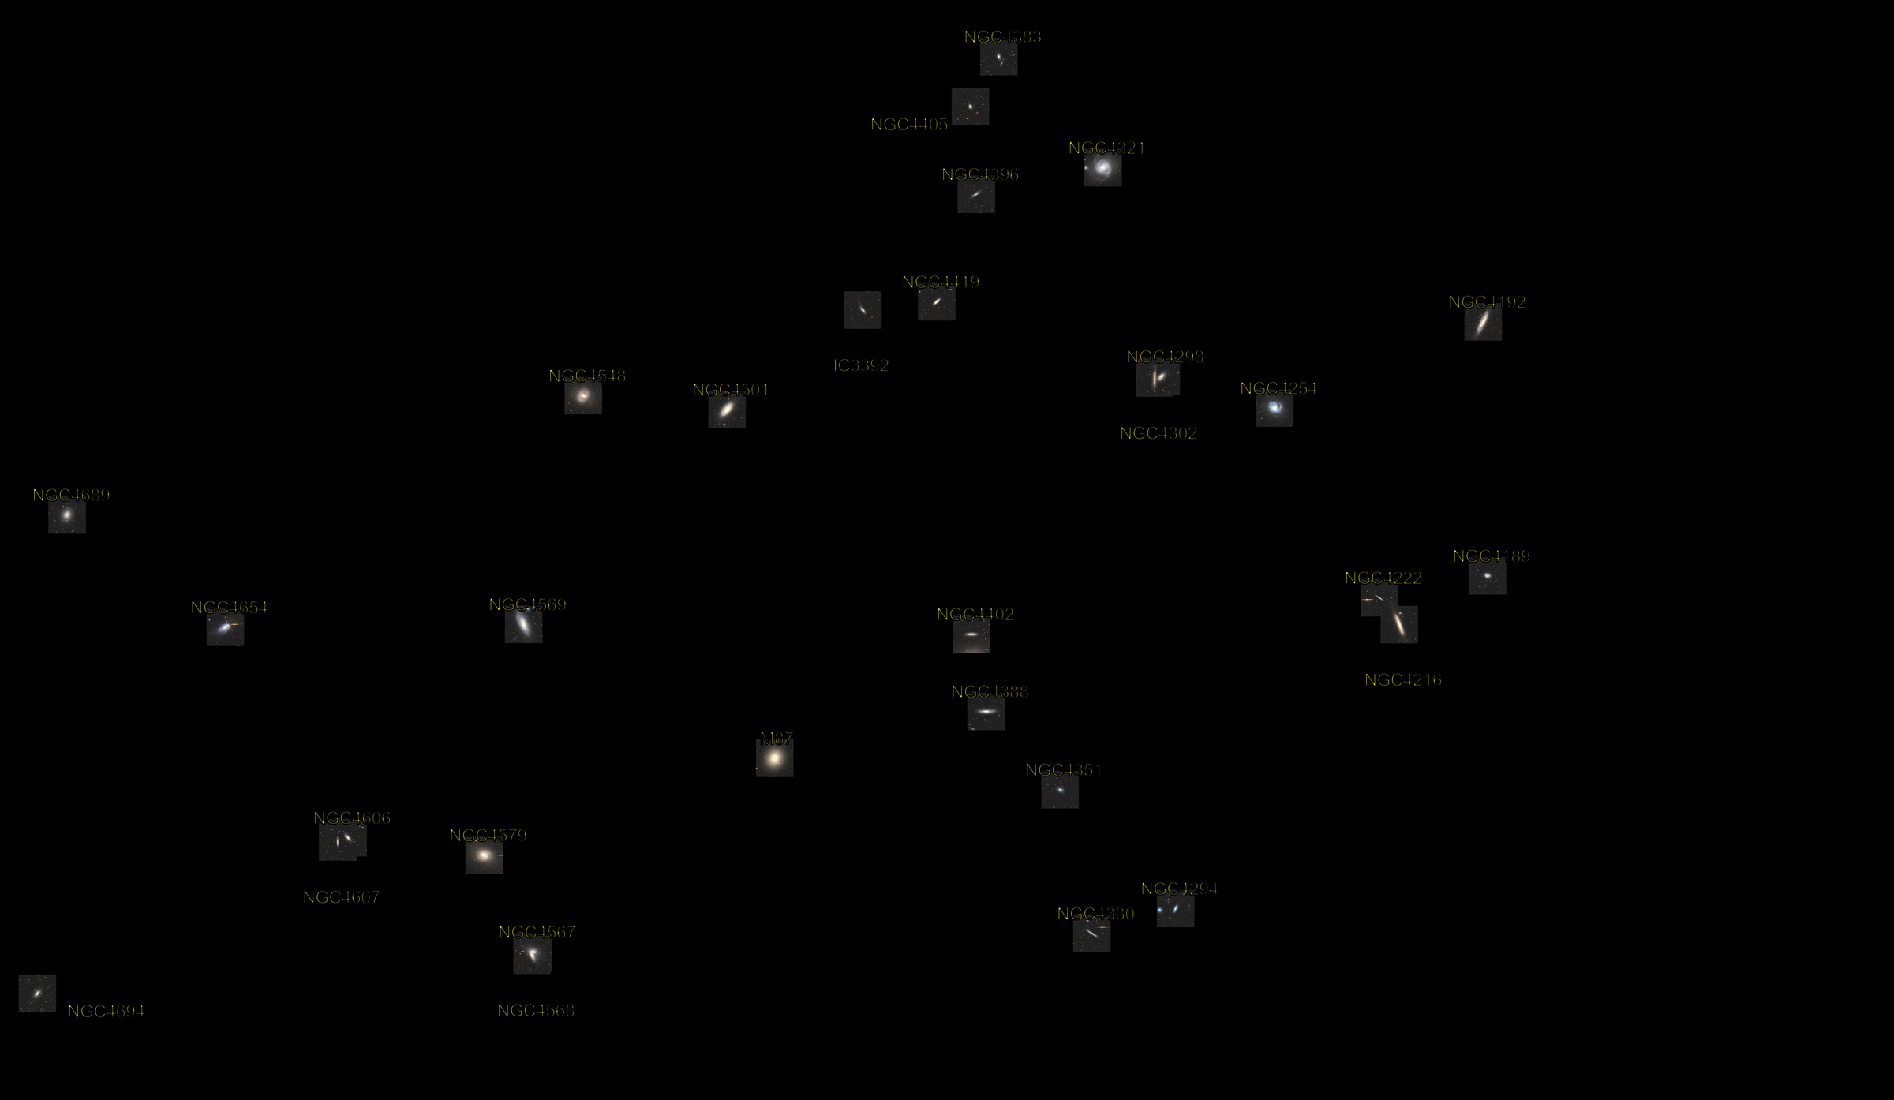
TEAM CONTEXT
MAUVE: resolving the Virgo baryon cycle at ~100 pc
Survey
Outflows
40 Virgo late-type galaxies; MUSE maps the stellar and ionised gas components, with ALMA molecular-gas context.
NGC4383 and NGC4064 show feedback/outflow physics in environmentally affected Virgo galaxies.
Multiphase gas
Population result
Cold neutral and molecular gas trace fountain-flow and gas-supply channels in stripped systems.
Virgo disks show elevated line ratios, DIG/shocks and broadened kinematics.
This talk adds the chemical-enrichment view:
when does O/H follow or fight star formation within HII-region regimes?
Current MAUVE outputs: Watts 2024; Catinella 2025; Attwater 2026; Cortese 2026; Brown 2026; Huang 2026.
MAUVE publications page, checked 2026-06-12
3

Slide 4
SAMPLE
Data: 14 MAUVE-MUSE Virgo spirals at HII-region scales
Sample
Resolution
14 fully reduced MAUVE-MUSE Virgo spirals in the accepted/in-press paper.
VLT/MUSE maps at roughly 100 pc scales over the molecular-gas disks.
Co-spatial maps
HII-region focus
Sigma_*, Sigma_SFR and 12+log(O/H) are measured on the same physical grid.
Fiducial analysis uses BPT-selected HII-region spaxels.
No internal-review status language: this is a completed single-paper result.
EAS2026 SS7 | MAUVE-MUSE
4

Slide 5
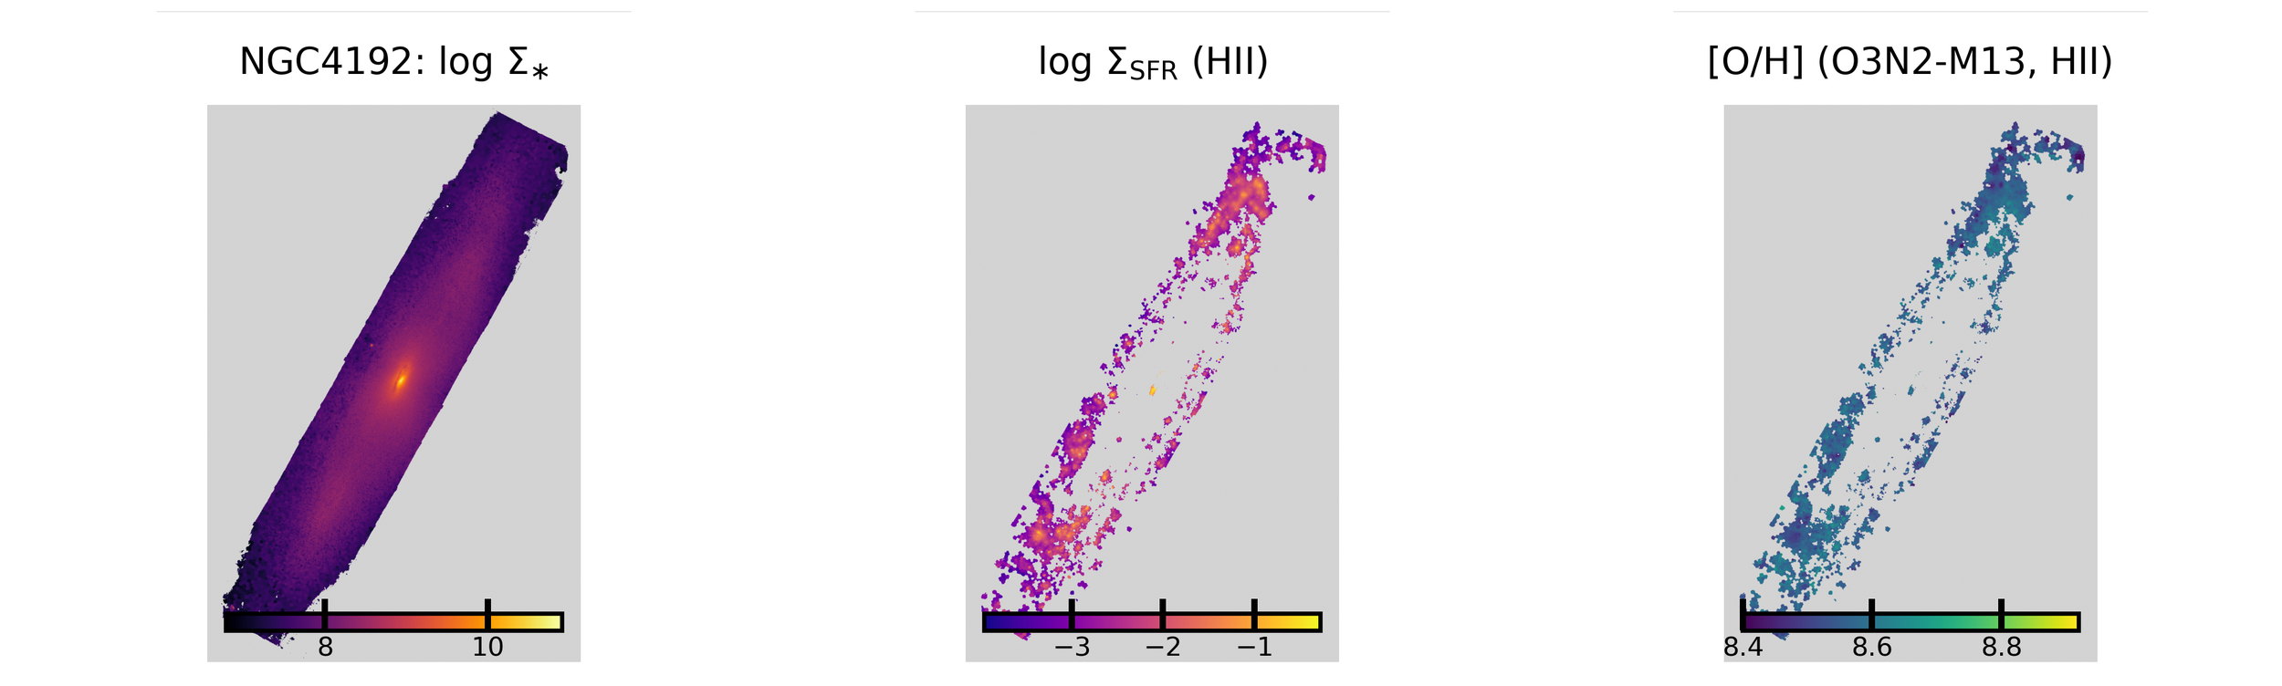
MEASUREMENT
What we measure: co-spatial local maps
Stellar structure
Current activity
Chemical state
Sigma_* defines the local mass regime for each HII-region spaxel.
Sigma_SFR traces where the ISM is actively forming stars.
O3N2-M13 gives the fiducial oxygen abundance map.
EAS2026 SS7 | MAUVE-MUSE
5

Slide 6
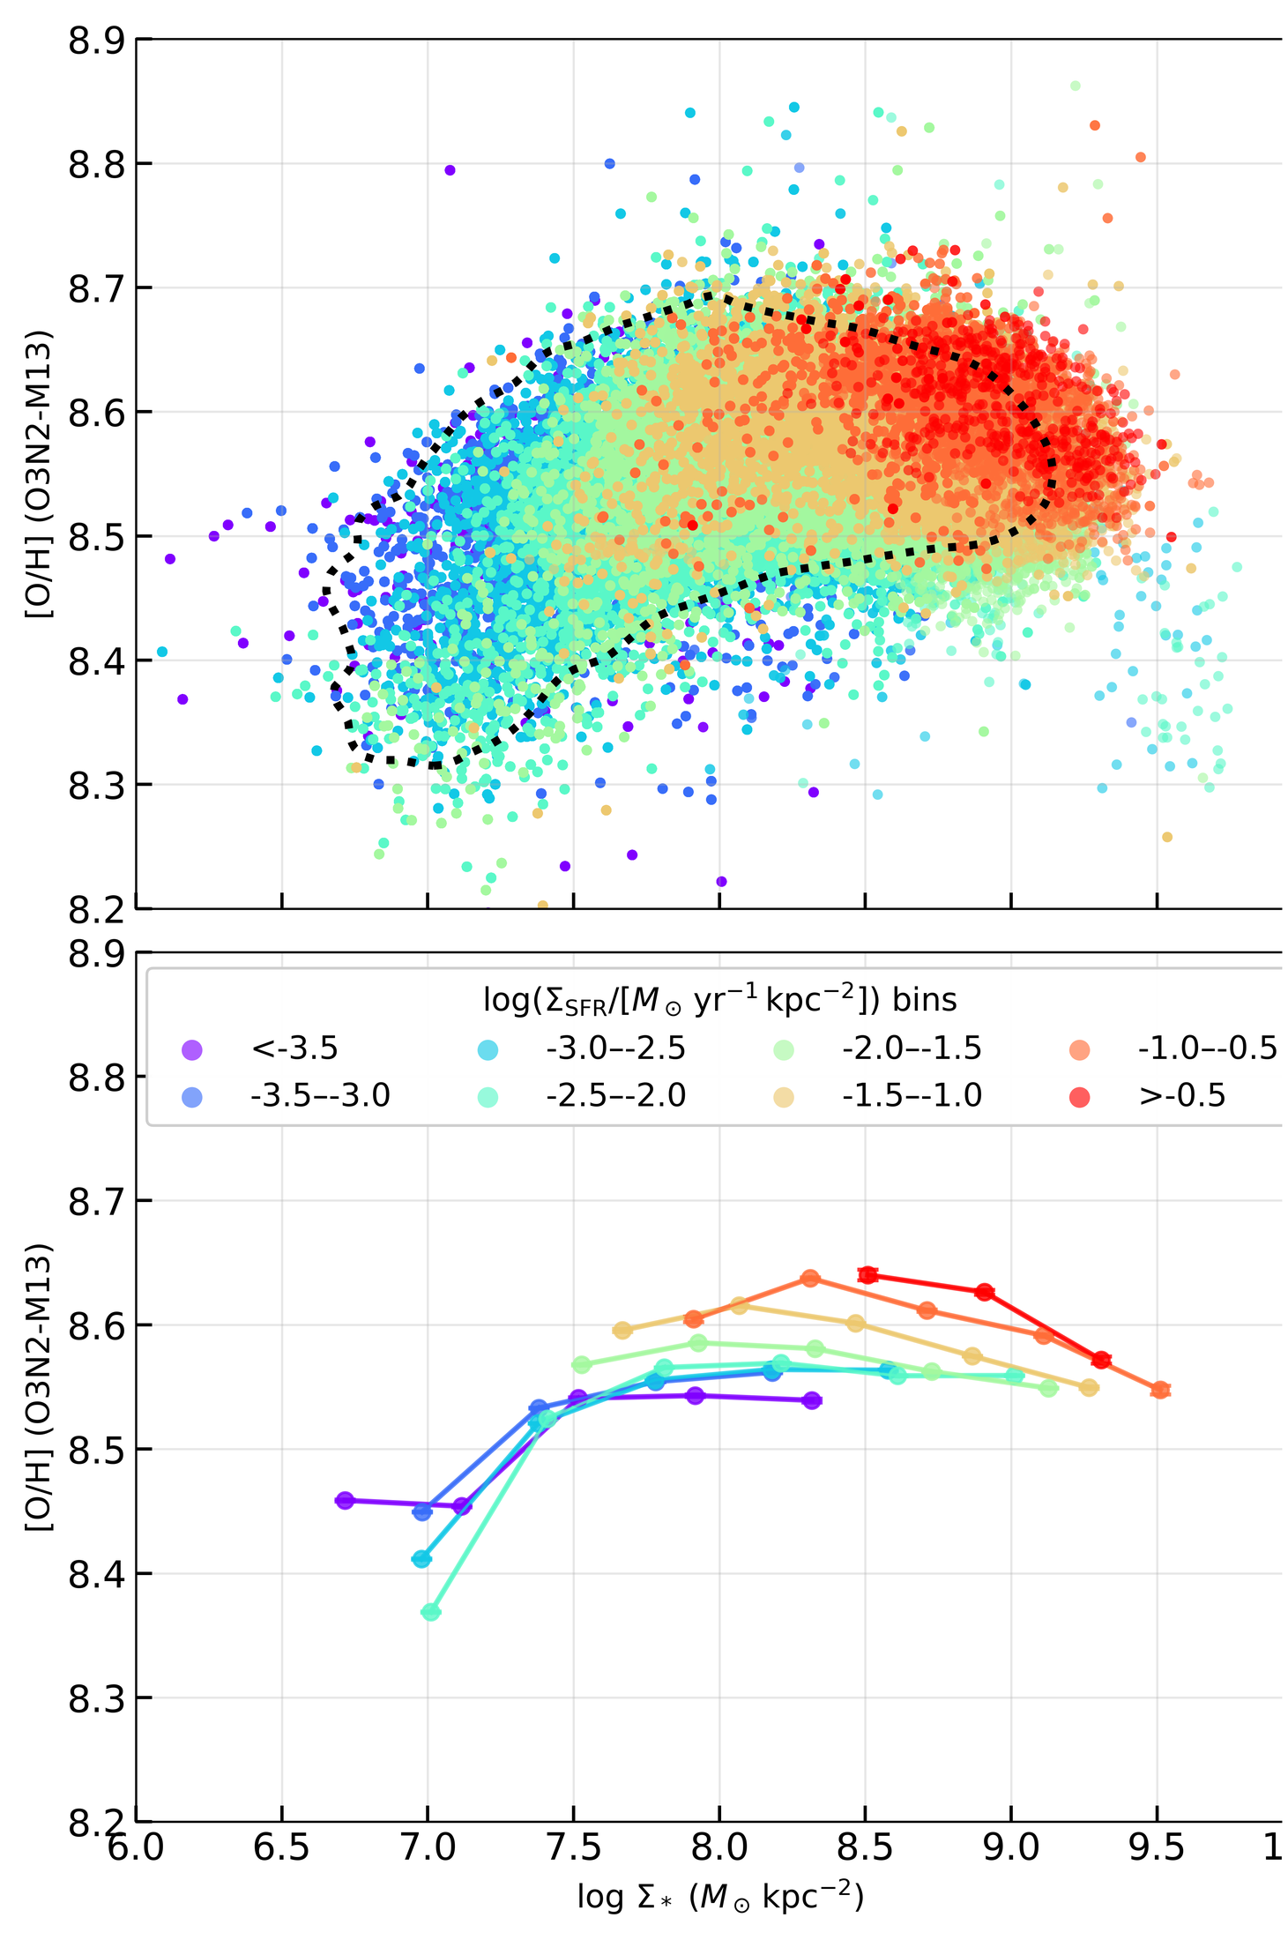
VISUAL HINT
Result 1: the resolved MZR is standard
MAUVE-MUSE follows a normal rMZR at ~100 pc.
O/H rises with local Sigma_*.
The scatter is not random: it carries Sigma_SFR structure.
That structure is the first visual hint of the sign flip.
EAS2026 SS7 | MAUVE-MUSE
6

Slide 7
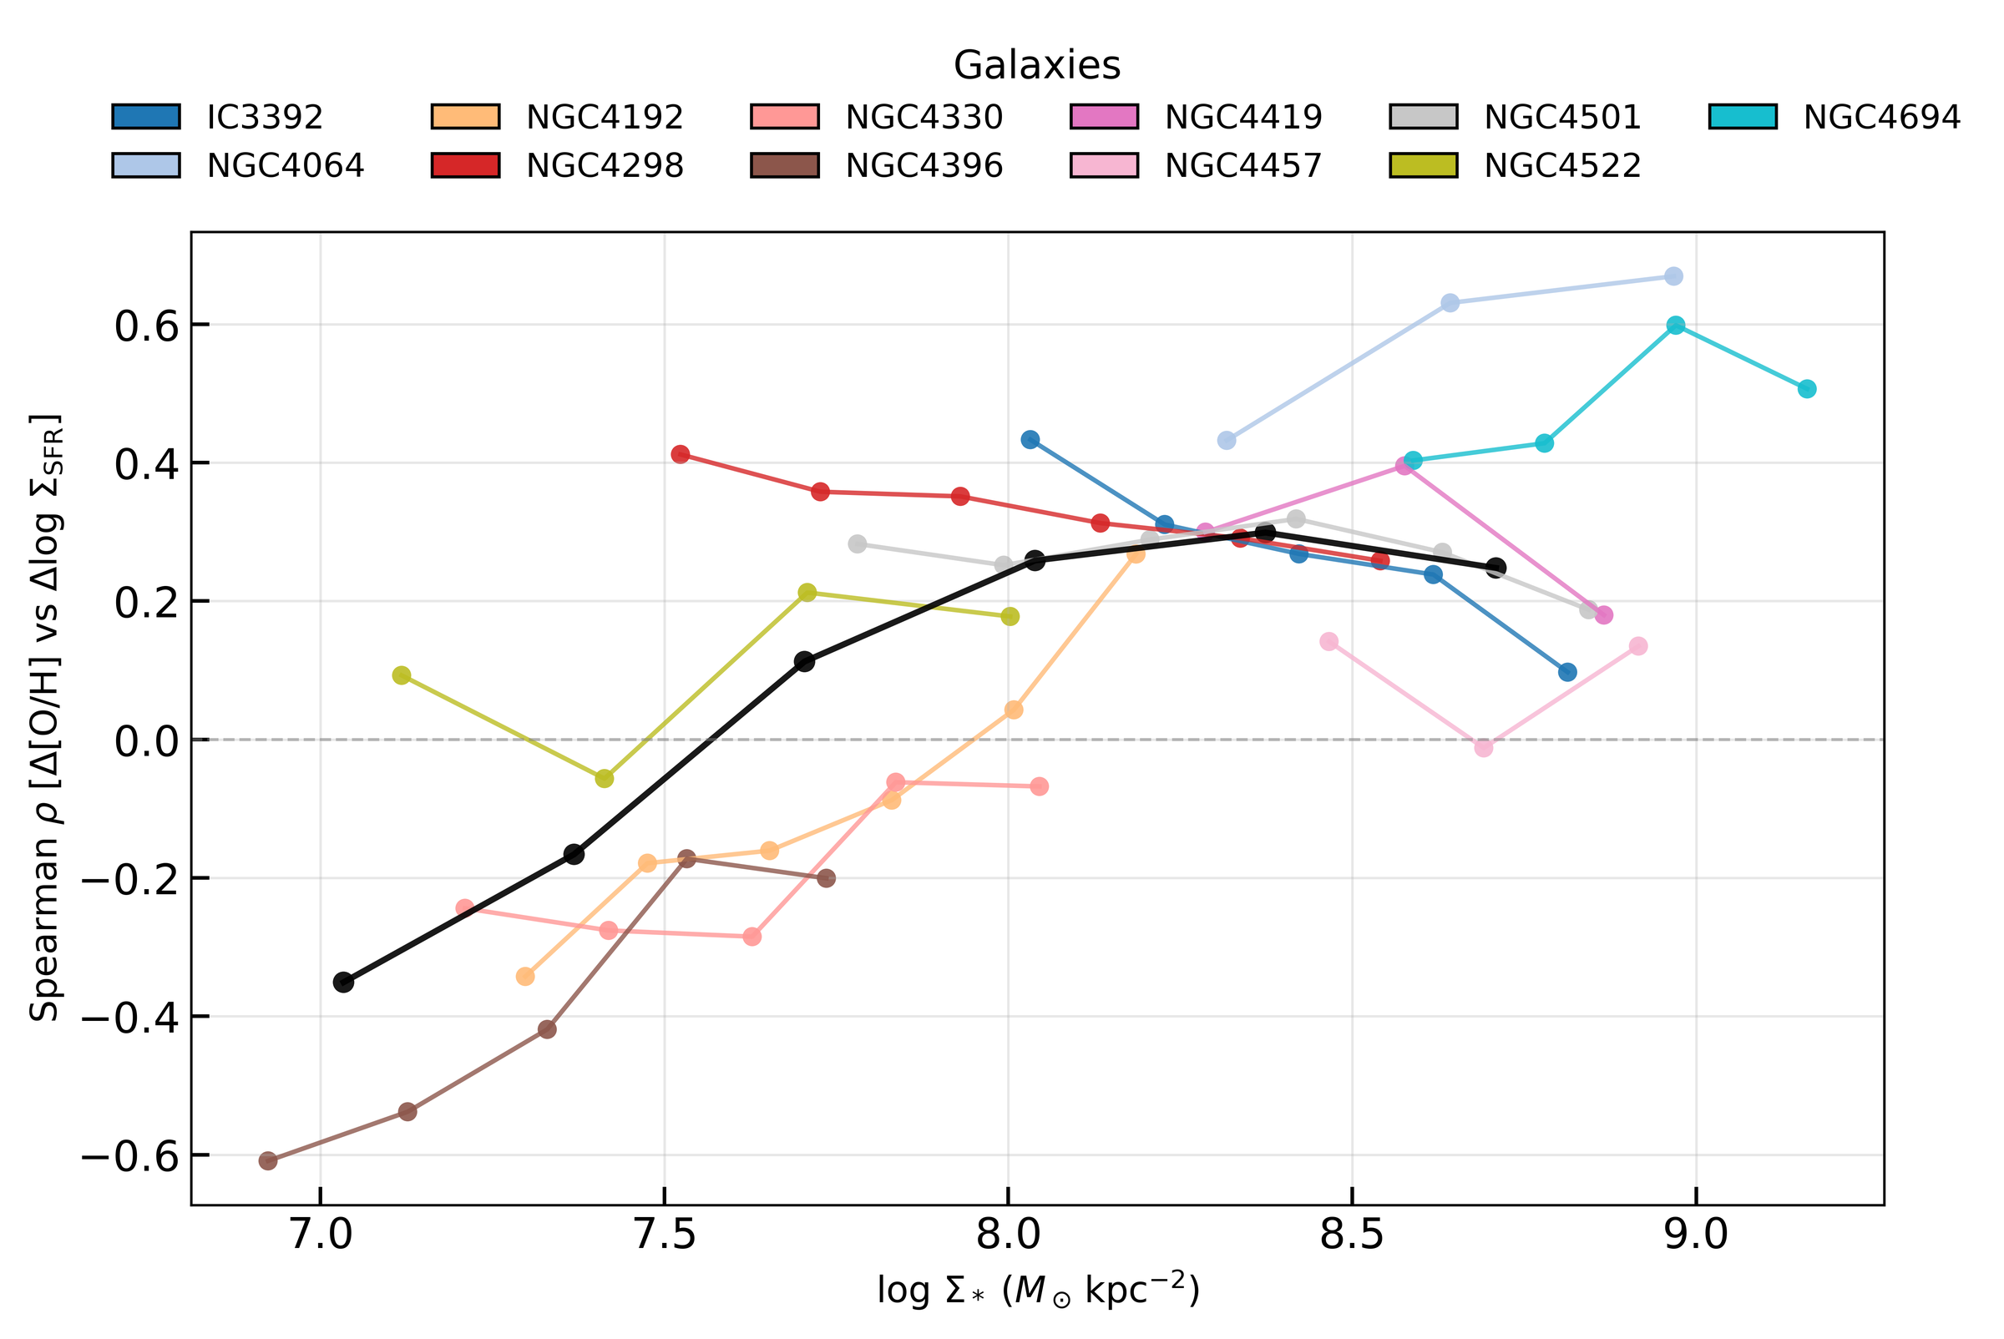
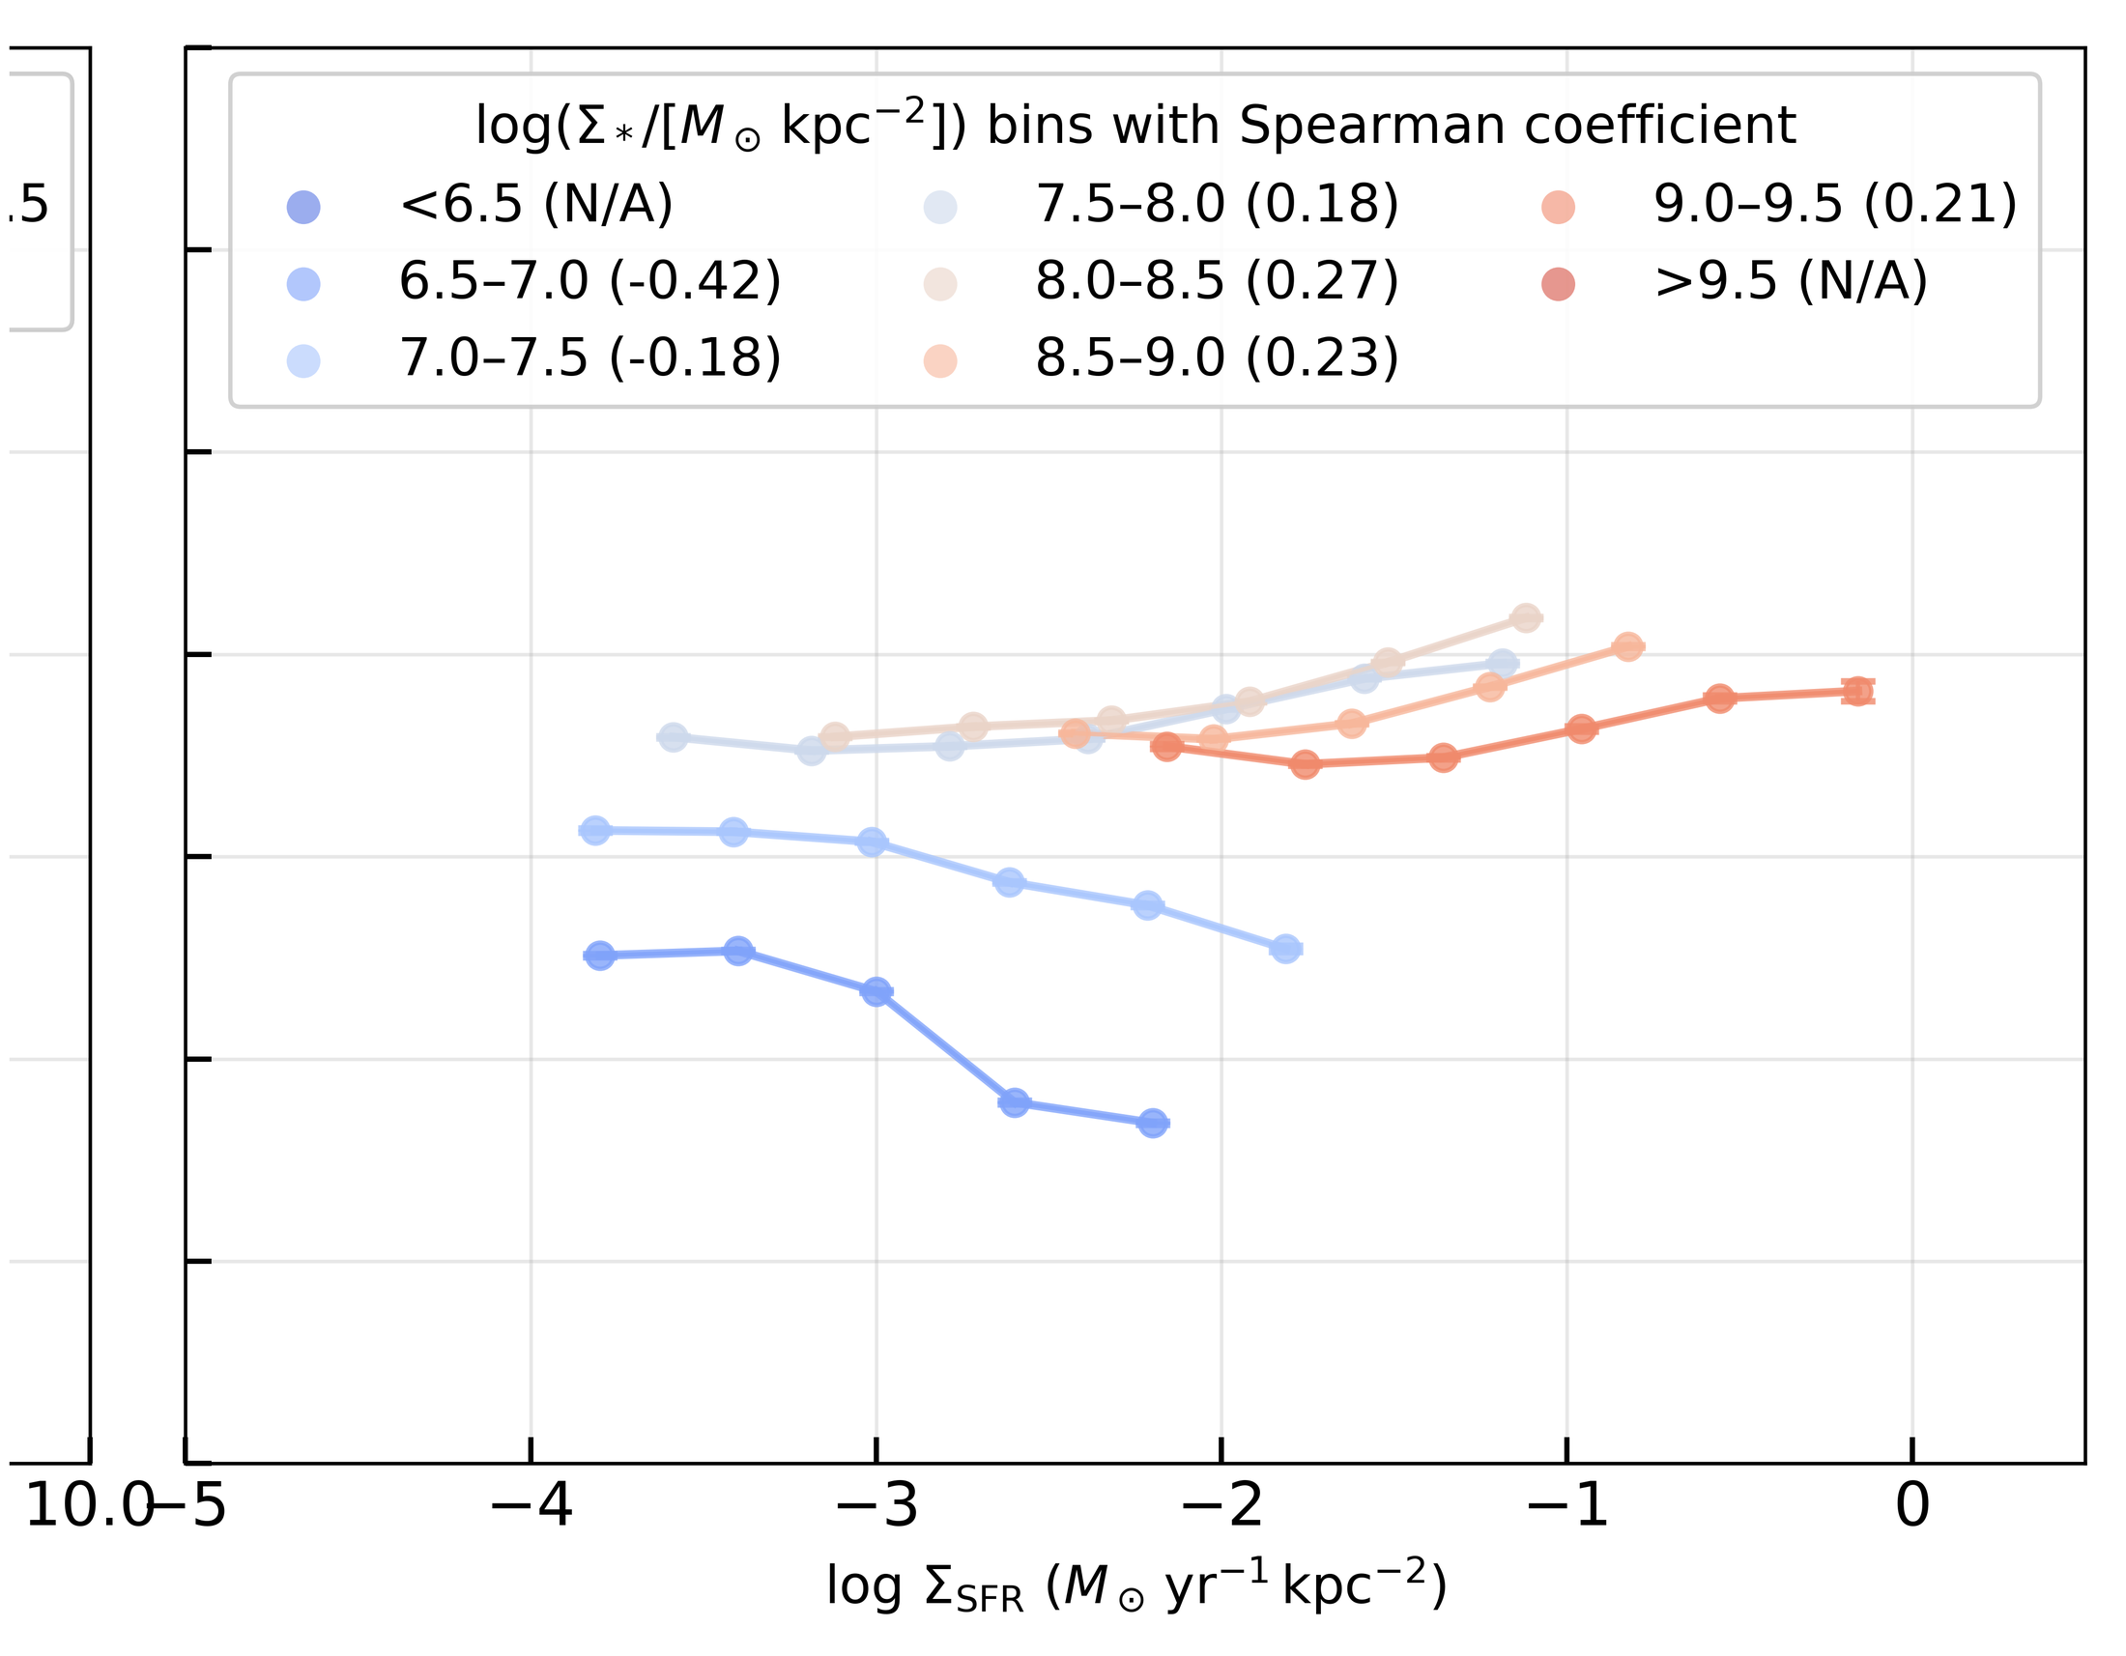
INVERSION
Main result: the metallicity-SFR trend changes sign
rho < 0 at low Sigma_*
rho > 0 at high Sigma_*
Zero-crossing around log Sigma_* ~ 7.5-8.0
EAS2026 SS7 | MAUVE-MUSE
7

Slide 8
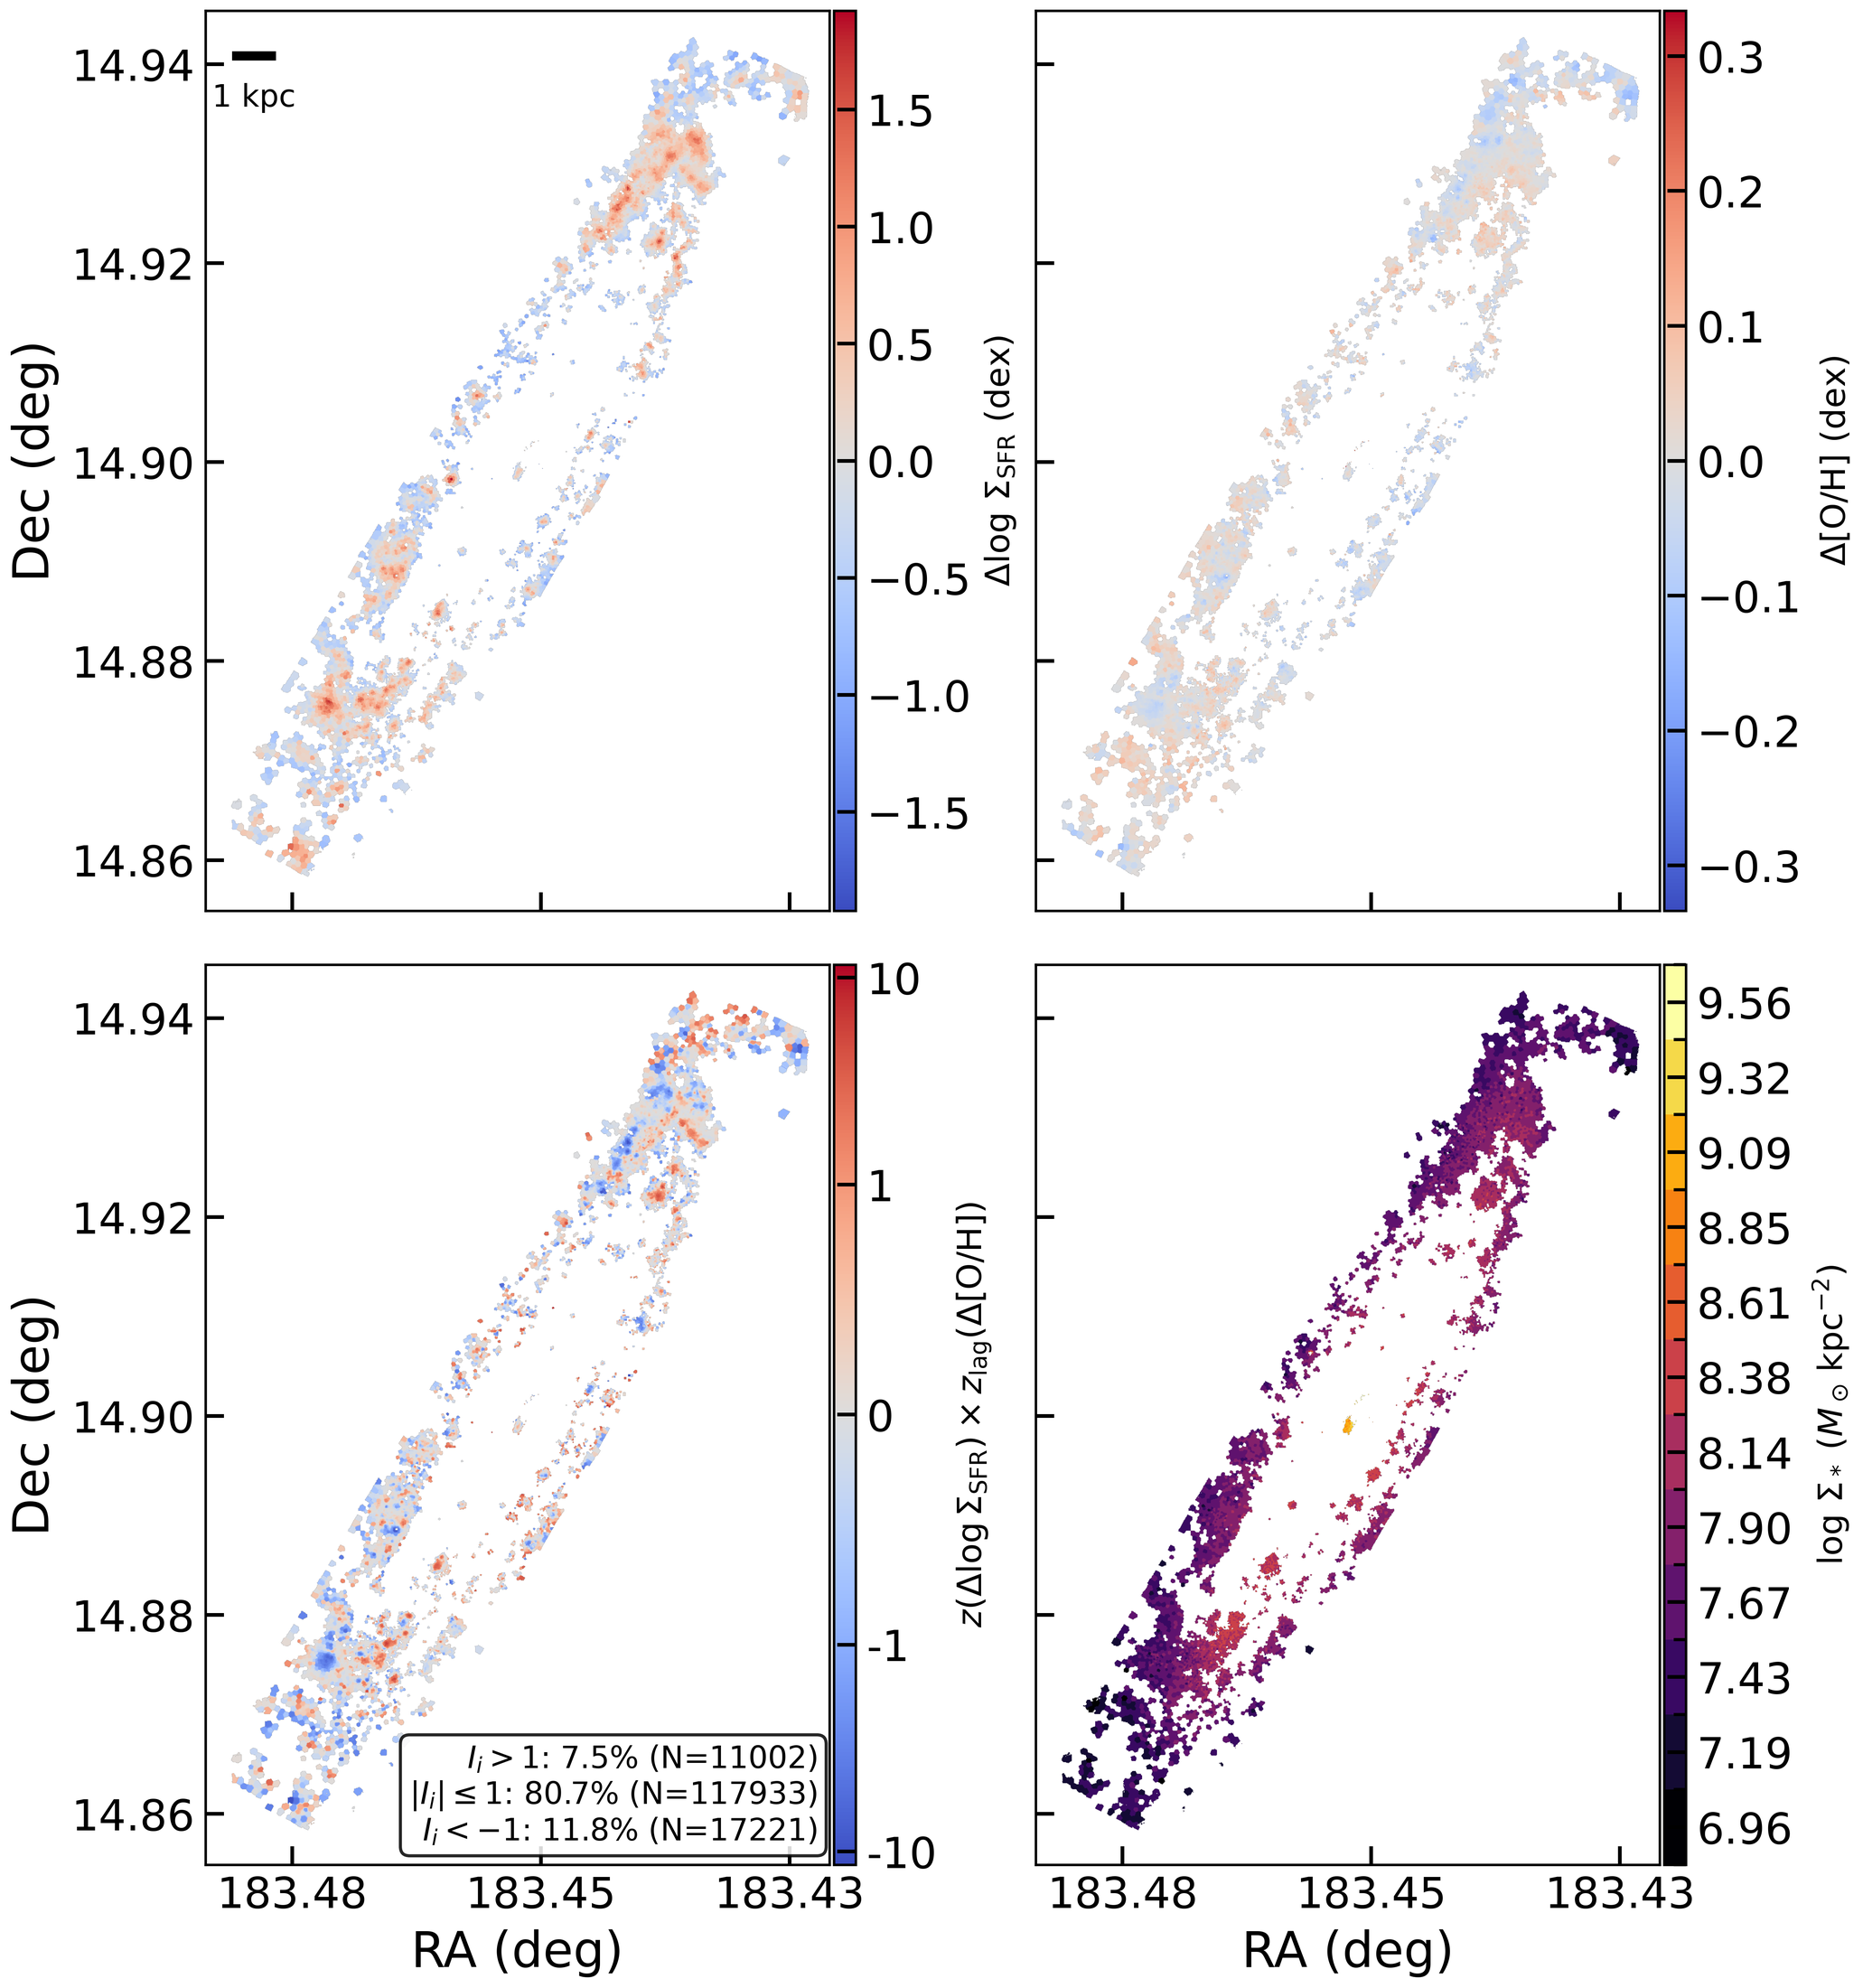
LOCAL STRUCTURE
Spatial coexistence: both signs live inside the same disk
Within one disk
NGC4192 contains both positive and negative local O/H-Sigma_SFR structure.
Why bin by Sigma_*
The mass dependence appears only after grouping HII-region spaxels by local stellar mass surface density.
Bridge to SS7
Integrated spectra average over a spatial mixture of HII-region regimes.
EAS2026 SS7 | MAUVE-MUSE
8

Slide 9
GAS REGULATOR
Interpretation: a competition between enrichment and dilution
Gas supply variation
Local HII-region regime
SFE / enrichment variation
more fresh gas -> higher SFR, lower O/H
set by Sigma_* and gas-cycle variability
more efficient SF -> higher SFR, higher O/H
Low-Sigma_* regions are more dilution sensitive; high-Sigma_* regions are more enrichment/SFE sensitive.
That is why a single global metallicity-SFR anti-correlation is not the right local description.
EAS2026 SS7 | MAUVE-MUSE
9

Slide 10
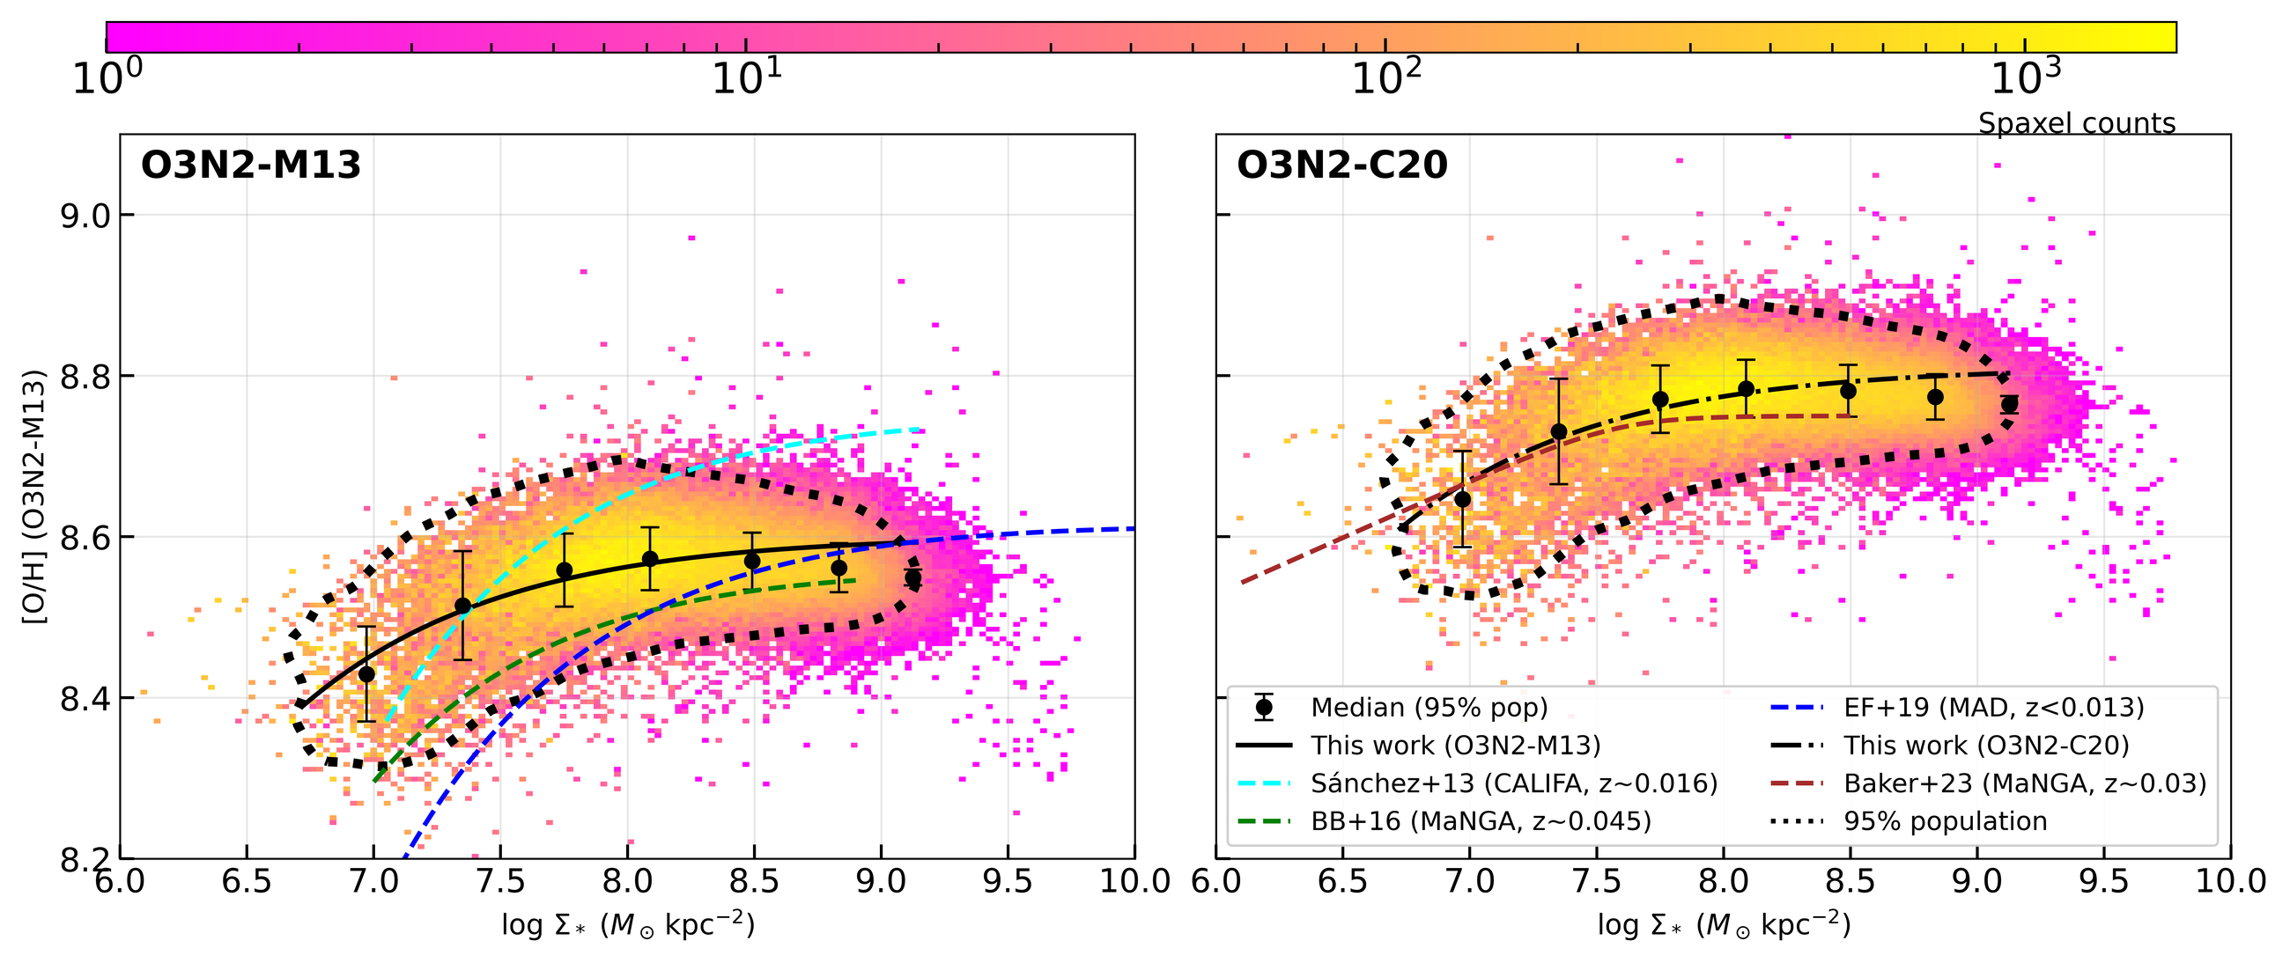
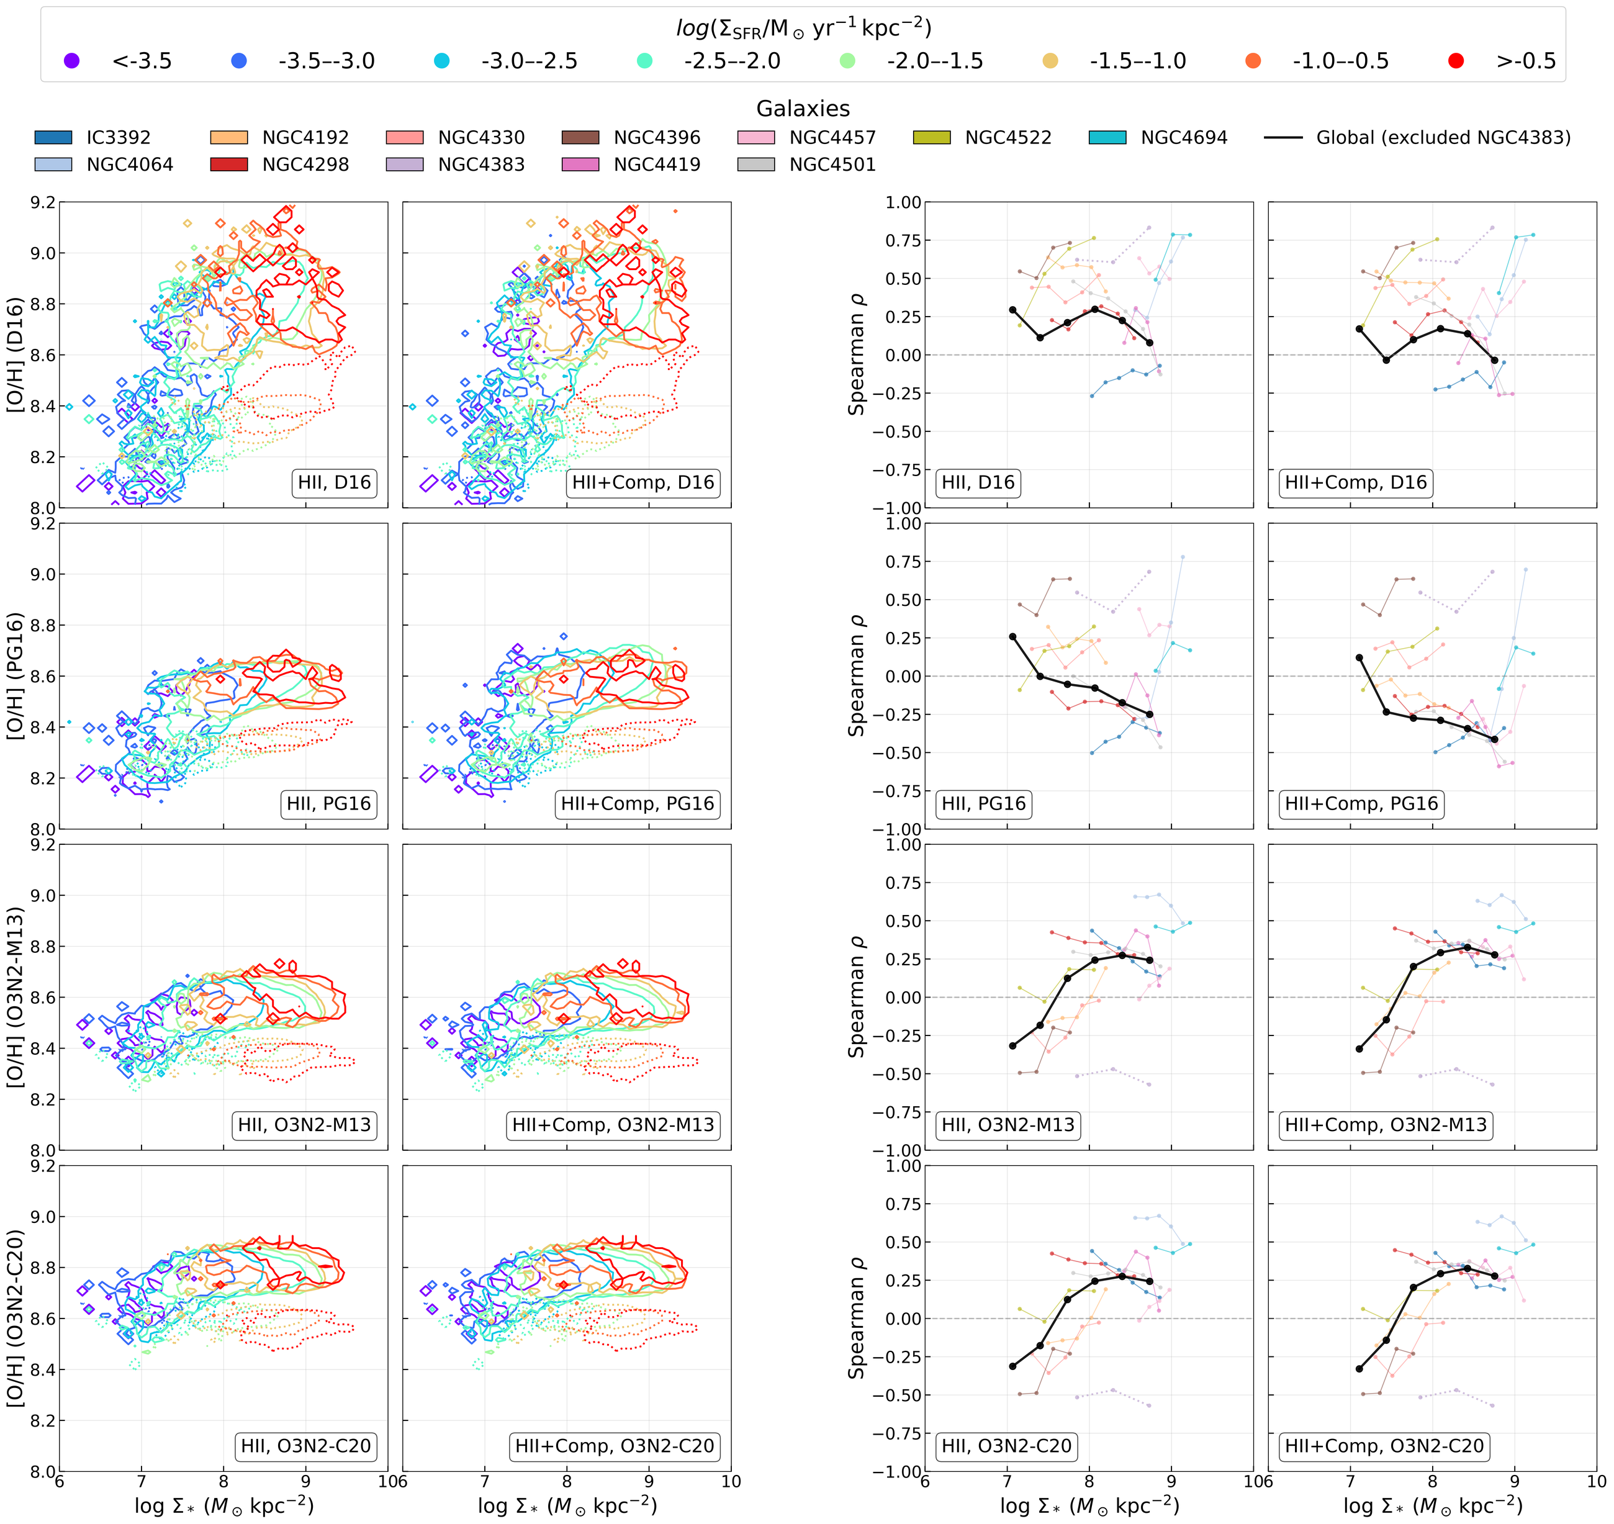
CAVEAT
Robustness: O3N2 is central, but diagnostics matter
What is robust
O3N2 calibrations show the clearest mass-dependent inversion.
What is not universal
The strength and even visibility of the trend depend on metallicity indicator and excitation selection.
Physical caveat
NGC4383 is treated separately because the outflow system is physically distinct.
So the result is a resolved-regime statement, not a claim that every calibration gives the same secondary relation.
EAS2026 SS7 | MAUVE-MUSE
10

Slide 11
Take-home
At ~100 pc, MAUVE-MUSE recovers a standard resolved mass-metallicity relation.
The metallicity-SFR coupling changes sign with local Sigma_*: dilution at low Sigma_*, enrichment/SFE at high Sigma_*.
Unresolved measurements mix these HII-region regimes, so integrated trends hide local physics.
Thank you - questions?
MAUVE Team / MNRAS in press / arXiv:2605.31412

Slide 12
Backup
Full figures and technical details if asked

Slide 13
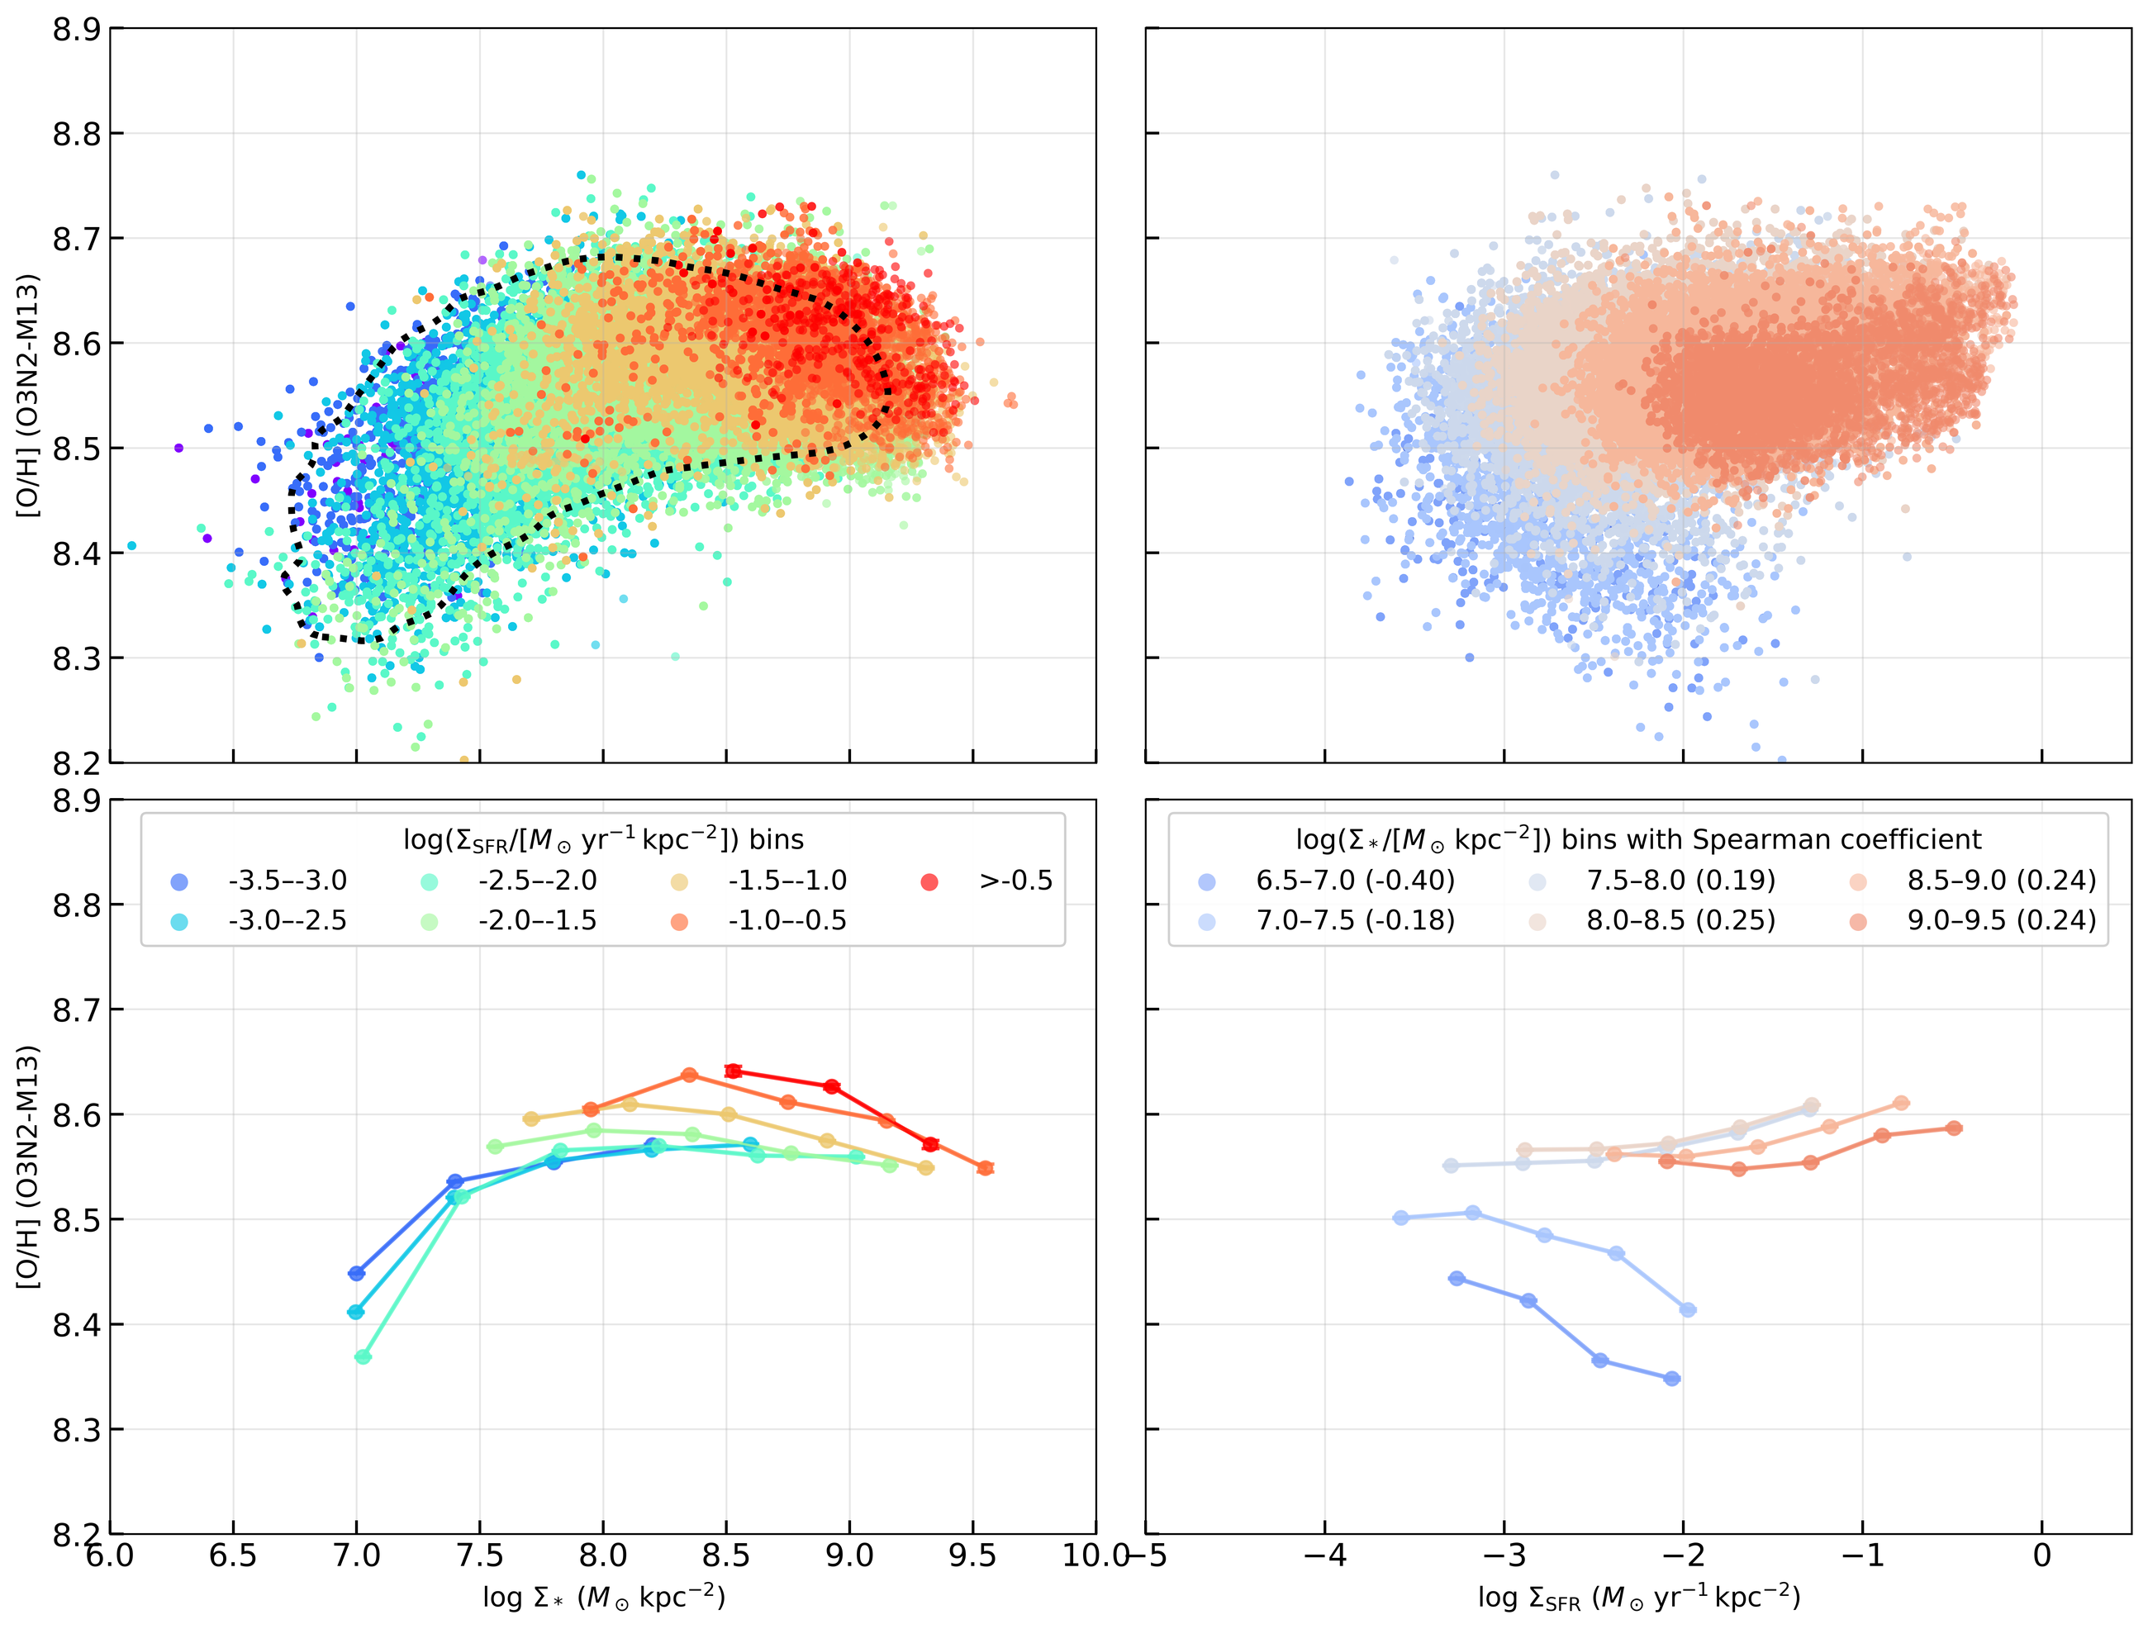
BACKUP
Backup: full rMZR and O/H-Sigma_SFR figure
Backup
B1

Slide 14
BACKUP
Backup: calibration and excitation-selection dependence
Backup
B2

Slide 15
BACKUP
Backup: pipeline details kept out of the main talk
Mass.py
SFR+Z.py
SFR+Z.py
nGIST SFH weights + SSP mass-to-light ratio + photometric flux corrections -> Sigma_* map.
Balmer-corrected H-alpha luminosity + inclination correction -> Sigma_SFR map.
BPT-selected HII-region spaxels + O3N2-M13 fiducial calibration -> 12+log(O/H).
Main-talk wording avoids code names; this slide preserves the technical path for questions.
Backup
B3

