Slide 1
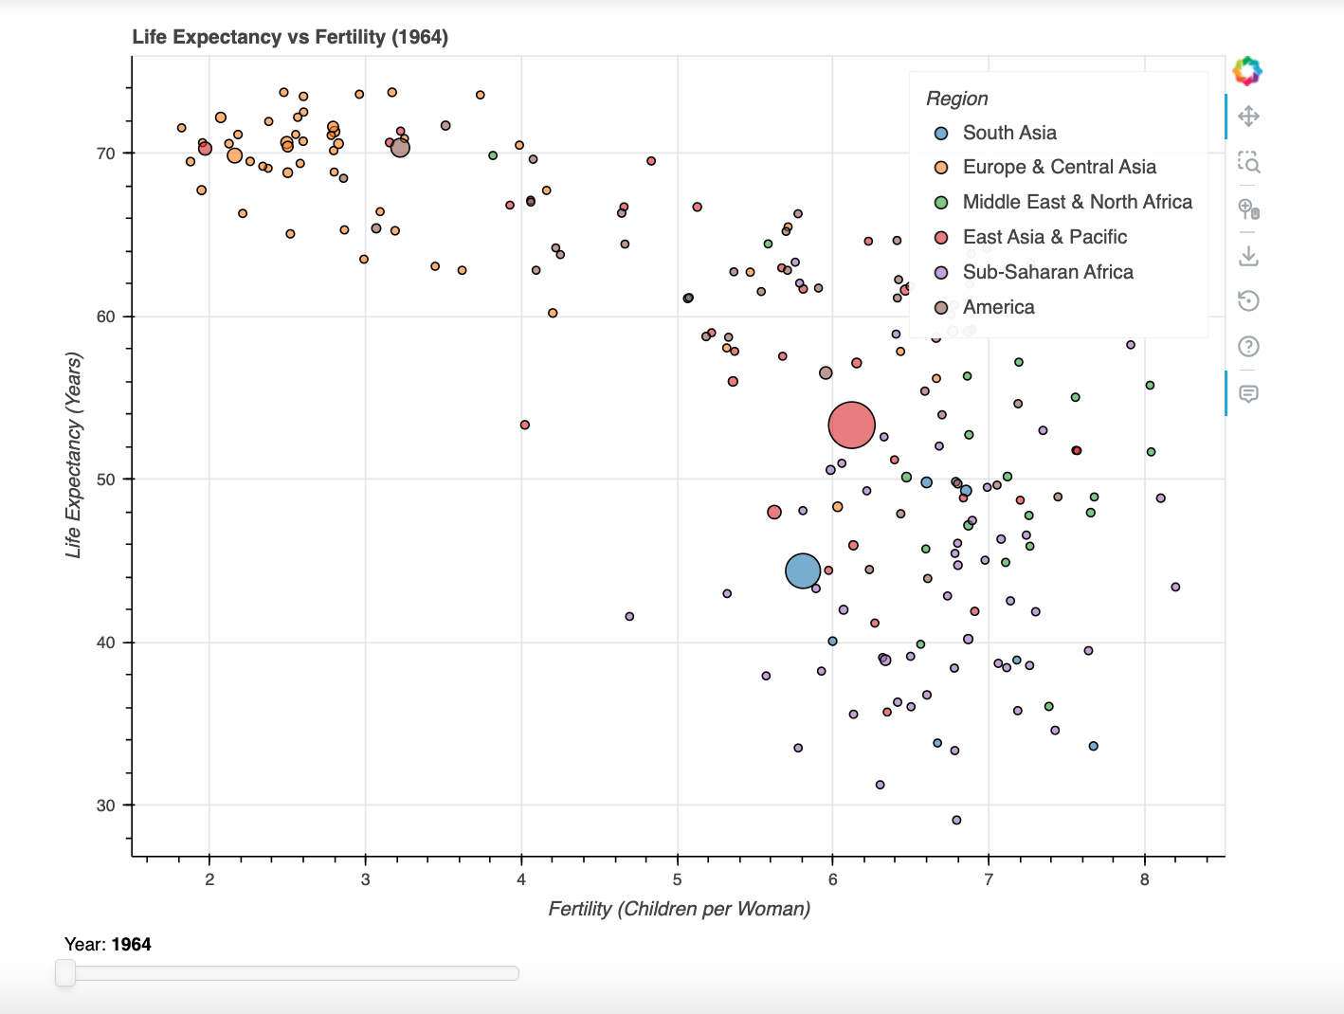
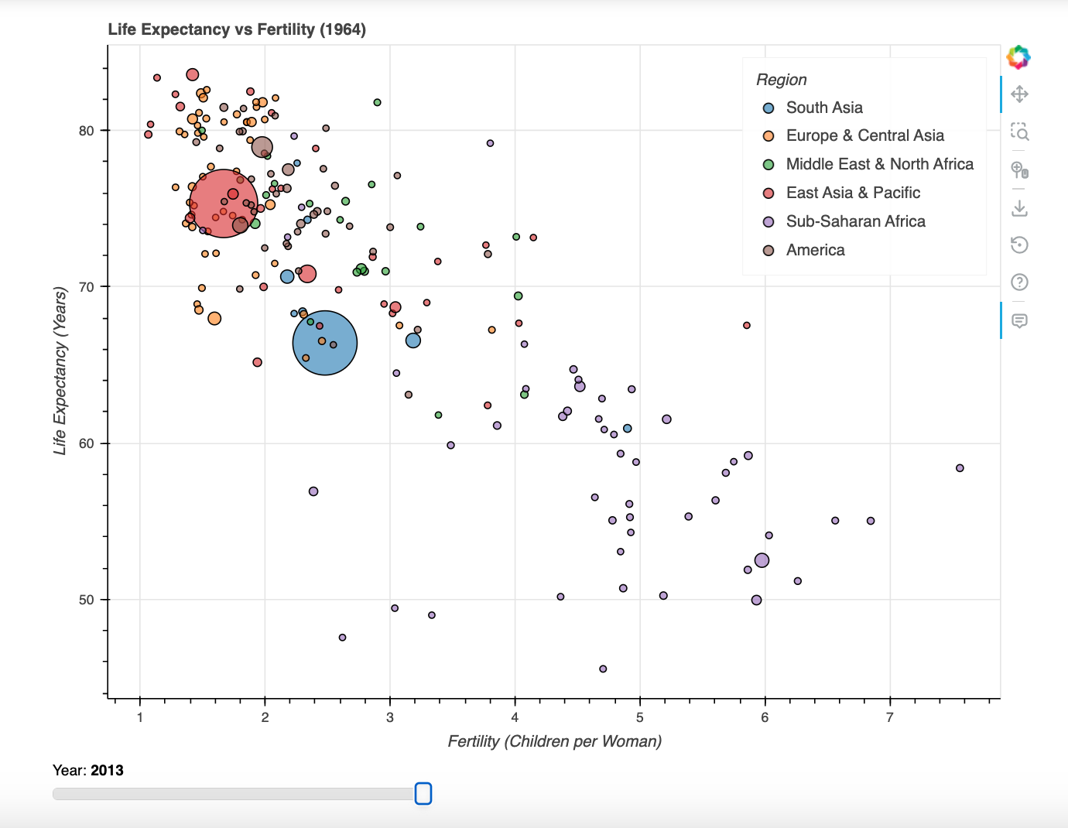
Life Expectancy and Fertility Visualization
Interactive Data Visualization using Python and Bokeh
Rongman Sun

Slide 2
Research Question
Main Question
How did life expectancy and fertility change between 1964 and 2013?
Which regions developed the fastest?
Did differences between countries become smaller?
Goal
interactive visualization:
compare regions
long-term changes
global development trends.

Slide 3
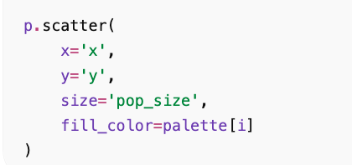
Dataset & Design Choice
Dataset
Gapminder.org
244 countries
1964–2013
CSV format
Variables
Country
Year
Region
Population
Life expectancy
Fertility
Scatter Plot Design
X-axis → Fertility
Y-axis → Life expectancy
Bubble size → Population
Color → Region
Purpose
compare multiple variables
regional differences
time changes

Slide 4
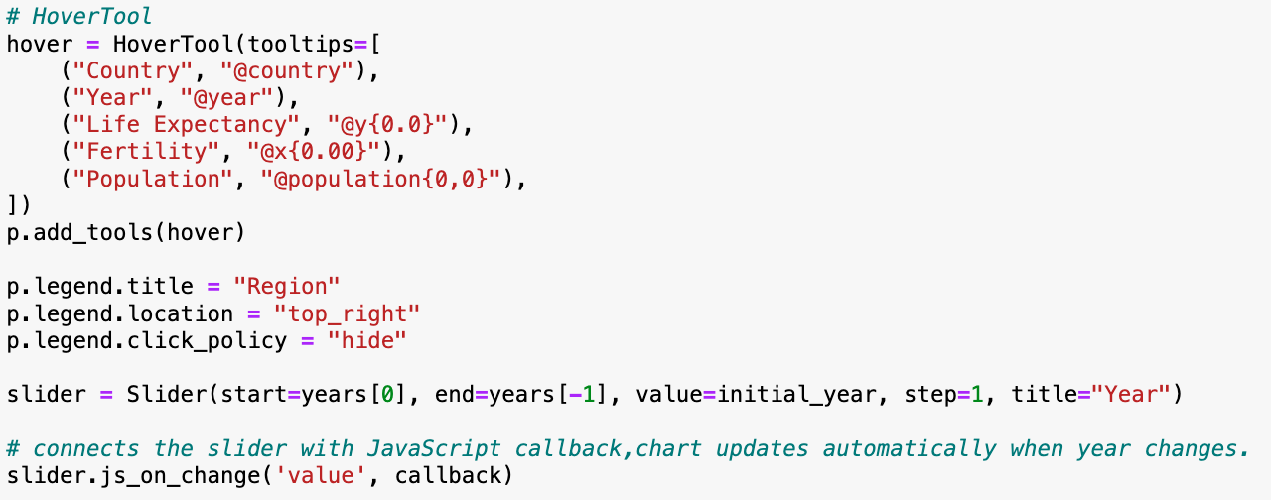
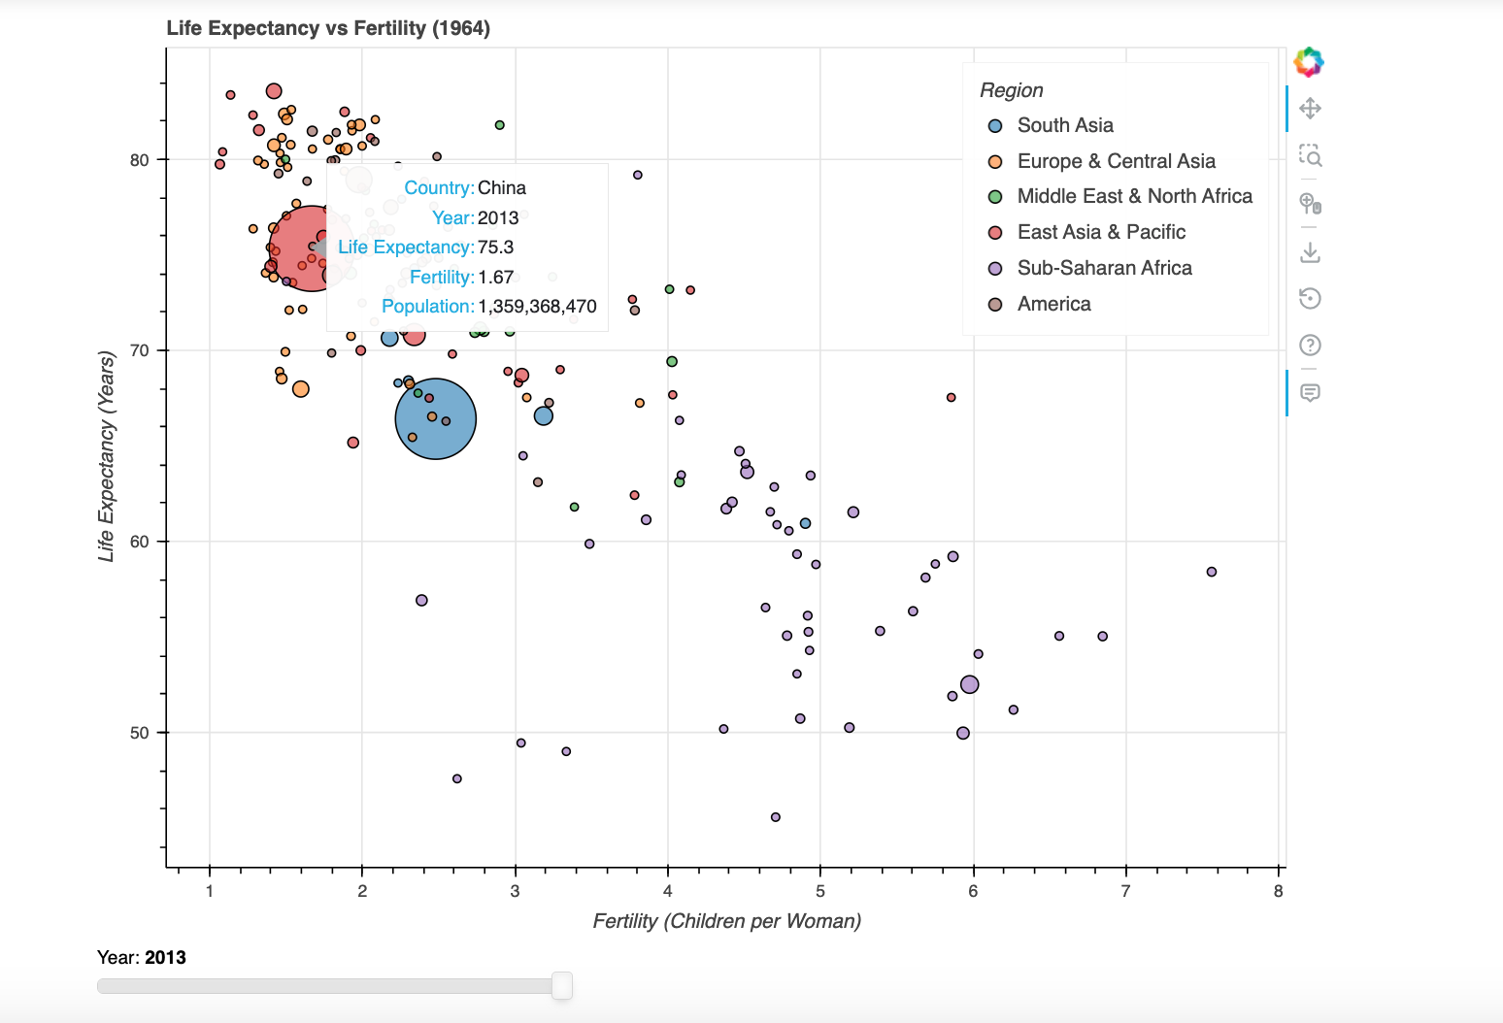
Interactive Features
Bokeh Features
Year slider
Hover tooltips
Clickable legend
Dynamic updates
Hover Information
Year
Country
Population
Fertility
Life expectancy
Interaction Slider + JavaScript callback.

Slide 5
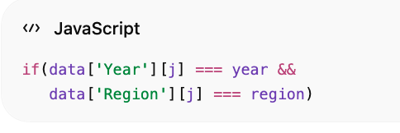

Workflow
Python → HTML → JavaScript → BokehJS
Data process
Python/Pandas (CSV, scale pop, split region)
Bokeh visualization (plot, slider, legend, hover)
User selects a year (slider Interaction)
JavaScript callback (filter data source)
BokehJS redraw (update chart)
Main Learning
Python + JavaScript + Bokeh
interactive systems

Slide 6
Main Findings
Global Trends (chart shift)
Fertility ⬇️ Life expectancy ⬆️
Regional Development (Life expectancy)
Europe&North America developed earlier
East Asia rapidly
Sub-Saharan Africa slowly
Country Differences (points concentrated)
Countries became similar

Slide 7
Limitations & Future Improvement
Limitations
Overlapping countries
Simplified population scaling
Missing data
Browser performance limits
Future Improvements
Country search function
Animation playback
Map visualization

Slide 8
Challenges & Learning
Challenges
First time using Bokeh
JavaScript callbacks
Multiple data sources
What I Learned
Interactive visualization
Data transformation (read + scale + split)
Bokeh (Python + Javascript)
GitHub (code + project)
design choices simplify data, interactive visualization better trends

Slide 9
Thanks

