Slide 1
Co-evolution based computational analysis of protein-protein interactions
Yifei Hu, Zhaoxu Meng, Rongqing Yuan
02/27/2024

Slide 2
Contents
Background
Methods
Results
Discussions

Slide 3
Contents
Background
Methods and Results
Discussions

Slide 4
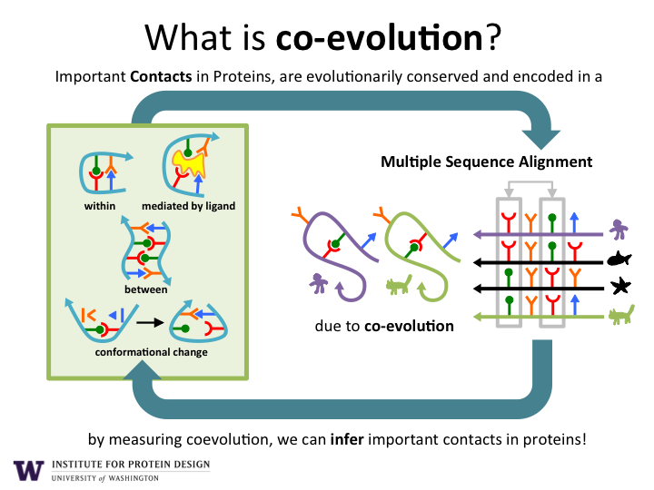
Co-evolution
From Internet
Notes:
https://www.ipd.uw.edu/2017/01/big-data-shapes-the-fold-for-of-hundreds-of-protein-families/

Slide 5
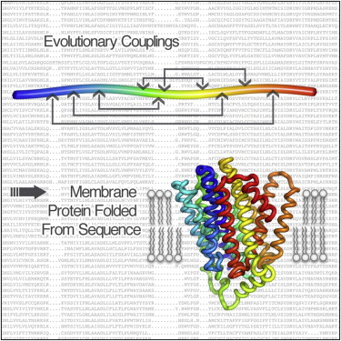
Co-evolution for contact prediction
Thomas A. Hopf, et al., Cell. (2012)
Notes:
https://www.cell.com/fulltext/S0092-8674(12)00509-0

Slide 6
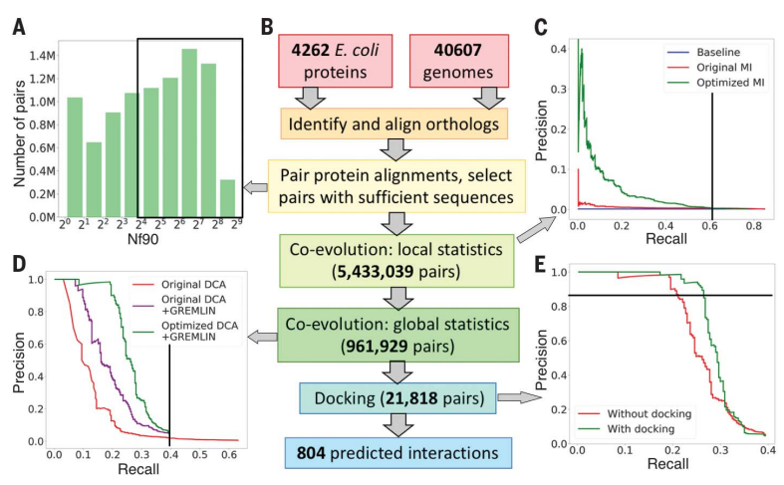
Proteome wide prediction
Qian Cong, et al., Science. (2019)

Slide 7
Contents
Background
Methods and Results
Discussions

Slide 8
Data preparation
Remove positions with gap rate > 0.5.
Remove sequences with gap rate > 0.5
 | A | B | C | D
Sequences | 3104 | 3040 | 3178 | 3643
Sequence length | 161 | 264 | 267 | 401

Slide 9
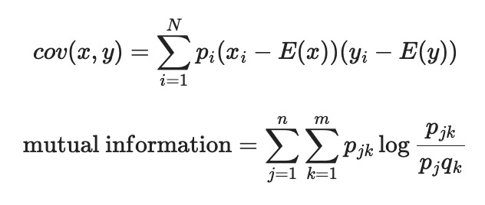
Methods
Statistical analysis
Statistical analysis
Covariance matrix (N, N)
MI matrix (L, L)
Collapse
Compute MI between residues
Covariance data (L, L, 21, 21)
Input (N, L, 21)
Compute covariance between residues
Input (N, L, 21)

Slide 10
Permutation test

Slide 12
Contents
Background
Methods and Results
Discussions

Slide 13
What sequences are they?
BLAST against UniProt
No hit
Predict structure with ESMFold, then use Dali.
No significant result

Slide 14
Why bacterial data?
Much more data available
No alternative splicing
Eukaryotes underwent several rounds of genome duplications, and it can be difficult to distinguish orthologs from paralogs.
Ian Humphreys, et al., Science. (2021)
Notes:
eukaryotes underwent several rounds of genome duplications in multiple lineages (15), and it can be difficult to distinguish orthologs from paralogs, which is important for detecting coevolutionary signal because the protein interactions of interest are likely to be conserved in orthologs in other species but less so in paralogs.

Slide 15
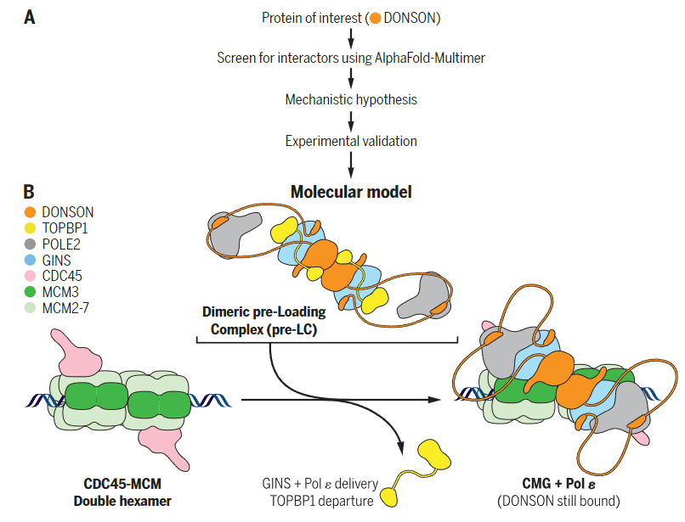
Computational tools promotes scientific discovery
“New directions in science are launched by new tools much more often than by new concepts.”
— Freeman Dyson
Yang Lim, et al., Science. (2023)

Slide 16
Thanks for listening!

Slide 17
Thanks for listening!

