Slide 1
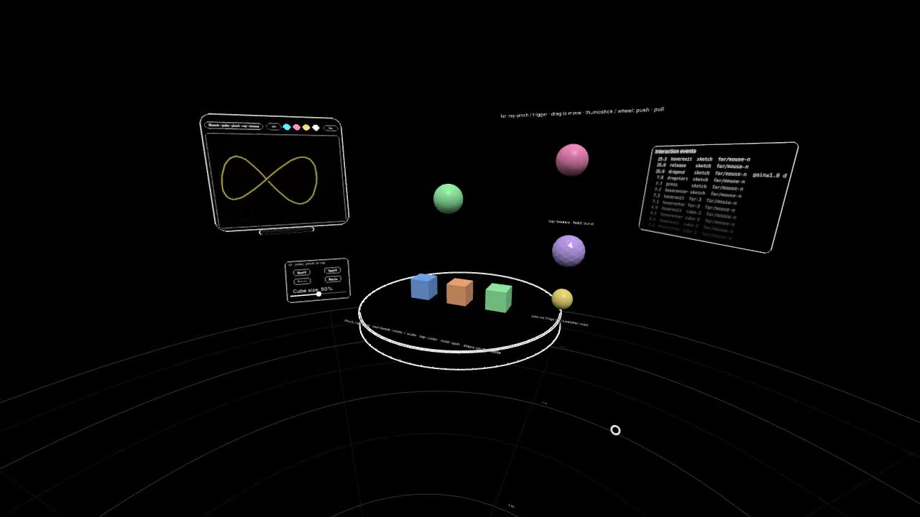
VibeXR
SHARING · OCTOBER 2026
An interaction framework for vibe-coded WebXR. From a link to hands-on XR in one HTML file.
Rongxuan Mu · rongxuanmu.com
Notes:
VibeXR is the interaction framework under all my browser XR prototypes. Today: what WebXR is, why it's hard to build for, and how VibeXR makes every new idea start from interaction that already feels right.

Slide 2
The browser's door into headsets
01 · WEBXR
WebXR is the web standard that lets a page take over a headset: open a link, tap Enter, you are in.
SESSIONS
VR and AR
immersive-vr for full immersion, immersive-ar for the room through passthrough.
INPUT
Hands to gaze
Head pose, controllers, tracked hands with 25 joints, and gaze-and-pinch on Vision Pro.
REACH
No install
Quest, PICO, Vision Pro, Galaxy XR and Android XR browsers. A URL is the whole distribution.
Notes:
WebXR is a web standard: a page asks the browser for an immersive session and gets head pose, input and a render loop. No install, no store.

Slide 3
The fastest loop from idea to headset
02 · WHY IT MATTERS
Idea
said out loud
One HTML file
written with AI
Push or paste
GitHub Pages · CodePen
Headset
refresh and try
Minutes, not builds: edit, refresh in the headset, feel it.
Shareable: a link works on someone else's device the same day.
AI-friendly: models write HTML and three.js fluently; a single file is easy to read, diff and paste.
Notes:
The loop is the point: say an idea, get one HTML file, push or paste it, refresh in the headset. Minutes, not builds.

Slide 4
Good engines, thin interaction
03 · WHAT'S OUT THERE
FRAMEWORK | STRONG AT | WHAT YOU STILL BUILD YOURSELF
three.js | Rendering, a light WebXR manager | Rays, grabs, pokes, UI, hand logic: all of it
A-Frame | HTML-like scenes, quick starts | Polished near / far interaction across inputs
Babylon.js | A full engine with XR features | Weight and an engine's way of doing things
React Three Fiber + xr | Pointer events in XR, React | An npm / bundler toolchain around every idea
Unity WebXR export | Familiar tools and assets | Heavy builds, slow iteration in a browser
Notes:
These are all good at what they are for. What none of them hands you is interaction that already feels right on every input.

Slide 5
Every prototype rebuilds the same things
04 · THE PROBLEMS
1
Interaction is left to you: ray, pinch, grab, poke, two-hand scale and buttons, written again for each project.
2
Inputs diverge: hands, controllers, Vision Pro's gaze pointer and a desktop mouse each behave differently.
3
VR-first habits: passthrough is an afterthought, and "VR only" makes no sense on see-through glasses.
4
Toolchains get in the way: npm, bundlers and frameworks, while AI works best with one file you can paste.
5
No desk testing: without a headset on, you can't try the interaction at all.
Notes:
The same five things come back on every project. Interaction especially: a ray, a pinch, a grab, a poke and a button, written again each time.

Slide 6
Start from interaction that already feels right
05 · OUR APPROACH
1
file
One HTML file on three.js. Paste it into CodePen or push it to a site: that's the build.
1
Enter button
AR with passthrough by default; headsets without AR quietly get VR. No "VR only".
1
interaction model
Hands, controllers, gaze and mouse all point, pinch, poke and grab, near or far.
∞
worlds
A project supplies only its world. The framework brings the hands, UI and feel.
The tuning comes from XR OS interaction design work: when the ray appears, how far a far grab travels, how big a poke volume is, how a hover outline reads on a messy model.
Notes:
One file, one Enter button, one interaction model, and as many worlds as you like. The framework is the stable part; a project only writes its world.

Slide 7
Four inputs, one interactor, the same events
06 · HOW IT WORKS
Hand
pinch · poke · grab
Interactables
draggable · twoHand · precise · constrain · translateOnly · multi
Controller
trigger · grip · stick
Interactor
hover decides: near touch or far ray
Events
press · drag · tap · longpress · release · statechange
Gaze
Vision Pro pinch
UI kit
Panels, buttons, sliders, labels, a palm-up hand menu, a sketch board, a log.
Mouse · keys
desktop preview
Notes:
Every input becomes the same kind of interactor. Hover decides near or far: within reach you touch, beyond it the ray takes over. Objects get the same events whatever drove them.

Slide 8
A world is a few lines
07 · BUILD ON IT
const Hello = {
id: "hello",
init(ctx) {
const { root, THREE } = ctx;
root.add(new THREE.HemisphereLight(0xffffff, 0x222222, 2));
const cube = new THREE.Mesh(new THREE.BoxGeometry(0.1, 0.1, 0.1),
new THREE.MeshStandardMaterial());
cube.position.set(0, 1.3, -0.5); root.add(cube);
// grab near or far; two hands rotate and scale
ctx.add(cube, { draggable: true, twoHand: true })
// one event, whether a hand, a controller, a gaze pinch or a mouse did it
.on("tap", () => ctx.log("tapped"));
},
};
app.worlds.register(Hello);
Notes:
This is a whole world: a cube you can grab near or far, scale with two hands, and tap. The tap fires the same way for a hand, a controller, a gaze pinch or a mouse.

Slide 9
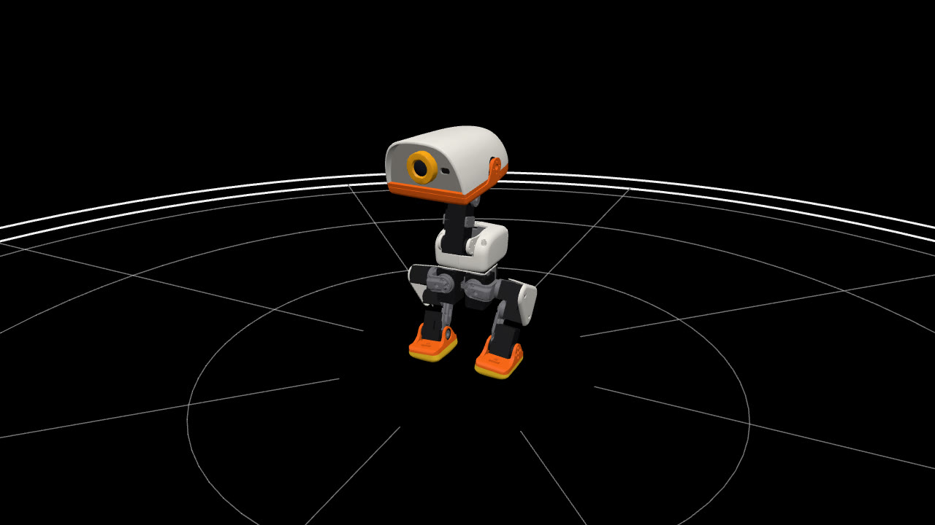
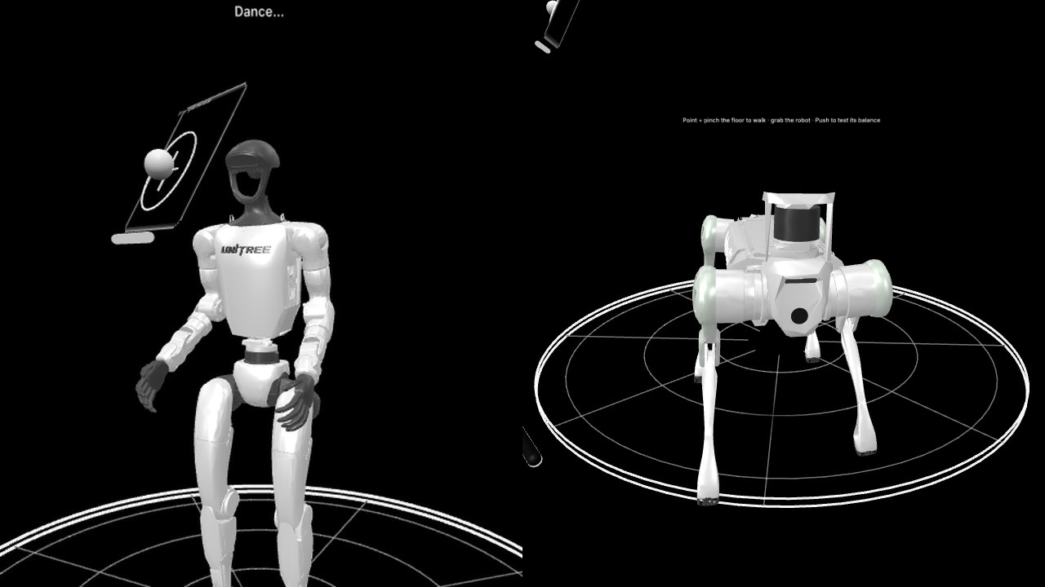
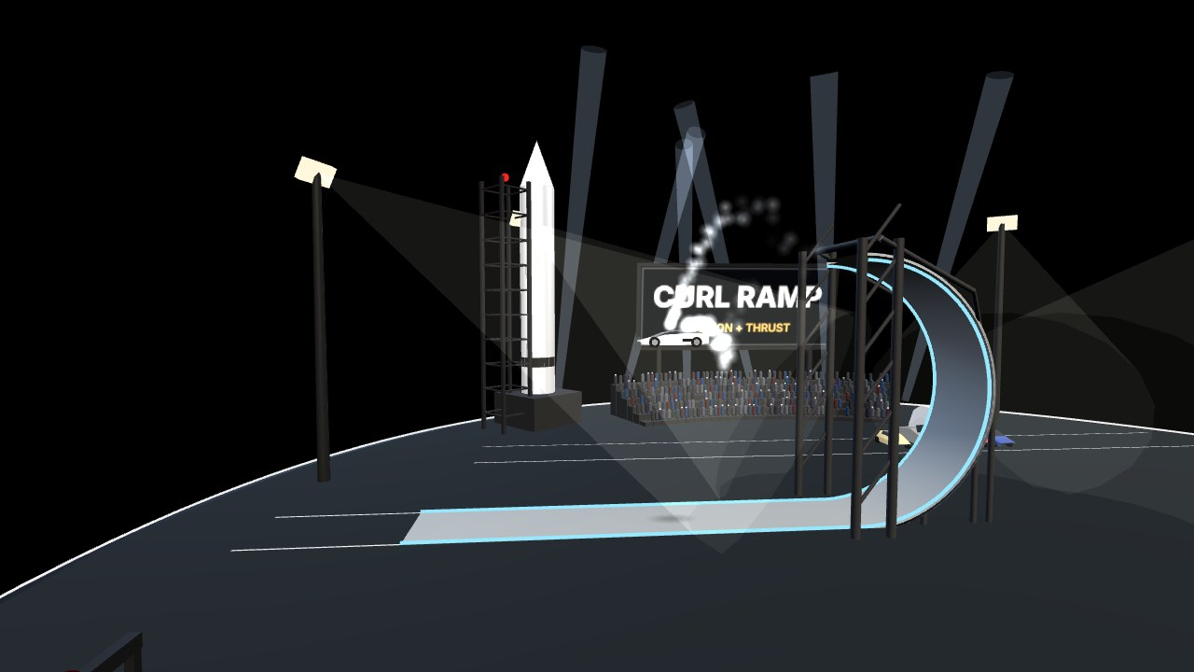
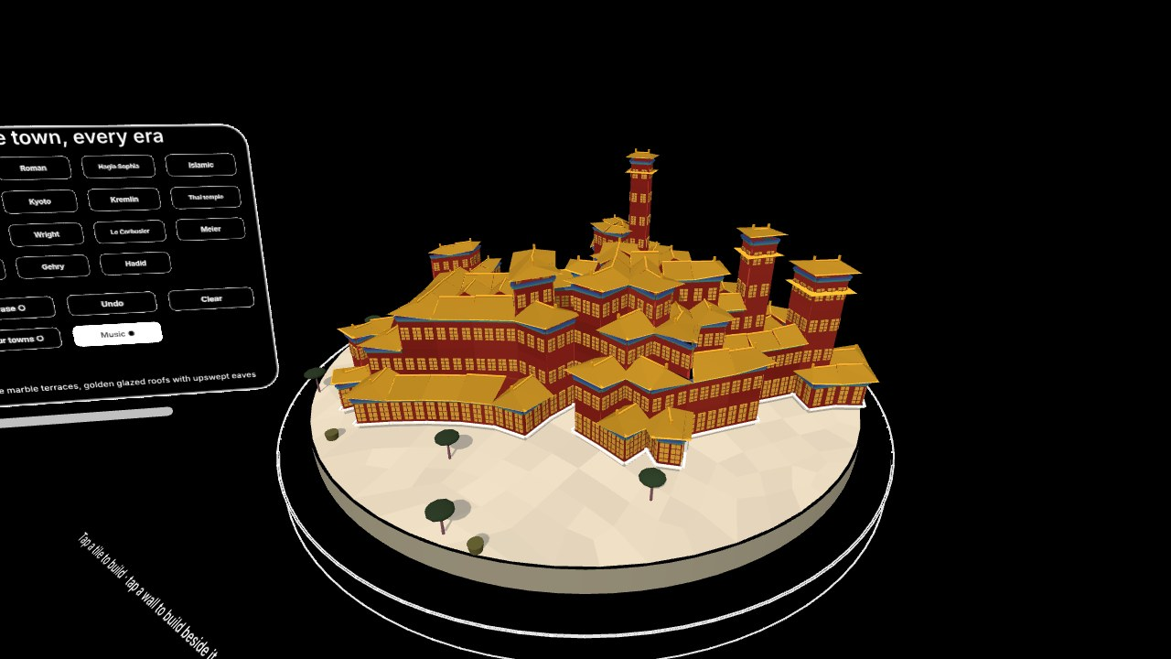
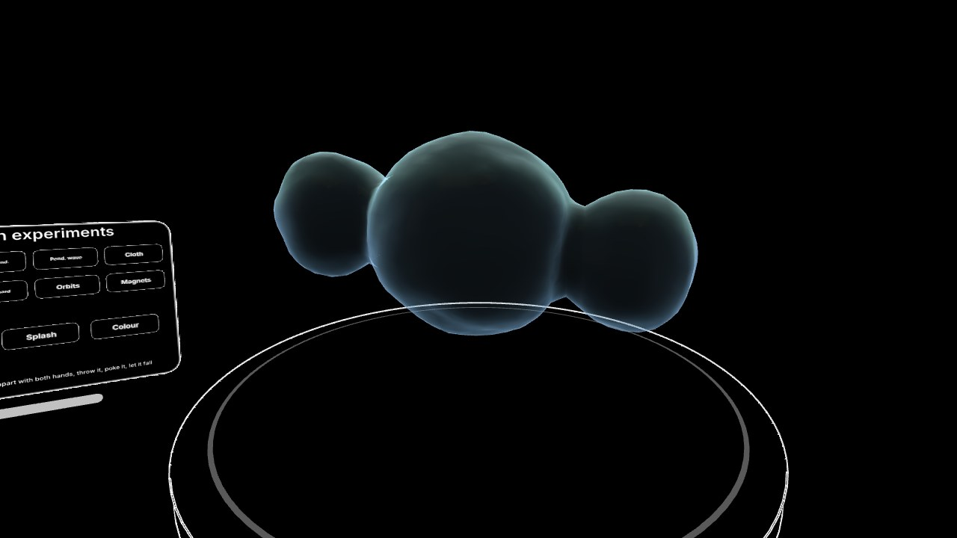
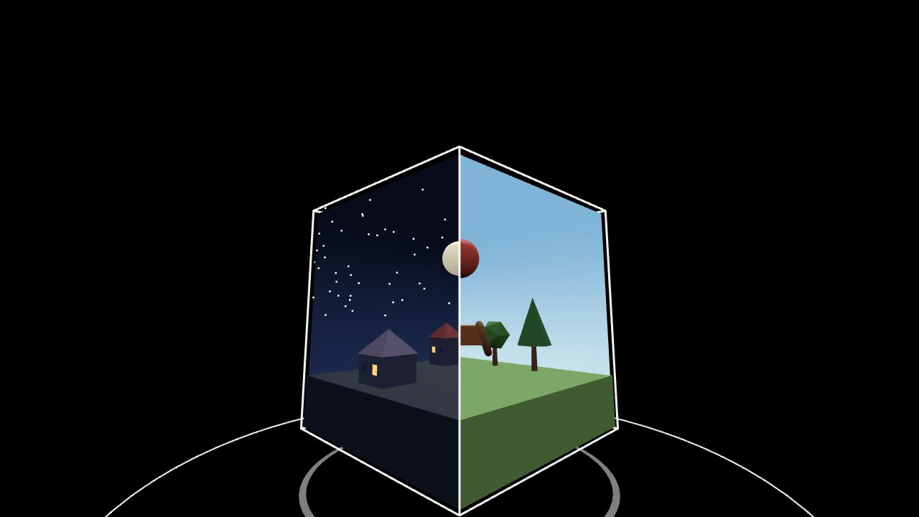
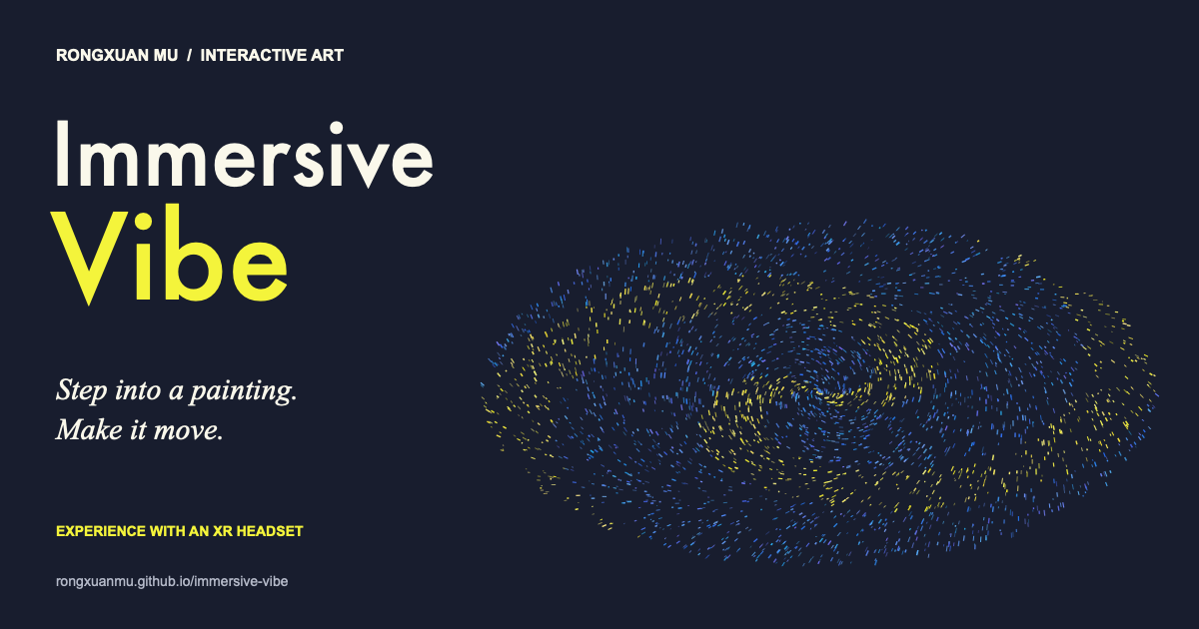
Countless worlds, one framework
08 · BUILT ON IT
Microduck XR
a real robot policy on your floor
Robot Zoo XR
humanoids and robot dogs
Roadster Night
a launch event as a diorama
Archiscape
architecture through the ages
Physics Cabinet
ten experiments in your hands
Dream Cage
a portal cube puzzle
Immersive Vibe
paintings you step into
Playground
the framework itself
Notes:
Everything here runs in a headset browser from a link. Click any picture to open it.

Slide 10
Rules that keep it working everywhere
09 · WHAT WE LEARNED
Passthrough first
Things live in your room: a stage on the real floor or a desk at your height, measured from your head.
Diorama scale
Big worlds become tabletop or floor miniatures you can walk around, and they can run faster so they don't read as slow motion.
The console rides along
Panels follow the stage they control, and each can be dragged by its own bar.
Light enough for glasses
Generated geometry, no heavy assets, so standalone headsets and puck-tethered see-through glasses keep up.
Notes:
Four rules that came out of building these: passthrough first, diorama scale, the console rides along, and light enough for glasses.

Slide 11
How these were made
10 · WORKFLOW
Voice note
in the headset
AI agent
edits the world
Headless tests
screenshots · checks
/dev page
try in a headset
Release
site + CodePen
The framework is the stable part: the agent only writes the world, so interaction quality never regresses.
Rules live in the repo: "one Enter button, passthrough first" is written down once and followed every time.
Every change is shown before it ships: screenshots, measured trajectories, a test page.
Notes:
Voice notes from inside the headset go to an AI coding agent, which edits only the world. Every change is checked headless, tried on the dev page, then released.

Slide 12
Put on a headset and open a link
DEMO · THANK YOU
Any WebXR browser: Quest, PICO, Vision Pro, Galaxy XR. On a laptop, everything runs as a desktop preview.
Interaction Playground ↗
Microduck XR ↗
Roadster Night ↗
Framework page ↗
Rongxuan Mu
rongxuanmu.com
Notes:
Live demo: the playground first, then Microduck and Roadster Night. The video on this slide is Microduck XR in a headset, as a fallback if the live demo can't run. Questions.

