Slide 1
UCSD Alumni
Group 17: Andrew Britten, Rongzichen Song, Qingyang Su, Nansu Xu
Notes:
Introduce

Slide 2
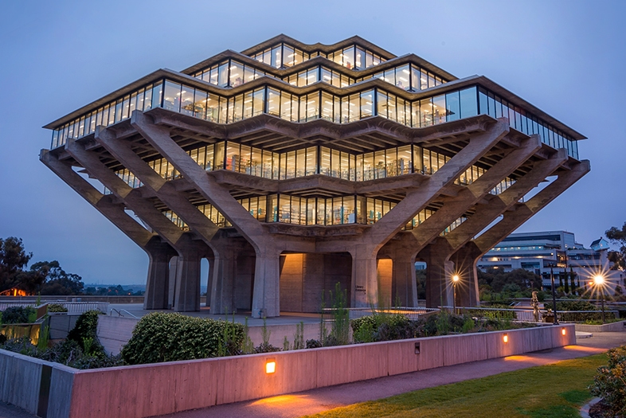
Objective
UCSD education
Students Careers
Notes:
State our questions, details

Slide 3

Data source
UCSD Graduate Division Website
Linkedin
UCSD General Catalog 2019-2020
Notes:
Our data mainly came from three different sourses

Slide 4
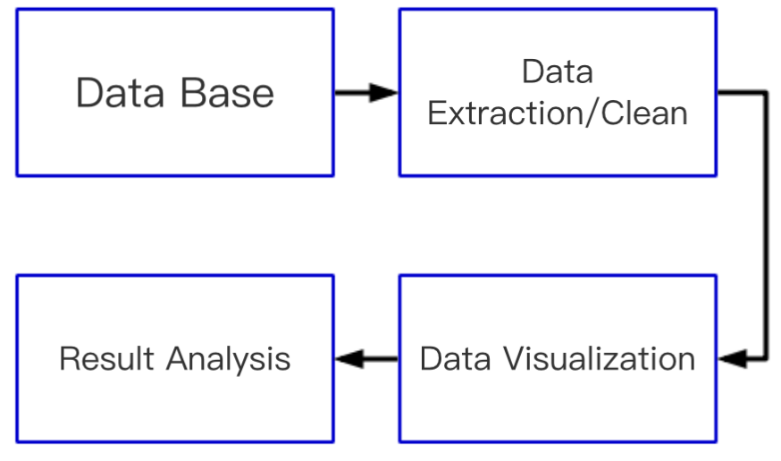
General WorkFlow
Notes:
Here is the workflow of our project

Slide 5
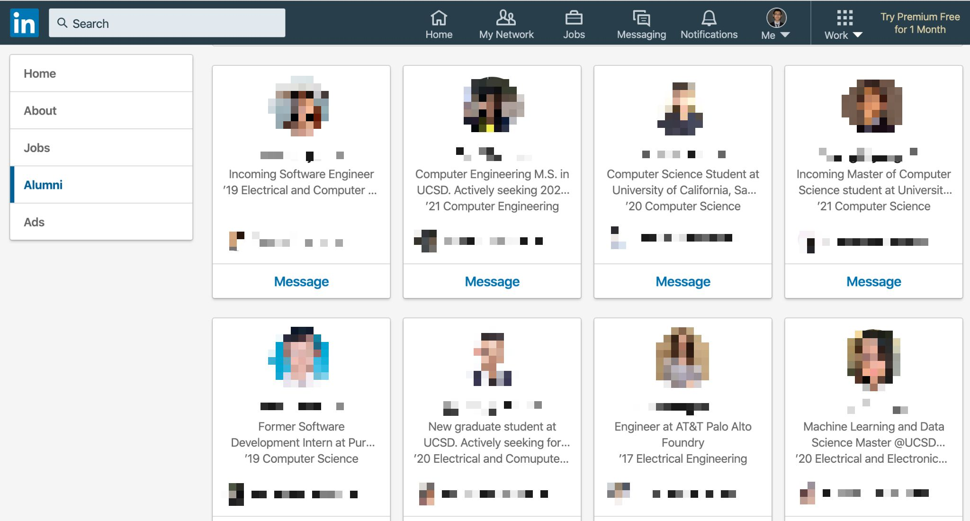
Workflow
Notes:
We first go to UCSD alumni front page, where it contains links of all UCSD students profile page

Slide 6
Workflow
Json file
Url 1
Url2
...
Url n
{person 1 data}
{person 2 data}
...
{person 3 data}
Linkedin
page
Python script

Slide 7
Questions to answer
Where they came from, and where are they now?

Slide 8
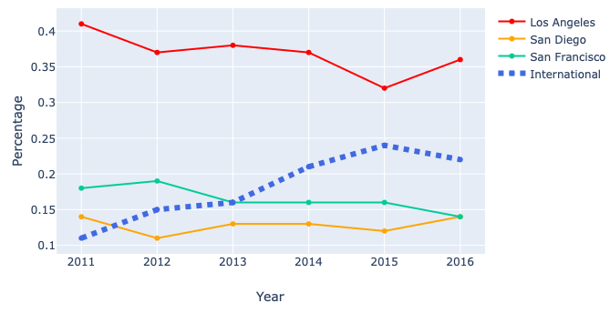
Where do the student came from?

Slide 9
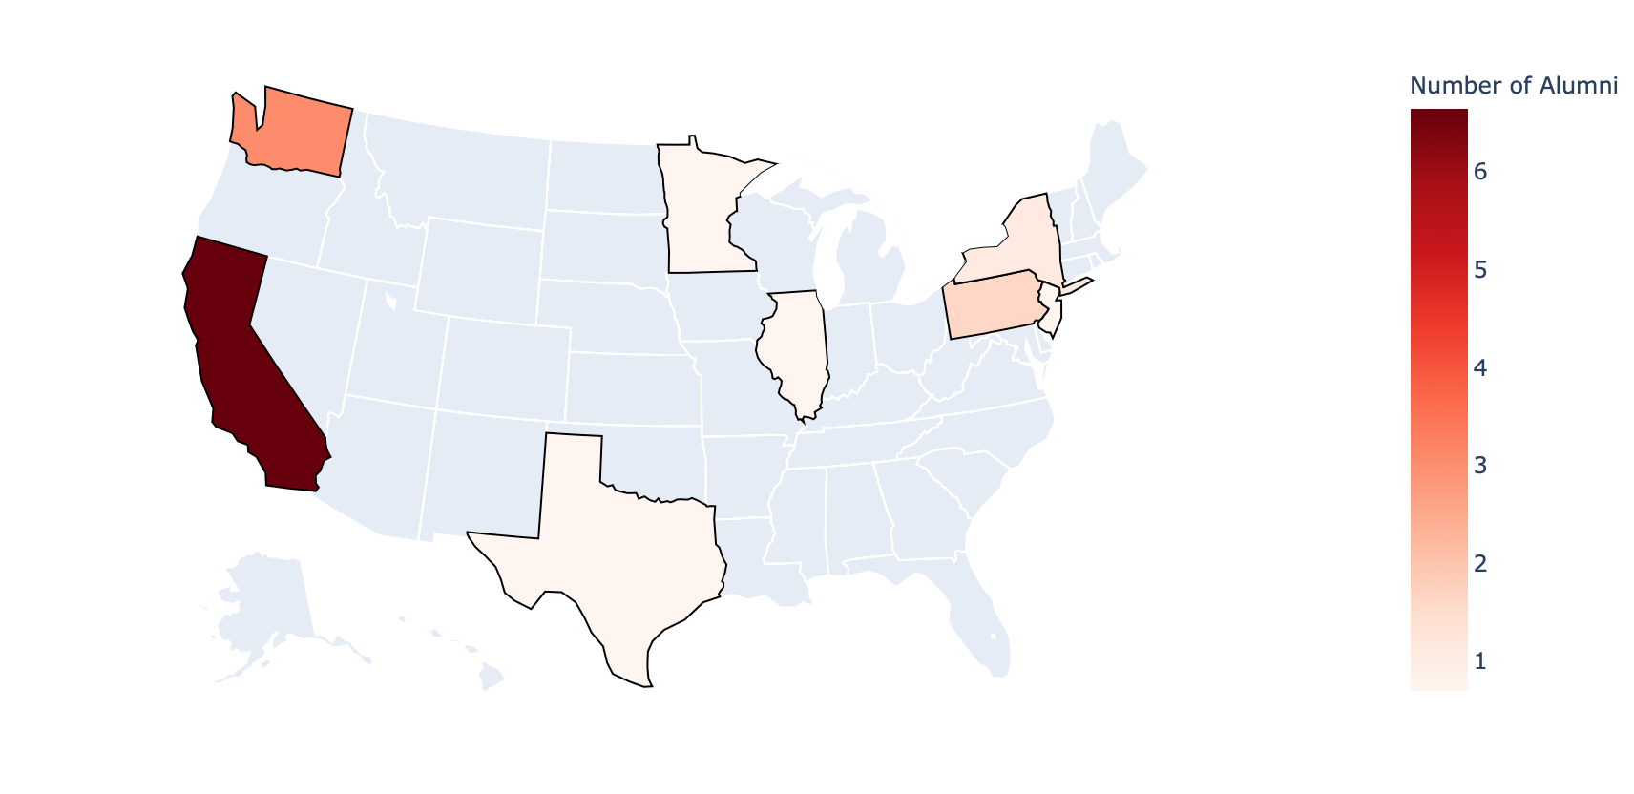
UCSD Alumni Distribution

Slide 10
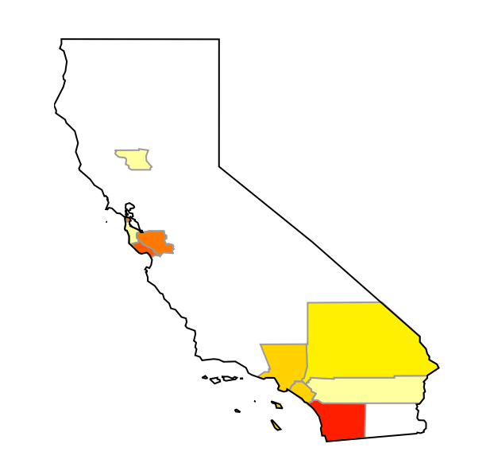
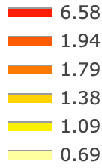
UCSD Alumni Distribution in California
Colusa
San Francisco Bay Area
San Bernardino
Los Angeles
Orange
Riverside
San Diego
Notes:
Add city name

Slide 11
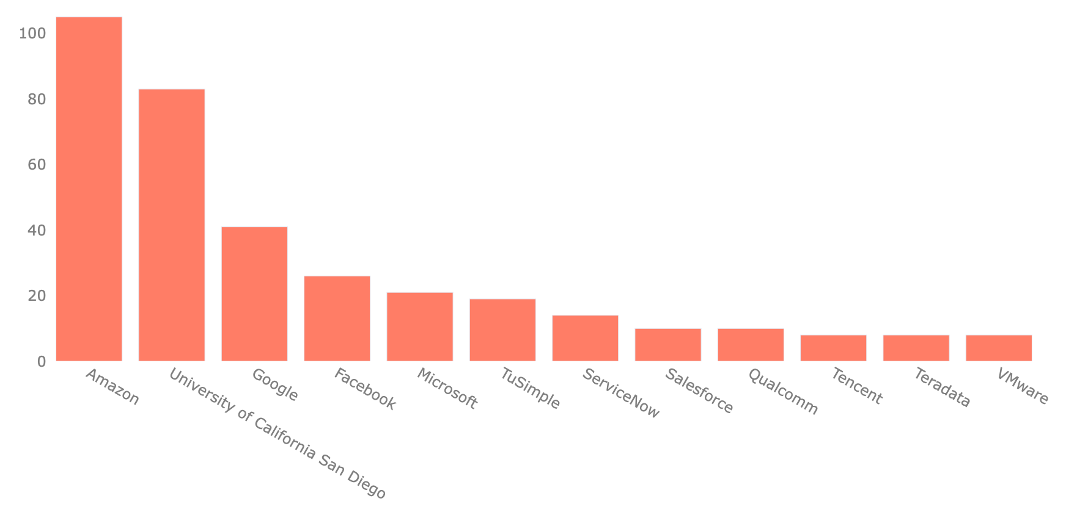
Top 10 Companies Alumni went to
Notes:
We also looked at the companies people go to.
This graph shows the location distribution simi

Slide 12
Questions to answer
Where they came from, and where are they now?
Are the major align with what they are doing now?

Slide 13
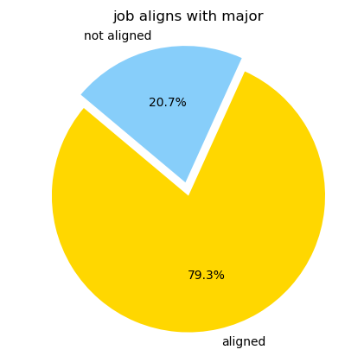
Are the job they find align their major?
After a painful automated merging
24 different majors
29 different industry

Slide 14
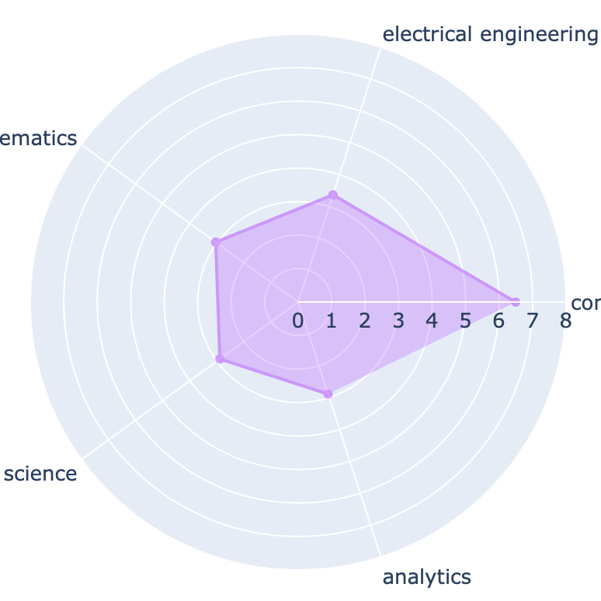
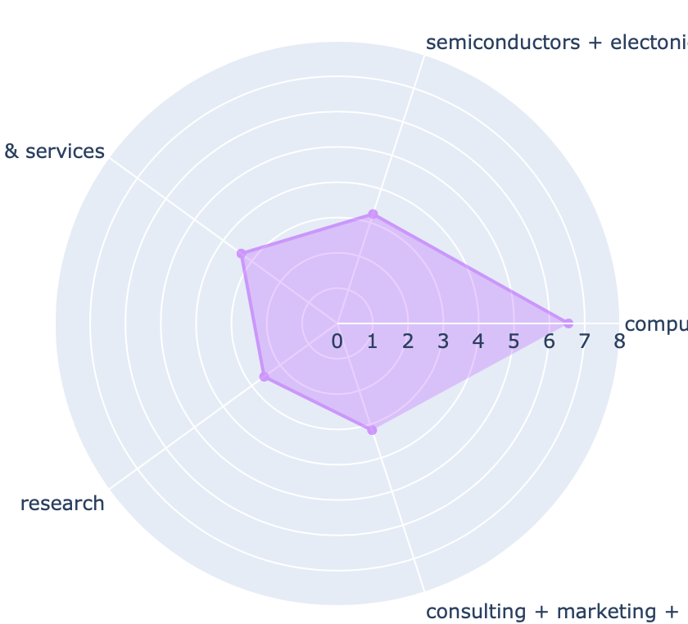
Top 5 Major & Industry Alignment
UCSD Majors
Correlated Industries
Electrical Engineering
Semiconductors + Electronics
Information Technology
Applied Mathematics
Computer Software
Computer Science
Machine Learning
Research
Consulting + Marketing
Analytics
Notes:
Then, we further break down into top 5 popular major at ucsd and their corresponding industries

Slide 15
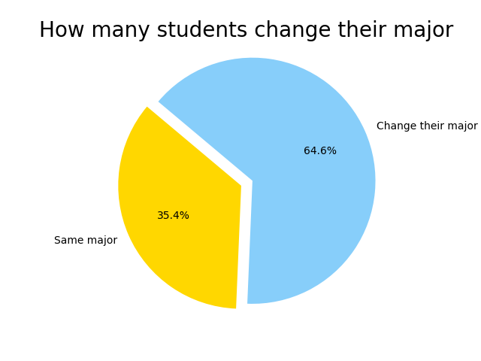
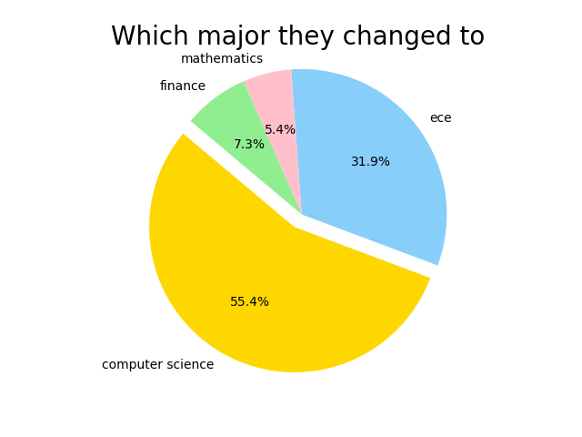
Let’s see how many graduate students in UCSD have changed their major
Notes:
There are still 20% of the students who doesn’t work in the industry related with their major. We think they did so because they are not happy with their major. So we investigated on how many grad student in changed their major.

Slide 16
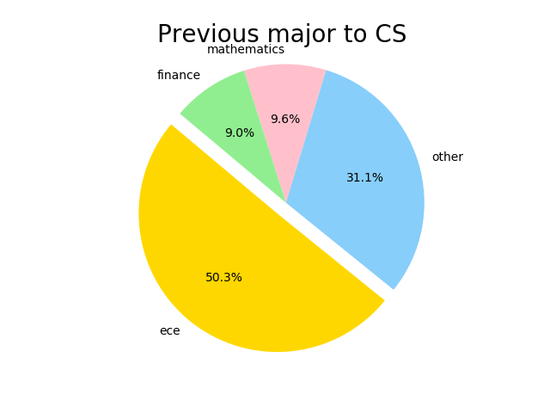
For those who change their major to CSE (55.4%), here is a distribution of their previous major
Notes:
So many students are transfering to computer science major make us think that course optimization is necessary

Slide 17
Questions to answer
Where they came from, and where are they now?
Are the major align with what they are doing now?
What skills do they learn at UCSD?

Slide 18
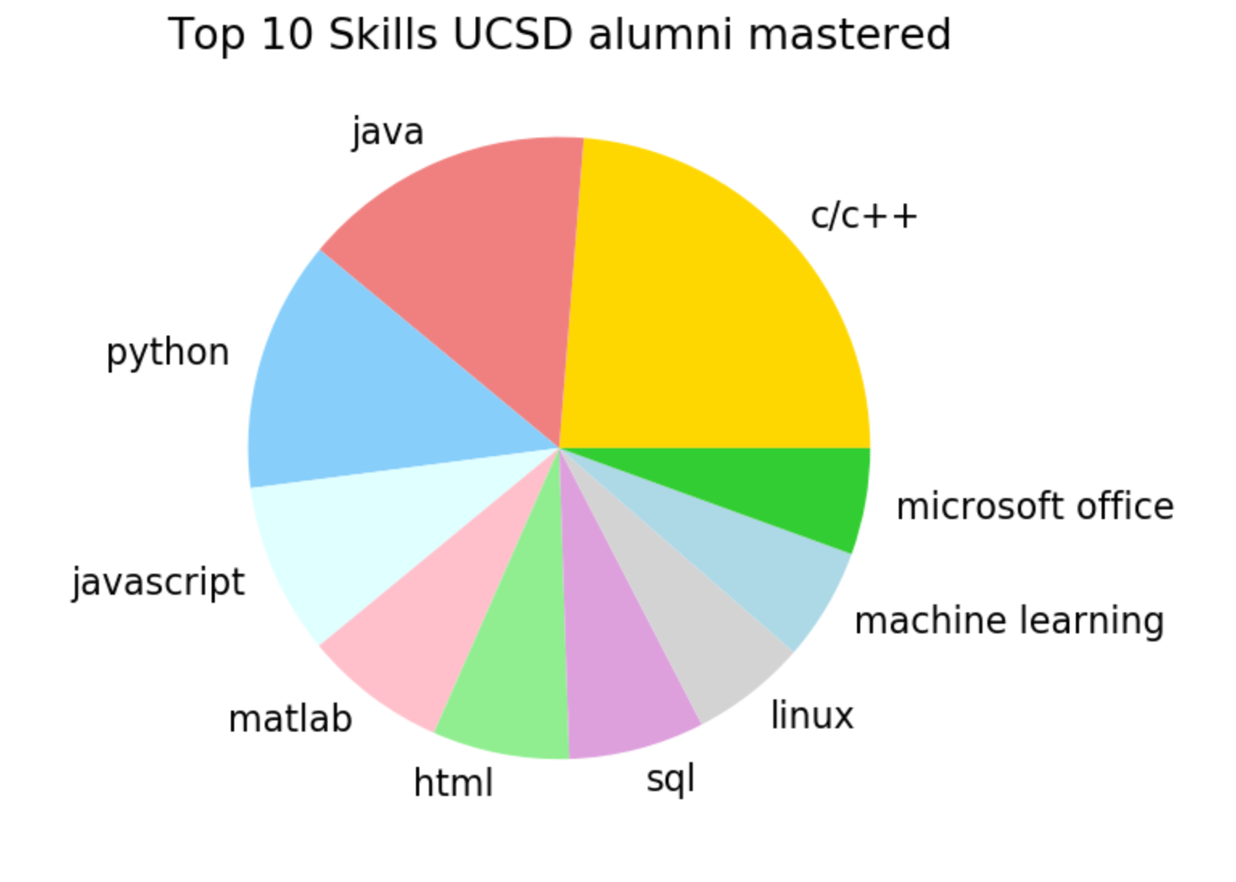
What do students learn at UCSD
Notes:
Machine learning & bar chart

Slide 19
Questions to answer
Where they came from, and where are they now?
Are the major align with what they are doing now?
What skills do they learn at UCSD?
How to optimize the course setting?

Slide 20
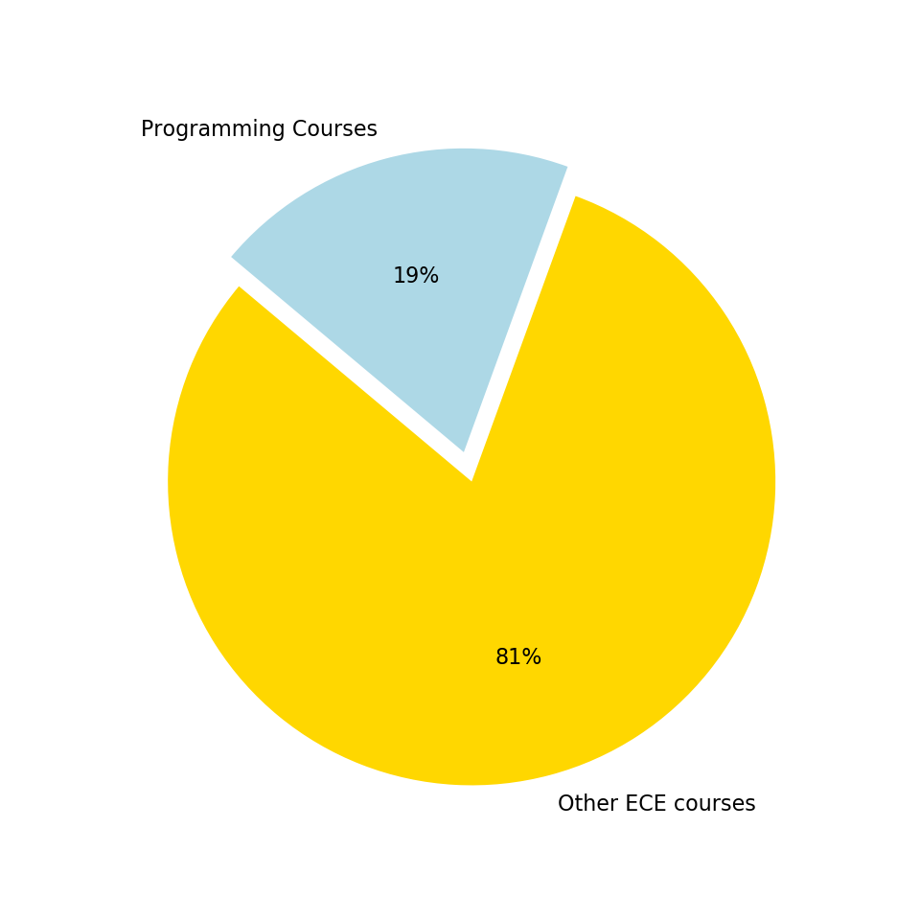
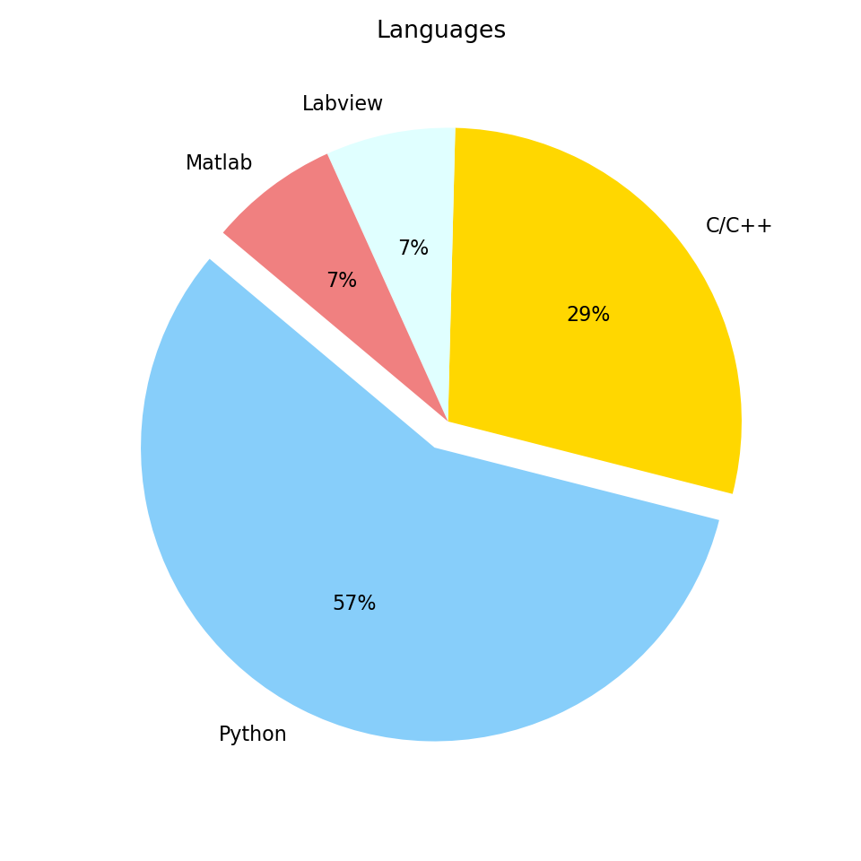
ECE Programming Courses

Slide 21
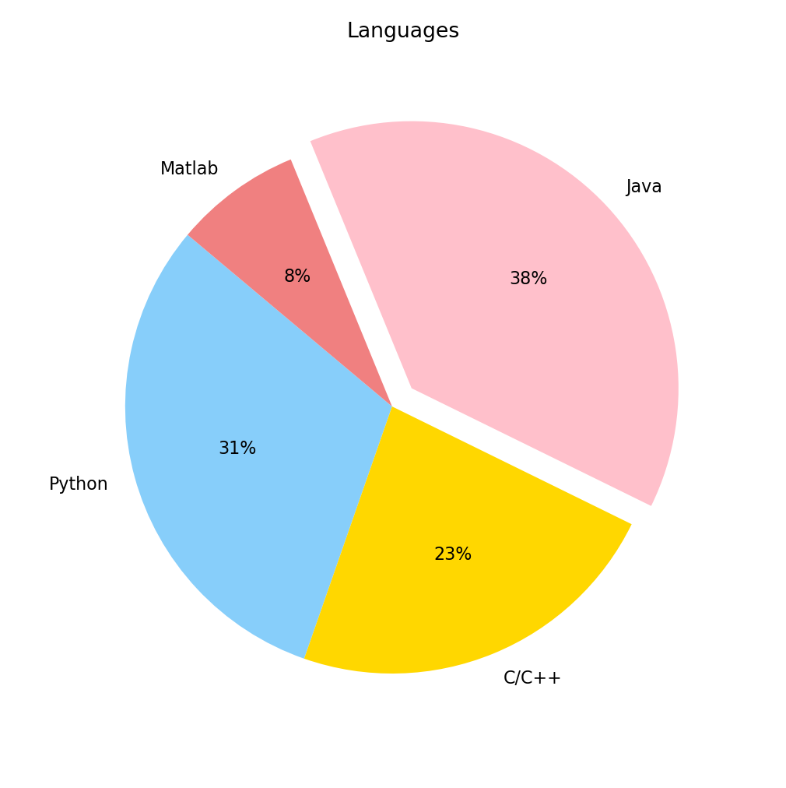
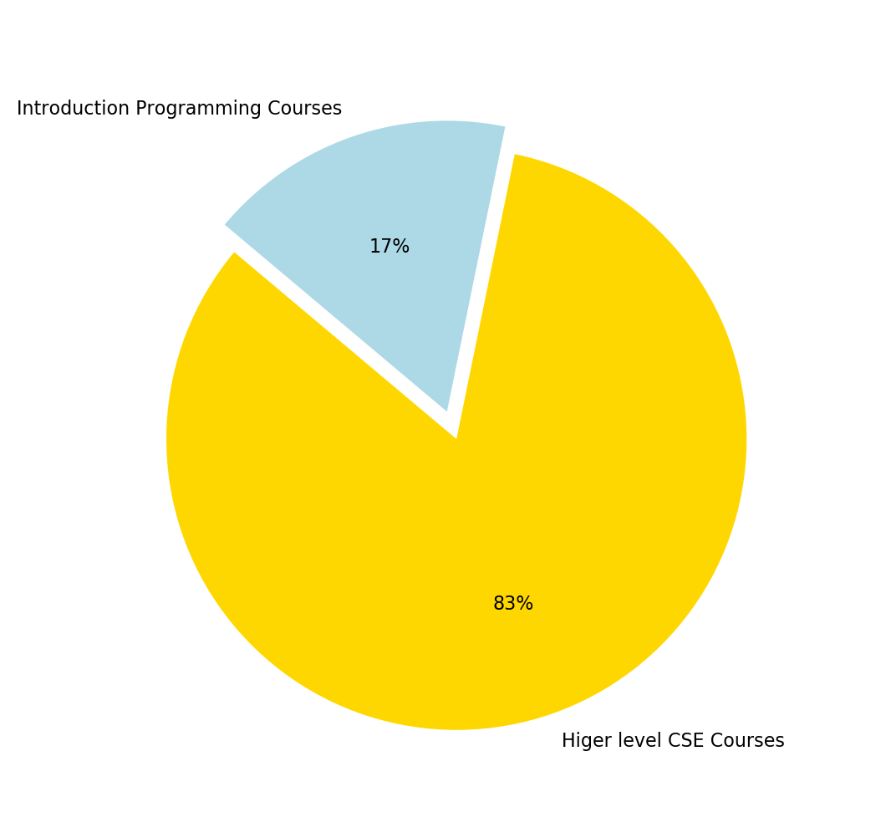
CSE Introduction Programming Courses

Slide 22
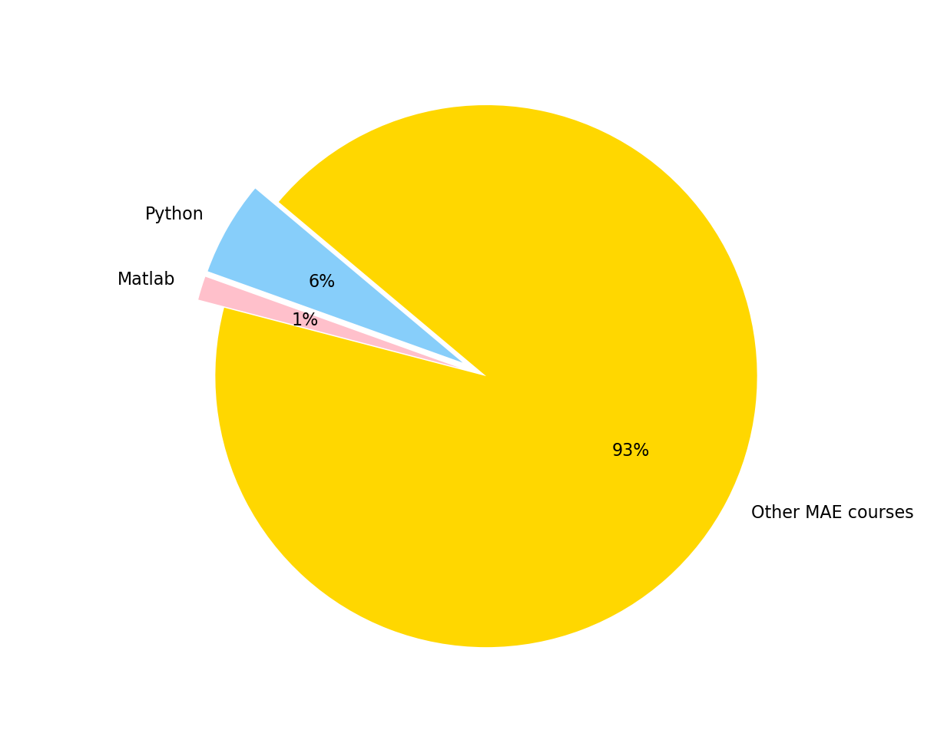
MAE Programming Courses

Slide 23
Recommendation Course settings for Undergraduates (Electives)
ECE
CSE
PYTHON | C/C++ | LABVIEW
ECE 16 | ECE 17 | ECE 144
ECE 143 | ECE 141A
ECE 174 | ECE 141B
ECE 175A
ECE 175B
JAVA | C/C++ | MATLAB
CSE 8A | CSE 86 | CSE 7
CSE 8B | CSE 100
CSE 11
CSE 12

Slide 24
In Summary
UCSD undergraduates
Californians and international
UCSD Alumni
Live in California
Work in tech industry
Want to stay in CA? Work for tech?
Aligned major to work
ECE and Computer science
Optimize Classes for programming skills
Major change to ECE/CSE
Programming skills to learn

Slide 25
In Conclusion, we recommend:
Take programming courses
Stay with your ECE/CSE major
ECE department should provide Java courses
CSE department should expand on transfer acceptance

Slide 26
Questions?

Slide 27
Flow
What is the university distributions of the incoming UCSD graduate student?
How UCSD education help students with their careers? Does the job they find align with their major?
What companies or industries do UCSD graduate students most interested in?
What expectations can students have when they finished their studies in UCSD?
How to optimize the course settings and course contents for future students?

