Slide 1

Transaction Scheduling using VQE and QAOA
Quantum Computing
Notes:
→ welcome to introduction
→ you might wonder why you should bother about this topic
→ billions of database transactions each day
→ unefficient scheduling causes waste of resources such as cpu and time
→ more efficient scheduling leads to either usage of less resources or enabling more work in the same amount of time

Slide 2
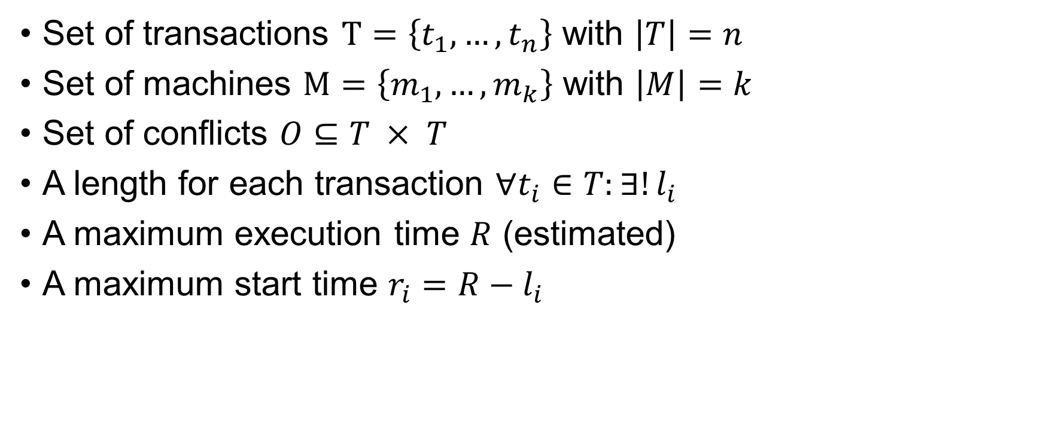
Transaction Scheduling
Set of transactions $T=\left\{t_{1}, …,t_{n}\right\}$ with $\left|T\right|=n$
Set of machines $M=\left\{m_{1}, …, m_{k}\right\}$ with $\left|M\right|=k$
Set of conflicts $O⊆T × T$
A length for each transaction $∀t_{i}∈T:∃!l_{i}$
A maximum execution time $R$ (estimated)
A maximum start time $r_{i}=R−l_{i}$

Slide 3
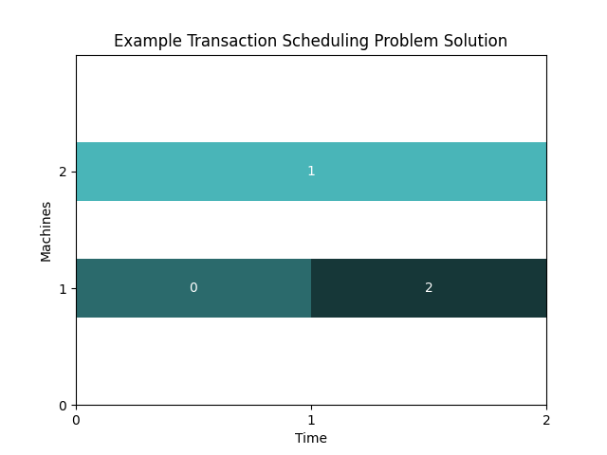
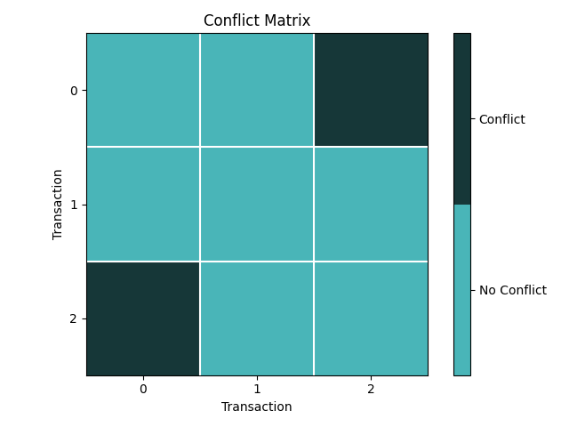
Transaction Scheduling

Slide 4
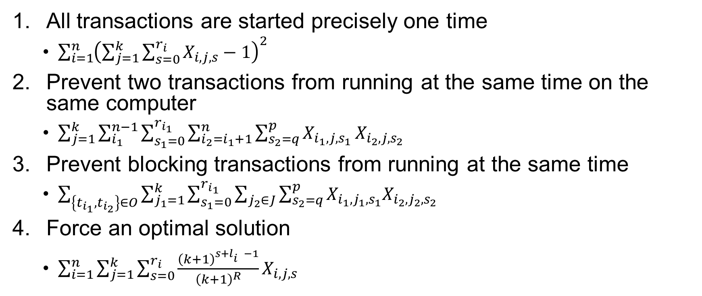
Representation as an Optimization Problem: QUBO
All transactions are started precisely one time
$\sum_{i=1}^{n}{{\left(\sum_{j=1}^{k}{\sum_{s=0}^{r_{i}}{X_{i,j,s}−1}}\right)}^{2}}$
Prevent two transactions from running at the same time on the same computer
$\sum_{j=1}^{k}{\sum_{i_{1}}^{n−1}{\sum_{s_{1}=0}^{r_{i_{1}}}{\sum_{i_{2}=i_{1}+1}^{n}{\sum_{s_{2}=q}^{p}{X_{i_{1},j,s_{1} }X_{i_{2},j,s_{2}}}}}}}$
Prevent blocking transactions from running at the same time
$\sum_{\left\{t_{i_{1}},t_{i_{2}}\right\}∈O}{\sum_{j_{1}=1}^{k}{\sum_{s_{1}=0}^{r_{i_{1}}}{\sum_{j_{2}∈J}{\sum_{s_{2}=q}^{p}{X_{i_{1},j_{1},s_{1}}X_{i_{2},j_{2},s_{2}}}}}}}$
Force an optimal solution
$\sum_{i=1}^{n}{\sum_{j=1}^{k}{\sum_{s=0}^{r_{i}}{\frac{{\left(k+1\right)}^{s+l_{i}^{}−1}}{{\left(k+1\right)}^{R}}X_{i,j,s}}}}$
Notes:
Quadratic Unconstrained Binary Optimization
Hamiltonian
Goal: find lowest energy → optimal solution
R needed to be estimated upfront to reduce the amount of possible start times → equation 2

Slide 5

Continuous Transaction Scheduling Problems
Estimate $R$
Split $R$ into equally sized time steps
Ceil each $l_{i}$ to the next multiple of the time step length
Re-estimate $R$ based on discrete lengths
Notes:
→ in real world transaction scheduling does not follow discrete time intervals
→ limitation of QUBO
→ too many variables/options make computation complex
→ solution: discretization
→ first approximate R based on paper [1]
→ then split R into 10 equally sized time steps → 10 is parameter to be choosen (fixed in this work as this guarantees equal size across different problems with same number of transactions and machines)
→ then fit transaction lengths into an integer number of time steps by applying ceil
→ then re-calculate R based on discrete values to ensure that it accounts for the added overhead
→ Overhead could be reduced when converting the time back to continuous
→ could help in real world as exact length might not be known upfront

Slide 6
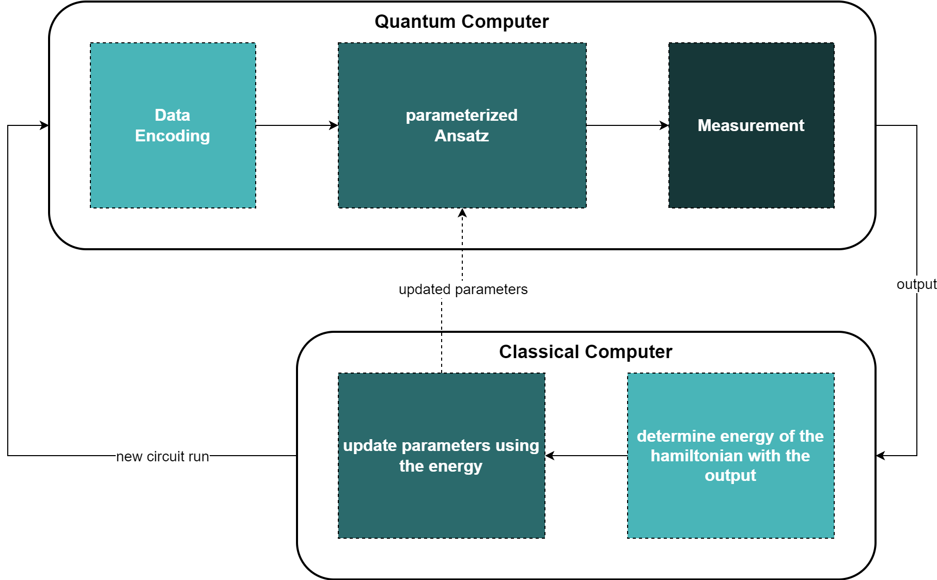
Variational Quantum Algorithms: VQE and QAOA
Notes:
Hybrid quantum-classical algorithms
Follows basic principle of quantum models (top)
Parameters of Ansatz optimized

Slide 7
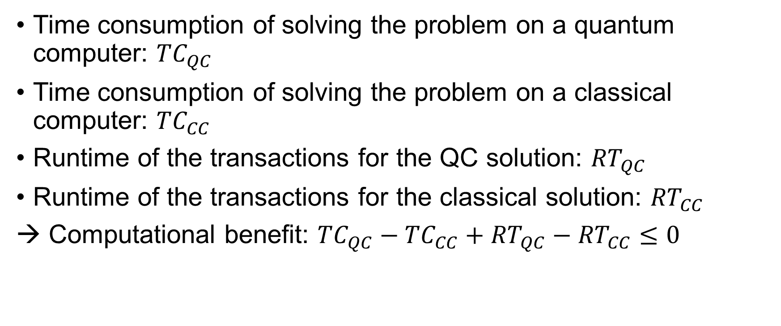
Achieving Benefit Through Quantum Computing
Time consumption of solving the problem on a quantum computer: ${TC}_{QC}$
Time consumption of solving the problem on a classical computer: ${TC}_{CC}$
Runtime of the transactions for the QC solution: ${RT}_{QC}$
Runtime of the transactions for the classical solution: ${RT}_{CC}$
→ Computational benefit: ${TC}_{QC}−{TC}_{CC}+{RT}_{QC}−{RT}_{CC}≤0$
Notes:
→ Hopes of using quantum computers: better schedule in shorter time
What we need to put in contrast:
QC = discretizing Problem
mapping problem as QUBO
representing QUBO as quantum readable state (e.g. Sparse Pauli)
sending Problem to QC
Calculating Problem on QC
Retrieving the result
mapping result to a solution
applying the solution
Costs
Time (computational benefit)
Time + Money (economical benefit)

Slide 8
Further Research
Limitations
QCs still limited in the amount of usable qubits
QCs are subject to intense noise
Future Work
How do VQE and QAOA perform on QCs compared to Quantum Annealing and further classical alternatives?
What parameters are optimal for the given problem domain (Ansatz, time step size, selection of initial parameters)?
Outlook: How much better do QCs have to be in order to provide an economical benefit?
Notes:
Are there Ansätze for VQE that perform better for this particular problem?
Which initial parameters for the given Ansätze perform best?
How many time steps should be choosen for discretization? (Trade-Off: number of variables vs. number of possibilities/resolution → introduced error)
What are common problem sizes? Does it make sense to use quantum computing only for special cases where many transactions occur at the same time?
How good are the estimated lengths of the transactions? (How do we know these lengths?)

Slide 9
Bibliography
[1] Tim Bittner and Sven Groppe. 2020. Avoiding blocking by scheduling transactions using quantum annealing. In Proceedings of the 24th Symposium on International Database Engineering & Applications (IDEAS '20). Association for Computing Machinery, New York, NY, USA, Article 21, 1–10. https://doi.org/10.1145/3410566.3410593
[2] Berend Denkena, Fritz Schinkel, Jonathan Pirnay, and Sören Wilmsmeier. 2021. Quantum algorithms for process parallel flexible job shop scheduling. In CIRP Journal of Manufacturing Science and Technology. The International Academy for Production Engineering, Paris, France. Volume 33, 100-114. https://doi.org/10.1016/j.cirpj.2021.03.006
[3] Jules Tilly, Hongxiang Chen, Shuxiang Cao, Dario Picozzi, Kanav Setia, Ying Li, Edward Grant, Leonard Wossnig, Ivan Rungger, George H. Booth, and Jonathan Tennyson. 2022. The Variational Quantum Eigensolver: A review of methods and best practices. In Physics Reports. Volume 986, 1-128. https://doi.org/10.1016/j.physrep.2022.08.003
[4] Edward Farhi, Jeffrey Goldstone, and Sam Gutmann. 2014. A Quantum Approximate Optimization Algorithm. In arXiv. https://doi.org/10.48550/arXiv.1411.4028

Slide 10
Quadratic Unconstrained Binary Optimization (QUBO)

Slide 11

Representation as an Optimization Problem: QUBO
Calculation of $q$:
$q=max\left\{0,s_{1}−l_{i_{2}}+1\right\}$
Calculation of $p$:
$p=min\left\{s_{1}+l_{i_{1}}−1,r_{i_{2}}\right\}$
Calculation of $J$:
$J=\left\{1,…,k\right\}\backslash \left\{j_{1}\right\}$
Notes:
→ -1 is added as it seems to be missing in the paper

Slide 12
From QUBO to Ising to Sparse Pauli Operators

Slide 13
Results

