Slide 1
Enhancing X-Ray Imaging Analysis with Active Learning
Data Analysis and Presentation Lab Final Project
Nimrod Solomon, Matan Shiloni, Roni Fridman

Slide 2
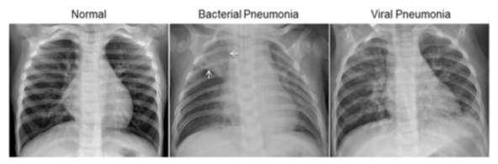
Introduction
Pneumonia Impact: A severe lung infection affecting millions, high mortality in vulnerable groups.
X-Ray Role: Essential for pneumonia diagnosis, revealing infection indicators in lung imaging.
Data Challenge: ML for X-ray diagnosis needs extensive labeled data, costly to obtain.
Active Learning Advances: improve accuracy by selecting informative images with fewer labels.

Slide 3
Dataset Overview
Source: Kaggle’s "Chest X-Ray Images (Pneumonia)“
Structure: 5,863 X-ray images divided into train, validation, and test sets
Labels: Two categories: “Normal” and “Pneumonia”
Imbalance: Distribution imbalance in training set (1,341 normal, 3,875 pneumonia)

Slide 4
Methodology - Experimental Framework
Model Architecture: ResNet18 CNN, adjusted for binary classification.
Grid Search Architecture: Supports various sampling methods; each experiment involves:
Loading the dataset and initializing the model.
Running an Active Learning loop that trains on labeled data, selects new samples to be added to the training set, and evaluates performance on validation set.
Output: A list of evaluation metrics for each iteration, enabling performance comparisons across strategies.
Core Loop Steps:
Init

Slide 5
Data Preprocessing
Image Preprocessing: Resize to 312x312 pixels, convert to tensors, normalize values
Dataset Division: Initial labeled and unlabeled train sets, validation, and test sets
Sampling Method: Update labeled set at each iteration in the AL pipeline

Slide 6
Traditional Active Learning Sampling Methods
Random Sampling:
Randomly chooses samples to be labeled and incorporated
Uncertainty Sampling:
Predicts the probability of each sample belonging to every class.
Selects samples whose class association probabilities are closest to a 50-50 distribution.
Entropy Sampling:
Computes the entropy of the class probability distribution for each sample.
Identifies and selects the samples with the highest entropy values, indicating greater uncertainty.

Slide 7
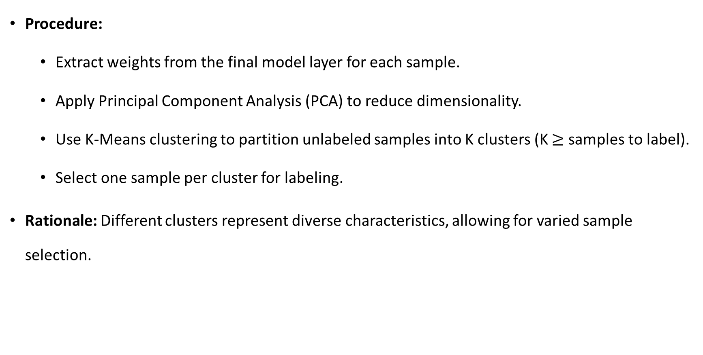
Novel Sampling Approach - PCA then K-Means
Procedure:
Extract weights from the final model layer for each sample.
Apply Principal Component Analysis (PCA) to reduce dimensionality.
Use K-Means clustering to partition unlabeled samples into K clusters (K $≥$ samples to label).
Select one sample per cluster for labeling.
Rationale: Different clusters represent diverse characteristics, allowing for varied sample selection.

Slide 8
Experiments Overview
Purpose:
Evaluate the effectiveness of Active Learning in X-ray imaging classification.
Compare "PCA then K-Means" approach with random, uncertainty, and entropy sampling methods
Experiment Configuration:
Machine learning model used
Number of training samples
Samples labeled per iteration
Active Learning iterations
Epochs per iteration
Sampling method
Etc.
Metrics Collected:
Accuracy
Precision
Recall
F1-score
ROC-AUC score
Confusion matrices

Slide 9
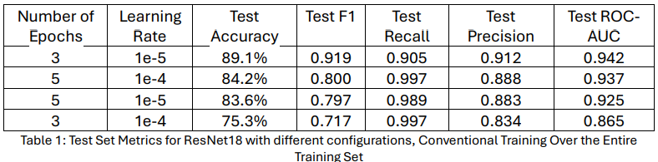
Baseline Evaluation
Objective:
Assess feasibility and effectivity of Active Learning against training on the full dataset.
Baseline Method:
Trained ResNet18 on the entire training set to establish maximum potential accuracy.
Challenge: Model excels in identifying pneumonia but struggles with healthy patient X-rays, probably due to train set imbalance.
Results:

Slide 10
Sampling Method Comparison
Experiment Design:
Four versions using the different sampling methods.
Started with 100 observations; added 90 over 10 iterations for a total of 1000 observations.
Findings:
Random, Entropy, and PCA then K-Means consistently outperform uncertainty sampling in Accuracy, F1-Score, and Precision.
Uncertainty sampling shows variable results, excelling in Recall but lacking in other metrics.

Slide 11
Further Experimentation
Second Experiment:
Similar setup as before, with 100 observations and adding 30 over 30 iterations to reach 1000 observations.
Insights:
Models converge to similar metric values but 3 times slower with reduced samples per iteration.
Same labeling effort needed to achieve similar results across sampling methods.

Slide 12
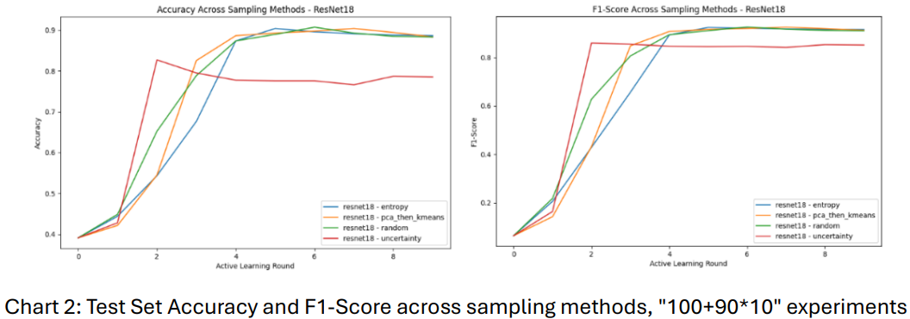
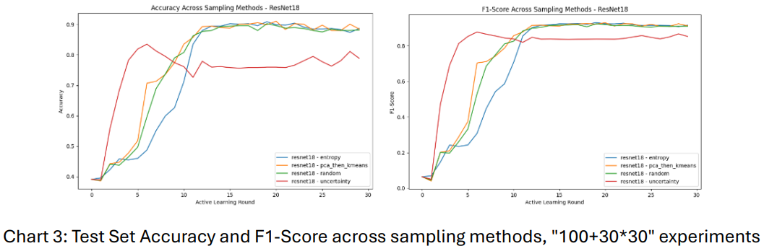
Experiments Results - Visualizations

Slide 13
Discussion
Employing Active Learning proved to yield accuracy levels like those obtained from training on the complete dataset, even when working with a significantly smaller labeled data subset
Efficacy of the "PCA then K-Means" sampling strategy
Depending exclusively on uncertainty may be inadequate for some tasks
Future research:
Generative models
Hybrid sampling methodologies
Different ML models rather than ResNet18

